Slide 1




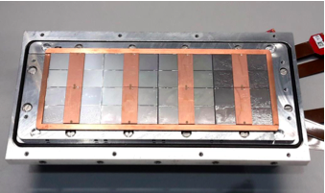



Pixel TPC
Single chip Quad Module TPC plane
2017 2018 2019

Slide 2
Analysis of the 22 December laser data
After some exchange with Sander and Martin, we conclude on the time structure of the time pixel data the following:
time = heartbeat spidertime toa ftoa (64 bit unsigned integer)
Quad 8-22 16 14 12 (nr of bits)
8-Quad design 8 14 12
8-Quad now 7 14 12
The toa (time of arrival) is in units of 25 nsec
The ftoa (fine time of arrival) divides this into 4096 pieces
Currently, there is a one-bit overlap between the highest bit of the toa and the lowest spidertime bits. So only 7 bits spidertime add new time information.
In the run the heartbeat was sent each 40 msec.
This is too low for a 7 bit spidertime and will cause wrong bits.
If the time is compared to the trigger time one expects so errors/jumps due to the low heartbeat frequency.

Slide 3
Quad Timing – what to expect
Here a single Quad laser run 806 taken with T2K gas taken in May 2019.
The units are micro secs: so 0.3 =300 nsec and RMS = 33 nsec
NB: driftTime = pixel time – trigger time

Slide 4
Analysis of the 22 December laser data
To analyze the data the decoding of the data in Packet.h was updated
time = heartbeat spidertime toa ftoa (64 bit unsigned integer)
Quad 8-22 16 14 12 (nr of bits)
8-Quad design 8 14 12
8-Quad now 7 14 12
The bit overlap had to be treated correctly (use 7 bits of the 8 bits spider)
Also the masking of bits for the heartbeat was updated. NB only the highest bits are used and de lower ones masked.
The quad had 8/9 bits more than the 8-quad.
More bits of the heartbeat should be added to form the time
The logic of checking of the bit overlap between heartbeat and (spider)time cannot be applied due to the too low heartbeat frequency

Slide 5
Pattern recognition strategy
Because the heartbeat can be wrong. Pattern finding used the spidertime plus toa plus ftoa times. So the hearbeat was “stripped” off:
time (stripped) = spidertime toa ftoa
A laser track has the characteristic that all the pixel times are very close.
So e.g. the spidertime is identical for the hits of the laser track.
The toa values are also very similar (25 nsec bin).
First hits around the expected laserpostion in a windowof 20 mm are preselected.
A hough histogram technique was used to do a first pass and find the bin (time) with most hits. Then the hits within a window of 2, 0.01 and 0.0001 msec are collected in three iterations and the mean (stripped) time is calculated.
The data of all chips and both concentrators was analysed this way.
If all chips and concentrators are timed in this should work and it did!

Slide 6
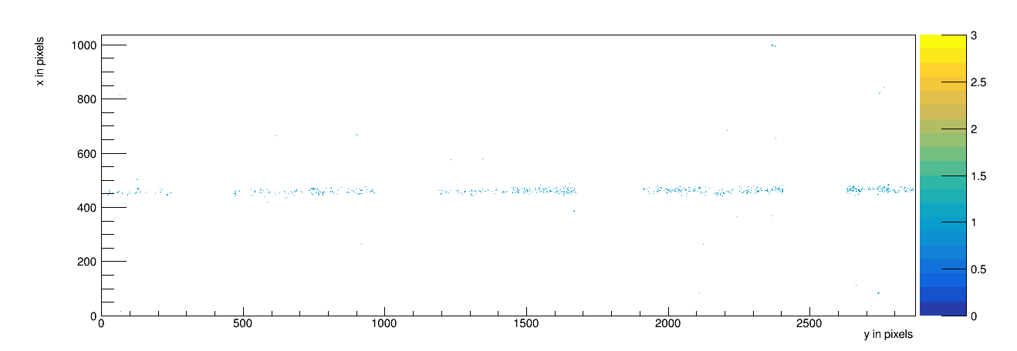
8-Quad event display Event nr 6

Slide 7
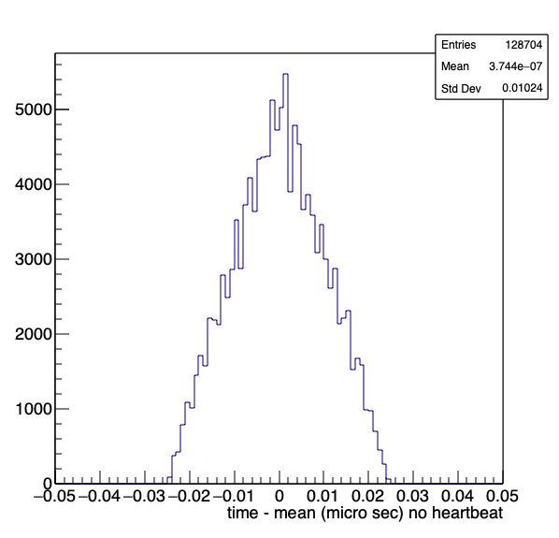
8-Quad timing wrt mean time
Here 300 events.
The stripped hit times wrt stripped mean time looks pretty good.
The window in the last iteration is 100 nsec.
It was checked that hits from all chips were found.
This means that the concentrators are timed in correctly.
The units are micro secs: so RMS = 10 nsec

Slide 8
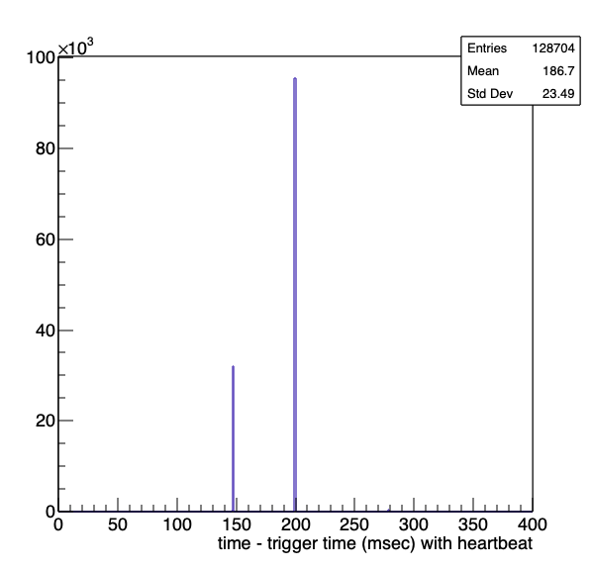
8-Quad timing wrt trigger
Here we must use the full time (including the heartbeat) and compare it to the trigger time.
A clear two peak structure is found. That indicates that a wrong bits (of ˜50 msec) are set.
This can be expected due the fact that the heartbeat frequency is too low.
The scale goes up to 400 msec

Slide 9
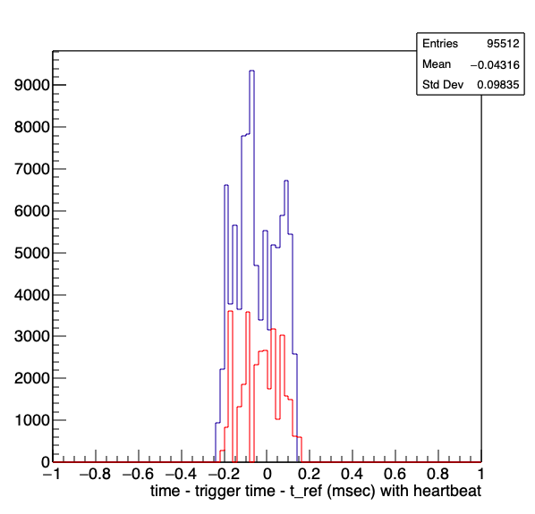
8-Quad timing wrt trigger
After subtracting the reference time of the two peaks we find a distribution that is much too broad.
The width is 400 micro sec.
This is not expected … the objective is a window of 100-300 nsec.
The scale goes up to 1 msec

Slide 10
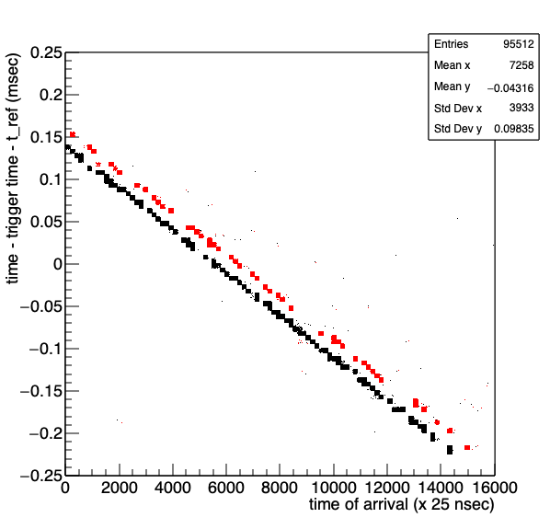
8-Quad timing wrt trigger
Here we observe a clear anti-correlation with the time of arrival (including ftoa).
The correlation is rather large about 0.4 msec for a 400 micro secs range

Slide 11
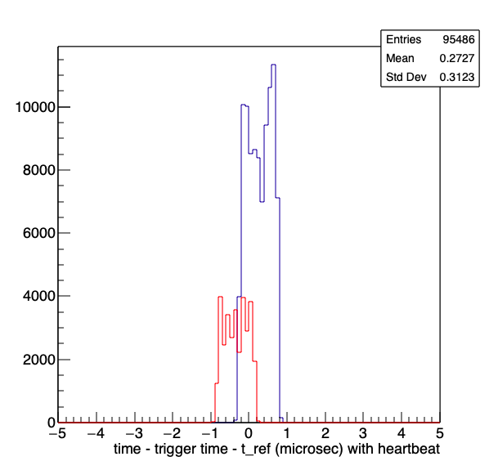
8-Quad timing wrt trigger
The time is corrected by:
Time’ = Time + toa/40000
Here the time is in units of 25 nsec.
After this ad hoc correction the window is still rather large ˜1 micro sec.

