Slide 1




Pixel TPC status and research plans
Yevgen Bilevych, Klaus Desch, Sander van Doesburg, Jean-Paul Fransen, Harry van der Graaf, Markus Gruber, Fred Hartjes, Bas van der Heijden, Kevin Heijhoff, Charles Ietswaard, Dimitri John, Jochen Kaminski, Peter Kluit, Naomi van der Kolk, Auke Korporaal, Cornelis Ligtenberg, Oscar van Petten, Gerhard Raven, Joop Rövekamp, Tobias Schiffer and Jan Timmermans
    GridPix production and improvement of resistivity TPX3 layer SiN
    Ion Back Flow measurement Quad
    Negative Ion Pixel TPC paper
    TimePix4 potential TPC applications
    Pixel TPC and Quad Module performance

Slide 2


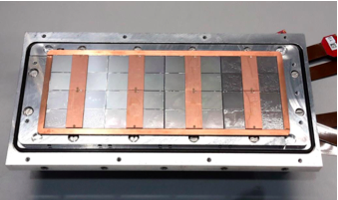

Pixel TPC
Single chip Quad Module TPC plane
2017 2018 2019

Slide 3
    GridPix production and improvement of resistivity TPX3 layer SiN
  In the post-processing step a resistive layer is put on the TPX3 chip
  This protects the device from sparks
  In the quad beam tests it was found that the SiN layer charges up at very high rates (> 10 kHz)
  Yevgen is investigating how to reduce significantly the resistivity of the SiN layer; this will reduce the charge up
  Different trial samples were made in 2020; this continues in 2021
  Production of TPX3 wafers with InGrids @ IZM Berlin is foreseen 2021
  Bonn has a new Detector Lab starting in March 2021

Slide 4
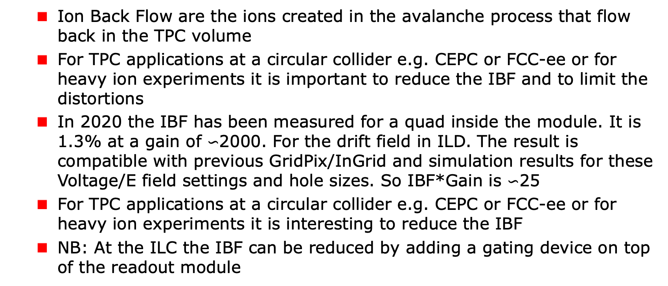
    Ion Back Flow measurement
  Ion Back Flow are the ions created in the avalanche process that flow back in the TPC volume
  For TPC applications at a circular collider e.g. CEPC or FCC-ee or for heavy ion experiments it is important to reduce the IBF and to limit the distortions
  In 2020 the IBF has been measured for a quad inside the module. It is 1.3% at a gain of $∽$2000. For the drift field in ILD. The result is compatible with previous GridPix/InGrid and simulation results for these Voltage/E field settings and hole sizes. So IBF*Gain is $∽$25
  For TPC applications at a circular collider e.g. CEPC or FCC-ee or for heavy ion experiments it is interesting to reduce the IBF
  NB: At the ILC the IBF can be reduced by adding a gating device on top of the readout module

Slide 5

    Reducing the Ion Back Flow in a Pixel TPC
  The Ion back flow can be reduced by adding a second grid to the device. It is important that the holes of the grids are aligned. The Ion back Flow is a function of the geometry and electric field ratios in the regions.
  Detailed simulations – validated by data - have been presented in LCTPC in April 2020 WP 326 and shown at the International Workshop on the High Energy Circular Electron Positron Collider Shanghai in October 2020
  With a hole size of 25 μm an IBF of 3 10⁻⁴ can be achieved and the value for IBF*Gain would be 0.6. Simulation is without magnetic field, and assuming equal E field ratios of 16. This is interesting to pursue further.
Plan 2021 to test a second
grid and measure IBF

Slide 6
    Negative Ion pixel TPC
  There is an interesting application for a pixel TPC using negative ions
    The idea for a NITPC was presented by Martoff et al. in NIMA A 440 (2000) 355
    Use a gas CS₂ (SF₆) here negative ions are formed. They drift slowly to the read-out plane. These gasses have a very small diffusion coefficient: high resolution - interesting for pixels
    NITPC with GEM read-out experiment for dark matter searches Drift IIb
  We took data in 2020 with a Ar-iCH₄₋CS₂ 93.6/5.0/1.4 gas mixture and ran it at atmospheric pressure and room temperature.
    Preliminary results were shown by Kees in LCTPC WP 329 June 2020

Slide 7
    Negative Ion pixel TPC paper
Submitted NIMA December 2020
  Important conclusion is that the diffusion coefficient of a NITPC is for the chosen gas mixture pretty close to the thermal limit
  For dark matter applications: using minority and majority carriers the drift distance can be determined rather accurately

Slide 8
    TimePix 4 potential TPC applications
  In April 2020 we held a brainstorm meeting to discuss the construction of a GridPix detector based on Timepix4 (https://indico.nikhef.nl/event/2243/)
    The TPX4 has the size of a typical Quad (3.5/4)
    The layout Fred proposed will have a larger coverage than the Quad. Quad coverage is about 69%. Still there will be an area (˜1+3.5 mm) where the wirebonds are connected to the PCB - with a guard on top of it. Estimated coverage is 73%.
    The layout will not need an expensive flex/PCB. That is a large improvement with respect to TPX3.
    For TPX4 a multiplexer board for a module is not needed
    Lower power consumption (0.55 W/cm²) than TPX3

Slide 9
    TimePix 4 potential TPC applications
    Assembly due to the layout of the TPX4 will be much easier
    The use of Through Silicon Via’s will alllow to improve the coverage substantially: potentially up to 96%. It is interesting to follow the TSV developments
  Several years effort
    It all starts with post-processing of a TPX4 wafer
    At Nikhef there is only support for TPX4 silicon tracking applications and the read out SPDR software for TPX4
    Support will be easier with ILC approved or CEPC funding

Slide 10
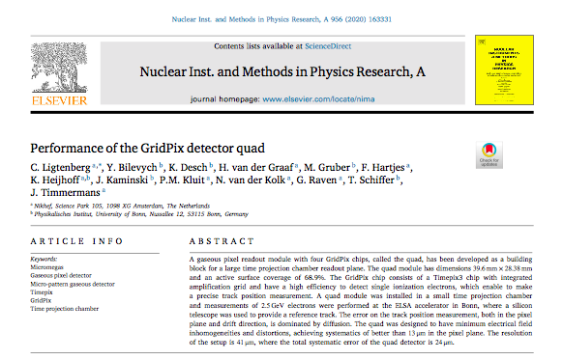
    Pixel TPC and Quad Module performance
  The details of the construction of the Quad Module were presented by Fred Hartjes in LCTPC 2020 https://agenda.linearcollider.org/event/8362/timetable/#20200114.detailed.
  The Pixel TPC simulation and the latest results are updated wrt LCTPC 2020 and written up in the thesis of Kees Ligtenberg that will be submitted before March 2021. A summary was e.g. presented by Kees in the Topical workshop on New Horizons in Time Projection Chambers, 7 October 2020
  In the following slides I will review the current status of the Quad and the status of the 8-Quad Module.
Quad paper published
https://doi.org/10.1016/j.nima.2019.163331

Slide 11
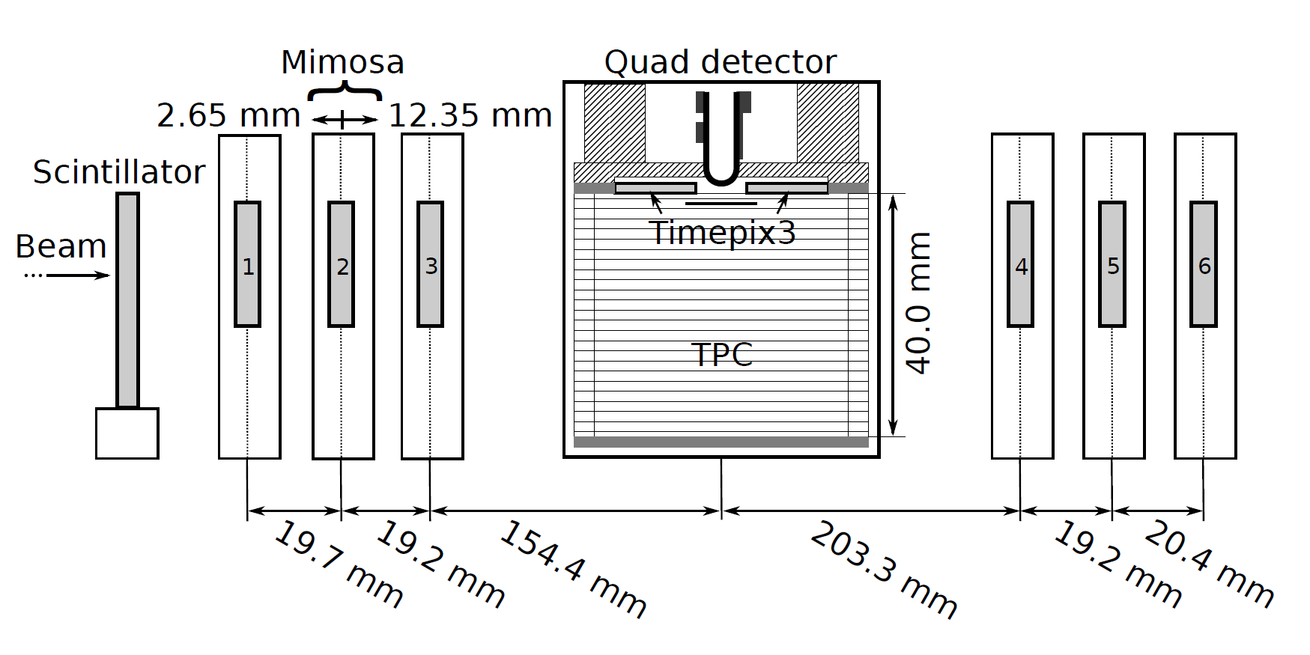
Test beam measurements (2018)
2.5 GeV electrons at the ELSA accelerator in Bonn, Germany
T2K gas with E_{drift} = 400 V/cm, V_{grid} = -330 V
Events are triggered by a scintillating plane
6 plane mimosa telescope with 18.4 μm × 18.4 μm sized pixels
180 º

Slide 12
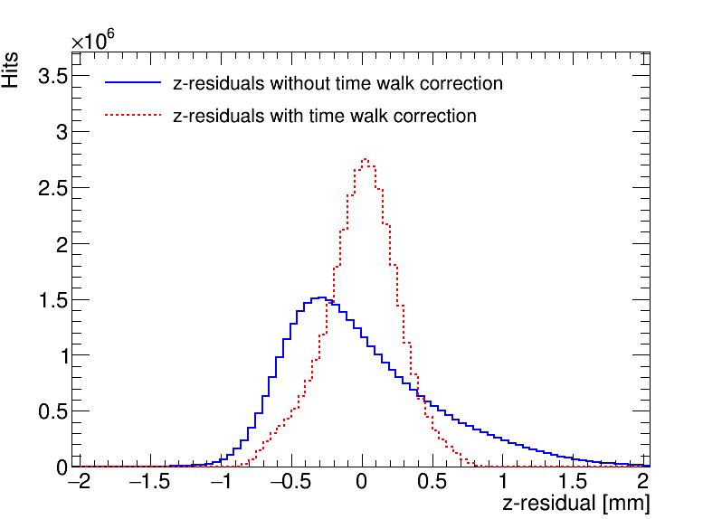
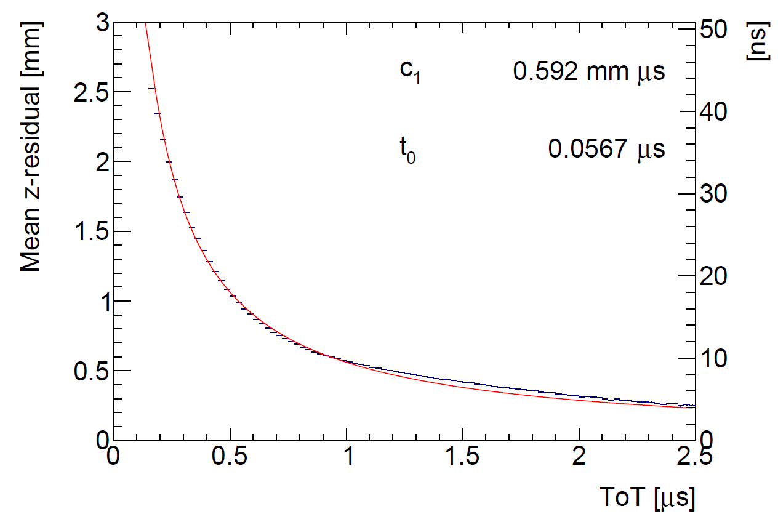
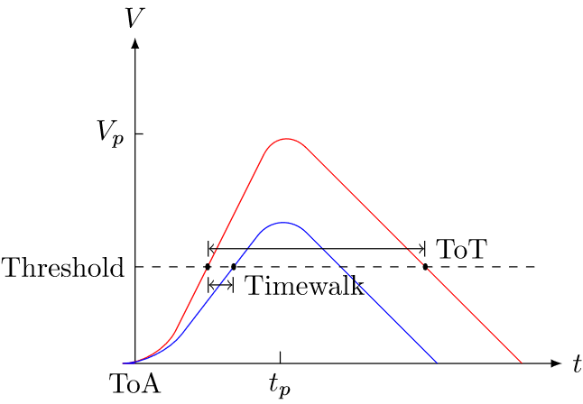
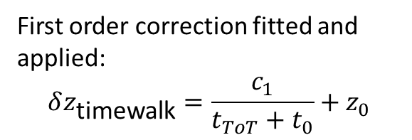
Time walk correction with the Timepix3
Time walk error: time of arrival depends on signal amplitude
Time walk can be corrected using Time over Threshold (ToT) as a measure for signal strength
First order correction fitted and applied:
$$δz_{\text{timewalk}}=\frac{c_{1}}{t_{ToT}+t_{0}}+z_{0}$$
Distribution of residuals becomese more Gaussian after the time walk correction

Slide 13
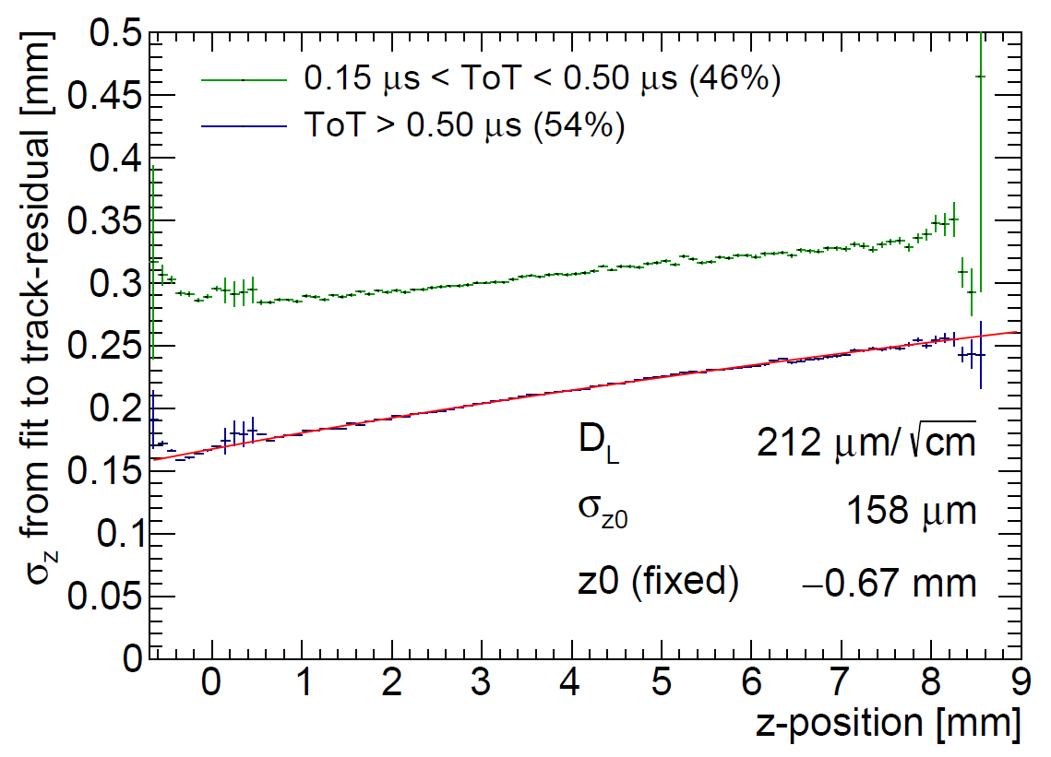
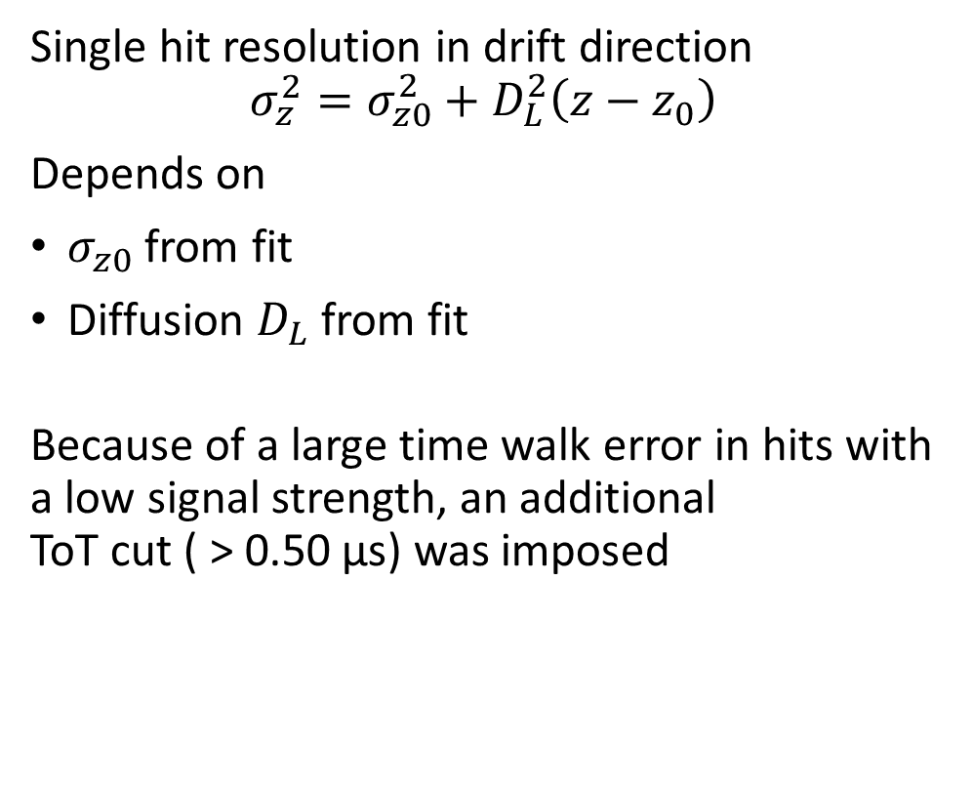
Hit resolution in the drift direction
Single hit resolution in drift direction
$$σ_{z}^{2}=σ_{z0}^{2}+D_{L}^{2}\left(z−z_{0}\right)$$
Depends on
$σ_{z0}$ from fit
Diffusion $D_{L}$ from fit
Because of a large time walk error in hits with a low signal strength, an additional
ToT cut ( > 0.50 µs) was imposed

Slide 14
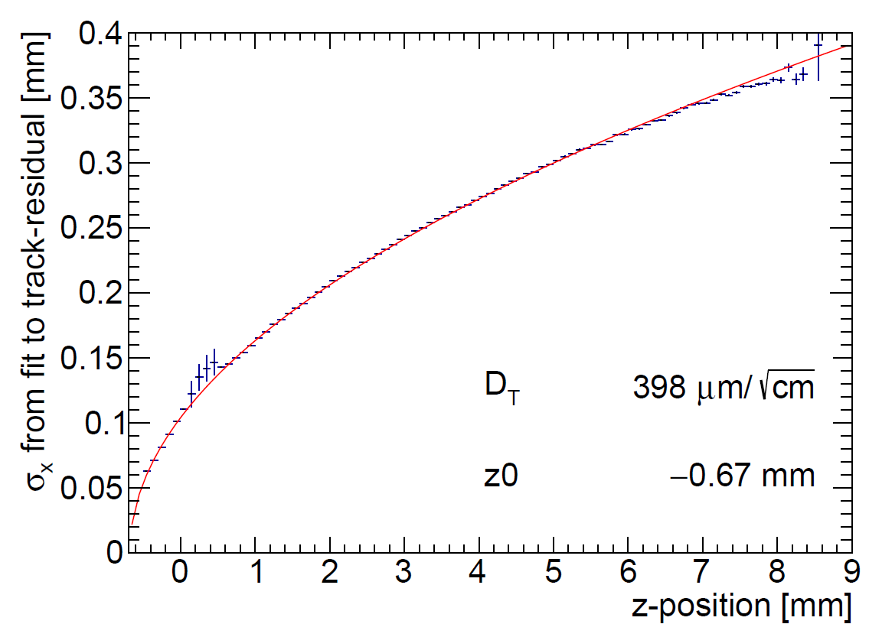

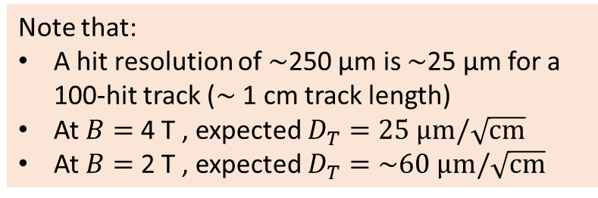

Hit resolution in the pixel (precision) plane
Single hit resolution in pixel (precision) plane:
$$σ_{y}^{2}=σ_{y0}^{2}+D_{T}^{2}\left(z−z_{0}\right)$$
Depends on:
$σ_{y0}=$ pixel size 55 µm$/\sqrt{12}$
Diffusion $D_{T}$ from fit
Scattering on guard
B$=0$ T
Note that:
A hit resolution of $\sim$250 µm is $\sim$25 µm for a 100-hit track ($\sim$ 1 cm track length)
At $B=$ 4 T , expected $D_{T}=25 \text{μm}/\sqrt{\text{cm}}$
At $B=$ 2 T , expected $D_{T}=\sim 60 \text{μm}/\sqrt{\text{cm}}$

Slide 15
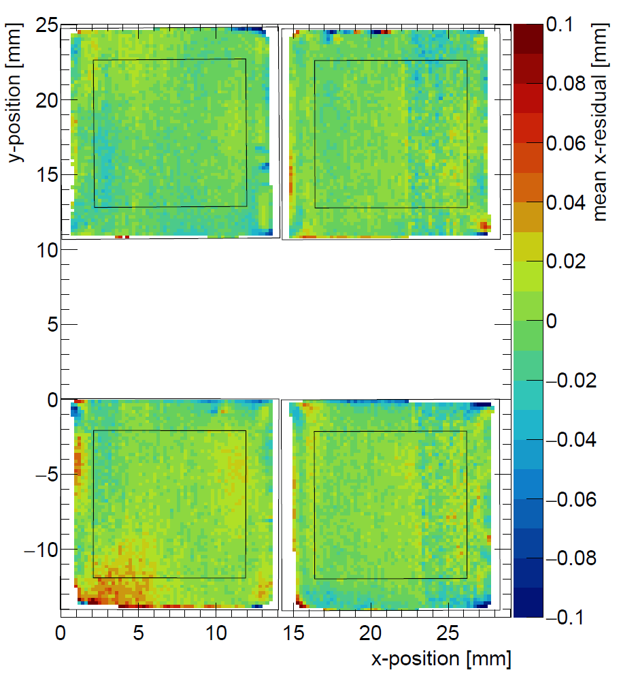
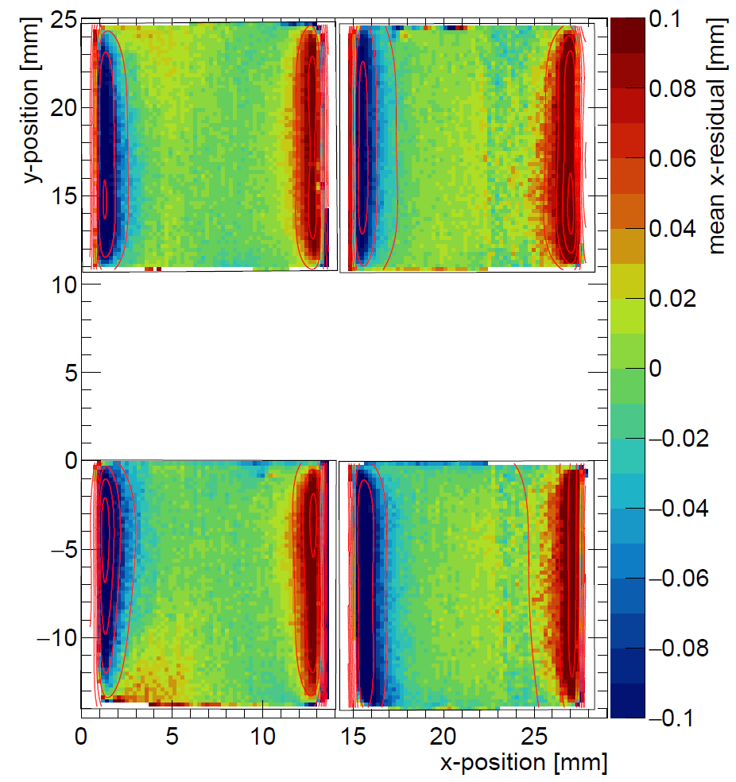
Deformations in the pixel (precision) plane
Corrected for electric field deformations
Investigation of systematic deviations over the pixel plane
Each bin displays mean of residuals from
4 × 4 pixels
After correction of the residuals for the distortions from the electric field
The RMS is 13 µm over the whole chip, and 9 µm in the centre (black outline)

Slide 16
8 quad module development
The 8 quad test box has 32 chips in total
Simultaneous read out through one SPIDR board using data concentrators
Field wires added to improve electric field, and reduce deformations
with field wires at boundaries

Slide 17
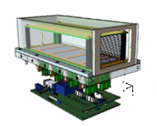
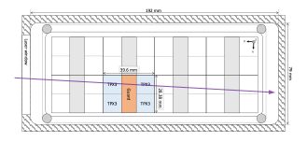
    8-Quad Module status
  Organisation of the DAQ: one SPIDR is connected to 2 concentrators that serve 8 quads. Another SPIDR registers a timestamp for the laser and synchronizes the 2 concentrators.
  Three data streams are made: LINK0 and LINK1 for the two concentrators and the TIMESTAMP laser trigger stream
  It took considerable effort to commission the online ‘concentrator’ and offline ‘daq’ software and to sort out the timing. Now things look quite good, as the event display demonstrates. Currently, 30 from the 32 chips can be read out.

Slide 18
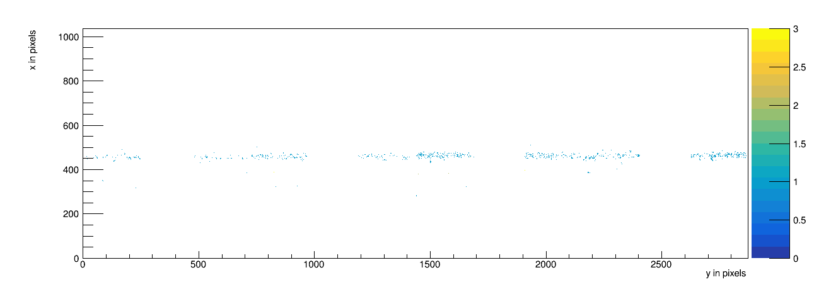
    8-Quad Module performance
Run 1298 event 14 on 22 December 2020 with laser tracks
V_{grid} = -330 V and V_{drift} = -280 V; all pixels shown for a 50 msec window
The timing has still a 50 ms spread that is understood and will be fixed next week.

Slide 19
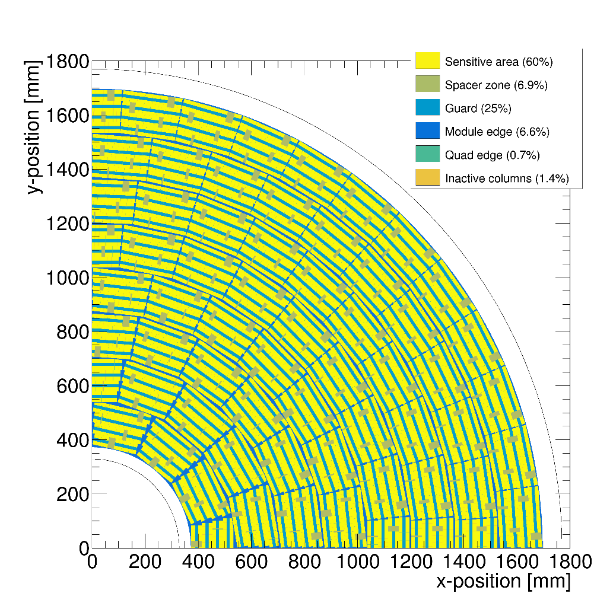
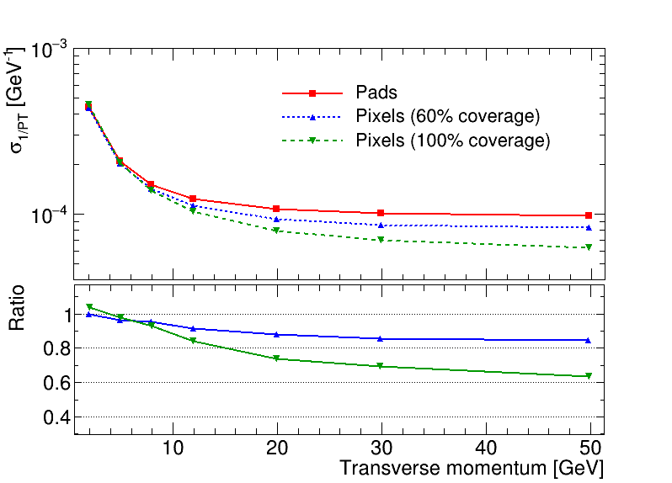

Performance of a GridPix TPC at ILC
Thesis of Kees Ligtenberg
From full simulation, momentum resolution can be determined
Momentum resolution is $\sim$15% better (with realistic 60% coverage)
Realistic tiling with quad module
Momentum resolution of the TPC for a simulated muon
60% coverage

Slide 20
    Conclusions
  A quad module with four Timepix3 based GridPix chips has been designed and built
  The resolution is limited by diffusion
  Systematic uncertainties are small: 9 µm in the pixel plane
  A GridPix readout will allow for dE/dx measurements through cluster counting
  The status of the 8-Quad Module was presented
  The test of the Module at test beam DESY is scheduled for June 2021
    We will take data with a silicon telescope that will allow us to measure the performance in a magnetic field as well as the deformations in a module
  A Pixel TPC is a good option at the ILC (CLIC) and circular e⁺e⁻ colliders
  ILD Simulations show an improvement in momentum resolution of a pixel TPC read out over a pad readout of 15 – 35 %

Slide 21
    GridPix Pixel TPC Plans
  Improvement of SiN layer and production of TPX3 GridPixes
  Ion Back Flow: Try out of a double grid structure
  TPX4: follow the ongoing development Nikhef R&D group
  8-Quad Module Test beam in DESY is scheduled for June 2021
    Measure the performance in a magnetic field as well as the deformations for a module
    Analysis of the data and publication of the results
  Future manpower resources at Nikhef are rather limited
    Post doc Naomi left and Kees will submit his thesis
    No follow up project approved yet
    The test beam is supported
  We are contacted by groups that show interest for: X ray polarimetry in space, TPC for Dark Matter searches or in a Heavy Ion experiment

Slide 22
Back up slides

Slide 23
Pixel TPC with double grid to reduce the ion back flow
Question: can one reduce the Ion Back Flow of a GridPix detector?
We could design a GridPix detector using a double grid
The idea is that by creating two field regions, one with a medium field and one with a high field (our standard Grid Pix) one could reduce the ion backflow in two stages.
  The high field avalanche region has a measured IBF of 1.3%
  The aim is to reduce the IBF by another factor 100
  The second Grid replaces the Gating device and is always operational

Slide 24
Design of a double Grid
Drift region
Second Grid
e.g.
250 μm
Intermediate Field
GridPix
50 μm
High field

Slide 25
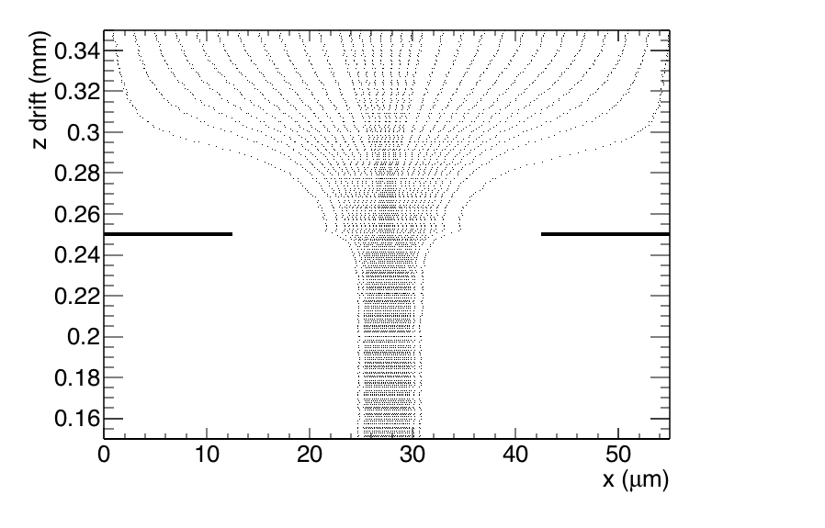
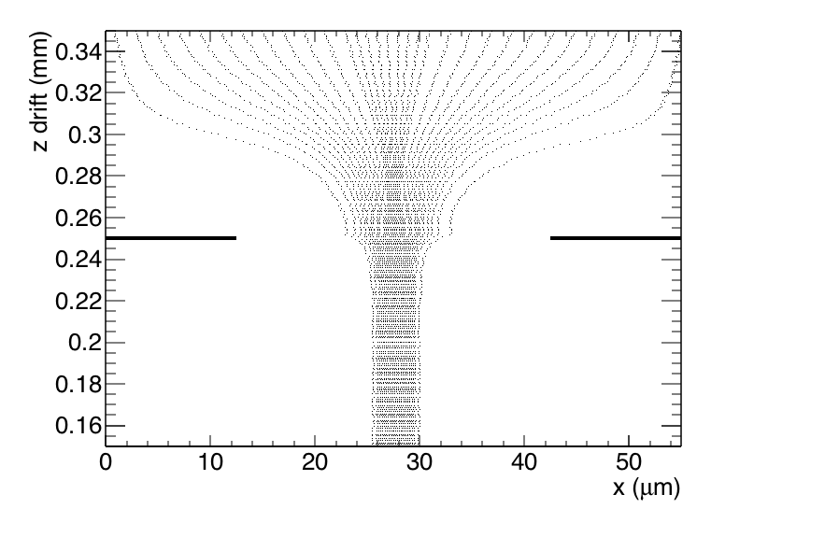
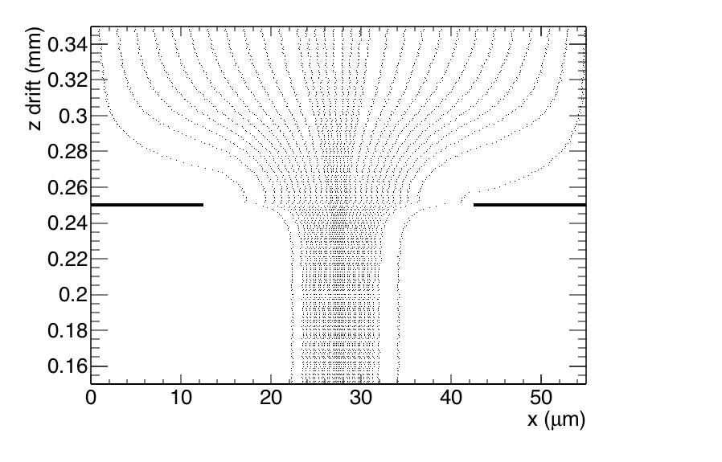
In (down) flow trajectories second Grid
Field ratio 40
Field ratio 10
Field ratio 240
Geometry: second grid at 0.250 mm (z); Cathode at 550 mm
Standard GridPix pitch 55 μm and hole 30 μm
Field ratio = mean Field (0-0.250 mm)/ mean Field z (2-550 mm)
Electron tracking without diffusion:
σ (rms) size of funnel (focussing E field) = 2.6-1.5-1.1 (Fr 10,40,240)

Slide 26
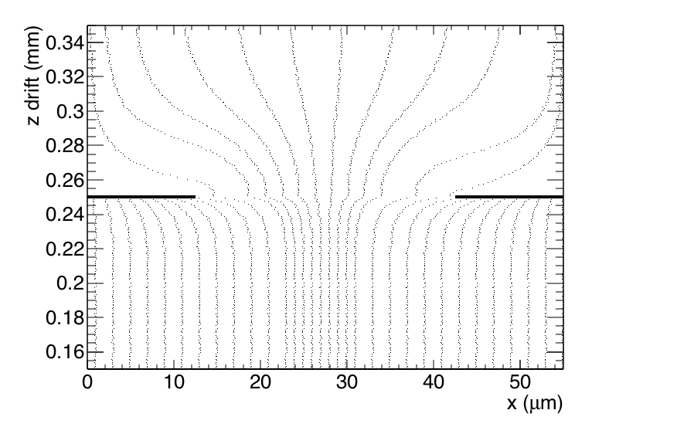
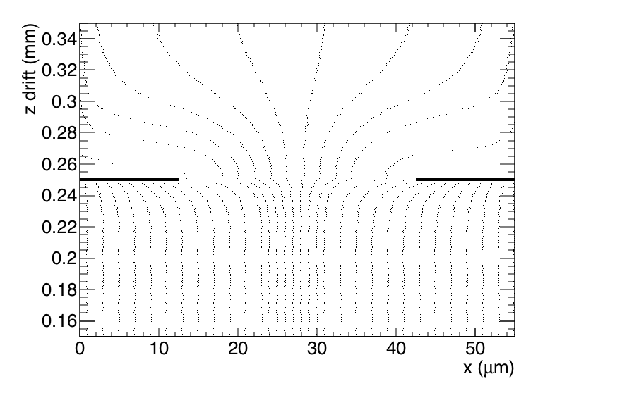

Backflow (up) trajectories second Grid
Field ratio 10
Field ratio 40
Field ratio 240
Here the trajectories of ions from the bottom upwards are shown
The differences between the different field ratios are small

Slide 27
Modeling of ion back flow
Modeling of the ion backflow is based on the measurements for a standard GridPix with FR 240. The ion backflow was measured to be 1.3%.
The Ion BackFlow is sensitive to the diffusion in the high field region.
The electron funnel size is 1.1 μm just from the field focussing.
For the GridPix (gap 50 μm) one expects an electron diffusion of 150-200 μm/√cm. This gives a smearing of the funnel of about 10-14 μm.
The calculated IBF corresponds to 1.3% for a smearing of 15 μm.
So this agrees reasonably well with expectations.
The performance IBF of the top grid.
What happens is that the back flowing ions that make it through the lower
grid that runs at FR240 will be flat distributed if one is 60-100 μm or more
above it.

Slide 28
IBF of the second grid
The performance IBF of the second grid.
What happens is that the back flowing ions that make it through the lower grid that runs at FR240 will be flat distributed if one is 60-100 μm or more above it.
The field ratio should not be too high to avoid gas amplification in
the top grid. Therefore we leave out the FR240 point.
IBF (% ) FR 40 | FR 10
1.2 | 3.5

Slide 29
Transparancy of the grid
Another important aspect is the electron transparancy.
Using the simulation this can be calculated.
It is important to choose a FR with a high (electron) transparancy
so with FR of 40 or higher.
Transparancy (%) FR 240 | FR 40 | FR 10
100. | 100. | 99.0

Slide 30
Further reflections on the gap size
Another important aspect is diffusion that takes place in the
intermediate field region. For the T2K gas this can be at most 400 μm/√cm. The gap is the distance between the two grids.
So in case of a 1 mm gap there is a sizeable probability that the
neigbour pixels detect the avalanche.
So a smaller gap is preferable.
Smearing σ (μm) gap 1 mm | gap 250 μm | gap 60 μm
126 | 63 | 31

Slide 31
Ion backflow for a double grid
Here calculations for the IBF of the two grids in case one has a total FR of
about 240 – normal GridPix operation. For the simulations the FR of the top
grid was put at 16. The lower Grid(Pix) was at FR 16 too. Total FR 256.
In order to reach IBF*Gain (2 10³) below one has to choose a slightly
smaller hole size of 25 or 20 microns.
Ion backflow | Hole 30 μm | Hole 25 μm | Hole 20 μm
Top grid | 2.2% | 1.2% | 0.7%
GridPix | 5.5% | 2.8% | 1.7%
Total | 12 10⁻⁴ | 3 10⁻⁴ | 1 10⁻⁴
transparancy | 100% | 99.4% | 91.7%

Slide 32
Conclusions: double grid
The Ion Back Flow can be significantly reduced by putting a grid with a
identical pitch and hole size on top of the Gridpix.
A device placed e.g. at 60-250 μm above the GridPix and ran with a
Field ratio of 16 (top) and 16 (lower) would do an excellent job.
The electron transparancy would be over 99 (91)% and the IBF would go
down from 1.3% to 3 (1) 10⁻⁴ for a hole size of 25 (20) μm.
This would solve the issue of IBF at CEPC and ILC.
We could do a test at Nikhef mounting this grid on top of the
Gridpix (holes 30 μm) and measure the electron transparancy and the
IBF and test the prediction on the previous slide.
It would be interesting to think about a post-processing step to
integrate the two grids.

Slide 33
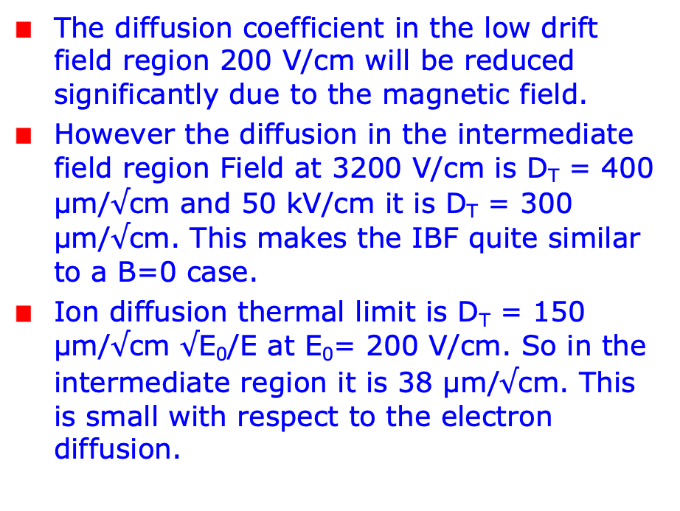
Ion back Flow in a magnetic field
The diffusion coefficient in the low drift field region 200 V/cm will be reduced significantly due to the magnetic field.
However the diffusion in the intermediate field region Field at 3200 V/cm is D_{T} = 400 μm/$√$cm and 50 kV/cm it is D_{T} = 300 μm/$√$cm. This makes the IBF quite similar to a B=0 case.
Ion diffusion thermal limit is D_{T} = 150 μm/$√$cm $√$E₀/E at E₀= 200 V/cm. So in the intermediate region it is 38 μm/$√$cm. This is small with respect to the electron diffusion.

