Slide 1
BDT Classifier for muons
26-11-2020

Slide 2
BDT classifier for muons
Create a boosted decision tree that can separate muon hits from other hits
16789 CC and NC nu events (1.28x10⁷ mc hits, excluding cuts removing events with no muon) in the two ROOT files
ARCA_GSGHE_nu12CC_muons.jsirene.jte.aashowerfit.root
ARCA_GSGHE_nu12NC_muons.jsirene.jte.aashowerfit.root
Used 10% to train, test and evaluate the BDT (create the model) (BDT.py)
492401 hits; 1634 Signal and 490767 Background
Other events were used to test the trained BDT (classification.py)

Slide 3
Variable list
1. Time residual computed with shower-hypothesis (rs)
2. Time residual computed with track-hypothesis (rt)
3. Distance from (hypothetical) muon track to the hit (d)
4. Angle between between (hitpos - showerpos) and shower direction (a)
5. Shower direction reconstructed shower energy (E)
6. Muon yes/no (truth)
These were computed using best_reco_track() and mc_hits

Slide 4
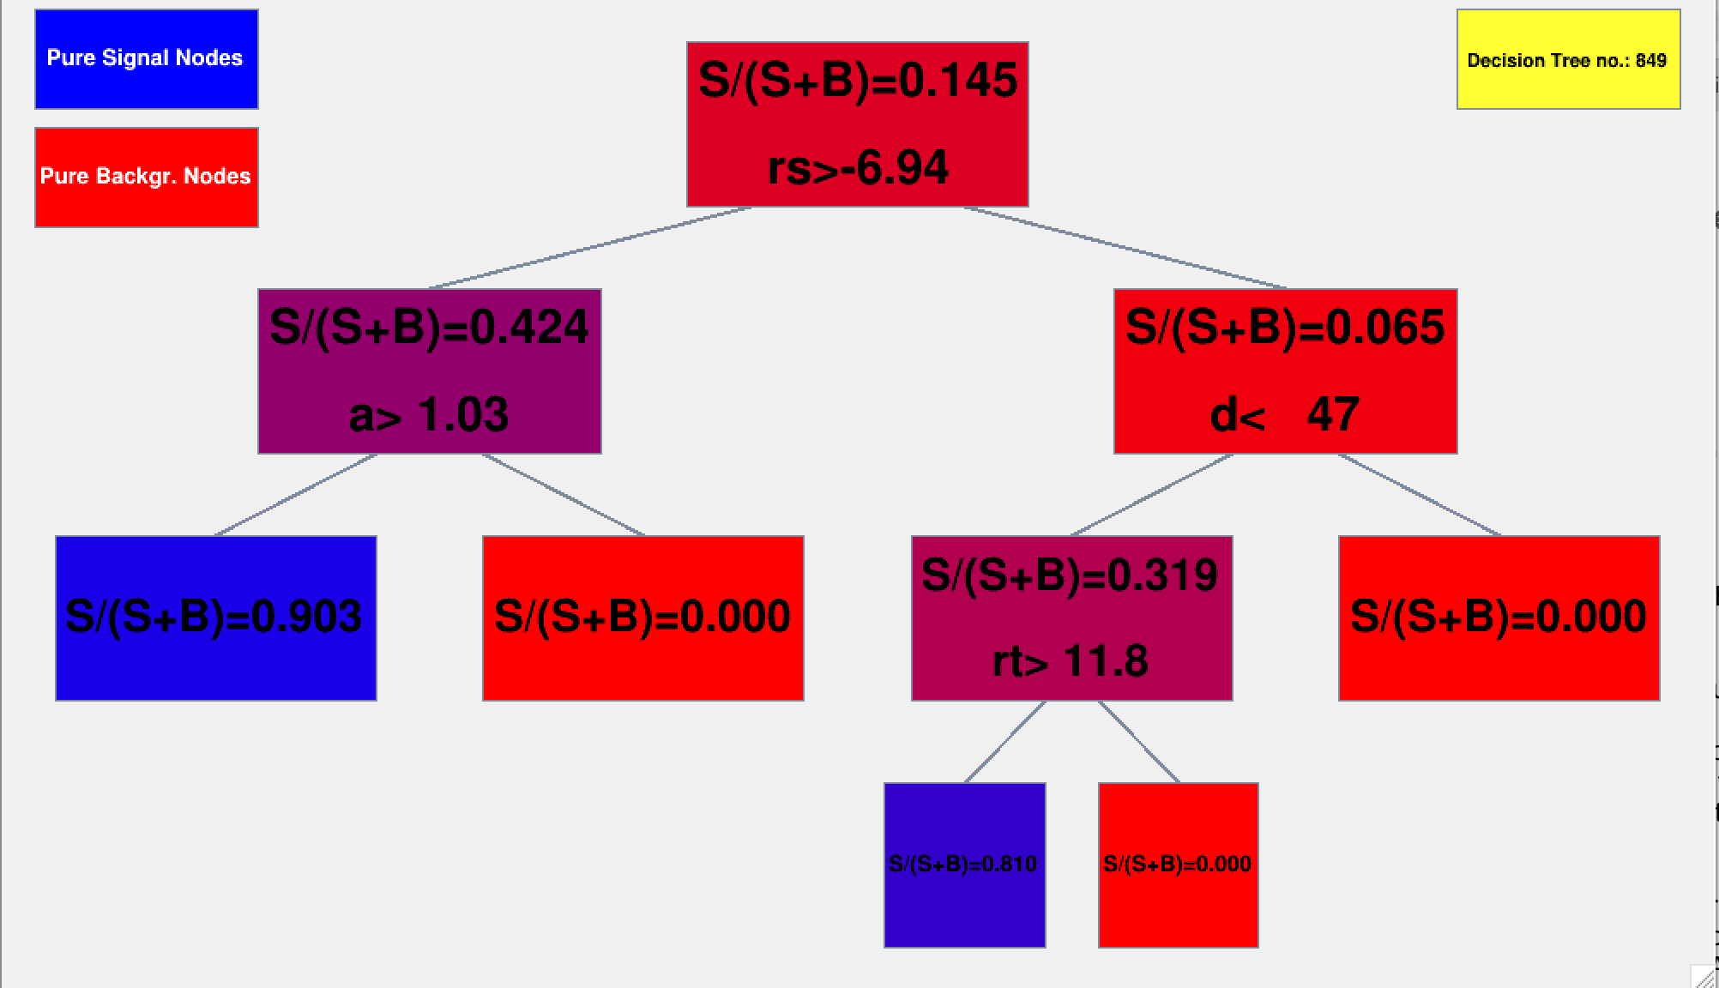
BDT training
Run time of about 1 hour
Used default TMVA settings
ROC integral of 0.991

Slide 5
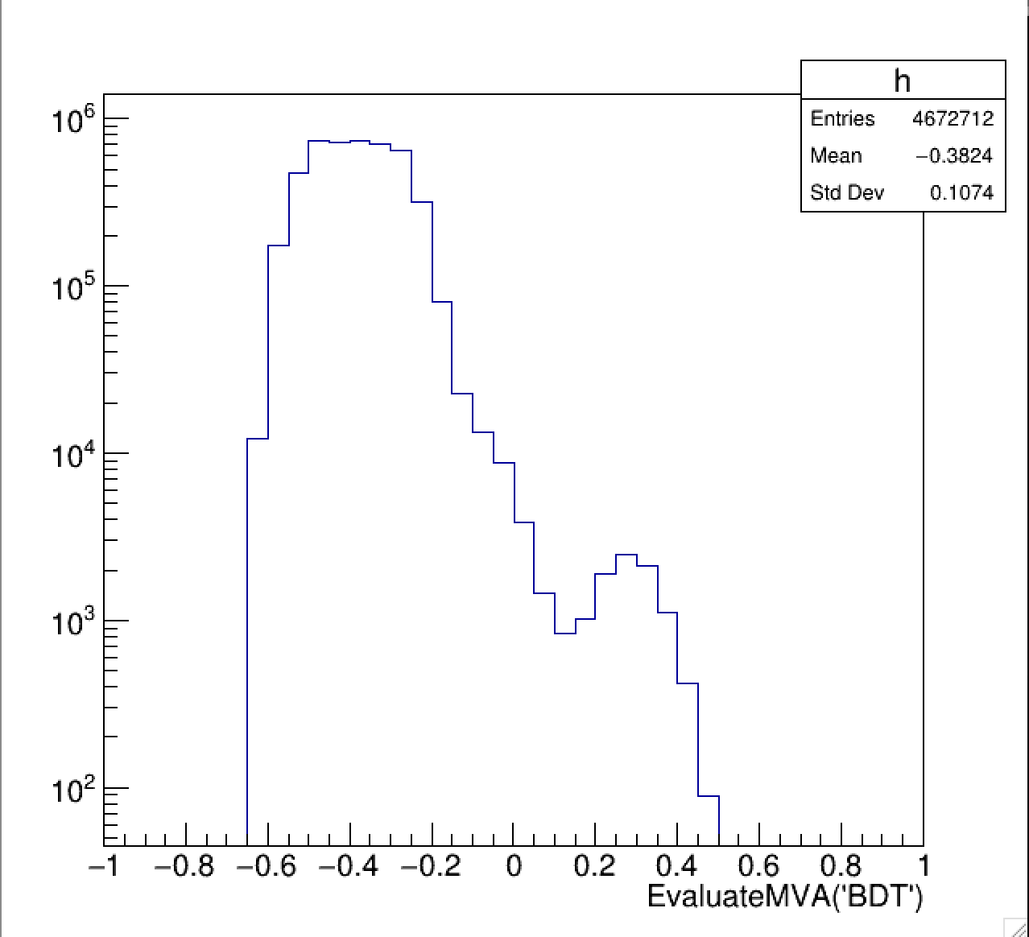
Classification
With the trained model it can classify any data tree with variables rs, rt, a, d and E
BDT classifies with value: -1 < reader.EvaluateMVA('BDT’) < 1

Slide 6
Classification
This is split based on classification threshold
Different thresholds will split data differently and result in different a confusion matrix (more or less false positives etc)
Example has threshold signal>0 and background<0
Want to minimize the false positives
True Positives: 10459 | False Negatives (Is positive but tested negative): 3340
False Positives (Is negative but tested positive): 4757 | True Negatives: 4654157

Slide 7
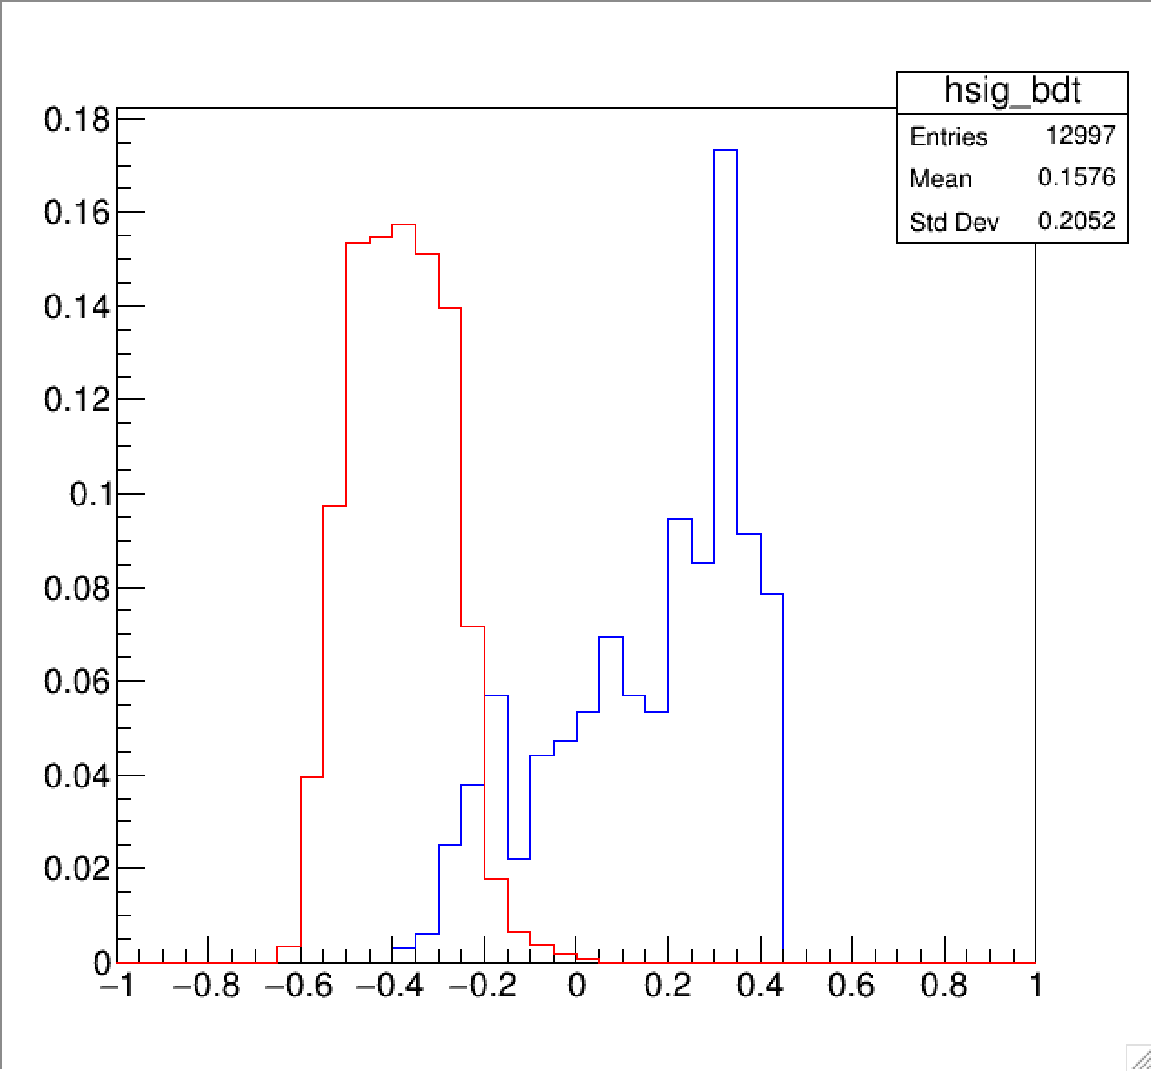
Classification
How the data looks with classification threshold at zero:
True signal is in blue
True background is in red
False positives may seem small but this is due to normalization (signal is only 14000 events and background is 4.6x10⁶ events)
TN
TP
FN
FP

Slide 8
ROC and AUC
Receiver Operator Characteristic plots the true positive rate (TPR) against the false positive rate (FPR)
TPR or recall is the ratio of how many positives were classified correctly TP/TP+FN
FPR is the ratio of how many negatives were classified incorrectly FP/FP+TN
Would like a large TPR and small FPR, this changes as classification threshold changes

Slide 9
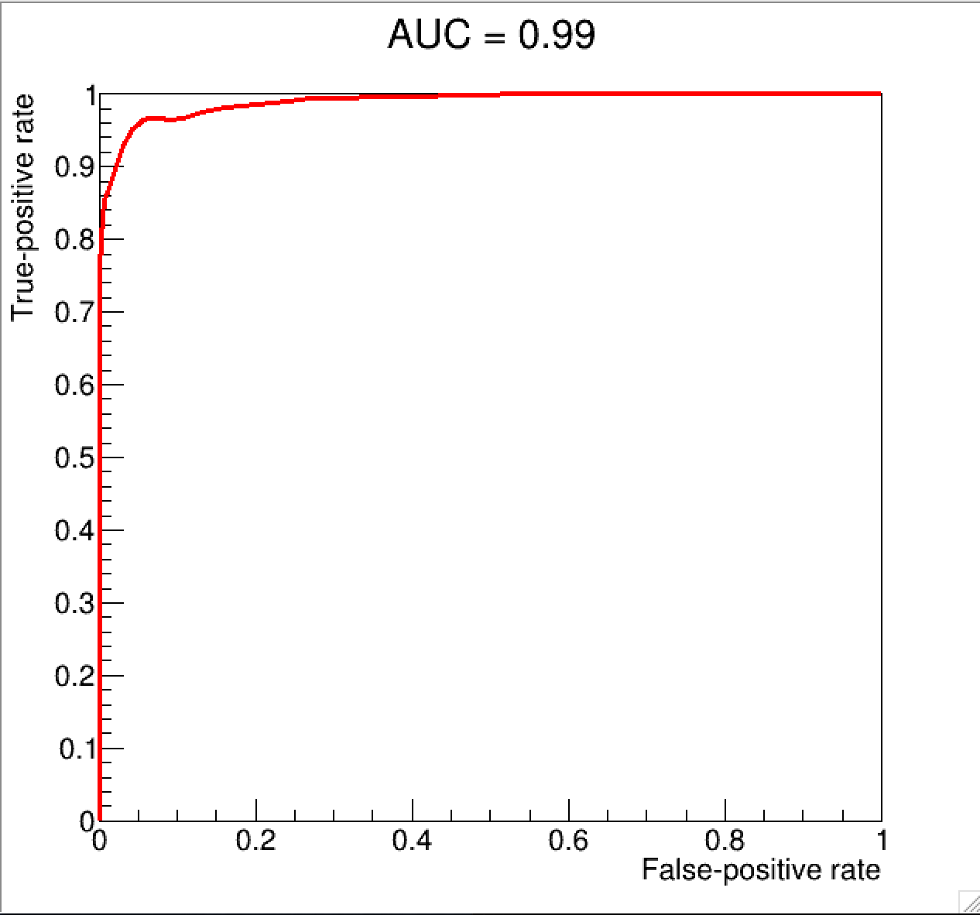
Final ROC curve of the dataset
Plots FPR vs TPR at different classification steps,
Need to record each classification step with corresponding FPR and TPR
AUC is a good indicator of performance across all classification threshold. Ideal would be 1.0.

Slide 10
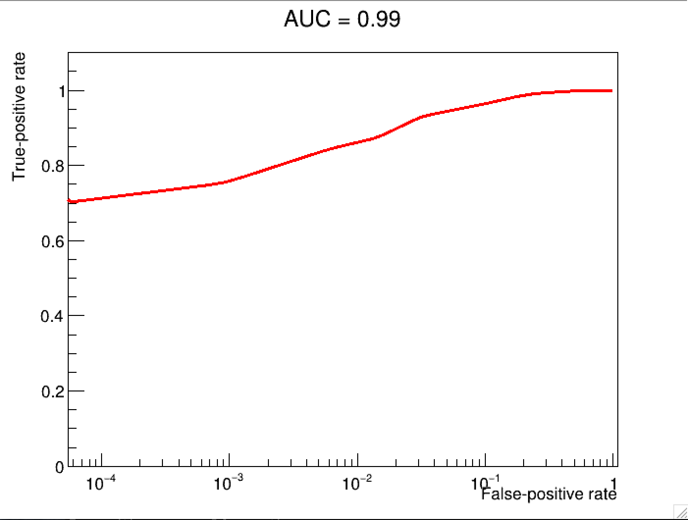
Where is FPR=0
Classification threshold = 0.050000000000000044
True positives: False negatives:
223 94
False positives: True negatives:
6 99678
TPR: FPR:
0.7034700315457413 6.0190201035271456e-05

Slide 11
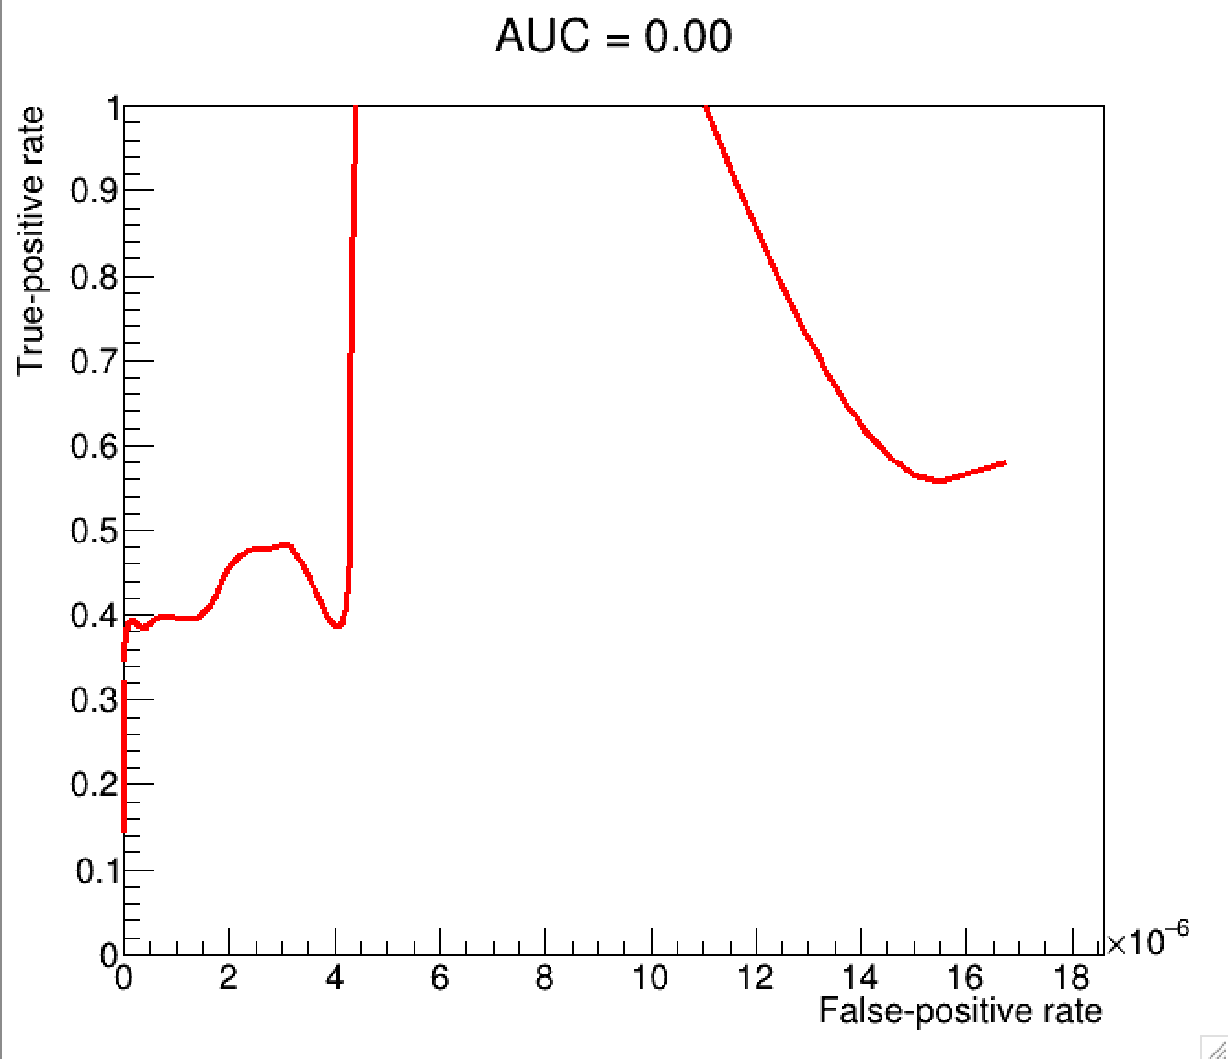
Where is FPR=0
Classification threshold = 0.28
True positives: False negatives:
4761 9037
False positives: True negatives:
0 4658914
TPR: FPR:
0.3450500072474272 0.0
Classification threshold = 0.27
True positives: False negatives:
5331 8467
False positives: True negatives:
2 4658912
TPR: FPR:
0.3863603420785621 4.2928459293303117e-07

Slide 12
Classification
Classification threshold at 0.3
Will have many false negatives but no false positives. (TPR=0.27, FPR=0)
TN
TP
FN

Slide 13
Conclusion
With a classification threshold of 0.3 the BDT will not report any false muon hits.
Next step would be to do this on an event level
Check for event if there are 5 or more muon hits, then there is a muon in the event.

