Slide 1
Intensity and time in likelihoods
Aart Heijboer
https://www.overleaf.com/read/wpyfxcxndmbn

Slide 2
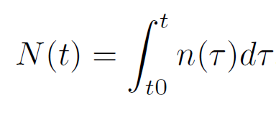
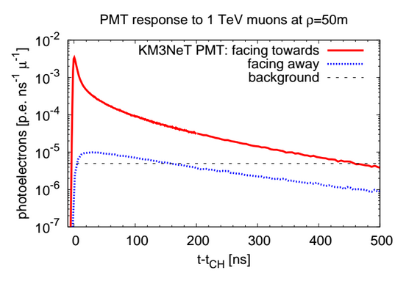
Density of photons (or pe or hit) at time t
(not a PDF)
Number of photons detected before t
(not a probability)
n(t) (ns⁻¹)

Slide 3
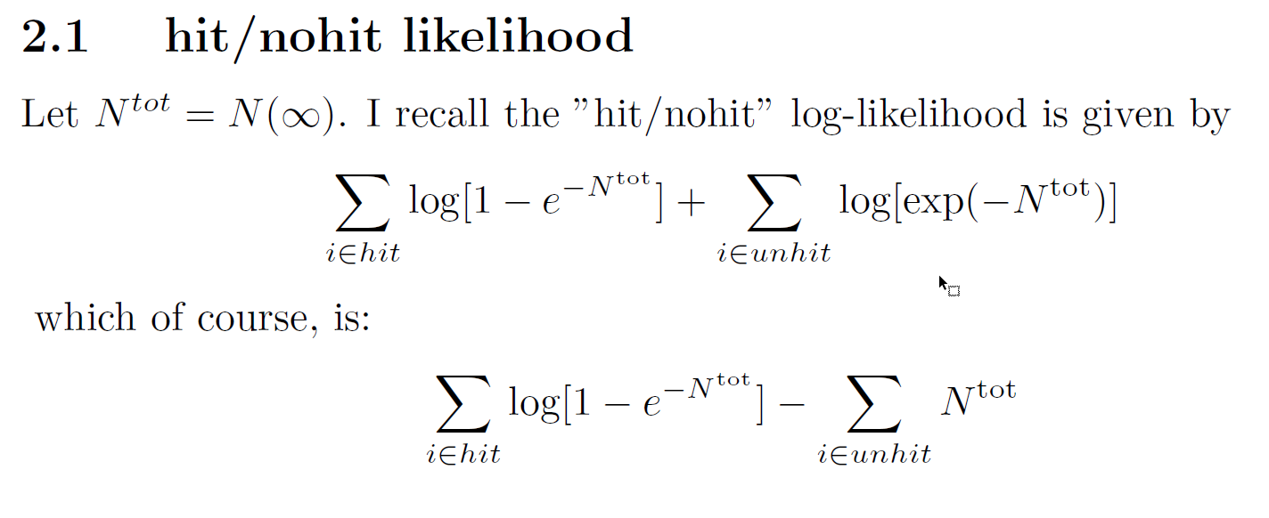
Reminder : the “hit/nohit” likelihood as used in aashowerfit
For energy- and direction reconstruction

Slide 4
Interested in time of first photon, because that is what we have in data.
“Density of first photons” (not a PDF)
P(zero hits before t)
Probability to have at least one
photon before t. ( <1 )
The PDF of the first
Hit-time t1
P(at least one hit ever)
For the connoisseurs: works for ‘any’ n(t₁), no time-window needed… in contrast to p(t)

Slide 5
If we have (constant) background:
This is 1, thanks to the background
Okay, so let’s write down the full likelihood of all the first-hit-times….
Subscript s : signal
R : background rate

Slide 6
Okay, so let’s write down the full likelihood of all the first-hit-times….
M: number of PMTs
[time⁻¹]
[time⁻¹]
[dimensionless]
t_{i} : first hit time om PMT_{i}
The functions n and N formally also need an index i (they differ per PMT)

Slide 7
“hit”
“no hit”
n(t)
signal
Define a t_{c} so that all the signal photons are
guaranteed to happen before t_{c}
background
t_{c}
t →
constant
zero
N_{s}^{tot}
constant

Slide 8
*
Does not look like the hit-PMT term from the hit/nohit likelihood.
Instead, it almost looks like the PDF of the first hit-time…
… just need the normalization.
Exactly the empty-PMT
Term from the hit/nohit
Likelihood.
Does not depend on t_{i}!
The PDF of t, p(t)
With N^{tot} all (s+b) hits expected before t_{c}
*probably this the simplest expression for the likelihood if we don’t care about splitting it up for educational purposes.

Slide 9
So, finally:
log(pdf(first-hit-time))
The “hit-PMT” term from the
hit/nohit PDF!
Calling PMT with t > t_{c} “unhit” :

Slide 10
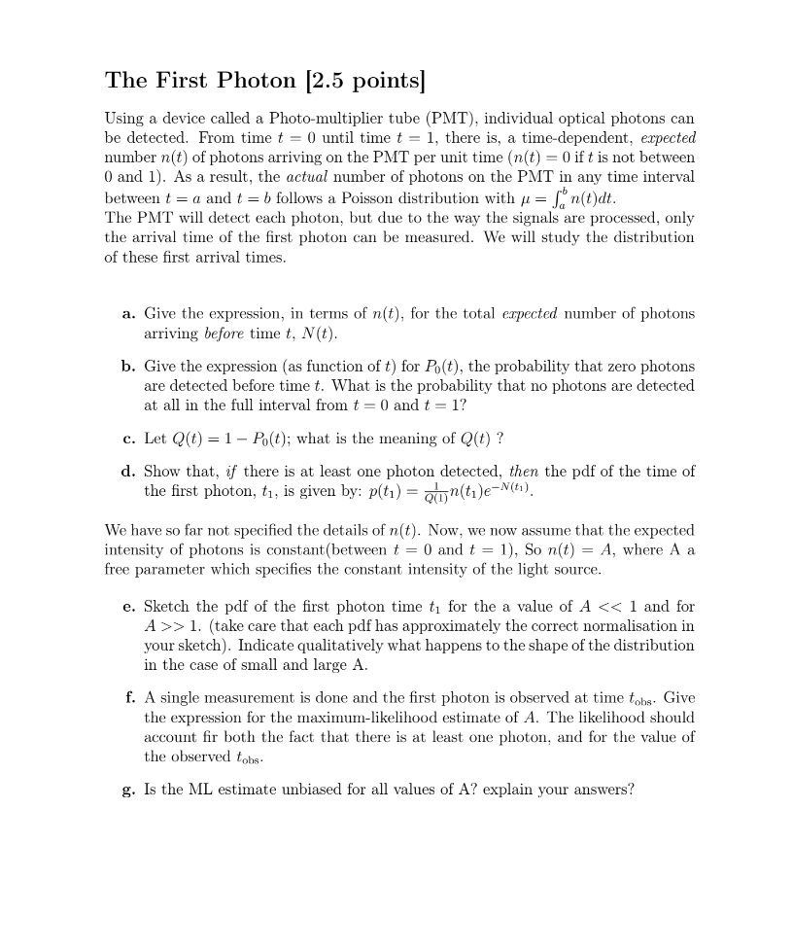
What have we learned?
Rigorous way to talk about and combine different aspects of the data.
Evaluate information in each term.
In the end: the first hit times contain all the information (because if you have a hit time, you know you have at least one hit).
In the end, it’s all ‘obvious’
Statistical data analysis exam question…

Slide 11
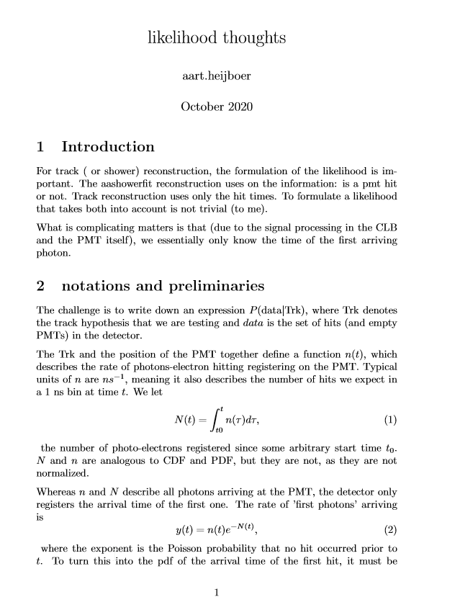
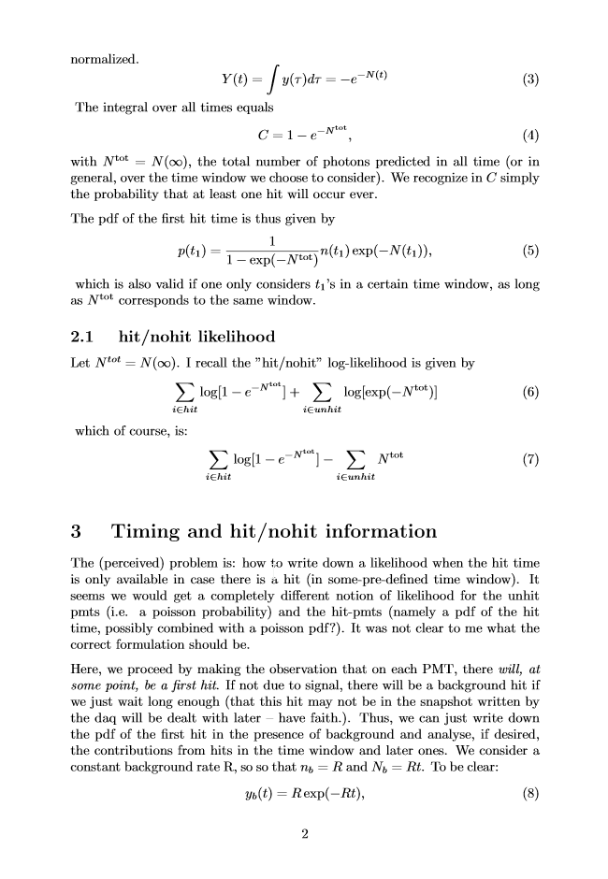
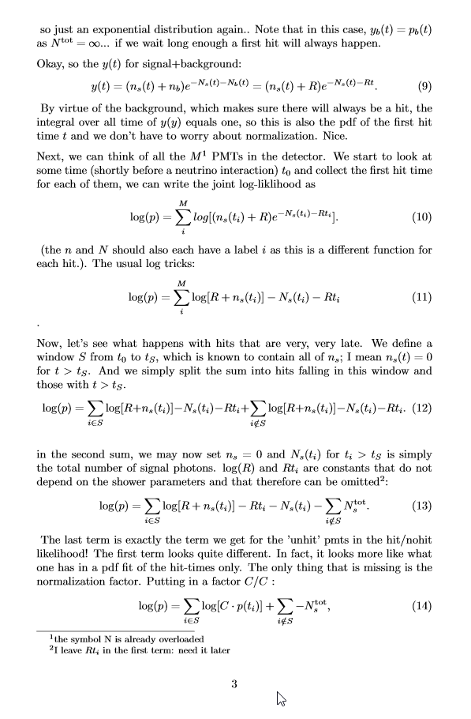
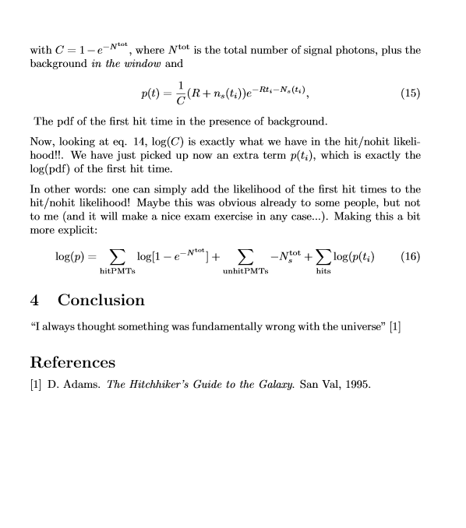
Combine hit/nohit with time?

Slide 12
Combine hit/nohit with time?
Problem: write down likelihood that is correct
start from first-hit time pdf, separate in signal-window and very-late hits
Existing aashowerfit pdf
Pdf of first hit time
We can add these likelihoods!
Analyze information in each term in coherent way
prospect of using one likelihood for all event signatures.

Slide 13
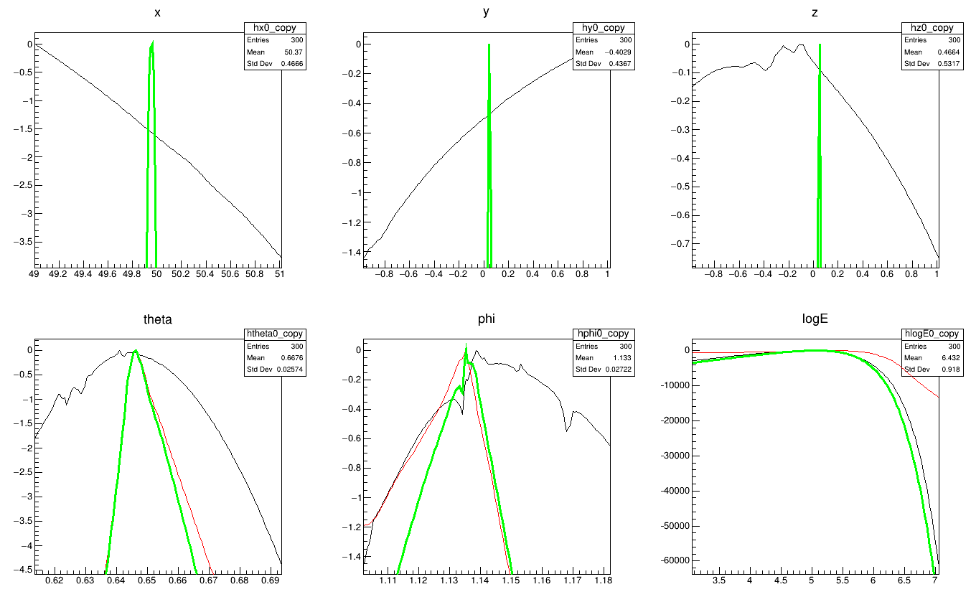
Information
Hit presence does noting for position
Energy dominated by hit presence
Direction : both, but time dominates (!)
E = 10⁵, point-like shower

Slide 14
Information
Adding timing has potential
for the direction!
(Jordan is on the case)
Peaks and valleys stemming from JPP Pdfs.
Reviving ‘photon tracking’
Hit presence does noting for position
Energy dominated by hit presence
Direction : both, but time dominates (!)
E = 10⁵, point-like shower

