Slide 1
Cascade likelihood studies
Aart Heijboer

Slide 2
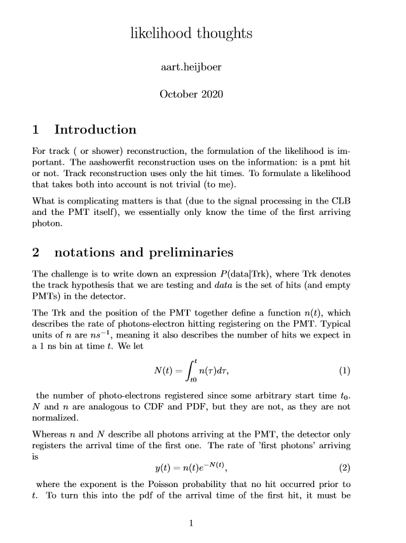
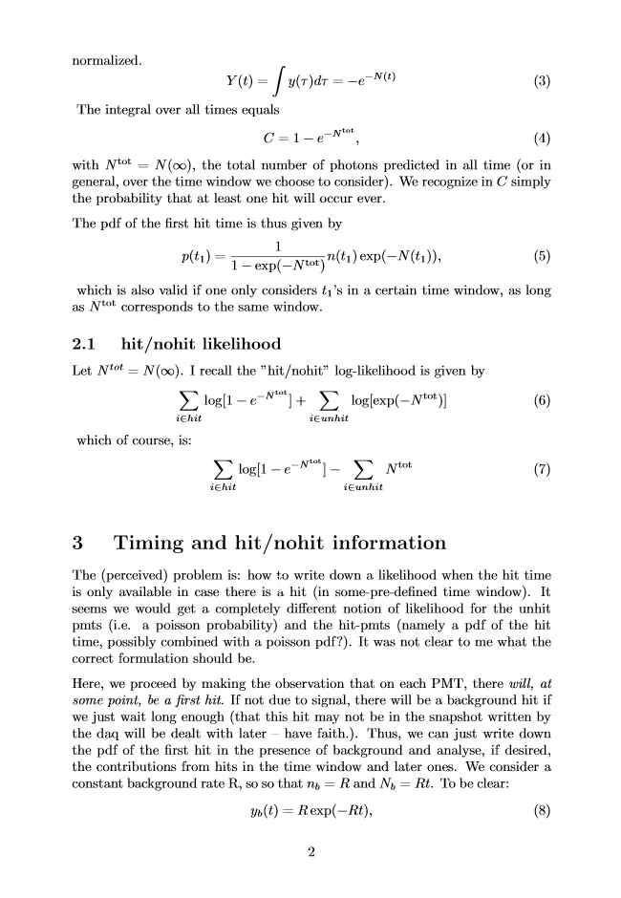
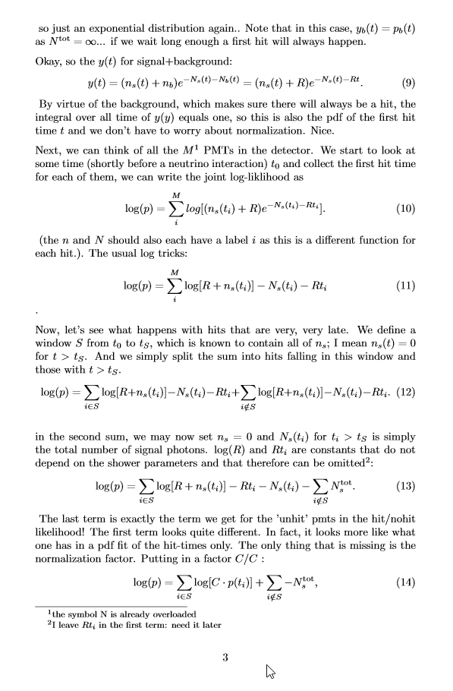
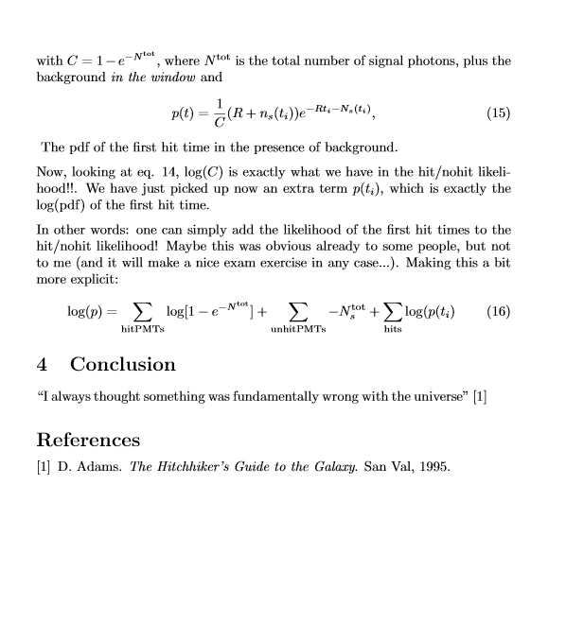
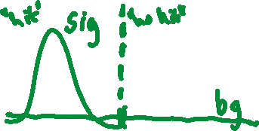
Combine hit/nohit with time?

Slide 3
Combine hit/nohit with time?
Problem: write down likelihood that is correct
start from first-hit time pdf, separate in signal-window and very-late hits
Existing aashowerfit pdf
Pdf of first hit time
We can add these likelihoods!
Analyze information in each term in coherent way
prospect of using one likelihood for all event signatures.

Slide 4
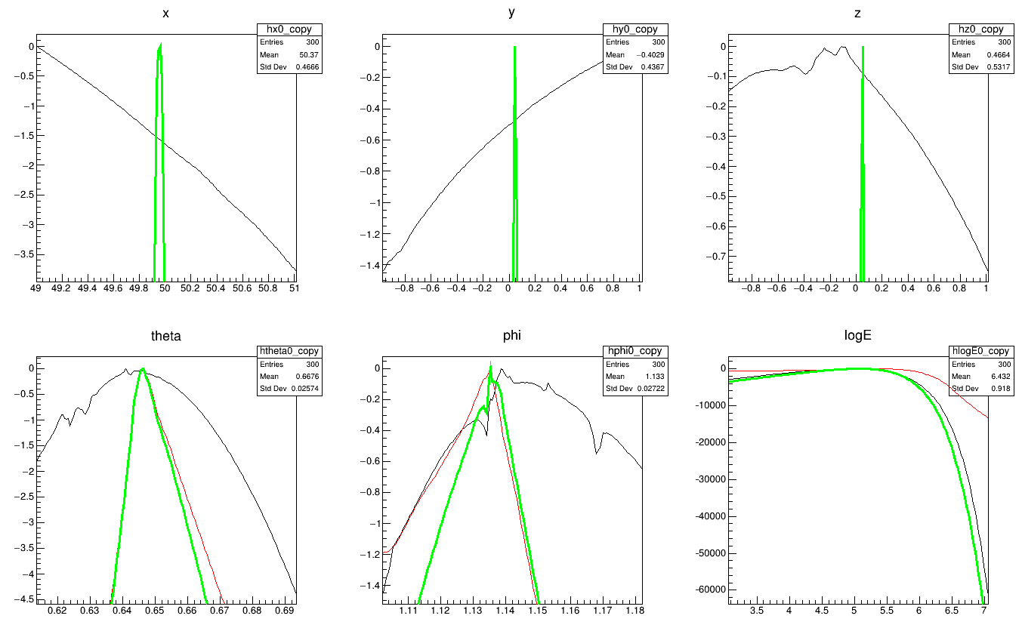
Information
Hit presence does noting for position
Energy dominated by hit presence
Direction : both, but time dominates (!)
E = 10⁵, point-like shower

Slide 5
Information
Adding timing has potential
for the direction!
(Jordan is on the case)
Peaks and valleys stemming from JPP Pdfs.
Reviving ‘photon tracking’
Hit presence does noting for position
Energy dominated by hit presence
Direction : both, but time dominates (!)
E = 10⁵, point-like shower

