Slide 1
Shower muon hits Pepijn Kruidenier 22/10/2020
2 files, nue_CC and nue_NC interactions in ARCA115
Looking at the time residuals of mc_hits
Without muons, expect hits to have time residuals above zero
Should be able to find muons in hits with time residuals under zero

Slide 2
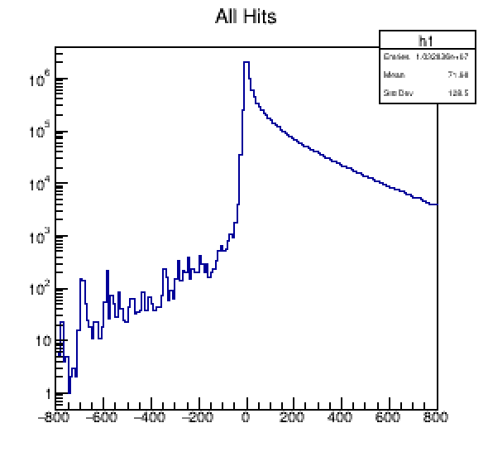
Shower muon hits
All mc_hits (nuCC and nuNC
Muon hits should make up earlier hits..
Residual (ns)

Slide 3
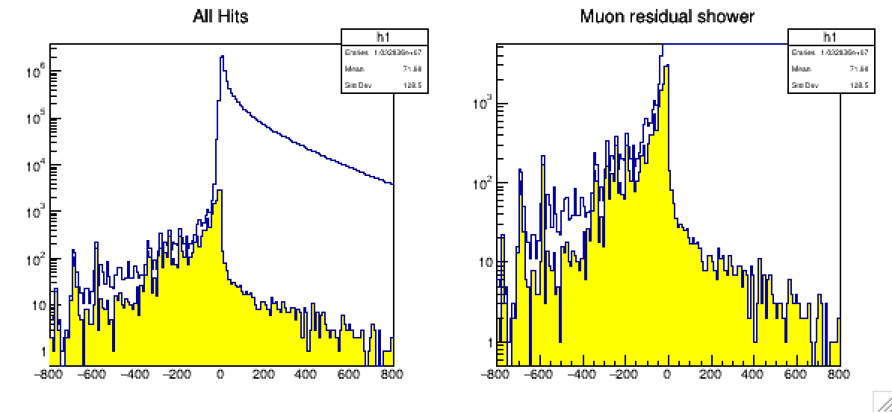
Shower muon hits
Not all hits with time residuals under zero are muons
Found the source of the other hits to come from bremstrahhlung and delta-rays
Look at the origin of these hits..
Residual (ns)
Residual (ns)

Slide 4
Shower muon hits
Origin of all bremstrahhlung and delta-ray hits came from the muons
Replaced the bremstrahhlung and delta-ray hits with muons
Residual (ns)
Residual (ns)

