Slide 1
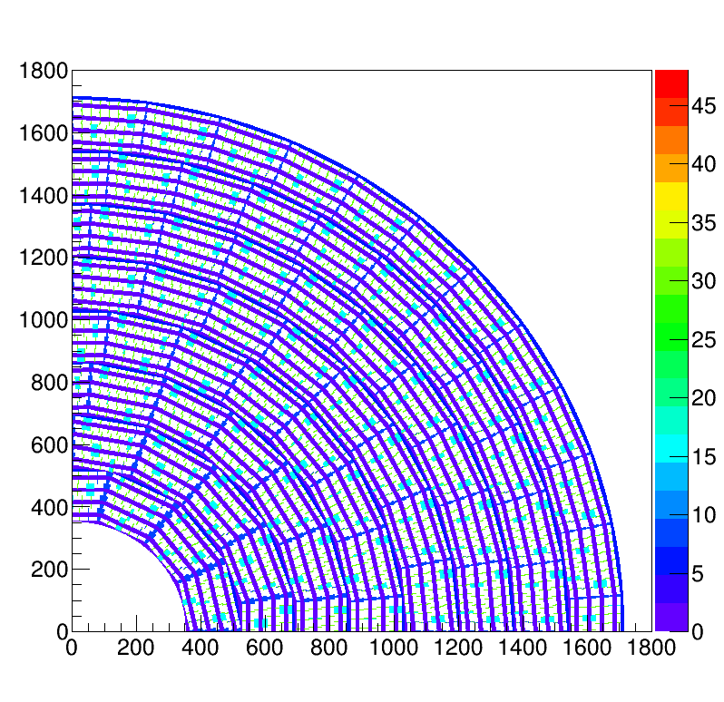
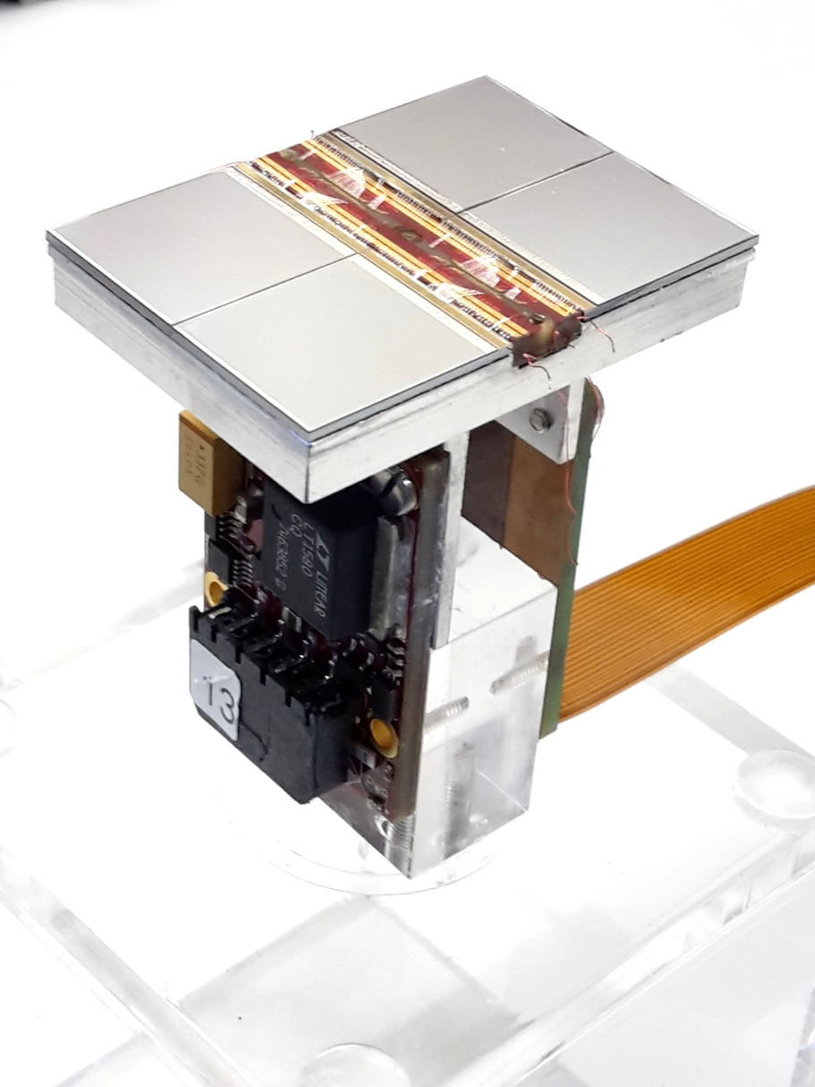
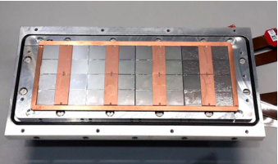
Pixel TPC
Single chip Quad Module TPC plane
2017 2018 2019

Slide 2
First Laser data taking with 8-quad module
Data taking with logging of
1 The laser positions and times
2 The trigger timestamps datastream TIMESTAMP
3 The data streams for the two concentrators LINK0 and LINK1
We took one longer run V_{grid} = -340 V; V_{drift} = -280 V
- x position = 1 mm steps of 4 mm in total 12 steps
Logging laser positions (1) did not work yet (in 1 run it worked)
The trigger stamps (2) were not streamed
The equalisation results were used. In the *dac.txt file the actual noise mean value is stored per chip. The rms of the noise is 7.5 counts.
In the DAQ the threshold is put at the noise mean value per chip plus a dac offset. In these run we used an offset of 25 counts.
The threshold was checked with noise runs. A few pixels had to be masked. NB in previous runs 55 counts were used. A lower value is preferable.

Slide 3
First Laser data taking with 8-quad module
The is the first try and we will need to learn from what did not work optimally yet.
The data analysis is more cumbersome, because two streams were absent. It is possible to use the datastreams LINK0 and LINK1 and build events using the timestamp. By collecting all hits for all chips from one concentrator within a time window of 2 10¹⁰ units (ns?).
To make a raw event display the geometry from Fred was used.
The chip hardware W30E07 nrs correspond to chip nr 1.
In the data stream one will find chip 1 that is located on the left top.

Slide 4
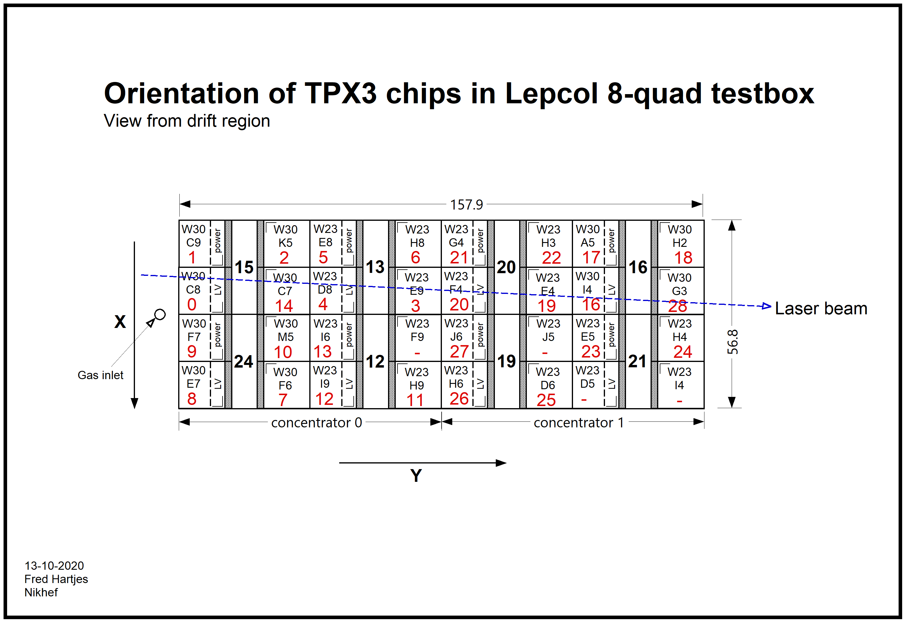
Layout chip nrs
1 2 9 10
0 3 8 11
6 13 14
7 12 15
29 30 21 22
31 20 23
26 17 18
24 27 16 19

Slide 5
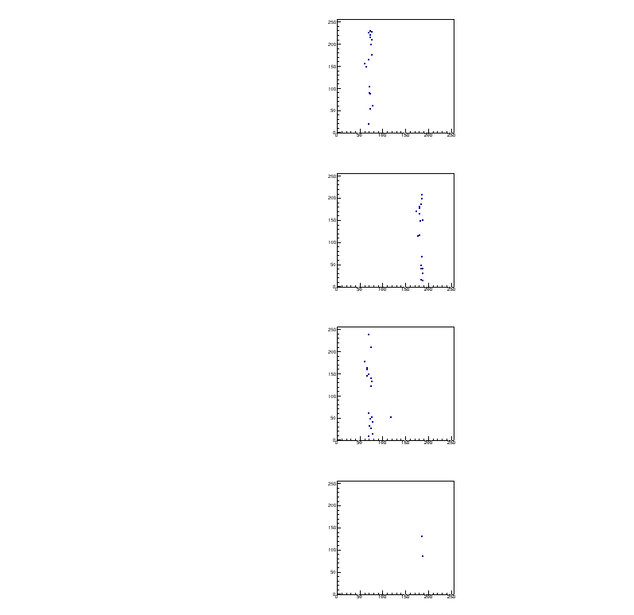
Event Display
Stage position 0
Event 5
Concentrator 0
Only chips with hits are drawn col vs row
Chip should be rotated
We don’t scan the chips in the right top column
There are just a few hits: less and less the further from the enry window
Chip should be rotated

Slide 6
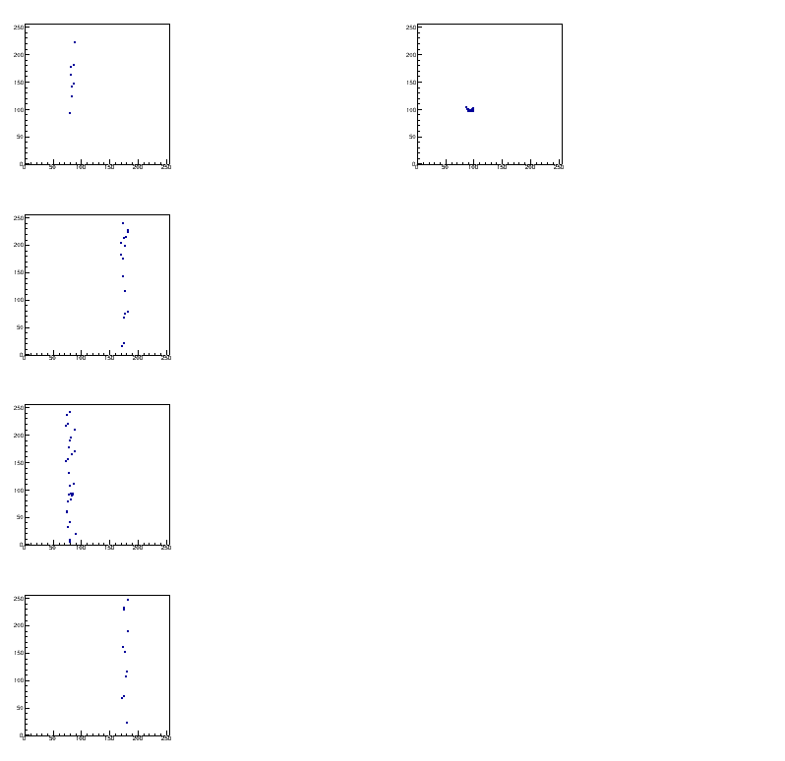
Event Display
Stage position 7
Event 1
Concentrator 0
Stage positions 8-11 fall out of the module
We need to move the box by ˜16 mm

Slide 7
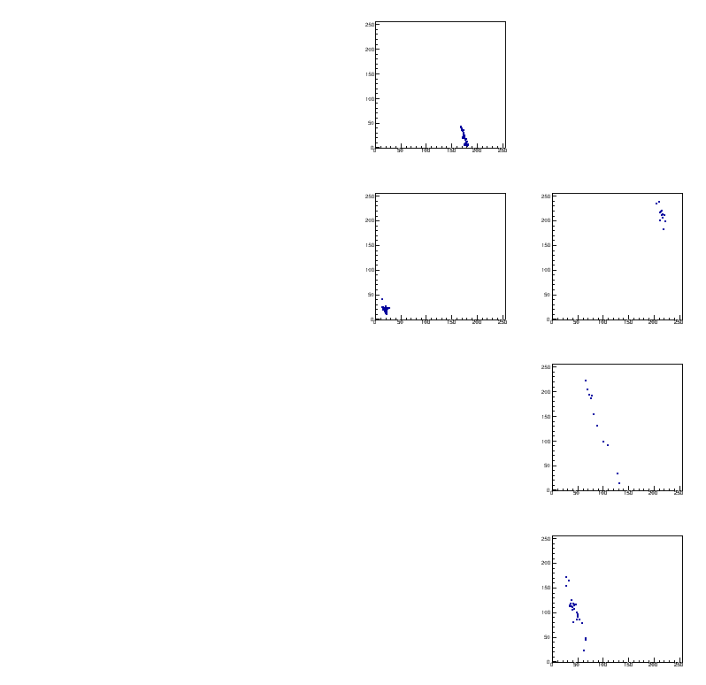
Event Display
Stage position 11
Event 8
Concentrator 0
Inclined track
Few hits in this concentrator
They are further from the entry window

Slide 8
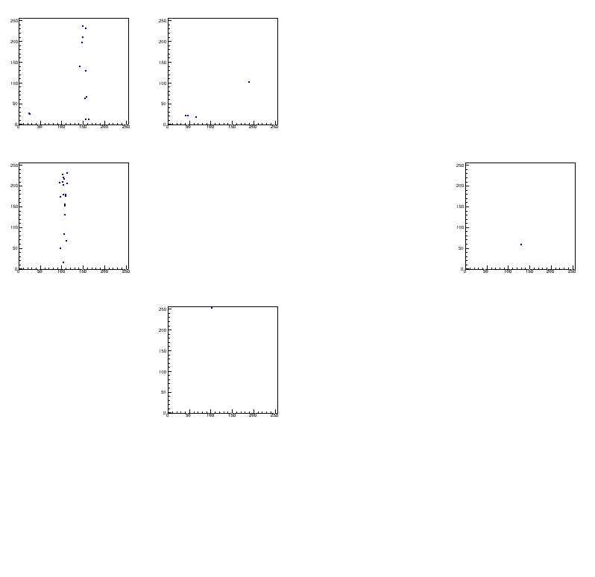
Event Display
Stage position 5
Event 44
Concentrator 1
Few hits in this concentrator
They are further from the entry window

Slide 9
Event display layout
1 2 9 10
0 3 8 11
6 13 14
7 12 15
29 30 21 22
31 20 23
26 17 18
24 27 16 19
Layout chip nrs

Slide 10
Updated event display layout

Slide 11
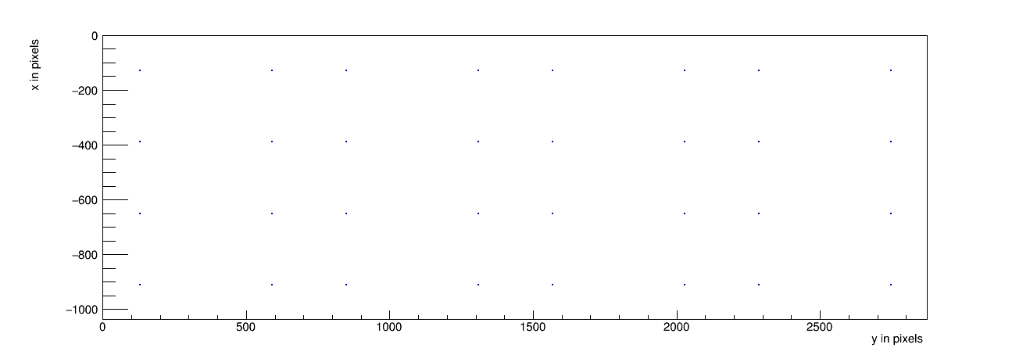
Event display layout: chip centres

Slide 12
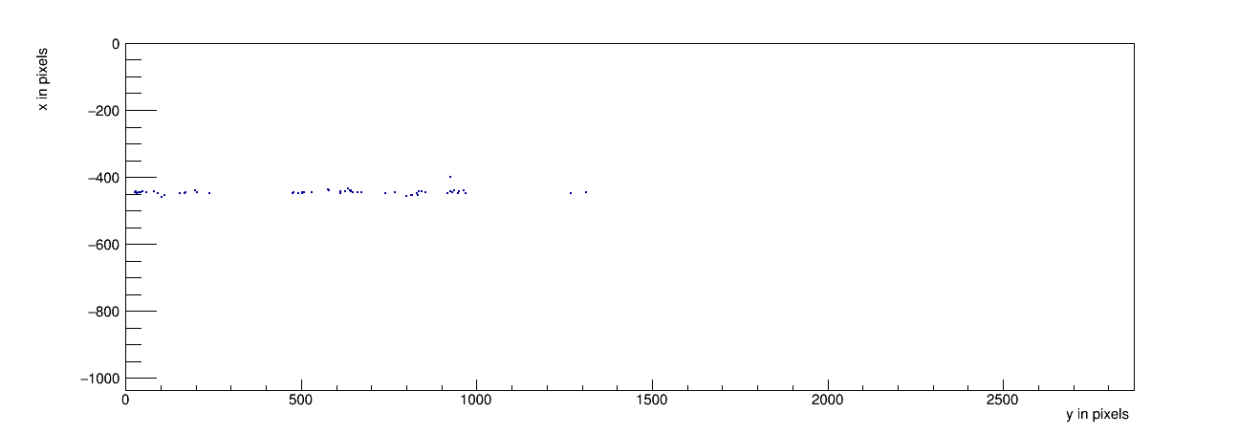
Event Display
Stage position 0
Event 5
Concentrator 0
Only chips with hits are drawn col vs row
Same events as above

Slide 13
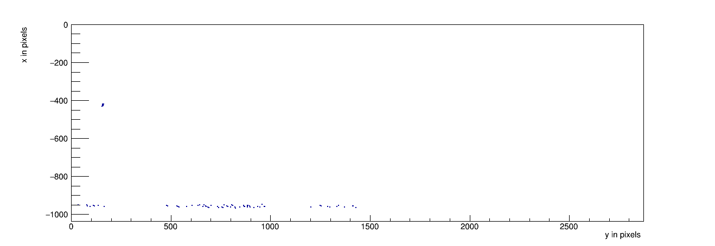
Event Display
Stage position 7
Event 1
Concentrator 0

Slide 14
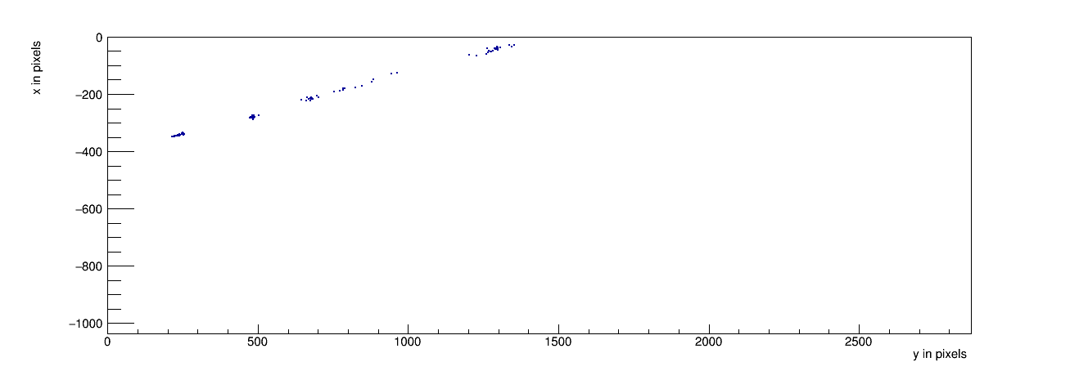
Event Display
Stage position 11
Event 8
Concentrator 0

Slide 15
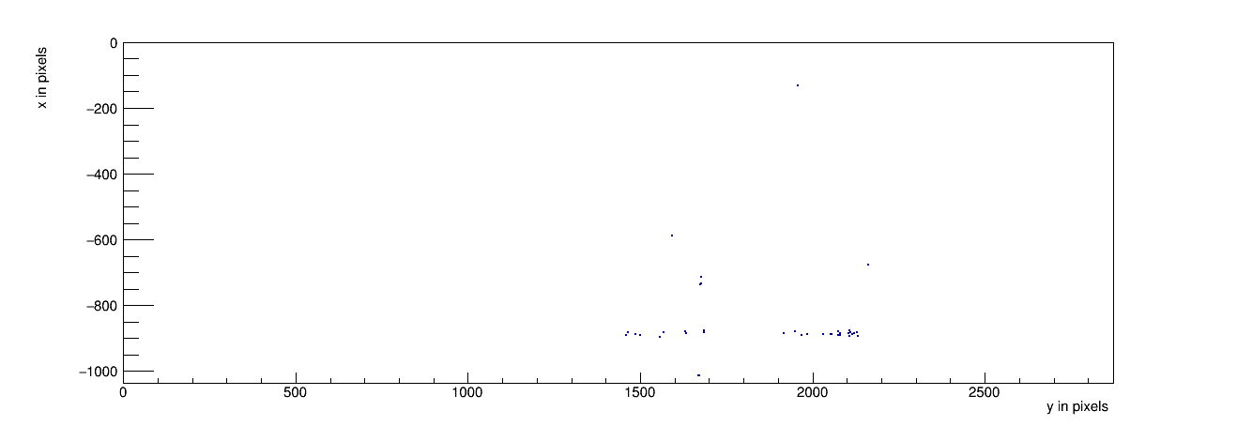
Event Display
Stage position 5
Event 44
Concentrator 1

Slide 16
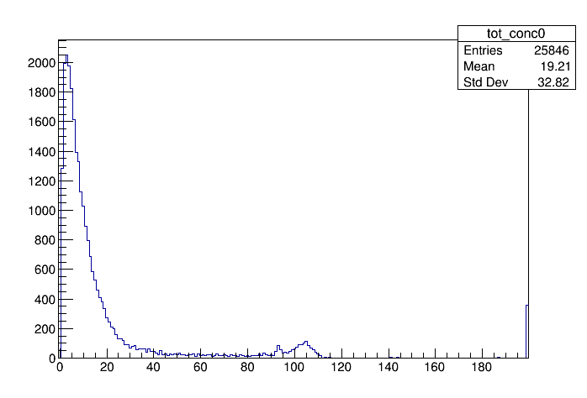
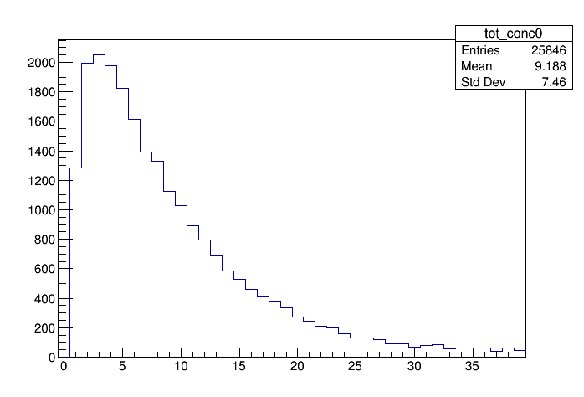
First Laser data taking with 8-quad module
ToT concentrator 0
zoom
The bump at 100 probably is not due to the laser track (unmatched hits)
The peak value at 4 counts = 100 ns is very low.

Slide 17
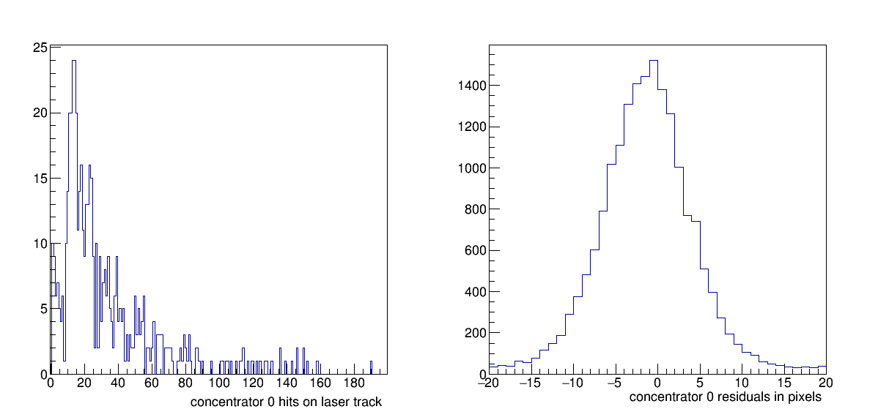
First Laser data taking with 8-quad module
Low nr of hits on full track
Residuals look fine

Slide 18
Conclusions
Thanks to the efforts of may of us and in particular the ET experts Sander van Doesburg, Henk Boterenbrood, Bas van der Heijden and the support of the Ruud Kluit and Martin van Beusekom, we can now run the daq, equalize all the chips and take laser data.
First events look nice but there are too few hits and the ToT is too low
In a new laser run we should re-position the module wrt the laser and optimize the laser optics. Also check the LV connections, correct loading of dac table to track down the low ToT value.
The cherry on the cake is data taking at a test facility like DESY. Due to COVID we had to re-arrange our testbeam plan. But we will get there.

