Slide 1
Hit residuals Aart Heijboer
- Reconstruction of shower-position depends on hit-time-residuals (in contrast to direction)
Should we correct hits / PDFs for
a) time-slewing ?
b) broadening due to TTS ?
Micro-analysis
Evt::mc_hits : MC photons reaching the photocathode (mc-hit)
Evt::hits : simulated output of the CLB “data-hits” (have no information on which mc_hit caused them)
match by PMT, time => can compare photon arrival time with data-hit.
The point? : data-hit residuals should be described by the (JPP) PDFs we use

Slide 2
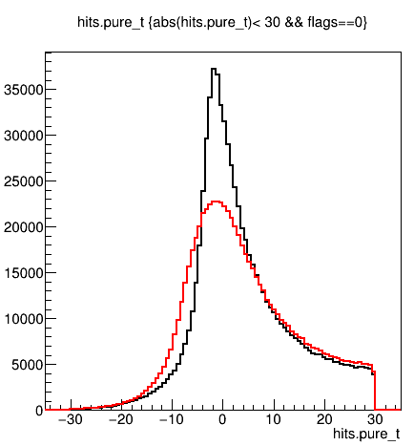
Observations: sirene nueCC
Also in genhen MC, there are muons in the nueCC -> remove them for studies like this
Residuals in data broader, as expected
Now let’s slew-correct the data-hits…
-- mc hits
-- data hits
Residual (ns)

Slide 3
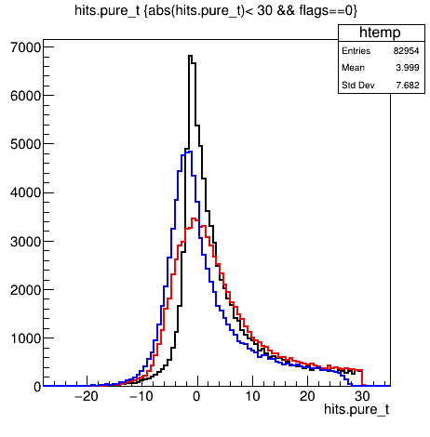
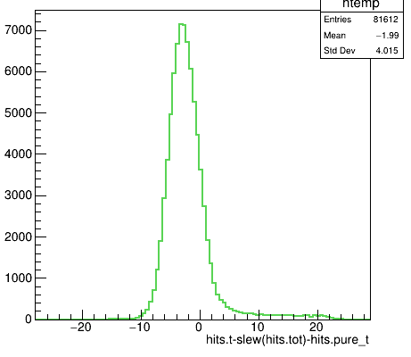
Observations : sirene nueCC
Also in genhen MC, there are muons in the nueCC -> remove them for studies like this
Residuals in data broader, as expected
Now let’s slew-correct the data-hits…
Slewing correction works (narrower distribution), but also: induces overall offset (~3ns), - which is most likely not in the pdf - in final reconstruction overall offset of all hits does not matter. But it can confuse us during reco development.
-- mc hits
-- data hits
-- slew-corrected data-hits
Residual (ns)

Slide 4
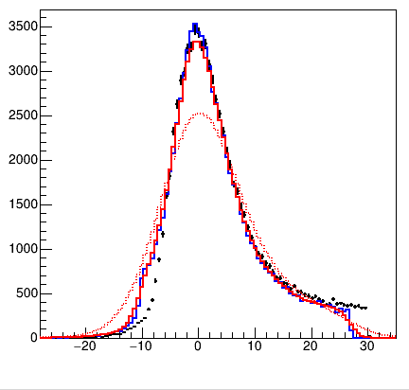
observations
+ data-hits
--- mc-hits, with slewing applied and 3ns shift
--- mc-hits, slewed, 3ns, blur Gaussian(1.3 ns)
- - mc-hits, slewed, 3ns, blur Gaussian(4.5 ns)
Blurring with TTS :
don’t confuse FWHM with sigma ☺
Realistic value changes distribution only slightly

