Slide 1

50th EUGridPMA
GN4 EnCo and EOSChub ISM
Amsterdam meeting
enabling communities through trust …
… close by and at a distance
September 2020

Slide 2
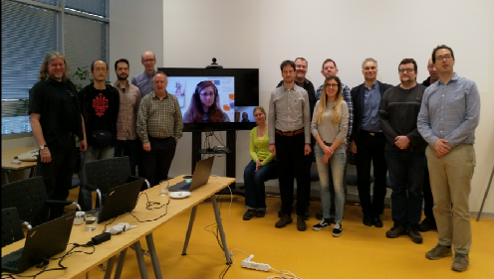
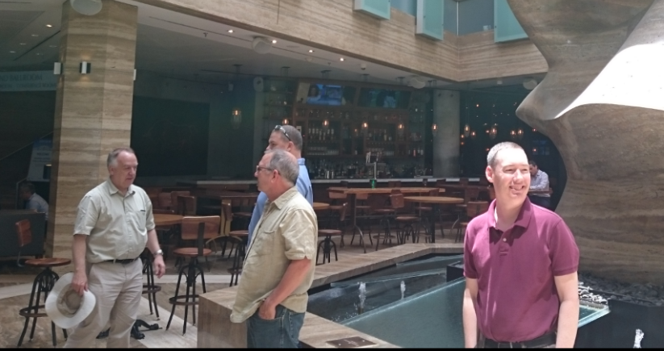
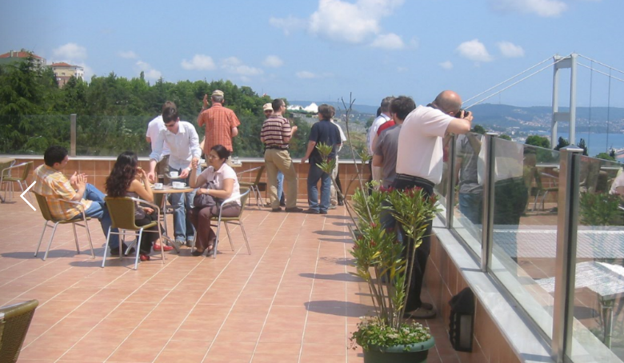
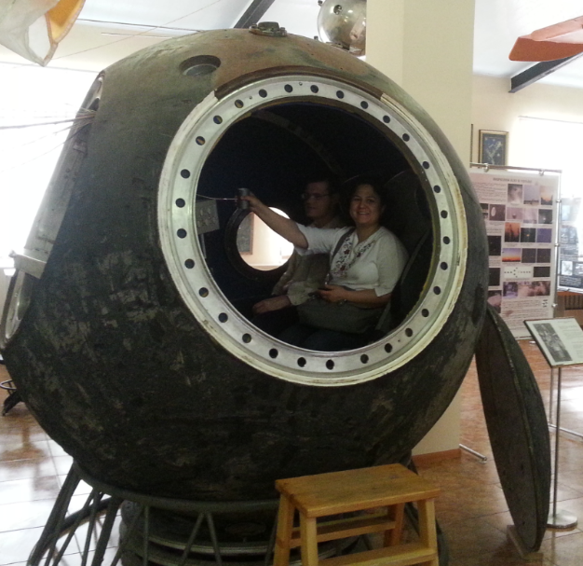
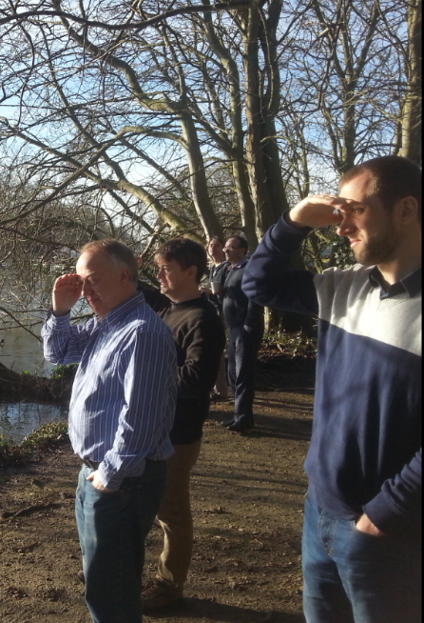
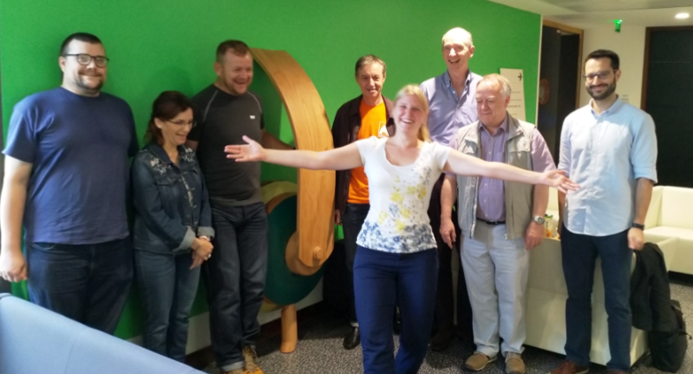
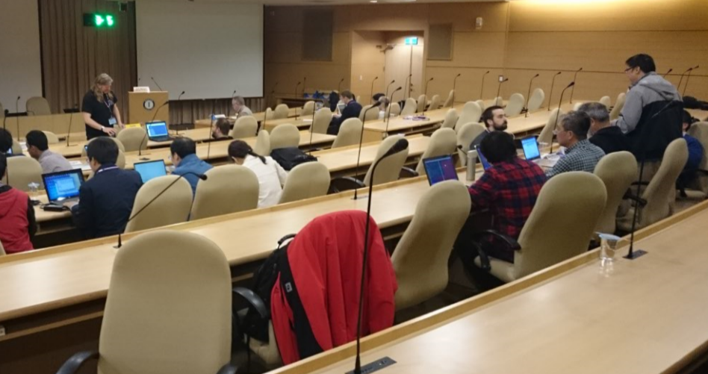
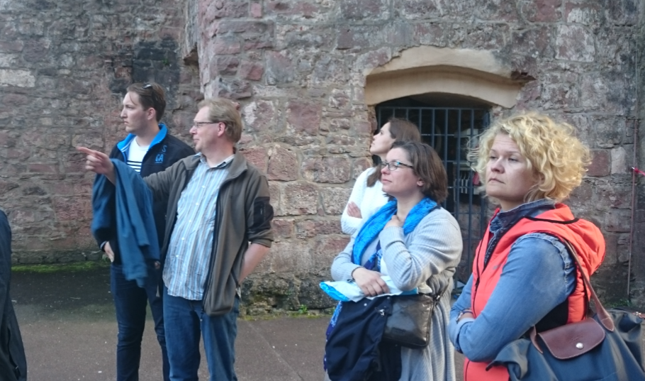
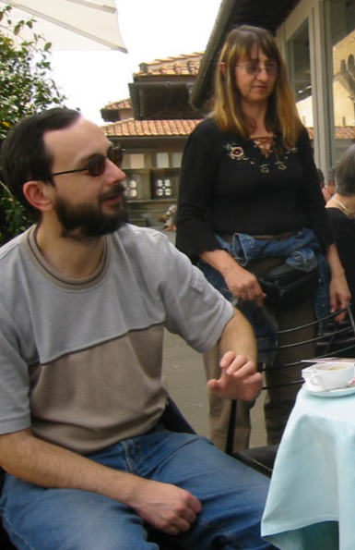
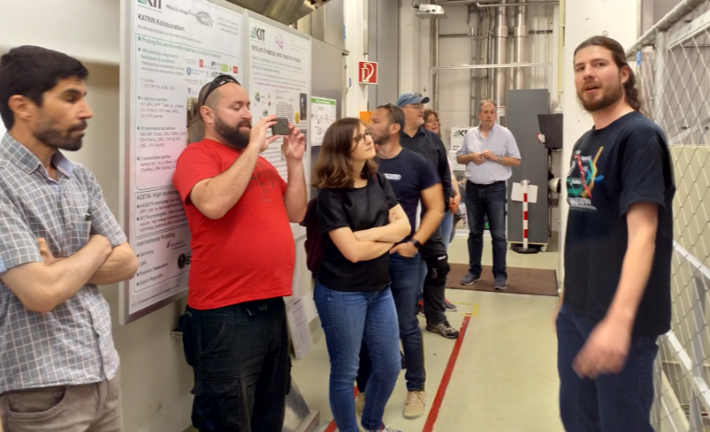
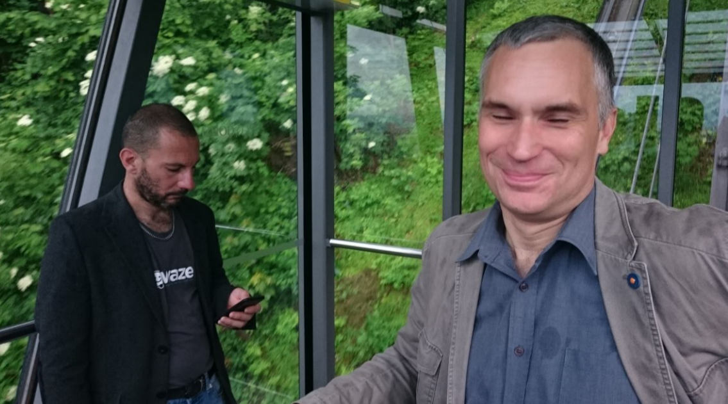
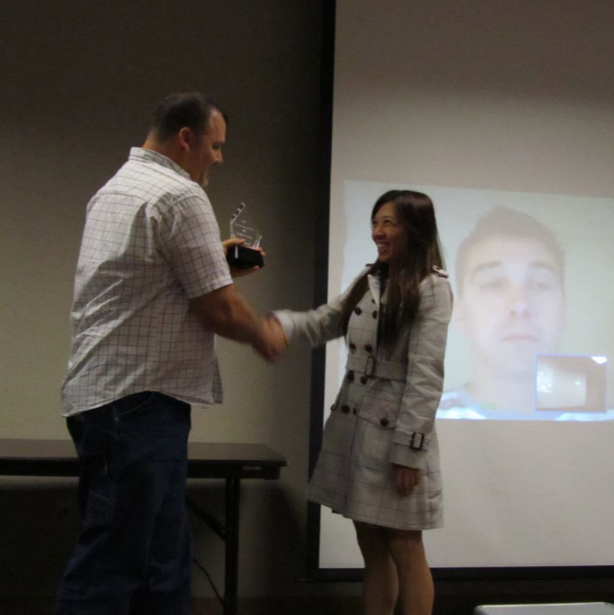
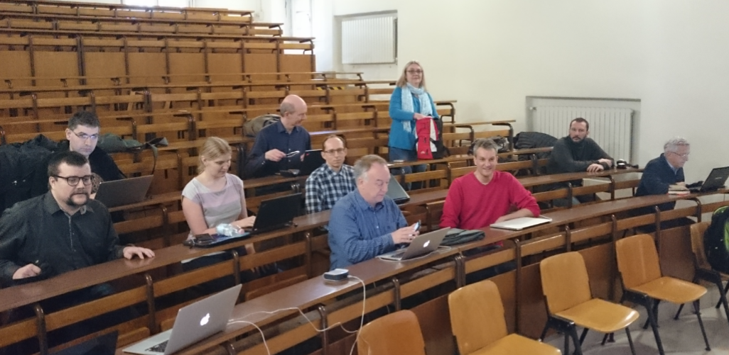
50 EUGridPMA+ meetings - from Firenze to Amsterdam

Slide 3
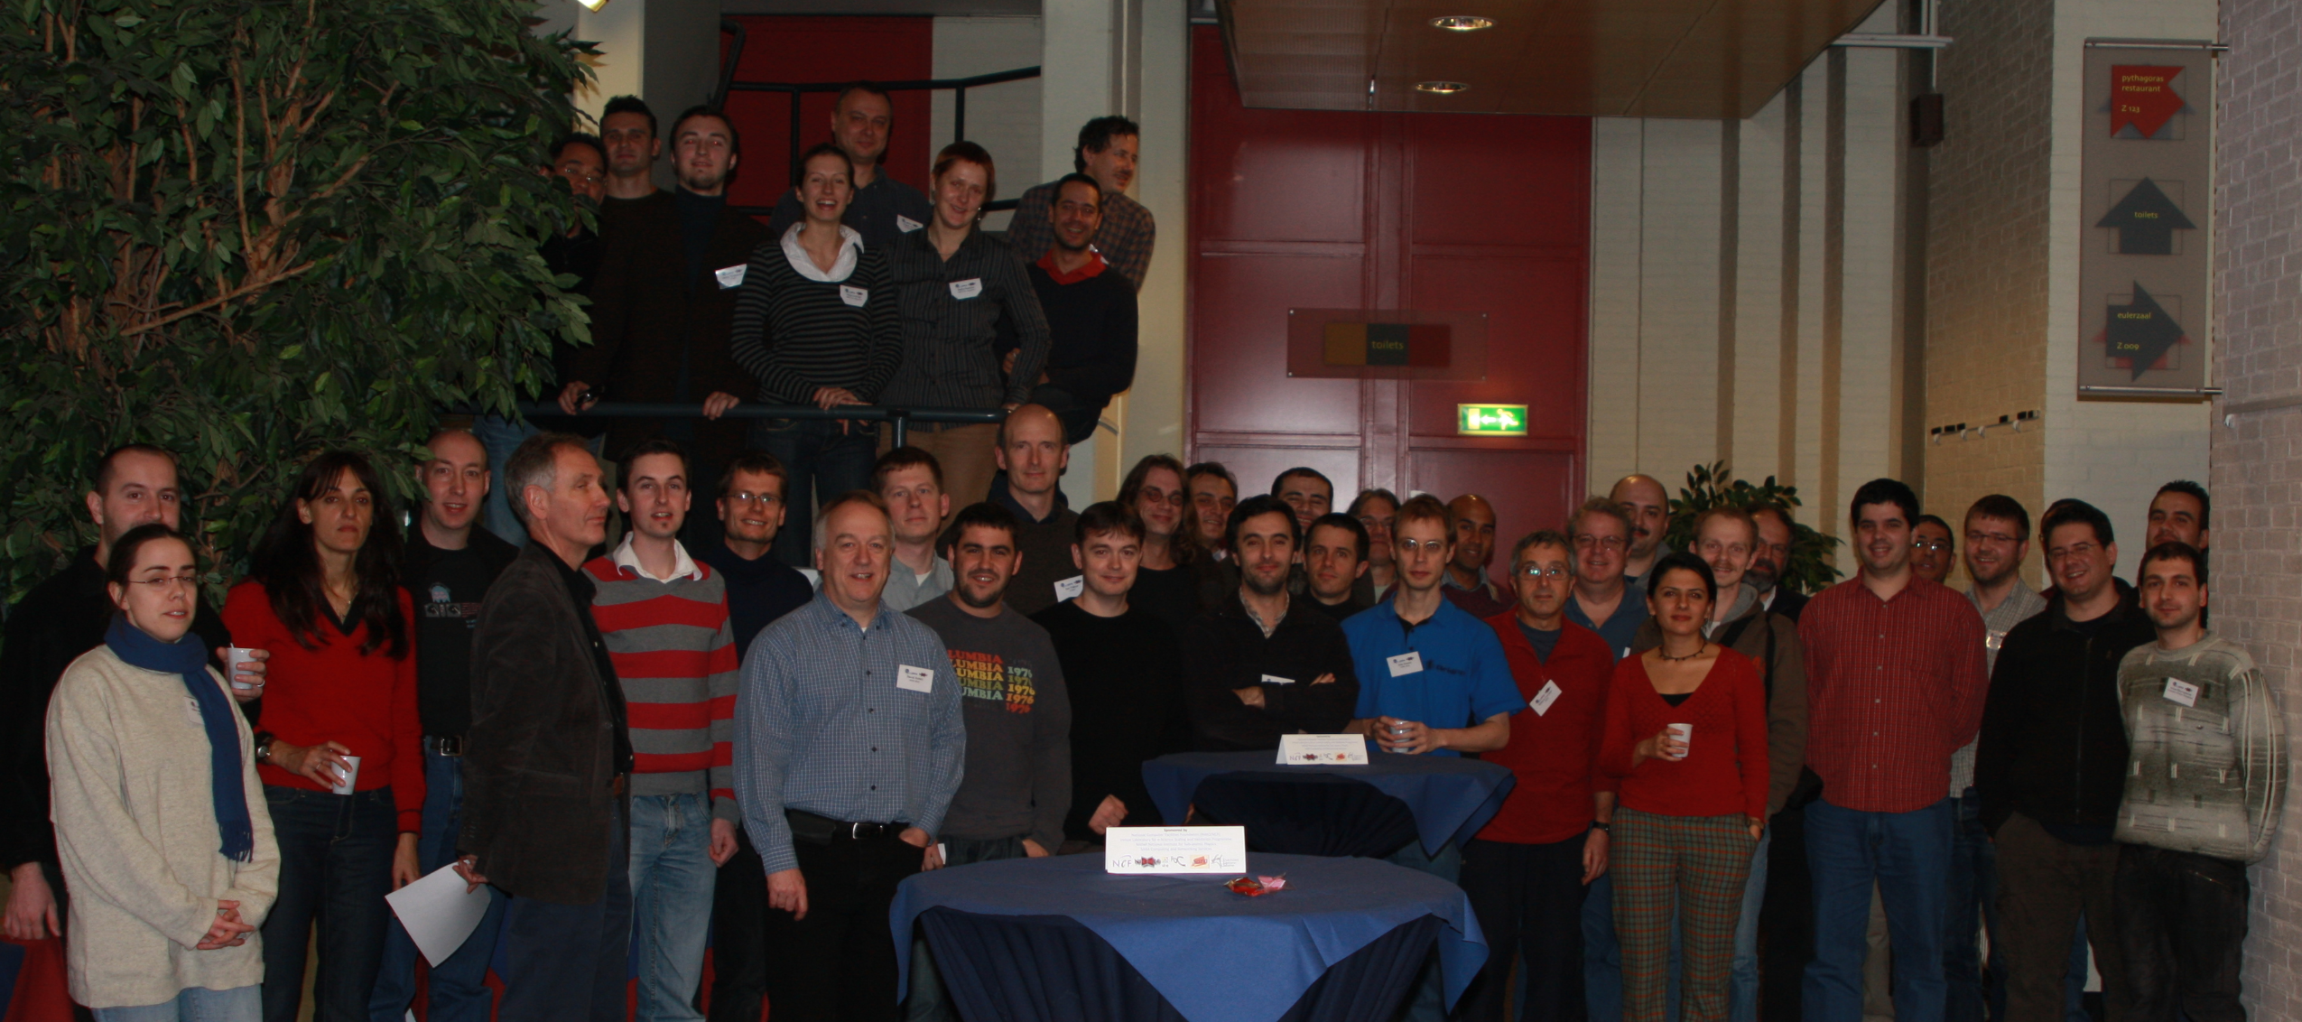
Amsterdam used to be a bit busier … ☺

Slide 4
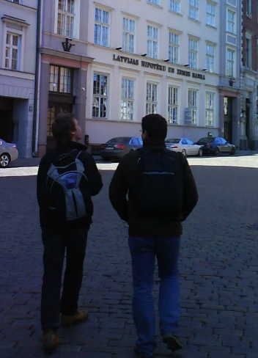
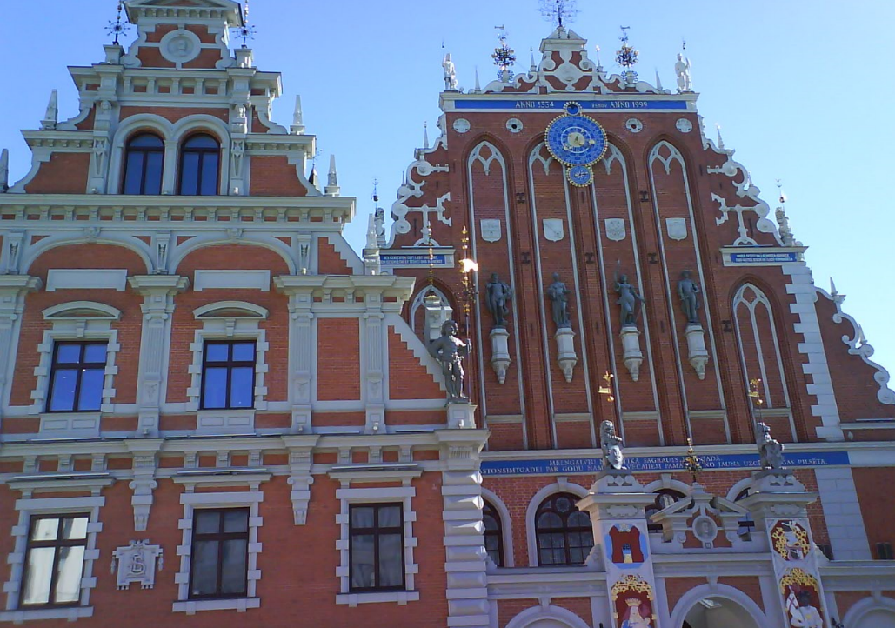
But we’ve done ‘almost-virtual’ meetings before

Slide 5
Shorter, yet stronger
While we appreciate the perseverance of all who habitually join remotely:
this meeting will be both talks and work
the coffee and lunch breaks here allow to you process email at home …
shorter, but more frequent breaks
the great break and lunch discussions I will miss most
although most of you are remote …
let it not be a series of presentations, but raise your (virtual) hand, engage, comment, engage in violent agreement, add or shorten, &c
let’s be hopeful for the January meeting
although it might still be a bit early ☹

Slide 6
Today – Monday 7, 09:30 - ~ 16:30
09.15 Welcome from local host, agenda, minutes last meeting, note taker, introductions
09.30 APGridPMA: developments in the Asia Pacific region (Eric Yen)
10.00 Self-audit review & status of suspended authorities (Cosmin Nistor)
10.10 CA Updates I: TCS experiences (DavidG)
10.30 Coffee
11.00 The EOSC ecosystem and trust – towards new horizons (introduction: David Groep)
11.30 CA Updates II/II
12.30 Lunch
13.30 The Implements Guide to SCIv2 – what do the SCIv2 requirements actually mean? (Uros)
15.00 Tea
15.30 TAGPMA - developments from the Americas (Derek Simmel)
16.00 AARC Policy Development evolution: review of top-level security policies and
comparing EGI, EOSC-hub, AARC-PDK, the draft UK-IRIS versions (Ian N)

Slide 7
Tuesday: 09:30 again
09.15 Enabling Communities: progress and next steps (Maarten Kremers)
09.45 Attribute Authority Operations v2 – clarifying AA operations guidance for a non-physical world
10.30 Coffee
11.00 AAOPS continued
12.30 Lunch
13.30 OpenID Connect Federation (Jouke Roorda)
14.00 RCauth.eu- the challenge of a distributed active-active federated CA across organisations
(Mischa Sallé, Kyriakos Gkinis, Jens Jensen, Nicolas Liampotis)
15.00 Tea
15.30 Risk-based assurance guidelines and recommendation document (DavidG, Jule)
17.00 Next PMA meeting January 2021 in Garching near Munich (Jule)

Slide 8
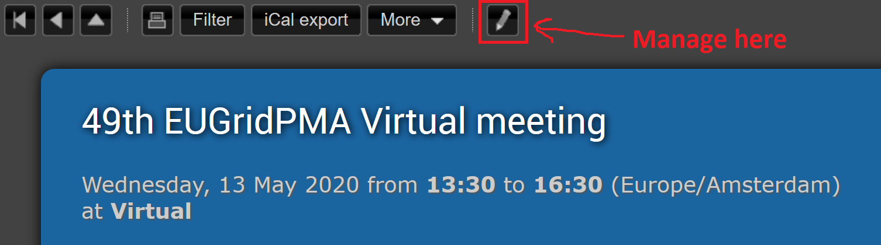
Logistics
Upload presentations to the agenda page
https://eugridpma.org/agenda/50
Go to management mode, and enter the password you know
Upload your materials there

Slide 9
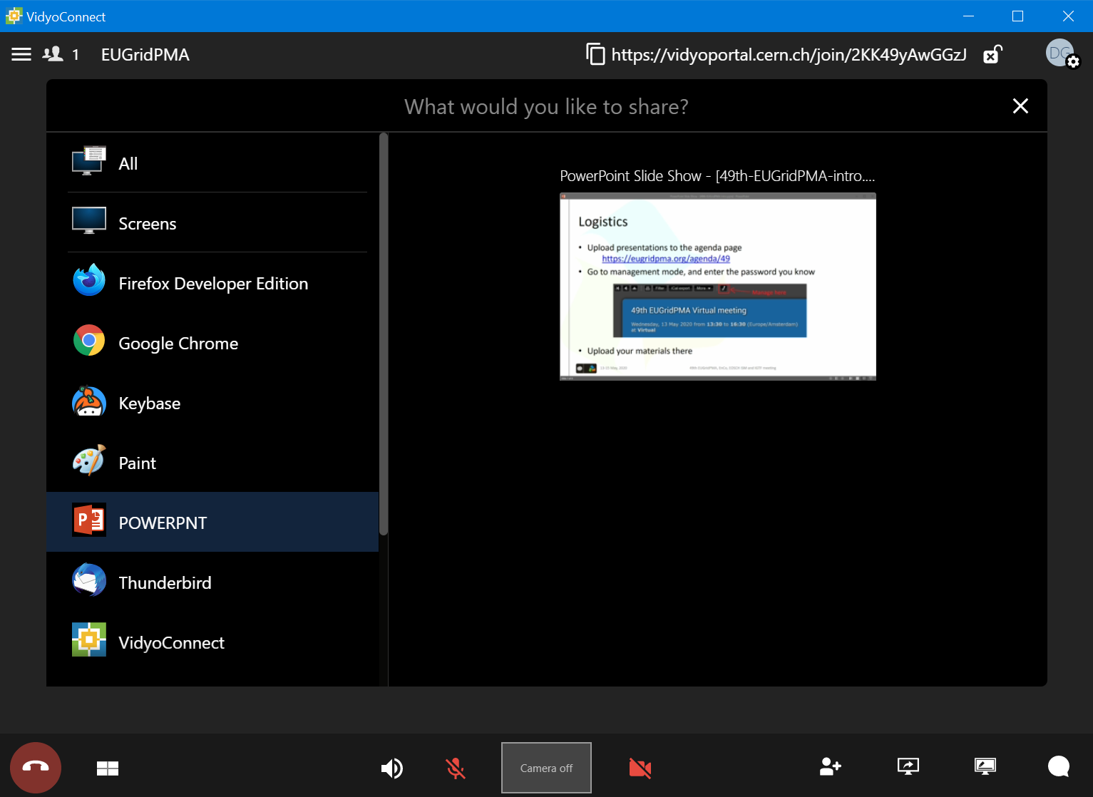

During the session
Please share your screen or presentation-application if you’re speaking
or discussing a document
Powerpoint for Windows: use “Reading view”
to keep sharing the right window
(Mac and 365web-only users are out of luck)
Adobe Acrobat: view file in “Read-mode”
(Ctrl-H) to keep sharing the right window
Please mute when you’re not speaking

Slide 10
Building a global trust fabric
Questions?

Slide 11
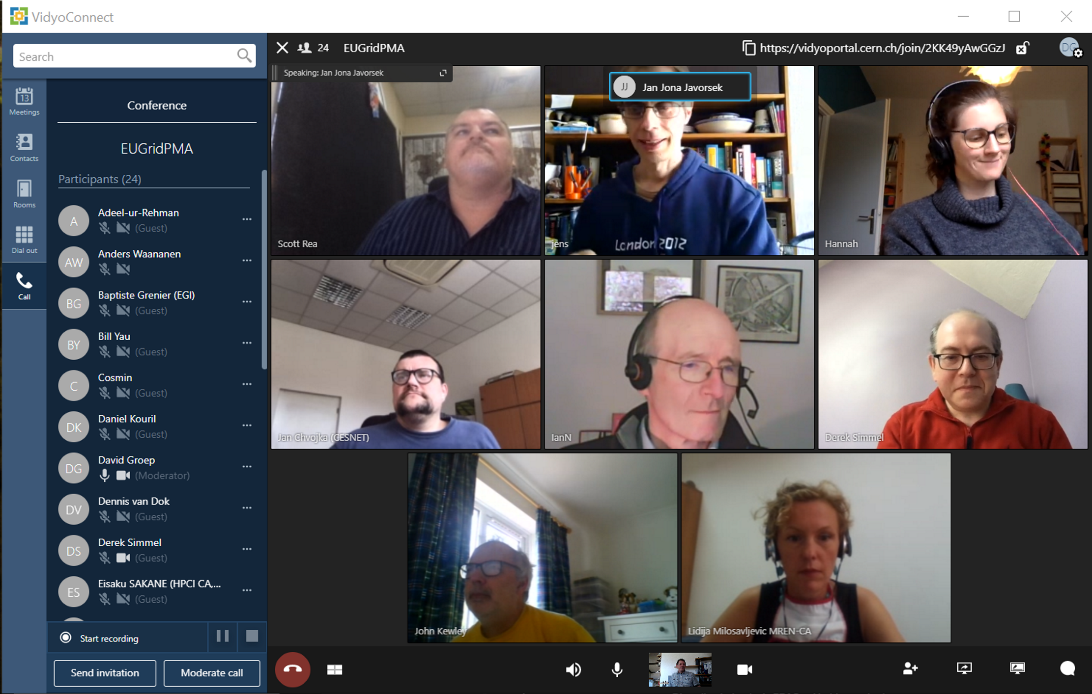
Thanks to you all for hanging on!
and to CERN for Vidyo!
Next meeting: January 2021
tentatively at LRZ in Garching
kindly hosted by Jule at LRZ!

Slide 12
Alternative mode – http://eugridpma.org/z/50
Topic: EUGridPMA 49 Joint Meeting: IGTF, GN43 EnCo, and EOSCH ISM
Join Zoom Meeting: https://nikhef.zoom.us/j/96194843289
passcode is 4483 (“IGTF”)
Meeting ID: 961 9484 3289
One tap mobile
+31207946519,,96194843289# Netherlands
+31207946520,,96194843289# Netherlands
Phone numbers: see https://nikhef.zoom.us/u/abf0kUNkiq
and who wants to use H.323 to call in? If so, I’ll order some connectors …

