Slide 1
Conclusion of the toy vertex reco Monte-Carlo
Jordan Seneca
September 2nd, 2020

Slide 2
Since last time:
Fix all hit reconstruction bug (the <npe> was used directly as a probability)
Fix background reconstruction bug (the <npe> of background events was also used directly as probability)
Results:
All hits reconstruction now better than first hits
Per pmt likelihoods look healthy

Slide 3
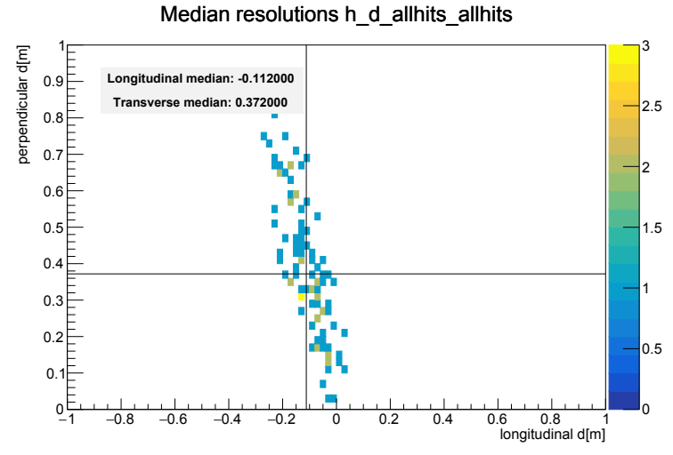
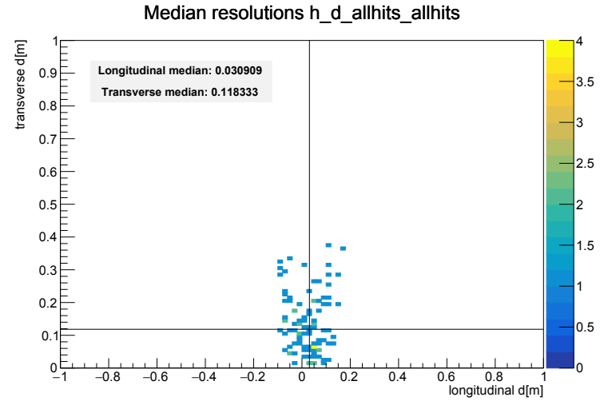
All hits reconstruction, pointlike
Starting position: 1x1x1m from mc truth
Before bug fixes
After bug fixes
Big improvement, correlation disappears

Slide 4
All hits reconstruction, pointlike
Starting position: 1x1x1m from mc truth
R
Good event (2cm long res)
Bad event (15cm long res)
Clear development in direction of neutrino as time residual increases.

Slide 5
All hits reconstruction, pointlike
Starting position: 1x1x1m from mc truth
R
Good event (2cm long res)
Bad event (15cm long res)
Interesting double peaks appear at large distances

Slide 6
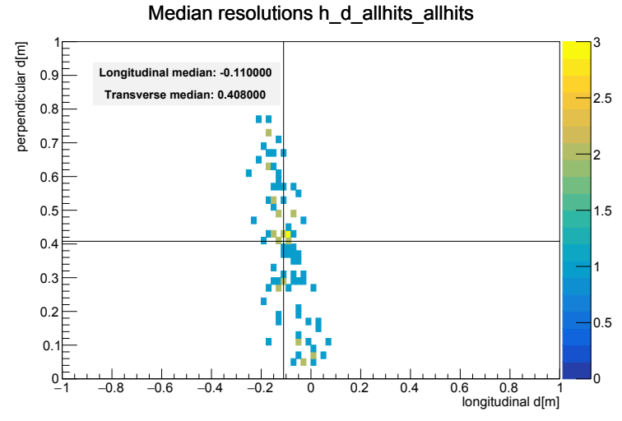
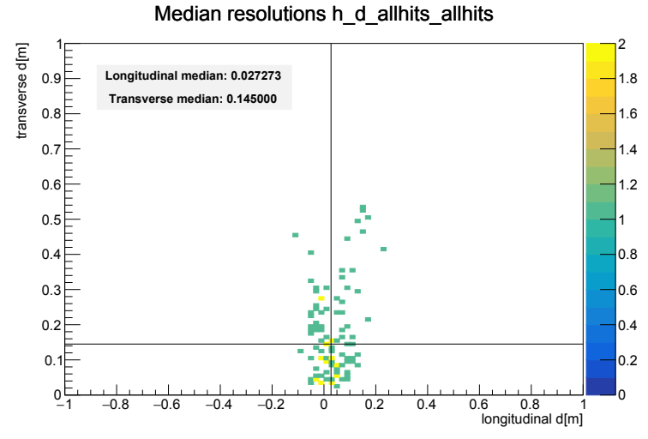
All hits reconstruction, elongated
Starting position: 1x1x1m from mc truth
Before bug fixes
After bug fixes
Elongated case looks similar

Slide 7
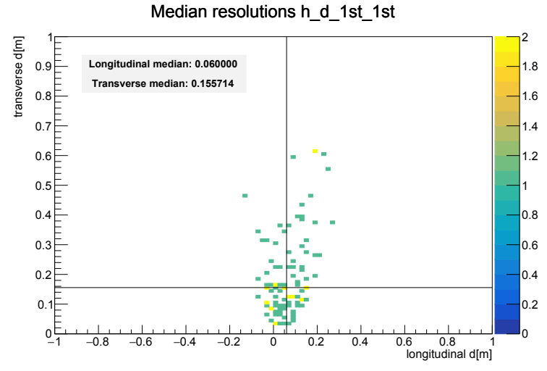
Position reconstruction, elongated, after fixes
Starting position: 1x1x1m from mc truth
First hits method
All hits method
Potentially achievable resolution:
Longitudinal: 6 – 3 cm, Transverse: 16 – 15 cm

Slide 8
Conclusion:
The position reconstruction on the toy MC events is now very good. At this point there are no obvious outstanding issues with the toy MC and its reconstruction.
There are however some interesting oddities in the likelihood which could be worth pursuing.

