Slide 1
Antares in JPP
update

Slide 2
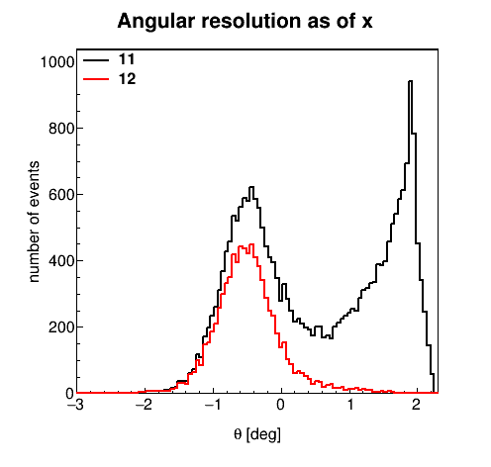
Antares fitted by AAfit.
11 – AAfit uncut
12 – AAfit with
Lambda >-5.2
Beta0 > 1
Upgoing tracks

Slide 3
JPP Fit parameters I use
Parameter | Range | Cut
Chi2 | 0~300+ | 35 +
Reduced Chi2 | 0~5 |  | Chi2/NDF
#Of Fits going the same direction | 1~NumberOfPrefits | 2 +
Ratio of Fits going the right direction | 0~1 | 50%+
Beta0 | 0 ~ 0.020 | 0.010 -
Zenith Angle | 0 ~ 180 | upgoing

Slide 4
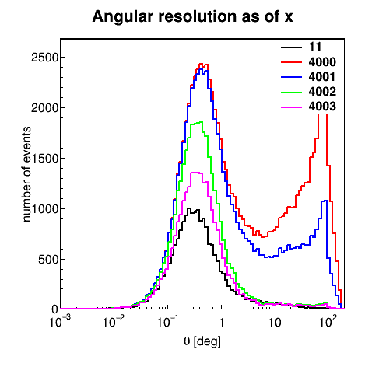
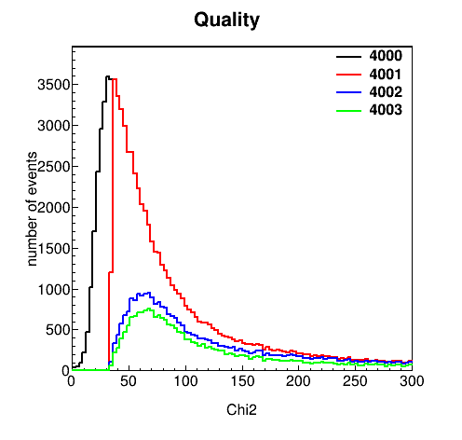
Current cuts

Slide 5
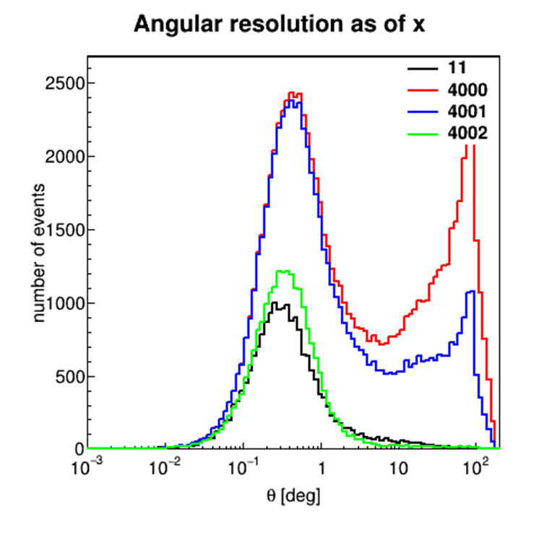
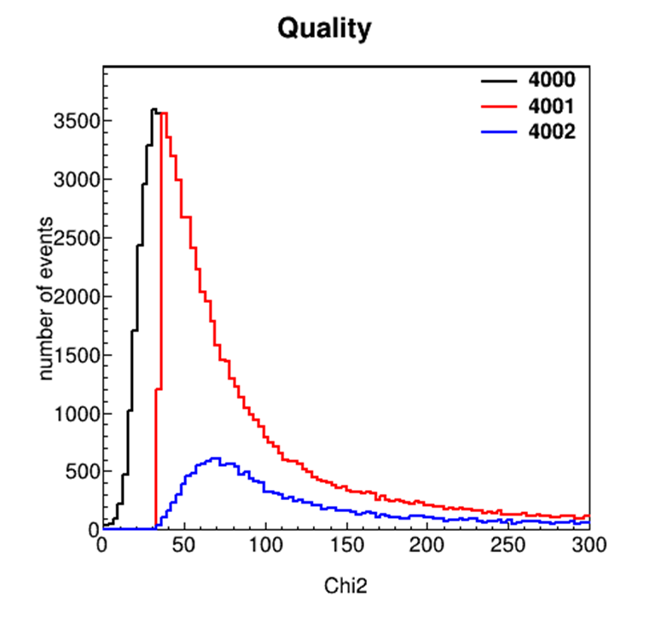
Always better but very low gain.

