Slide 1
RCauth Online CA service
Distributed operations and plans
Dissemination level: Public

Slide 2
Reminder - for n00bs and people with dodgy memories
RCauth is an IGTF accredited IOTA (DOGWOOD class) CA
Online credential conversion
Connected to eduGAIN (R&S+Sirtfi) plus direct e.g. EGI Check-in
EOSC Hub is implementing a High Availability setup across three sites
Private key is to be cloned and hosted in HSMs at each site
Cloning is done by XORing key with random strings
OTP randomness exchanged using different means (usually in-person)
=> key is 3-of-3 encrypted
Any part, or any two of the three, will have no information about the key

Slide 3
Outline
Overview of where we are
Changes to plans wrt lockdown & other risks
Review of tasks
Key cloning
Deployment
Database
Documentation
Next steps
Q&A
Notes:
Note that some tasks are more affected than others by the lockdown

Slide 4
Overview of where we are

Slide 5
Tasks overview (details later)
Task 5.1.7 (RCauth operations)
Translated into Jira tasks 205-206 (operator comms) , 207 (self audit)
Task 5.1.8 (High Availability RCauth setup) - run across NIKHEF, GRNET, STFC
Tasks 201 (key cloning), 202 (deployment), 203 (database), 204 (HA testing)
Still not finished!!
RCauth other (WP13)
Tasks 208 (service integration), 209 (end user docs), 210 (monitoring docs), 211 (final PMA review)
Currently focusing on 201-203

Slide 6
Changes to plans wrt lockdown & other risks

Slide 7
WFH adjustments/snags
STFC
Intended production HSM is offline and needs on-site activation
Can use older (out of support) nCipher as an interim measure
Random secret data from NIKHEF is in the office, offline (it’s a CD)
NIKHEF
Also need to go into the office to share production key (but Nikhef not really closed)
Random secret data from STFC is in the office, offline (on paper)
GRNET
Can access machine remotely (through ssh)
Random secret data from Nikhef is in the office

Slide 8
Other problems that hinder progress?
STFC
Generally need Suleman's time (CA sysadmin)
Lockdown Level 5 would potentially mean resources shut down
Unlikely. UKRI (STFC’s parent org) has issued guidelines for transition to Level 3
NIKHEF
(Potentially) required changes to the software depend on the other partners
GRNET
ops-management @ rcauth.eu not reaching the intended GRNET recipients
FIXED by whitelisting the mailing list

Slide 9
Review of tasks - details
Key cloning (task 201)
Deployment (task 202)
Database (task 203)
Documentation (task 208-210)

Slide 10
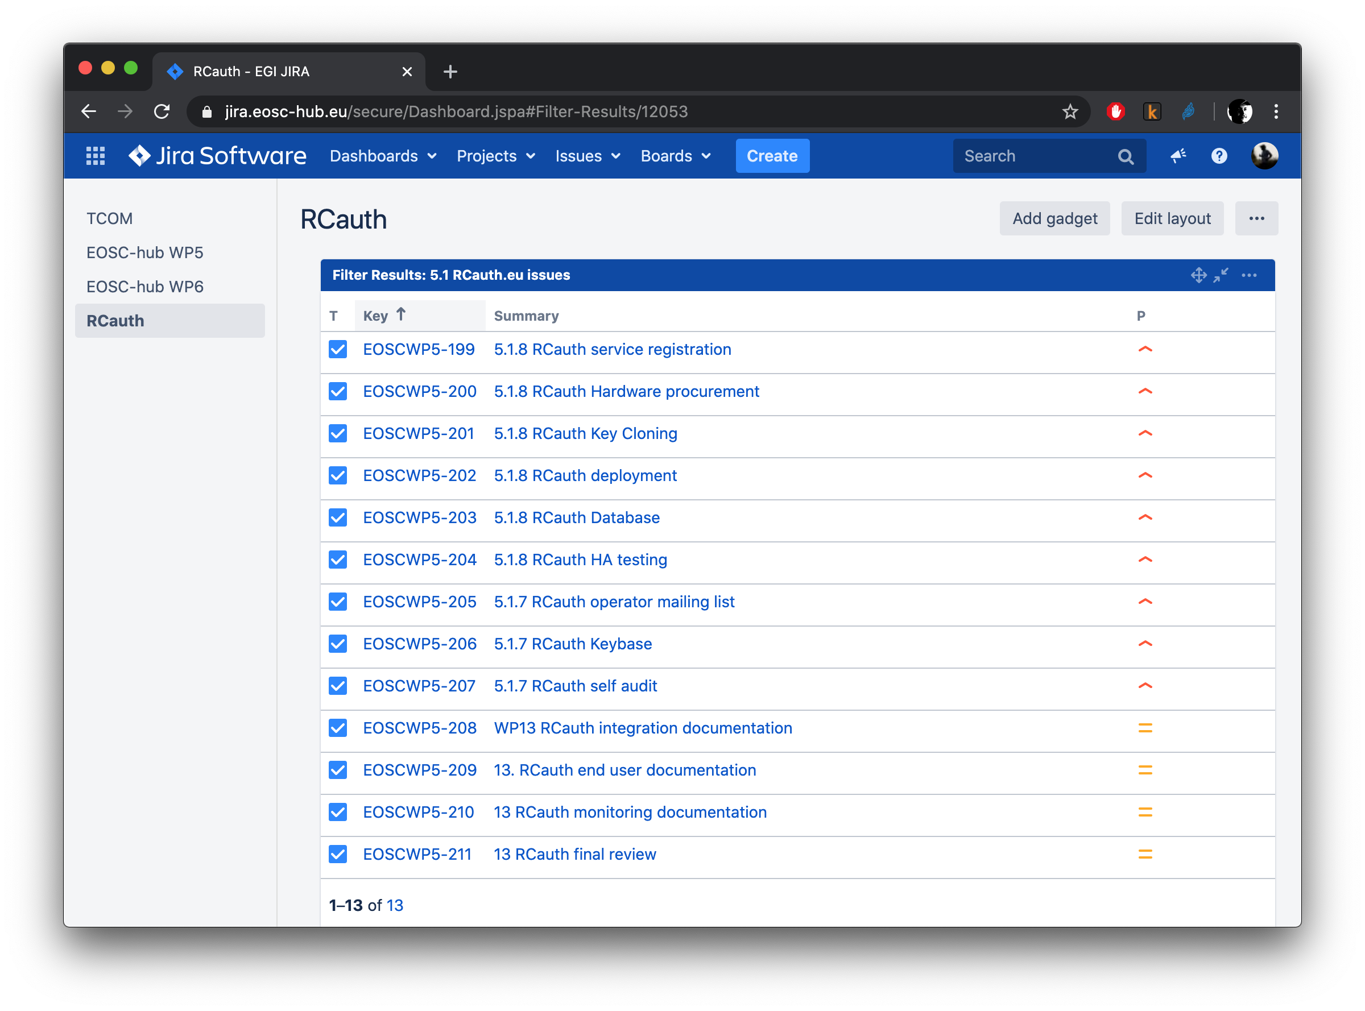
Review of tasks
JIRA dashboard
Regular biweekly ops calls for reviewing/planning

Slide 11
Review of tasks: Key cloning (task 201) - 1/2
Agree plan with PMA [STFC, NIKHEF, GRNET] - DONE
Develop software [STFC,NIKHEF] - DONE
Generate secret A [STFC] - DONE
Exchange A with NIKHEF [STFC] - DONE
Share recipe for generating random numbers in HSM with GRNET [NIKHEF, STFC] - DONE
Generate secret B [GRNET] - NEXT
Select additional methods for sharing keys - courier/snailmail, keybase or PGP email - DONE
Exchange B with NIKHEF [GRNET] - ?
...
Note: This task is the one most affected by the current lockdown

Slide 12
Review of tasks: Key cloning (task 201) - 2/2
...
Generate C1 [NIKHEF] - DONE
Exchange C1 with STFC [NIKHEF] - DONE
Generate C2 [NIKHEF] - DONE
Exchange C2 with GRNET [NIKHEF] - DONE
Calculate S1 = S+A+C1 [NIKHEF]
Exchange S1 with STFC [NIKHEF]
Calculate S2 = S+B+C2 [NIKHEF]
Exchange S2 with GRNET [NIKHEF]
Calculate S from S1 [STFC]
Install S in HSM [STFC]
Calculate S from S2 [GRNET]
Install S in HSM [GRNET]

Slide 13
Review of tasks: Deployment (task 202)
Package/containerise software [NIKHEF] - DONE
Generate deployment recipe (ansible) [NIKHEF] - DONE
Set up infrastructure [STFC] - DONE
Set up infrastructure [GRNET] - IN PROGRESS
Deploy delegation server [STFC]- IN PROGRESS
Deploy delegation server [GRNET] - IN PROGRESS
Access keybase git and deploy MyProxy/signing on infrastructure [STFC] - IN PROGRESS
Access keybase git and deploy MyProxy/signing on infrastructure [GRNET]
Note: steps 7 and 8 will likely require software adaptation

Slide 14
Review of tasks: Database (task 203)
Generate OpenVPN recipe [STFC, NIKHEF, GRNET]
Set up VPN endpoint [STFC]
Set up VPN endpoint[GRNET]
Set up VPN endpoint [NIKHEF]
VPN functional tests [all]
VPN performance tests [all]
VPN monitoring [all]
Database deployment recipe [NIKHEF] - IN PROGRESS
Database synchronisation configuration [NIKHEF]
Deploy database [STFC]
Deploy database [GRNET]
Database monitoring [STFC]
Database monitoring [GRNET]
Set up synchronisation [STFC]
Set up synchronisation [GRNET]
Database synchronisation testing [NIKHEF]
Notes:
Note that the order of the steps is flexible as long as we are using only testing setups.

Slide 15
Review of tasks: Documentation
The stuff in the NIKHEF wiki is pretty good... and github - DONE
https://wiki.nikhef.nl/grid/RCauth.eu_and_MasterPortal_documentation
https://rcauth.eu/tech-resources
End-users:
Instructions for end-users on how to use SSH key authentication for proxy retrieval
Do we need anything else?

Slide 16
Q&A

Slide 17
RCauth Operations team ops-management(AT)rcauth.eu

