Slide 1
GN4-3 - T&I - eScience Global Engagement
Maarten Kremers, SURFnet
EUGridPMA #49 / GN4-3 EnCo / EOSC-HUB Security
Virtual Meeting 14th May 2020

Slide 2
GN 4-3 T&I Objectives
Expand the Reach of Federated Access
Operate T&I services
Develop and Enhance the T&I services
Explore new or disruptive ideas
Engage with the relevant stakeholders

Slide 3
Incubator
Enabling Communities
T&I Services
Identity Feds
r/e-infras
EOSC
eGov
Operational Support

Slide 4
Miroslav Milinović (SRCE)
Davide Vaghetti
(GARR)
T&I Services
Christos Kanellopoulos (GÉANT)
Michelle Williams (GÉANT)

Slide 5
Enabling Communities

Slide 6
T&I Business Development Coordination
Facilitating of the AEGIS group
T&I eScience Global Engagement

Slide 7
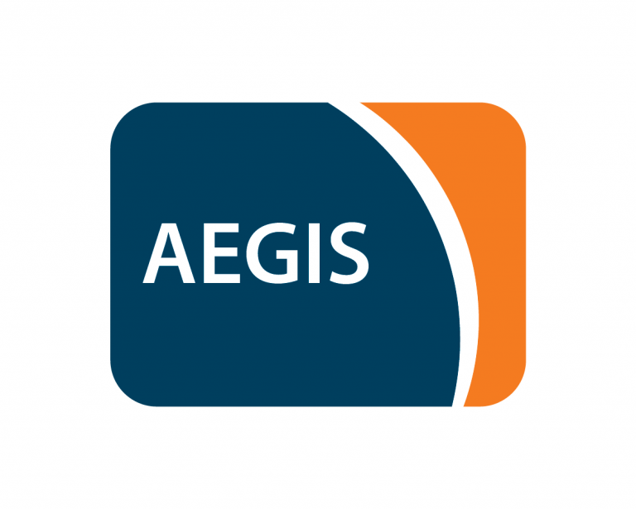
AEGIS
The AARC Engagement Group for Infrastructures (AEGIS) brings together global representatives from AAI operators in research infrastructures and e-infrastructures, which are implementing authentication and authorisation services that support federated access, to discuss adoption of policy and technical best practices that facilitate interoperability across e-infrastructures ands e-infrastructures.

Slide 8
T&I eScience Global Engagement
The 'eScience Global Engagement' of EnCo in the GEANT project is there to support those developments in the policy and best practice areas that would benefit the community at large, and do that by means of supporting the work in the existing forums such as WISE, FIM4R, IGTF, REFEDS, AARC-community, and the research and e-Infra communities directly

Slide 9
T&I eScience Global Engagement

Slide 10
T&I eScience Global Engagement

Slide 11
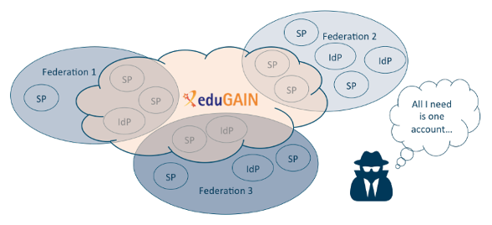
T&I eScience Global Engagement

Slide 12
T&I eScience Global Engagement

Slide 13
T&I eScience Global Engagement

Slide 14
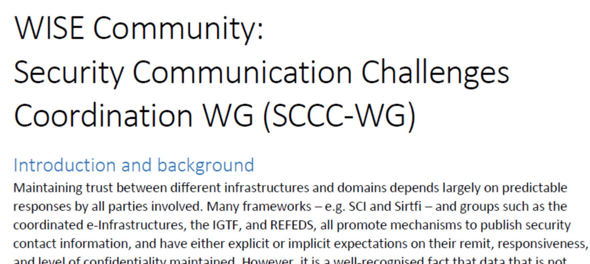
T&I eScience Global Engagement

Slide 15
T&I eScience Global Engagement

Slide 16
T&I Outreach
AARC Materials
Webinars ?
Infosheets ?

Slide 17
Thank you
Any questions?
maarten.kremers@surfnet.nl
As part of the GÉANT 2020 Framework Partnership Agreement (FPA), the project receives funding from the European Union's Horizon 2020 research and innovation programme under Grant Agreement No. 856726 (GN4-3).​​​

