Slide 1
TCS Gen 4 the good, the ^H^H^H, and … seen from an e-Infra perspective
May 2020 EUGridPMA meeting
David Groep Nikhef

Slide 2
15 years of TCS …
based on a concept by Jan Meijer back in 2004
driven primarily by the NREN constituency, but with the eScience use cases very much in mind
NREN (GEANT constituency) requirements on public trust, today esp. EV, but also eIDAS
in a way that scales to 45 countries and ~100k active certificates today, increasing steadily
and also ~10000 organisations, most of which cannot deal with certificates … or with much change
now going to its 4th iteration: GlobalSign, Comodo, DigiCert, … and now Sectigo again
1st CfP
SCS G1 (GlobalSign)
2nd CFP and start of TCS eScience with Comodo
TCS G4 CfP
TF-EMC2 concept
2004
2005
2006
2009
2015
2019
2020
Commissioning ongoing …
TCS G3 with DigiCert and eduGAIN

Slide 3
Main IGTF relevant items
validation for server certs and model for personal/robot remains the same
adherence to TCS CP/CPS the same (and augments the provider CP/CPS)
so now on top of Sectigo’s CP/CPS https://sectigo.com/uploads/files/Sectigo-CPS-v5.1.5.pdf
it is a new hierarchy (when installed correctly, ends in self-signed USERTrust CA
keeps the current prefix /DC=org/DC=terena/DC=tcs/…
issuer names changed as needed, and since these show visibly in the UX
joint OV browser trust (and MUA trust for personal certs) retained
distributed the new RSA Root and intermediates in 1.104 release (early April)
brings RSA and ECC! (more on that at the end)

Slide 4
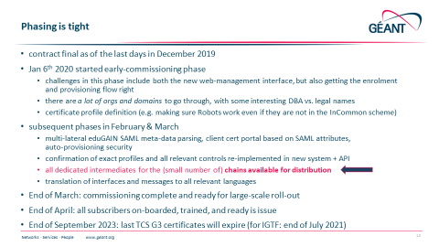
Where is the TCSG4 now … ? the plan was:
< pushed in 1.104
< TCS is ~here now
(as seen from an org standpoint at Nikhef)

Slide 5
Current state, end of May 2020
it is not impossible to get TCS ‘IGTF profile’ compliant end-entity certs ☺ if only thanks to the persistence of Sigita and interventions by Klaas. Thanks!
self-service issuance portal for personal certificates works really great, available in eduGAIN, using the same authorisation model with eduPersonEntitlement = urn:mace:terena.org:tcs:personal-user
can also produce PKCS#12 server-side generated credentials, to address increasing trouble with browsers
robot email (mailing lists, team robots) work as usual via explicit invite
non-eduGAIN (explicit invite) personal certs work for the kind of people who otherwise love to write email by typing SMTP commands :)

Slide 6
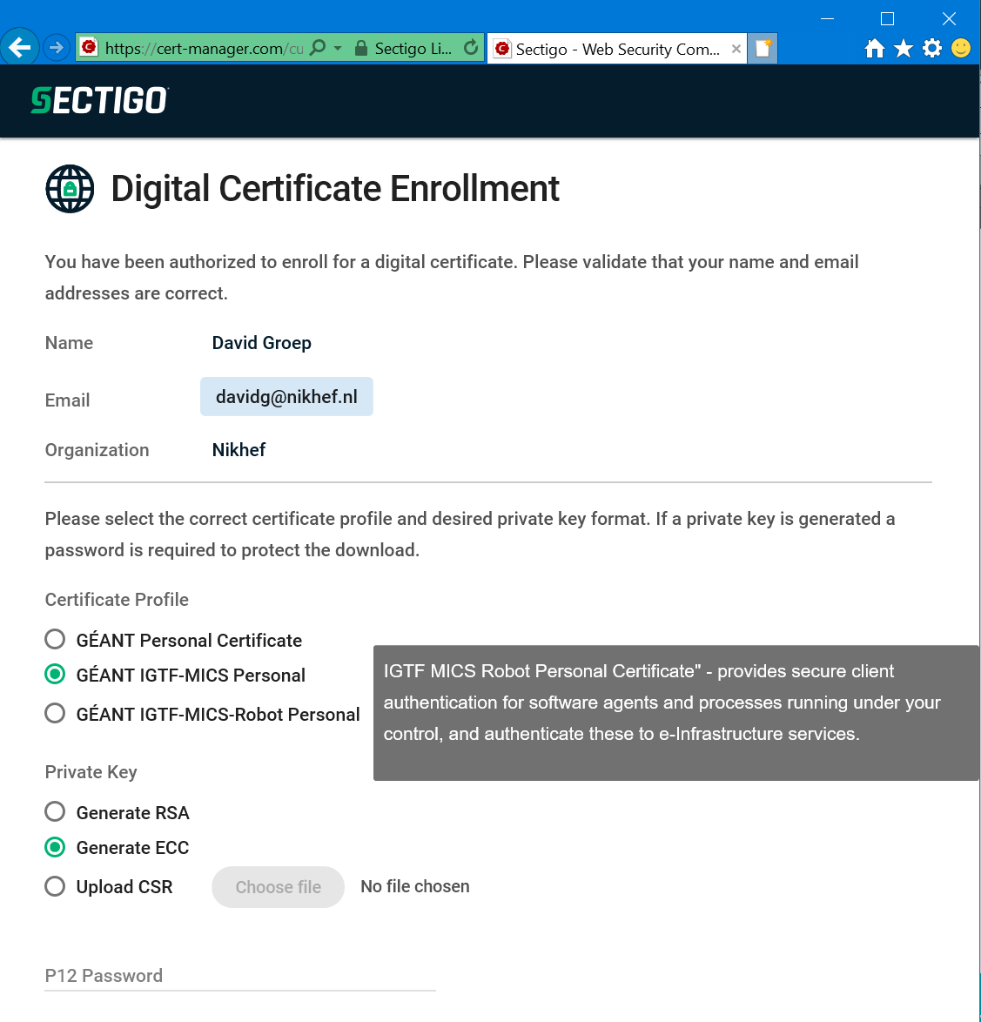
New ‘SAML portal’
Newly developed by Murray @Sectigo
& is one thing that works absolutely great
Picks profile and name form directly
from product type
includes ePPN as uniqueID but stores it as the email address ☹ so orgs cannot re-use an ePPN as an email address later …
Support .P12 generation and CSR

Slide 7
Policy OIDs – complete and the correct 1SCP suite
Server OV SSL: classic issuance
Robot Email: classic issuance
Classic
Is a networked entity (host)
Key material held in files
Classic
Is a non-human automated client or robot
Key material held in files

Slide 8
Current state, end of May 2020 (continued)
all things that work OK have been now mentioned …
time to switch to a very small font to make the rest fit on this slide:
undisclosed here in this presentation

Slide 9
A new thing: ECC IGTF certs
Although ECC certs were available in TCSG3 as well, it was ‘a well-hidden option’ and never advertised and through the IGTF we never distributed the ECC variants of TCS G3
New self-service portal for TCS G4 personal – since it generates keypairs on the CA side – now makes ECC certificates very prominent, and a first-class citizen of the ecosystem
TCS G4 ECC intermediates, and the USERTrust ECC CA root, as ‘experimental’ CAs in the IGTF 1.105 release

Slide 10
ECC certs in the main RP contexts
No idea what will happen to software if they are installed – it … needs testing! Proposal: test as far as possible with a few instances and roll in 1.106
At least voms-proxy-init in emi-ui >=3.7 does not explode, which is good™ (but the same in versions <=3.3 is known to get confused by them)
Installing as extra trust anchors should be harmless, until a user trigger one

