Slide 1

Community Security Policy
EUGridPMA virtual meeting, May 2020
Ian Neilson – UKRI-STFC

Slide 2
Background
Presentation at virtual WISE meeting, April 2020
  “Community security policy in UK IRIS” – Crooks & Neilson
  https://wiki.geant.org/display/WISE/Virtual+WISE+meeting+21+April+2020
Summary
  Community policy in AARC PDK is incomplete
    Membership Management ✓ Community Operations ✗
  Highly interlinked with other policies
  Internally a complex set of many requirements (~93)
    Community Managers, Infrastructure Operators …
  Hard to understand and difficult to implement

Slide 3
So?
Propose:
Policy plus Guidance
Policy
  Membership and Operations
  Fewer, higher-level policy statements
Guidance
  Recommendations and implementation details
Pros if done correctly ✓
  Easier to understand
  Fewer cross-links with other policies
  Flexibility of implementation
  Good feedback into AARC PDK
Cons if done badly ✗
  Too vague to be useful and secure
  Just as complex and confusing as before
Community
Policy
Community
Guidance

Slide 4

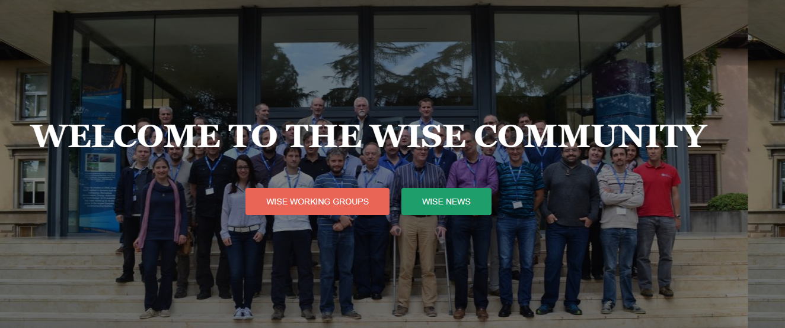
How?
Form Task Force of interested individuals
Under the WISE SCI WG “banner”
  Leverage dedicated effort from UK IRIS
  Need a broader focus input and consultation
  GN4-3 EnCo + EGI UCB + EOSC-hub + FIM4R + …
Maybe 4-6 focussed meetings to make a good draft
  2-4 weeks between meetings
  Each with a few clear goals
I can edit and co-ordinate if wanted
  … but need buy-in

Slide 5
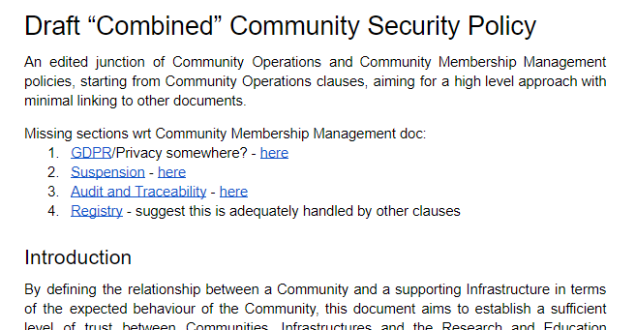
First steps …
UK IRIS draft
Community Operations + topics from Membership Management
Strip out many details
  But don’t lose them!
Restructure ongoing …
https://bit.ly/3al8TMV
https://docs.google.com/document/d/1LxfkL9mIhtKNpkGRCuzxM7mQXJA14eysZmEIIcSABYs/edit?usp=sharing

Slide 6
Questions
From me
  A good approach?
  Interested in contributing?
    Tell me now or send me your email
    Find a date and time offline
From you
  … ?
⬧

Slide 7

Thank you
Facebook: Science and Technology Facilities Council
Twitter:@STFC_matters
YouTube: Science and Technology Facilities Council

Slide 8
A few (random) discussion points
Draft at - https://bit.ly/3al8TMV
Clause grouping. “The Community …”
  “… must …”
  “… shall apply due diligence in …”
  “… acknowledges that …”
Collapsing Membership Lifecycle to
“…its membership is restricted at all times to bonafide individuals.”
GDPR
  “…respecting the legal rights of its members and others in respect of the processing of their personal data”

