Slide 1
Ion backflow calculations
Fred Hartjes
NIKHEF

Slide 2
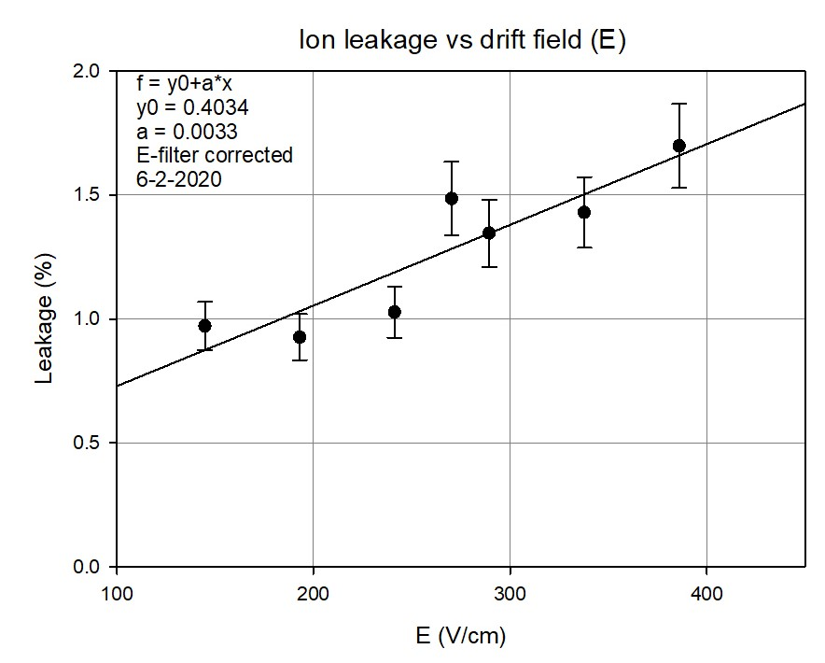
Leakage for different drift fields
Accuracy affected by instabilities
Field dependent micro discharges at field cage
The 1.45% value at 270 V/cm was measured a few hours before the other measurements
The fit suggests rather 1.3% at 270 V/cm

Slide 3
Assumption
At first I assume that the ion backflow is always reduced by ion collection of the grid
In the hypothetical case where the drift field outside the grid is equal to the amplification field under the grid, I assume that the reduction of the ion backflow is completely determined by the geometry, i.e. the surface of the holes divided by the total surface of the grid
In this case the geometrical factor (G) is 0.234 for a 30 um diameter hole
So for a drift field of 68 kV/cm (the amplification field) we would get an ion backflow of 23.4%
Secondly I assume that the ion backflow (IBF) is further reduced by the square root of the ratio between the drift field (E_{drift}) and the amplification field (E_{amp})
$$IBF=G ×\sqrt{{E_{drift}}/{E_{amp}}}$$

Slide 4
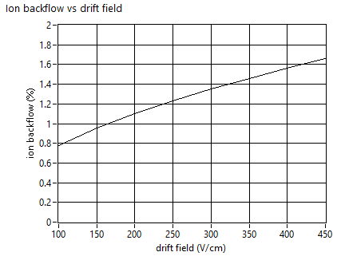
Comparing the assumption with the experimental result
Hole diameter tuned to 28 um to get the correct agreement with the experimental result
=> G = 0.204
$$IBF=G ×\sqrt{{E_{drift}}/{E_{amp}}}$$
Calculation

Slide 5
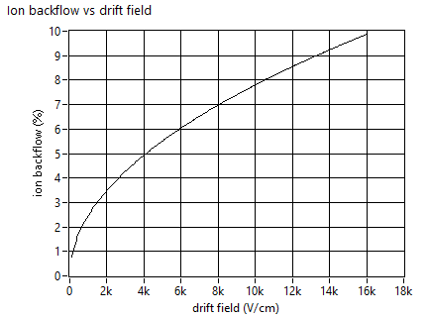
Backflow to an intermediate field
At a field ratio of 40
=> 11.2 kV/cm intermediate field
=> IBF = 8.26%
$$IBF=G ×\sqrt{{E_{drift}}/{E_{amp}}}$$
Calculation

Slide 6
Effect of the second grid
$$IBF=G ×\sqrt{{E_{drift}}/{E_{amp}}}$$
We get the same curve but only multiplied by the backflow factor (G = 0.204) of the second grid
There is NO dependence on the value of the intermediate field
But of course there will be a dependence on the electron transparency of the intermediate field
IBF = 0.27 % at 280 V/cm
Calculation for two grids

Slide 7
Conclusions
From the IBF measurements for different drift fields we learned that IBF increases with Edrift
Using two simple logical assumptions we get an expression that gives a good agreement with the measurements
Adding a second grid reduces the IBF, but only by the geometrical factor of the grid (~ 0.2)
The IBF does not depend on the intermediate field, so this field should be chosen to get the highest electron transmission

