Slide 1
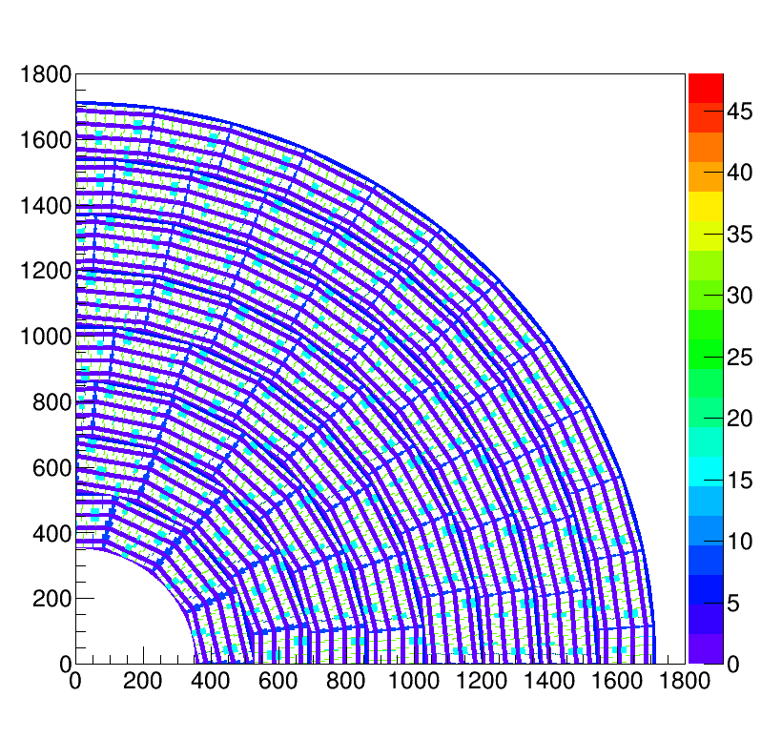
TPX4 Brainstorm session Ideas for a large surface detector ILD and CEPC: pixel TPC based on the TPX4 chip
Fred Hartjes, Peter Kluit
and Jan Timmermans

Slide 2
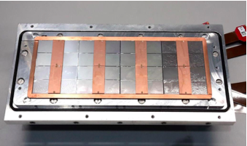
Current TPX3 situation
We are able to construct an 8-quad Module keeping the deformations in the precision plane small enough
Points that may need improvements
Resistivity of the layer not optimal
Quad has a rather limited active area
The “flex” and electronics board are expensive
Read out with multiplexer is rather complex
For CEPC Z running one needs to reduce the Ion Back Flow
For ILC one can use the Japanese gating grid
None of the items are critical
In principle one can build a pixel TPC for ILD, it will be costly
For CEPC the IBF should be adressed

Slide 3
CEPC: Ion Backflow reduction
Idea is to put a second grid above the GridPix
By running with an intermediate Field (40) stronger than the drift field
Calculations show that the IBF goes from 1.7% (measured) to 3 10⁻⁴ keeping a high transparancy of 96%
This needs to be tested
It could solve the IBF issue for CEPC and make a pixel TPC – running with high lumi at the Z pole - viable
Design of a double Grid
Drift region
Second Grid
Intermediate Field
GridPix
High field

Slide 4
TPX4 and large surfaces
The TPX4 has the size of a typical Quad (3.5/4)
With the scheme Fred proposed we will have a larger coverage than the Quad. Quad coverage is about 69%. Still there will be an area (˜1+3.5 mm) where the wirebonds are connected to the PCB - with a guard on top of it. How small we can make this area is still open (rough estimate coverage 73%).
The proposed scheme will not need an expensive flex/PCB. That is a large improvement with respect to TPX3.
For TPX4 readout a multiplexer board for a module is not needed
Lower power consumption (0.55 W/cm²) than TPX3
Assembly due to the layout of the TPX4 will be much easier
It is however clear the use of Through Silicon Via’s will alllow to improve the coverage substantially: potentially up to 96%. Intereting to follow the TSV developments

