Slide 1
GridPix with double grid to reduce the ion back flow
Question: can one reduce the Ion Back Flow of a GridPix detector?
We could design a GridPix detector using a double grid
The idea is that by creating two field regions, one with a medium field and one with a high field (our standard Grid Pix) one could reduce the ion backflow in two stages.
The high field avalanche region has a IBF factor of 1.5%
The aim is to reduce the IBF by another factor 100
The second Grid replaces the Gating device and is always operational

Slide 2
Design of a double Grid
Drift region
Second Grid
Intermediate Field
GridPix
High field

Slide 3
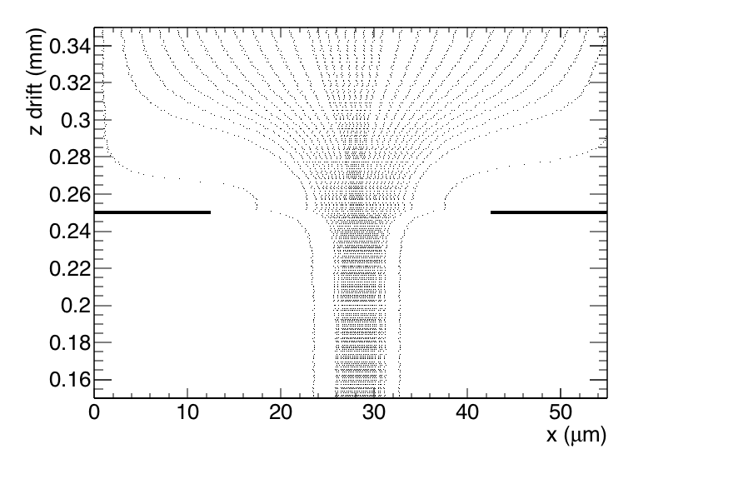
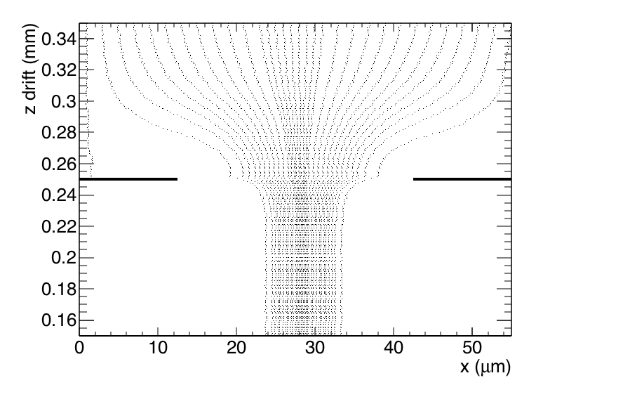
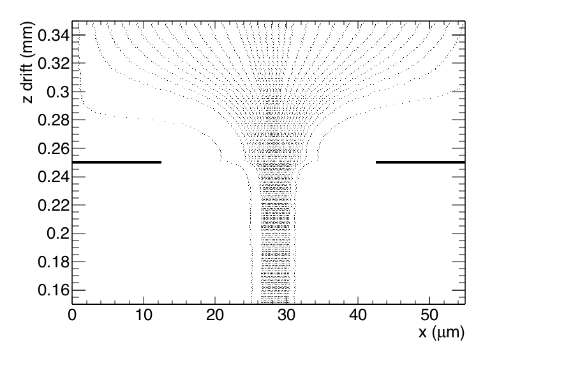
In (down) flow trajectories second Grid
Field ratio 40
Field ratio 10
Field ratio 240
Geometry: second grid at 0.250 mm (z); Cathode at 550 mm
Standard GridPix pitch 55 μm and hole 30 μm
Field ratio = mean Field (0-0.250 mm)/ mean Field z (2-550 mm)
σ (rms) size of funnel (focussing E field) = 8.5-7.8-7.5 μm (Fr 10,40,240)

Slide 4
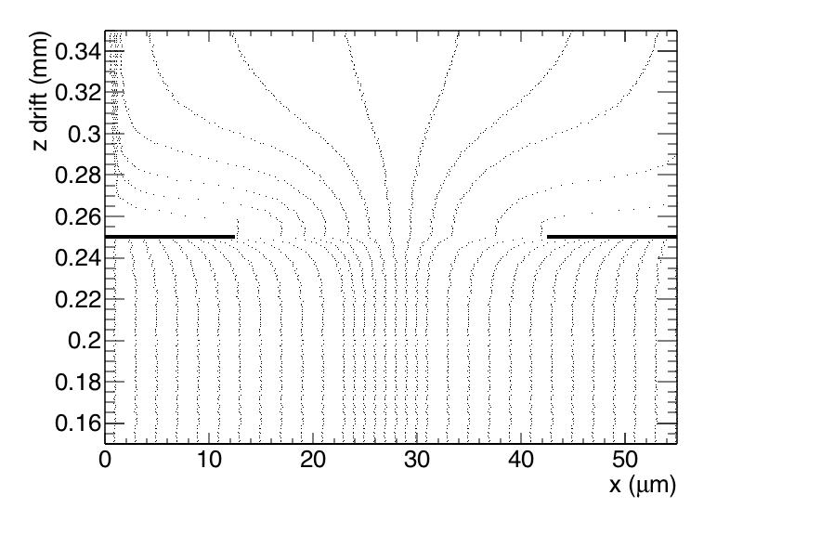
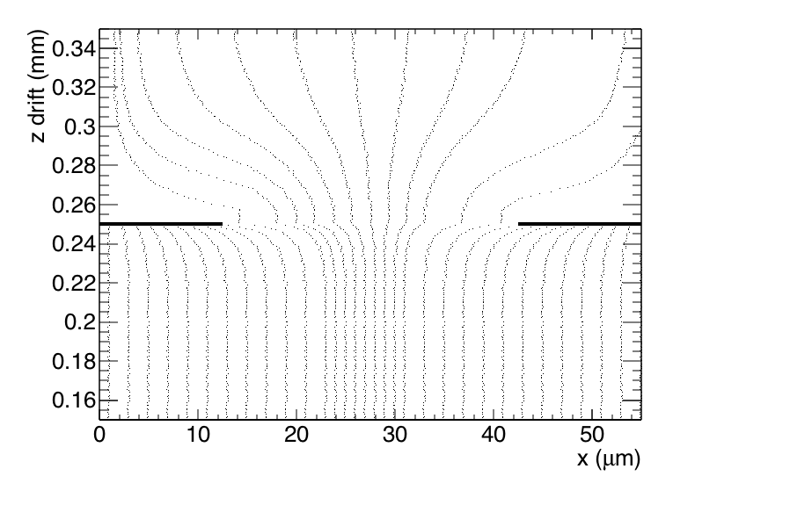
Backflow (up) trajectories second Grid
Field ratio 10
Field ratio 40
Field ratio 240
Here the trajectories of ions from the bottom upwards are shown
The differences between the different field ratios are small

Slide 5
Modeling of ion back flow
Modeling of the ion backflow is based on the measurements for a standard GridPix with FR 240. The ion backflow was measured to be 1.7%.
The Ion BackFlow is sensitive to the diffusion in the high field
region. The electron funnel size is 7.5-8.5 μm just from the Field
focussing.
To reach an IBF of 1.7% the ions need to diffuse with a (mean)
transverse diffusion constant of D_{T} = 1.1 mm/√cm. This number is
kept constant for the FR 10-240.
Calculating the the IBF for different field ratios gives 1.8%.
So this factor is rather constant. This is also what one would expect from the ion backflow field lines.

Slide 6
Reflections on double grid
Another important aspect is the electron transparancy.
Using the simulation this can be calculated.
It is important to choose a FR with a high (electron) transparancy
so with FR of 40 or higher. The IBF in that is 1.8%.
The field ratio should not be too high to avoid gas amplification in
the top grid.
Transparancy % FR 240 | FR 40 | FR 10
99.3 | 96.1 | 88.0

Slide 7
Conclusions
The Ion Back Flow can be significantly reduced by putting a grid with a identical pitch and hole size on top of the Gridpix.
A device placed e.g. 250 μm above the GridPix run with a Field ratio
of 40 would do an excellent job. The electron transparancy would be
96% and the IBF would go down from 1.7% to 3 10⁻⁴.
This would solve the issue of IBF at CEPC and ILC.
We could do a test at Nikhef mounting this grid on top of the
detector, and measuring the electron transparancy and the IBF.
It would be interesting to think about a post-processing step to
integrate the two grids.

