Slide 1
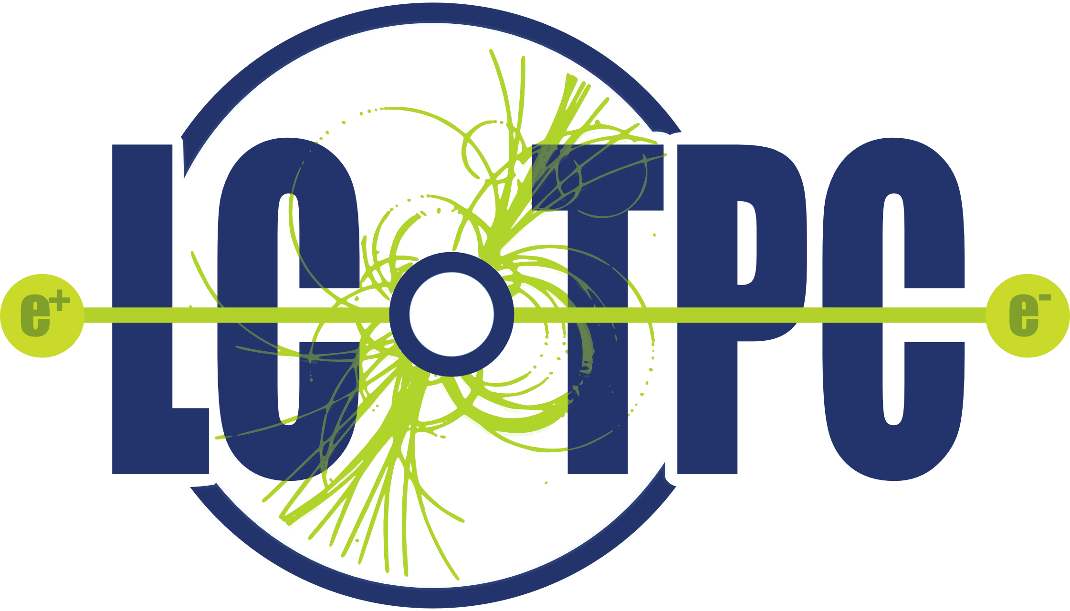
GridPix with double grid to reduce the ion back flow
Question: can one reduce the Ion Back Flow of a GridPix detector?
We could design a GridPix detector using a double grid
The idea is that by creating two field regions, one with a medium field and one with a high field (our standard Grid Pix) one could reduce the ion backflow in two stages.
The high field avalanche region has a IBF factor of 1.5%
The aim is to reduce the IBF by another factor 100
The second Grid replaces the Gating device and is always operational

Slide 2
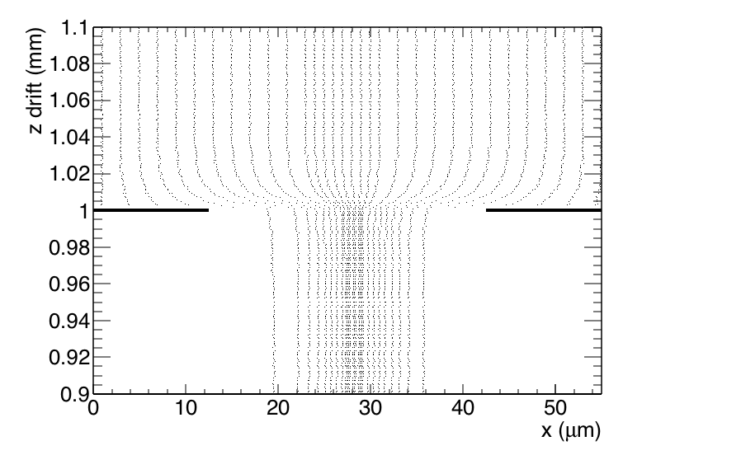
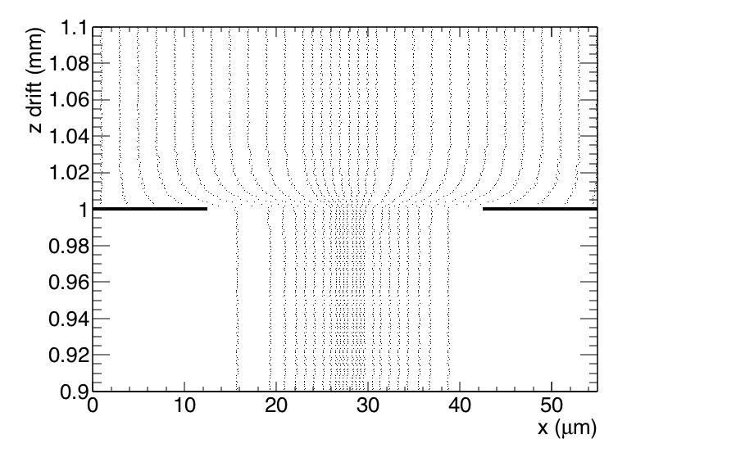
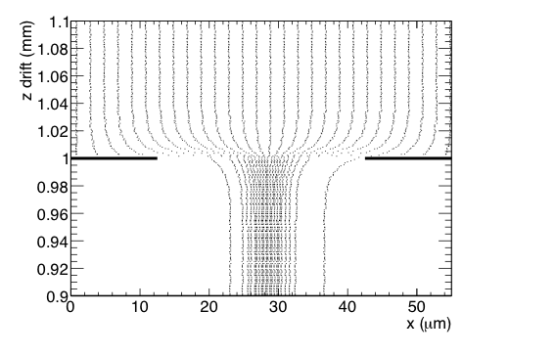
In (down) flow trajectories second Grid
Field ratio 40
Field ratio 10
Field ratio 240
Geometry: second grid at 1 mm (z); Cathode at 550 mm
Pitch 55 μm and hole 30 μm
Field ratio = mean Field (0-1 mm)/ mean Field z (2-550 mm)
σ size of funnel (focussing E field) = 5.9-4.3-2.1 μm (Fr 10,40,240)

Slide 3
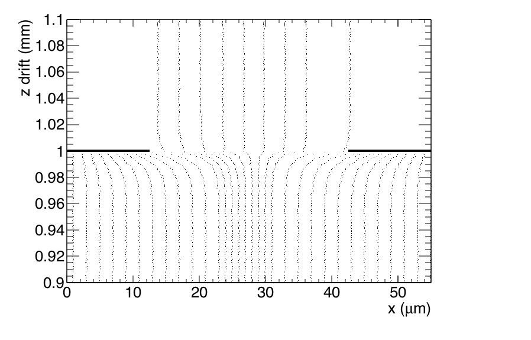
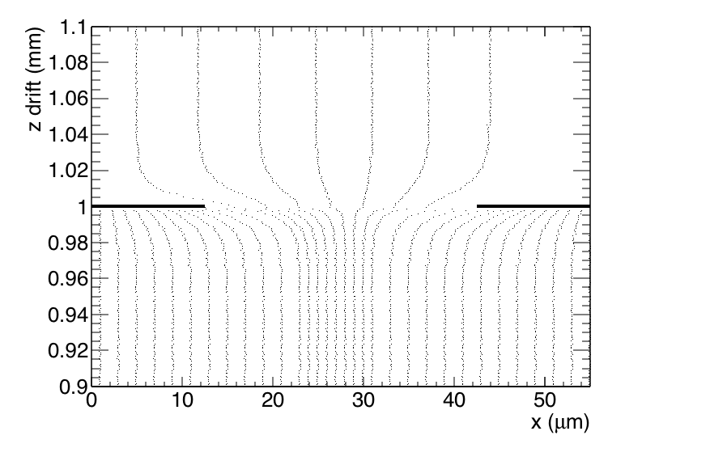
Backflow (up) trajectories second Grid
Field ratio 10
Field ratio 40
Field ratio 240
Modeling of the ion backflow is based on FR 240 = standard Grid Pix
The ion backflow was measured to be 1.7%
The electron funnel size is 10 microns (for a 50 micron gap)
The efficiency in 1D should be 13.3%. This can only be achieved/modeled if additional smearing is applied to the ions of 8 x 7 microns.
so Dt = 800 mu/sqrt(cm)

Slide 4
Reflections on double grid
Did more studies for the Ion back flow:
any Field ratios from 10-240 give an Ion Backflow of 3-1.5%
So a stack of two grids could substantially reduce the IBF.
We should run the Grid at a Field ratio below say 100, this because we don’t want amplification to take place.
Discovered that the transparancy of the grid is very important.
At low Field ratios (<240) the efficiency of the grid get very close to the optical transparancy (now 30*30/55/55).
We need to optimize the Grid to be transparent at field ratios around 100.

