Slide 1
HV tuning update
Bouke Jung (bjung@nikhef.nl), Alexandre Creusot (creusot@apc.in2p3.fr), Maarten de Jong (mjg@nikhef.nl)
Nikhef KM3NeT group meeting
2020/03/13

Slide 2
Recap
Move to HV-tuning procedure based on gain-estimates
Motivated by theory (see doxygen):
Implementation through fit or interpolation of linearized data
Extract high-voltage settings from database
Extract gain-estimates from JFitToT output
Outliers in gain-estimates need to be inspected
Database integration via Json

Slide 3
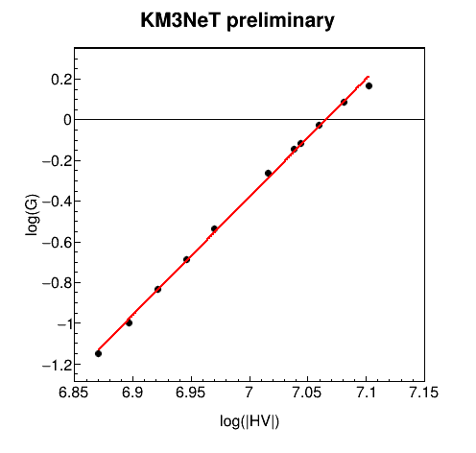
HV fit
HV-fitting routine is being implemented in JFitHV (updates in Jpp git branch fitToT_full_spectrum)
DB-interfacing has been implemented
Automatically retrieves (HV,G)-data for all PMTs in user-specified list of data-files
Initial results are promising
Clear linear behavior on log-log scale for most PMTs
A couple of issues
Nominal Gain (G = 1.0)
Minimum fit-range (G = 0.3)

Slide 4
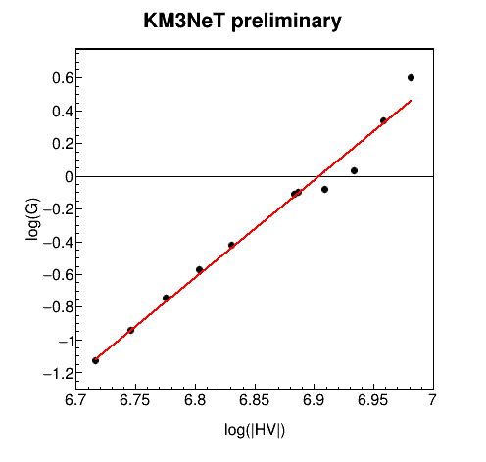
HV fit
HV-fitting routine is being implemented in JFitHV (updates in Jpp git branch fitToT_full_spectrum)
DB-interfacing has been implemented
Automatically retrieves (HV,G)-data for all PMTs in user-specified list of data-files
Initial results are promising
Clear linear behavior on log-log scale for most PMTs
A couple of issues
Deviation from linear behavior at high or low |HV| for some PMTs
Fit-range bounds for gain-estimate in JFitToT
Maximum fit-range (G = 2.0)
Nominal Gain (G = 0.9)
Minimum fit-range (G = 0.3)

Slide 5
ToT-fits for increasing HV
N.B: These are animated gif files

Slide 6
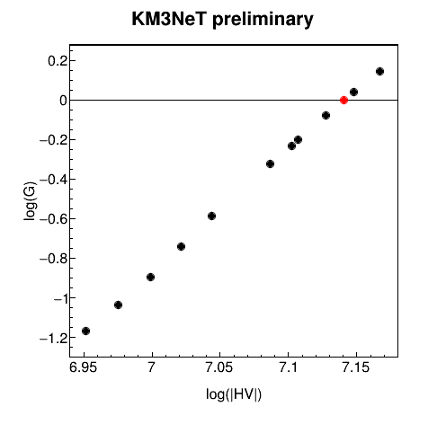
Solutions
Making the ToT-fit work for all possible HV-settings is asking too much…
For the specific purpose of HV-tuning, set fit-range to region surrounding ToT-distribution peak
The datapoints directly surrounding the optimal gain (= 1.0) tell the most about the optimal high voltage setting
Switch to linear interpolation/extrapolation

Slide 7
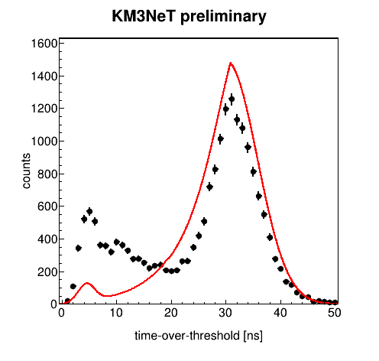
Remaining anomalous ToT-fits
Thresholdband and PunderAmplified too low to account for large peak at 5ns
Large secondary contribution at 10ns
Normalization does not account for large relative fraction of 5ns- and 10ns-peak counts
Causes fit to unduly scale down model contribution by increasing its spread
Extremely high HV

Slide 8
Remaining anomalous ToT-fits
Thresholdband and PunderAmplified too low to account for large peak at 5ns
Model contribution nearly indistinguishable from 10ns-peak contribution
Extremely low HV

Slide 9
Remaining anomalous ToT-fits
Discovered one PMT (808483678.5) with anomaly in first and second bin
Output from JCalibrateToT
Some artefact in the triggering?

Slide 10
Planning
Set up a bash script to automatically extract the gain-estimates and find the optimal HVs using a set of user-specified raw data files
Prognosis: √
Implement DB-integration (via JSon)
Prognosis: today/tomorrow
Document remaining anomalous ToT-fits on ELOG and git
Prognosis: today
Analyze results with recent (L0-)data using the provided bash script
Prognosis: weekend/start of next week
Adjust TIME_OVER_THRESHOLD_NS to optimal gain-setting
Prognosis: tomorrow/weekend (non-critical)

