Slide 1
Mispointing the detector

Slide 2
Goal of my BSc project
“See” the moon
Determine the orientation of the detector
Calibrate the detector to avoid mispointing

Slide 3
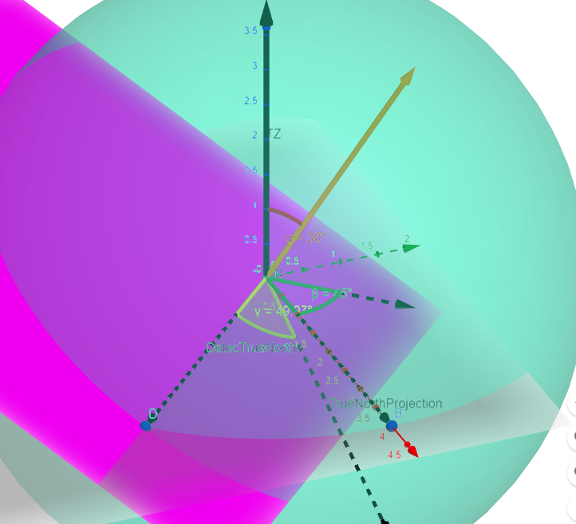
Program inputs
Magnitude of offset from the zenith
Direction of offset from the zenith
Offset of the detector north w.r.t. true north

Slide 4
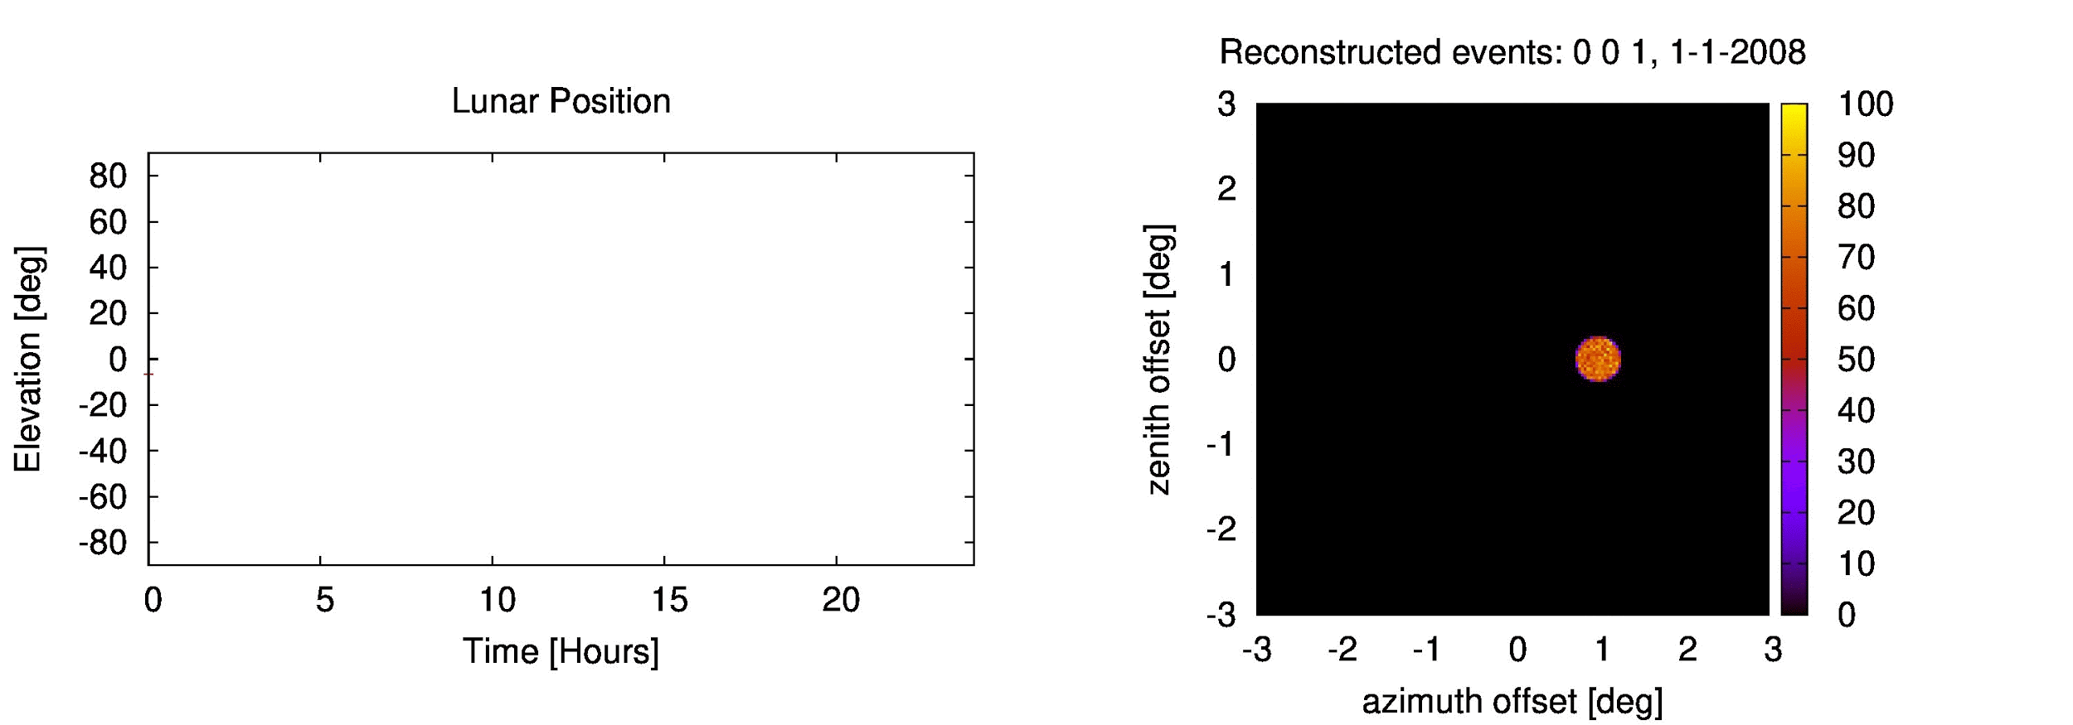
Effects: Offset of the detector north

Slide 5
What happens?

Slide 6
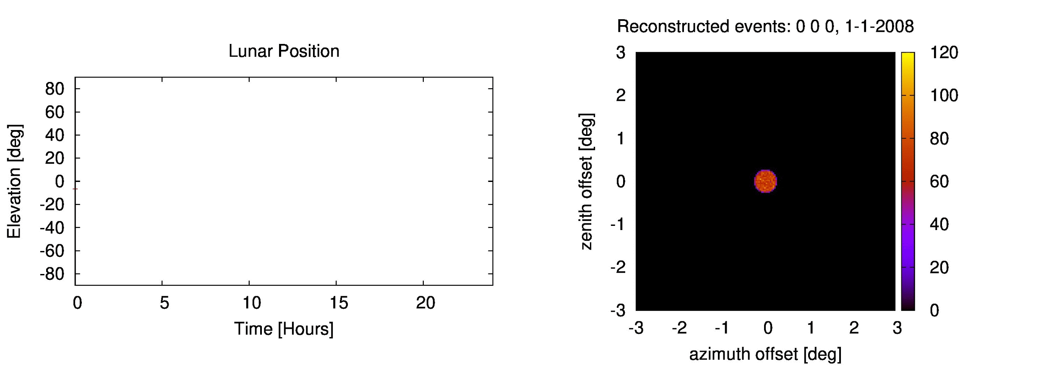
Fixed the bug

Slide 7
Effects: Offset of the detector north

Slide 8
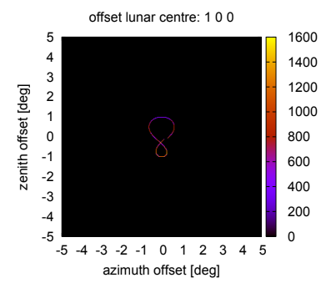
Effects: Magnitude of offset from zenith

Slide 9
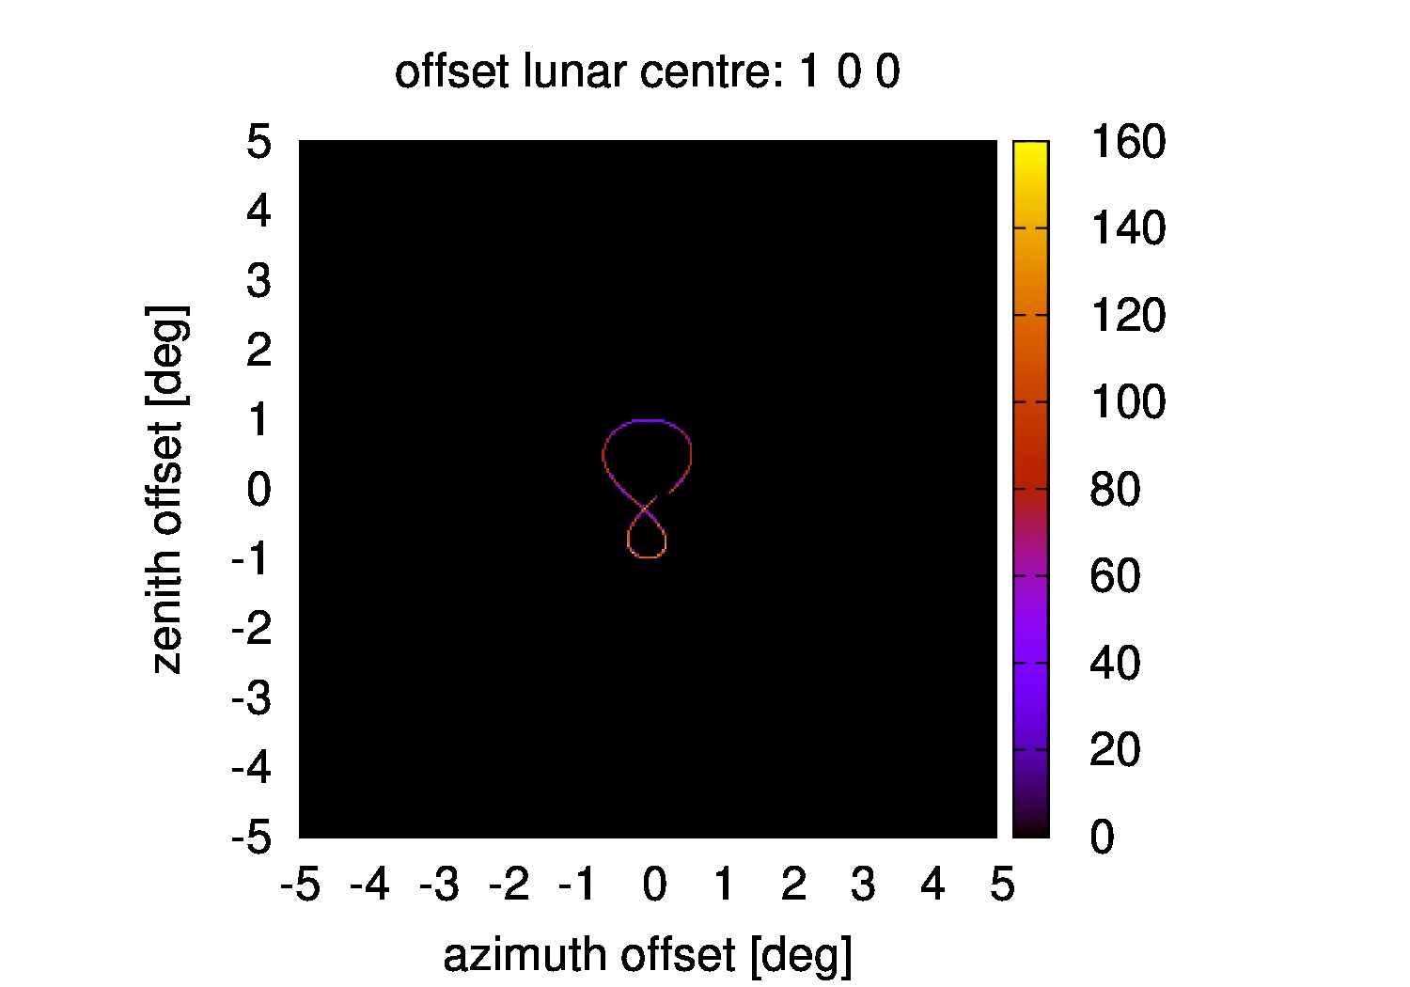
Effects: Direction of offset from the true zenith

Slide 10
Conclusion
Mispointing causes artifacts
More Important:
Azimuth and zenith are not absolute distances
Artifacts
Solved with sinusoidal term

Slide 11
Other updates
Angular resolution depends on zenith angle
Event density depends on zenith angle

Slide 12
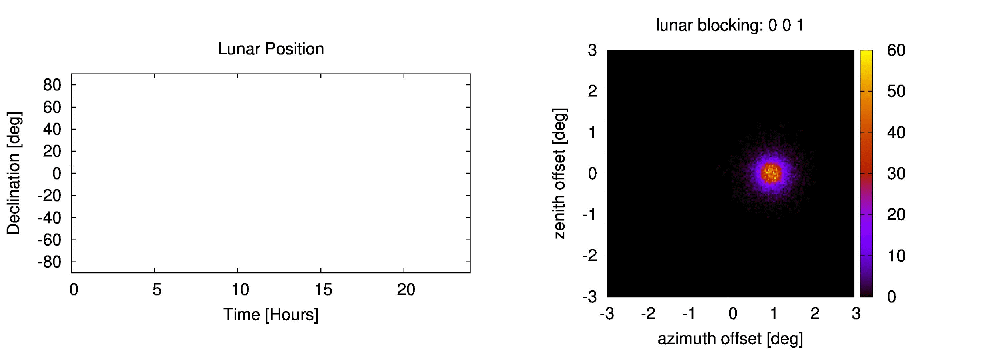
Before

Slide 13
Angular Resolution

Slide 14
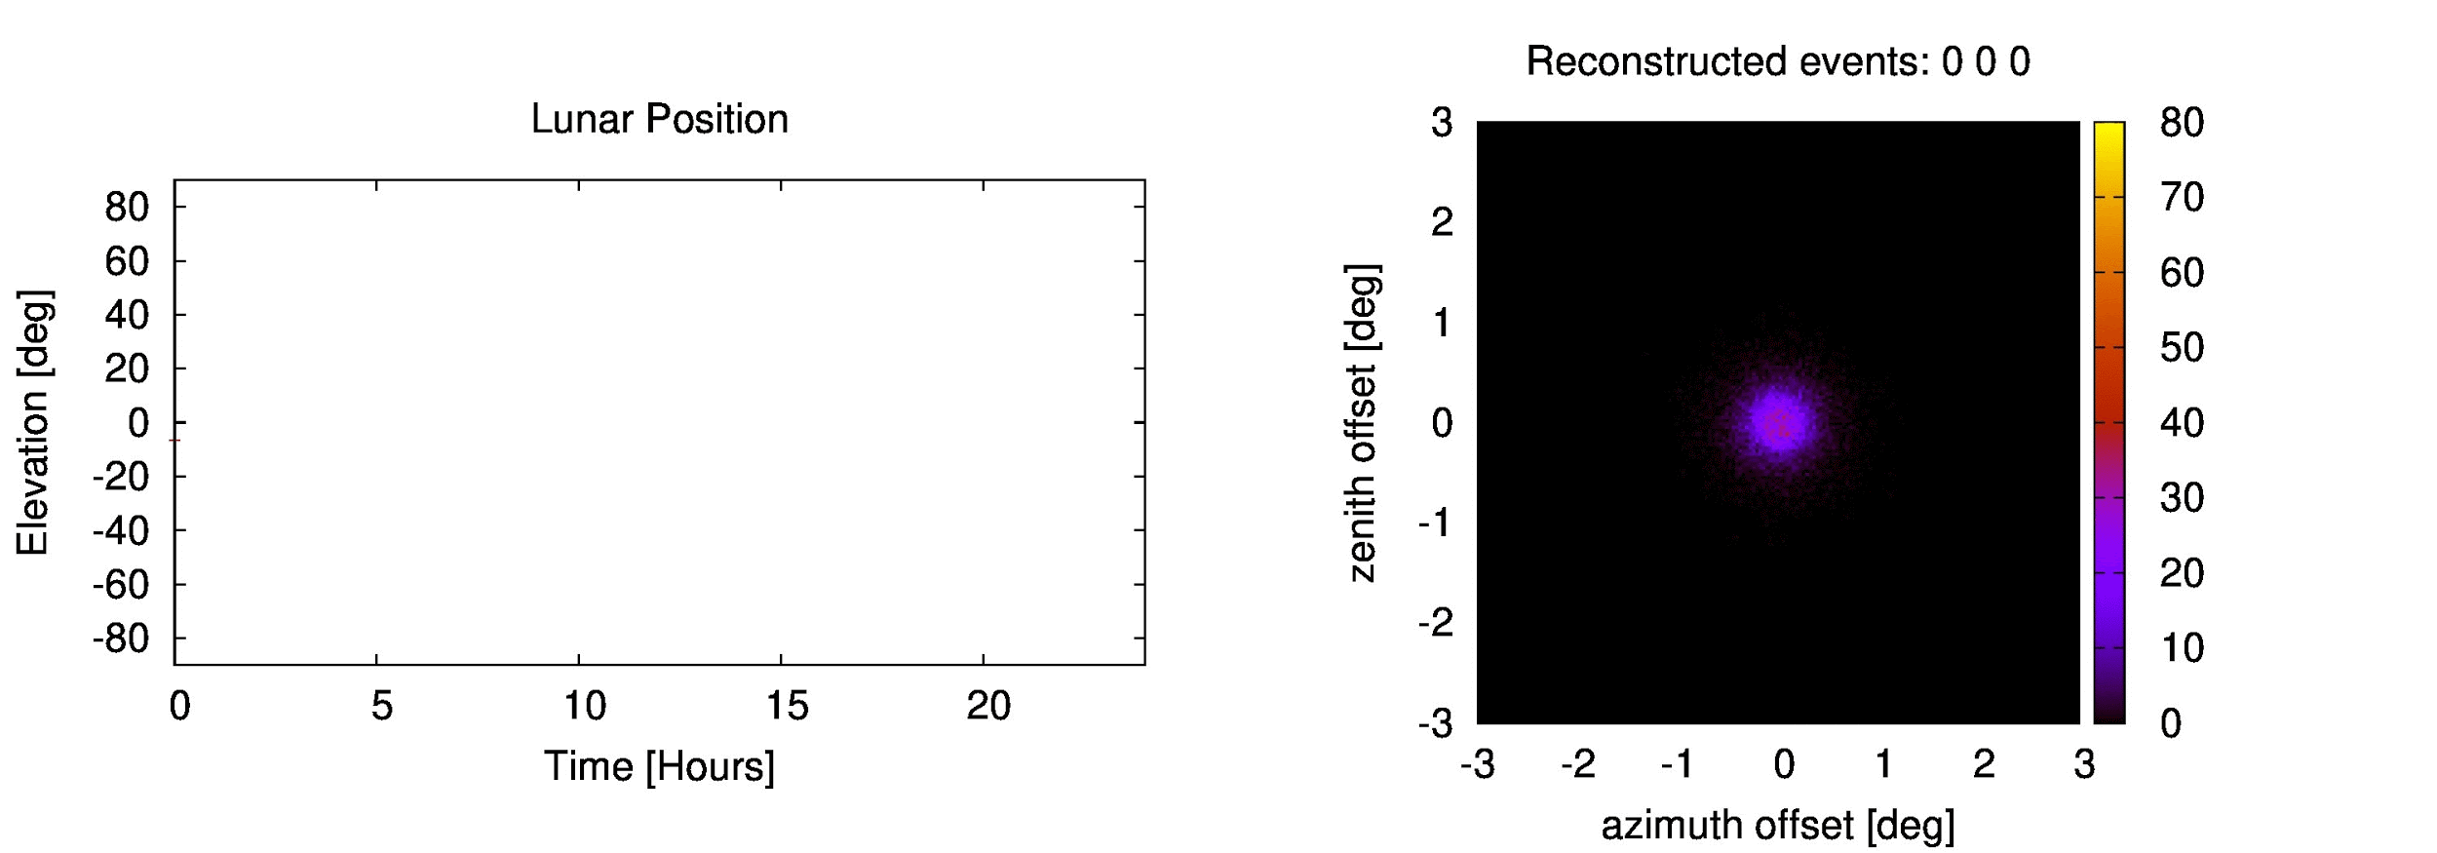
Event Density

