Slide 1
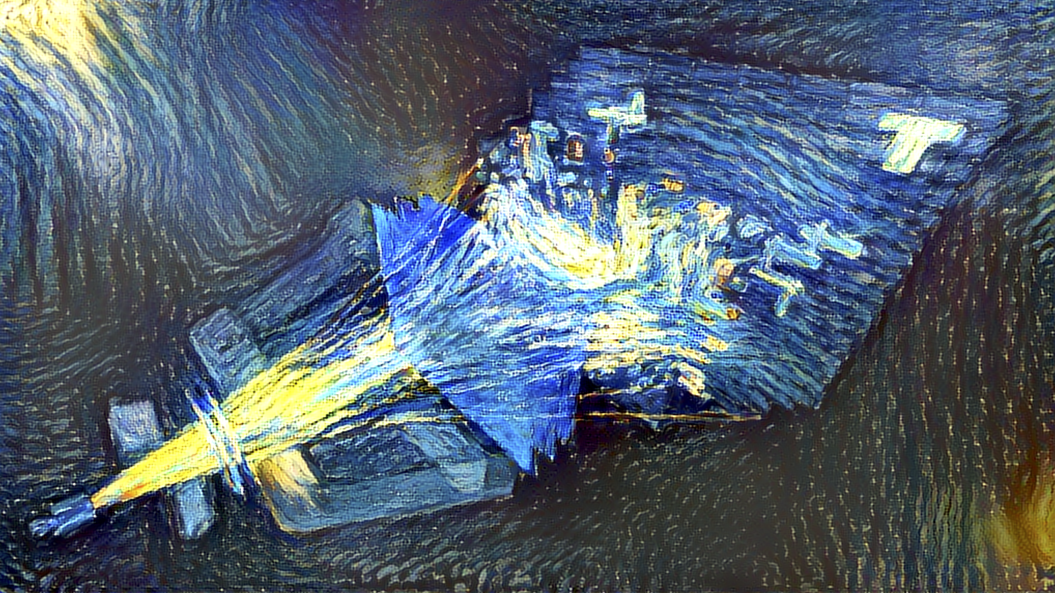
LHCb Vista, Oct 2020
Marcel Merk for the bfys group
Notes:
Impressionistic Vista with van Gogh version of LHCb

Slide 2
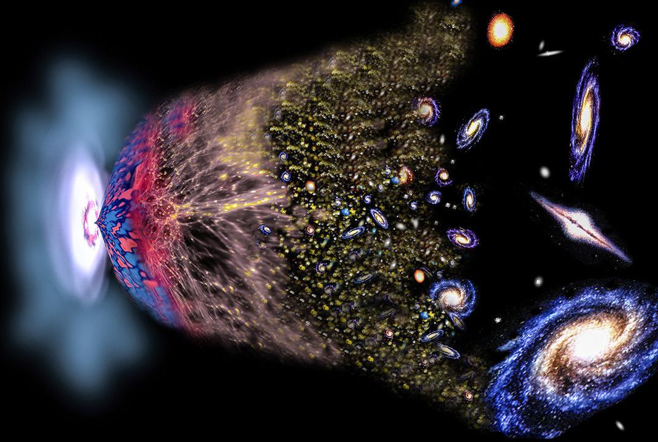
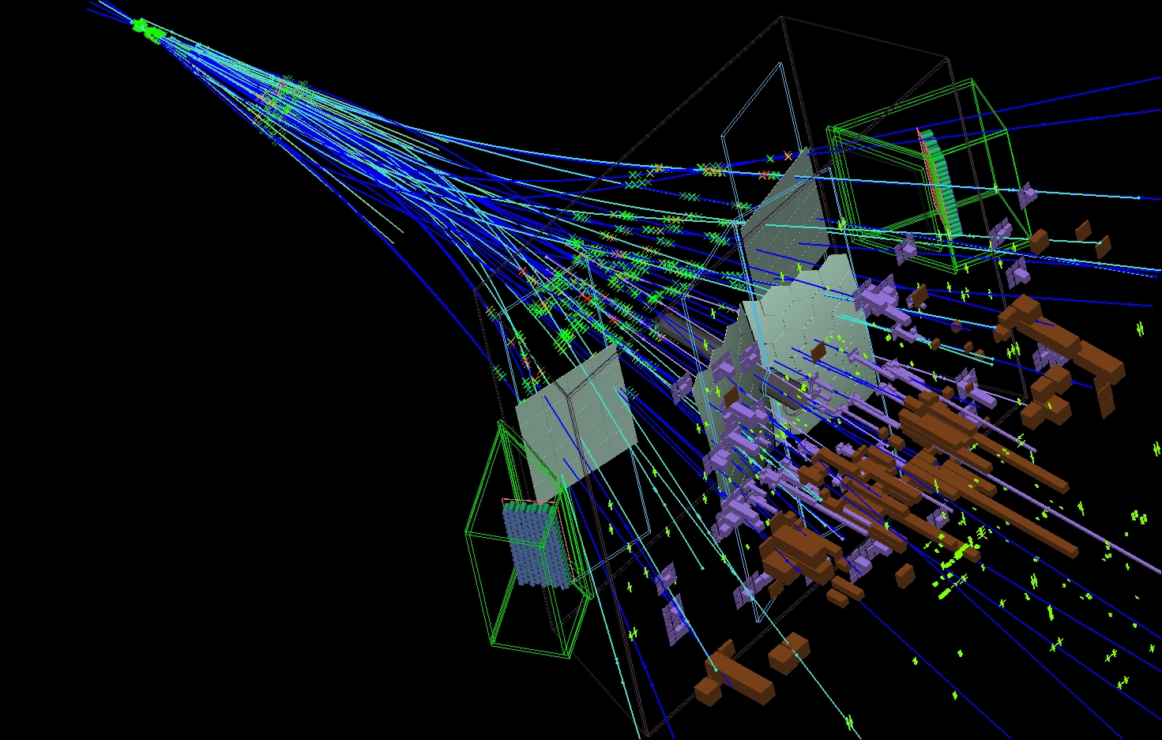

Physics Motivation: The Flavour Puzzle
Why no antimatter particles?
Why three generations?
Why these particle masses?
Notes:
LHCb is about the flavour puzzle:
What is the origin of three generations of particles and why is there no antimatter?

Slide 3


Flavor Anomalies: effect in b→s decays ?
JHEP 06 (2014) 133
JHEP 06 (2014) 133
JHEP 06 (2014) 133
JHEP 02 (2016) 104
JHEP 09 (2015) 179
JHEP 06 (2015) 115
Branching fractions related to $b→s μ^{+}μ^{−}$transition consistently lower than predicted.
Notes:
Over the past years:
collected a series of measurements that hint at effect of semileptonic b → s decays into two muons
Branching ratio's of these decays seem consistently low

Slide 4
Flavor Anomalies: effect in b→s decays ?
JHEP 06 (2014) 133
JHEP 06 (2014) 133
JHEP 06 (2014) 133
JHEP 02 (2016) 104
JHEP 09 (2015) 179
JHEP 06 (2015) 115
Branching fractions related to $b→s μ^{+}μ^{−}$transition consistently lower than predicted.
Notes:
The so-called P5' effect points at an effect in corresponding angular distribution anomaly of the final state

Slide 5










Data Interpretation: “b→s” and “b→c”
JHEP 08 (2017) 055
$$Λ_{b}→{pK}^{−}l^{+}l^{−}$$
PRL 122 (2019) 191801
$$B^{+}→K^{+}l^{+}l^{−}$$
$$B^{0}→K^{∗0}l^{+}l^{−}$$
$$b→s$$
$$b→s$$
$$b→s$$
Global Fits
$$b→s$$
$$b→c$$
$$B_{(s)}→μ^{+}μ^{−}$$
Notes:
Correspondingly the effect is confirmed in more robust non-universality ratio's of muons / electrons in these rare b --> s transition
Unexpectedly, there may be an effect in non-rare semileptonic b → c transitions with taus
Global fits of Wilcon coefficients are consistent with new left handed vector couplings "C9"

Slide 6
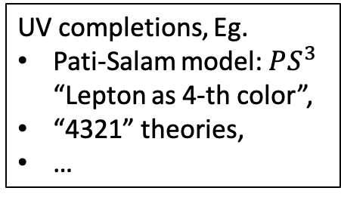
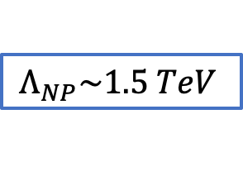
Flavour Anomalies: Interpretation
Why is there excitement?
  No single significant observation
  But “coherent” small effects
Non-universal: consistent with NP coupling to 3rd generation
  Communicates to 1st and 2nd generation via symmetry breaking
  “Opposite” idea to Minimal Flavour Violation; eg 3rd gen. U1 LQ
?
Isidori et al, 2017
$$Λ_{NP}\sim 1.5 TeV$$
UV completions, Eg.
Pati-Salam model: $PS^{3}$ “Lepton as 4-th color”,
“4321” theories,
…
Notes:
EFTs U1 vector quarks:
C_S=Singlet coupling
C_T=triplet coupling.
Speculations for UV completion
Pati-Salam has no proton decay.
Massive U1 LQ arises from breaking:
SU(4) → SU(3)_C x U(1)_B-L PS^3: #rd generation

Slide 7
LHCb @ HL-LHC
LHCb-U2: LS4 Major upgrade
  Exploitation of fast timing information; “4D-reconstruction”
Notes:
Timeline LHC; Upgrade-1 starts 2021/2022
LHCb-U2 in LS4
All ready first limited upgrades in LS3

Slide 8
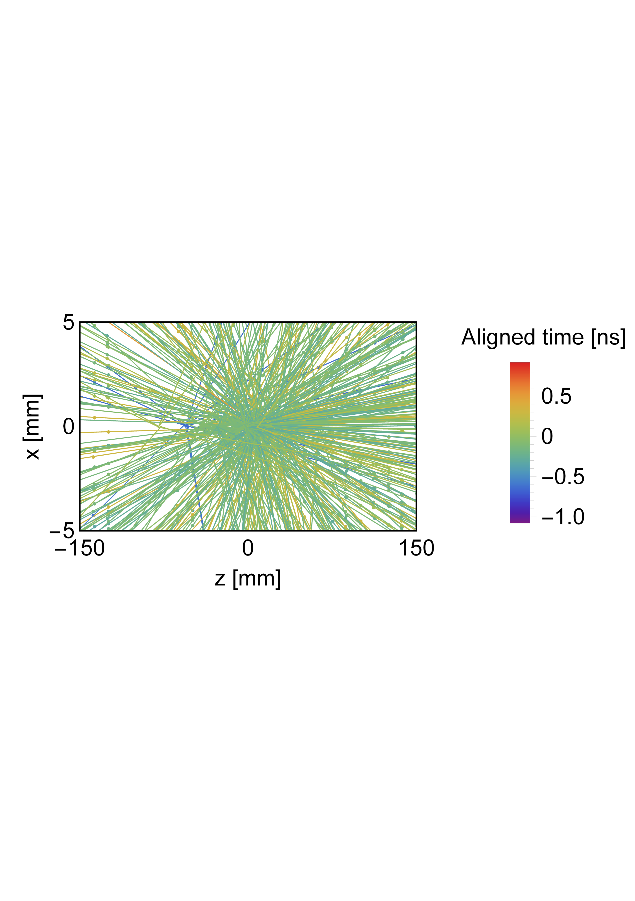
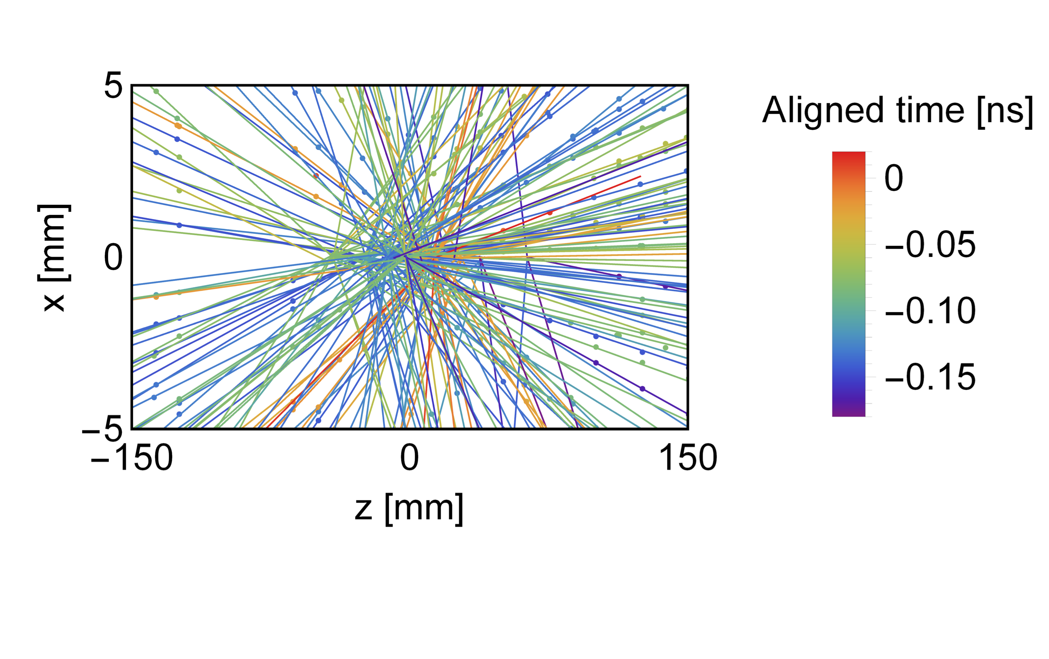
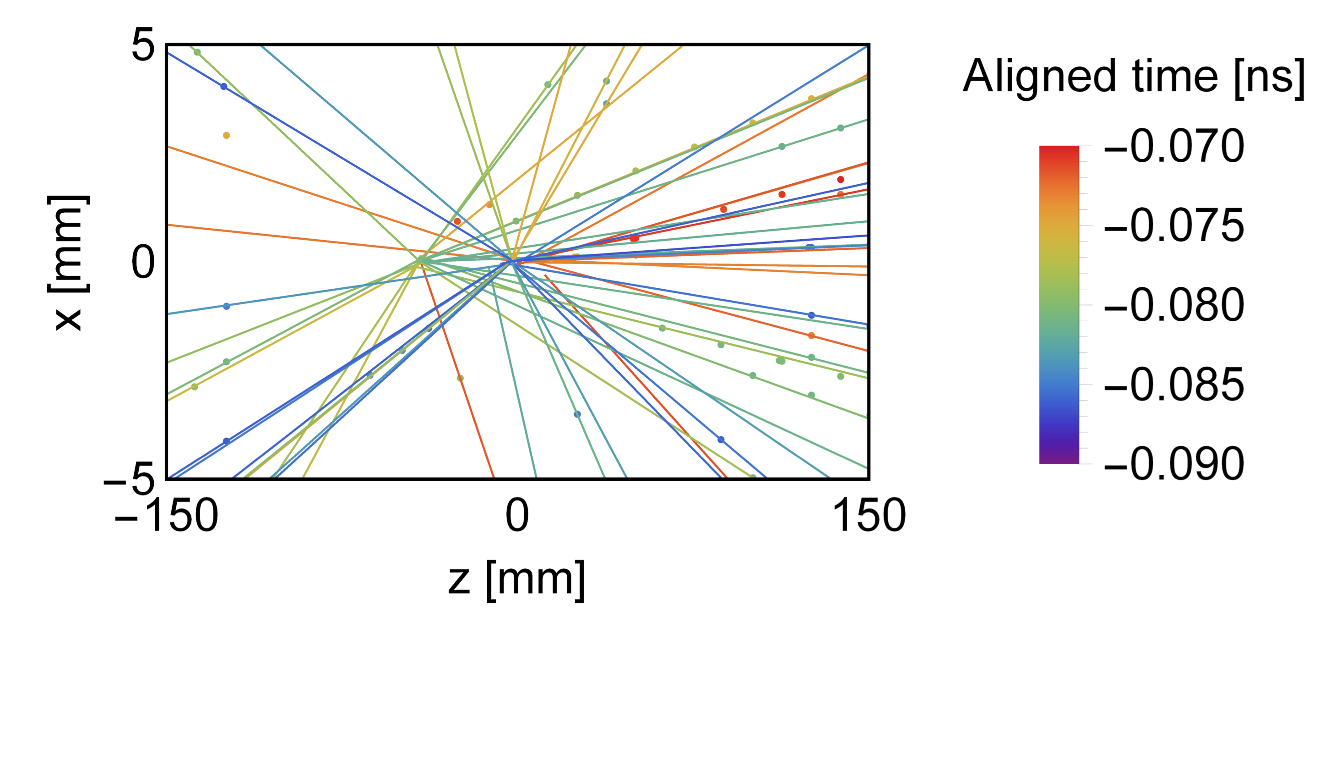
@Nikhef: R&D on 4D-tracking
2000 ps
The power of 4D-tracking (“ChronoPix”)
  Fast timing provides a tremendous tool for 2nd vertex association in high lumi environment.
LHCb specific
  Radiation tolerance challenge. Which technology?
  Prototype for LS3 ; new Vertex detector LS4
LHC wide R&D initiative on Si sensor & electronics
  Collaboration between R&D, LHCb, Alice and Atlas
200 ps
20 ps
Notes:
1st Focus point: 4D tracking
Effect of timing resolution on vertexing:
Remember B-physics is associating a B-decay with PV
LHCb @ 5 mm from interaction point in vaccum!

Slide 9
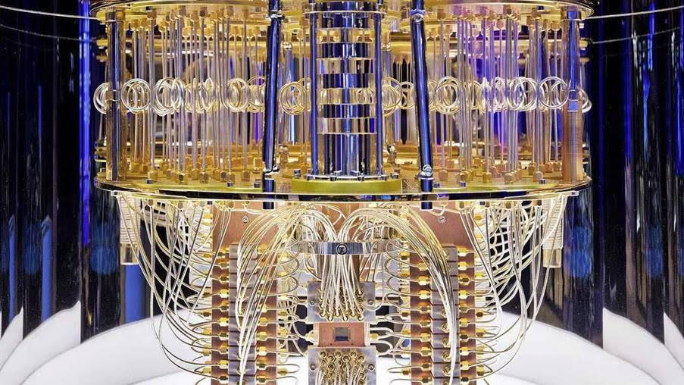
@Nikhef: Data Processing
HLT-1
HLT-2
Computing and Tracking algorithms
  Real Time Analysis
    HLT-1 on GPUs: “Allen”
    R&D for HLT-2@Nikhef
    Collaboration with Nikhef PDP
  Quantum Computing for HL-LHC
    Collaboration LHCb & Einstein Telescope
    Collaboration with Data Science (DKE) @ UM
    Exploring collab with PDP, IBM, ING, TNO, CWI
Notes:
2nd Focus point: data processing and software
Data processing sequence
1. RTA
HLT-1 GPU basis designed and implemented by Nikhef
HLT-2 propose R&D on remote trigger
2. New Initiative starting on QC

Slide 10



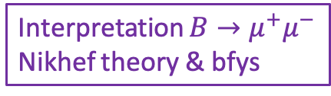

@Nikhef: Data Analysis
Data analysis
  Precision CP violation NP
    CKM phases $φ_{s} , γ$
  Rare decays:
    Very rare decays: $B_{s,d}→l^{+}l^{−}$
    LFnU, angular distributions
$B_{s}$- phase
$B_{s}$-oscillations
$$B_{d/s}→μ^{+}μ^{−}$$
Interpretation $B→μ^{+}μ^{−}$
Nikhef theory & bfys
Notes:
Data analysis: CPV and Rare decays
Bs oscillations plot and bs-mixing phase by our PhDs
Rare decays our PhD
Interpretation collaboration with Nikhef theory

Slide 11
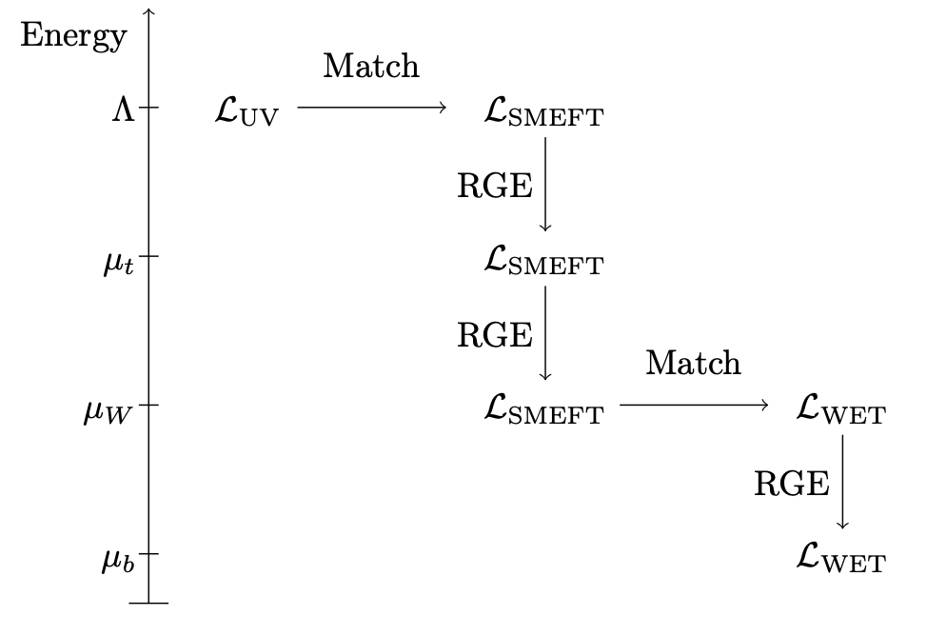
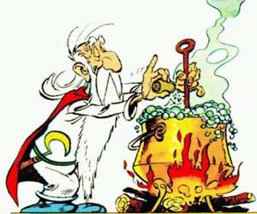
@Nikhef: Data Interpretation
SMEFT
@Nikhef: ATLAS group
Top quark +Higgs sector
Multi-sector EFT global fit including
Flavor sector
Top quark sector
+ Higgs sector [ + searches + EDM…. ]
Get ultimate potential out of LHC data
  most stringent constraints on Wilson coeff. (i.e. on New Physics)
WET: flavour sector
@Nikhef:
Flavor anomalies
Rare decays. CP-violation…
Make use of existing expertise at Nikhef:
  Collaboration with Theory, Atlas, EDM
Notes:
Intensify collaborations
Energy scales:
SM effective theory
Weak effective theory
Renormalisation group equations to evolve
Global fitting.
UV complete → EFT = easy , while EFT →UV = hard

Slide 12
First: still lots to do for Upgrade-1…
Scifi Module installation on C-frames
Velo Module

Slide 13
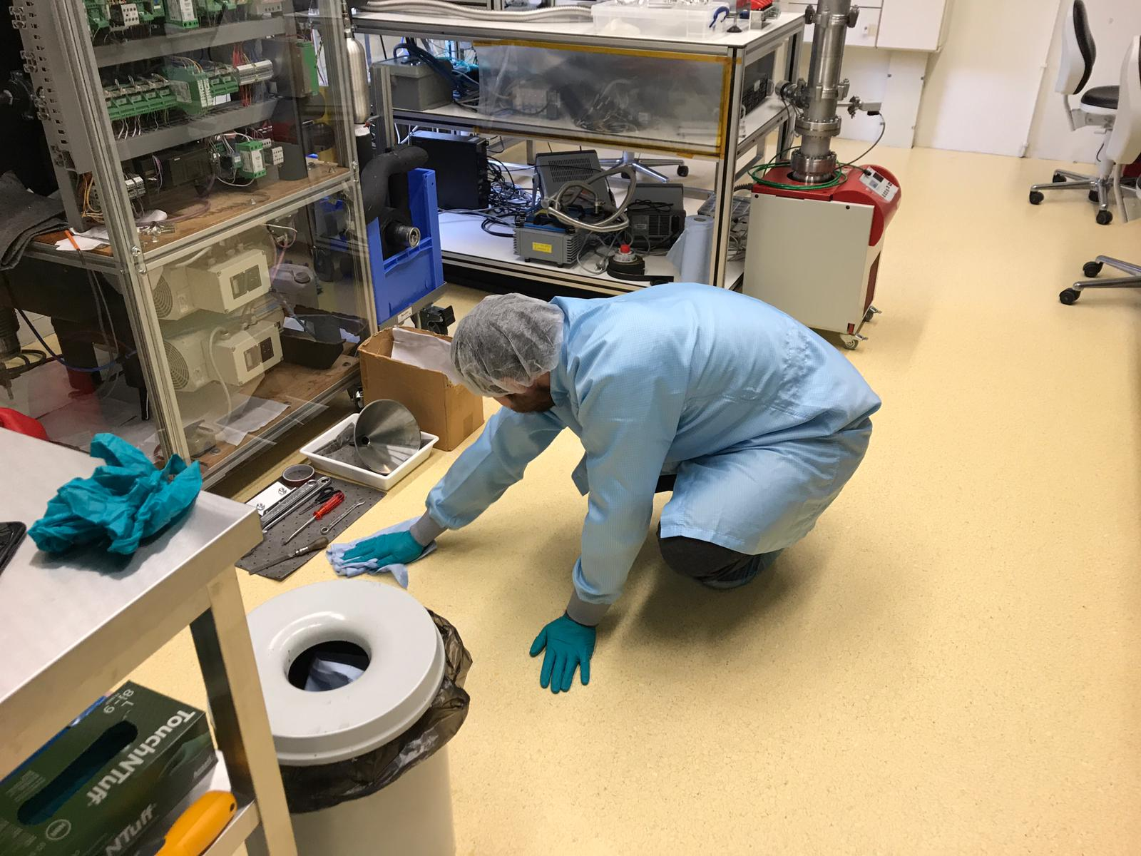
… including high-tech lab work!
Scifi Module installation on C-frames
Velo Module
“Cleaning the clean-lab”

Slide 14
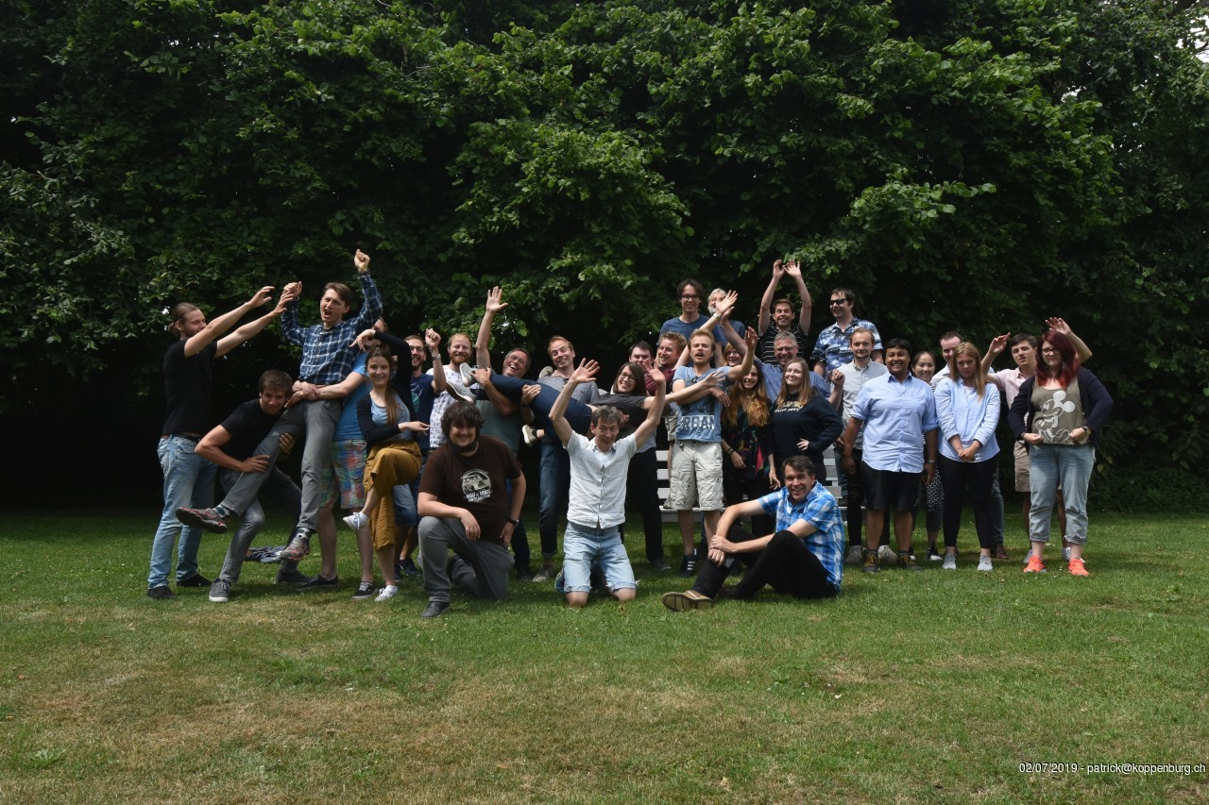
Group and Funding
Notes:
Finally on the group

Slide 15
Group and Funding
Current Staff & WPT:
  Staff: 12, distributed over Nikhef: 5.5, VU: 2, RuG: 2, UM: 2.5
    Collaborations with R&D, Theory, PDP, UM: DKE, MSP
  Postdocs: 1.5 bfys program, 6.5 FTE external funding (Vici, SNF, MC, RuG, UM)
  PhDs: 2 bfys program, 8 FTE external funding (Vici, project), several ending soon.
Bfys program funding has ended, current Vici personnel all hired
  Need new strategic funding from ENW-XL
  Intend to submit a proposal along the lines
    Physics analysis, fast-timing R&D (4D tracking), Computing
Require funding for LHCb upgrade-2 investment
  Initially: moderate funding for R&D and prototypes for LS3 upgrade
    Estimated budget for 2021 - 2026: 0.5 – 1.0 M€
  Later: large investment for LHCb-III (LS4) detector.
    Estimated budget for 2026 - 2031: ~ 5 M€
Notes:
PhDs and Postdocs: mainly from external sources: Vici!
Additional funding applications ongoing

Slide 16
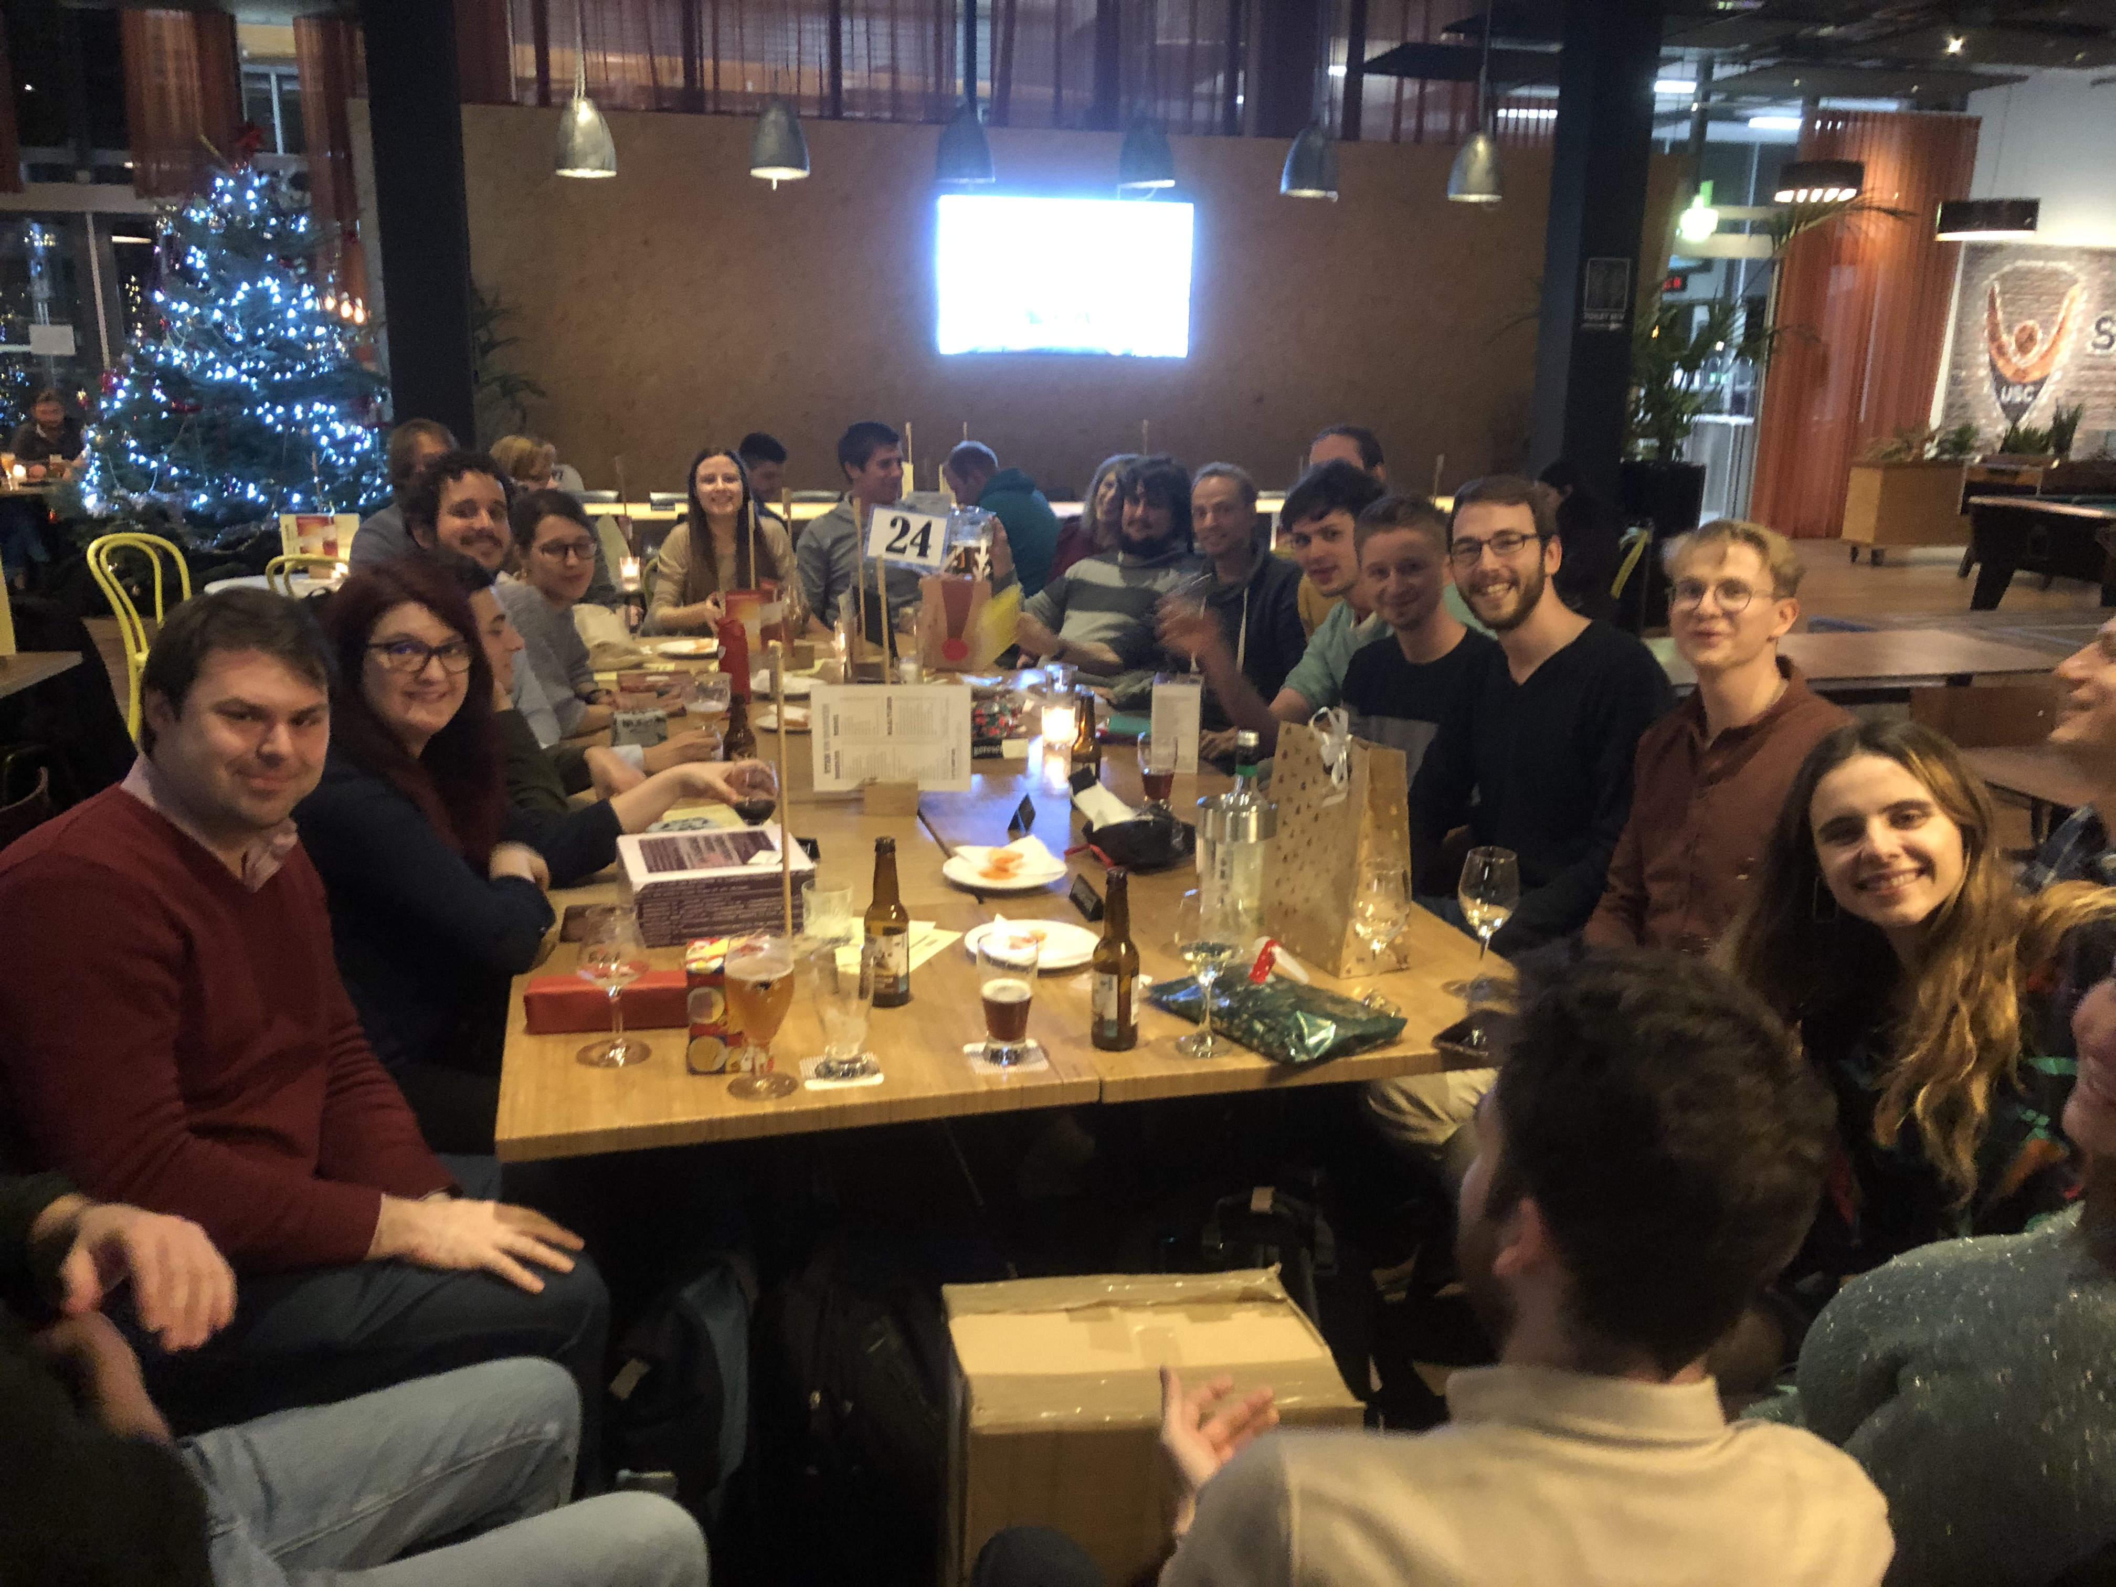
Really looking forward to group gatherings...

