Slide 1

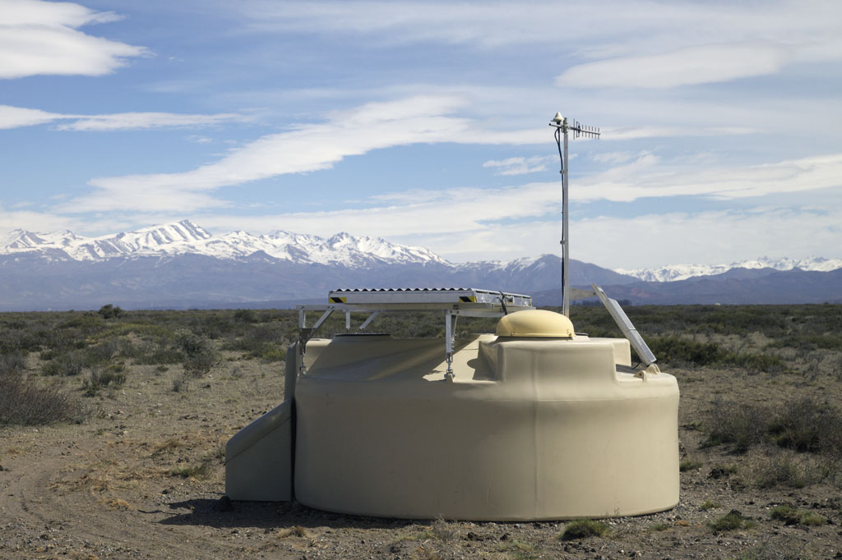

Ultra-high-energy cosmic rays
Sijbrand de Jong
Take home message:
Highest energy accelerators & interactions
Multi-messenger astroparticle physics
Coherent long term programme: Auger & GRAND
Nikhef Vista Update Discussion 21-10-2020 (Cosmic Rays, SdJ)

Slide 2
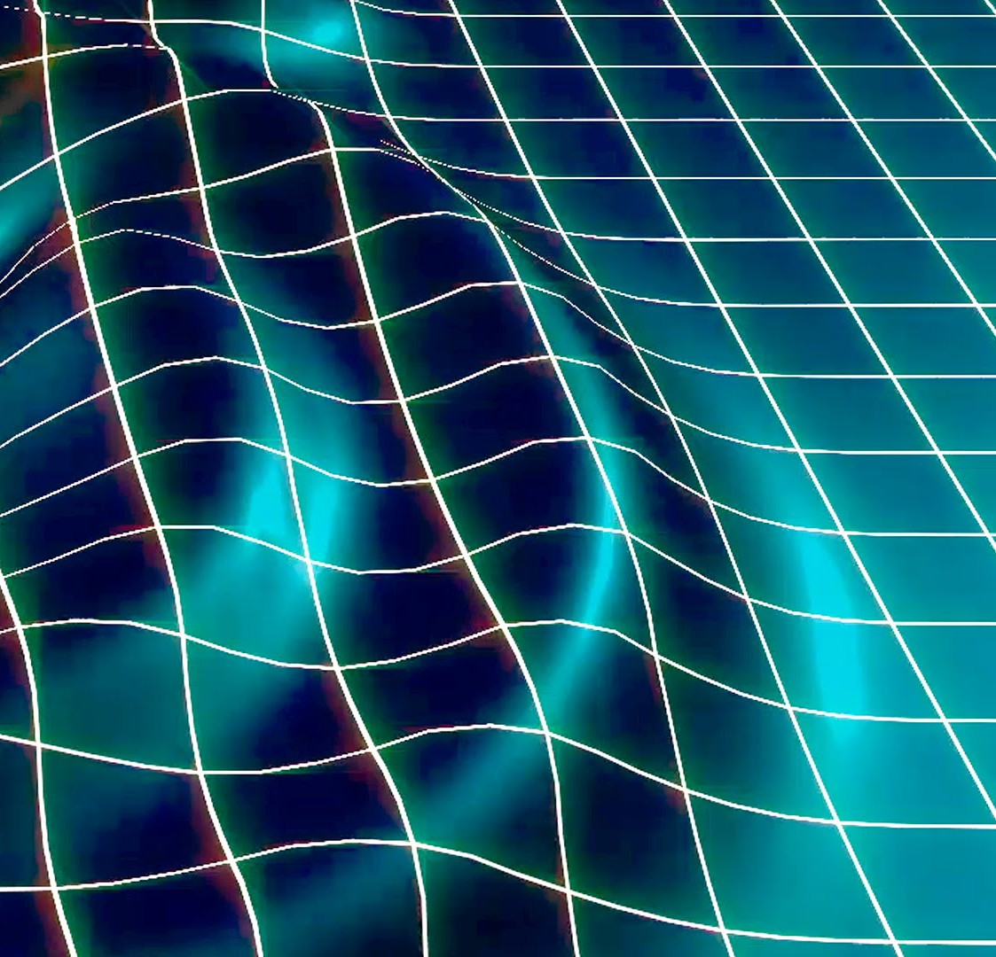
Cosmic Rays in the Universe
Gravitational Waves
Astronomy +
Physics of
cosmic accelerators
Particle interactions
Cosmic B-fields +
Structure of
space-time
Notes:
Cosmic Ray Physics concerns itself with high energy particle messengers from the Universe: the physics of their sources, their propagation through space and their interactions on Earth. For us the focus is on Ultra-High-Energy Cosmic Rays, with energy above an ExaElectronVolt, 10⁹ GeV, which are the most interesting from the point of acceleration, propagation and particle interactions.

Slide 3
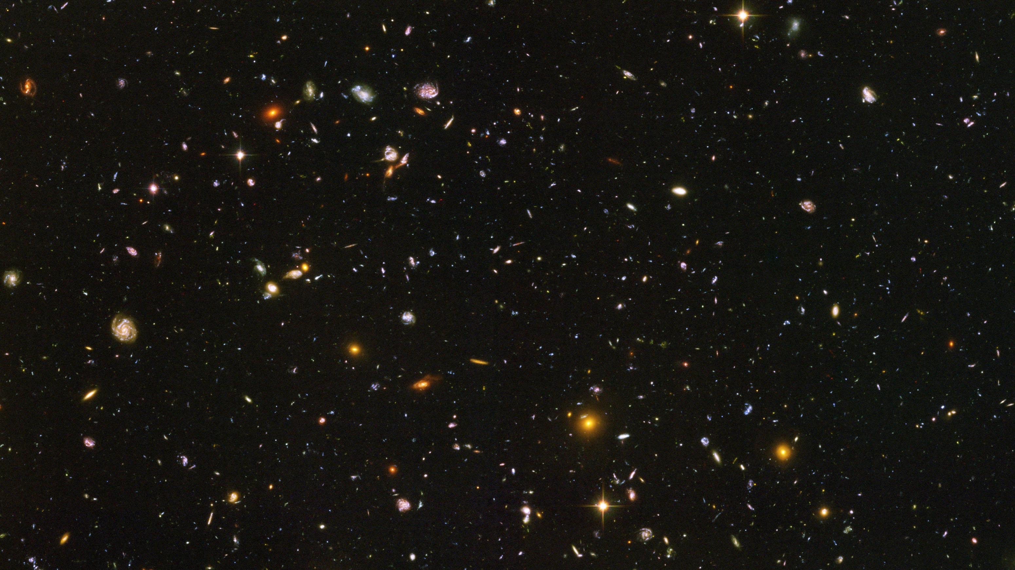
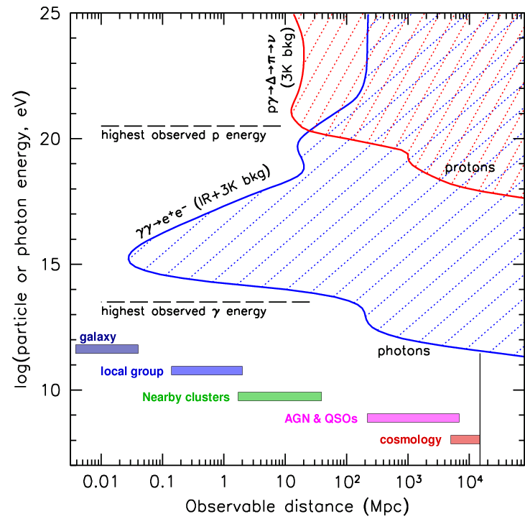
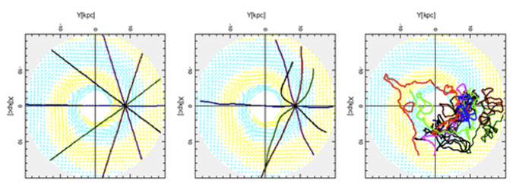
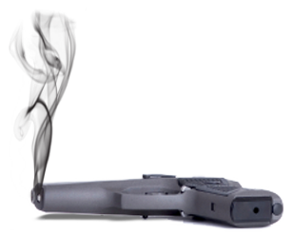
Cosmic magnetic field, particle type and sources
Trajectories of proton in our Milky Way
10¹⁸ eV 10¹⁹ eV 10²⁰ eV
Only pointing back to source for rigidity > 10 EeV
GZK interactions/cosmic horizon
p + γ -> p/n + π -> p/n + γγ/μν
Notes:
Things to keep in mind for cosmic rays are that the easiest to see: nuclei, bend in the vast cosmic magnetic fields and do not point back to their source until they reach the ultra-high-energy of 10 EeV. This is of course not true for photons and neutrinos.
Ultra-high-energy nuclei and photons have interactions with the cosmic photon background which limits their range. This is not true for neutrinos which travel in straight lines through the whole universe.

Slide 4
Multi-messenger to find sources
Proton & Nuclei
Point sources
Cosmogenic
p+γ_{CMB} → p+π⁰
π⁰ → γ+ γ E_{γ} ≈ E_{p}/10
p+γ_{CMB} → n+π⁺
π⁺ → μ⁺+ ν_{μ} E_{ν} ≈ E_{p}/20
μ⁺ → e⁺+ ν_{μ}+ ν_{e} E_{ν} ≈ E_{p}/1000
A+γ_{CMB} → A′+p
p+γ_{CMB} → ν’s E_{ν} ≈ E_{A}/A/20
p+γ_{CMB} → γ’s E_{γ} ≈ E_{A}/A/10
p
N
Fe
He
Gamma & neutrino
* Being sensitive to both cosmic rays, neutrinos and photons is the key to guaranteed success.
Notes:
The interactions during propagation of nuclei also offer opportunity, as always pions are produced that decay in either photons or neutrinos, which in turn point back to the place of interaction. Their yield tells something about the nucleus type composition, because pion production rate depends on the nucleus type.

Slide 5
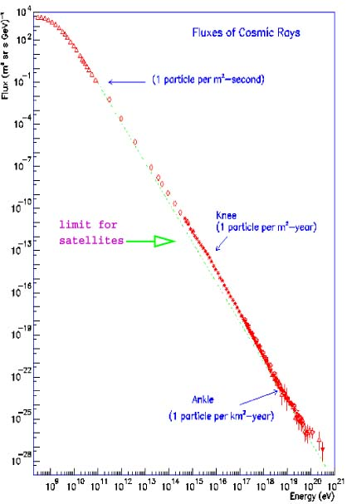

Energy spectrum and detector size
Need
Huge
detector
Nuclei
Neutrinos
10⁴
10²
10⁻¹
10⁻⁴
10⁻⁷
10⁻¹⁰
10⁻¹³
10⁻¹⁶
10⁻¹⁹
10⁻²²
10⁻²⁵
10⁻²⁸
1 /m²/sec
Flux [/m²/s/sr/GeV]
Nikhef open dag, 5 oktober 2019
knee
1 /m²/year
ankle
1 /km²/year
Region of interest:
100 - 1 per km² per century
10⁹ 10¹⁴ 10¹⁷ 10²⁰
Energie [eV]
Notes:
The flux of cosmic rays drops fast as their energy increases, by three orders of magnitude in flux for every order of magnitude in energy. In the part that interests us we have between 100 and 1 particle per square kilometer per century. Therefore, we need particle detectors with a huge surface.

Slide 6
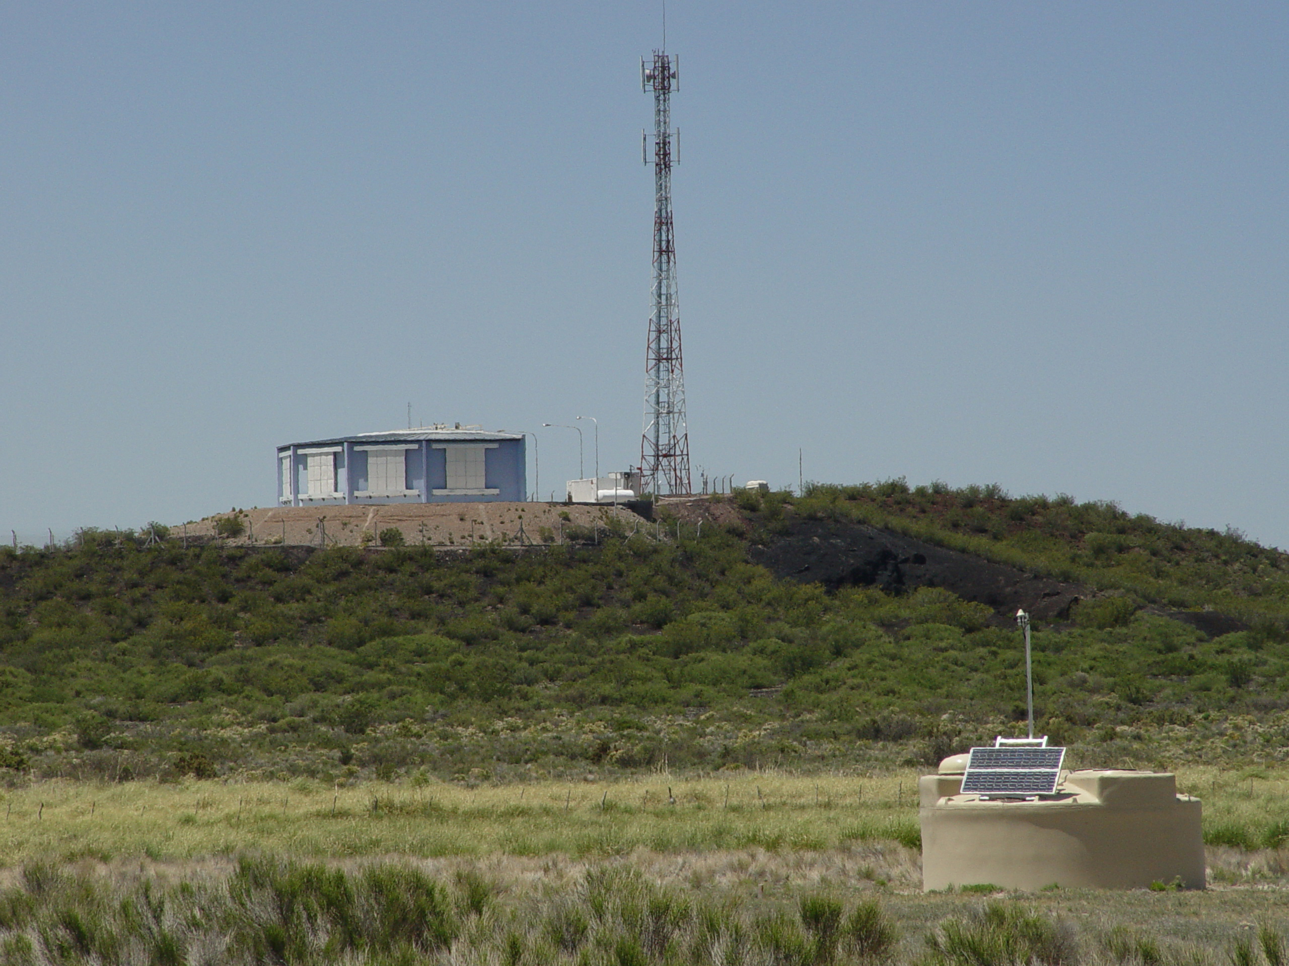

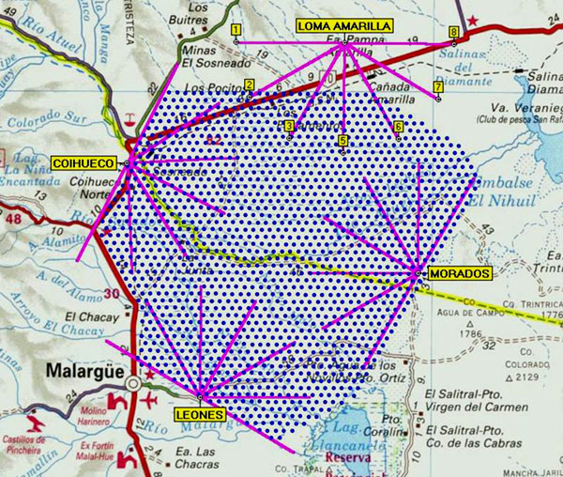
Pierre
Auger
Observatory
3000 km²
27
Fluorescence
Telescopes
1660
Water Cherenkov
Particle Detectors
Notes:
The Pierre Auger Observatory is the biggest active cosmic ray detector. A 3000 km² hybrid detector with 12 m³ water Cherenkov particle detectors spaced every 1.5 km and 27 fluorescence detectors around the site.

Slide 7
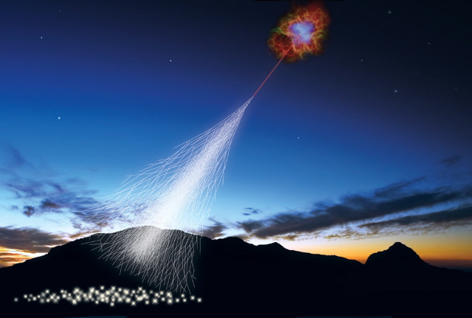
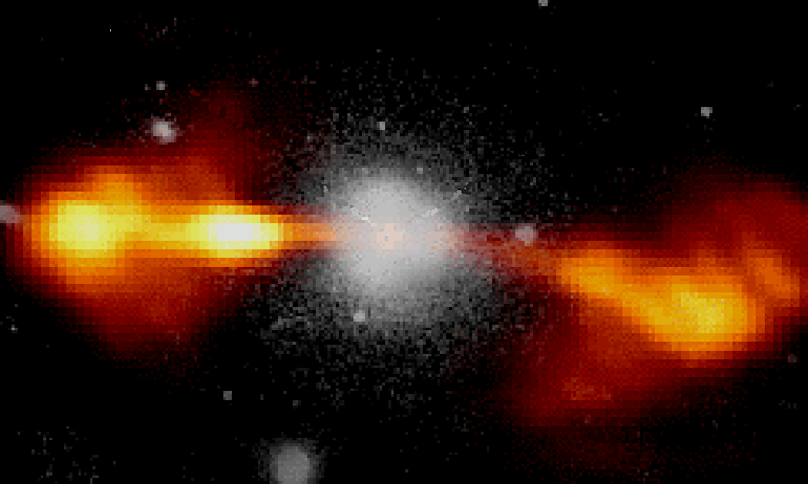
Ultra-High-Energy Cosmic Rays
Particle interactions
at the highest energy
ever seen
Origin of highest-energy
particles in the Universe
?
?
Particle type is the key !
We are installing the detector !
* This is the simplified picture.
Notes:
The missing information for breakthrough science in finding sources, CR propagation and studying UHE particle interactions is the particle type of the UHECRs.

Slide 8
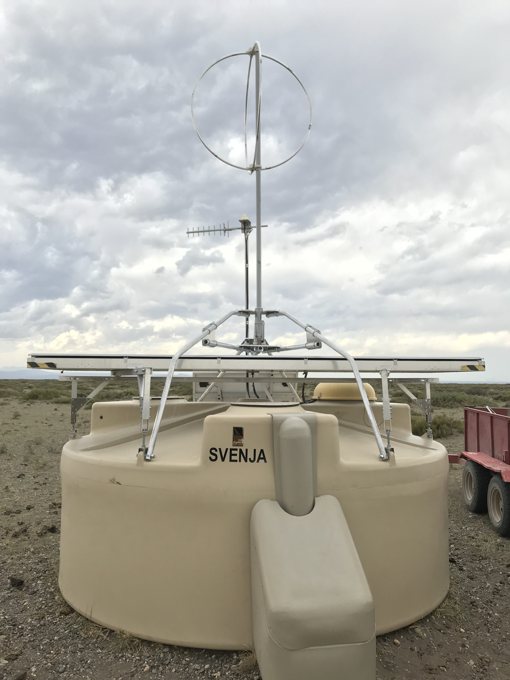
Measure particle type at highest energies
combination gives
e and μ separately
total # e
e + μ in
shower tail
μ in
shower
tail
a e+b μ
in shower tail
Notes:
Short description of the functionality of the upgrade.
In the SSD upgrade, the Nikhef group plays a very significant role, the RD upgrade is completely dominated by Nikhef.

Slide 9
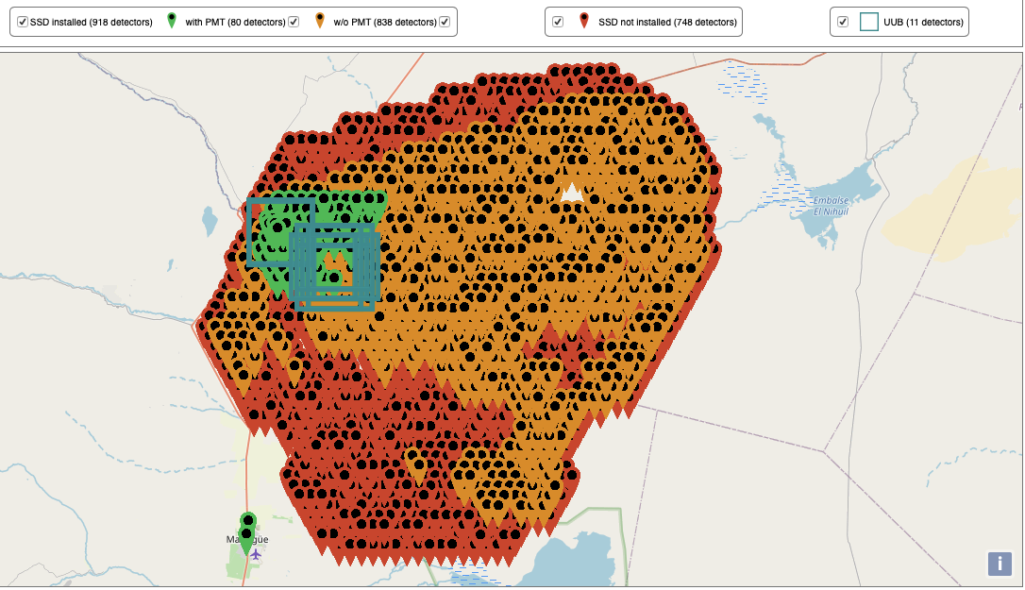
Auger RD
Antenna 5 m above ground
SSD installation status
20 October 2020
918 of 1518 SSD modules installed
(green+orange)
SSD PMTs ordered
Upgrade Electronics Board to be ordered soon
Installation finished 2021-2022
* Picture by Tim Huege (KIT).
Notes:
The SSD production has been nearly finished with large participation of Nikhef. 918 of 1518 SSDF modules have been installed in the field.

Slide 10
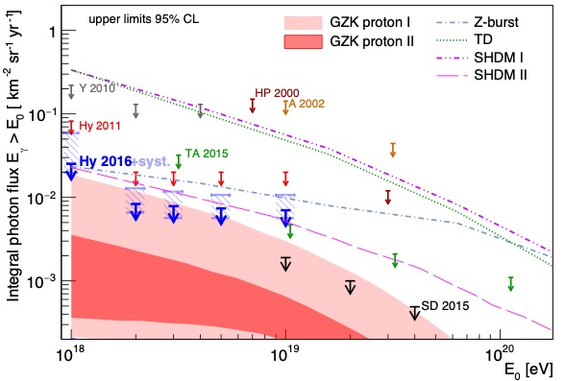
Multi-messenger: γ and ν
(Ultra-) High-Energy Neutrino Search Ultra-High-Energy photon search
Auger results for
Gamma and nu
Auger
ANTARES
IceCube
Auger will come close to first detection of UHE ν and γ,
but will not be able to collect significant statistics
Notes:
The upgrade will also much enhance the capabilities to find UHE neutrinos and photons and bring Auger sensitivity into the region where we expect these particles, so also exclusion will have ramifications in our understanding.
To be sure to detect UHE neutrinos and photons a much larger observatory than Auger is required.

Slide 11
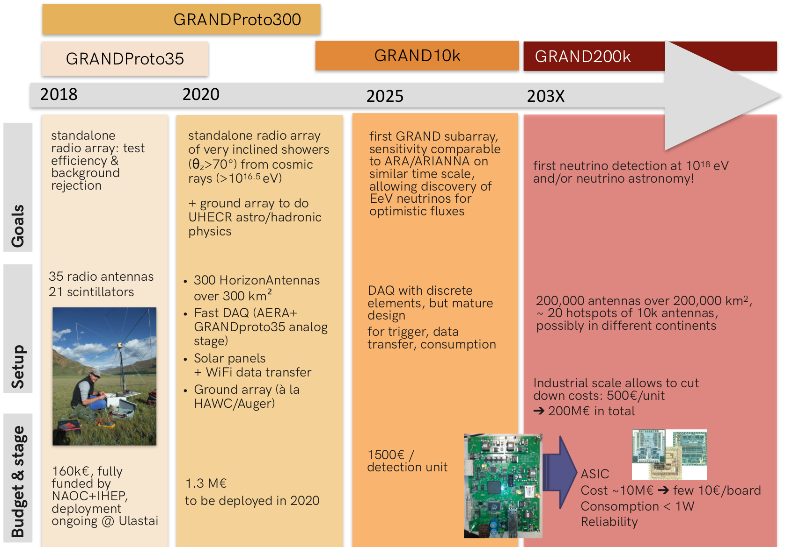
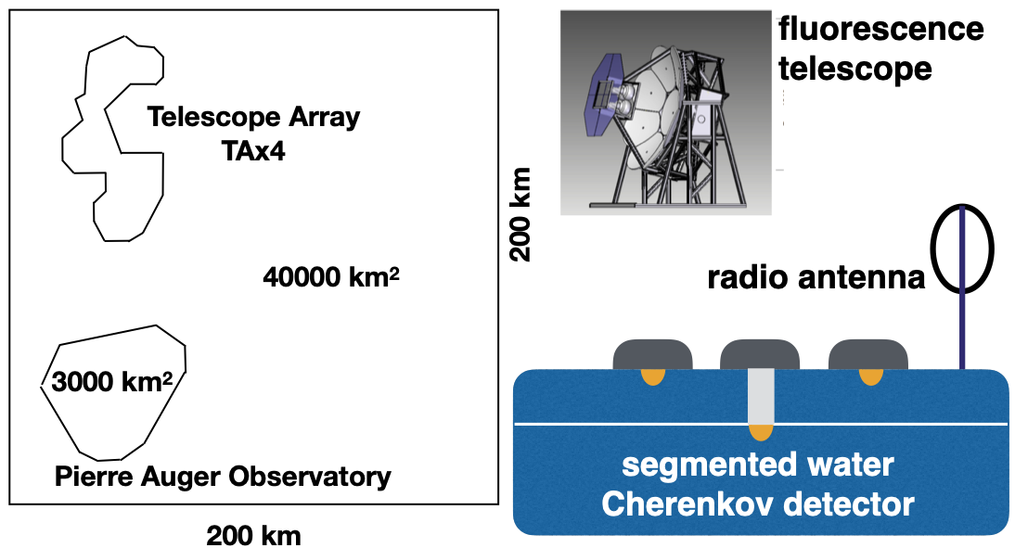
Cosmic Ray Observatory Road Map
Multiple sites desirable
for transient phenomena.
Likely will also mix technologies.
One or more organisations.
x5
Notes:
There are several plans for a successor experiment for Auger. GRAND is a plan for a 200 000 km2 radio detector and most advanced in its development and plans. GCOS is an extended and improved version of Auger. There are other ideas on observatories and technologies too.
In any case multiple sites are desirable to cover the whole sky at any time for transient phenomena. Also technologies can be mixed on one site or mixed from several sites and all this may be centered in one organisation or be collaboration between several organisations.

Slide 12
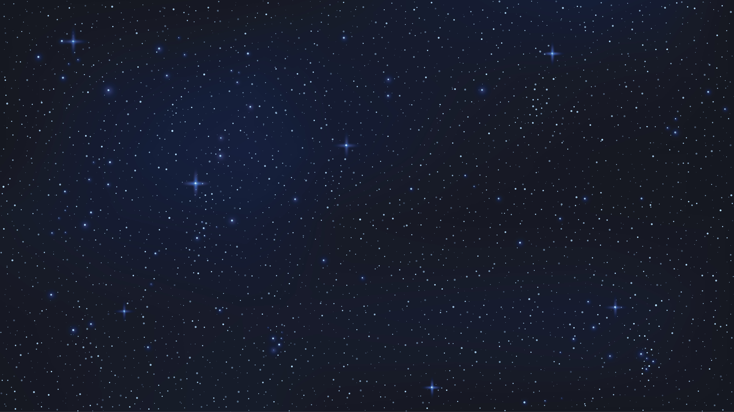
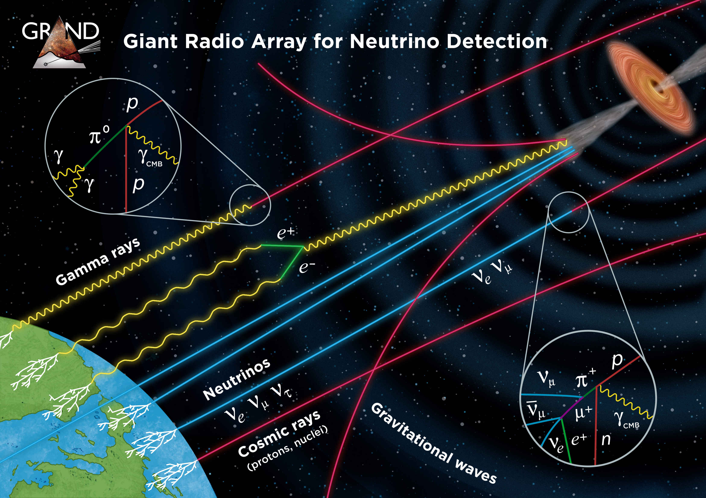
GRAND as multi-messenger observatory
Astronomy collateral
Notes:
GRAND is a genuinely versatile apparatus, doing multi-messenger in one observatory and can at the same time address a number of neutrino properties and astronomy subjects. We are already quite heavily involved in GRAND, although at a very modest level compared to Auger.

Slide 13
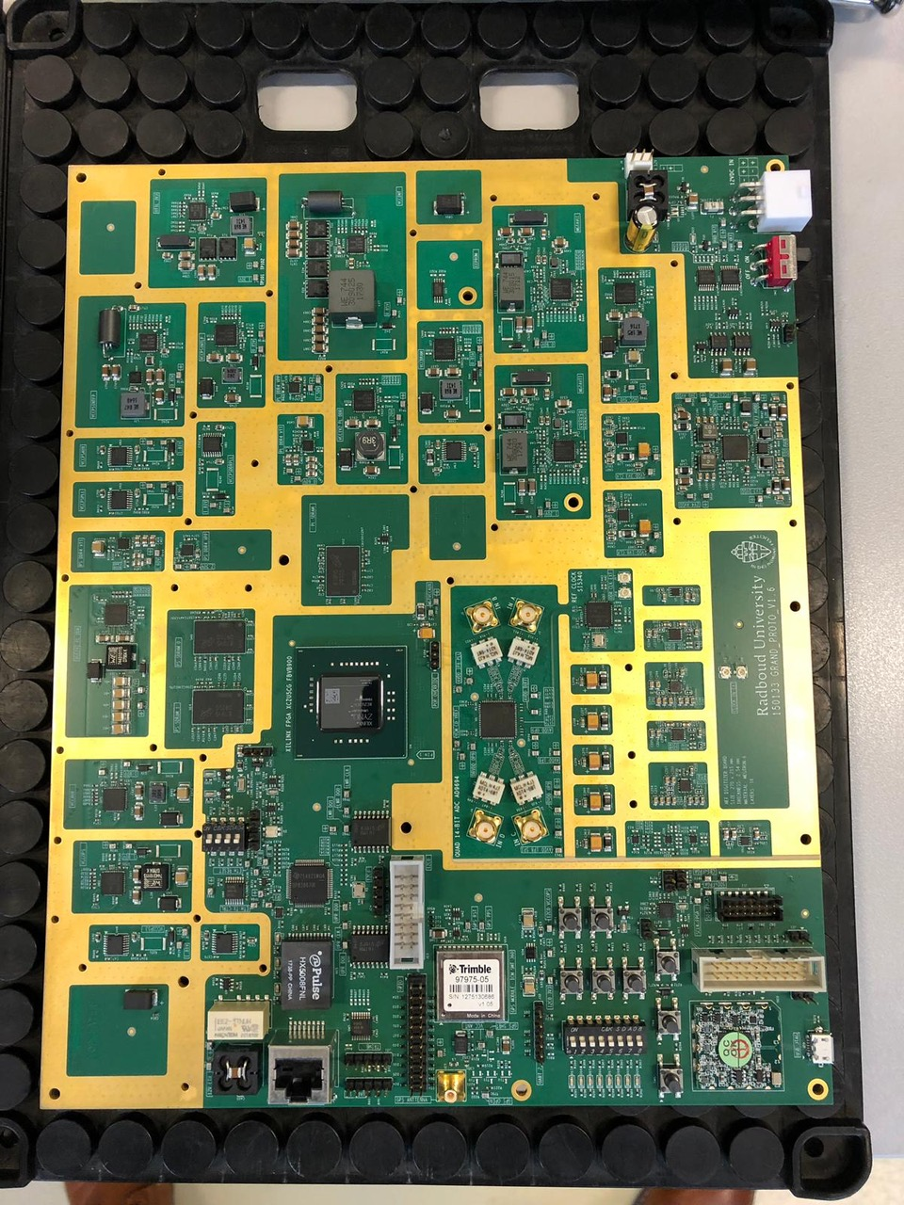
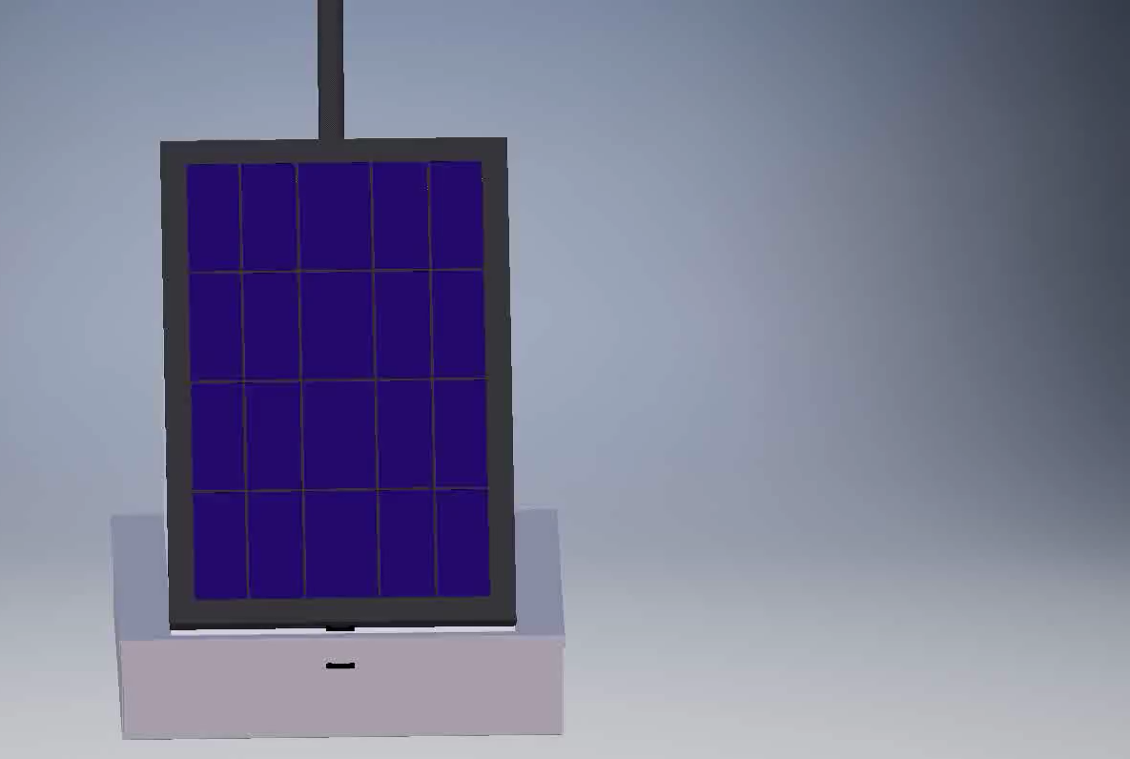
Nikhef/RU Electronics and Mechanics
Notes:
Our group, using the Radboud University Techno Center, delivered the digitizer and auxiliary electronics and the mechanical design of the GRANDProto300 stations.

Slide 14
Summary
Cosmic Ray programme includes (multi-messenger !): nuclei, neutrinos and photons with E>1 EeV
now – 2030+ AugerPrime Upgrade & harvesting
now – 2030 GRAND, GCOS, … development
2030 – 2040+ GRAND, GCOS, … data taking
2030: UHECR sources will be found,
UHECR propagation will be (partly) understood,
>EeV hadronic, ν (maybe γ) interactions will be understood,
multi-messenger will be done,
… (surprises !?) Exciting times ahead !
Notes:
To summarise: the Nikhef Cosmic Ray programme is already multi-messenger in itself, but of course also fully participates in multi-messenger approaches with other observatories.
The timeline is that we are now very busy with the AugerPrime upgrade and we will be very busy running the detector and harvesting the physics results for the next decade.
A larger observatory is required for the ultimate answers to out questions number of ideas exist for a larger

