Slide 1
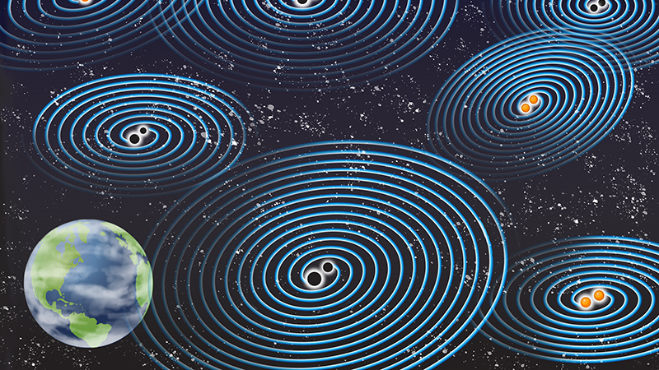
1
13
Gravitational Waves
new window upon our Universe
Nikhef Vista 2020, 20-21 October, Gravitational Waves
Frank Linde for GW group

Slide 2
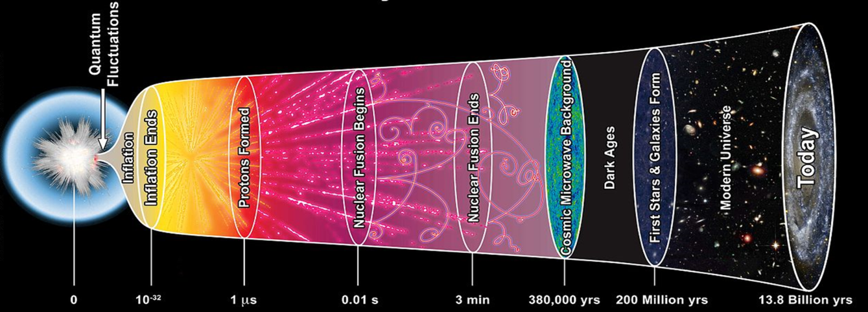
particle physics & gravitational waves
2
13
‘Particle physics like’ science: extreme matter, origin of elements, graviton, early Universe,
dark matter & -energy, quantum gravity, • • •
astronomy
Standard Model
particle physics
?
GW?
ν?
γ
CERN connections: Technology: vacuum, cryo, controls, civil engin. & computing & also: EuCAPT, Giudice’s talk @ EPPS symposium, JENAS, • • •
General
Relativity
(2019: CERN-INFN-Nikhef MoU)
2020
2018
2019

Slide 3
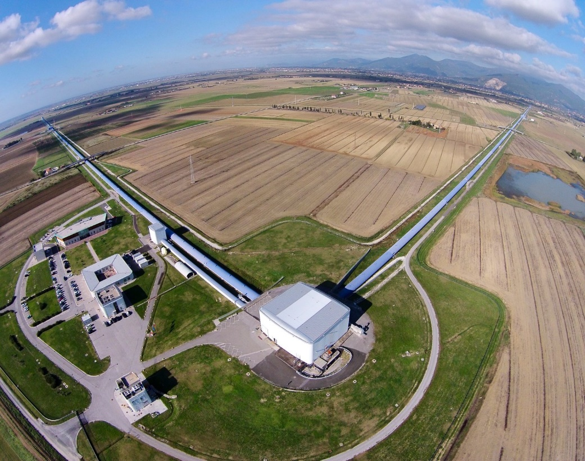
2000
2010
2020
2030
2040
3
13
VIRGO
ETpathfinder
Our science project
3,5 M€ (2019-2023) mostly Virgo upgrades
Science for coming decade(s) lots of data analysis/simulation Steady flow of publications
also 2.6 M€ (2019-2025) for junior scientists (PhD/Postdoc)

Slide 4
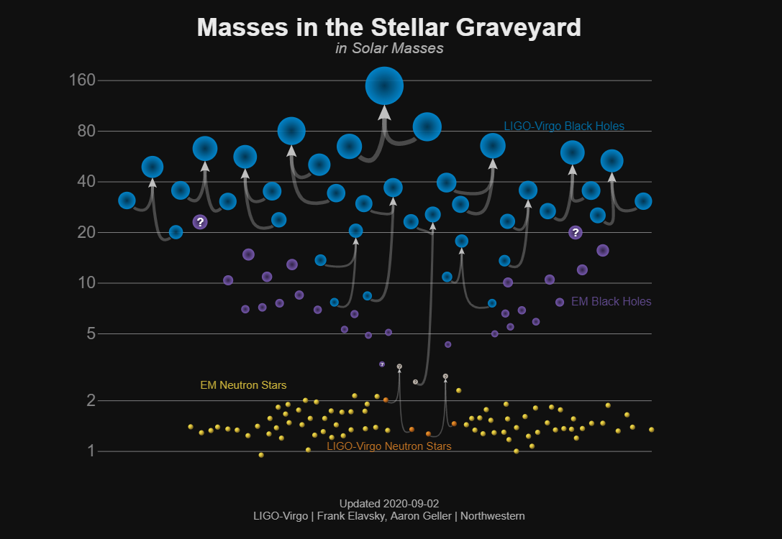
2000
2010
2020
2030
2040
4
13
VIRGO
ETpathfinder
Our science project
3,5 M€ (2019-2023) mostly Virgo upgrades
‘mass
gap’
BH
(2019)
Science for coming decade(s) lots of data analysis/simulation Steady flow of publications
1st
BBH
(2015)
Masses in M
1st
BNS
(2017)
also 2.6 M€ (2019-2025) for junior scientists (PhD/Postdoc)

Slide 5
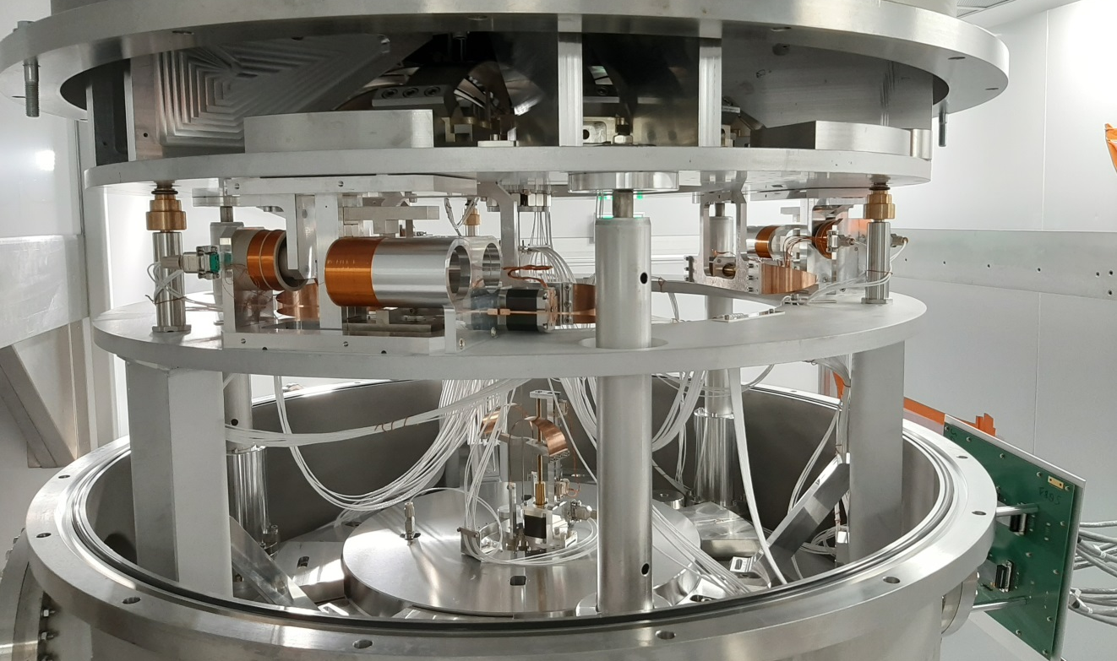
2000
2010
2020
2030
2040
5
13
VIRGO
ETpathfinder
Our science project
3,6 M€ (2019-2022) mostly Virgo upgrades
Science for coming decade(s) lots of data analysis/simulation Steady flow of publications
Continuous noise hunting
Virgo Phase-I upgrade (funded)
f-dependent squeezer
Gravity Gradient Noise
New/better sensors
Better controls
Virgo Phase-II upgrade (unfunded)
Large mirrors!
And more • • •
nice
Nikhef
hardware
also 2.6 M€ (2019-2025) for junior scientists (PhD/Postdoc)

Slide 6
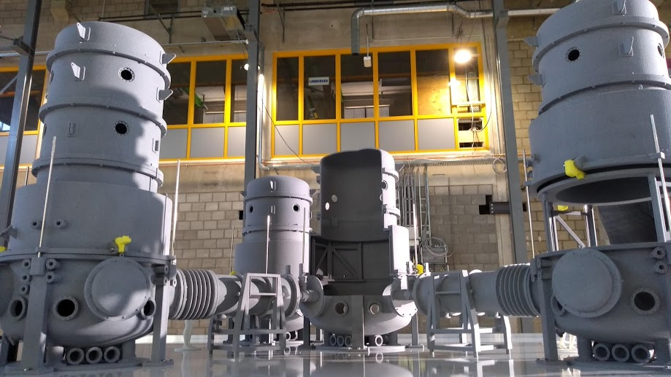
2000
the long-term R&D lab
2000
2010
2010
2020
2020
2030
2030
2040
2040
6
13
VIRGO
ETpathfinder
Our ‘fun’ project
14,5 M€ (2019-2022) for hardware alone
Cleanroom (contract awarded)
Vacuum vessels (tender posted)
The real exciting fun:
Vibration attenuators
10-20 K cryogenics
Fancy (silicon) optics & optics simulations
Modern controls
Testbed for creative ideas
Conor’s ERC starting grant
Long-term R&D laboratory
Key to collaboration industry
Maastricht University
will run out of funding in 2024 • • • i.e. new grants needed

Slide 7
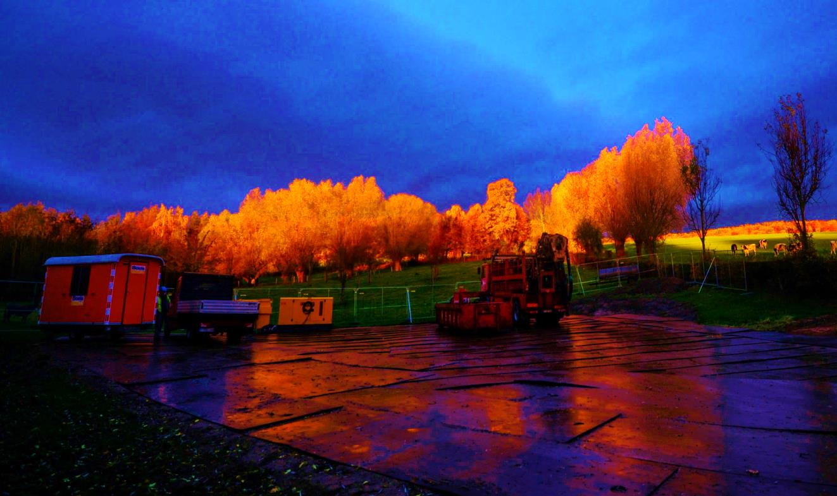
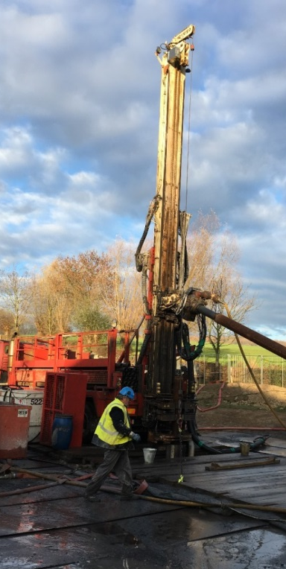
2000
2010
2020
2030
2040
7
13
VIRGO
ETpathfinder
1. large cryogenic Si mirror test setup
2. geology: active seismic & boreholes
15 M€
Geology studies
KNMI, TNO, Liège, Aachen, Bonn, • • •
Many discussions with civil engineering firms
Terziet: continuous seismic data
2021: Cottessen borehole?
2021: passive/active seismic
2022: 3-4 more boreholes
2023: optimal ET site?
Liège University
RWTH Aachen
Crucial: pinpoint optimal ET layout in Euregio Meuse-Rhine

Slide 8
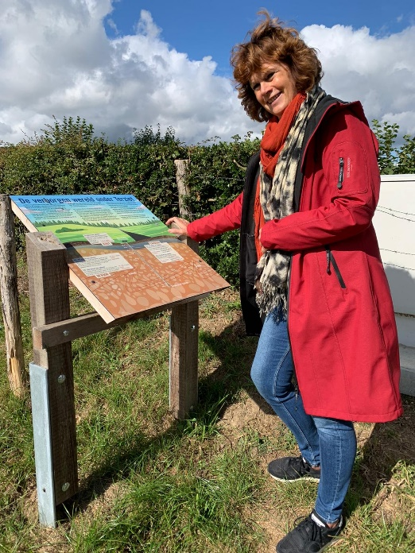
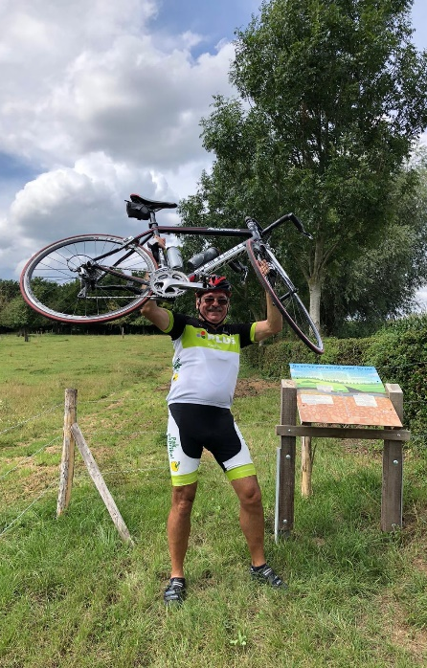
2000
2010
2020
2030
2040
7
13
VIRGO
ETpathfinder
1. large cryogenic Si mirror test setup
2. geology: active seismic & boreholes
15 M€
Geology studies
KNMI, TNO, Liège, Aachen, Bonn, • • •
Many discussions with civil engineering firms
Terziet: continuous seismic data
2021: Cottessen borehole?
2021: passive/active seismic
2022: 3-4 more boreholes
2023: optimal ET site?
Liège University
RWTH Aachen
Crucial: pinpoint optimal ET layout in Euregio Meuse-Rhine

Slide 9
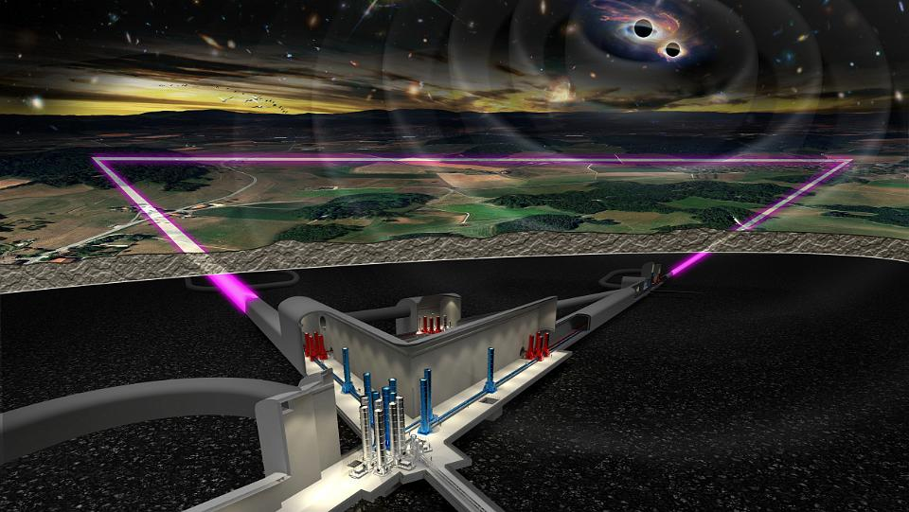
2000
2010
2020
2030
2040
≥ 50 years of science!
8
13
VIRGO
ETpathfinder
Highlight: 9-Sep ET ESFRI-application submitted
Science case:
Observe the entire Universe!
Instrument case:
Mindboggling infrastructure
Special features:
Unique chance to host it (partially) in Netherlands
Strong support Limburg
Lots of industrial interest
Dates: Oct 2021 ESFRI roadmap 2024: ET site decision? 2027: civil engineering?
ET/EU ↔ ET/B-D-NL
5 countries (B, ES, D, NL, P) & 41 institutes (11 countries)

Slide 10
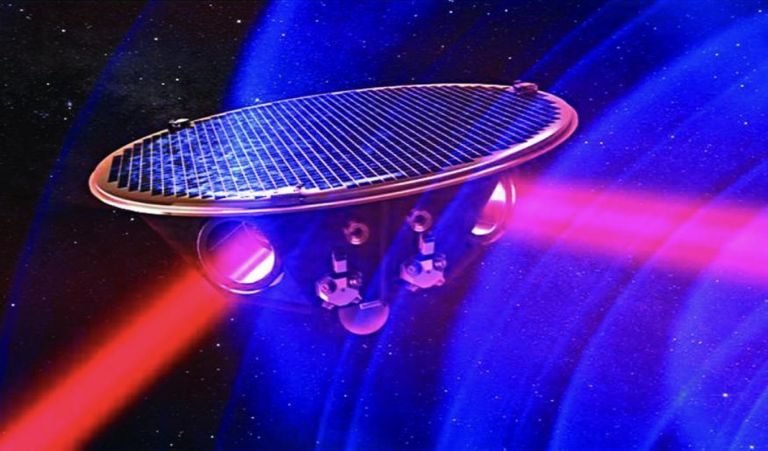
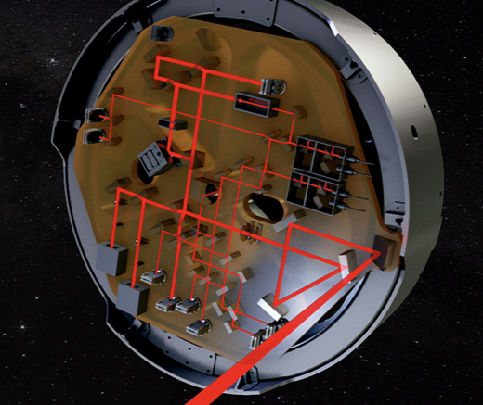
2000
2010
2020
2030
2040
9
13
VIRGO
ETpathfinder
Via SRON involvement in LISA (QPDs)
Science fiction project to become reality around 2035
LISA & ET are complementary
Astronomers in the lead
Nikhef: QPDs (InGaAs) co-development with industry
Smart Photonics
Bright Photonics
Link to astronomy

Slide 11
2000
2010
2020
2030
2040
10
13
VIRGO
ETpathfinder
Via SRON involvement in LISA (QPDs)
Science fiction project to become reality around 2035
LISA & ET are complementary
Astronomers in the lead
Nikhef: QPD (InGaAs) co-development with industry
Smart Photonics
Bright Photonics
Link to astronomy

Slide 12
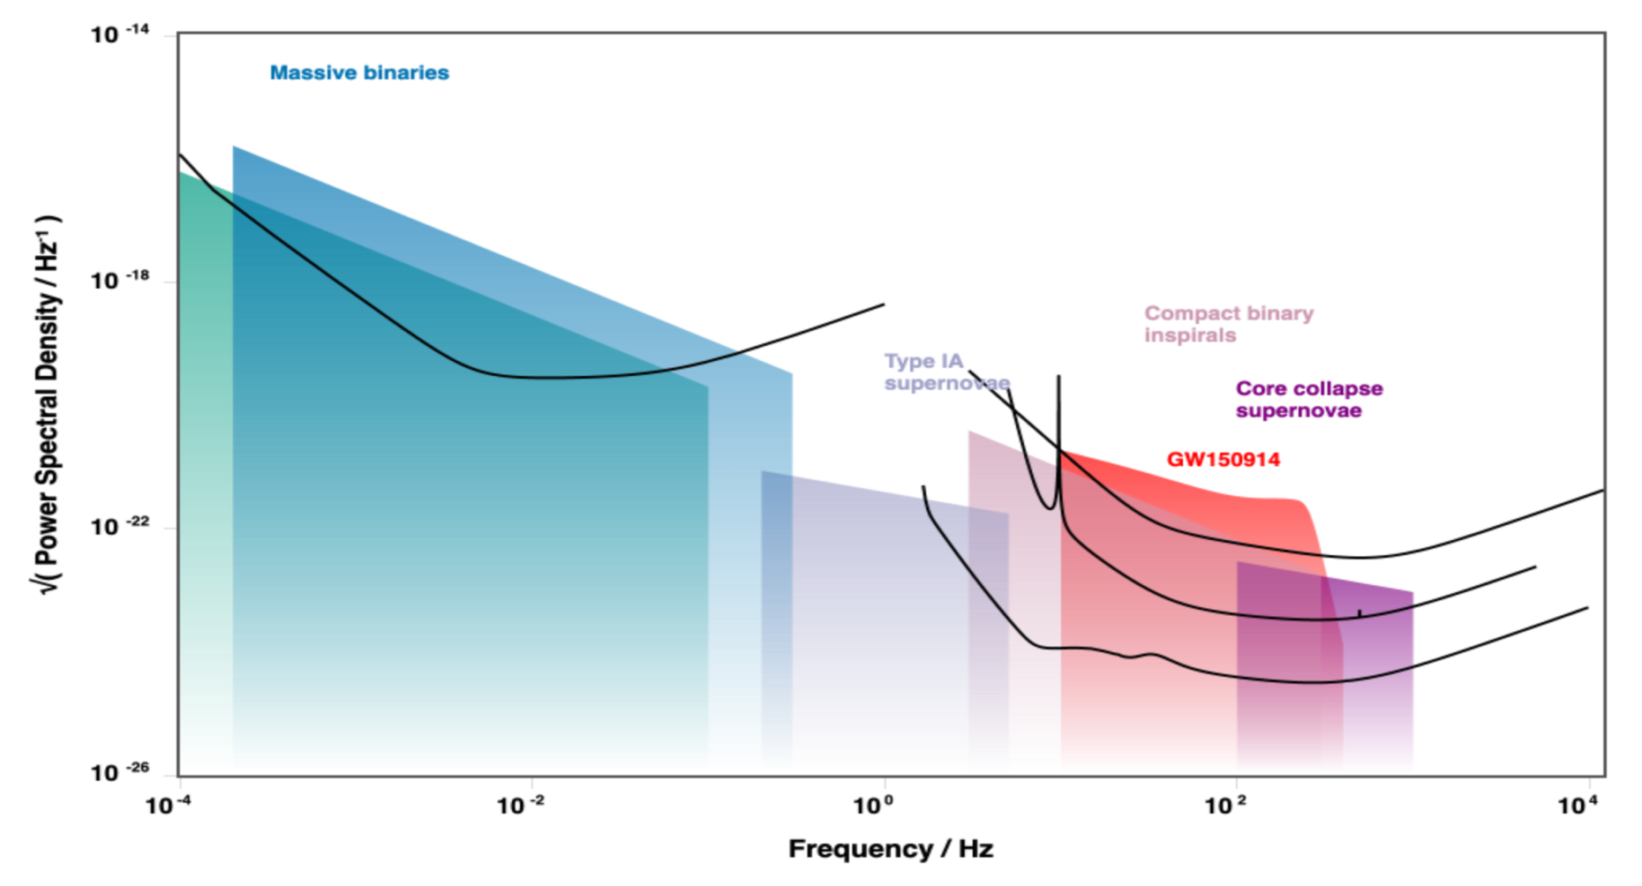
2000
2010
2020
2030
2040
11
13
VIRGO
ETpathfinder
new window on Universe
LISA
Virgo
LIGO
ET

Slide 13
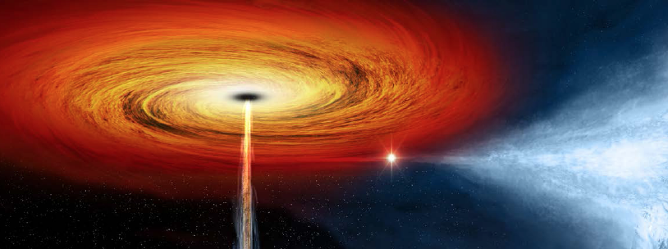
12
13
VIRGO
ETpathfinder
technology
development
industrial
participation
education & training
of the next generation
astrophysics
cosmology
particle physics

Slide 14
And as always: funding is an issue • • •
13
13
Bad news: some projects require Nikhef capital investment (ETpathfinder, ½ M€) & some will overspend
(I fear)
Good news: 1. some projects alleviate Nikhef budget: NWO-Groot & NWO-Physics via UvA matching
2. pursuing –apart from ERC & Vernieuwingsimpuls– many funding opportunities:
Interreg-EMR industry co-fund proposal submitted
NWA: DBHC in evaluation & new initiatives submitted/considered (26 October!)
ENW-Klein proposals considered (2)
OPZuid (Brabant/Limburg/Zeeland) industry collaboration proposal considered
NWO-Gravitation proposal being worked upon
NWO-Groot Virgo Phase-II proposal desirable (2022?)
Do we need a follow-up NWO-Physics program at some time?
Follow-up funding ETpathfinder & probably some for geology/civil engin. studies
Eventually an Einstein Telescope GWI Roadmap proposal
National ‘Groeifonds’ for Einstein Telescope?

