Slide 1
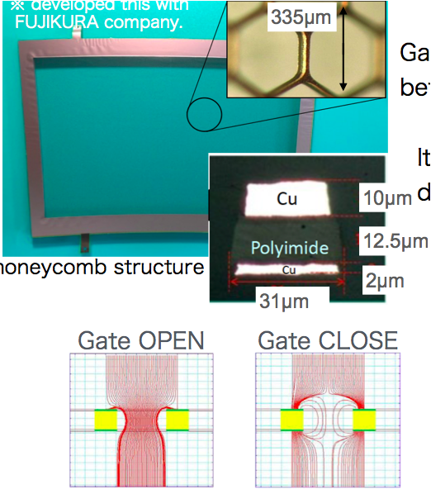
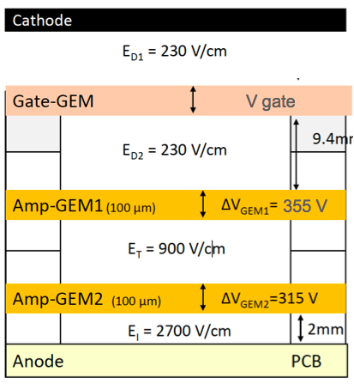
(Pixel) TPC gating
LCWS19 presentation ILD gating GEM
Yumi Aoki (KEK)
Plots do not have the right geometry and deform …

Slide 2
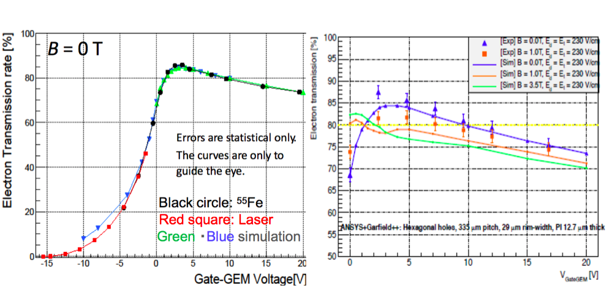
Transparancy Gate

Slide 4
Modeling the Gating device
Making E field calculations for the device with approximate dimensions
Make rectangular grid with 300 μm spacing and rim 30 μm. So optical transparancy 81%.
The two planes are put 50 μm apart (a bit further than the Japanese Gate).
There is a central voltage V_{c} applied that should correspond to the potential of the field without the gating device (here 250 V/cm). And a voltage difference dV that is controlled to switch the gate
The upper part of the gate is at 10 mm and the lower at 9.95 mm from the bottom plate (ground). The anode is 550 mm away.
Exact expressions for the E field of rectangular (plates) are used; by using mirror charges the ground is put at z = 0. By adding and subtracting charges a grid with holes is created.
Questions: how can we minimize distortions? How precise should we control voltages and dimensions (how flat should the gate be mounted)?

Slide 5
Trajectories in Gating device
Gate closed -30 V
Gate open 1+1.5 V

Slide 6
Trajectories in Gating device
Gate open 1+1.5 V
Gate open 0.1+1.5 V
Gate open 0.1+1.5 V
Max deviation
shift trajectory
Max deviation
shift trajectory
To open gate stay close to nominal field (and potential)
Deformations are smaller < 20 μm for dV = 0.1 V
Note that large maximum deviations will lead to ExB distortions

Slide 7
Deformed Trajectories in Gating device
Gate open 0.1+1.5 V
mismatch 10 V middle gate
Max deviation
shift trajectory
This means that the voltage of the Gate should be correct up to 5-10 V or the gate should be mounted with a precision of < 0.2-0.4 mm (250 V/cm). In that case the deviations remain less than < 20 μm

Slide 8
Conclusions Gating device
In order to keep deviations/deformations smaller than 10-20 μm:
The potential difference dV over the gate should be kept very close to the nominal field (times distance) plus/minus 0.1 V
This means that one should not tune the gate Voltage for the highest efficiency/transparancy, but use the above specification
The central voltage of the Gate V_{c} should be correct up to better than 5-10 V
The gate should be mounted with a precision of better than 0.2-0.4 mm in z
These specification can be achieved with the proposed gating device
controlling of the potential difference to 0.1 V is feasable
the tuning of the central voltage to better than 10 V is not difficult; the tuning of the Guard wires of the 8-Quad module was already a few Volts
It is usefull to mount a gate on the current module and measure deformations as a function of dV and V_{c}

