Slide 1
Pixel TPC Ion feedback
(Modified) Ramo Shockley theory
https://indico.cern.ch/event/843086/attachments/1958227/3253556/L3_signals_in_particle_detectors_riegler_2019.pdf

Slide 2
Modeling the Ion feed back
Cathode
Ion sheet
Electron sheet
Anode
Height (z) 4 cm
Witdh (x) 8
(y) 17 cm
Calculate the induced current on the cathode plate using the technique described by Riegler
Make electron and ion sheets at different z distances

Slide 3
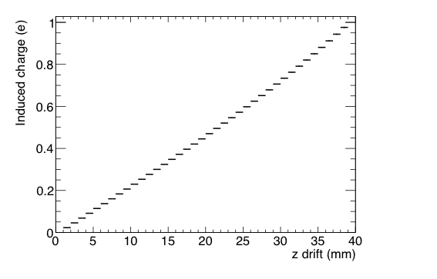
Induced Charge on cathode
From the potential

Slide 4
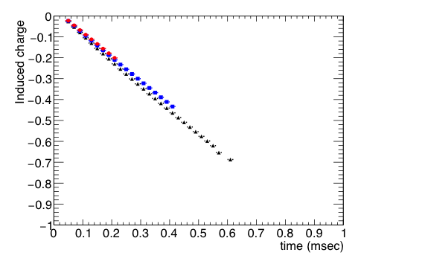
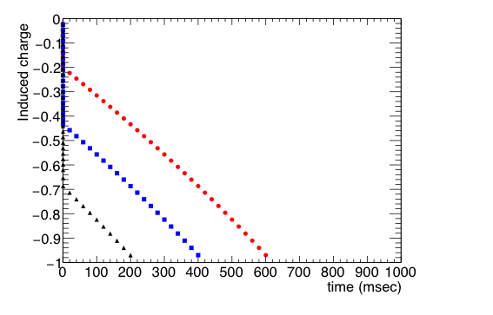
Induced Charge on cathode
Short times: electrons+ions
long times: ions
z 10 mm
20 mm
30 mm
z 10 mm
20 mm
30 mm

