Slide 1
Vista update post-it wall

Slide 3
About 50 post-its now
Anonimous

Slide 4
Questions
Comments on questionaire
Comments on Nikhef issues

Slide 5
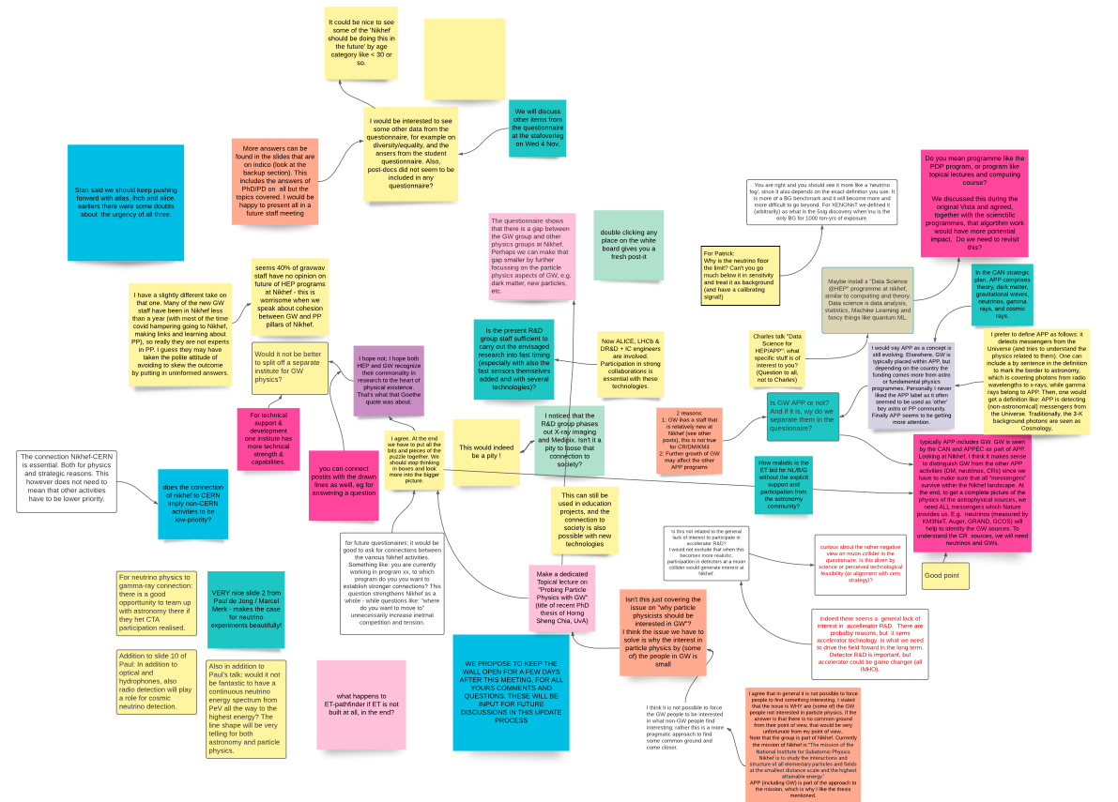
Questions
Wat is the procedure for Vista Update?
How domimant is the CERN agenda?
Why is R&D on X-ray imaging ending?
Why is the neutrino floor a limit? (Patrick)

Slide 6
Questionaire issues
How about age dependence?
How about issues like diversity and gender?
How about post-docs and PhD’s?
More questions on connections, please

Slide 7
Nikhef issues
GW and APP
Neutrino physics
Direction of R&D
Physics Data Processing, data science
Accellerator science
Nikhef at LHC

Slide 8
What the wall shows us
Strong interest in connecting
Severe worries about connections
New interests (Neutrino’s, R&D, Data Science)

Slide 9
So?
Wall stays open, also towards jamboree2020
Adding theme boxes
Regular analyses en updates

Slide 10
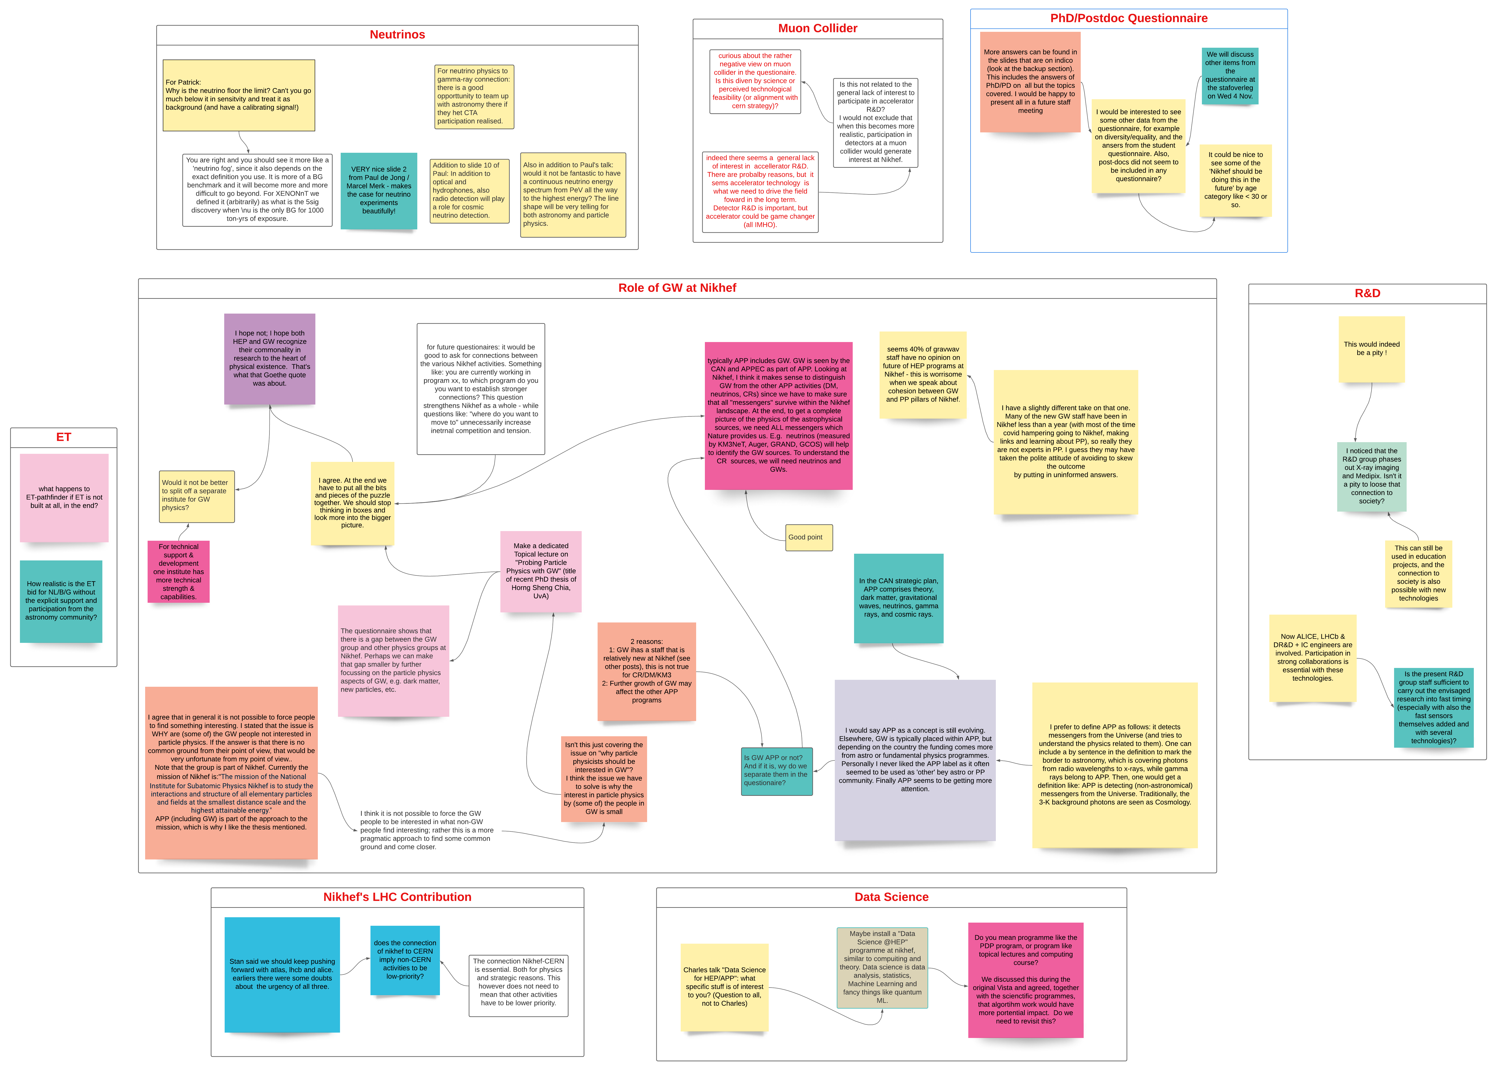
Added Theme boxes
GW en APP (ET or not ET)
New focal points (neutrino’s, data science)
Social issues (gender, career, environment)
Connecting ideas

Slide 11
https://lucid.app/lucidspark
martijn.van.calmthout@nikhef.nl
Mail me for an invitation

