Slide 1
Beyond scientific goals: PhD recruitment
Martine Oudenhoven
Stafoverleg 9 maart 2020

Slide 2
How it started…
Enough applications, but few from Nikhef-universities
Fixed timeslots to apply for a PhD 4x a year
Can you come up with a campaign or something?

Slide 3
The first month
Understand master students
Webpage with clear url (www.nikhef.nl/promoveren & www.nikhef.nl/phdpositions )
Flyers for coordinators, supervisors etc.
Social media campaign
Continue: publishing on vacancy sites, mailing lists and specific sites (HR and scientists)

Slide 4
The first year
Explore possibilities study associations & career fairs and platforms
Find the ‘why go for a PhD at Nikhef?’
Monitor
Then > Evaluate

Slide 5
Evaluation
Conversations with many people
Results PhD-questionnaire
Inspiration: look at universities
Web & social media statistics
Mini-questionnaire programme leaders
In-depth interviews with ‘fresh’ PhD students

Slide 6
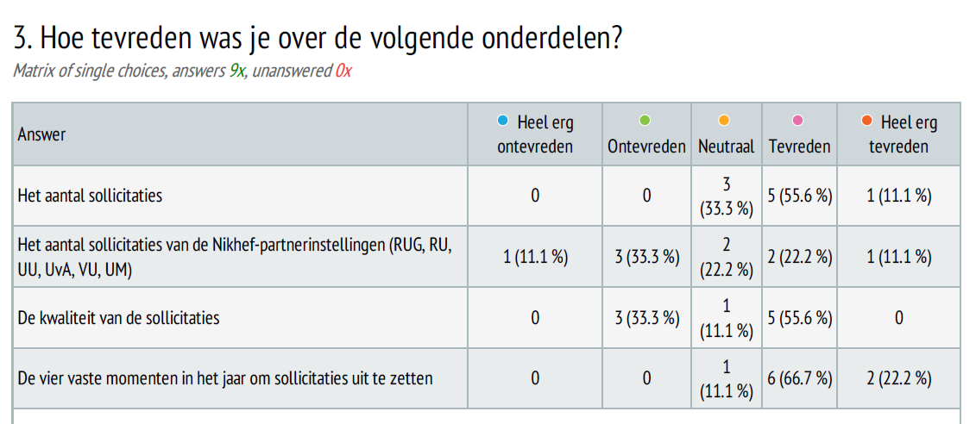
Mini-questionnaire programme leaders

Slide 7
Interviews with phd students

Slide 8
Start interest in particle physics
When | High school – bachelor programme physics
Contact/channel/ tool | Popular science media (documentaries, de Kijk) Study-orientation activity Orientation activity for bachelor or master project Education itself Teachers/professors Family and friends
To PhD | Content is interesting
Not to PhD | Can I do this, is this not too difficult for me? Is a technical university not better for me? Traumatized after bachelor

Slide 9
PhD in particle physics becomes an option
When | Bachelor programme – master programme in physics
Contact/channel/ tool | Summer studentship @CERN Research project in bachelor or master Talking to supervisor Talking to research group and PhD-students Education itself
To PhD | Content is interesting Good experience during research project (“This isn’t enough for me yet”) Nice people and atmosphere at Nikhef A lot of freedom
Not to PhD | Should I not take a break after my master’s? 4 years is a large commitment Personal reasons not to go abroad Uncertain academic career path Is the topic really a good match for me?

Slide 10
Searching for more information
When | Master programme (overlap with previous phase)
Contact/channel/ tool | Talking to PhD students Google Online forums Nikhef website Websites of other institutes and research groups General vacancy websites Other vacancies (also outside of academia) Nikhef-flyer about a PhD at Nikhef
To PhD | Content is interesting Good experience during research project (“This isn’t enough for me yet”) Nice people and atmosphere at Nikhef A lot of freedom Negative aspects are not that bad, it’s worth it
Not to PhD | Should I not take a break after my master’s? 4 years is a large commitment Personal reasons not to go abroad Uncertain academic career path Is the topic really a good match for me? A lot of negativity online about doing a PhD and the career prospects of someone with a PhD

Slide 11
Application phase
When | Master and afterwards
Contact/channel/ tool | Nikhef-website Ihep Hyperspace Network brought vacancy to attention Asked to do a PhD or apply
To PhD | Motivation to do this Good experience during application process
Not to PhD | No more barriers in this phase

Slide 12
General conclusions
4x a year, more transparancy, visibility and oppennes is appreciated. Shows a PhD at Nikhef as a real option.
Experiences during education & research projects play big role (comes with great responsibility)
Inclusive outreach is important
Some points to improve (findability in google, keep using mailing lists & specific websites)
Photo by Free To Use Sounds on Unsplash

Slide 13
To consider
A PhD at Nikhef: a part of the academic rat race or a stepping stone for a whole range of possibilities?
Is the PhD-programme we offer still interesting and relevant enough? (Students who chose not to proceed considered it to be ‘not the real world’ ‘too slow’ and ‘too individual’).
Photo by Brendan Church on Unsplash

