Slide 1
Stafoverleg
Gravitational Waves
9 March 2020

Slide 2
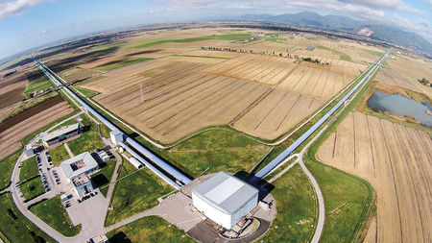
ESFRI roadmap
2021 update
ETpathfinder
progressing well
E-TEST
Interreg-EMR approved (15 M€)
Lots of ET activity!
2 board & 1 STAC meeting
Virgo reached 60 Mpc BNS sensitivity

