Slide 1
Cosmic Ray Highlights
Auger Installation
738 SSD’s installed

Slide 2
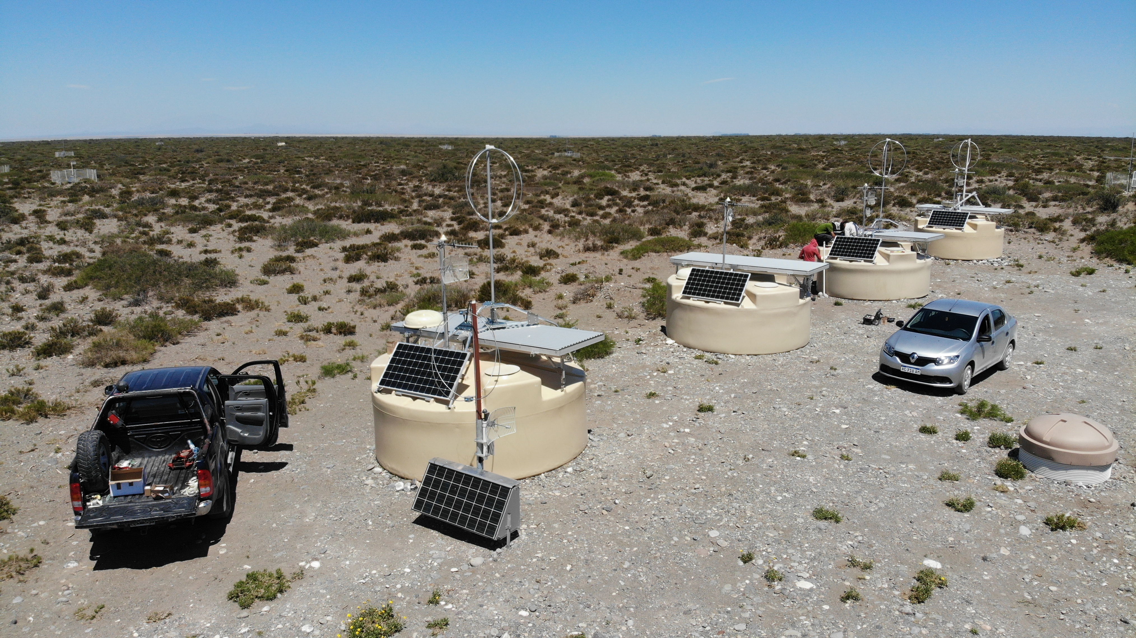
Cosmic Ray Highlights
Auger Radio
10 in the field
5 read out
Data analysis shows promising results
Electronics close to final
Production: Summer

Slide 3
Cosmic Ray Highlights
Update on large scale anisotropies
arXiv:2002.06172

Slide 4
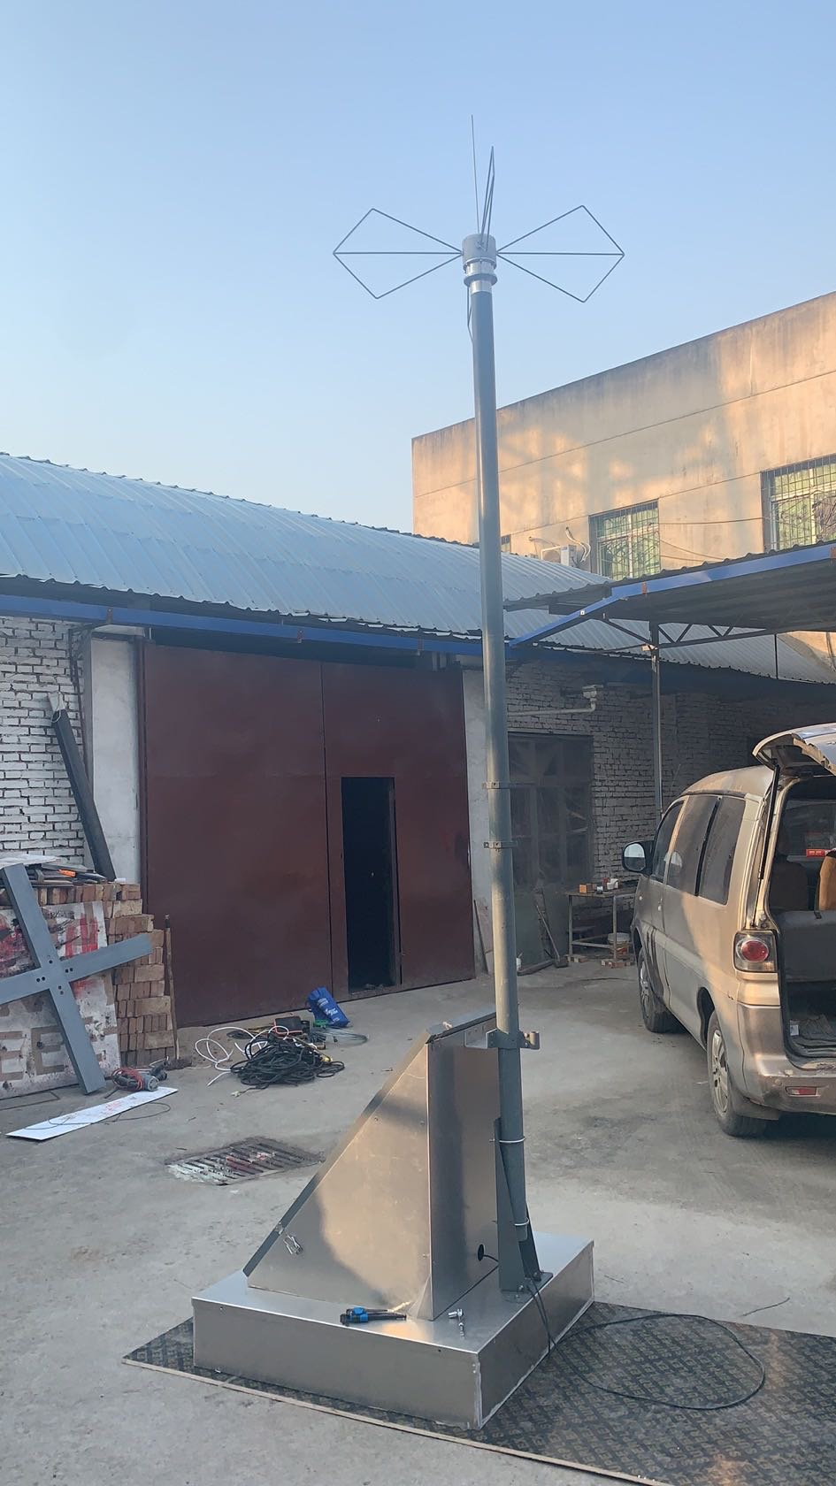
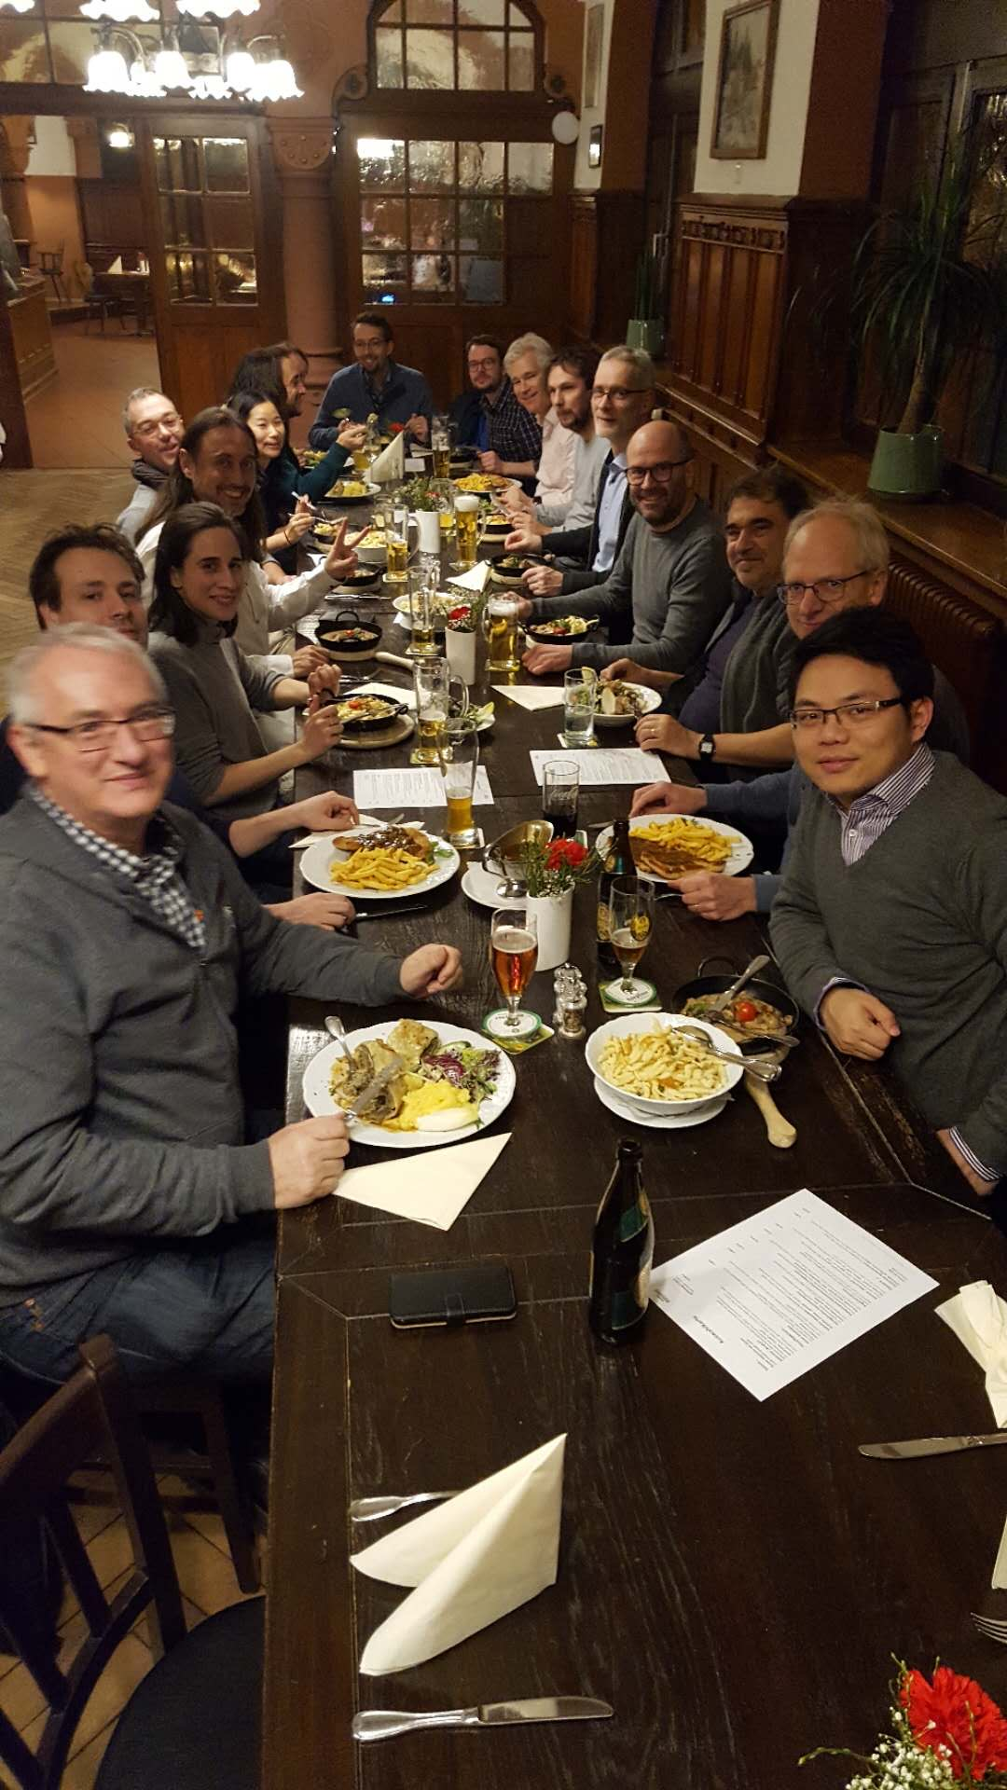
Cosmic Ray Highlights
GRAND: Prototypes produced
GRAND: Karlsruhe collaboration meeting affected by the Corona virus

Slide 5
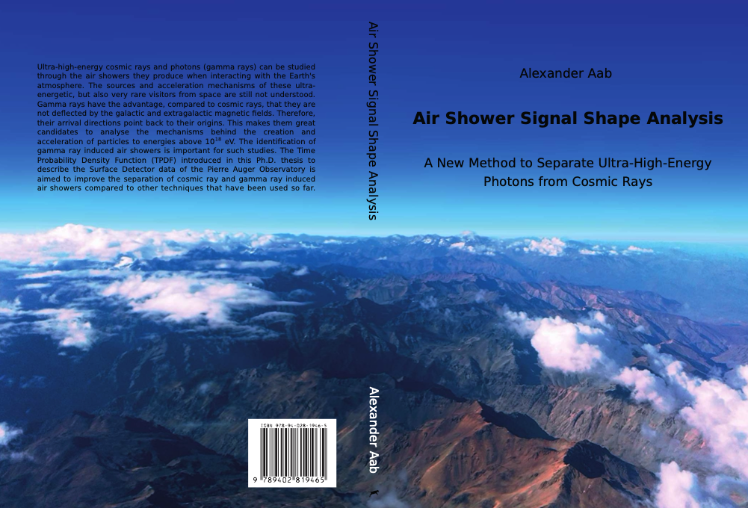
Cosmic Ray Highlights
PhD defense Alexander Aab
tomorrow 14:30

