Slide 1
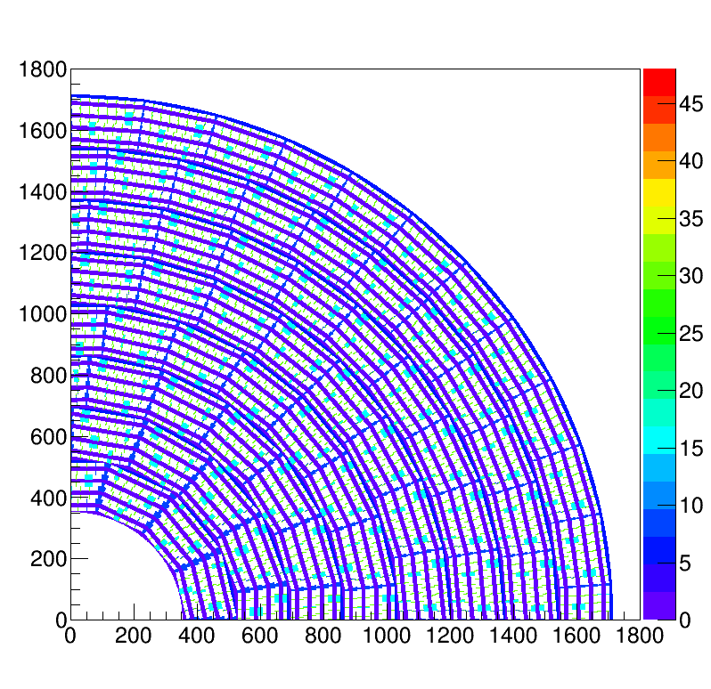
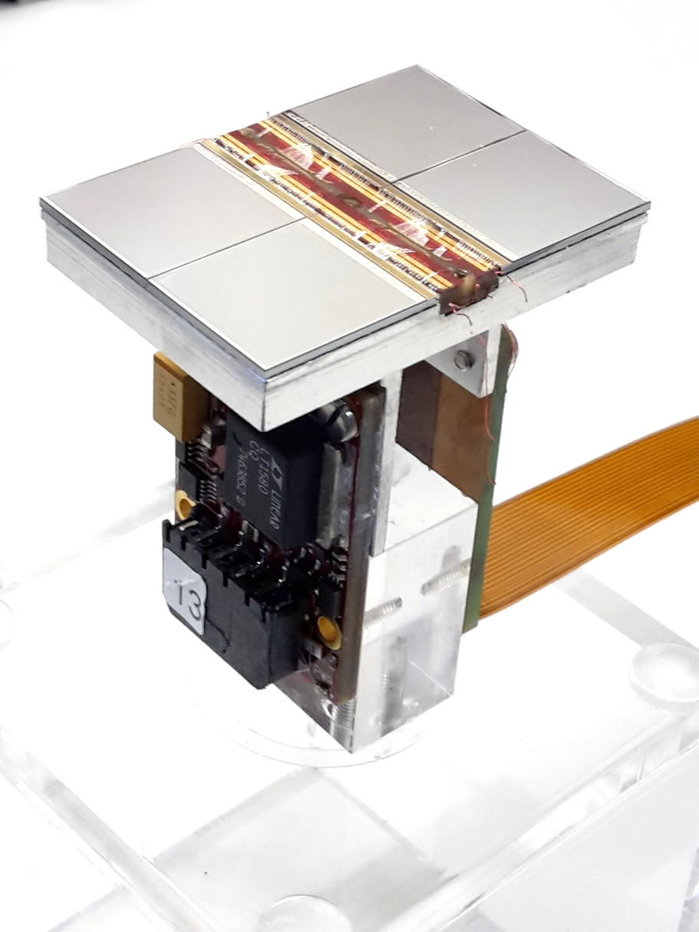
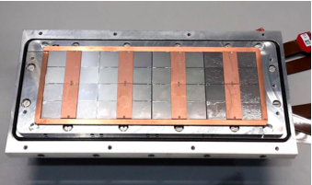
Pixel TPC
Single chip Quad Module TPC plane
2017 2018 2019

Slide 2
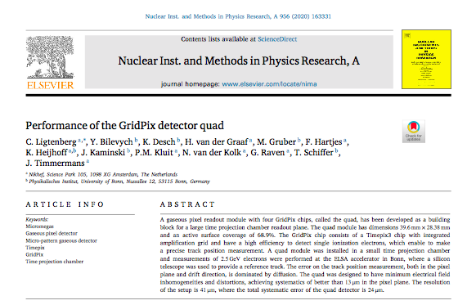
Highlights
Negative Ion Pixel TPC
Use slow drifting ions of CS₂⁻
Low diffusion at B=0 and T=20 C
Dark matter search e.g. Drift IIb
Quad paper published
https://doi.org/10.1016/j.nima.2019.163331
LCTPC collaboration meeting DESY:
“Pixel TPC is a baseline option for
the ILD experiment at ILC”
There is large interest by CEPC
Planned a test beam at DESY August
8-quad module in B field
operational multiplexer needed
looking far a master student
https://wiki.nikhef.nl/education/Master_Projects#Projects_with_September_2020_start
Brand new results laser tracks
Ar/iC₄H₁₀/CS₂ 95/4.5/0.5
Preliminary
Preliminary
D_{T} ≈ 130 μm/√cm D_{L} ≈ 170 μm/√cm

