Slide 1
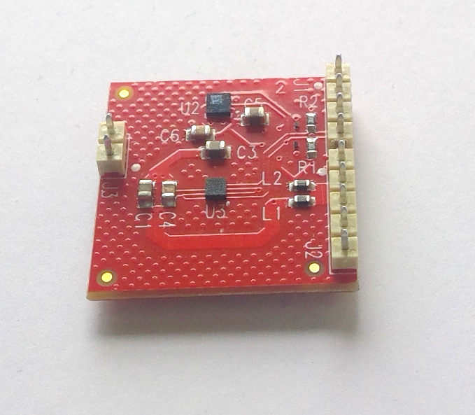
Compass studies Aart Heijboer
Pressure sensor
LSP25HB
Accelerometer & magnetometer
LSM303AGR
Issues: In DOMs and on CLBs
High residuals (up to 10 deg errors when measuring rotations of 90,180,270 degrees)
Results seem badly reproducible

Slide 2
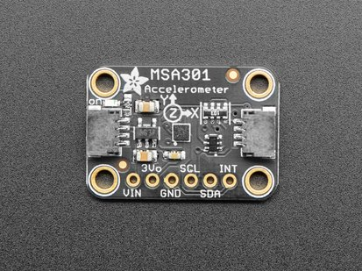
Compass studies Aart Heijboer
Issues in DOMs and on CLBs (Catania & Athens)
High residuals (up to 10 deg errors when measuring rotations of 90,180,270 degrees)
Results badly reproducible.
Much worse than previous version which had LSM303D device.
LSM303AGR very popular device (e.g. there are several Arduino libraries, adafruit breakout board)
Hard to believe it is intrinsically bad / cannot work in environment with other electronics.
=> Investigate bare boards detail.

Slide 3
Executive summary
turn on bit 1 of register 0x61 (offset correction)
and bit 7 of 0x60 (temperature compensation)
Implemented in CLB firmware & first tests on CLB+compass (Athens) seen to show good behaviour now.

Slide 4
Turntable with 3 compass boards
2 lsm303AGR (‘v3’)
1 lsm303D (‘v2’) (not read out)
Raspberry pi 4 for
Motor control, DAQ, analysis (ROOT)
Motor with gearbox &
Optical rotation sensor / angle
measurement : 1 tick = 0.42º of turntable rotation

Slide 5
offsets
Scale
M_So = 1.5+/-0.1 mGaus/LSB
‘hard iron’ offset |M_TyOff|<60 mGaus – must be measured externally
$$\hat{B}=S B+H_{b}+H_{h}$$
Device output
True B-field
“bridge” offset
can be measured by device
Temperature dependent.

Slide 6
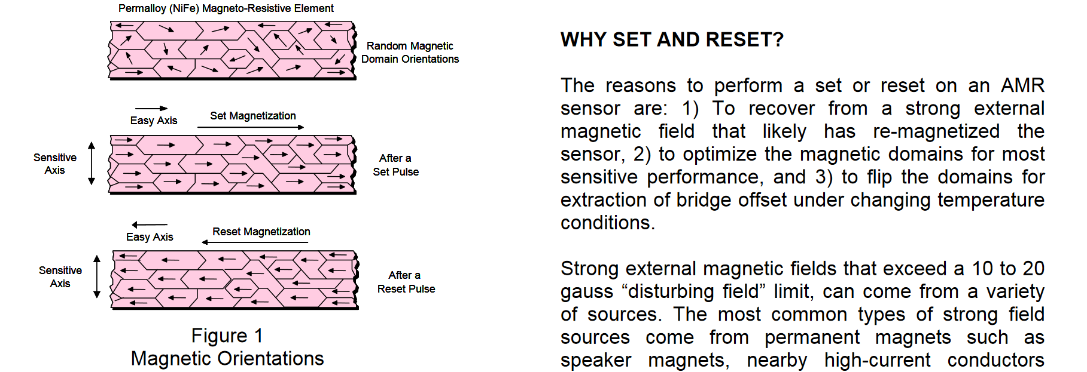
offsets
LSM303AGR has a mode where consecutive measurements return:
B + bridge-offset (after ‘set’ pulse)
B – bridge-offset (after ‘reset’ pulse)
Average = offset-corrected B-field
(still containing the ‘hard iron’ offset)
Difference = 2 x bridge-offset
Can correct for bridge offsets, but also measure and monitor their value
Device works with magnetized material who’s resistance
depends on B-field in some direction. The resistance is measured
by a Wheatstone Bridge.
Magnetization can be flipped.

Slide 7
Heat gun
a.k.a. my wife’s hair dryer.

Slide 8
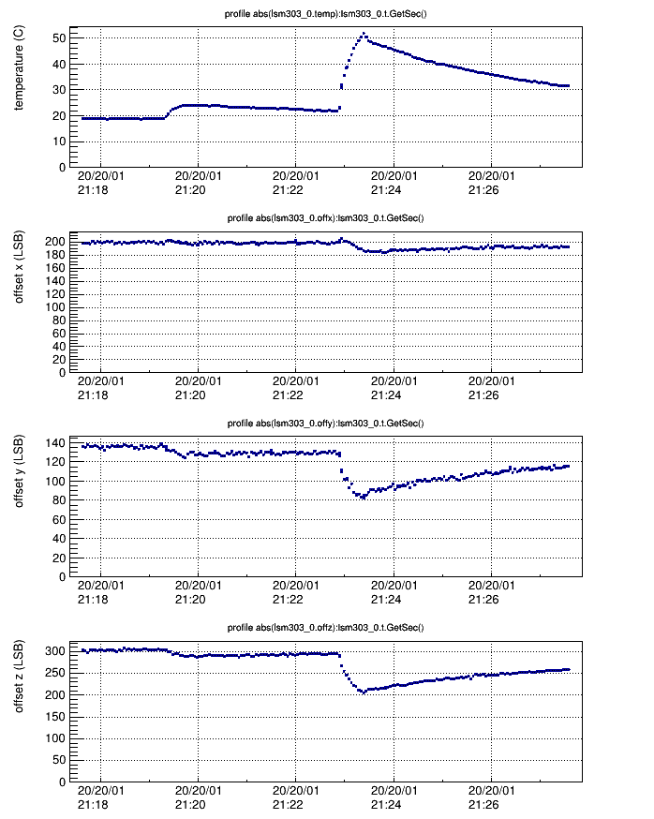
Bridge offsets: temperature
Bridge offsets very dependent on temperature
50 units (20 deg) for 30 ºC temp jup
Translates to error of 0.6 deg / ºC
nb: these offsets are currently simply included in the DOM measurements.
Sensor 0

Slide 9
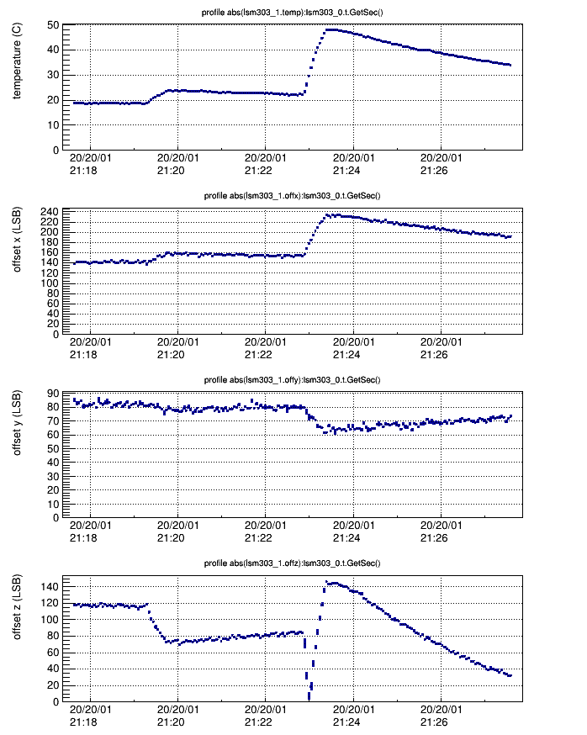
Bridge offsets: temperature
Bridge offsets very dependent on temperature
100 units (40 deg) for 30 ºC jump.
Translates to error of 1.2 deg / ºC
Offsets in z-direction even more sensitive
All we see in testing could be easily explained by T-dependence alone
difference bare CLB -> inside DOM
Bad reproducibility
Sensor 1
Actually plotting absolute value
Hence bounce here

Slide 10
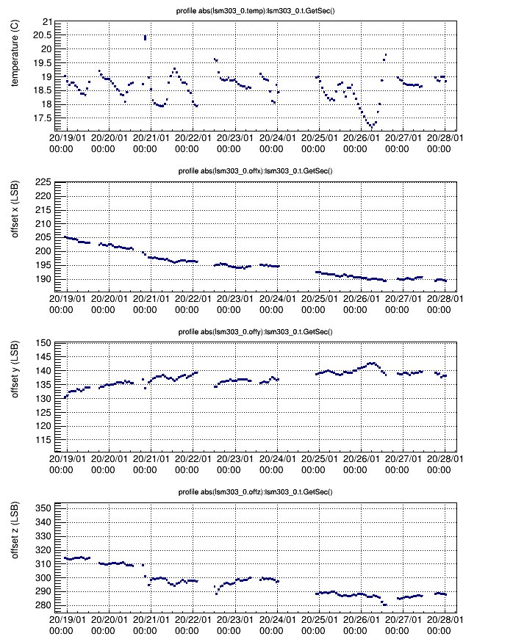
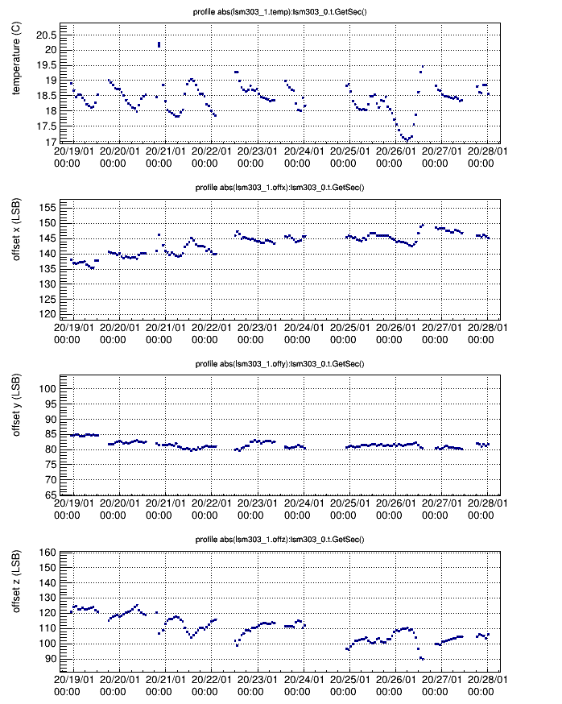
Bridge offsets : drift
Clear temperature correlation, also visible
Here,
But also drift :
Remember 0.4º/LSB
=> Up to 6 degrees in 2 weeks.
Can continue to take data

Slide 11
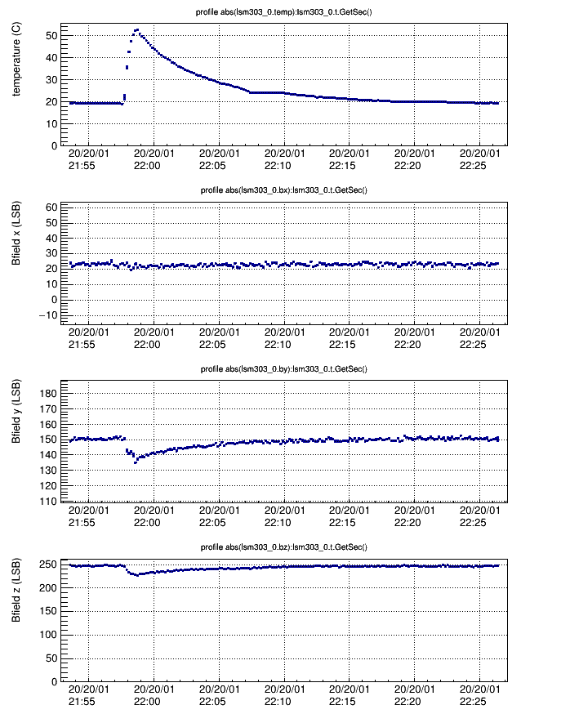
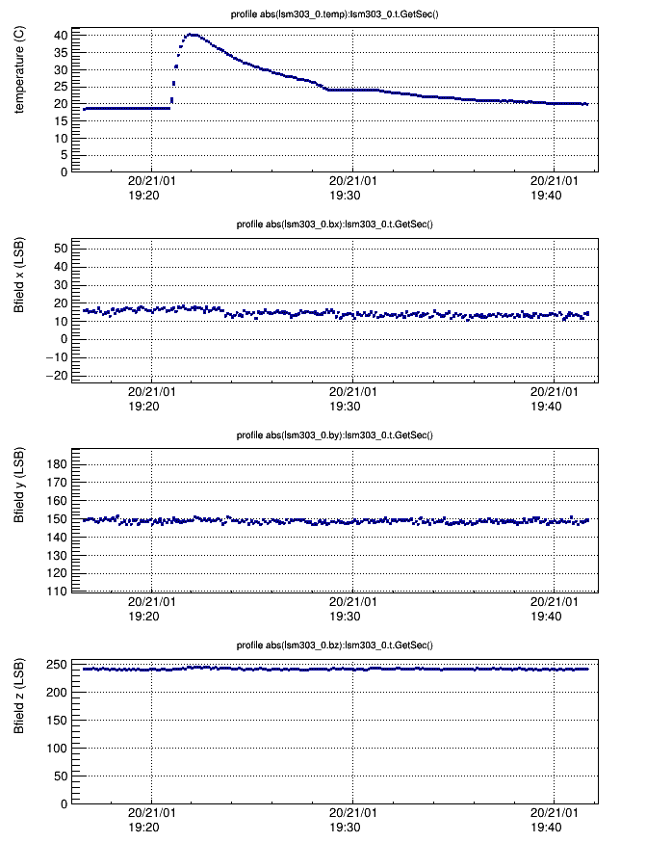
B-field (bridge-offset corrected): temperature
With temperature compensation
Without temperature compensation
Still some remaining effect
T-dependence of sensitivity M_So (in principle drops out of angle measurement, but still…. )
From datasheet

Slide 12
Calibration & Angle measurement
Offset-correction and
Temp-compensation on
Make turns, fit ellipse
(x,y offset, x,y scale )
Offset < 60 mGaus (in spec)
Compare with turn-table
angle measurement (from rotary sensor)
Residuals ~1 deg
very correlated between the two devices
-> table bias or soft-iron contribution.
y-scale
x-scale
x,y offset
compass angle
Compass – table angle
table angle
table angle
compass angle
Compass – table angle
table angle
table angle

Slide 13
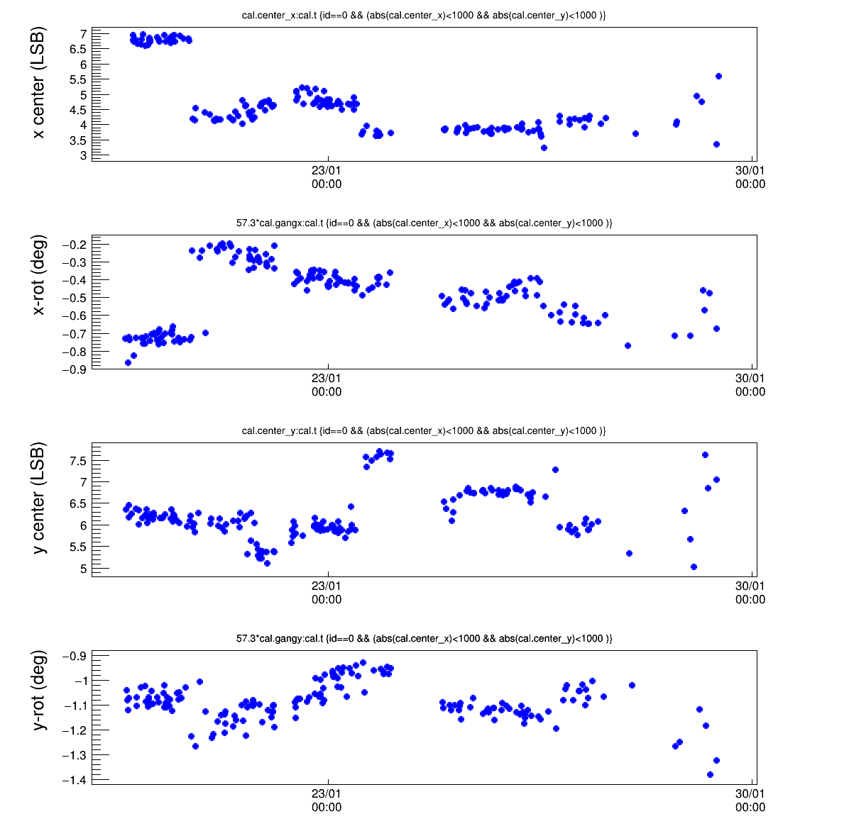
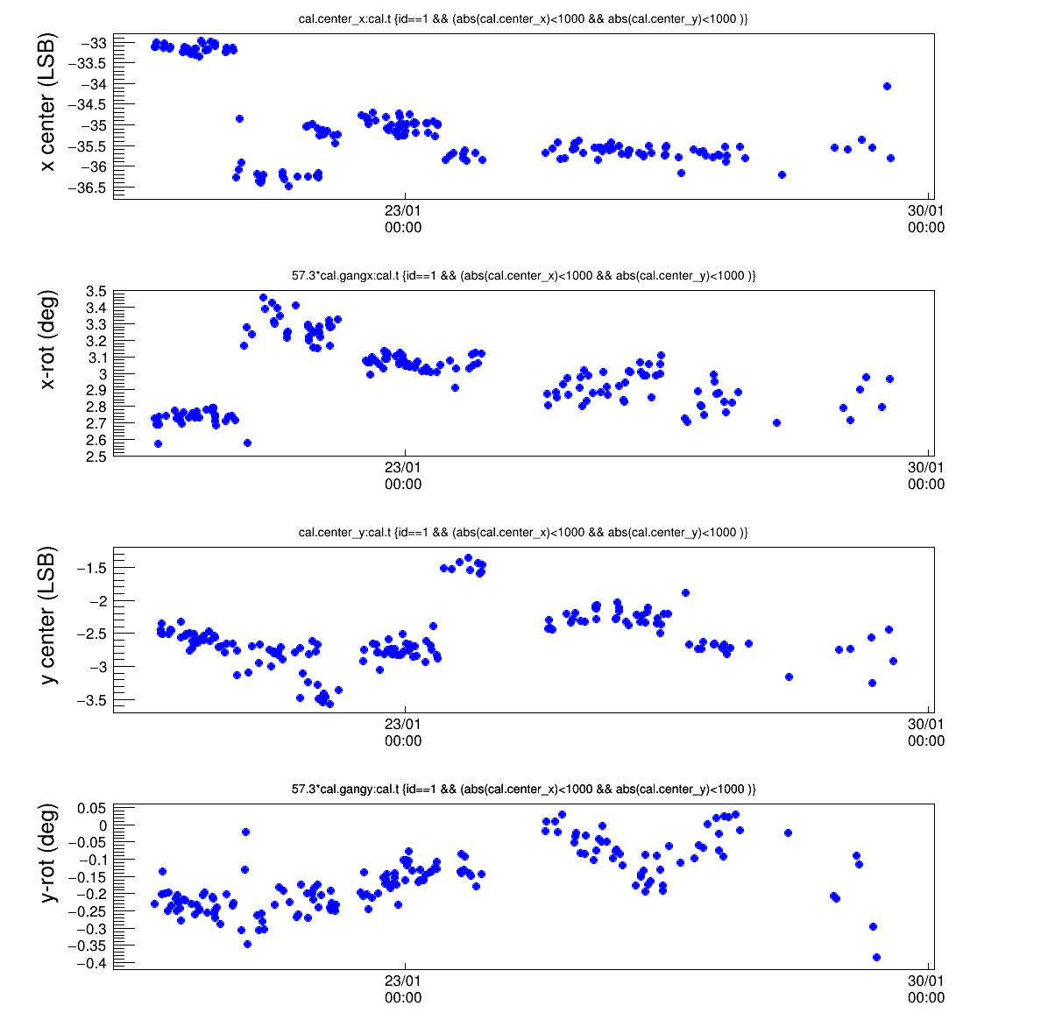
Stability of calibration
Device 0
Device 1
Calibration constants stable within ~4 LSB = about 1.5 deg.
Some variations due to small change in sensor orientation
Some variations still unexplained. E.g. jump in y-center - accelerometer shows no change - both sensors see it

Slide 14
Conclusions
LSM303AGR board tested in stand-alone setup
Device functioning according to specs
Sensor offsets more complicated than assumed
Temperature (and time)-dependent ‘bridge offset’ contribution must be corrected by device (via set/reset pulse)
Remaining hard-iron offsets and scales to be measured in calibration as usual.
Calibration offsets (hard-iron) after ‘bridge offset’ correction, stable to ~1.5 degrees.
(probably partly due to setup)

Slide 15
History
AHRS
Complex data-processing on-board
As much as possible disabled to be able to understand magnetometer data
LSM303D (v2)
Bridge-offset correction always applied ‘under the hood’ by device
datasheet : ‘set/reset pulse is automatically applied at each readout cycle’
‘hard iron’ offset correction applied by us ‘offline’
LSM303AGR (v3)
Did not realize existence of time/temperature dependent ‘bridge offsets’
Assumed ‘offset correction’ was not needed as we do it in calibration
Datasheet not very clear, although it offers hints.

Slide 16
Compass studies
LSM303AGR
Suspect it is an AMR device : Anisotropic Magneto-Resistance
Two types of offset
‘bridge offset’:
Internally measurable by device by flipping polarity of the magnetised material in the sensor.
Temperature-dependent and possibly drifting
remaining offset to be calibrated, aka ‘hard iron correction’ as usual
Bridge offset known to be temperature dependent

Slide 17
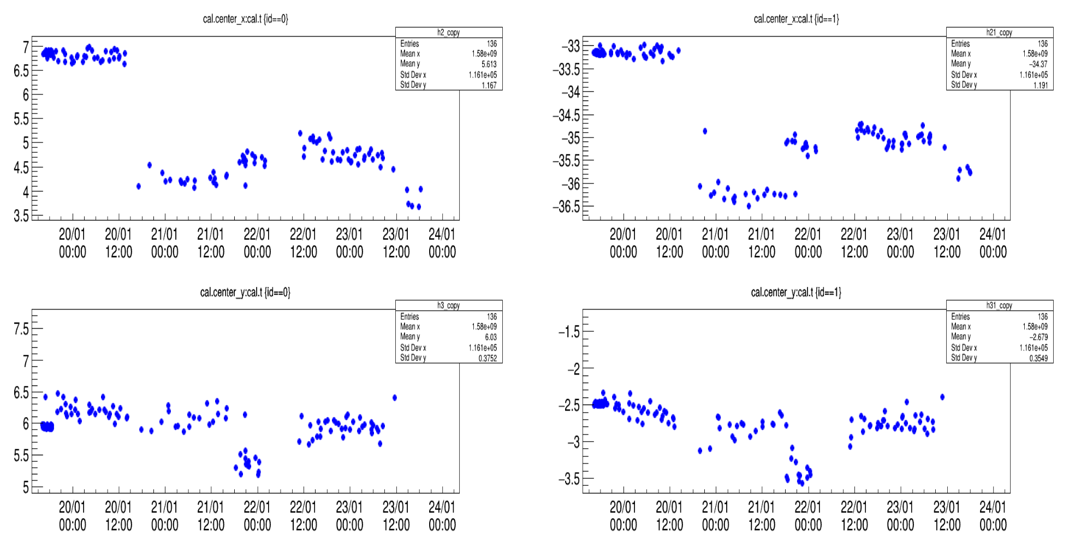
Stability of calibration
Device 0
Device 1
First temp.
cycle
Variations
-origin unknown
-correlated!
Maybe setup is tilted?
Check accell.

