Slide 1
New PMT model
New PMT model merged to master
Includes:
4 ns peak in ToT-distribution
New charge distribution:
Underamplified contribution
Threshold-band
Documentation written
Currently still different models in use
E.g.: Gaussian ToT-fit for HV tuning
Communicate with calibration group to converge towards consistent PMT-response modeling collaboration-wide
--> Evaluate possibility to tune HV to gain instead of ToT-peak

Slide 2
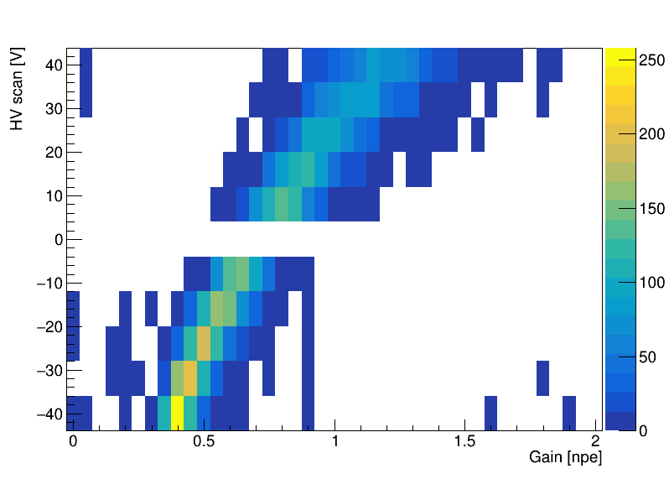
HV vs Gain

Slide 3
HV vs Gain
Low statistics?
HV-scan runs are short (~ 10 min)
Contain only L1-data

Slide 4
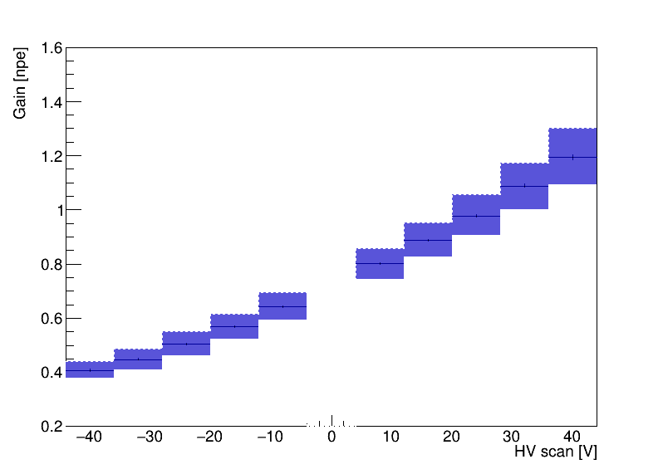
HV vs Gain

Slide 5
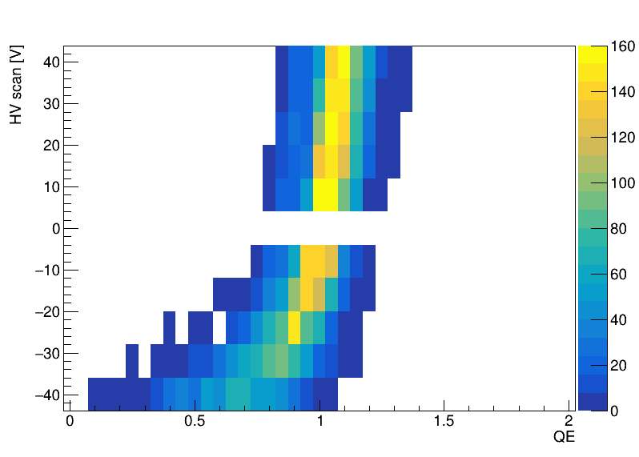
HV vs QE
Naively expect no dependence on HV
But collection efficiency decreases as HV goes down!

Slide 6
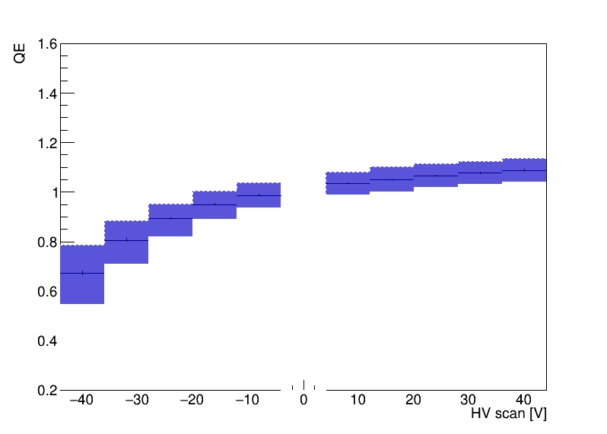
HV vs QE

Slide 7
TODO
Redo evaluations with higher statistics, e.g. darkroom data
Evaluate single PMT gain estimation consistency
Set up fit model for HV as function of gain

