Slide 1

Higgs Physics at
The Next Collider?
LHC
PS
SPS
FCC
photo: J. Wenninger
photo: J. Wenninger

Slide 2

OUTLINE
Higgs @ (HL-)LHC
Higgs @ e+e-
Self coupling
Other experiments
Some considerations
I will give an overview of the questions we can address at a future collider
I will not provide on a detailed comparison between the various options
The goal is not to be complete, but to give my view of what can be interesting

Slide 3
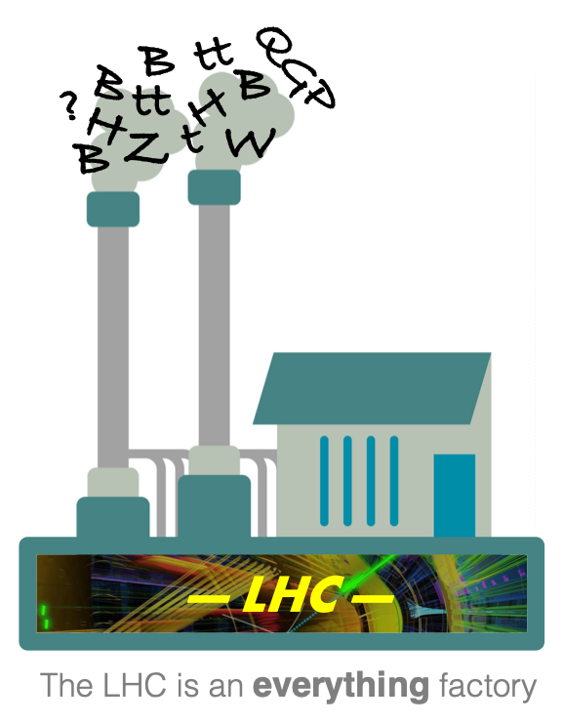
LHC
A.Hoecker, LHCP 2020
The LHC is awesome
  Discovery machine
    Higgs boson 2012
  Precision machine
    Huge statistics
Any new collider needs to be able
to beat the existing competition!

Slide 4
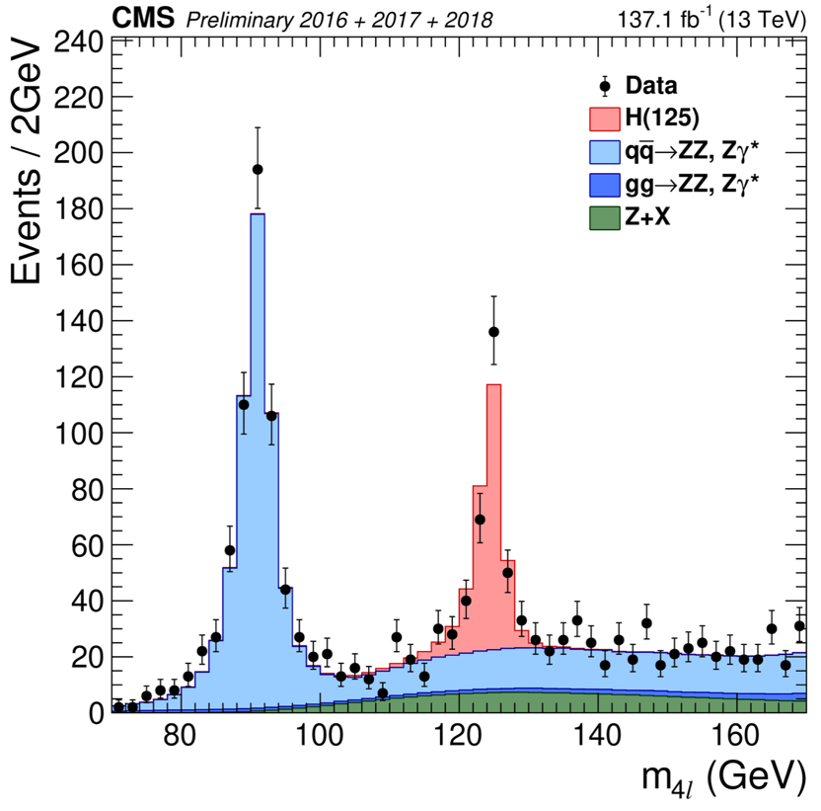
H→ZZ
Precision physics
  Cross-section unc. < 10%
  m_{H} = 125.35 ± 0.15 GeV
Maximal production (ggH)
Good resolution
Little background

Slide 5
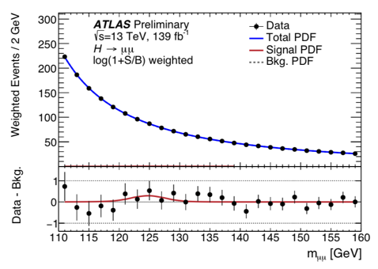
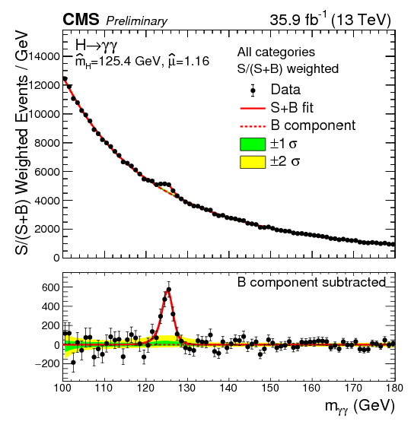
H→PEAKS
Current precision
  H→μμ : ~1 sigma
  H→ɣɣ: unc.<10%
Pros & cons
  Max. production
  Good resolution
  Backgrounds

Slide 6
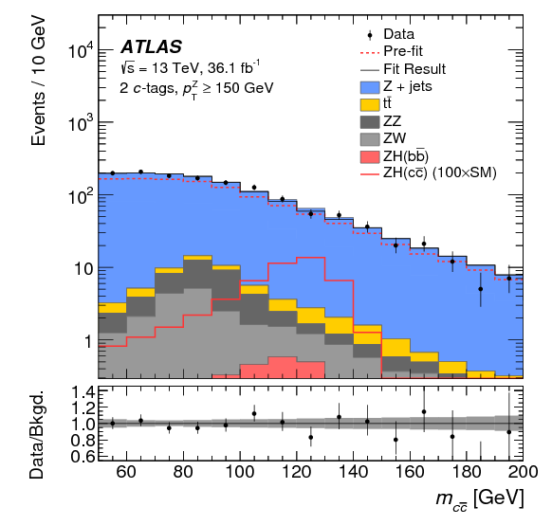
H→FERMIONS
Current sensitivities
  H→bb and ττ: 5σ
  H→cc: ~50xSM
Challenges
  Production
  channel
  b/c/τ tagging
  Backgrounds

Slide 7
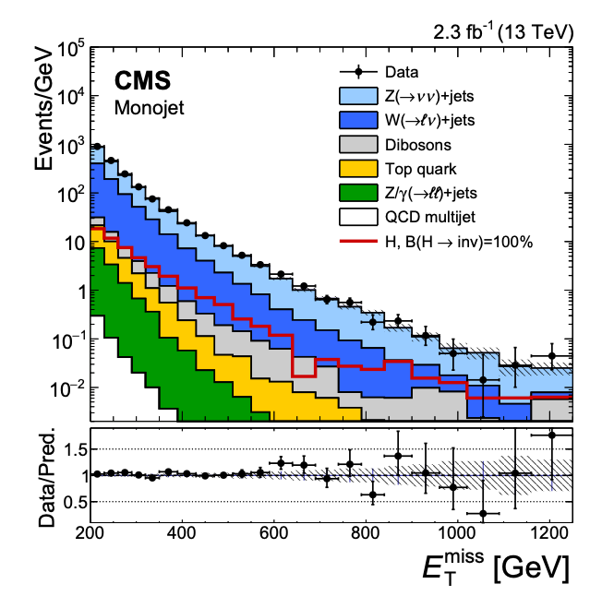
H→INVISIBLE
Current limit:
  BR_{H→inv} < 13%
Challenges
  Production channel
  Missing E_{T} resolution
  Backgrounds: Z(vv)

Slide 8
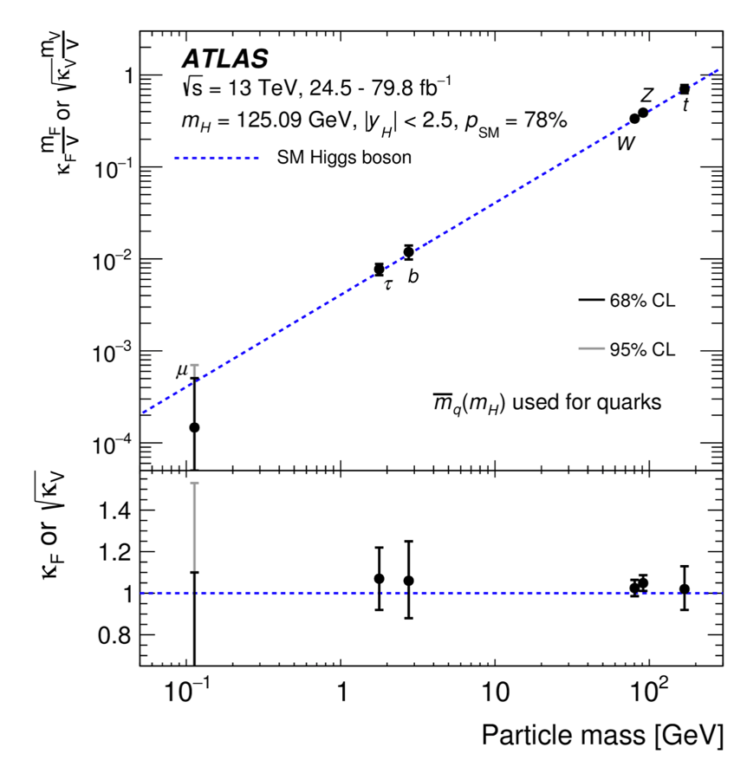
CURRENT PICTURE
Typically 5%-20%
➔ vector bosons
➔ 3rd gen. fermions

Slide 9

DO’S & DON’TS
“This measurement
agrees with the
Standard Model”
“What do we actually know
& understand?”

Slide 10
HIGGS COUPLINGS
Wikipedia user MissMJ

Slide 11
Gauge bosons
  WW, ZZ, γγ, gg

Slide 12
Gauge bosons
  WW, ZZ, γγ, gg
3rd generation fermions
  ttH, H→bb, H→ττ

Slide 13
Self
coupling?
1st & 2nd generation?
3rd gen. fermions
  ttH, H→bb, H→ττ
Leptons vs
u&d quarks?
Vector bosons: WW, ZZ, γγ, gg
Dark Matter & neutrinos?
WHY 3 ?!?
Questions?

Slide 14

HIGGS FACTORY
What we know now
  BEH mechanism
  3rd Gen
What we don’t know
  1st & 2nd Gen
  Invisible particles
    Neutrinos and Dark Matter
  Self coupling
    Higgs potential & Baryogenesis
  Anti-matter, CP, flavor, dark energy, inflation, …
http://newsline.linearcollider.org/2012/09/27/an-ilc-higgs-factory-is-it-enough/higgsfactory/
The Higgs boson plays such a central role in the Standard Model
➔ a Higgs factory might give us the answer to the biggest questions

Slide 15
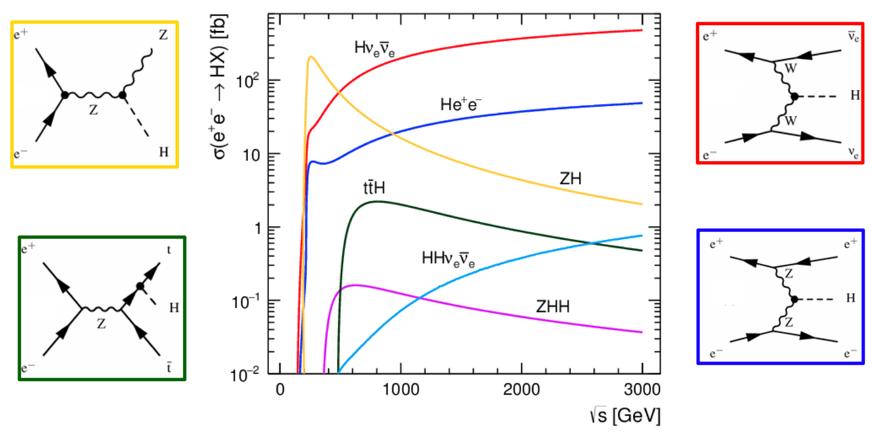
H @ e+e-
“Higgs strahlung”
“Vector boson fusion”
250 GeV

Slide 16
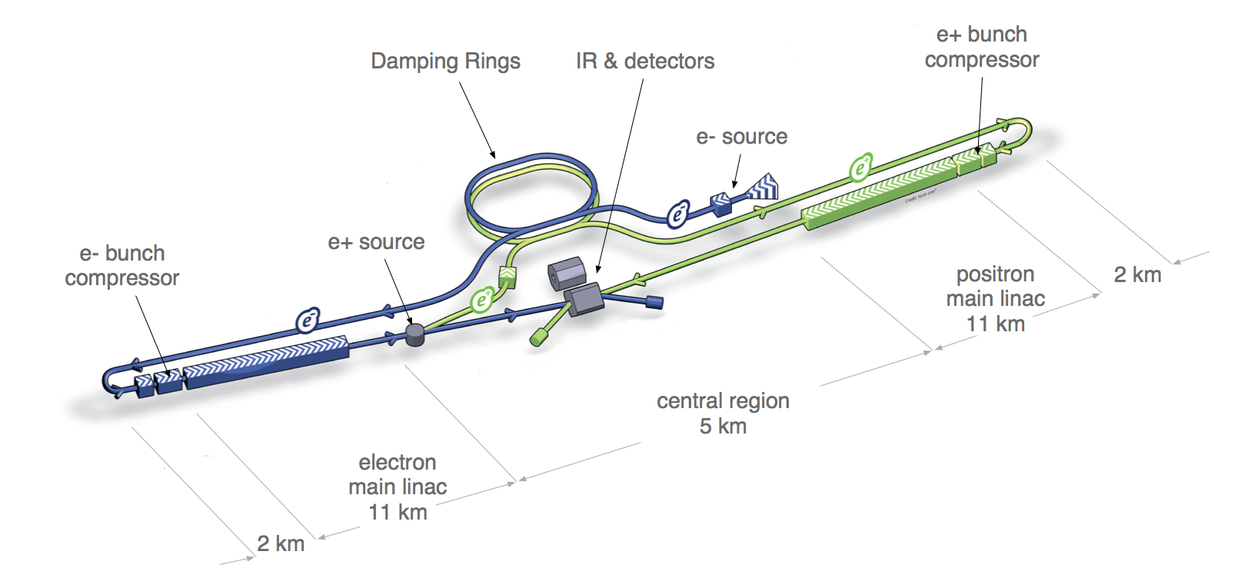
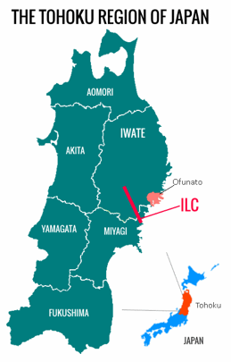
LINEAR
Japan: ILC
  Linear, 20km
  ZH: 250 GeV
CERN: CLIC
  Higher energies
Advantage:
Can be extended for higher energies

Slide 17
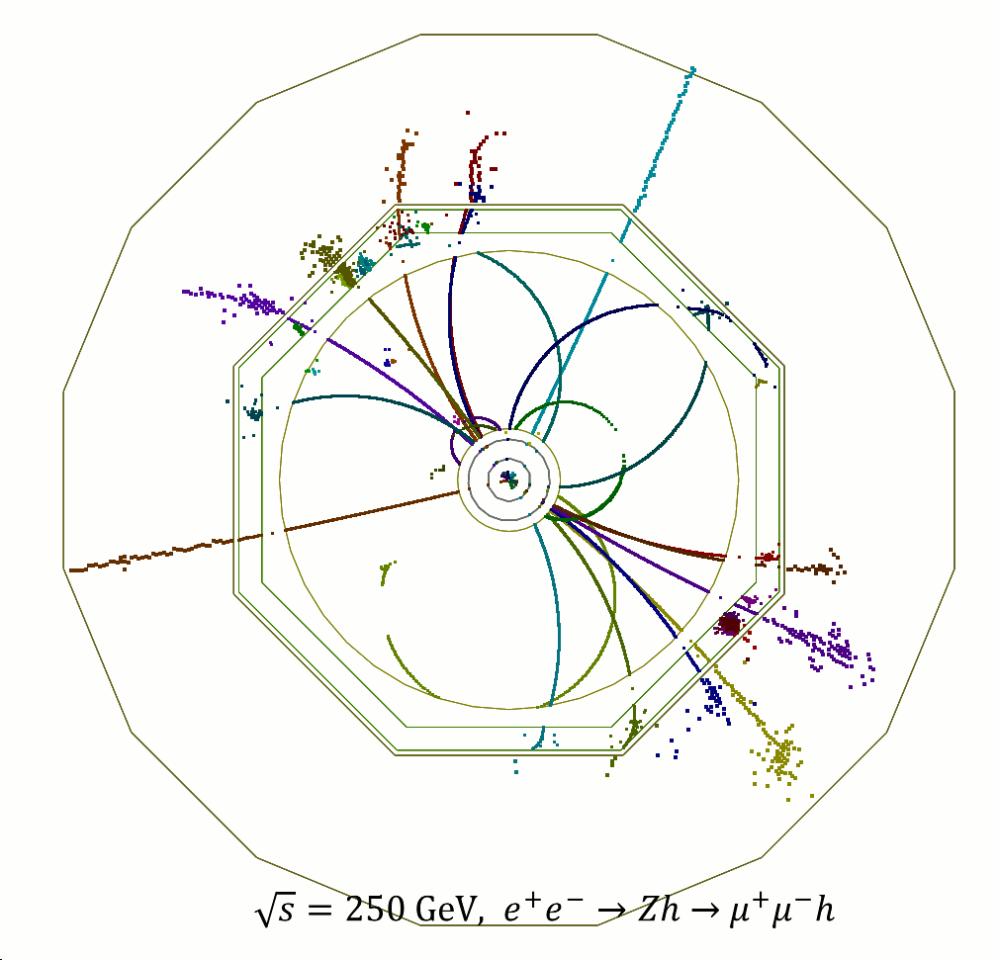
E+E-
Super clean events!

Slide 18
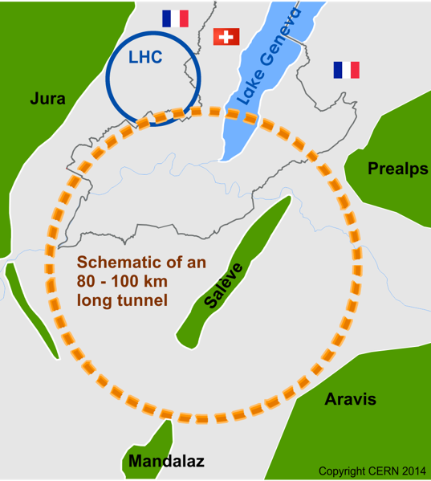
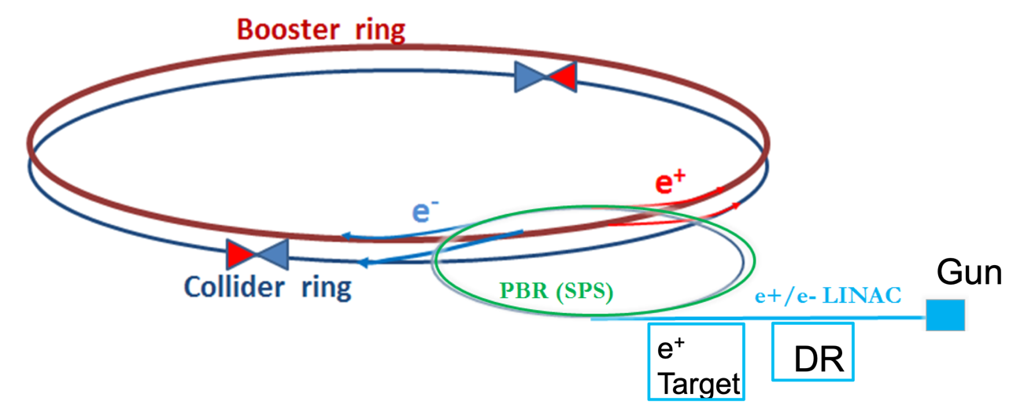
CIRCULAR
1500 H/day
CERN: FCC-ee
  Circle = 100 km
  Injection: SPS
  Z, WW, H, tt
China: CepC
  Similar concept
30 km
Advantage:
  Can use it for 100 TeV hadron collider (like LHC after LEP)

Slide 19
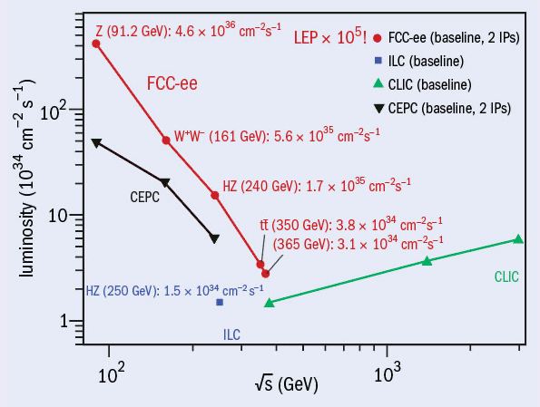
LUMINOSITIES
FCC-ee
CepC
ILC
CLIC
ZH is here

Slide 20
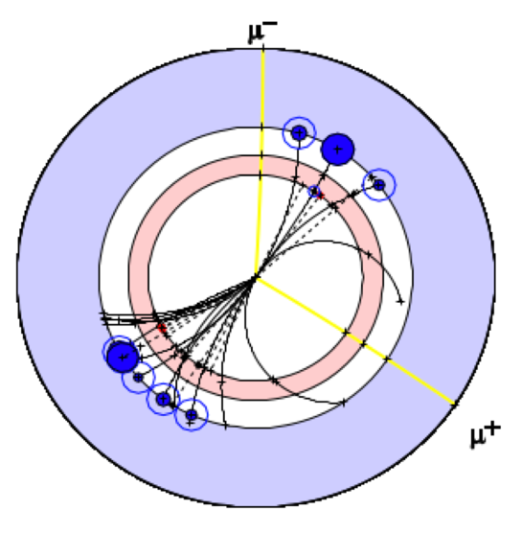
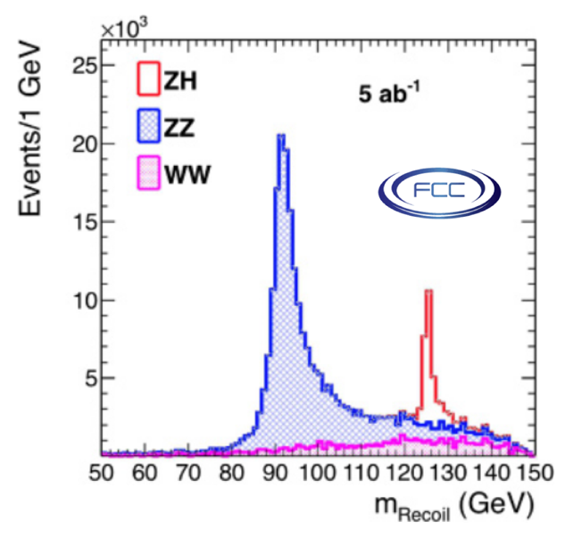

E+E- METHODOLOGY
“Recoil”
  Use collision energy and leptons from Z
  Reconstruct Higgs without seeing it
Estimate couplings model-independently
  Measure cross-section and total width
  Handle on H→gg, H→new, H→invisible
  Also benefits LHC/FCC-hh interpretations

Slide 21
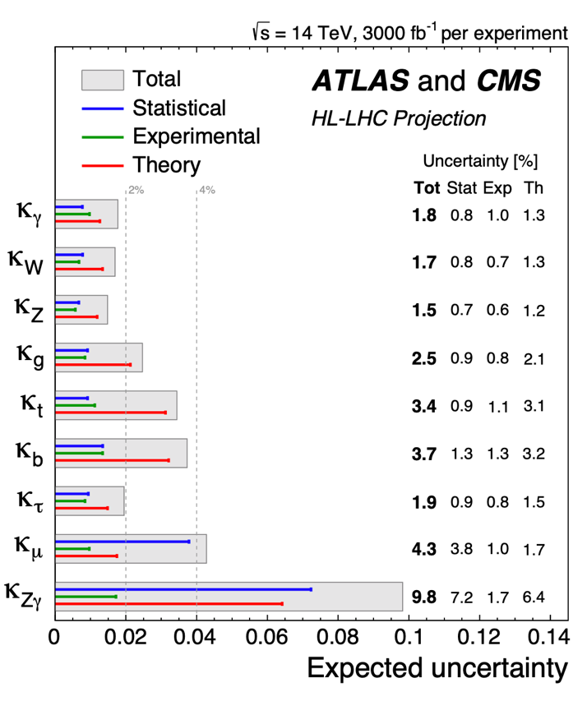
HL-LHC SENSITIVITIES
HL-LHC: precision few %
Tough competition to beat…

Slide 22
ILC PROSPECTS
ICFA Meeting
November 2017
No gain:
  ttH and H→μμ
Some gain:
  H→ZZ, H→WW, H→ɣɣ
A lotta gain:
  Fermions
    Order of magnitude: ττ & bb
    Even more in H→cc
arXiv/1710.07621
Some gain
Most gain!
No gain
Questions?

Slide 23
WHY H→CC ?

Slide 24
Asked what single mystery, if he could choose, he would like to see solved in his lifetime, Weinberg doesn’t have to think for long: he wants to be able to explain the observed pattern of quark and lepton masses. In the summer of 1972, when the SM was coming together, he set himself the task of figuring it out but couldn’t come up with anything.

Slide 25
Asked what single mystery, if he could choose, he would like to see solved in his lifetime, Weinberg doesn’t have to think for long: he wants to be able to explain the observed pattern of quark and lepton masses. In the summer of 1972, when the SM was coming together, he set himself the task of figuring it out but couldn’t come up with anything.
“It was the worst summer of my life! I mean, obviously there are broader questions such as: why is there something rather than nothing? But if you ask for a very specific question, that’s the one. And I’m no closer now to answering it than I was in the summer of 1972,” he says, still audibly irritated.
- CERN Courier, Oct.2017

Slide 26
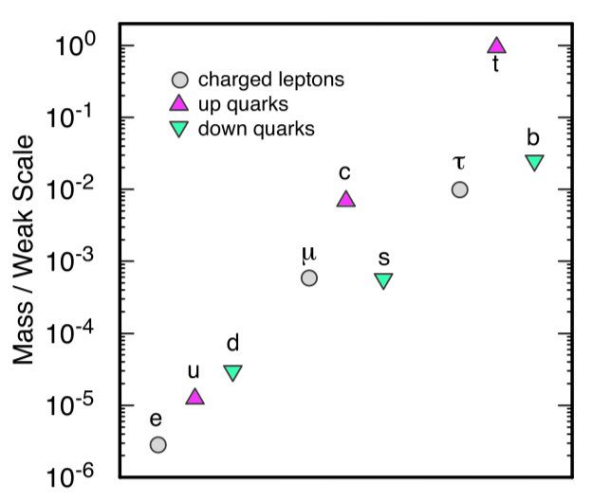

Slide 27
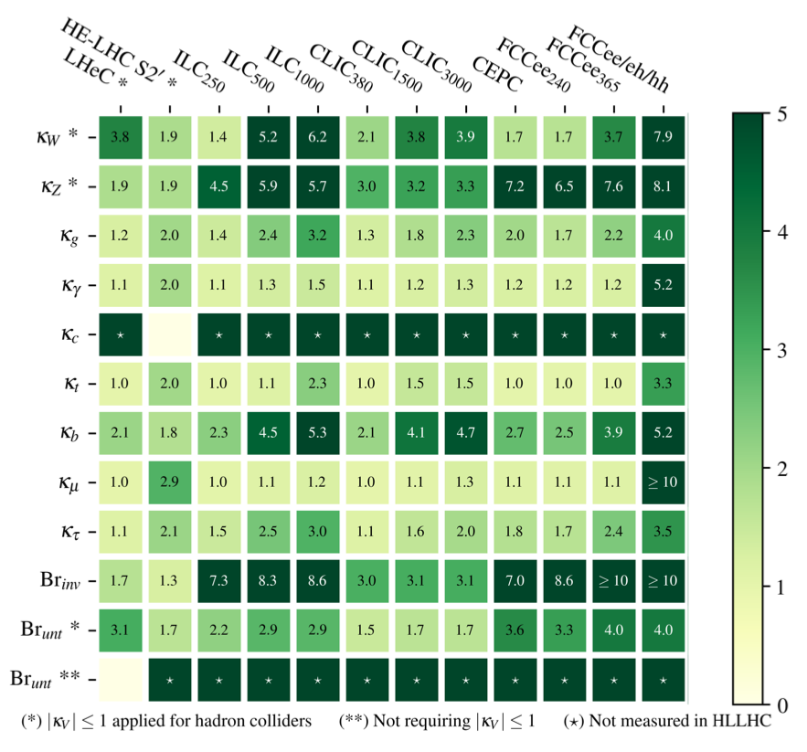
FCC PROSPECTS
ILC
FCC-ee
Improvements
w.r.t. HL-LHC
  https://arxiv.org/abs/1905.03764
  W.Verkerke et al
Particularly powerful
at all e+e- colliders
  H→cc
  H→inv

Slide 28
DARK
HIGGS

Slide 29
DARK
HIGGS
Higgs & DM interact?
Higgs decays to DM?
1) ‘Dark Matter has mass’
2) ‘Higgs gives mass’

Slide 30
DARK
HIGGS
Colliders are most sensitive for low-mass DM

Slide 31
DARK
HIGGS
Limits on BR(H→invisible)
NOW
HL-LHC
ILC
FCC
log
1
10⁻¹
10⁻²
10⁻³
10⁻⁴
Questions?

Slide 32
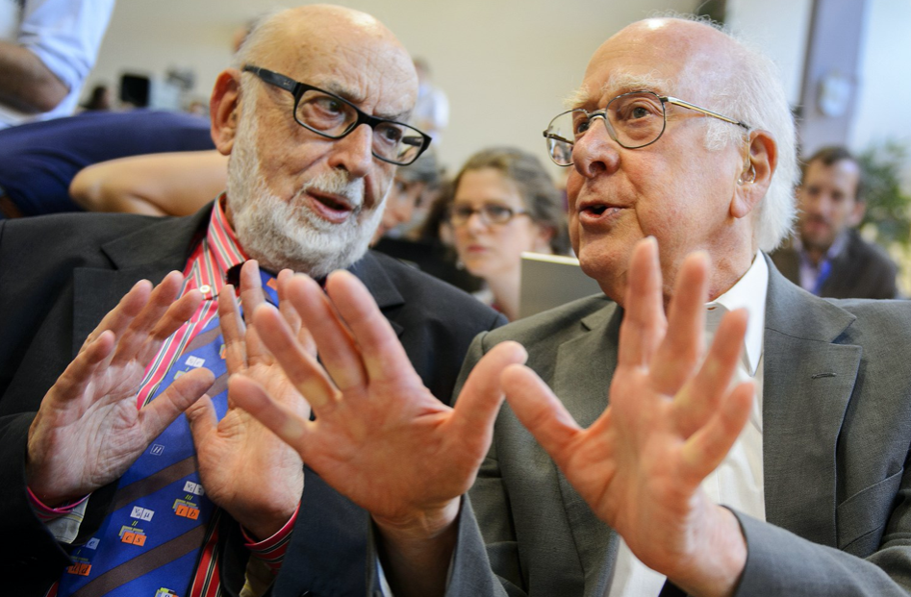
HH
Self coupling
Higgs potential
Baryogenesis
OK, but what about di-Higgs?

Slide 33
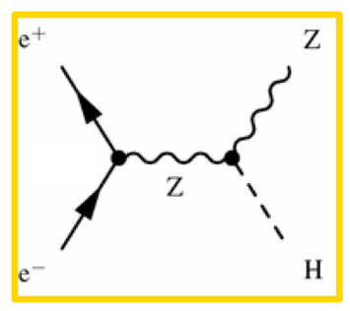
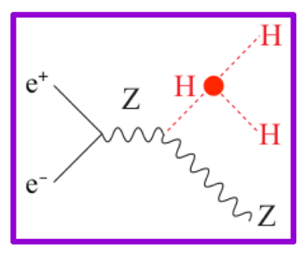
HH @ e+e-
“Double-Higgs strahlung”
450 GeV

Slide 34
HH PRODUCTION
ZHH peaks at 450 GeV
This is the worst place for the main proposed e+e- accelerators ☹
450 GeV

Slide 35
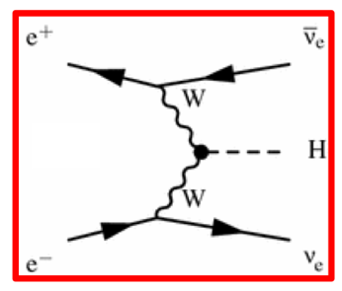
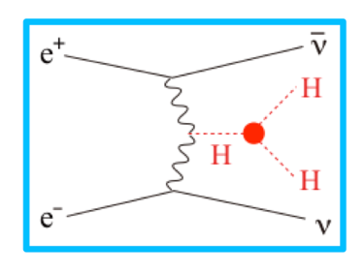
HH @ e+e-
HH @ e+e-

Slide 36
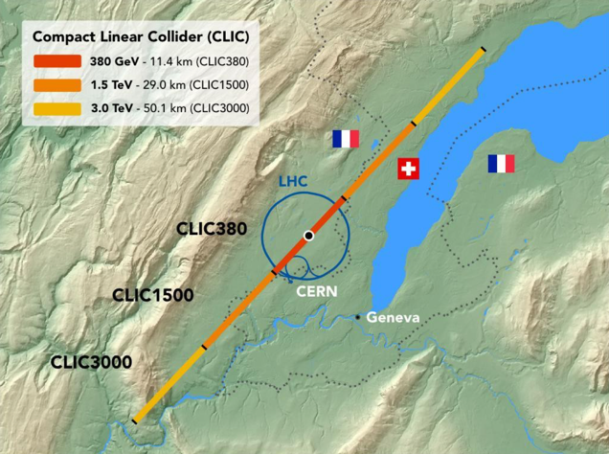

CLIC
“compact”
CERN linear accelerator
  Advanced technology
  Collision energy → 3 TeV
  Study self coupling
Nikhef colloquium – A.Robson: https://indico.nikhef.nl/event/1812/

Slide 37
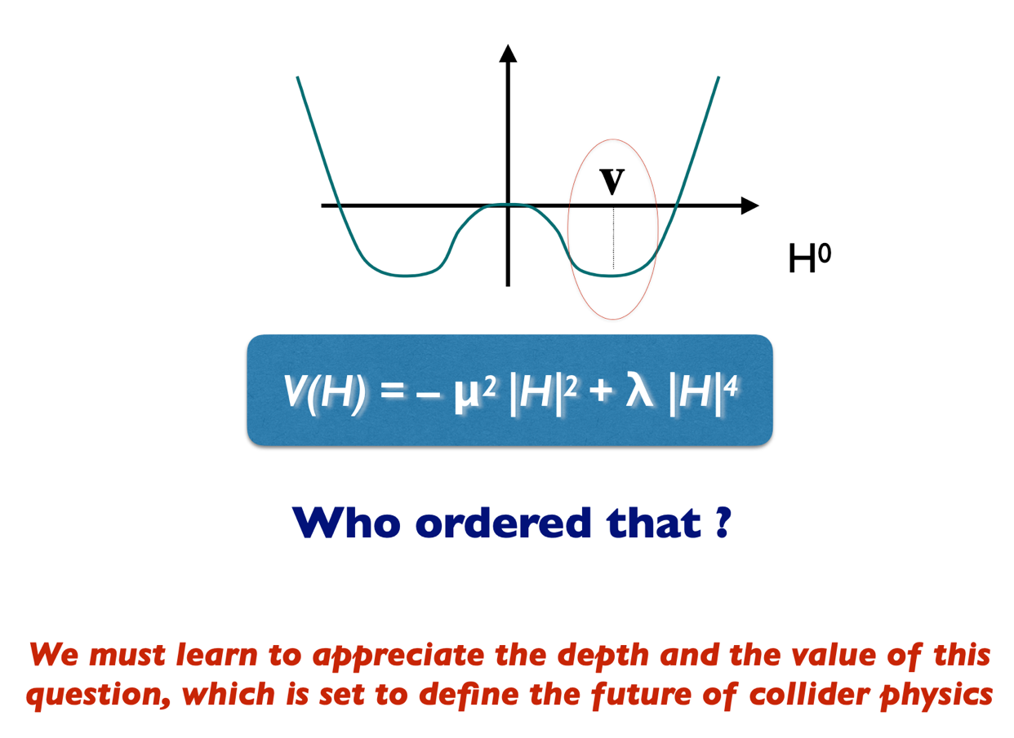
M.Mangano (CERN), HH2019

Slide 38
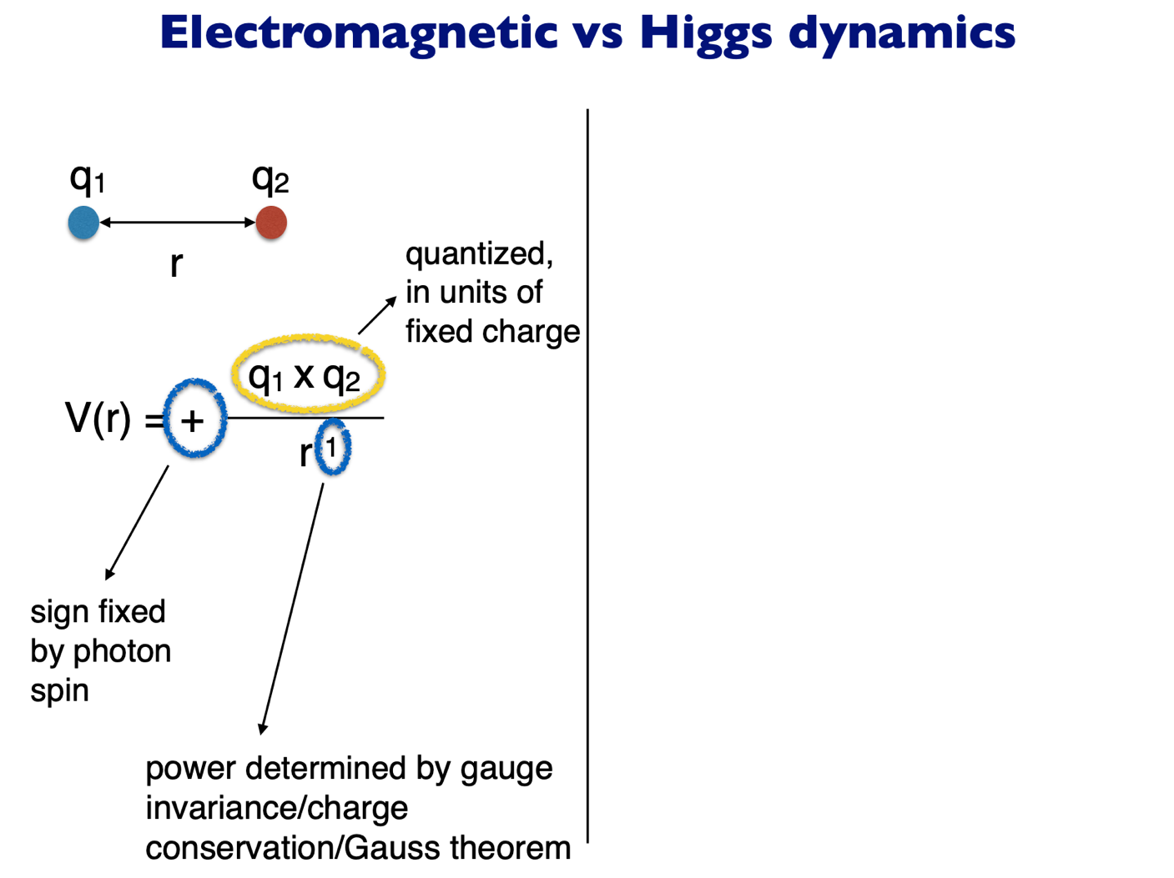
M.Mangano (CERN), HH2019

Slide 39
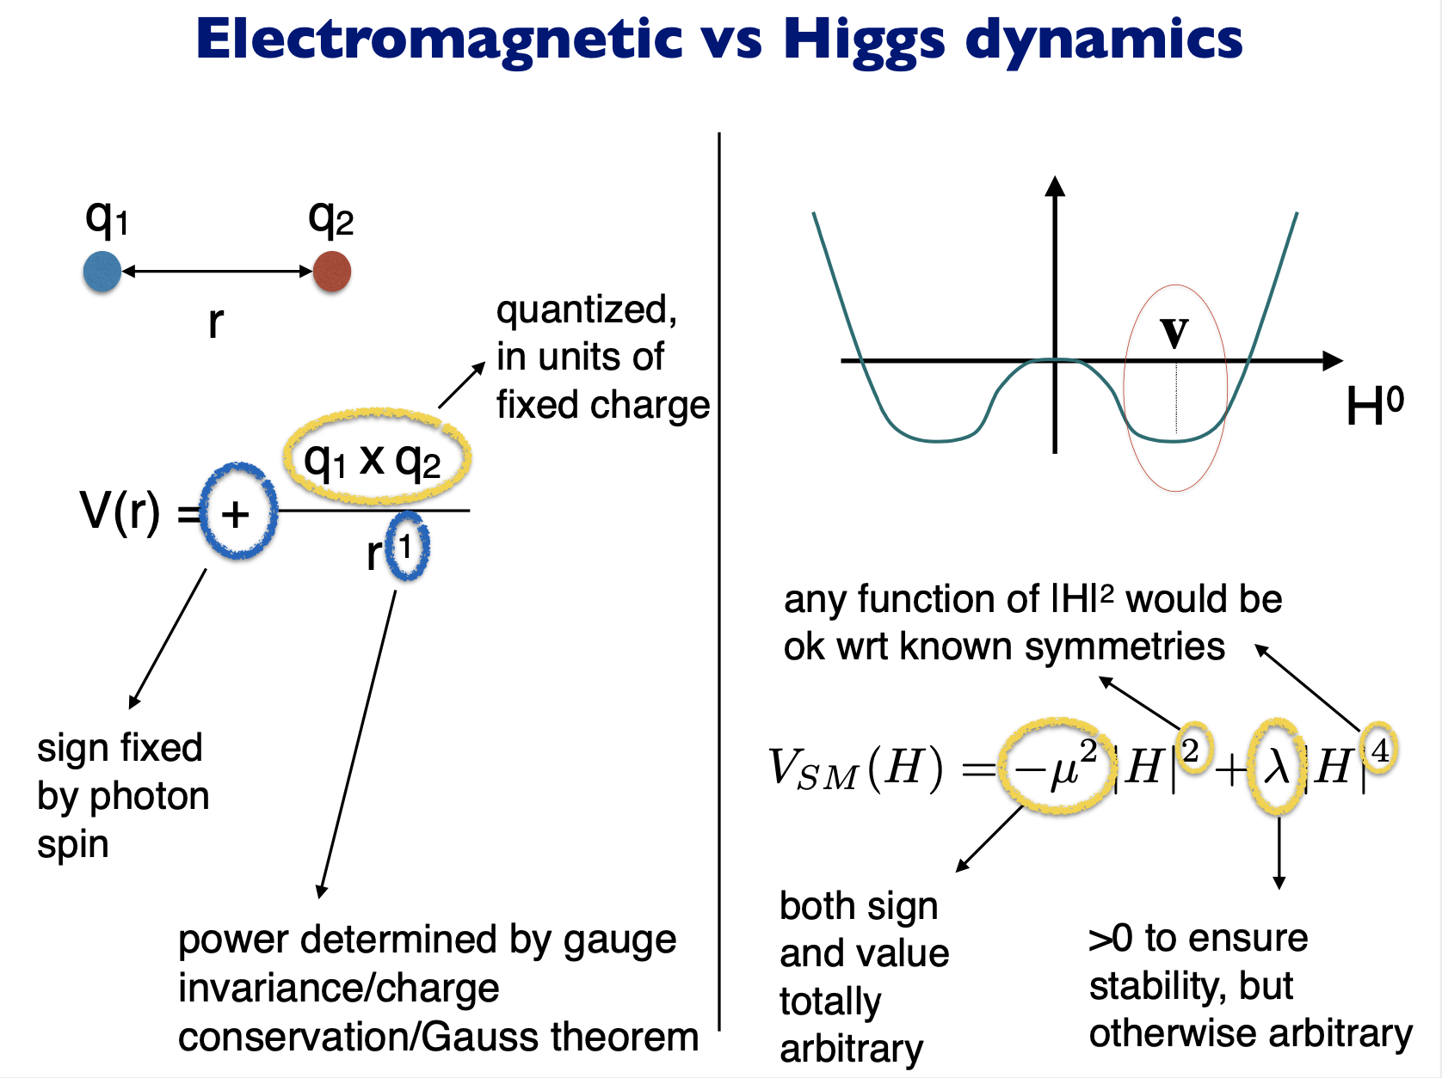

Slide 40
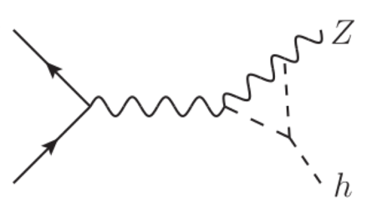
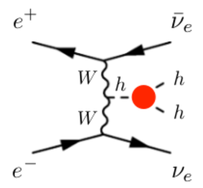
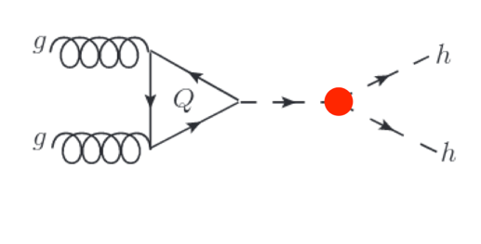
HOW DO WE MEASURE IT?
ZH @ e+e-
  ILC / FCC-ee
  Loops (“indirect”)
    Being done at LHC
HH @ e+e-
  CLIC @ 3000
HH @ pp
  LHC & FCC-hh

Slide 41
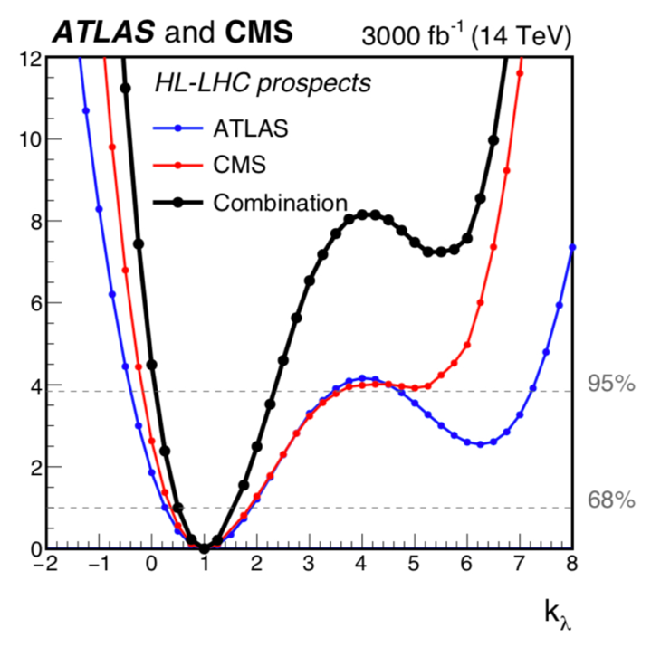
HH @ HL-LHC
Current sensitivity: ~10xSM
  H(bb)H(ɣɣ), H(bb)H(ττ), H(bb)H(bb)
HL-LHC: observe HH ~ 5 sigma
  3000/fb, ATLAS+CMS
Translates to O(100%) uncertainty
on self coupling
  Due to interference with
  other SM two-Higgs production

Slide 42
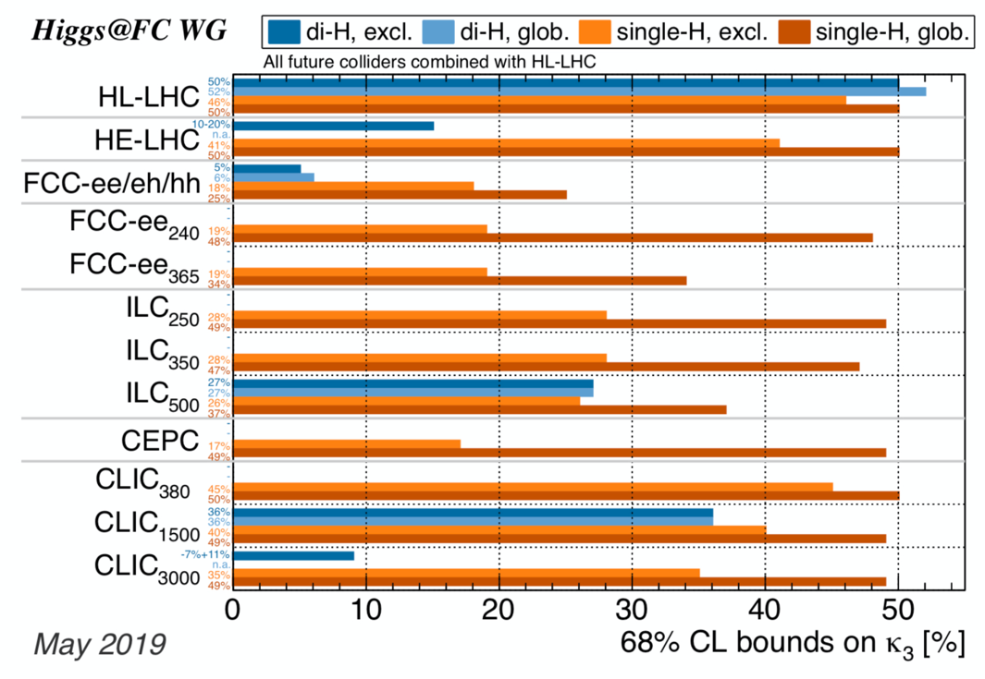
K₃ SUMMARY
5) HL-LHC: 50%
4) FCC-ee / ILC / CEPC:
20% - 50% (loops)
3) HE-LHC: 15%
2) CLIC-3000: 10%
1) FCC-hh: 5%
Questions?

Slide 43
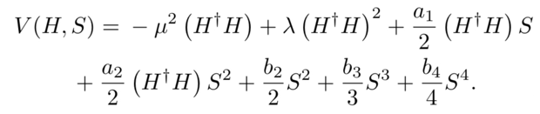
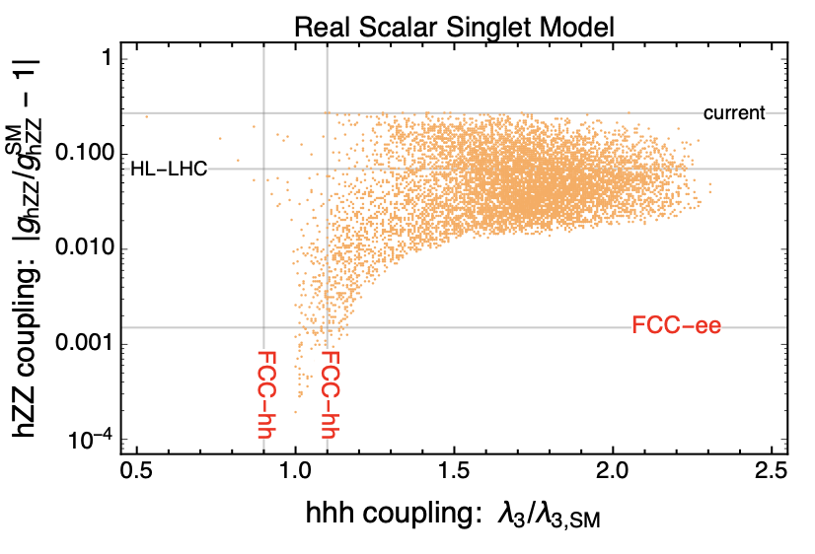
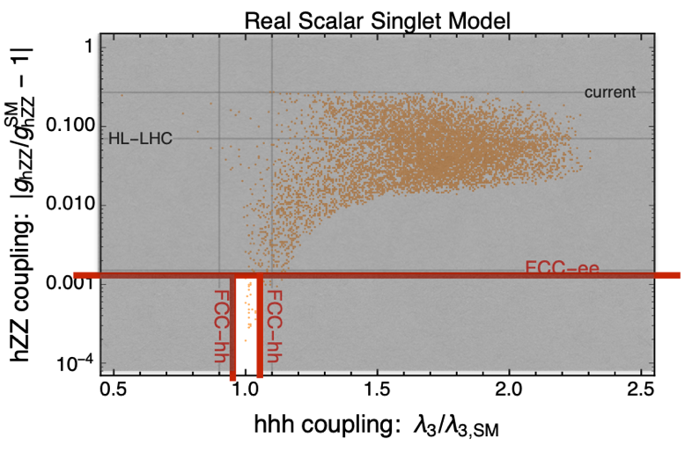
BARYOGENESIS?
Model with 1st order phase transition

Slide 44
ADVANTAGES
ILC
  Most ready
FCC-ee & CepC
  High lumi
  Z, WW, tt programme
  Upgrade to pp collider
CLIC
  Self coupling
FCC-pp (100 TeV)
  Highest rates
  Self coupling
These are the mainstream proposals.
If time allows I’ll mention a few other ideas

Slide 45
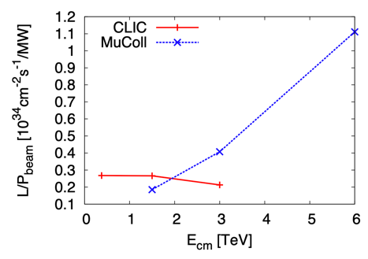
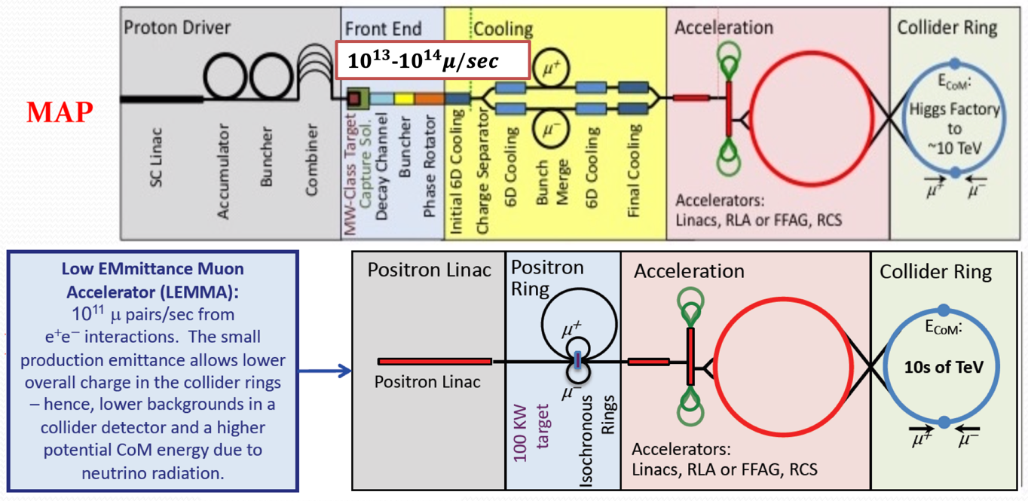
MUON COLLIDER
Goal: high energy
Two options: proton and positron
Nikhef colloquium – N.Pastrone: https://indico.nikhef.nl/event/1839/

Slide 46
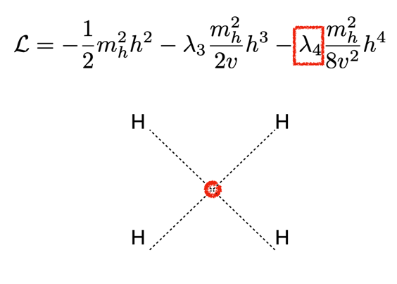
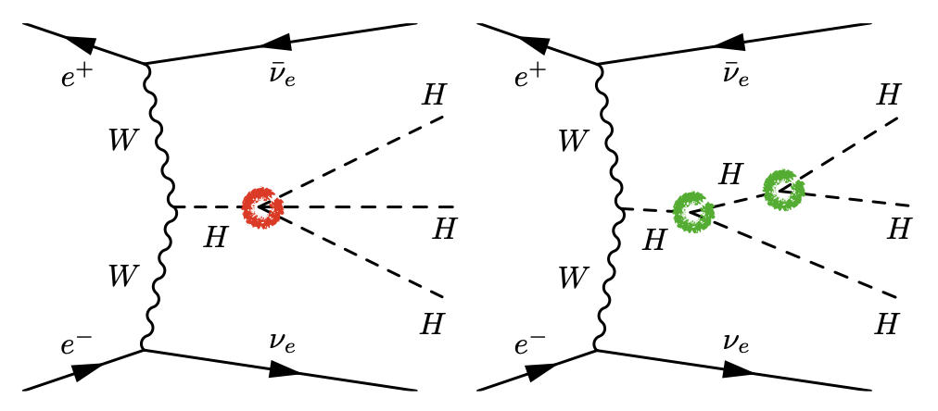
MUON COLLIDER
Quadrilinear coupling!
“K4 sensitivity few 10%” (E=14 TeV, L=20/ab)
  https://indico.cern.ch/event/801616/timetable/#20190410.detailed

Slide 47
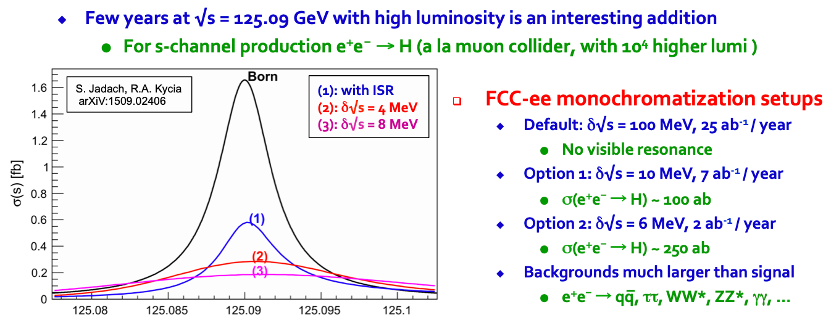
e+e- → H
https://indico.cern.ch/event/666889/
First generation Yukawa!
FCC-ee: SM sensitivity after ~5 years

Slide 48
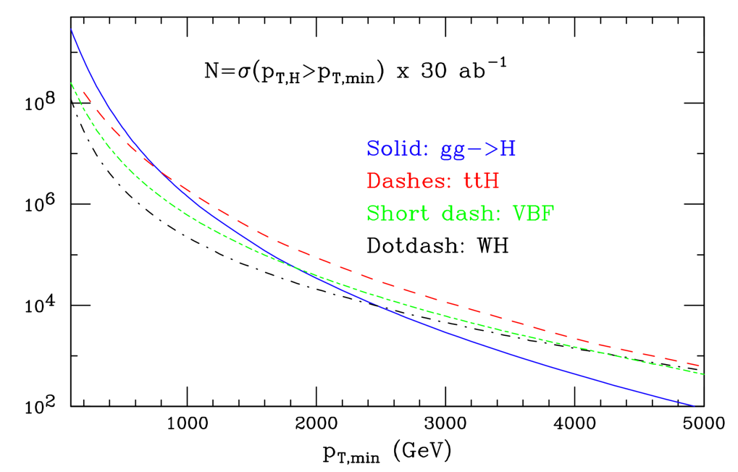
FCC-hh
At FCC-hh, everything will be
high energy production
  pp @ 100 TeV
  Everything boosted
  Zoom into loops
SM + c * (p_{T} / Λ)²

Slide 49
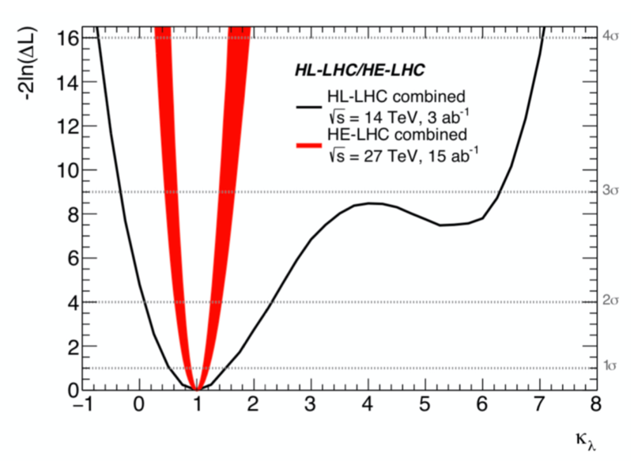
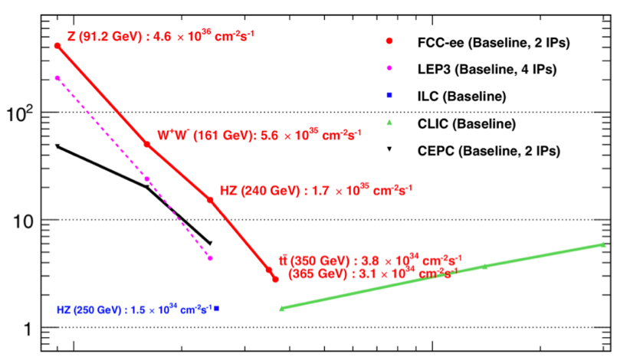
LEP++ and LHC++
HE-LHC (“LHC with FCC magnets”)
Not much discussed, but how about
reusing LHC tunnel for new accelerators?
LEP3 (“LEP tunnel with modern e+e- accelerator”)
LHC: 14 TeV
HE-LHC: 27 TeV
FCC-hh: 100 TeV
Some pros, some cons

Slide 50
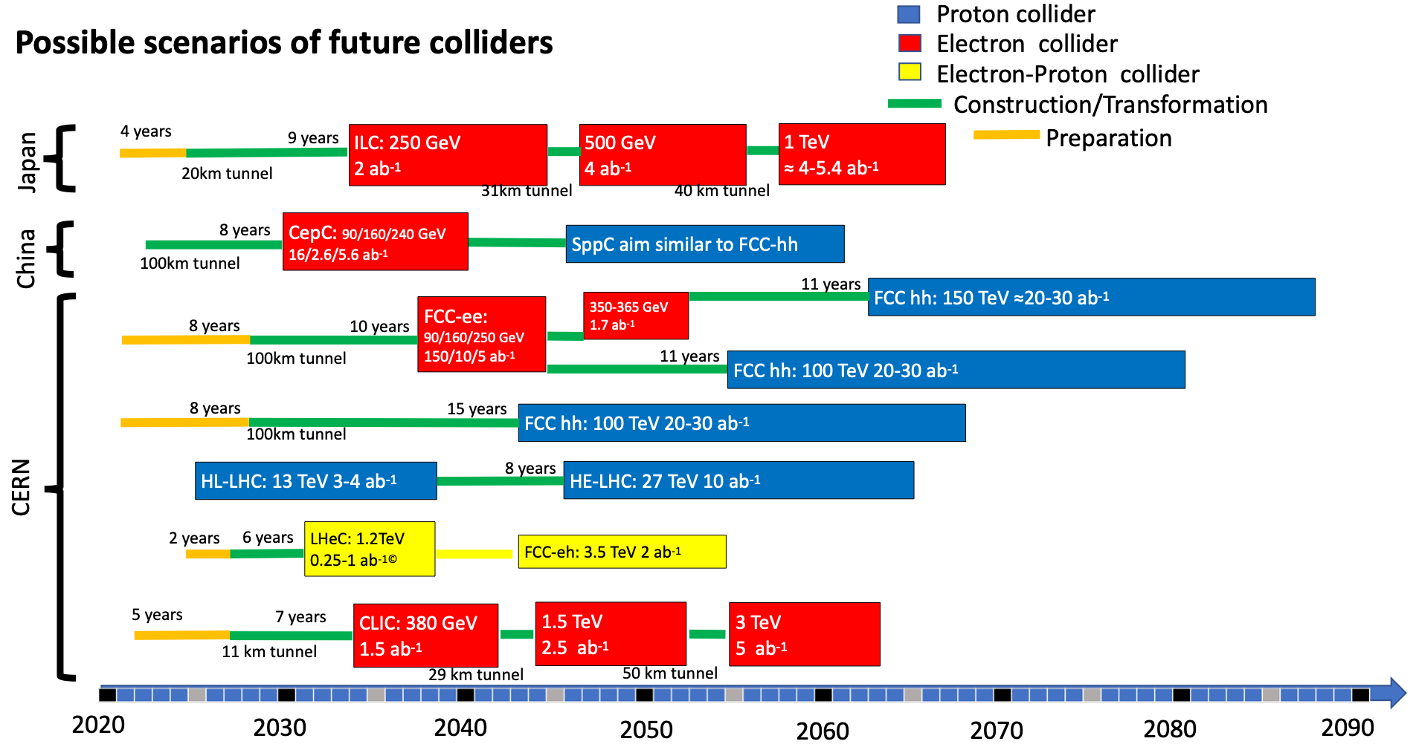
S.Bethke, ESPP May 2019

Slide 51
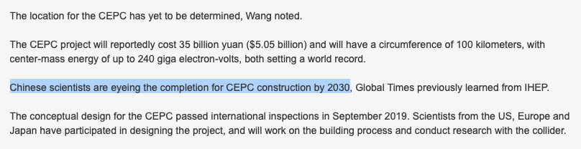
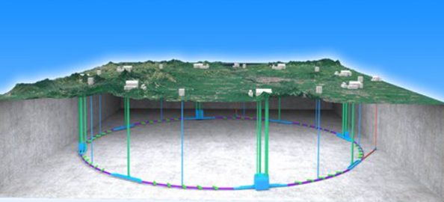
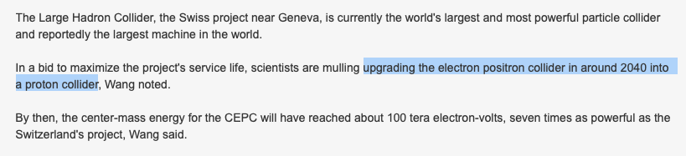
TIMELINES
https://www.globaltimes.cn/content/1189391.shtml
CepC @ China
Similar to FCC
  Accelerator less ambituous
  Timeline more aggressive

Slide 52
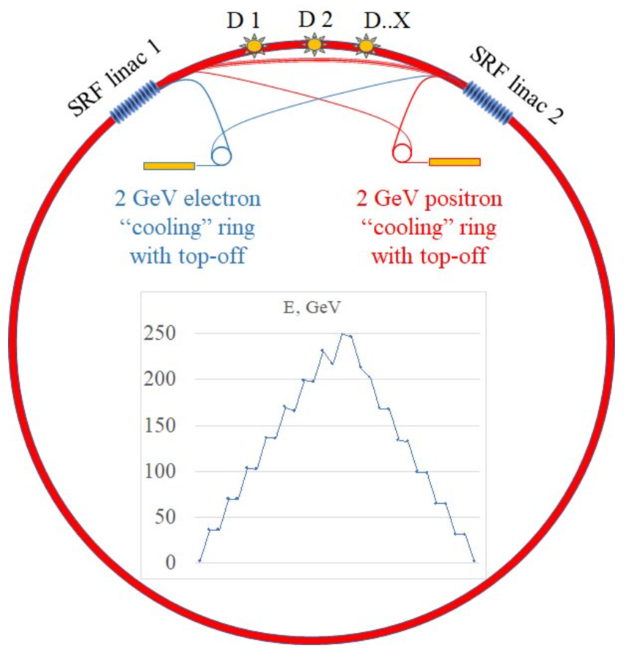
FCC with ERL
New idea! (2019)
Combine advantages
of linear and circular
  FCC-ee with
  Energy Recovery Linac
Nikhef colloquium – A.Jankowiak https://indico.nikhef.nl/event/2090/

Slide 53
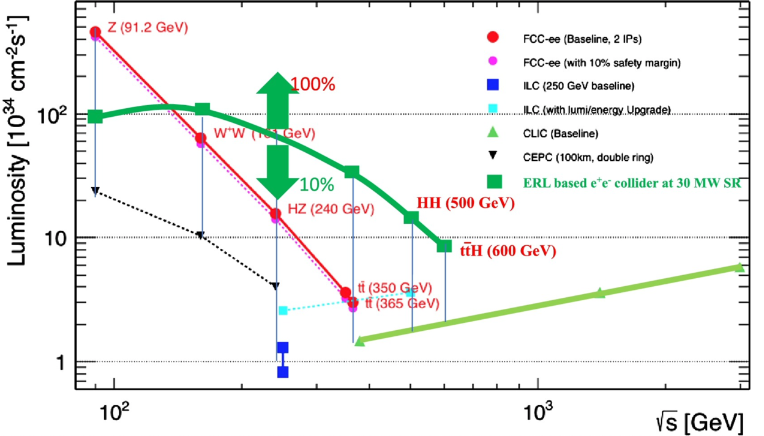
FCC with ERL
Is this the perfect e+e- collider? All the disadvantages of the other proposals are solved!
Many advantages:
Great physics!
Can do ttH and HH!
Interesting technology
And more ECO friendly!
https://phys.org/news/2020-05-energy-recovery-linear-next-generation-physics.html

Slide 54

SUMMARY
The next collider should be a Higgs factory
  General consensus in HEP community
  There’s still a lot of physics to learn
Different options on the table
  Shape and location open items
  Arguments not only science
Come join the discussion!
  Important & interesting

Slide 55

STRATEGY UPDATE
Tomorrow at 11:00!
  https://webcast.web.cern.ch/event/i924500

Slide 56
https://www.quantumdiaries.org/2013/08/19/a-fresh-look-for-the-standard-model/

Slide 57


Slide 58


Slide 59
PROSPECTS
NOW
HL-LHC
SM
ILC
FCC
BSM @ FCC-hh
arXiv/1606.00947
H→Z(vv)Z(vv)
Dark Matter prospects

Slide 60
MONO-JET
Dark Matter?

Slide 61
TRISTANDARD MODELTRI
H₁
H₂
H₃
TdP &
J.-M.Gérard
(UCLouvain)

