Slide 1


A pixel TPC readout for a detector at a future e⁺e⁻ collider
Wednesday 22 January 2020
Physics@Veldhoven
Cornelis Ligtenberg, H. van der Graaf, F. Hartjes, K. Heijhoff, P.M. Kluit, N. van der Kolk, G. Raven, J. Timmermans
Y. Bilevych, K. Desch, M. Gruber, J. Kaminski, T. Schiffer

Slide 2
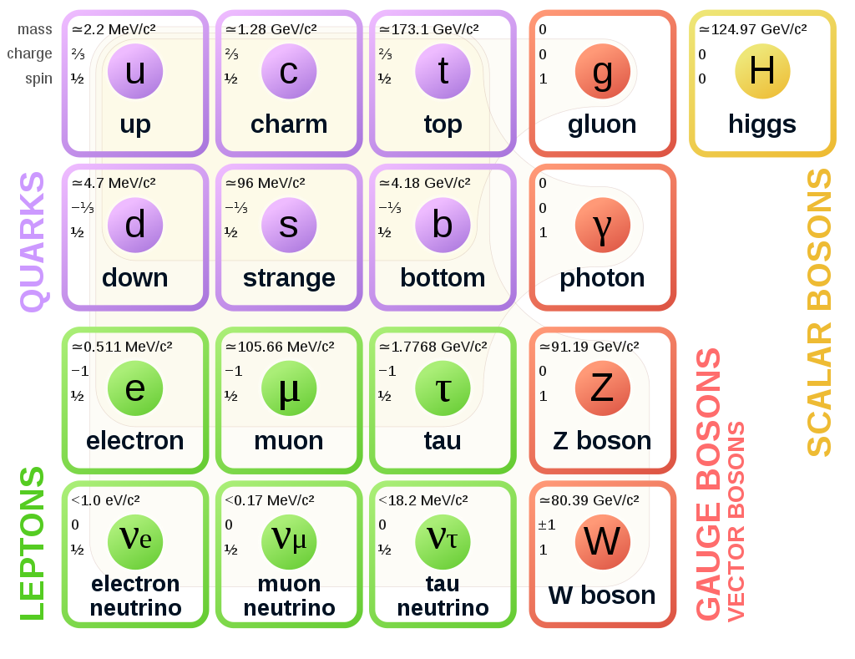
What are the research goals?
Higgs boson is the only scalar (spin 0 particle)
Some questions:
What is the origin of the Higgs mechanism?
How can the Higgs bosons be so light?
Are there more Higgs bosons?
The standard model of particle physics
We need Higgs precision measurements
Picture by MissMJ, Wikipedia

Slide 3
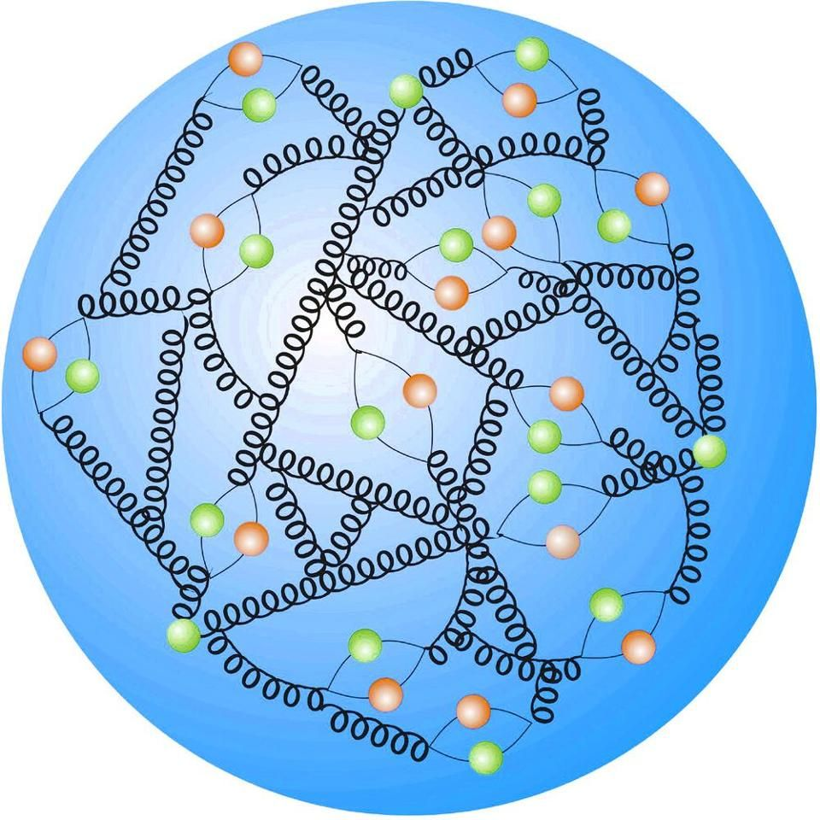

Why do we need a new collider?
The LHC collides the composite proton
Collision energy is unknown
Large backgrounds (noise)
Collisions of the fundamental electron
Energy is precisely known
Ideal for precision measurements
Proton picture by DESY

Slide 4
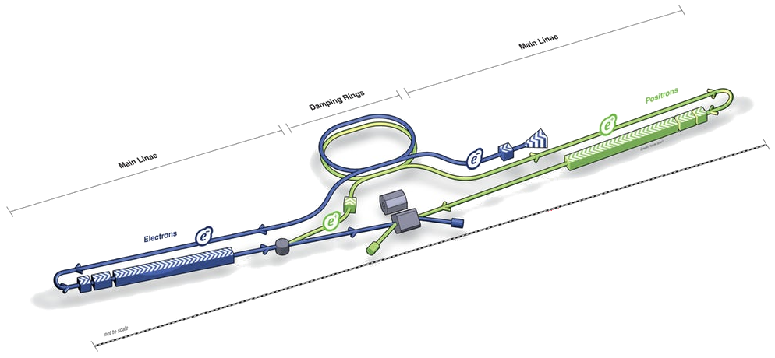


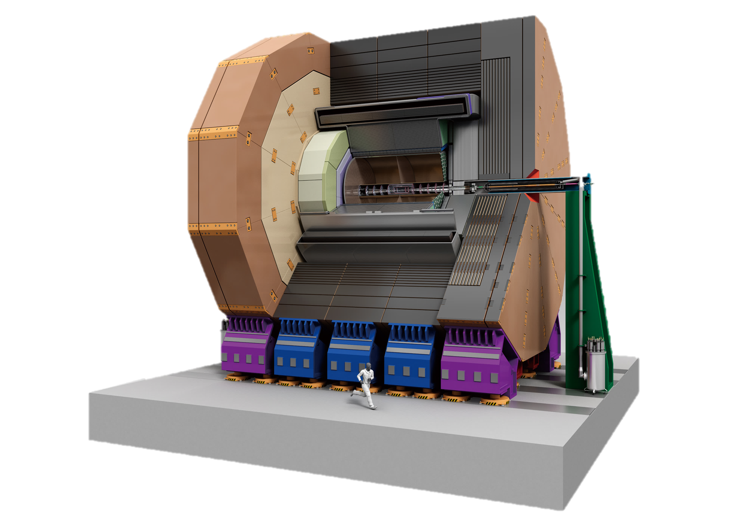
The international linear collider
20 km first stage as a Higgs factory at 250 GeV
Pictures from ILC CDR

Slide 5
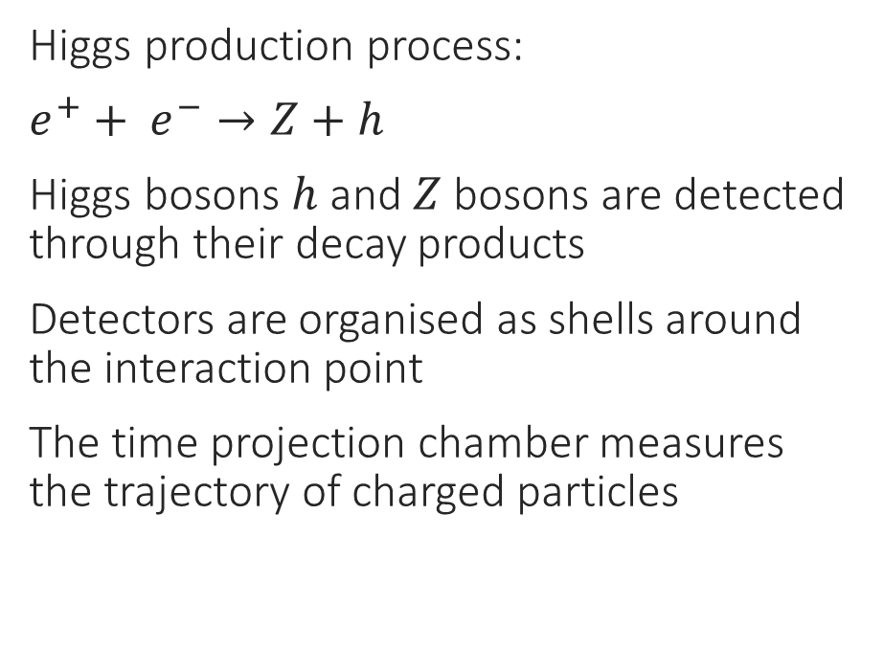
Detection of Higgs bosons
Higgs production process:
$e^{+}+ e^{−}→Z+h$
Higgs bosons $h$ and $Z$ bosons are detected through their decay products
Detectors are organised as shells around the interaction point
The time projection chamber measures the trajectory of charged particles
Z
Time projection chamber
e⁺
e⁻
h

Slide 6
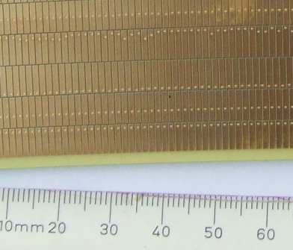
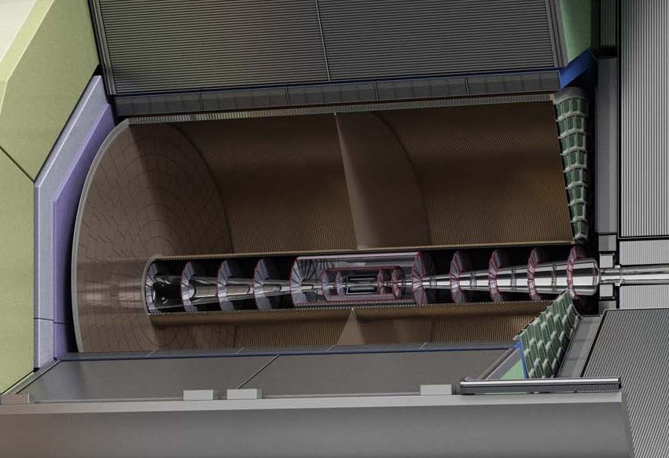
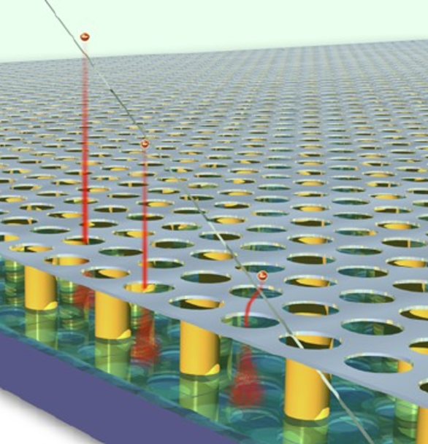
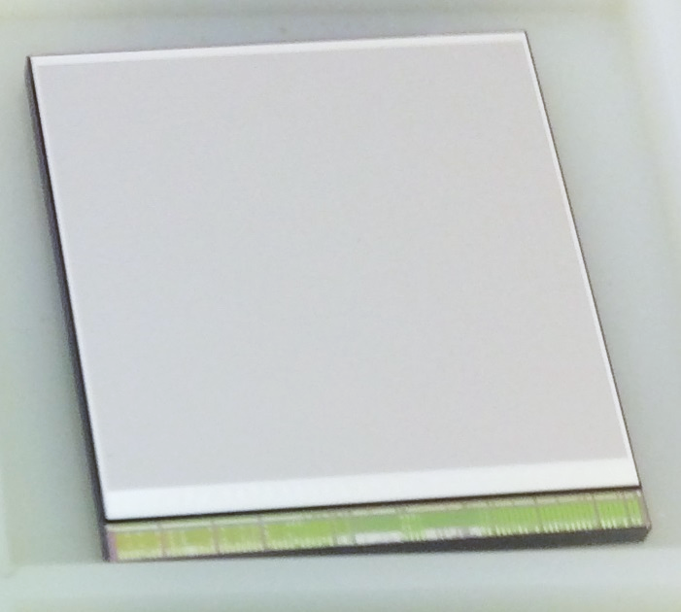
The time projection chamber
Conventional mm sized pads:
detection of distributions
Amplification
and detection at readout plane
Track
-E_{drift}
e⁻
e⁻
e⁻
e⁻
e⁻
Ionisation in gas
e⁻
GridPix: finer granualrity and sensitive to single ionisation electrons
e⁻
e⁻
e⁻
e⁻
e⁻
e⁻
e⁻
e⁻
e⁻
e⁻
e⁻
e⁻
55 µm pixels

Slide 7

Quad module development
A quad module was developed

Slide 8
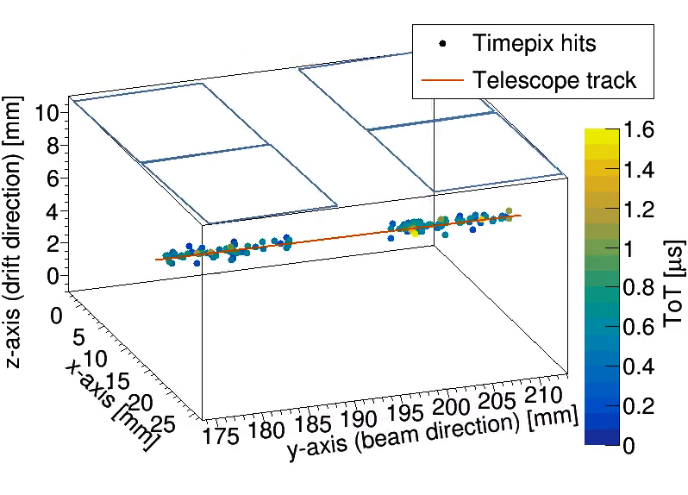
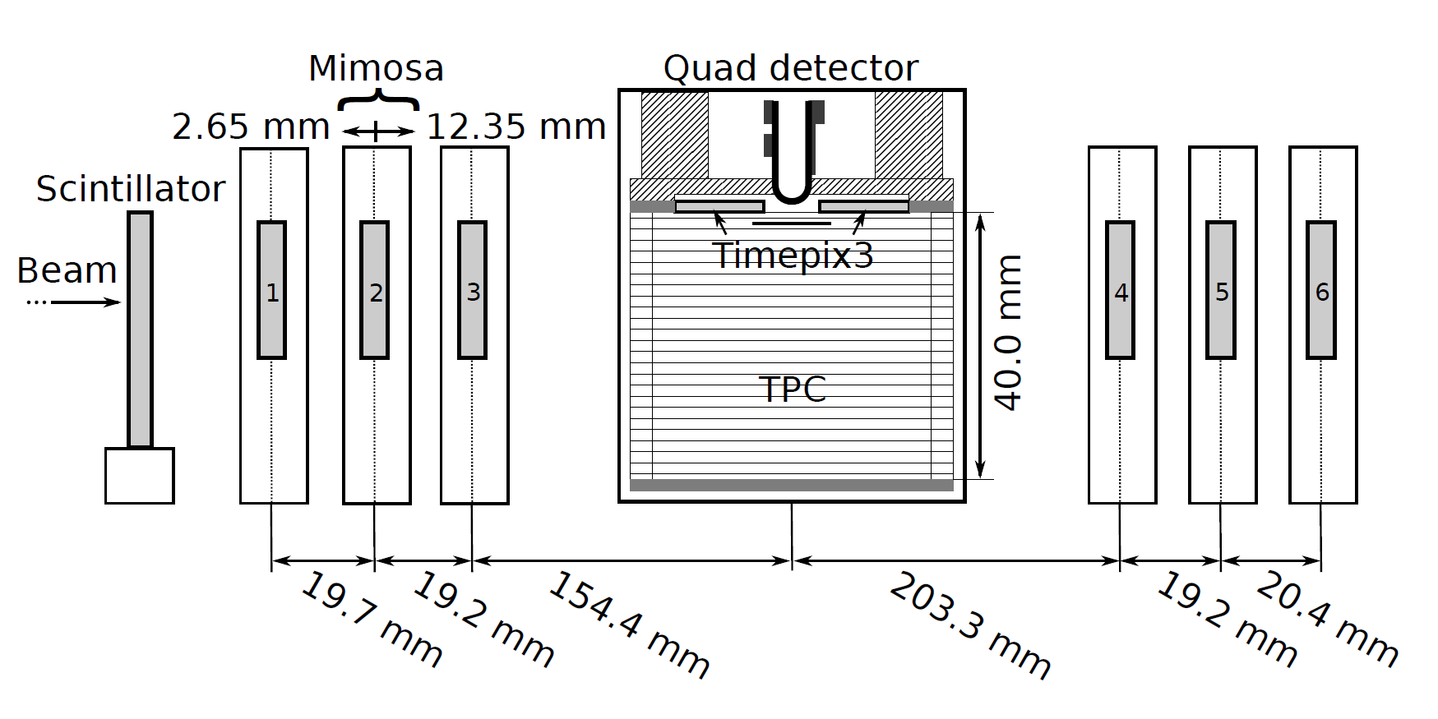
Experimental test setup
The quad module was tested with an electron beam at the ELSA accelerator in Bonn
October 2018

Slide 9
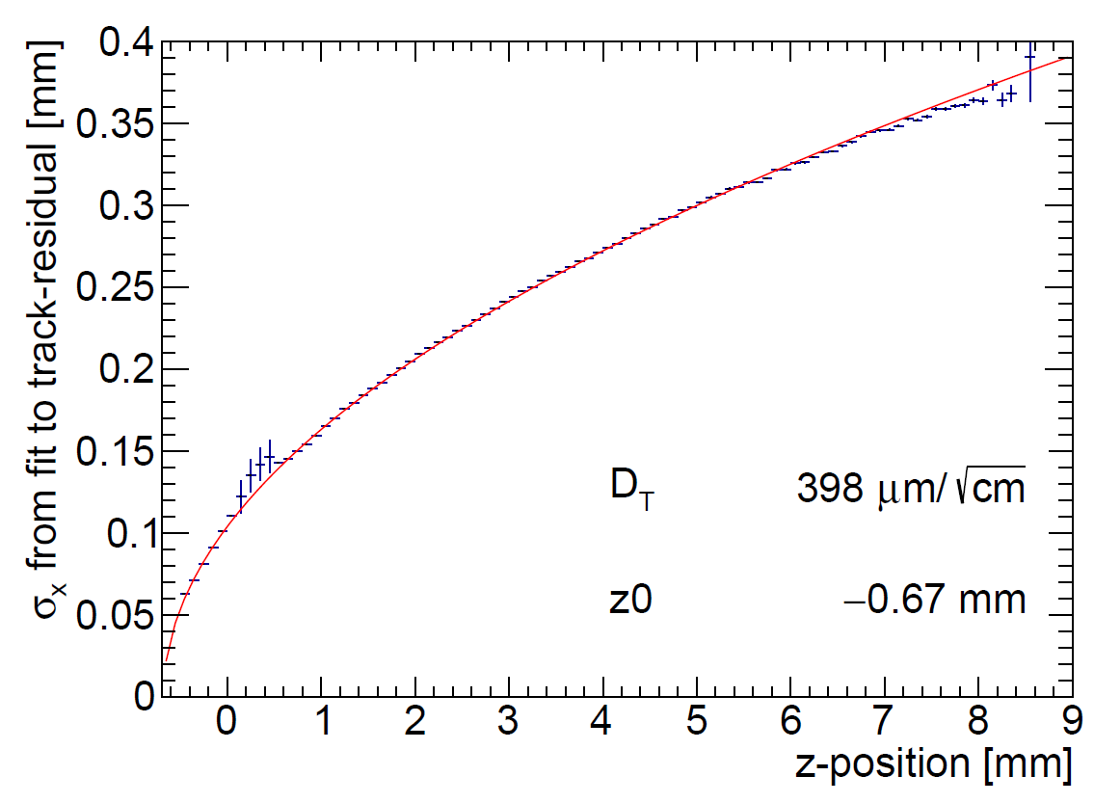
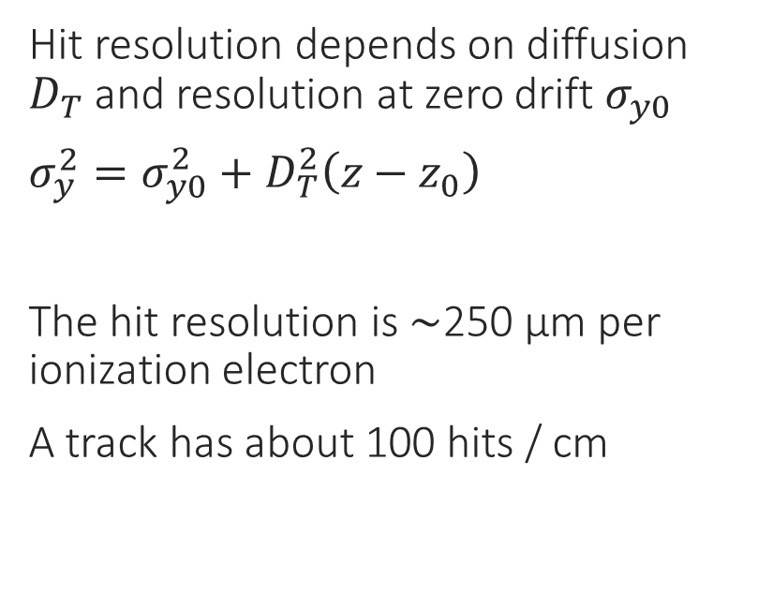



Hit resolution
Hit resolution depends on diffusion $D_{T}$ and resolution at zero drift $σ_{y0}$
$σ_{y}^{2}=σ_{y0}^{2}+D_{T}^{2}\left(z−z_{0}\right)$
The hit resolution is $\sim$250 µm per ionization electron
A track has about 100 hits / cm
Scattering on guard
Resolution $→$
B$=0$ T
Drift distance to readout chip $→$

Slide 10
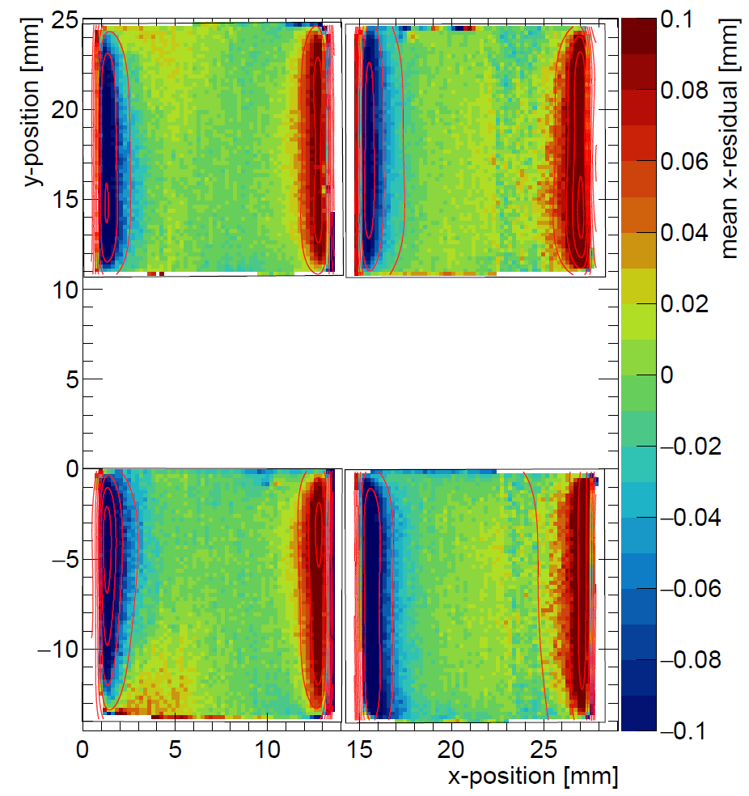
Systematic error in over the pixel plane
Without correction
Investigation of systematic deviations over the pixel plane
The color represents the distortions
The primary cause is electric field distortions
Correction of deformations with fitted Cauchy functions

Slide 11
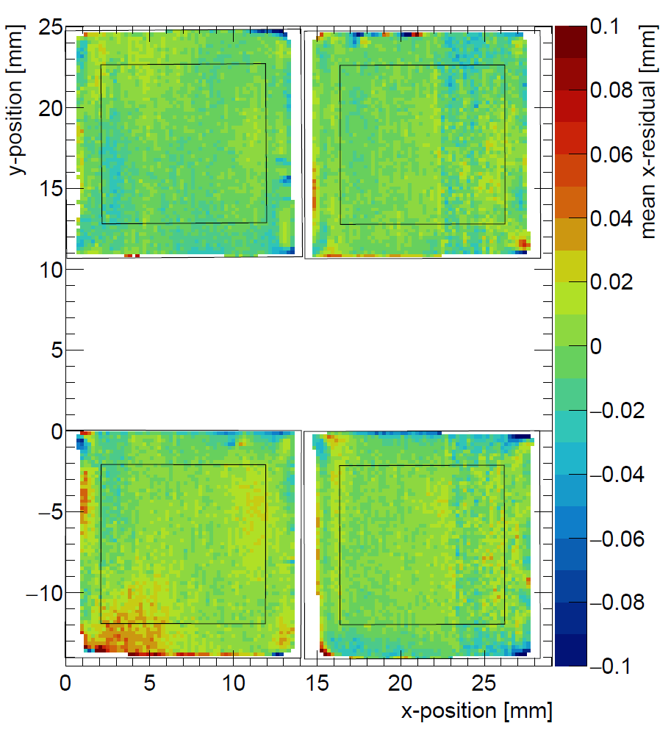
Systematic error in over the pixel plane
With correction
Investigation of systematic deviations over the pixel plane
The color represents the distortions
The primary cause is electric field distortions
Correction of deformations with fitted Cauchy functions

Slide 12
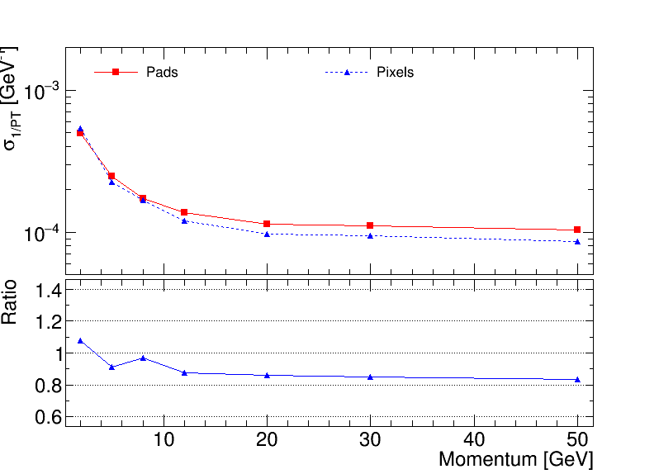
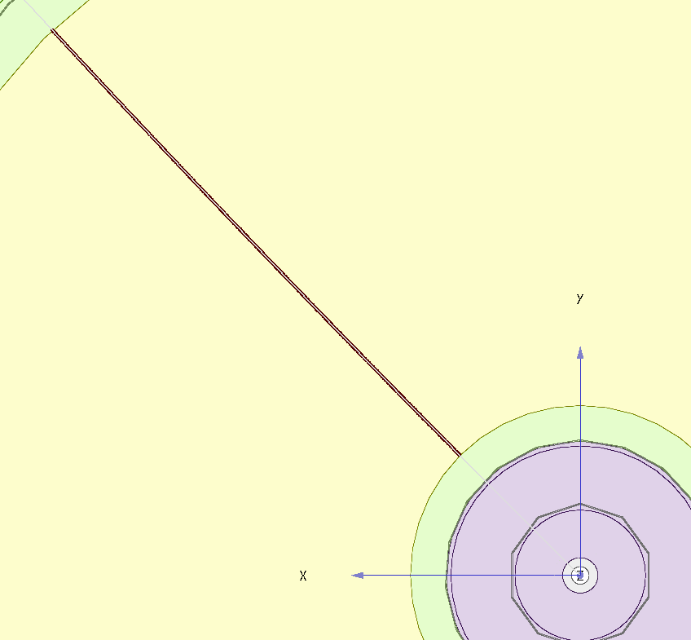
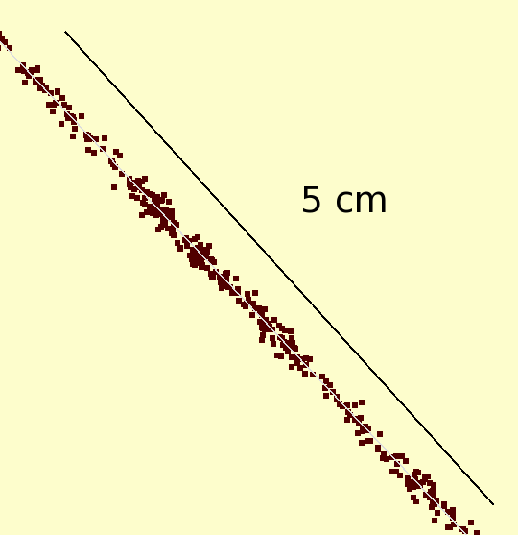

Extrapolation to a large detector
50 GeV muon track with pixel readout
Expected momentum resolution
Simulation
$\sim$20% improvement

Slide 13
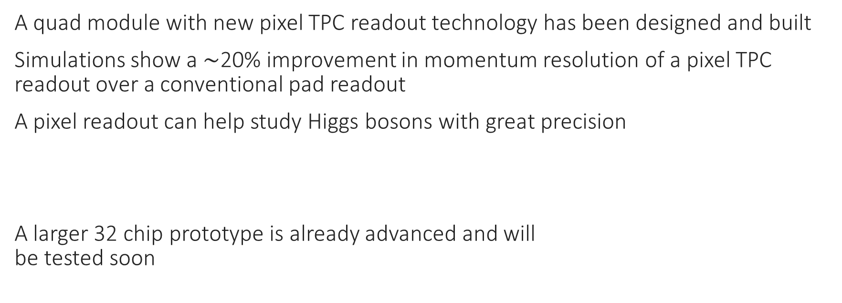
Conclusions
A quad module with new pixel TPC readout technology has been designed and built
Simulations show a $\sim$20% improvement in momentum resolution of a pixel TPC readout over a conventional pad readout
A pixel readout can help study Higgs bosons with great precision
A larger 32 chip prototype is already advanced and will
be tested soon

Slide 14
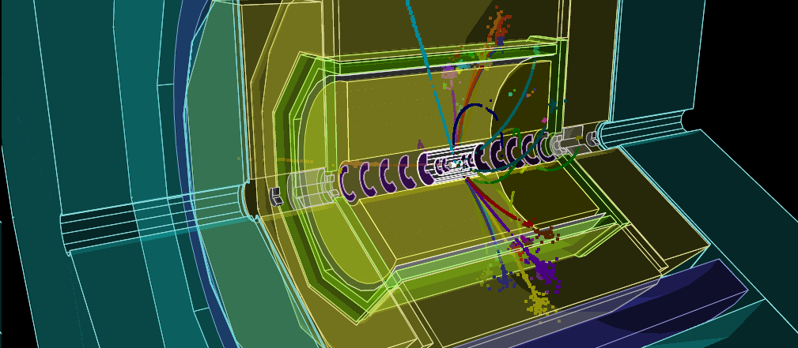
Backup
Simulated e⁺e⁻ -> Zh -> µ⁺µ⁻h (250 GeV)

Slide 15

Status of ILC
By Keisuke Fuji (KEK)
3 December

Slide 16
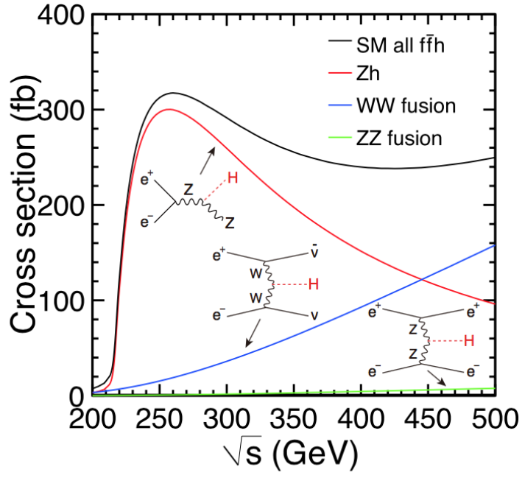
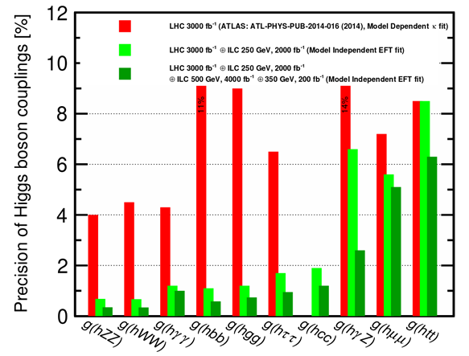
Some physics goals of the ILC
What is the origin of EWSB?
How can the Higgs bosons be so light?
Are there more Higgs bosons?
What is dark matter made of?
https://arxiv.org/pdf/1710.07621.pdf
LHC (3 ab⁻¹)
LHC + ILC 250 GeV ( 2 ab⁻¹)
LHC + ILC 250 GeV + ILC 500 GeV (4 ab⁻¹)

Slide 17
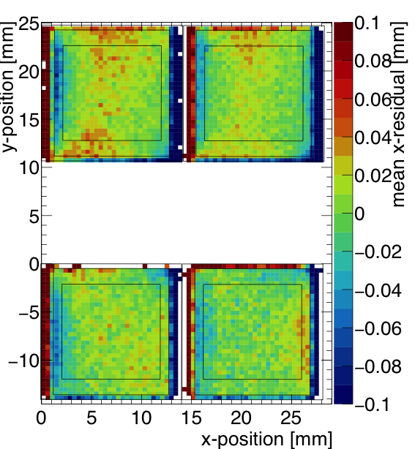
Quad results and outlook
Uncorrected residuals from quad test beam
Uncorrected residuals from laser test with field wires
October 2018
Preliminary
New field wires
8 Quad (32 chip module) to be tested with beam soon

Slide 18
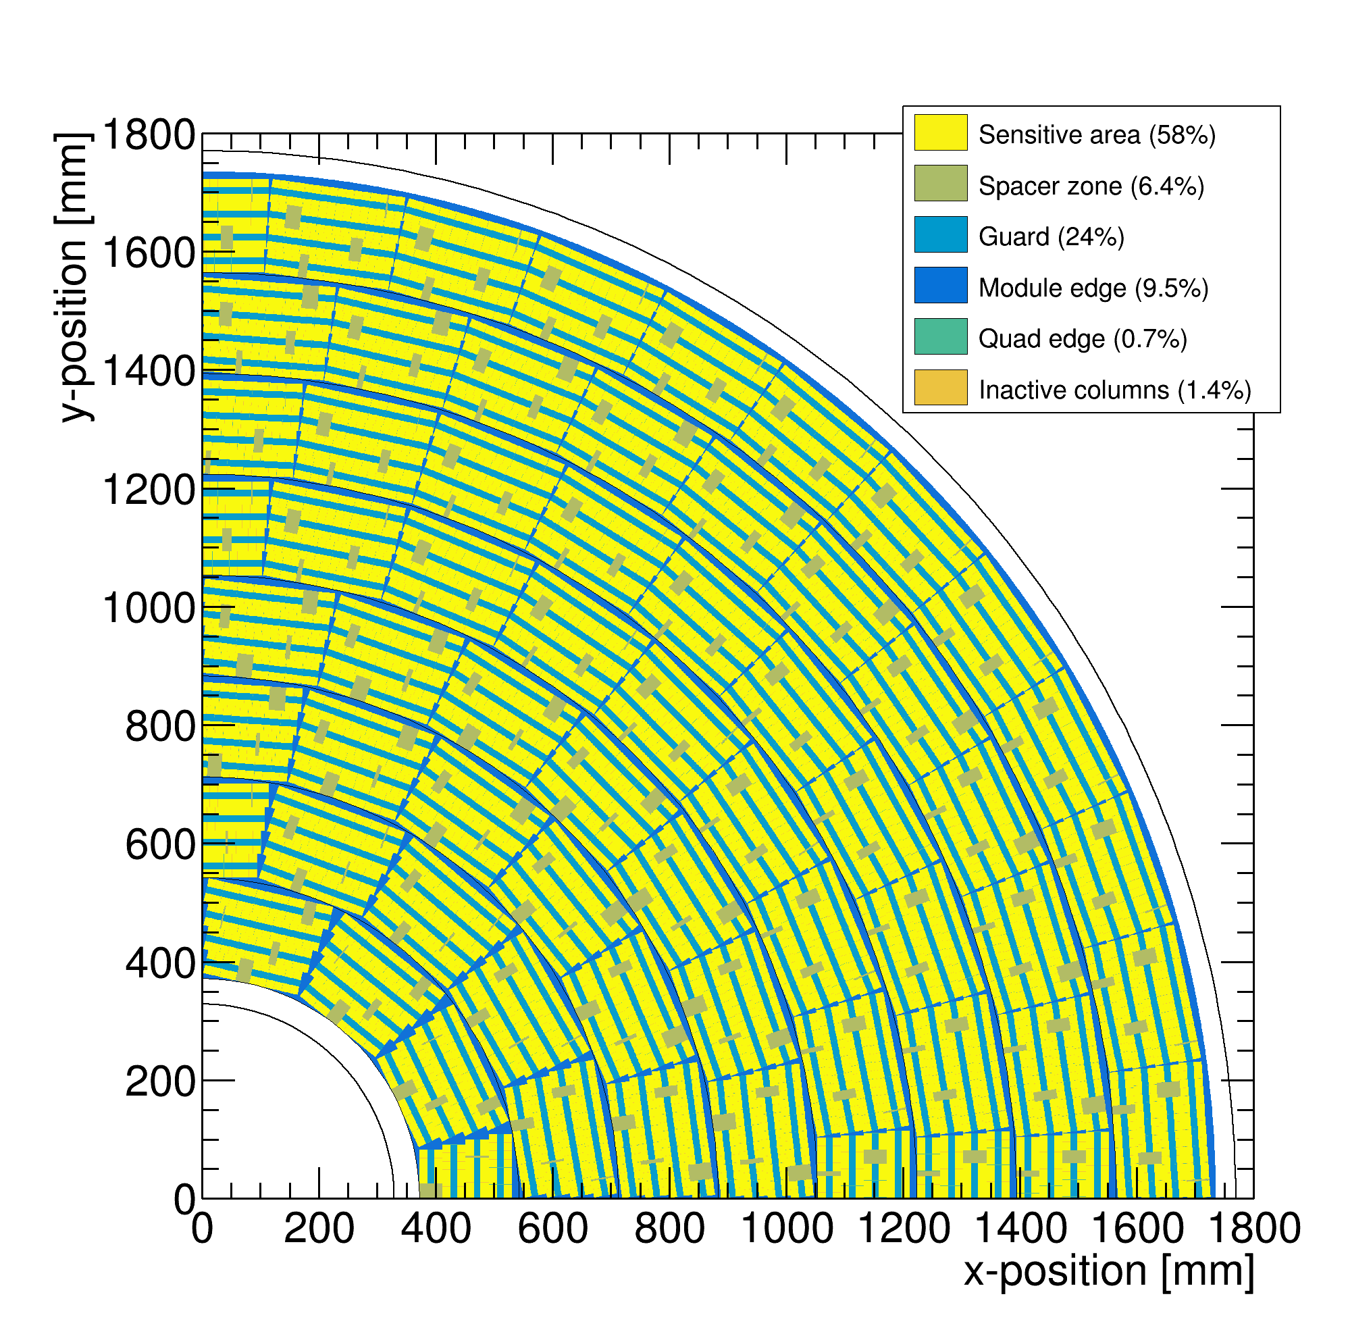
Quad module development
Coverage of end plate with quad modules
58% coverage

Slide 19
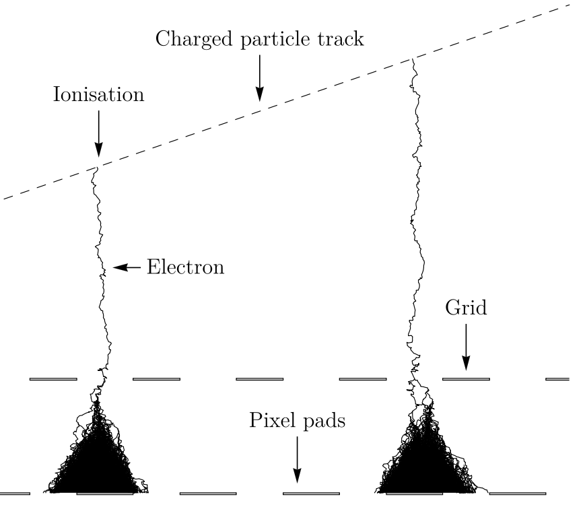
GridPix technology
GridPix is a type of micro-pattern gaseous TPC readout
The GridPix based on a Timepix3
  55 µm × 55 µm pixels
  Digital simultaneous registration of Time of Arrival (1.56 ns) and Time over Threshold
  An aligned Aluminium amplification grid is added by photolithographic postprocessing techniques
Single ionization electrons are detected with high efficiency
  The maximum possible information from a track is acquired
  dE/dx by cluster counting
35 µm
1 µm
50 µm
55 µm

Slide 20
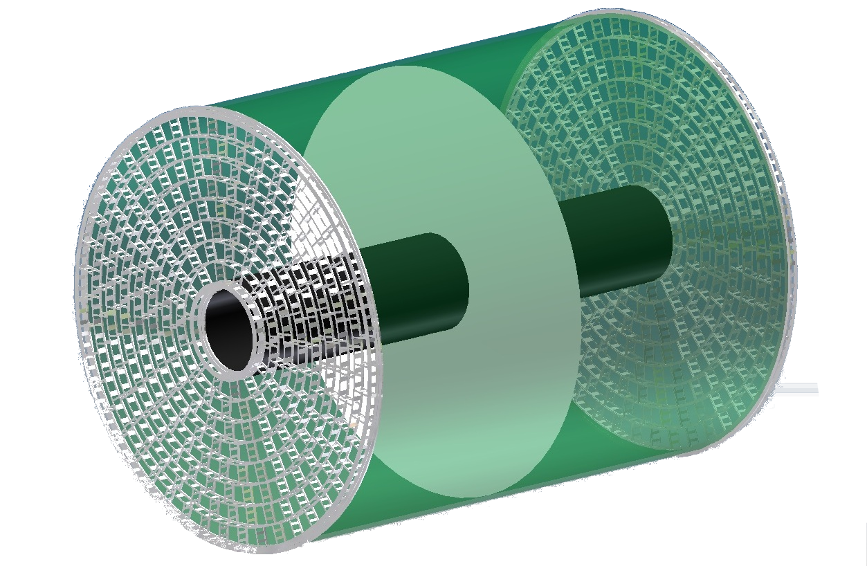
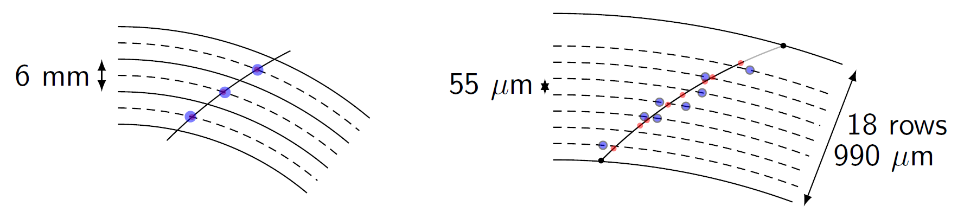

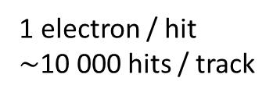
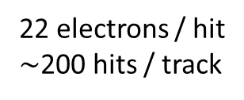
Simulation of ILD TPC with pixel readout
To study the performance of a large pixelised TPC, the pixel readout was implemented in the full ILD DD4HEP (Geant4) simulation
Changed the existing TPC pad readout to a pixel readout
Adapted Kalman filter track reconstruction to pixels
50 GeV muon track with pixel readout
Pads
Pixels
Continuous
3D tracking
6 mm
55 µm
22 electrons / hit
$∼$200 hits / track
1 electron / hit
$\sim$10 000 hits / track
Picture by Cornell

Slide 21

Performance of a GridPix TPC at ILC
From full simulation, momentum resolution can be determined
Momentum resolution is $\sim$15% better (with realistic coverage and delta’s)
Realistic tiling with quad module
Momentum resolution of the TPC for a 50 GeV muon
58% coverage

Slide 22
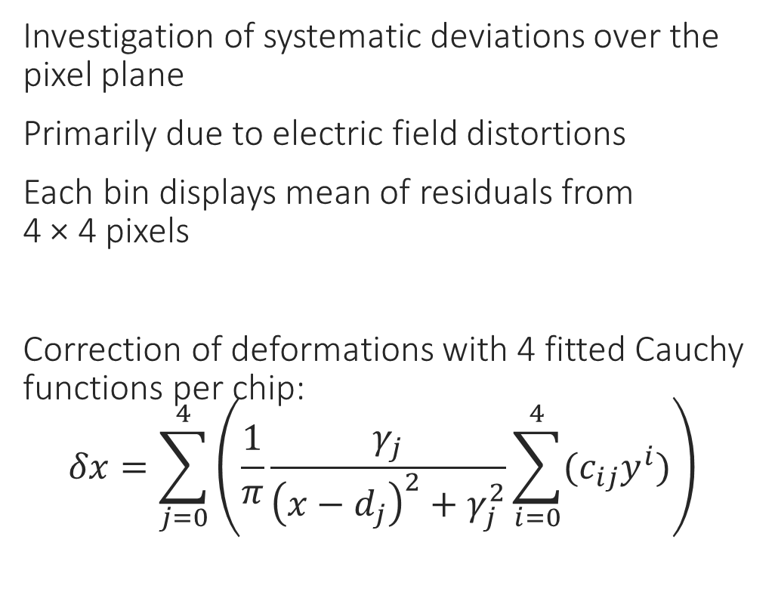
Systematic error in over the pixel plane
Investigation of systematic deviations over the pixel plane
Primarily due to electric field distortions
Each bin displays mean of residuals from
4 × 4 pixels
Correction of deformations with 4 fitted Cauchy functions per chip:
  $$δx=\sum_{j=0}^{4}{\left(\frac{1}{π}\frac{γ_{j}}{{\left(x−d_{j}\right)}^{2}+γ_{j}^{2}}\sum_{i=0}^{4}{{(c}_{ij}y^{i})}\right)}$$
Without correction

Slide 23

Systematic error in over the pixel plane
Investigation of systematic deviations over the pixel plane
Primarily due to electric field distortions
Each bin displays mean of residuals from
4 × 4 pixels
Correction of deformations with 4 fitted Cauchy functions per chip:
  $$δx=\sum_{j=0}^{4}{\left(\frac{1}{π}\frac{γ_{j}}{{\left(x−d_{j}\right)}^{2}+γ_{j}^{2}}\sum_{i=0}^{4}{{(c}_{ij}y^{i})}\right)}$$
With correction

Slide 24
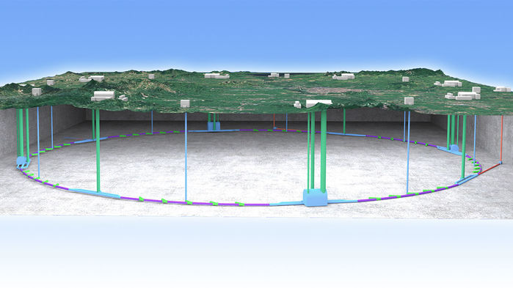
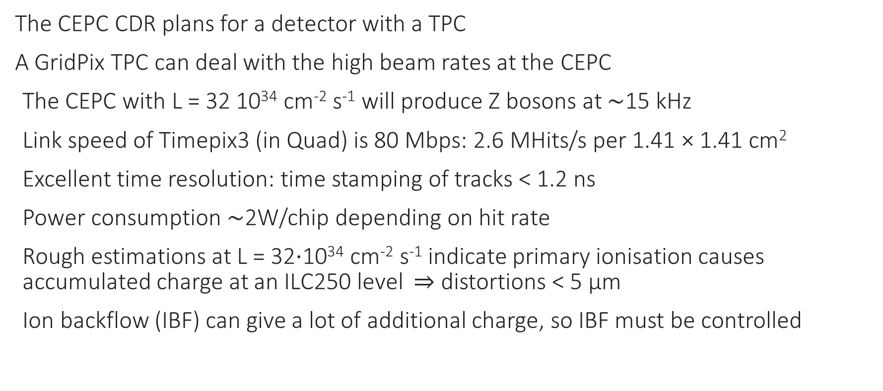
A TPC at the CEPC?
The CEPC CDR plans for a detector with a TPC
A GridPix TPC can deal with the high beam rates at the CEPC
The CEPC with L = 32 10³⁴ cm⁻² s⁻¹ will produce Z bosons at $\sim$15 kHz
Link speed of Timepix3 (in Quad) is 80 Mbps: 2.6 MHits/s per 1.41 × 1.41 cm²
Excellent time resolution: time stamping of tracks < 1.2 ns
Power consumption $\sim$2W/chip depending on hit rate
Rough estimations at L = 32⋅10³⁴ cm⁻² s⁻¹ indicate primary ionisation causes accumulated charge at an ILC250 level $⇒$ distortions < 5 µm
Ion backflow (IBF) can give a lot of additional charge, so IBF must be controlled
Picture IHEP

Slide 25
A negative ion TPC?
A negative Ion TPC has potentially a smaller diffusion than a TPC based on drifting electrons
Currently NITPCs are used in dark matter searches
Pixel read out – due to the fine granularity - allows to exploit high resolution regime
CS₂⁻ and SF₆⁻ are commonly used
What happens is that the track creates ionization; electron plus a positive ion; the electron is then captured by the CS₂ and SF₆ and forms a negative ion. This negative ion then drifts to the cathode.
Near the readout plane the electric field is so strong that the electron is stripped off and starts a “standard” avalanche. The critical field density where this happens (SF₆ ) is E/n = 100 x 10⁻¹⁷ V cm².

Slide 26
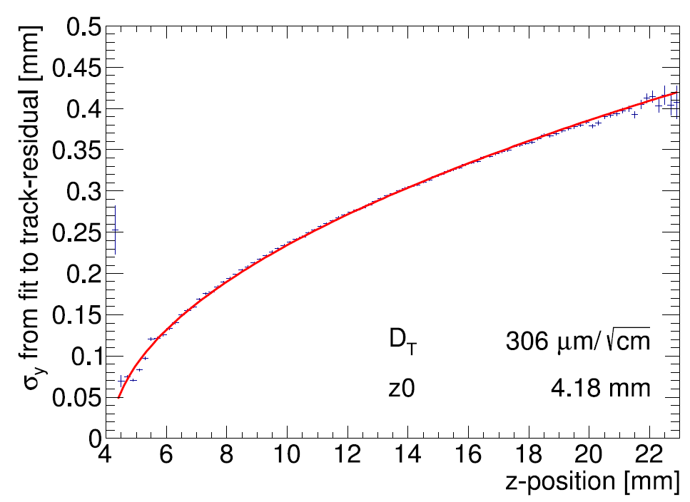
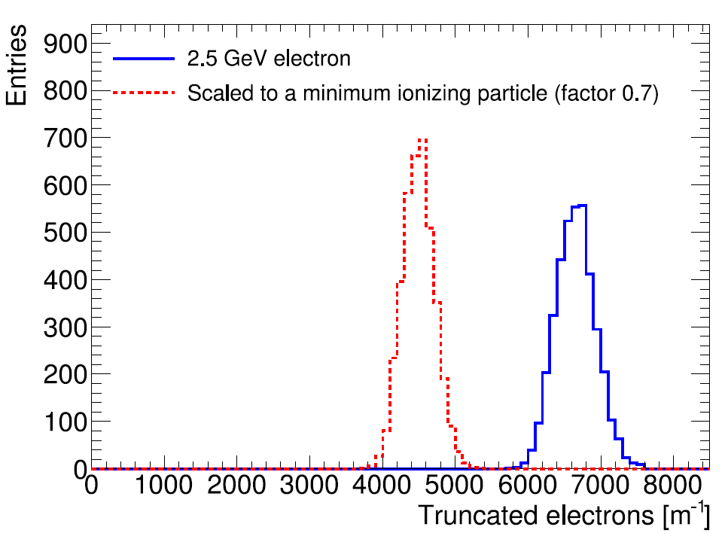
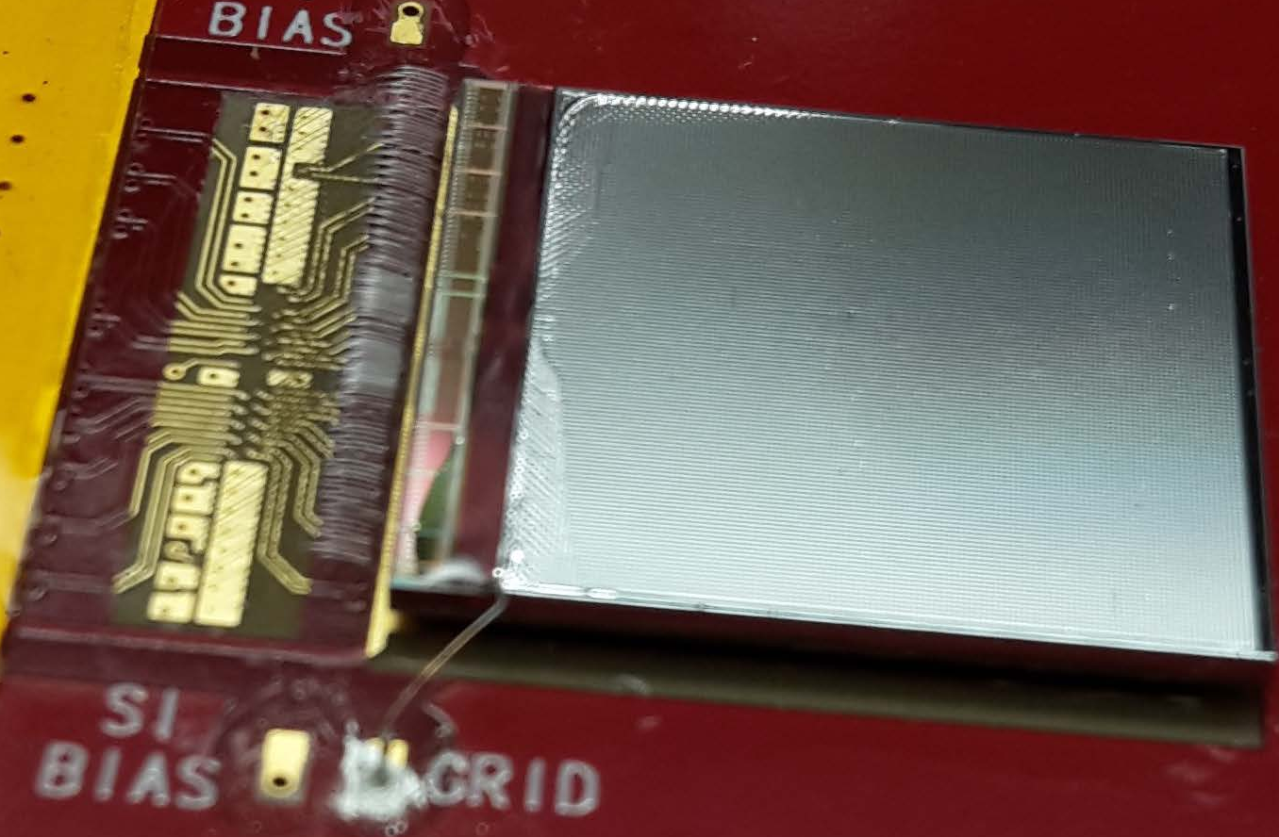


Single chip results (2017)
Hit resolution
A GridPix based on the Timepix3 chip was reliably operated in a test beam setup with 2.5 GeV electrons at ELSA (Bonn)
T2K gas and E_{drift} = 280 V/cm, V_{grid} = -350 V
The resolution is primarily limited by diffusion
Systematic uncertainties are low: < 10 µm in plane
Energy loss resolution (dE/dx) by electron counting is 4.1 % per meter
B$=0$ T
MIP
Electron
Published paper on this testbeam doi:10.1016/j.nima.2018.08.012

Slide 27
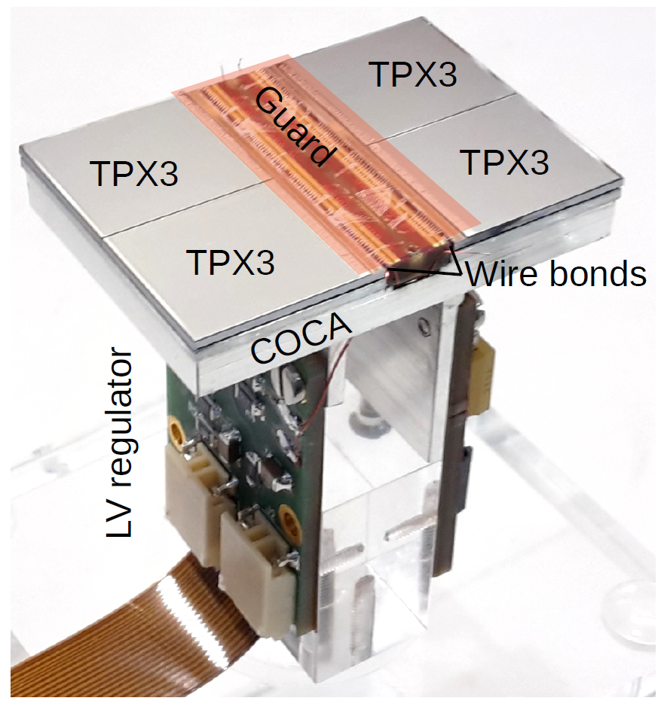

The quad module
A four chip module sized 39.6 mm $×$ 28.38 mm
The quad module has all services under the active area
  Can be tiled to cover arbitrarily large areas.
Area for connections IO was minimized
  Maximises active area ( 68.9% )
To maintain a homogenous electric field wire bonds are covered by a central guard
High precision < 20 μm mounting of the chips and guard
Cooling channels

Slide 28
Test beam measurements (2018)
2.5 GeV electrons at the ELSA accelerator in Bonn, Germany
T2K gas with E_{drift} = 280 V/cm, V_{grid} = -350 V
Events are triggered by a scintillating plane
6 plane mimosa telescope with 18.4 μm × 18.4 μm sized pixels
180 º

Slide 29
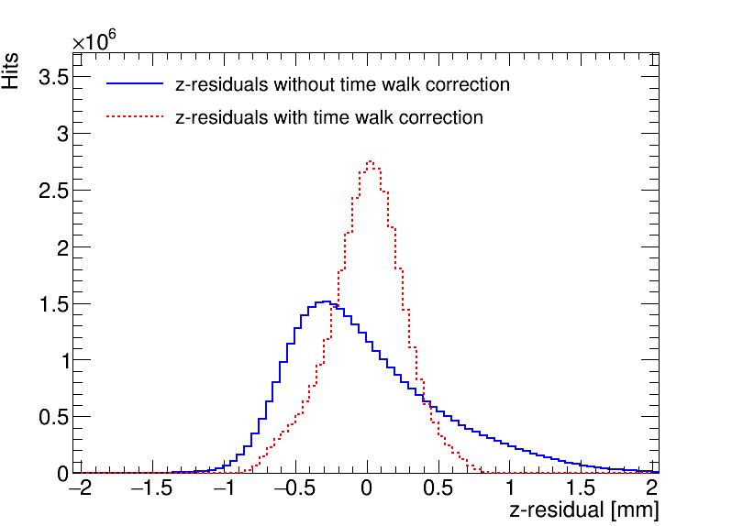
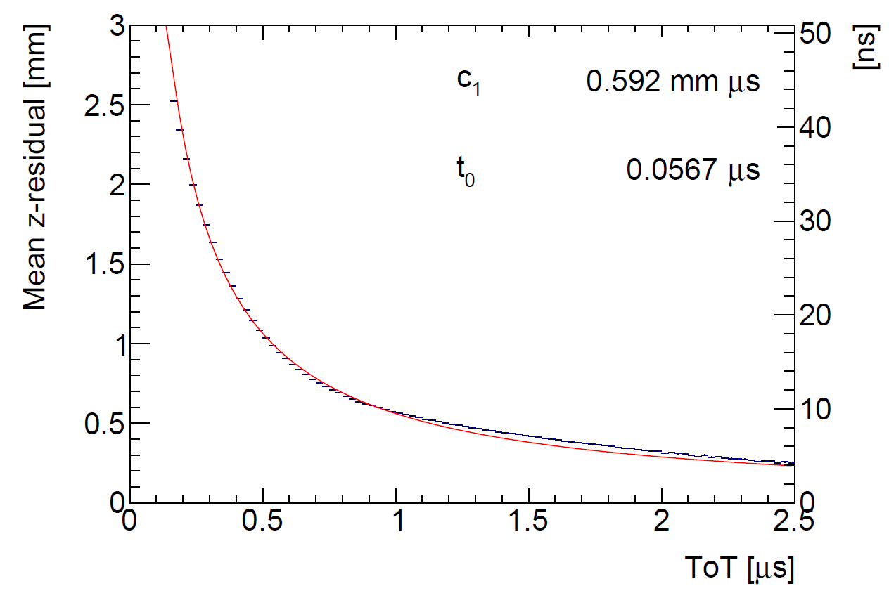
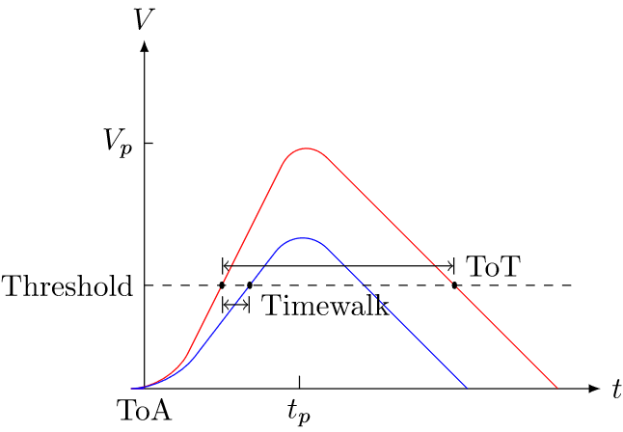

Time walk correction
Time walk error: time of arrival depends on signal amplitude
Time walk can be corrected using Time over Threshold (ToT) as a measure for signal strength
First order correction fitted and applied:
$$δz_{\text{timewalk}}=\frac{c_{1}}{t_{ToT}+t_{0}}+z_{0}$$
Distribution of residuals becomese more Gaussian after the time walk correction

Slide 30
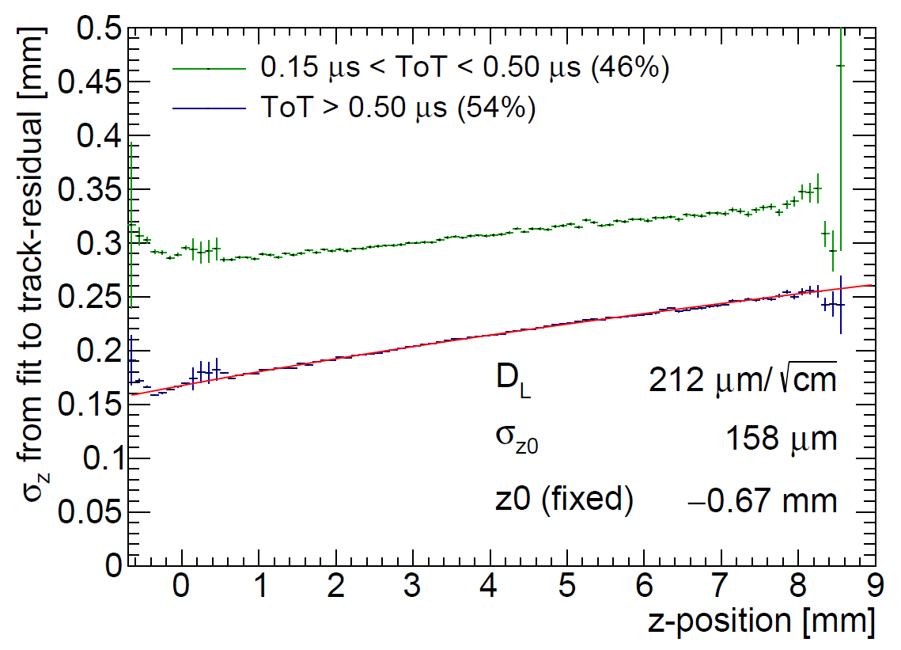
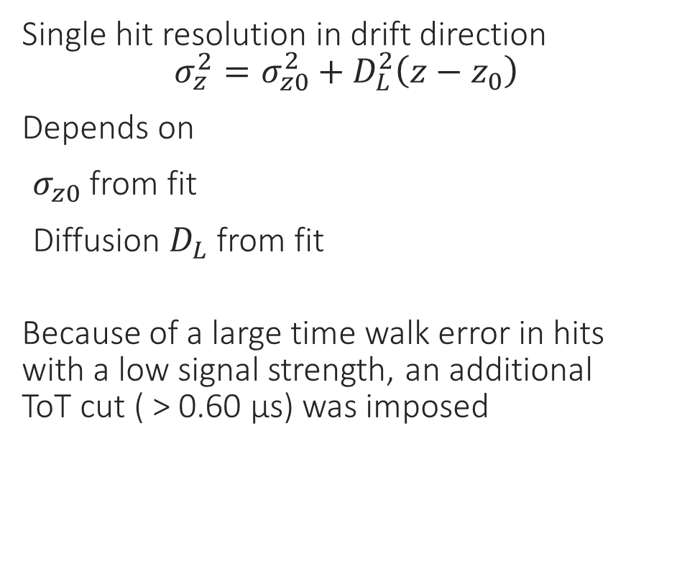
Hit resolution in the drift direction
Single hit resolution in drift direction
$$σ_{z}^{2}=σ_{z0}^{2}+D_{L}^{2}\left(z−z_{0}\right)$$
Depends on
$σ_{z0}$ from fit
Diffusion $D_{L}$ from fit
Because of a large time walk error in hits with a low signal strength, an additional
ToT cut ( > 0.60 µs) was imposed

Slide 31
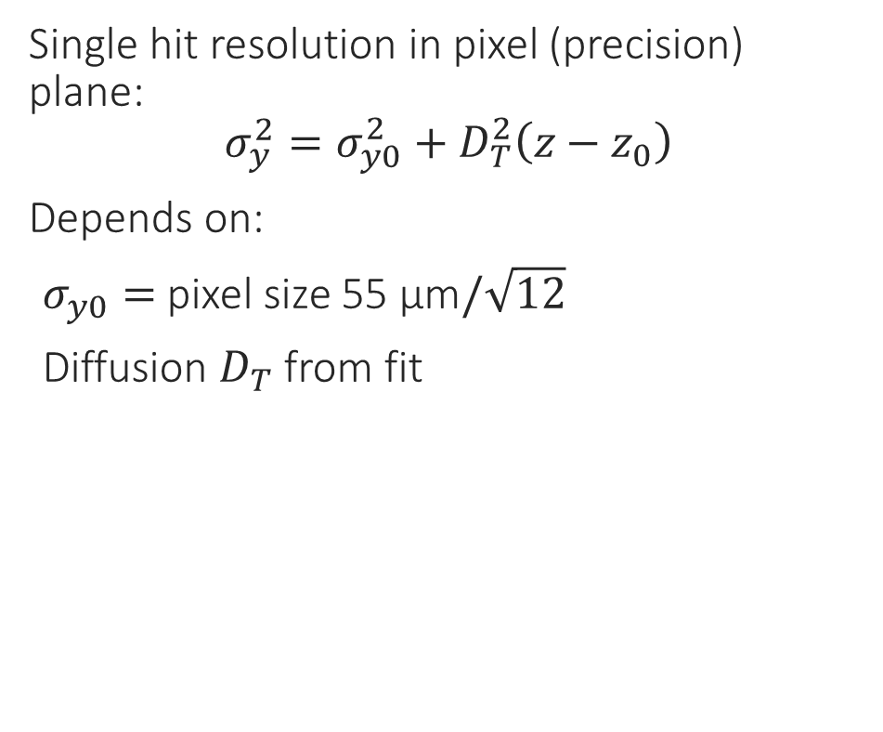
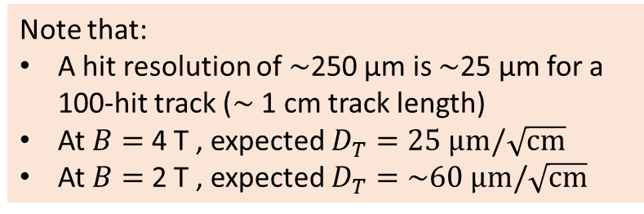

Hit resolution in the pixel (precision) plane
Single hit resolution in pixel (precision) plane:
$$σ_{y}^{2}=σ_{y0}^{2}+D_{T}^{2}\left(z−z_{0}\right)$$
Depends on:
$σ_{y0}=$ pixel size 55 µm$/\sqrt{12}$
Diffusion $D_{T}$ from fit
Scattering on guard
B$=0$ T
Note that:
A hit resolution of $\sim$250 µm is $\sim$25 µm for a 100-hit track ($\sim$ 1 cm track length)
At $B=$ 4 T , expected $D_{T}=25 \text{μm}/\sqrt{\text{cm}}$
At $B=$ 2 T , expected $D_{T}=\sim 60 \text{μm}/\sqrt{\text{cm}}$

Slide 32
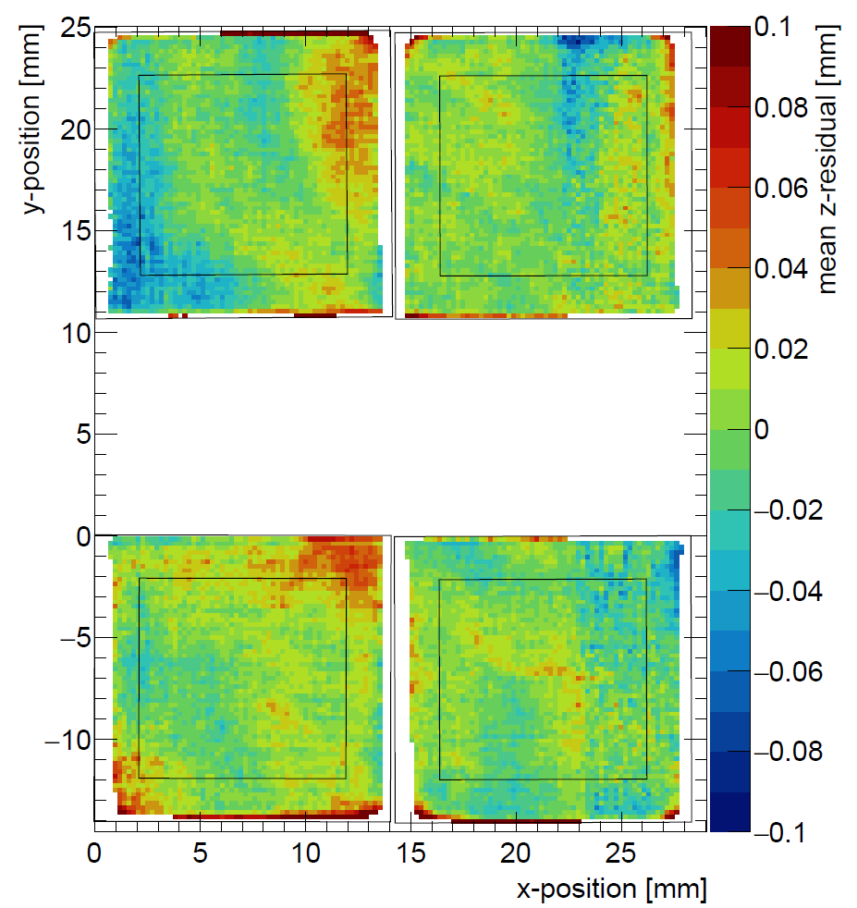
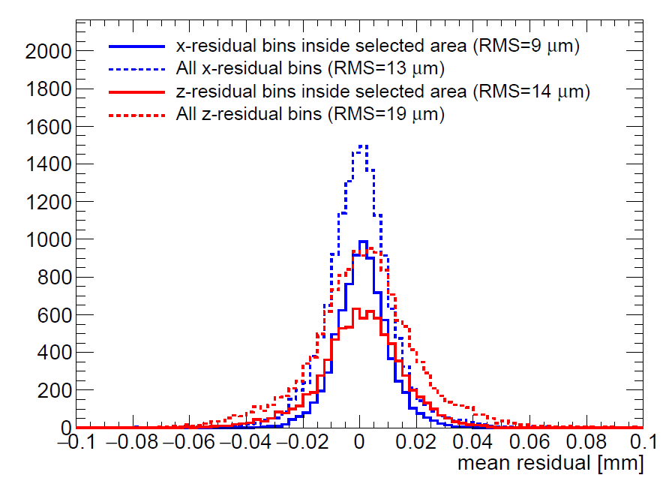
Deformations in pixel plane and drift direction
Each bin displays mean of residuals from 4 × 4 pixels
The RMS in the center of the chip is 9 µm (pixel plane after correction) and 14 µm (drift direction), which indicates small systematic errors
Corrected x deformations
Pixel (precision) plane
z deformations
Drift direction

Slide 33
8 quad module development
8 quad test box with (32 chips)
Simultaneous read out through one SPIDR board using a data concentrator
Field wires added to improve electric field, and reduce deformations
New field wires

Slide 34
8 quad module development
Laser test indicate a reduction in electric field deformations with field wires
Early 2020 test beam planned at DESY with 1 T magnetic field
Preliminary
Uncorrected residuals from quad test beam
RMS: 32 µm
Uncorrected residuals from laser test with field wires
RMS: 17 µm

Slide 35
Detection of Higgs bosons
Higgs production process:
$e^{+}+ e^{−}→Z+h$
Higgs bosons $h$ and $Z$ bosons are detected through their decay products
Detectors are organised as shells around the interaction point
The time projection chamber measures the trajectory of charged particles
Time projection chamber
Z
e⁺
e⁻
h

