Slide 1
Pixel TPC research plans
Yevgen Bilevych, Klaus Desch, Sander van Doesburg, Jean-Paul Fransen, Harry van der Graaf, Markus Gruber, Fred Hartjes, Bas van der Heijden, Kevin Heijhoff, Charles Ietswaard, Dimitri John, Jochen Kaminski, Peter Kluit, Naomi van der Kolk, Auke Korporaal, Cornelis Ligtenberg, Oscar van Petten, Gerhard Raven, Joop Rövekamp, Tobias Schiffer and Jan Timmermans
GridPix improvement of resistivity TPX3 layer SiN
Ion Back Flow measurement Quad
Negative Ion Pixel TPC tests
TimePix4 potential
Test beams 8-Quad module

Slide 2
GridPix improvement of resistivity TPX3 layer SiN
In the post processing a resistive layer is put on the TP3 chip
This protects the device from sparks
In the quad beam tests it was found out that the SiN layer charges up at very high rates (10 kHz)
Yevgen is investigating how to reduce significantly the resistivity of the SiN layer; this will reduce the charge up
Different trial samples will be made in 2020
Production of TPX3 wafers with InGrids @ IZM Berlin
Bonn will have a new Silicon Lab Summer 2020

Slide 3
Ion Back Flow measurement Quad
Ion Back Flow are the ions created in the avalanche process that flow back in the TPC volume
For the use of a pixel TPC at the CEPC it is important to know and reduce the Ion Back Flow (IBF)
It is in general known that a Grid Pix has a low IBF probability O(0.1%)
It is possible to measure the IBF using the Quad. One can extrapolate this number to the current operation point at a gain of 2000. This will be done beginning 2020

Slide 4
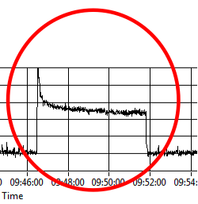
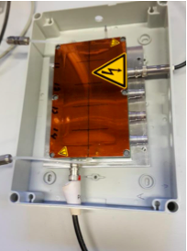
Negative Ion pixel TPC
There is another application for a pixel TPC using negative ions
The idea for a NITPC was presented by Martoff et al. in NIMA A 440 (2000) 355
Use a gas CS₂ (SF₆) here negative ions are formed. They drift slowly to the read-out plane. These gasses have a very small diffusion coefficient: high resolution - interesting for pixels
NITPC with GEM read-out experiment for dark matter searches Drift IIb
Fred started to look whether one could use Ar-CS₂ 98.8/1.2 gas mixture and run it at atmospheric pressure.
Indeed signals were observed with a 90Sr source for a V grid -370 V. Similar signal as the standard T2K gas.
Will proceed in 2020 to test a single chip
measure the diffusion “very thin” laser tracks …

Slide 5
TimePix 4 potential
Advantages of the Timepix4 (see also Fred his talk)
Larger area than TPX3 about factor 3.5
Better connectivity more space
Lower power consumption (0.55 W/cm²) than TPX3
Possible use of Through Silicon Vias (TSVs)
Current Quad coverage is about 69% could reach > 90%
Start with TPX4 when available; surface is equivalent to Quad
Can use simpler PCB (significant cost reduction)
Don’t need multiplexer to combine TPXs
Several years effort: need to get some steps approved in running of 2020
Will organize a brainstorm meeting with Bonn, Nikhef R&D
Support will be easier with ILC approved or CEPC funding

Slide 6
Test beams 8-Quad module
It is important to test the 8-Quad module in a test beam
The multiplexer that combines the signals from different quads needs to be operated and commissioned
Expect this to happen beginning 2020
Probably we will perform a pre-test for the test beam, either at DESY running parasitically, or in Bonn before the Summer
The ultimate test beam in DESY is now scheduled for August 2020
We will take data with a silicon telescope that will allow us to measure the deformations for a module (see Critical Items … https://agenda.linearcollider.org/event/8362/contributions/45065/)

