Slide 1
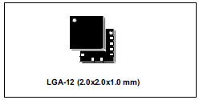
Playing with LSM303AGR

Slide 2
Compass boards continuing source of entropy in the collaboration
Accuracy, reproducibility
Transfer outside -> inside dom
Question:
Does the bare device reach resolution stated in the specs?

Slide 3
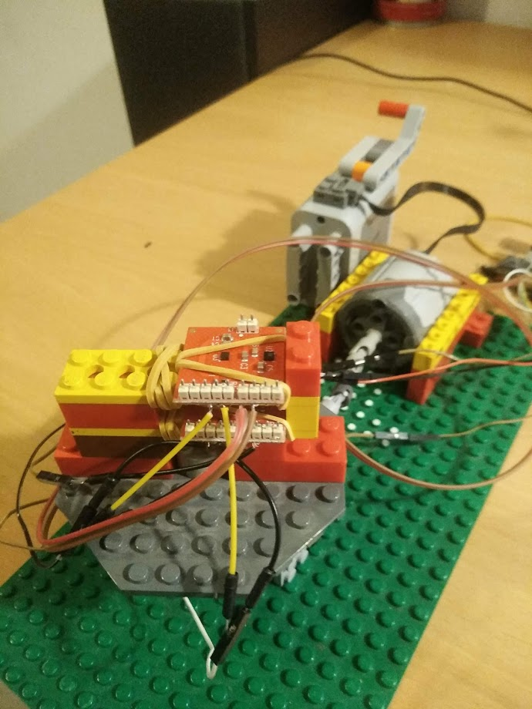
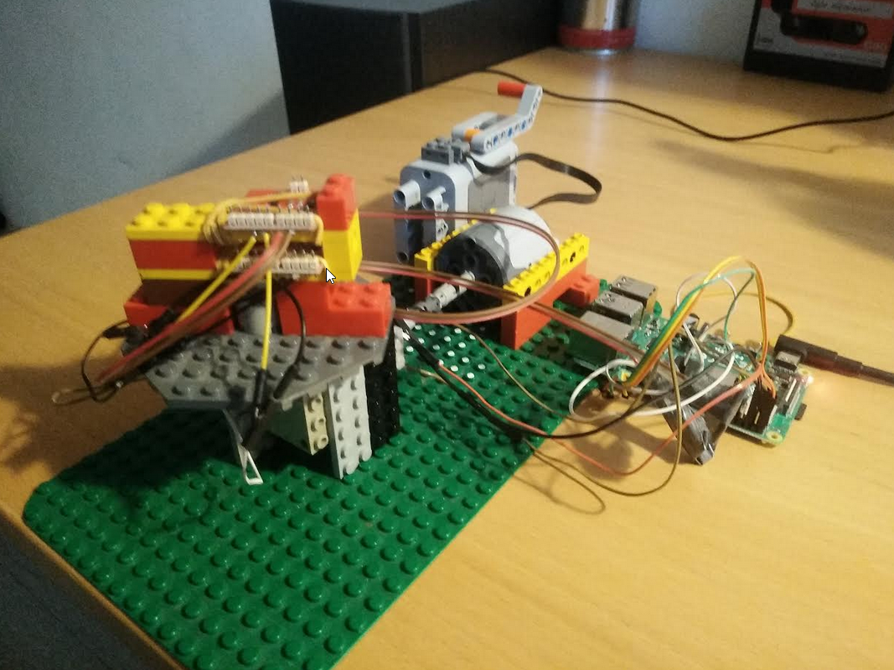
setup
Two identical devices in same
orientation. (idea was to separate internal noise from external influences)
Raspberry pi using for i2c readout.
Non-metalic turn-table setup

Slide 4
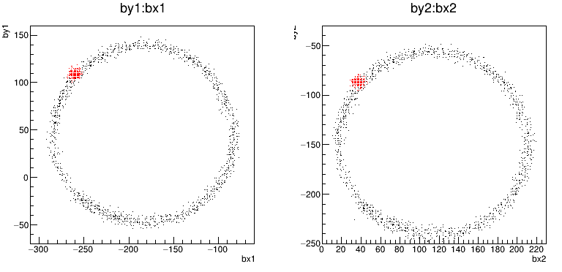
results
Radius ~ 100 (150 mGaus)
Output: Bx,By,Bz in units of 1.5 mGaus ( =0.3 % of Earth Mag Field).
full dynamic range = 50 Gaus!, -
Earth magnetic field is about 0.5 Gaus
Surprise : offsets are ‘big’ (compared to Earth. Mag Field)
Stated “noise level” : 3-4.5 mGaus (depending on operating mode)
So that is 2-3 units.

Slide 5
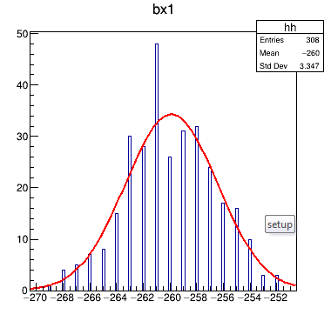
Noise / jitter / stability
Stationary compass,
1 minute @ 5 Hz
Sigma = 3.45 units ( = 5.2 mGauss)
[stated = 4.5 mGaus).
Not too bad.
Angle = 2 degrees
3.45
100
Expect angular uncertainty from ‘noise’ : sigma = 2 degrees

Slide 6
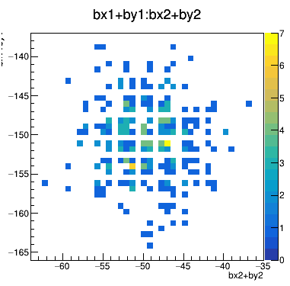
Correlation between sensors?
No correlation beween ‘noise’ in
Sensor 1 and Sensor 2.
(each sensor is sampling the B-field
at 10 Hz, So correlations on smaller
time- Scales not excluded).
Bx1+by1

