Slide 1
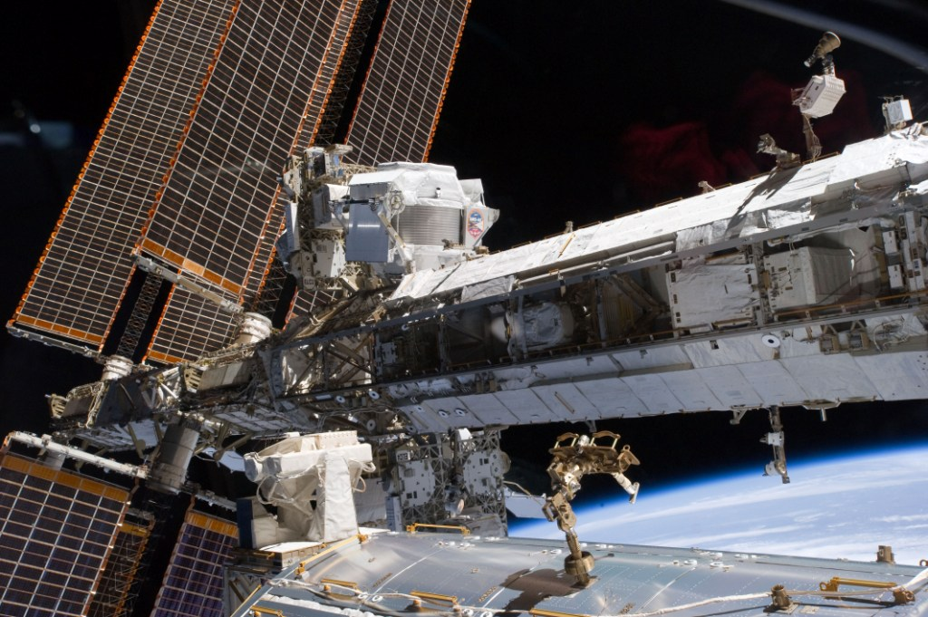
Inference of the Local Interstellar Spectra of Cosmic-Ray Nuclei Z ≤ 28 with the GALPROP–HELMOD Framework: Prediction Capability and Hints of Excesses
N. Masi (University of Bologna, INFN-Bo),
M. J. Boschini (INFN-Mib),
S. Della Torre (INFN-Mib),
M. Gervasi (INFN-Mib),
D. Grandi (INFN-Mib),
G. Jóhannesson (Uni Iceland),
G. La Vacca (INFN-Mib),
I.V. Moskalenko (Stanford),
S. Pensotti (INFN-Mib),
T.A. Porter (Stanford),
L. Quadrani (INFN-Bo),
P.G. Rancoita (INFN-Mib),
D. Rozza (INFN-Mib),
M. Tacconi (INFN-Mib)
Nicolò Masi

Slide 2
Explaining Z ≤ 28 CRs physics
by means of GALPROP and HelMod
Thanks to AMS-02 high precision data we can constrain CRs production and propagation at the % level;
AMS-02 published data can be fitted in the combined framework of GALPROP and HelMod (for Galactic and Heliosphere propagation, respectively) with a single model, capable of reproducing all primary and secondary spectra at the same time (see ApJ 840:115 No 2, 2017; ApJ 854:94 No 2, 2018; ApJ 858:61 No 1, 2018; ApJ 889:167, 2020; ApJS 250 27, 2020; ApJ 913 5, 2021; ApJ 925 108, 2022; ApJ 933 147, 2022);
The 28 proposed LISs fit Voyager-1, ACE-CRIS, HEAO-3-C2, Pamela, AMS-02, CREAM, ATIC-2 and recent NUCLEON, CALET and DAMPE data, from 10 MeV/n up to 200 TeV/n, representing a forecasting tool for astroparticle and solar physics.

Slide 3
MCMC Matrix Approach
Solution Of Heliospheric Propagation: Unveiling The Local Interstellar Spectra Of Cosmic Ray Species, The Astrophysical Journal 840:115 No 2, 2017
The Monte-Carlo-Markov-Chain interface to GALPROP was developed in Bologna from CosRay-MC and COSMOMC package, embedding GALPROP framework into the MCMC scheme;
The solar modulation is made using HelMod;
The experimental observables used in the MCMC scan include all primary CRs AMS-02 data and B/C ratio.
Va : Alfvén velocity
One order of magnitude of improvement for fundamental parameters uncertainties

Slide 4
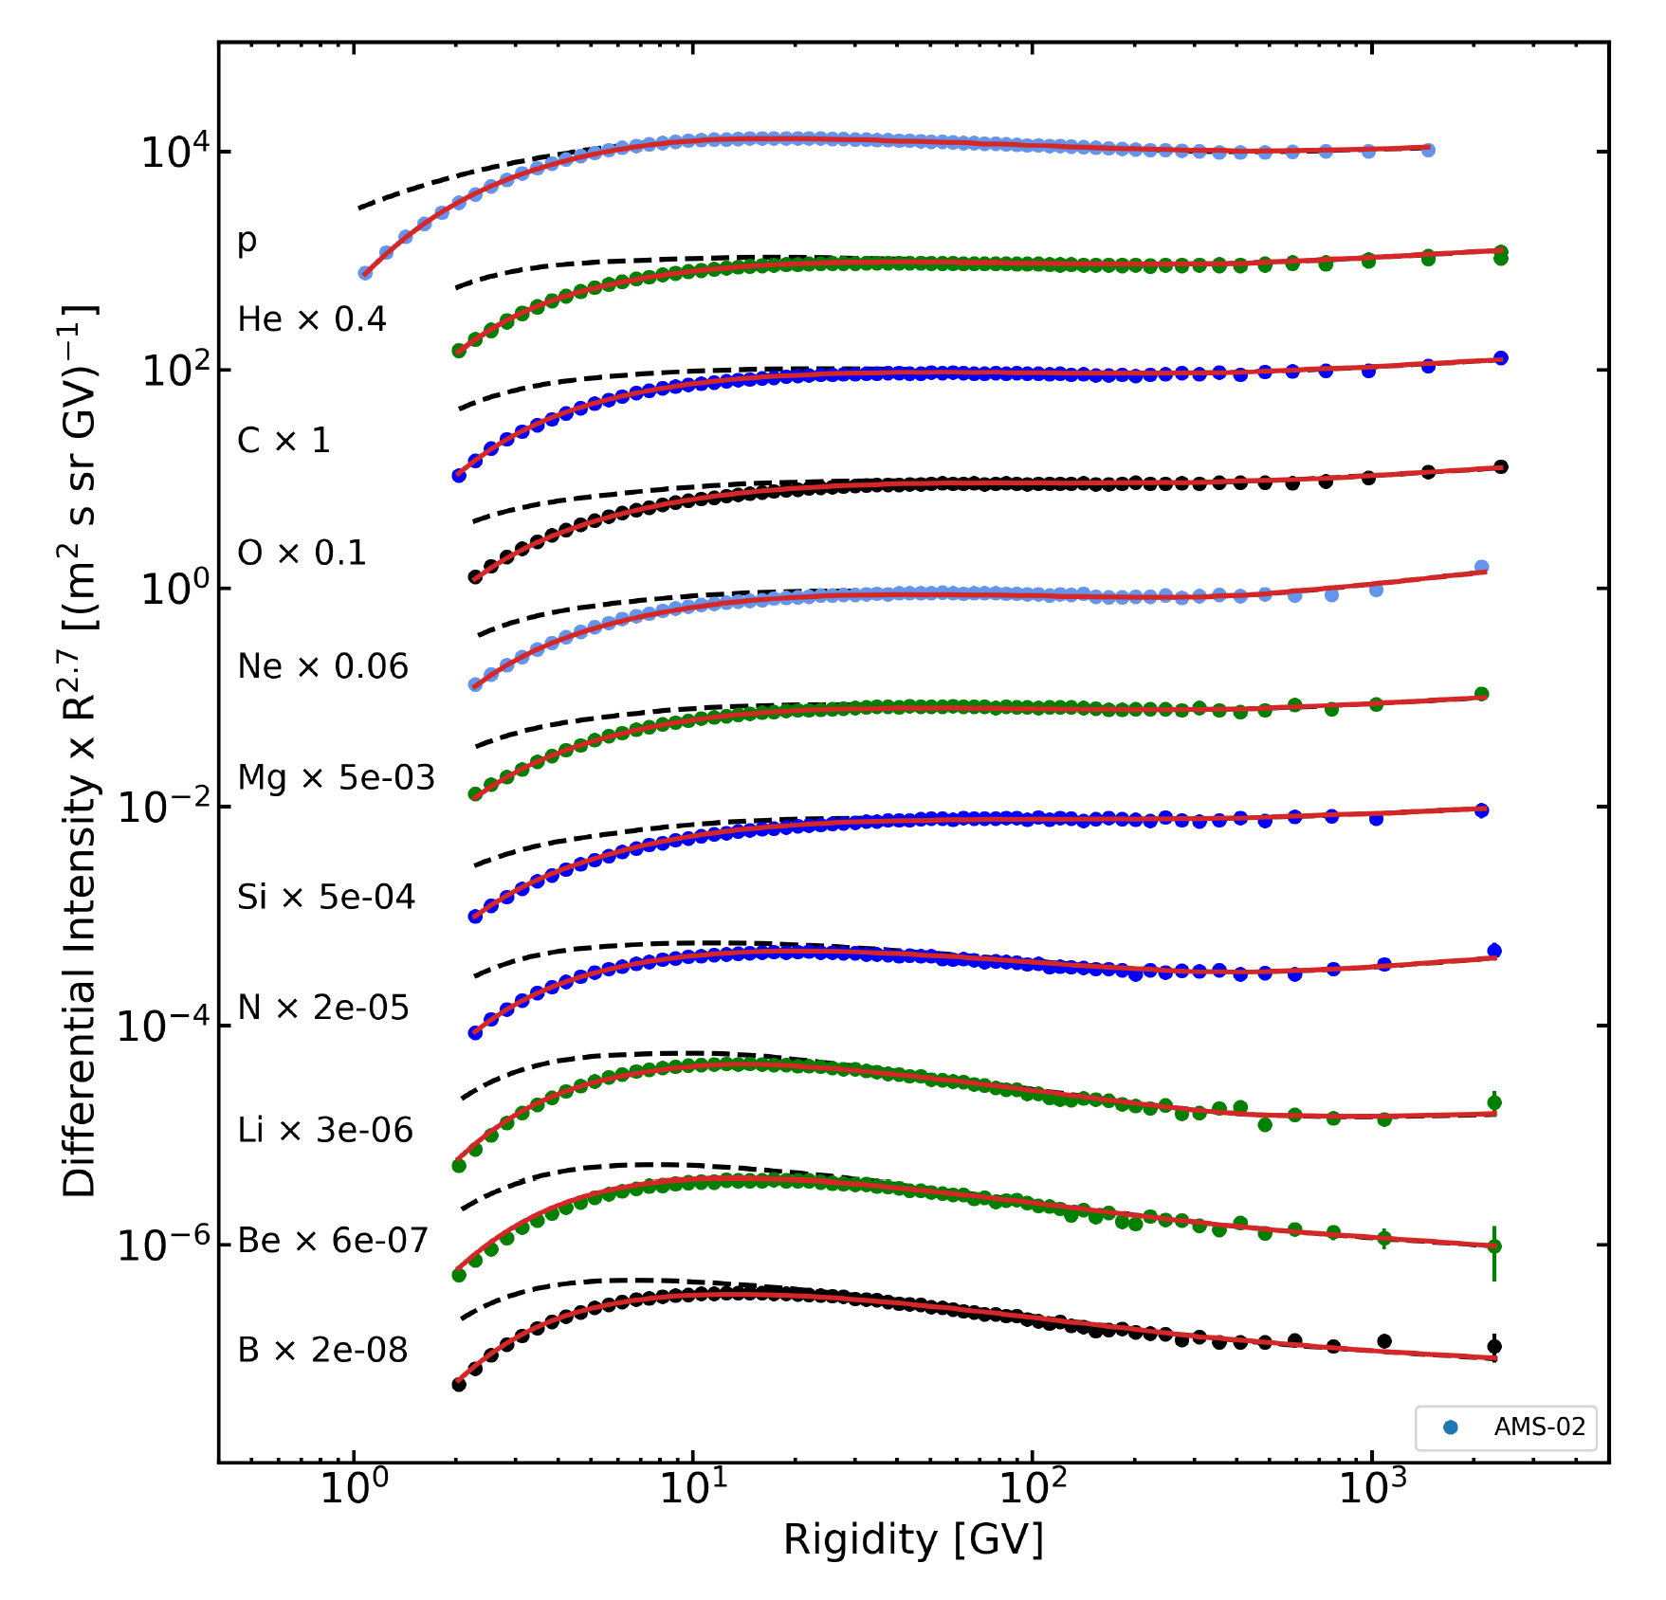
The Model confirms its prediction capability for all AMS-02 species with a single set of parameters
M. J. Boschini et al 2020 ApJS 250 27

Slide 5
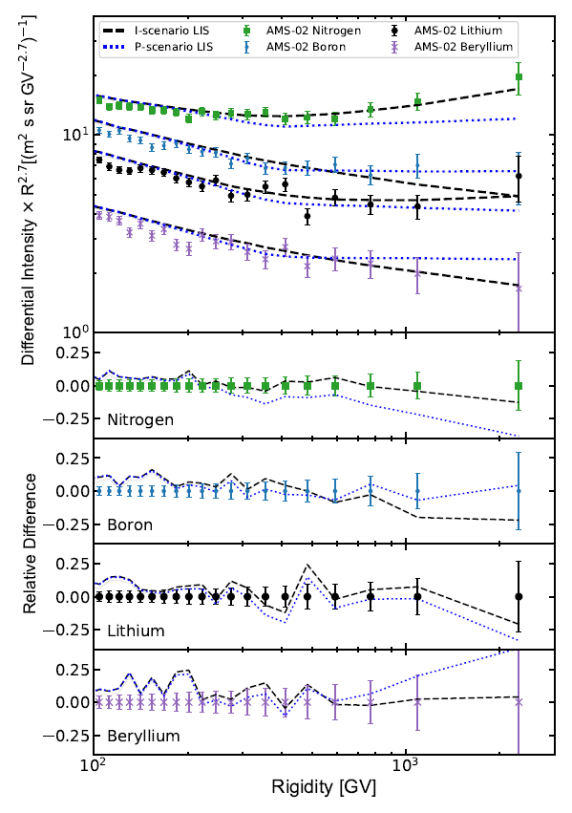
Injection versus Propagation scenarios to explain CRs hardening above 300 GV
I or P?

Slide 6
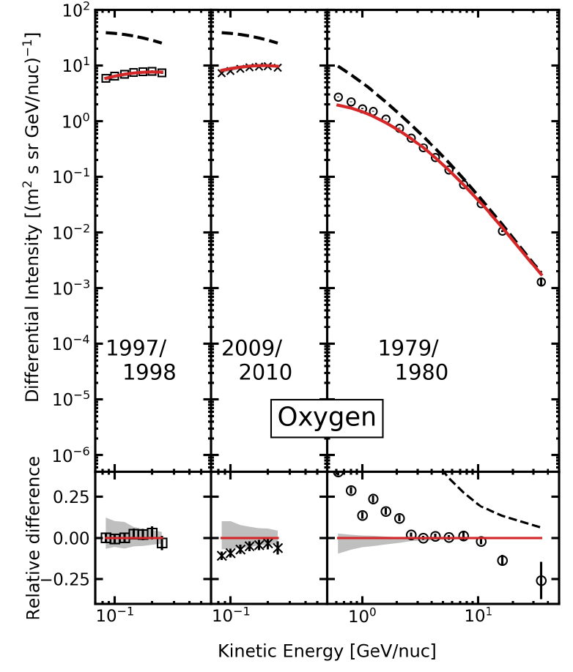
HEAO vs AMS-02 normalization
to forecast Z >14 nuclei
AMS-02 and HEAO normalization coincide at the % level in this region (2.65-10.6 GeV/n) for not to heavy species

Slide 7
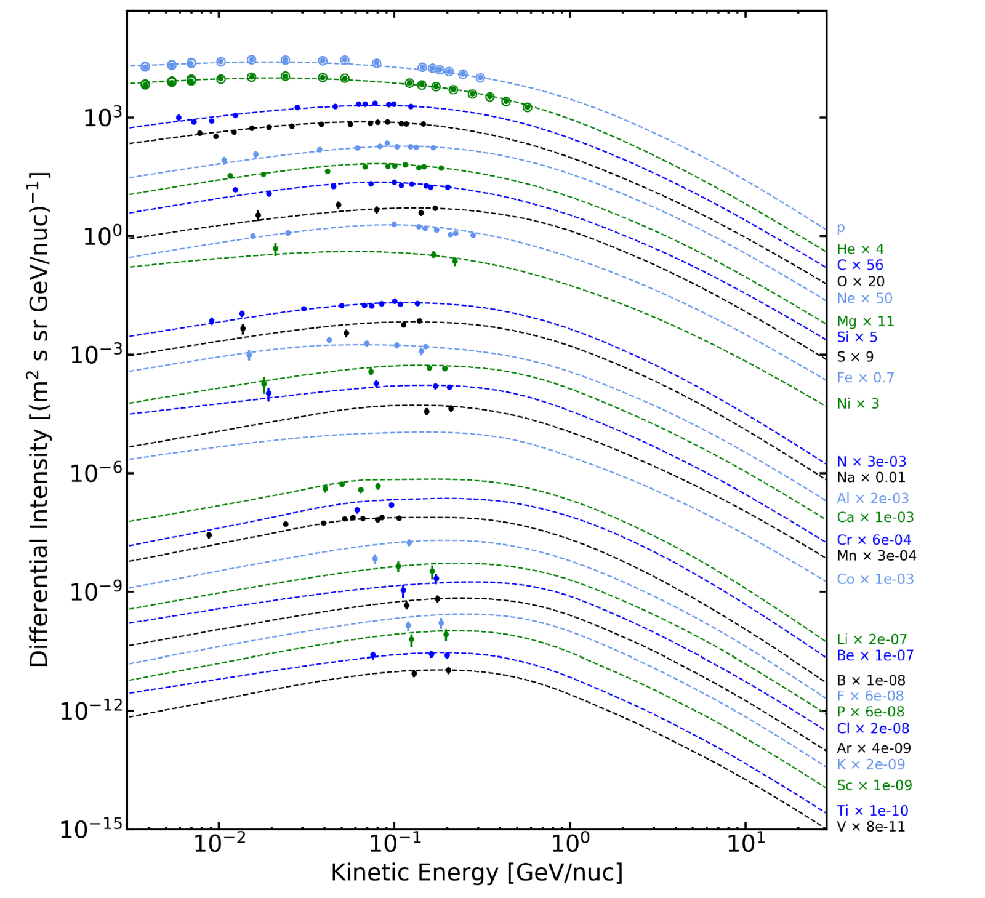
Interstellar spectra measured by Voyager-1
primary
All Z ≤ 28 are well reproduced
intermediate
secondary

Slide 8
Our website provides numerical LISs, formulas and plots
LISs will be futher
fine-tuned and updated on the website using incoming AMS-02 measurements
Some CR ions still requires the injection of an additional primary spectrum in some rigidity windows:
Lithium
Iron
Fluorine
Aluminum

Slide 9
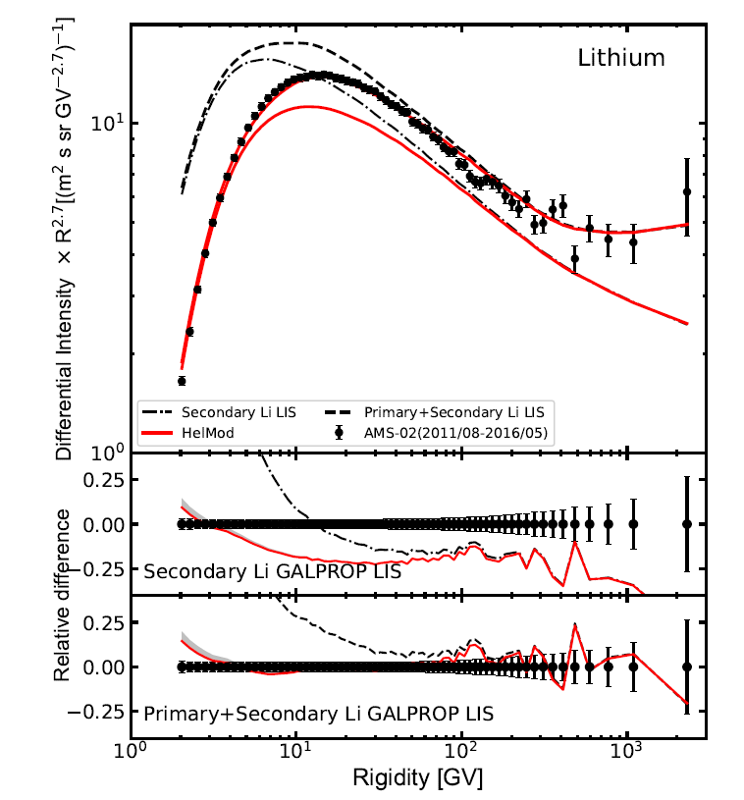
Primary Lithium
Boschini et al ApJ 889:167 2020
Examination of the Li isotopes production (from C and O) shows that the main reaction channels are well-constrained: a 20% error in one of them would correspond to only 2%–3% correction.
It is rather unlikely that cross-section errors are all biased on the same side leading to the observed 25% excess.
Primary ⁷Li through the Cameron-Fowler mechanism for intermediate-mass AGB (asymptotic giant branch) stars and Novae:
alpha-capture ³He(α,γ) ⁷Be
transport of ⁷Be into cooler layers
⁷Be decay (53.22 days) → ⁷Li
• Observation of blue-shifted absorption lines of partly ionized ⁷Be in the spectrum of a classical nova V339 Del about 40-50 days after the explosion is the first observational evidence that the mechanism proposed in 1970s is working indeed
• Consequent observations of other stars (V1369 Cen, V5668 Sgr and V2944 Oph, ASASSN-16kt [V407 Lupi], V838 Her) also reveal the presence of ⁷Be lines
• Primary Lithium from new stars processes is mandatory to explain AMS-02 measurement
25% lithium defect

Slide 10
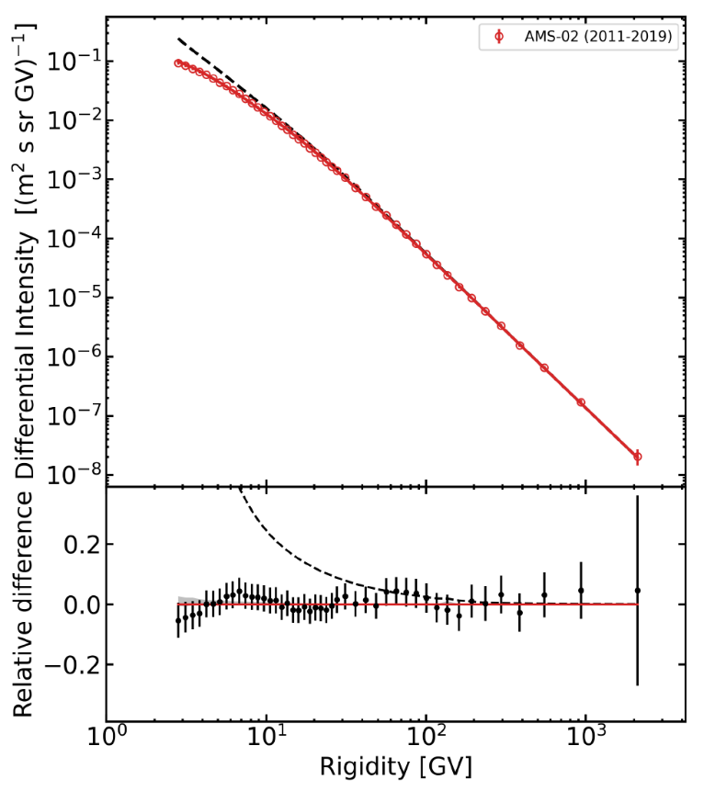
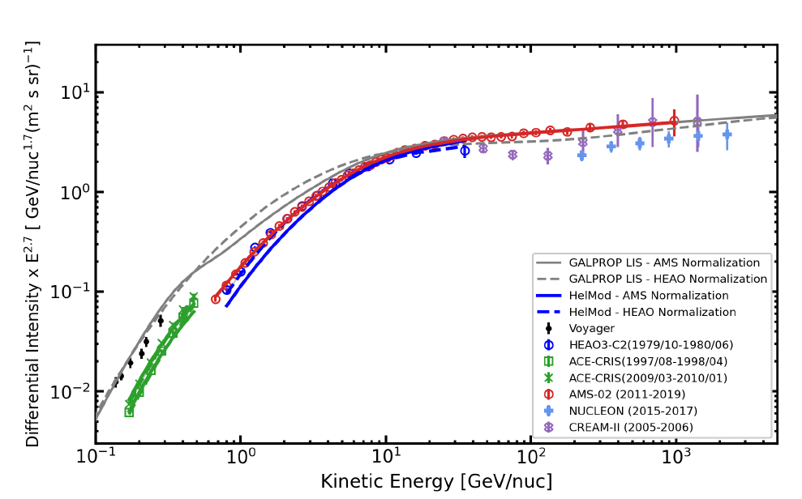
The new iron from AMS-02
Because of the large fragmentation cross section and ionization energy losses, most of CR iron at low energies is local
The analysis of AMS-02 iron spectrum together with Voyager-1 and ACE-CRIS data reveals the unexpected necessity of a bump in the iron spectrum at 1÷3 GV (0.2÷0.7 GeV/n)
Boschini et al ApJ 913:5 (2021)

Slide 11
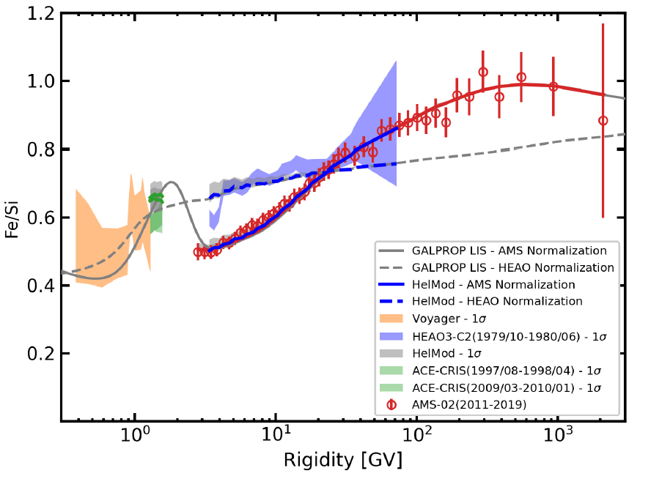
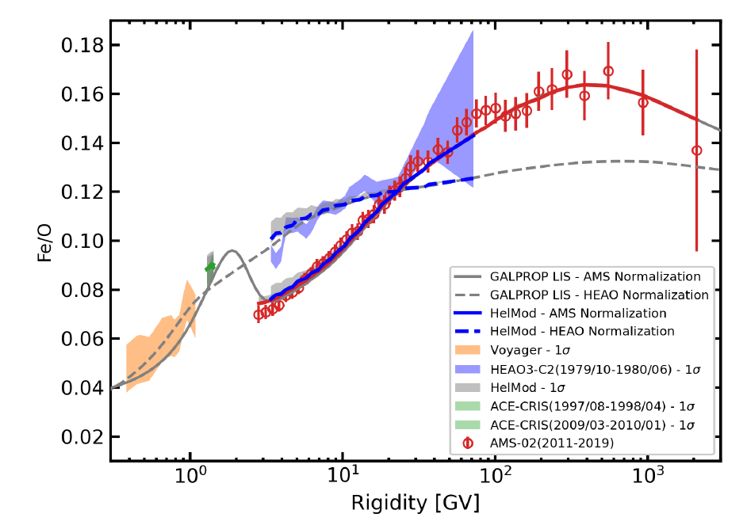
Iron to primaries ratios
The found excess fits well with recent discoveries of radioactive ⁶⁰Fe (half-life 2.6 million years) deposits in the deep ocean sediments, in lunar regolith samples and in the Antarctic snow. Such deposits can be made by SN explosions in the solar neighborhood.
Recent observation of ⁶⁰Fe in CRs by ACE-CRIS spacecraft implies that the low-energy CRs from the most recent SN are still around.
It is hard to establish the number of SNe events and their exact timing, but there could be several events during the last ∼10 Myr at distances of up to 100 parsecs (most likely in the Tucana-Horologium stellar group).

Slide 12
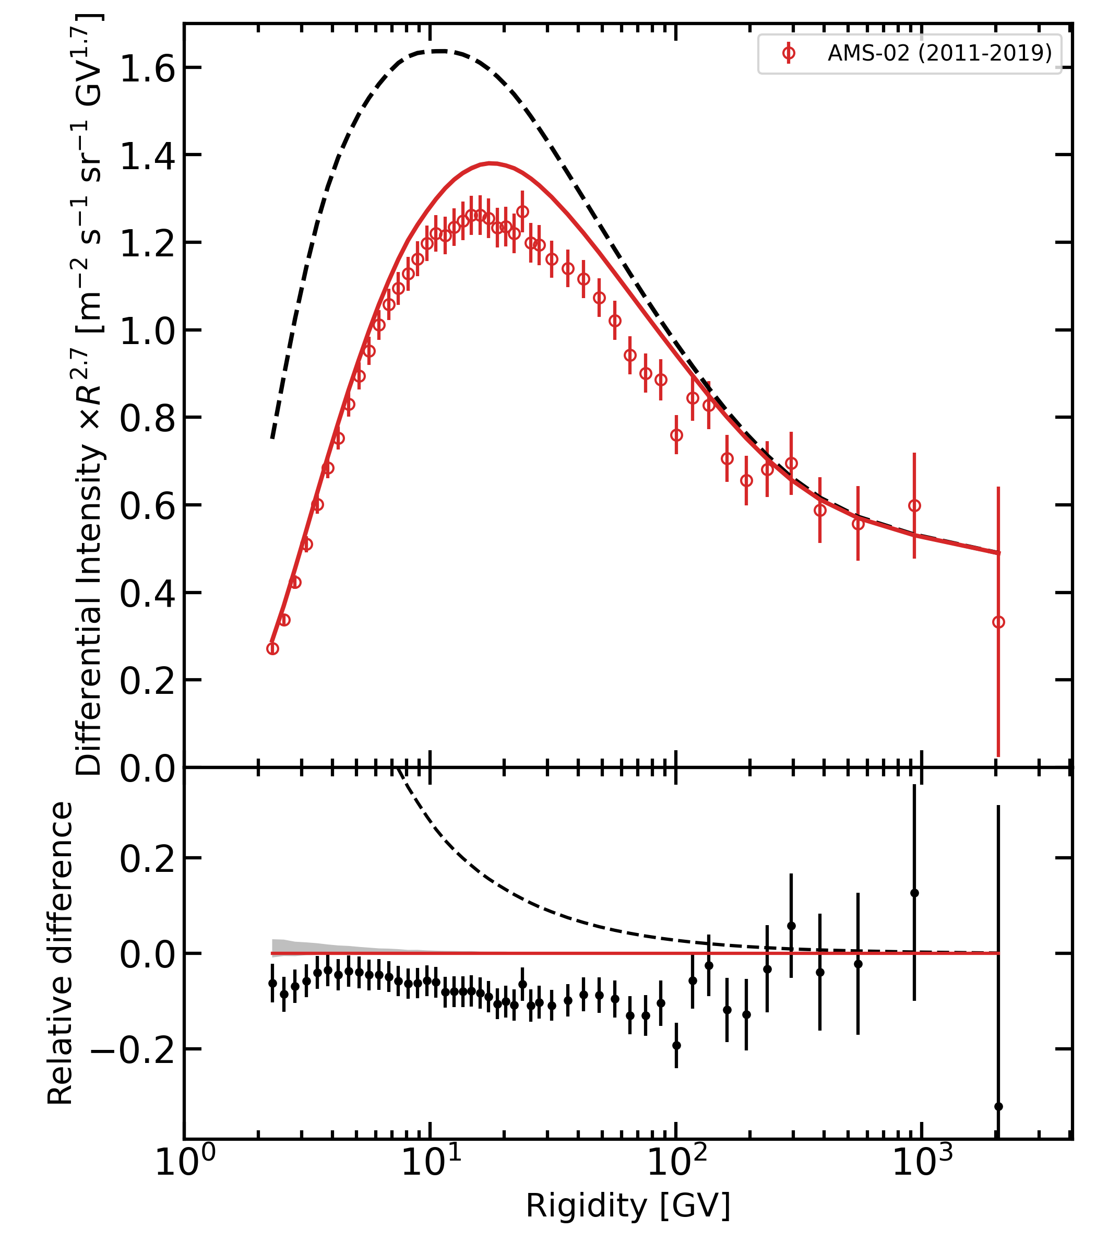
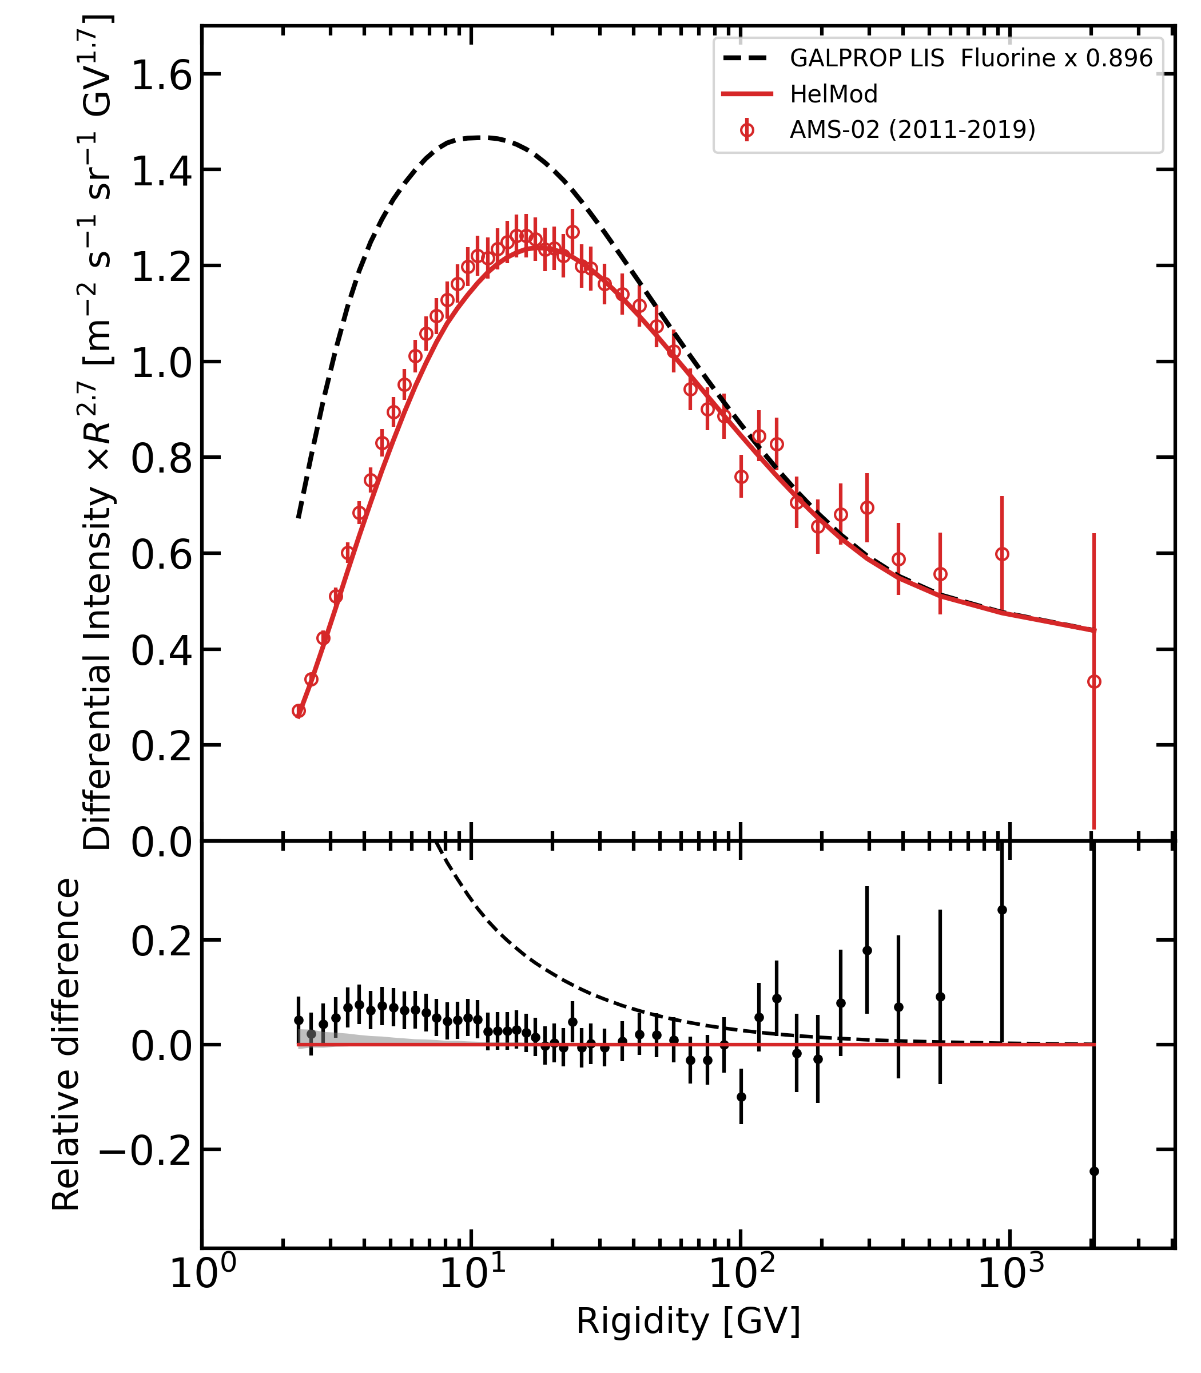
Fluorine spectrum
Sec+primary
Secondary only
Secondary renorm
Overall normalization (x 0.9) due to possible errors in the production cross sections ($\sim$constant)
Remaining excess < 10 GV is treated as a primary component
Boschini et al ApJ 925:108 2022

Slide 13
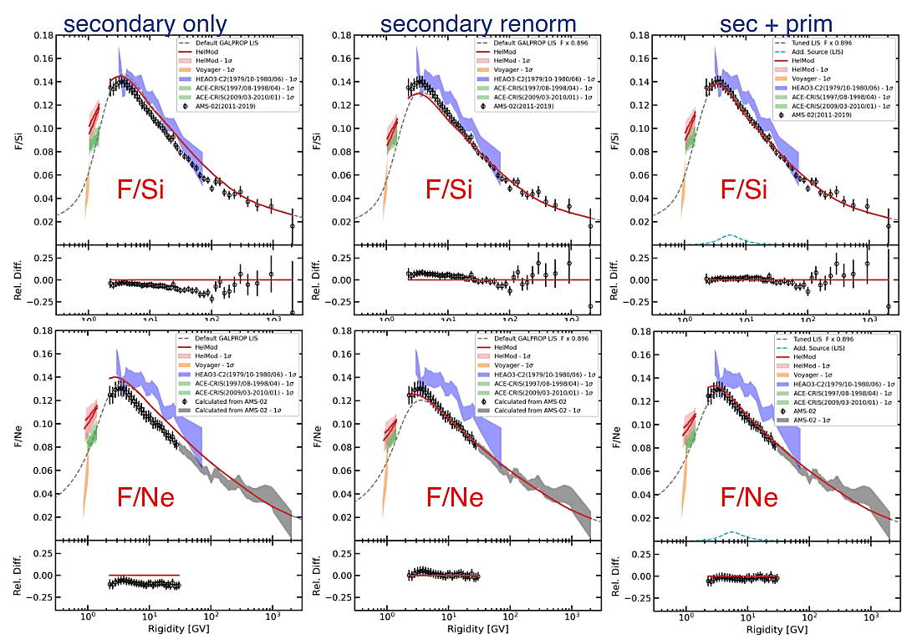
The origin of cosmic fluorine (from ¹⁴N) is still not well constrained: the main astrophysical sources of fluorine are thought to be SNe Type II, Wolf–Rayet stars and intermediate-mass AGB stars
They could be all important at different stages of chemical evolution of the Galaxy

Slide 14
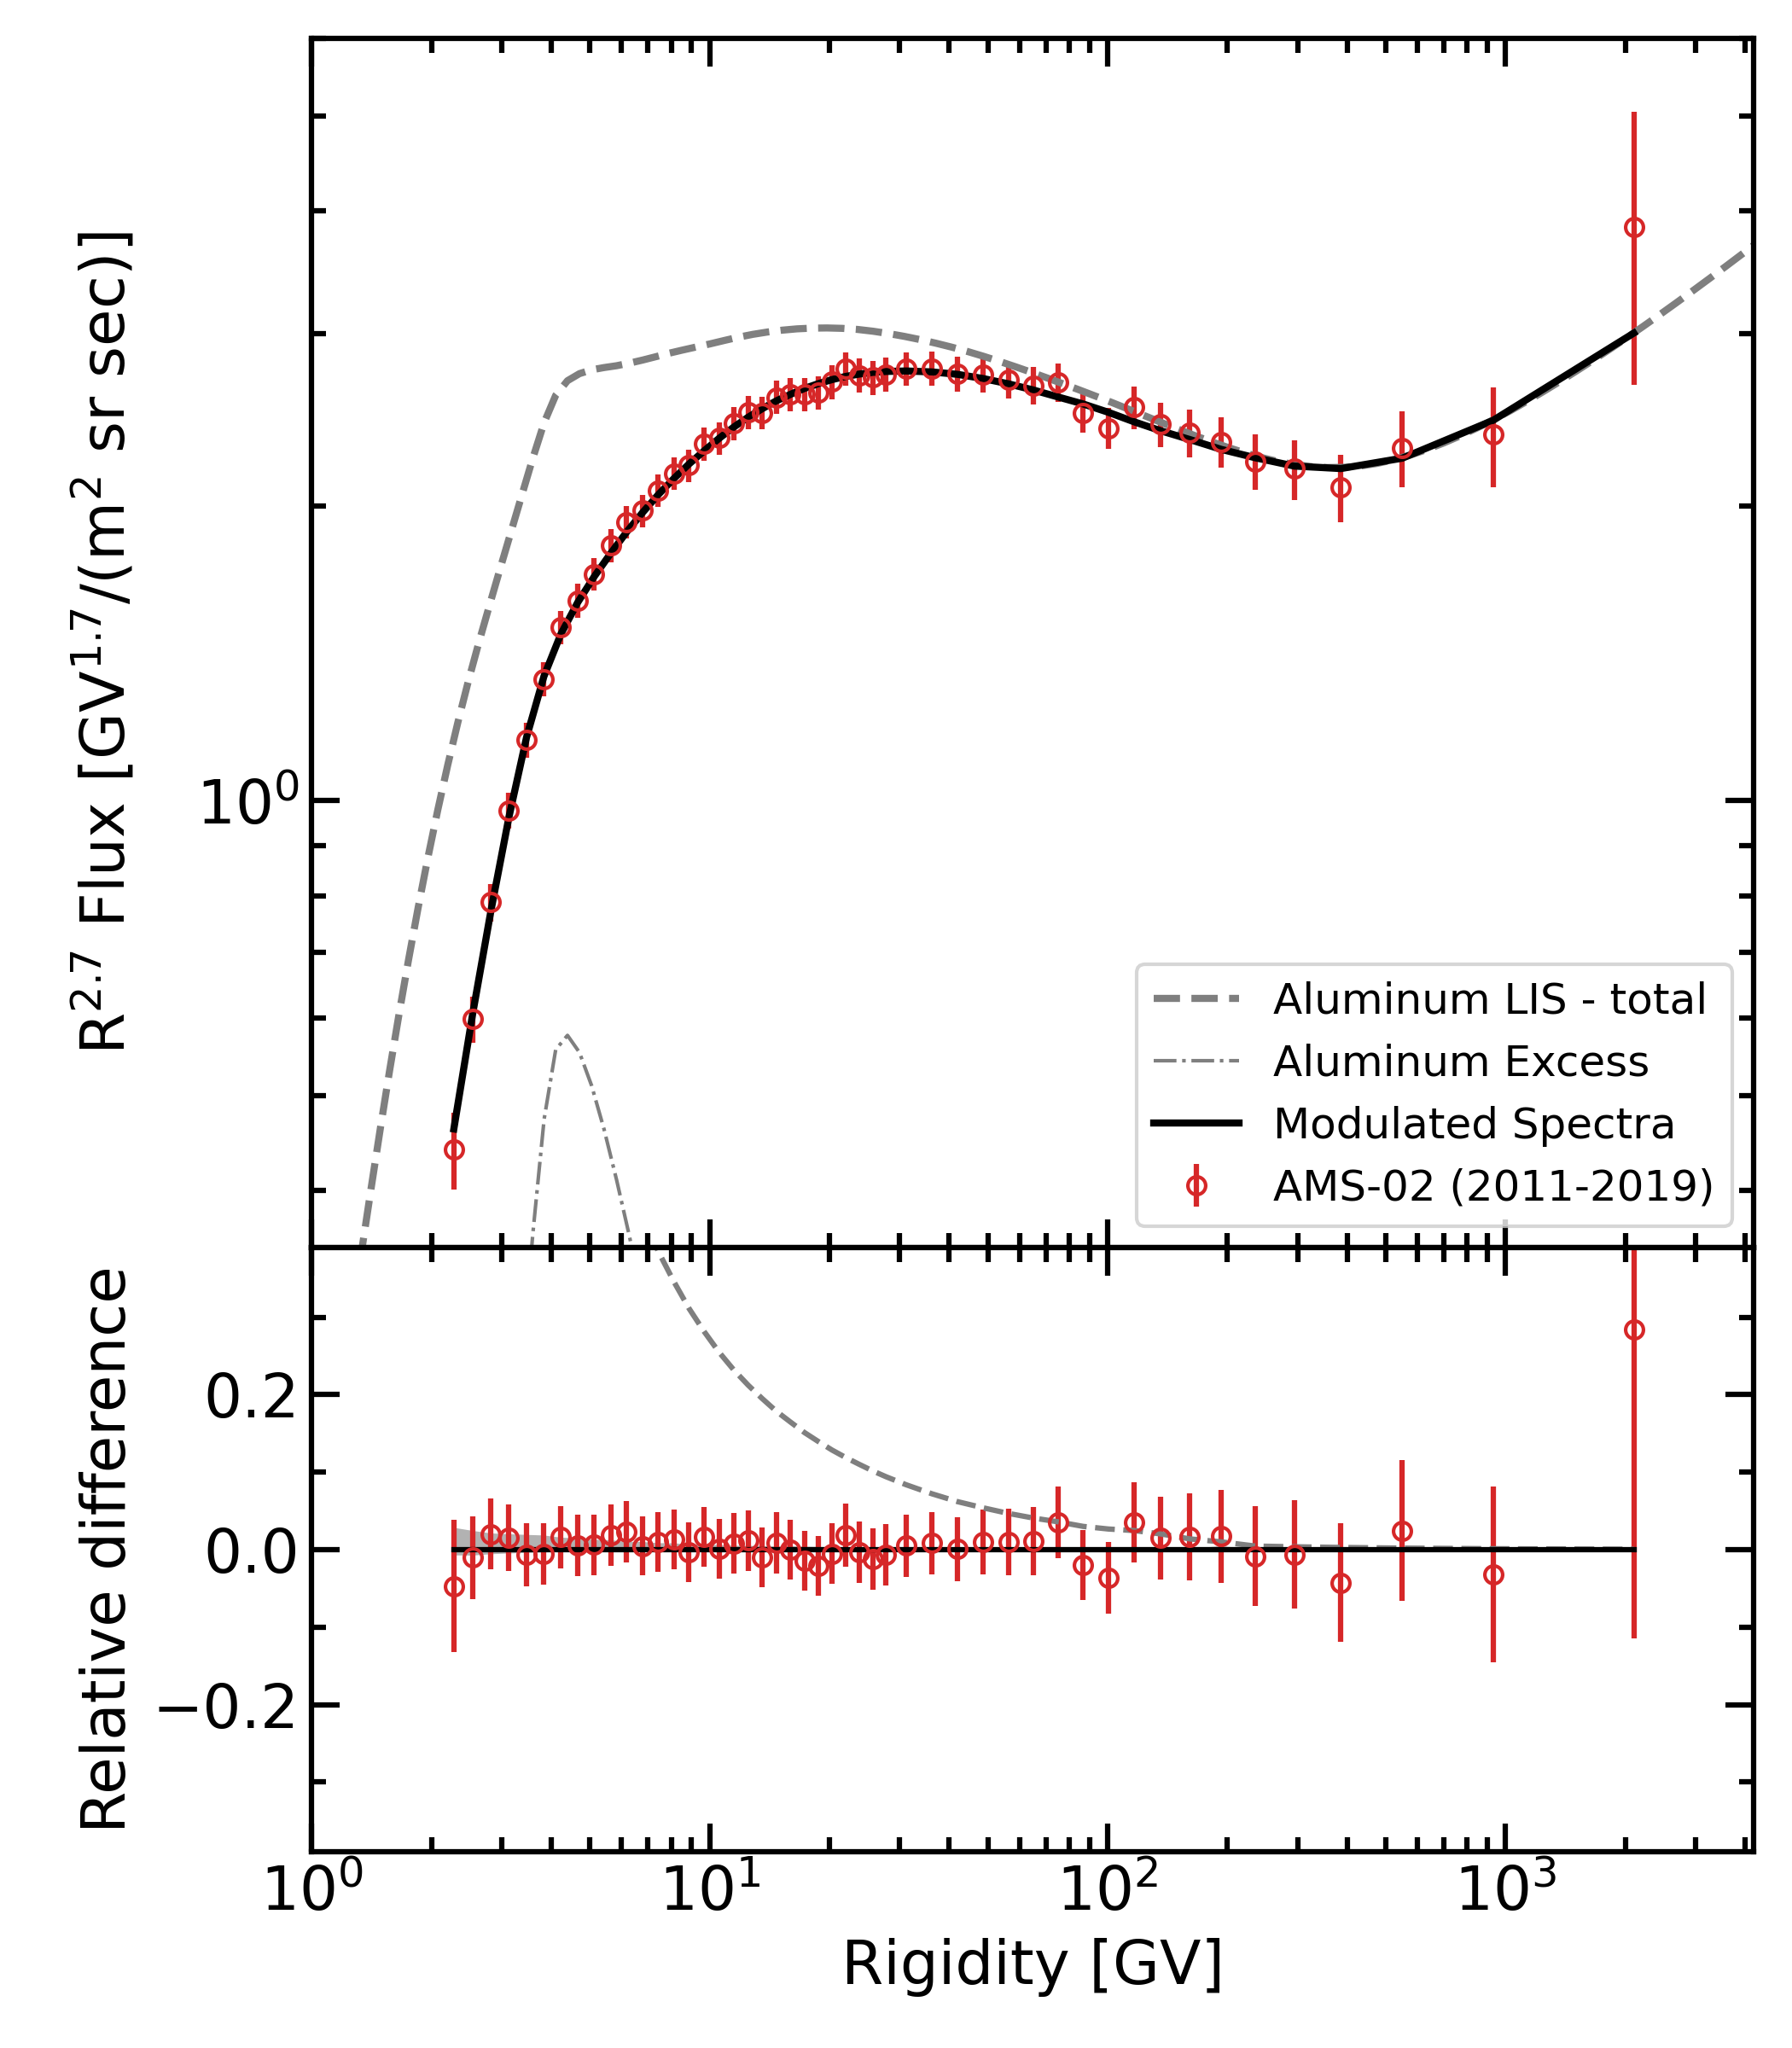
Aluminum
Recent AMS-02 spectra: Sodium and Aluminum
Boschini et al, ApJ 933 147 2022
There is no viable reason of why the Al injection spectrum in the 2–10 GV range should be different from its neighbors in the Si group

Slide 15
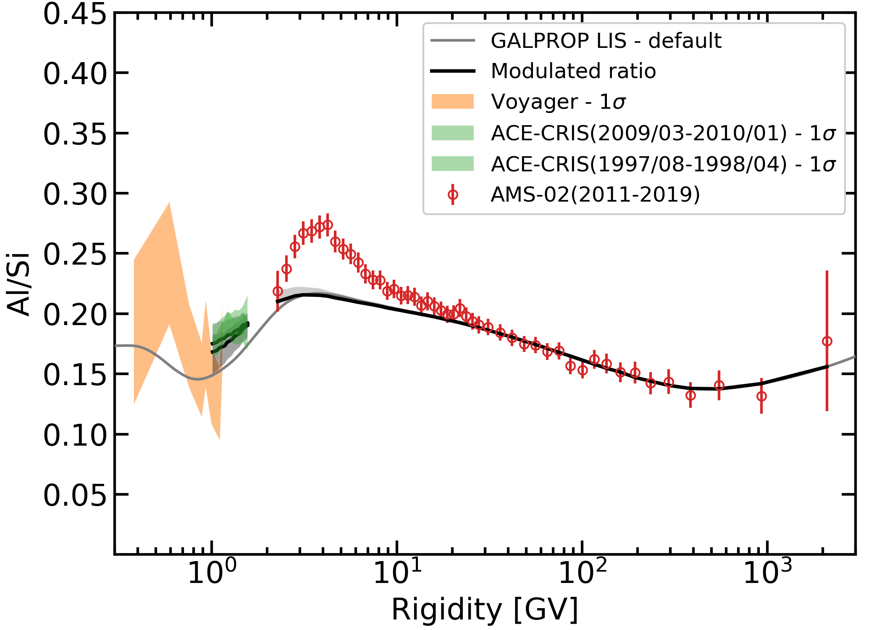
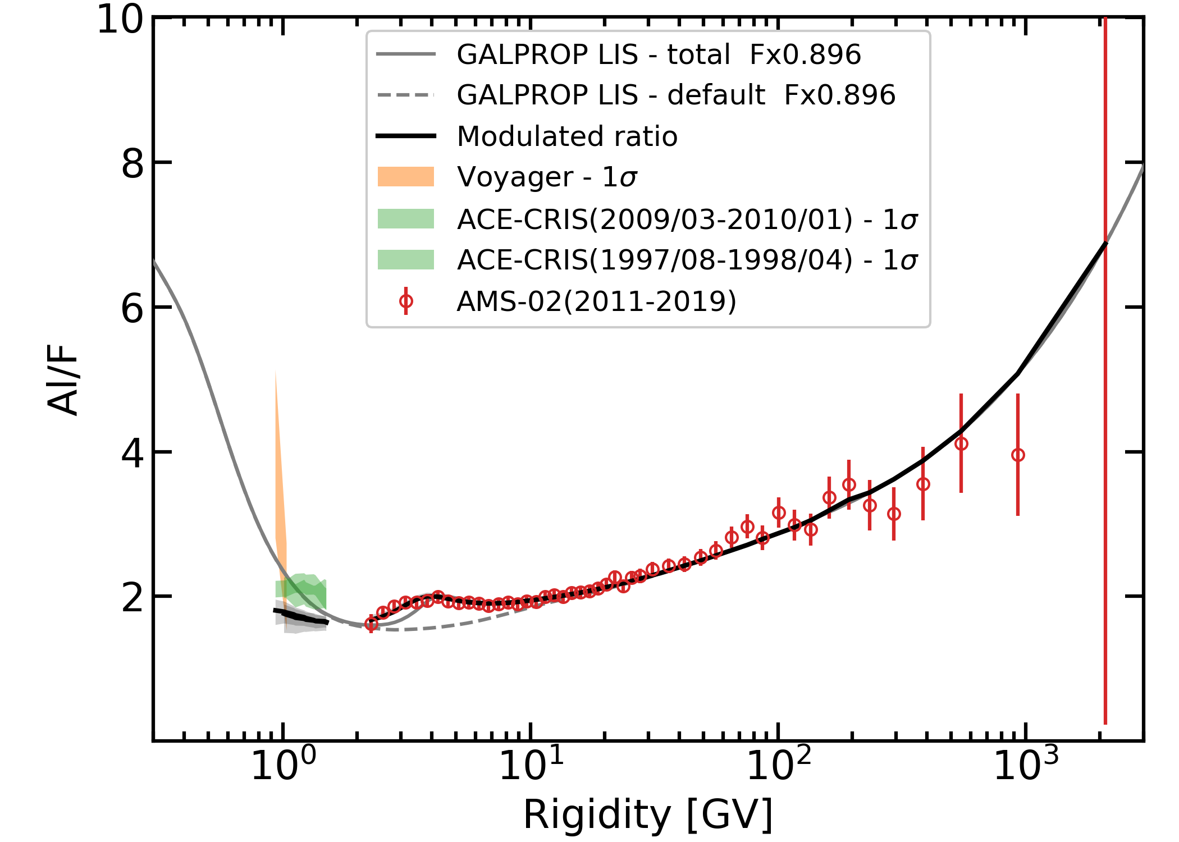
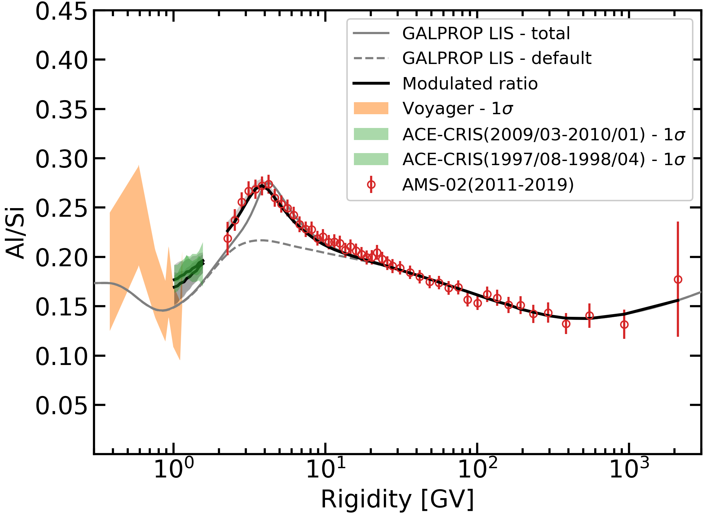
Without signal
With signal

Slide 16
Aluminum Excess
There are four possible physical reasons for the observed excess in the Al spectrum:
(i) an incorrect spectrum of ²⁸Si, the major progenitor of ^{26,27}Al
(ii) errors in the total inelastic cross sections of Al
Hardly account
for such excess
(iii) errors in the isotopic production cross sections of ^{26,27}Al
(iv) an additional local component of primary ²⁷Al
WR stars were already proposed to explain the observed anomalous ²²Ne/²⁰Ne, ¹²C/¹⁶O, ⁵⁸Fe/⁵⁶Fe ratios
All isotopic ratios measured with ACE-CRIS are consistent with ∼20% of WR material mixed with ∼80% material with solar-system composition
Since most of WR stars are found in the OB associations, they are the likely sources of a substantial fraction of CRs (Scorpius–Centaurus is located about 400 light-years from the Sun)
From observations of the distribution of the Galactic 1.809 MeV γ-ray emission line from ²⁶Al decay, potential sources include AGB stars, novae, core collapse supernovae, and Wolf-Rayet star winds
The sources of additional Al could be simultaneously also the sources of other rare isotopes, such as ⁷Li and ¹⁹F

Slide 17
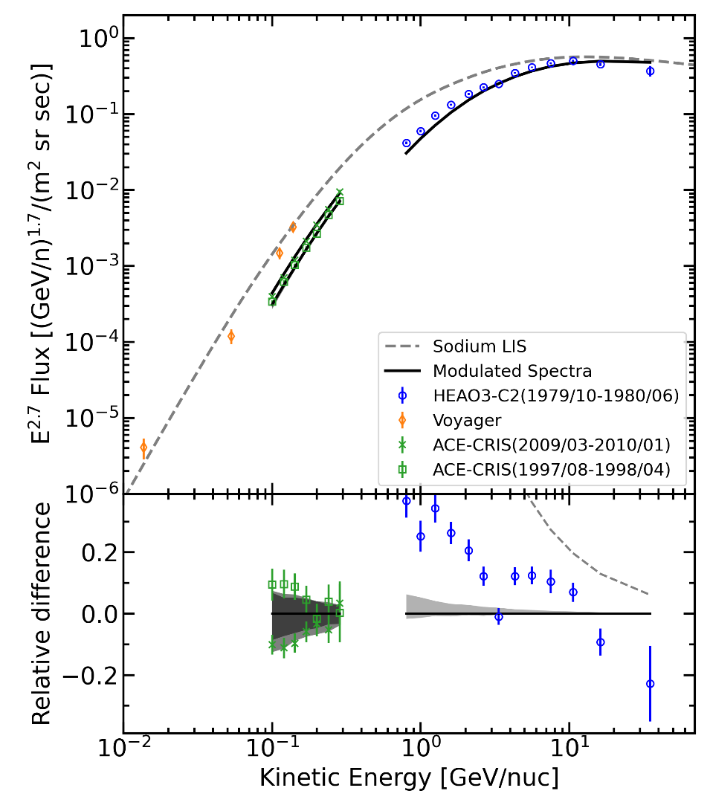
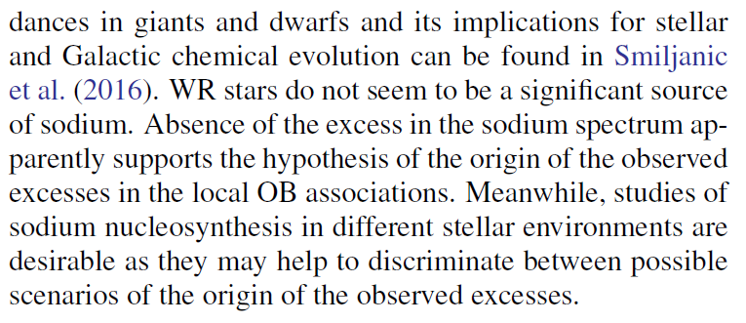
Sodium
Recent AMS-02 spectra: Sodium and Aluminum
No excess found

Slide 18
Conclusions
The analysis of nuclei by AMS-02 within the GALPROP–HELMOD framework, together with Voyager-1, HEAO-3-C2 and ACE-CRIS data, provided updated local interstellar spectra up to Z ≤ 28.
Al, F, Li and Fe spectra show significant excesses in some peculiar rigidity windows: contributions of local new sources are most likely.
The WR hypothesis, that was invoked to reproduce the observed isotopic ratios, could be also consistent with the observed excesses in Li, F and Al, while excess in primary Fe should be connected with a past SN activity in the Local Bubble.
Absence of a corresponding excess in sodium supports this hypothesis, as the WR winds are not a significant source of sodium.
The exploration of fine features in CR species has just begun, thanks to the data from the interstellar probes Voyager 1-2, ACE-CRIS and precise measurements by AMS-02: these features harbor the keys to understanding our local Galactic environment and the history of formation of the Solar System.

Slide 19
Backup

Slide 20
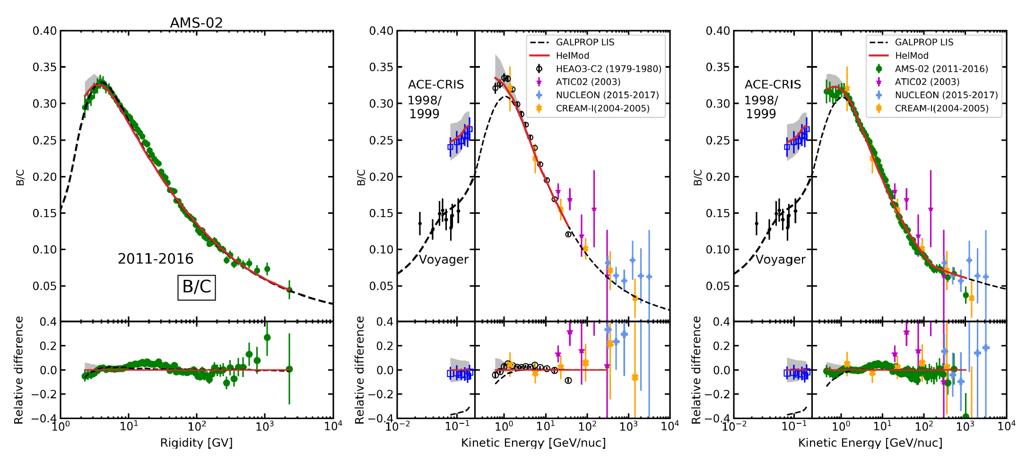
Updated secondary over primary ratio: B/C
Diffusive break case

Slide 21
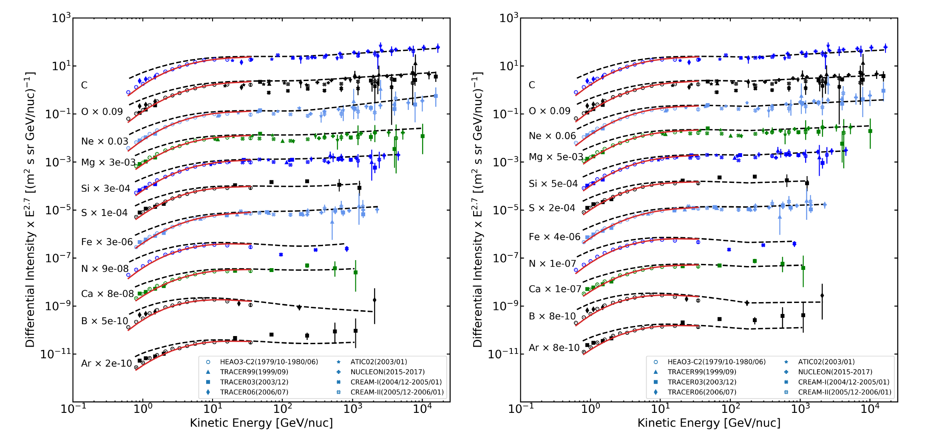
LISs validity is extended up to tens (and hundreds) TeV/n
for both injection and diffusive scenarios
Injection breaks scenario
Diffusive break scenario

