Slide 1
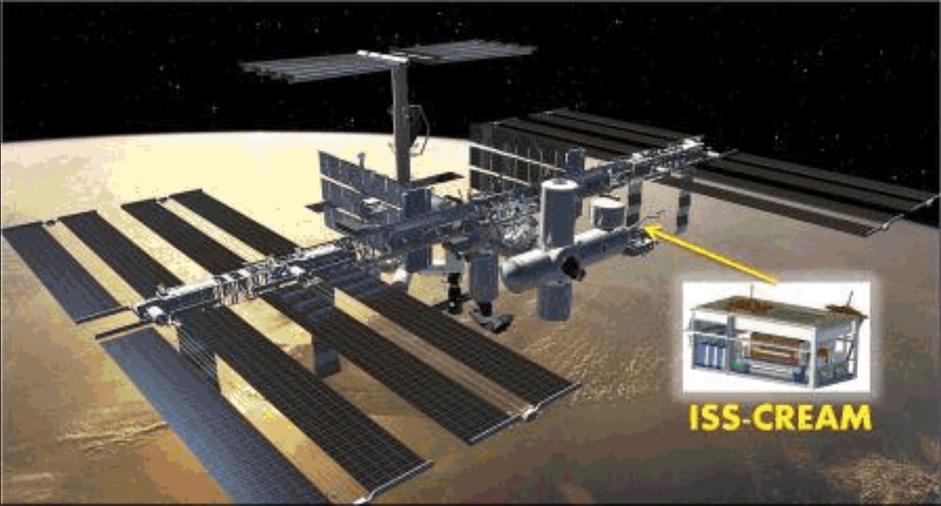
CREAM LED Data Analysis
Shrey Aggarwalª and Eun-Suk Seo^{a,b}
for the ISS-CREAM Collaboration
27th European Cosmic Ray Symposium (ECRS 2022)
ªDepartment of Physics, University of Maryland, College Park, MD, USA
^{b}University of Maryland, Inst. for Phys. Sci. and Tech. 4254 Stadium Dr, College Park, MD, USA

Slide 3
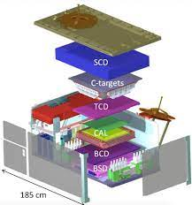
Cosmic Ray Energetic And Mass (CREAM) Experiment
E. S. Seo et al, Adv. Space Res., 53/10, 1451, 2014

Slide 4
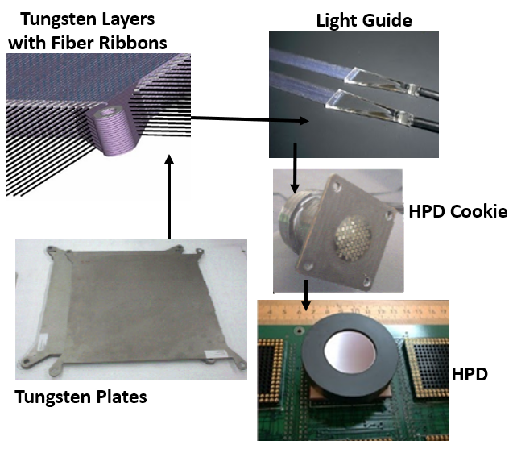
CAL Construction
Ahn et al., NIM A, 579, 1034, 2007
20 layers of tungsten interleaved with 20 active layers of 50 scintillating fiber ribbons (1 cm width each)
Layers are stacked perpendicular to one another
Each layer has ribbons readout at alternate ends using a Hybrid Photodiode (HPD) with 73 pixels
The clear fiber bundle is separated into smaller bundles for low, mid, and high ranges
25 scintillating fiber ribbons per HPD, 20×2 = 40 HPDs
M.H. Lee et al, Proc. 29th ICRC, 3, 413-416, 2005

Slide 5
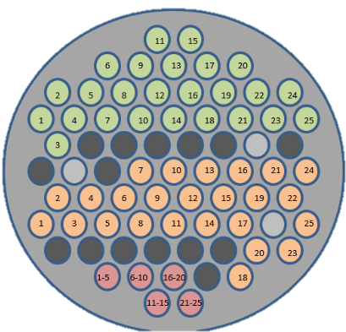
HPD Readout
Ahn et al., NIM A, 579, 1034, 2007
A pair of 32-channel application specific integrated circuit (ASIC) chip is used for electronic channel readout
Each HPD has 73 pixels, out of which 64 are readout as electronic channels
Readout Channels:
Consist of 3 channels (grey) that receive optical inputs from Light Emitting Diode (LED) sources
Cover the 25-low (green), 25-mid (orange), and 5-high (pink) range channels (55 channels) that are used for measuring optical signals produced by cosmic ray interactions
The remaining 6 channels have no optical inputs that are used for pedestal drifts and radio frequency noise measurements
Total of 2560 readout Channels (64 per board)

Slide 6
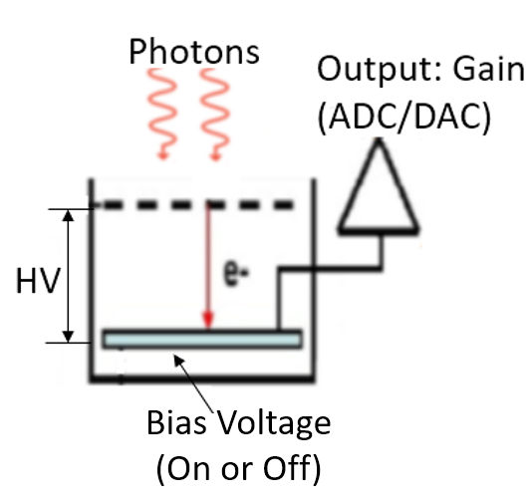
Electronic Inputs System
LED Settings
Controls the optical signal for the 3 LED channels in a board
Pulsed at 4 Hz
Intensity controlled by changing DAC values
High Voltage (HV):
Accelerates photoelectrons
0-12 kV
Reverse bias voltage:
Increases the depletion layer width to create more electron-hole pairs
0-60 V
Gain corrections need for HV and bias
May not operate under a bias voltage due to a malfunction
Different HV settings used in calibration tests and flight data
Gains can be corrected by analyzing signals for different HV and bias setting with various LED inputs

Slide 7
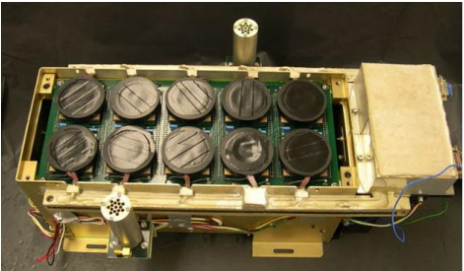
LED Data Taken on the Ground
LED Channels are used for:
In flight calibration and aliveness testing of the CAL
Optimizing pixel-to-fiber alignment for HPDs
(Ahn et al., NIM A, 579, 1034, 2007)
For this presentation:
LED data were taken on the ground
Optical signals were given only to the LED channels
Channel gains were measured by varying high voltages (HV) from 3 to 10.5 kV, LED intensity (DAC values from 6000 to 9000), and bias voltage on and off
The behavior of LED channels was analyzed for correcting gains with different HV and bias settings
HPDs
LED Source

Slide 8
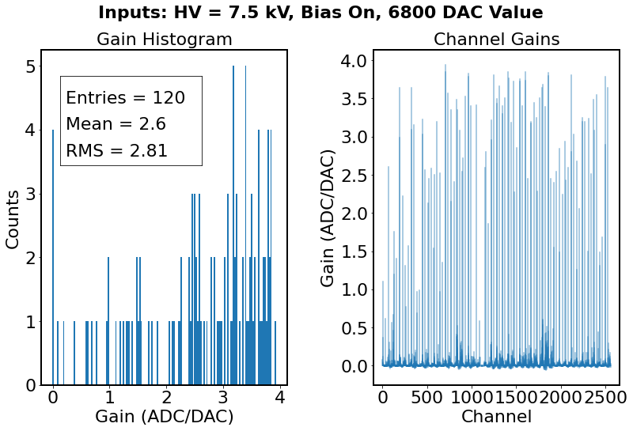
Data Acquired
For given HV and bias voltage, the LED intensity was changed from the lowest to highest value in steps of 100 DAC value
The left plot shows the distribution of gains from all LED Channels
The right plot shows gains for each channel

Slide 9
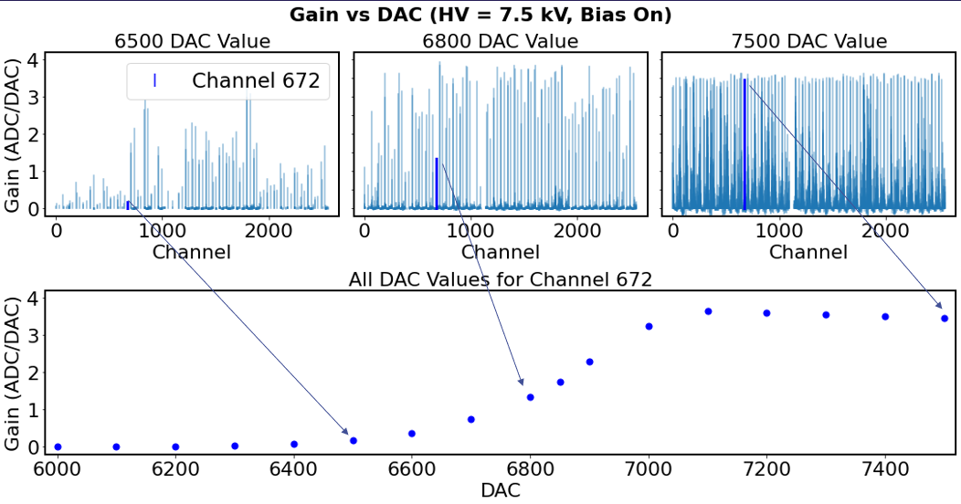
Gain vs DAC

Slide 10
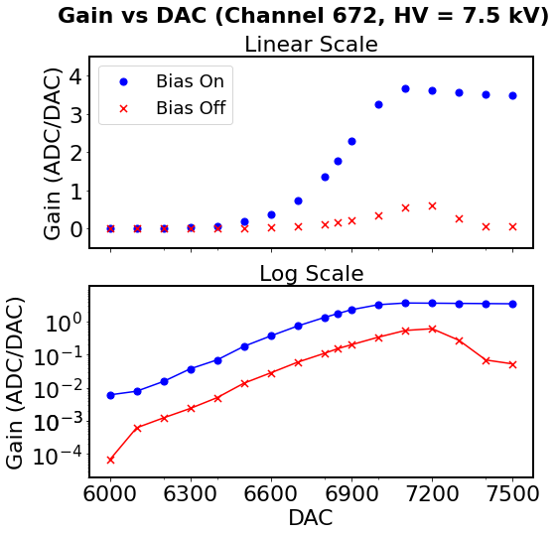
Gain vs DAC with bias on/off
The plot shows gains with bias on (blue) and off (red), and HV at 7.5 kV for a single LED channel (672)
The gains in both the bias increase for a certain range of DAC values
The curves for bias on and off are parallel for this DAC range, and their ratios are constant
For channel 672 at HV 7.5 kV, the bias on/off ratio is 11.92 ± 0.60

Slide 11
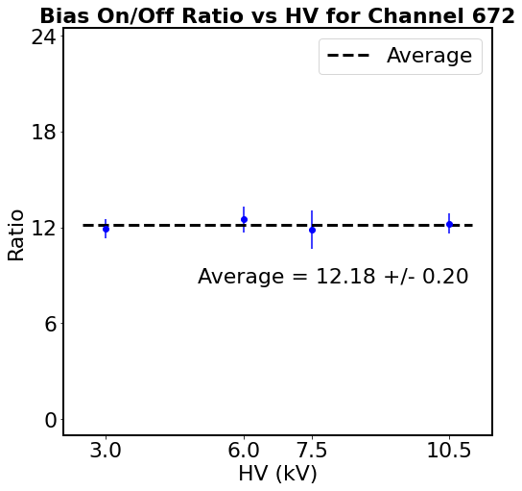
Bias On/Off Ratio
The plot shows the bias on/off ratios for different HVs
Ratios from all the HVs are consistent among each other within 1 uncertainty
The bias on/off ratio for channel 672 is 12.18 ± 0.20

Slide 12
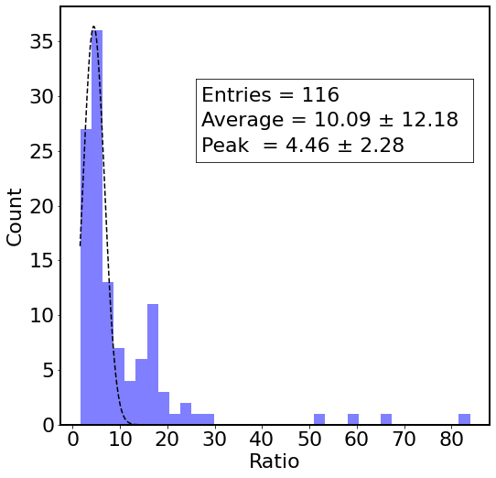
Bias On/Off Ratio Distribution for all LED channels
The histogram on the left shows the bias on/off ratios from all the LED channels
This ratio for most channels is 4.46 ± 2.28 with highest ratio over 80
The average ratio is ~ 10
The bias on/off ratios can be used for gain corrections when the CAL is operating without bias voltage

Slide 13
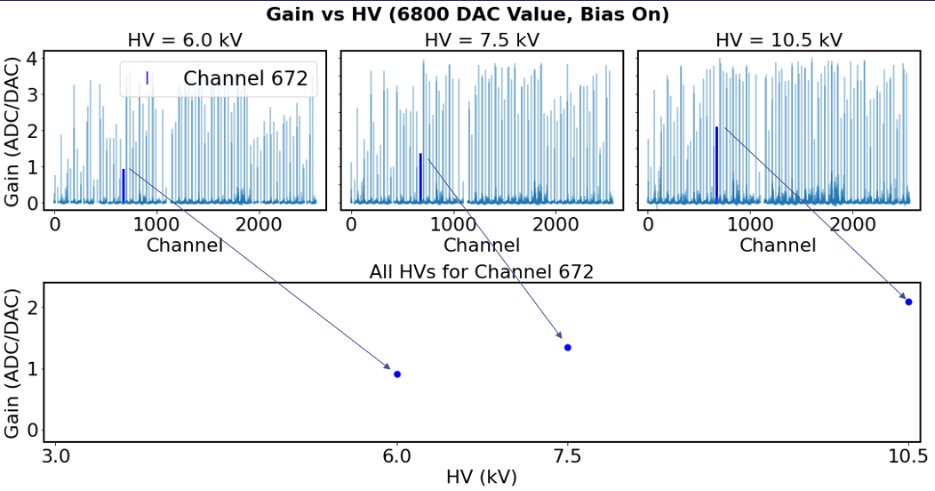
Gain vs High Voltage

Slide 14
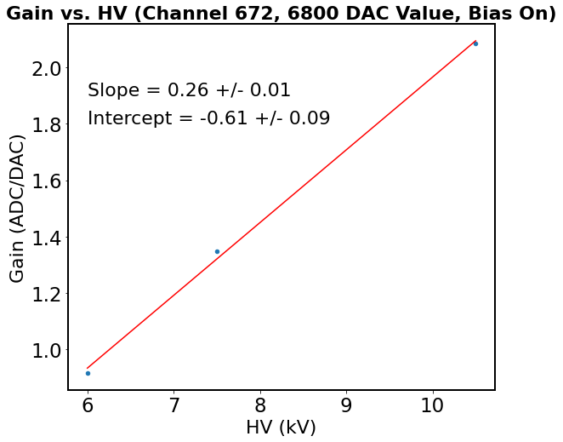
Gain as a linear function of High Voltage
The gains for LED channels increases with HV for all DAC values and bias setting as shown in this example
The linear fit results can be used to correct gains with different HV settings

Slide 15
Conclusion
Gains were measured for CAL Channels with various LED intensities (DAC values 6000 to 9000), HVs (3 kV to 10.5 kV) and bias voltage turned on and off
The bias on/off gain ratios for LED channels have the most probable value of 4.46 ± 2.28, and their average is ~ 10
The gains increase linearly with HV for LED Channels with all DAC and bias settings
The results of this analysis can be used to convert gains with different HV and bias settings of the CAL

