Slide 1


GridPix developments
Nikhef Jamboree 16 – 17 December 2019
Cornelis Ligtenberg, H. van der Graaf, K. Heijhoff, P.M. Kluit, N. van der Kolk, G. Raven, J. Timmermans
Y. Bilevych, K. Desch, M. Gruber, F. Hartjes, J. Kaminski, T. Schiffer

Slide 2
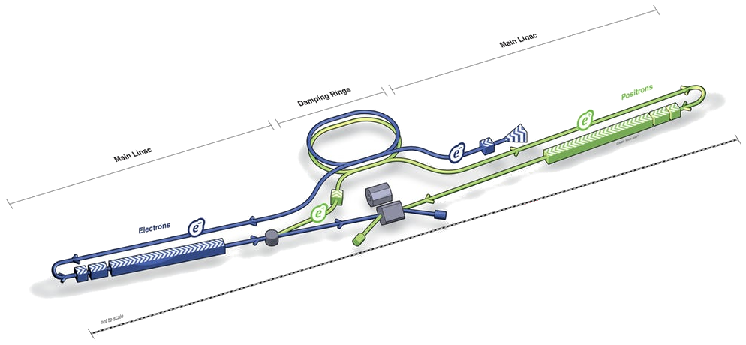


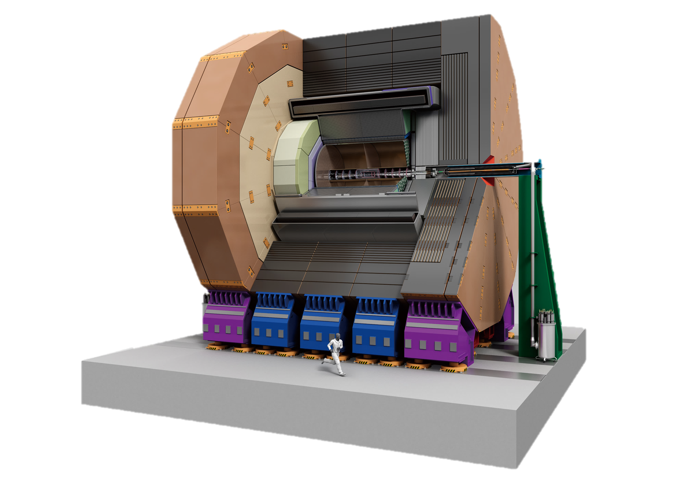
The international linear collider
TPC
20 km first stage at 250 GeV

Slide 3
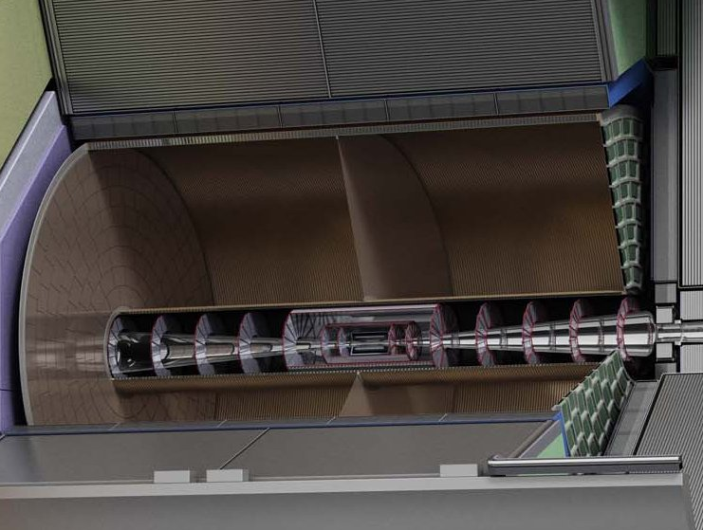
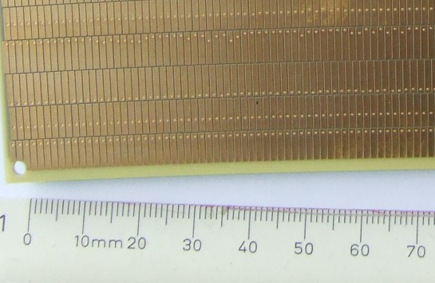

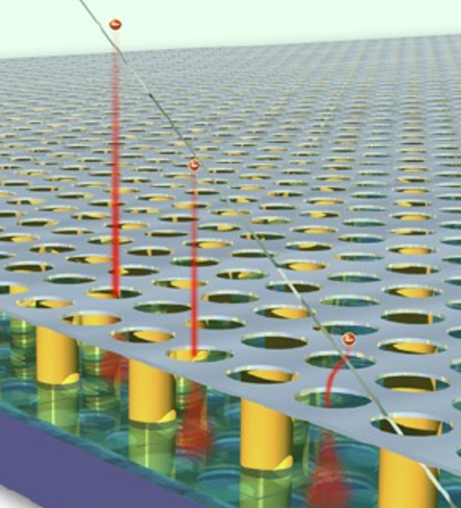
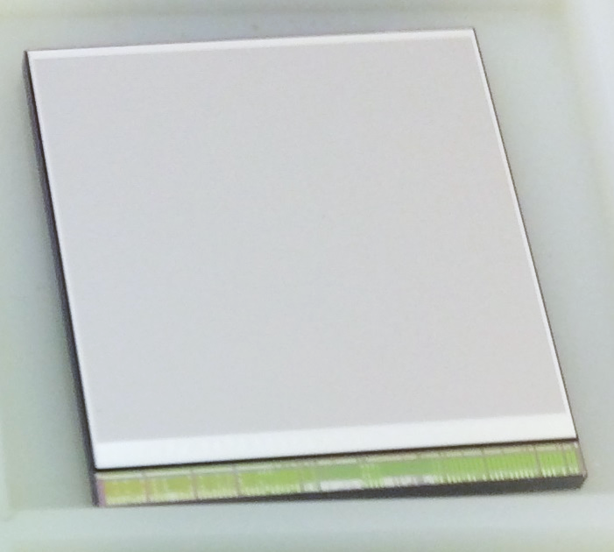
TPC with GridPix readout
Conventional 6 mm sized pads
Amplification
and detection at readout plane
Track
-E_{drift}
e⁻
e⁻
e⁻
e⁻
e⁻
Ionisation in gas
e⁻
e⁻
e⁻
e⁻
GridPix
e⁻
e⁻
e⁻
e⁻
e⁻
e⁻
e⁻
e⁻
e⁻
Chip surface 2 cm³
Challenge: Cover large area with small chips
Readout surface 10 m³
55 µm pixels

Slide 4
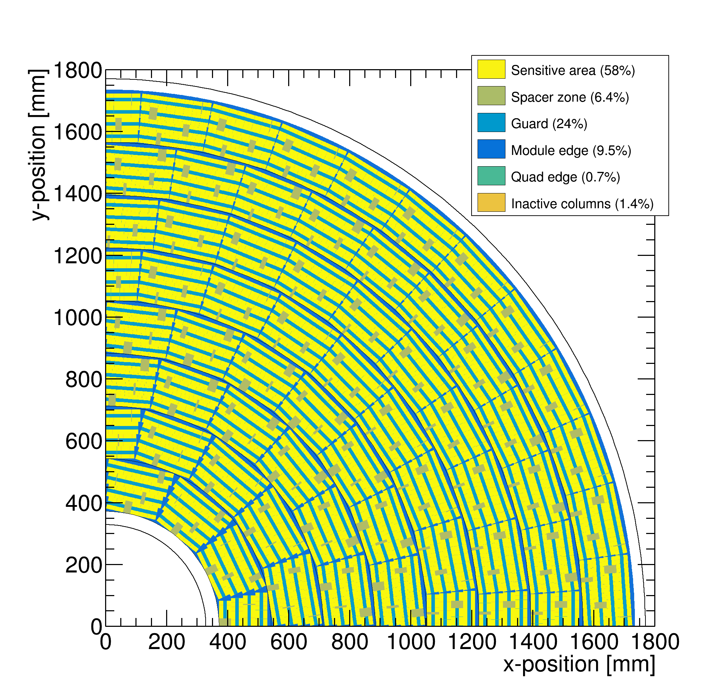

Quad module development
Coverage of end plate with quad modules
58% coverage

Slide 5
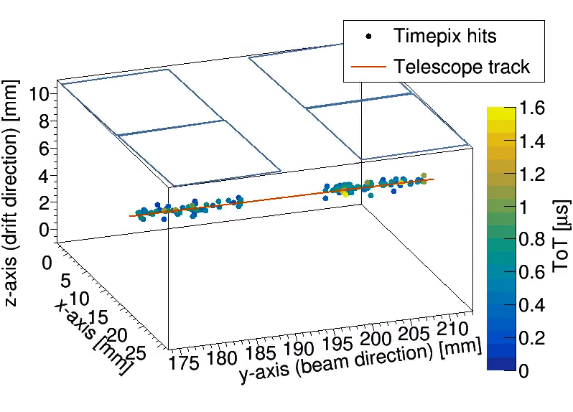
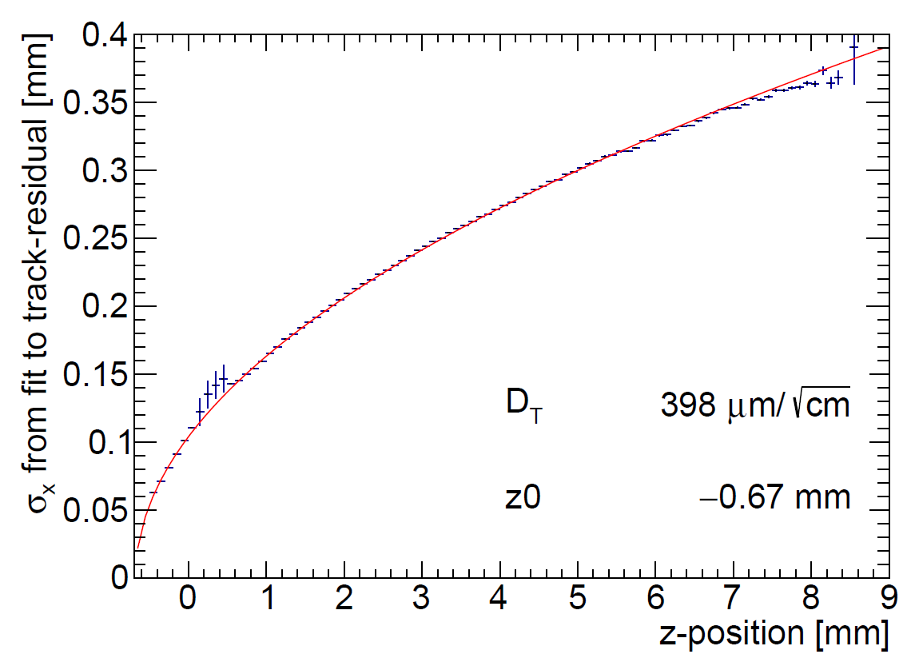
Quad results and outlook
Hit resolution per ionisation electron
8 Quad (32 chip module) to be tested soon

Slide 6
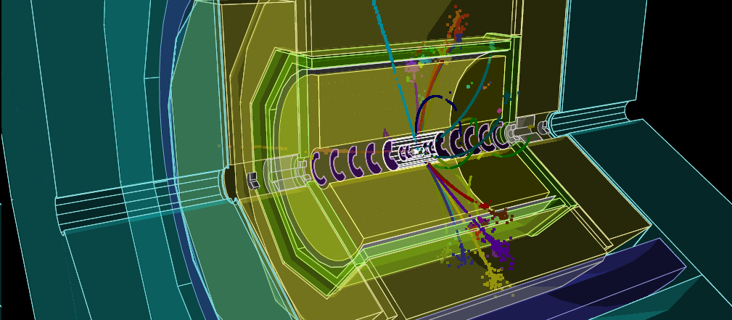
Backup
Simulated e⁺e⁻ -> Zh -> e⁺e⁻h

Slide 7
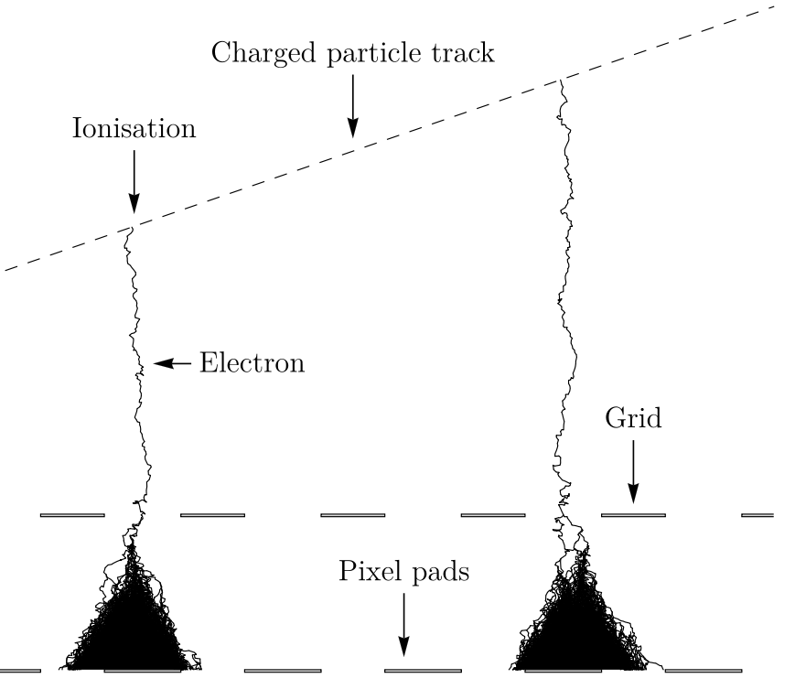
GridPix technology
GridPix is a type of micro-pattern gaseous TPC readout
The GridPix based on a Timepix3
  55 µm × 55 µm pixels
  Digital simultaneous registration of Time of Arrival (1.56 ns) and Time over Threshold
  An aligned Aluminium amplification grid is added by photolithographic postprocessing techniques
Single ionization electrons are detected with high efficiency
  The maximum possible information from a track is acquired
  dE/dx by cluster counting
35 µm
1 µm
50 µm
55 µm

Slide 8
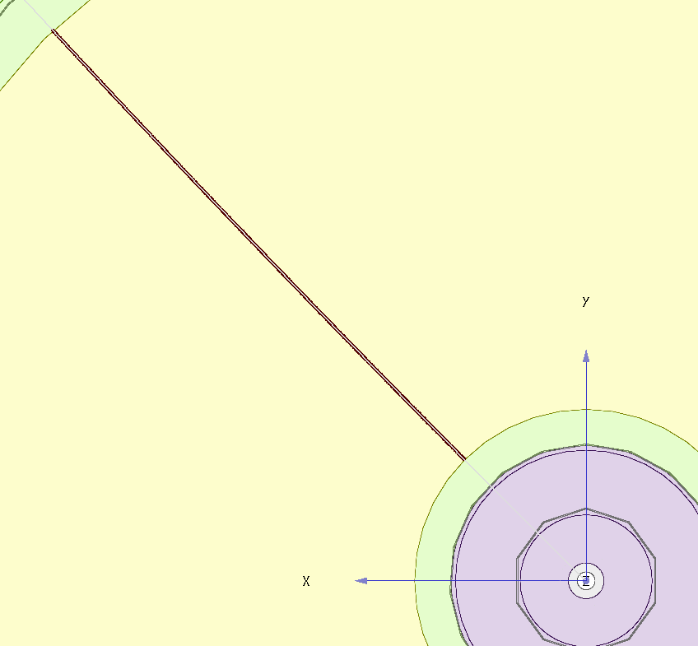
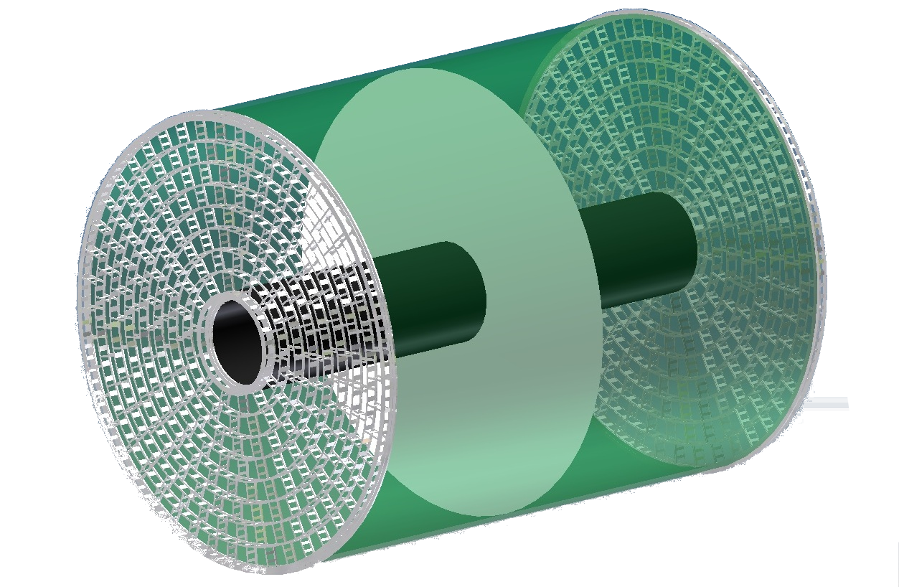
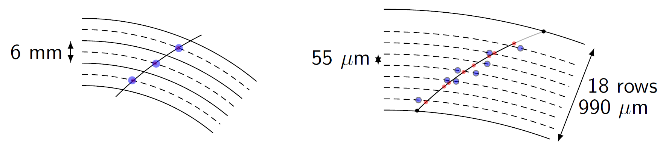
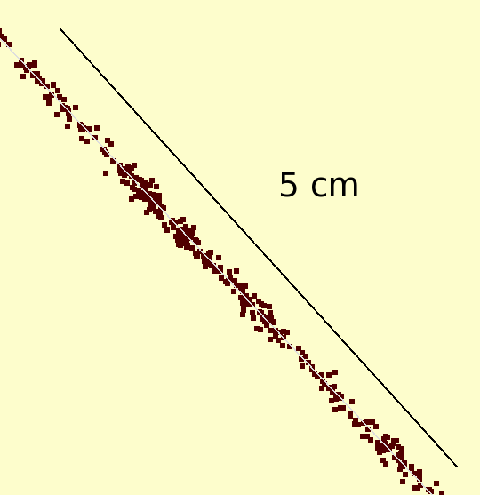

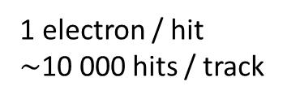
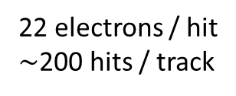
Simulation of ILD TPC with pixel readout
To study the performance of a large pixelised TPC, the pixel readout was implemented in the full ILD DD4HEP (Geant4) simulation
Changed the existing TPC pad readout to a pixel readout
Adapted Kalman filter track reconstruction to pixels
50 GeV muon track with pixel readout
Pads
Pixels
Continuous
3D tracking
6 mm
55 µm
22 electrons / hit
$∼$200 hits / track
1 electron / hit
$\sim$10 000 hits / track
Picture by Cornell

Slide 9
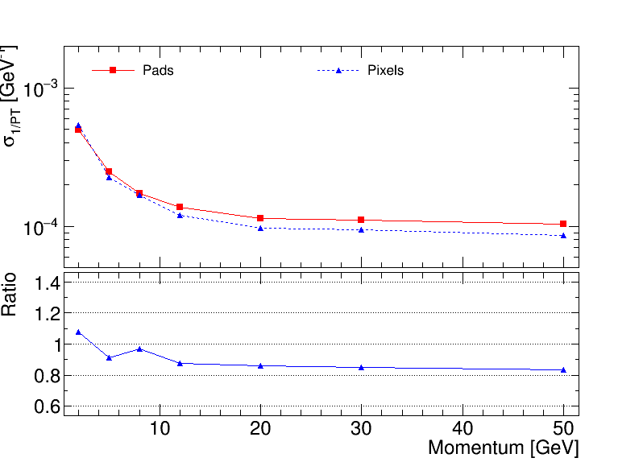

Performance of a GridPix TPC at ILC
From full simulation, momentum resolution can be determined
Momentum resolution is $\sim$15% better (with realistic coverage and delta’s)
Realistic tiling with quad module
Momentum resolution of the TPC for a 50 GeV muon
58% coverage

Slide 10
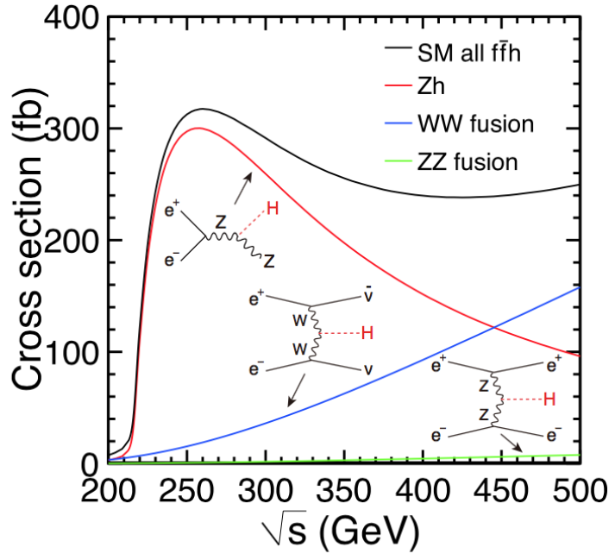
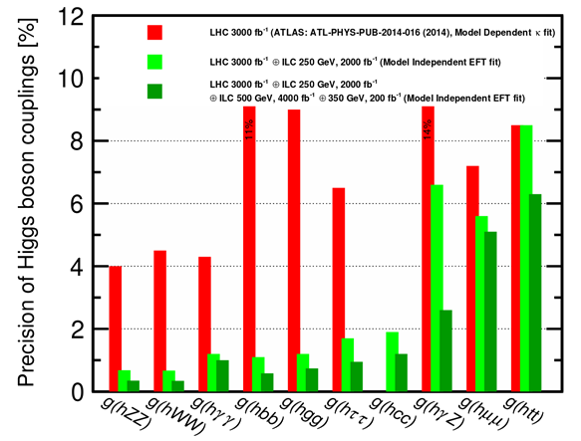
Some physics goals of the ILC
What is the origin of EWSB?
How can the Higgs bosons be so light?
Are there more Higgs bosons?
What is dark matter made of?
https://arxiv.org/pdf/1710.07621.pdf
LHC (3 ab⁻¹)
LHC + ILC 250 GeV ( 2 ab⁻¹)
LHC + ILC 250 GeV + ILC 500 GeV (4 ab⁻¹)

Slide 11
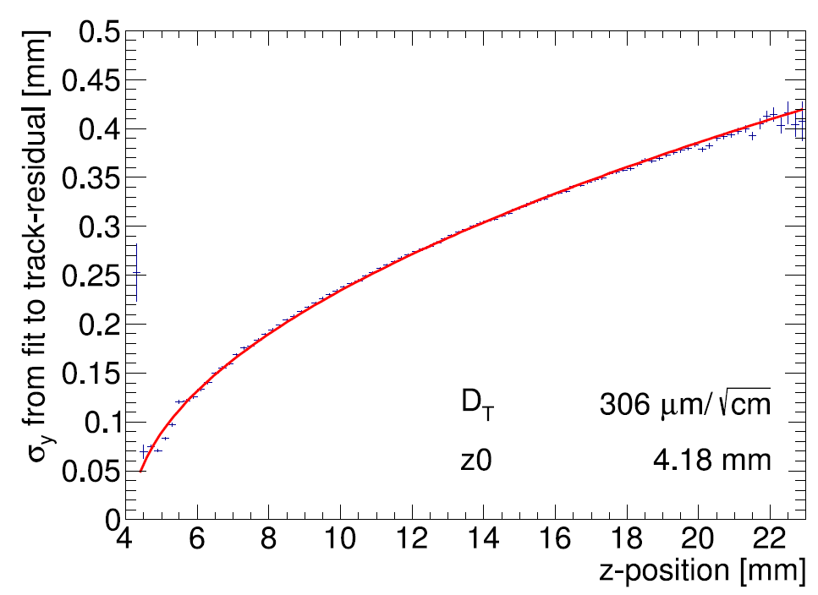
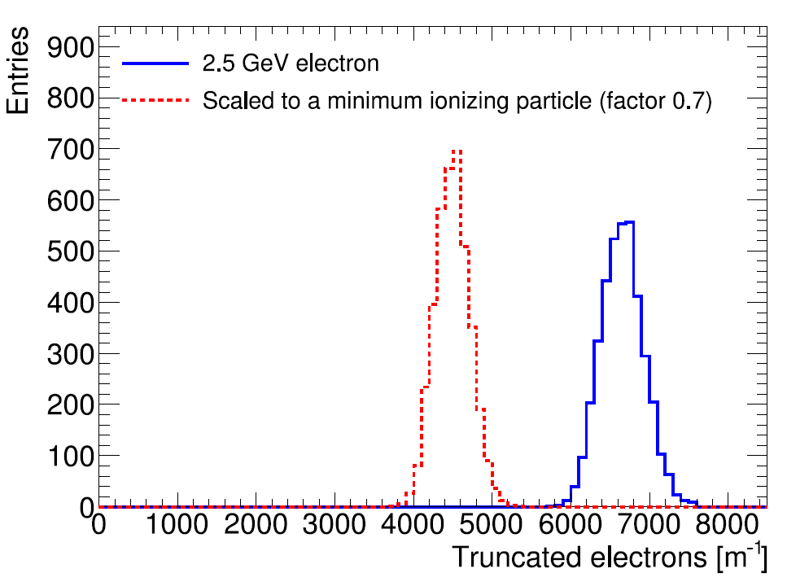
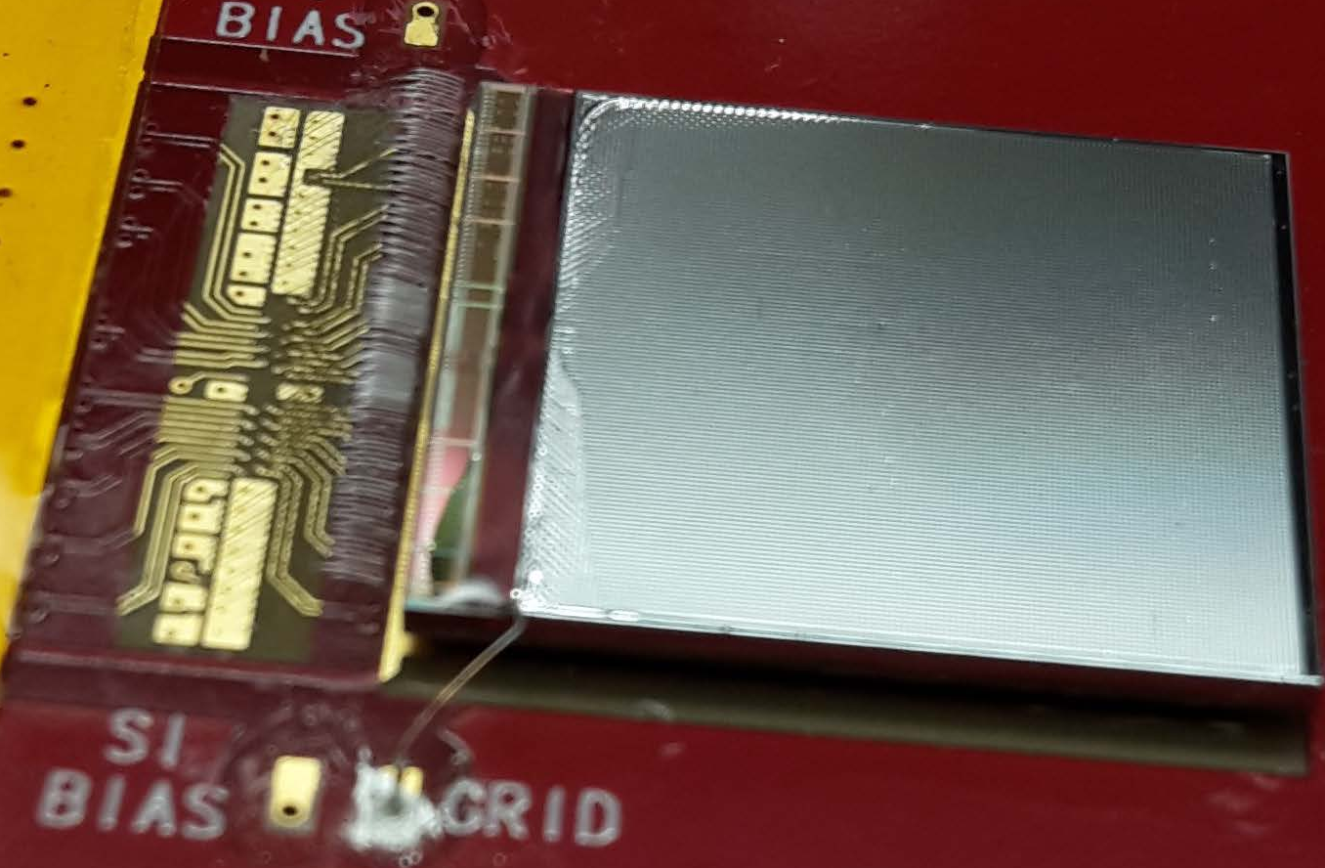


Single chip results (2017)
Hit resolution
A GridPix based on the Timepix3 chip was reliably operated in a test beam setup with 2.5 GeV electrons at ELSA (Bonn)
T2K gas and E_{drift} = 280 V/cm, V_{grid} = -350 V
The resolution is primarily limited by diffusion
Systematic uncertainties are low: < 10 µm in plane
Energy loss resolution (dE/dx) by electron counting is 4.1 % per meter
B$=0$ T
MIP
Electron
Published paper on this testbeam doi:10.1016/j.nima.2018.08.012

Slide 12
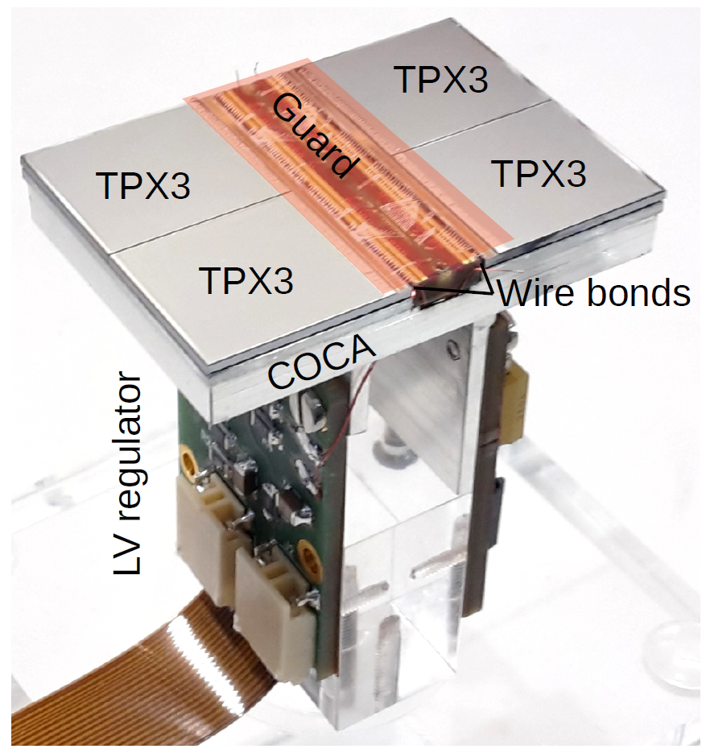

The quad module
A four chip module sized 39.6 mm $×$ 28.38 mm
The quad module has all services under the active area
  Can be tiled to cover arbitrarily large areas.
Area for connections IO was minimized
  Maximises active area ( 68.9% )
To maintain a homogenous electric field wire bonds are covered by a central guard
High precision < 20 μm mounting of the chips and guard
Cooling channels

Slide 13
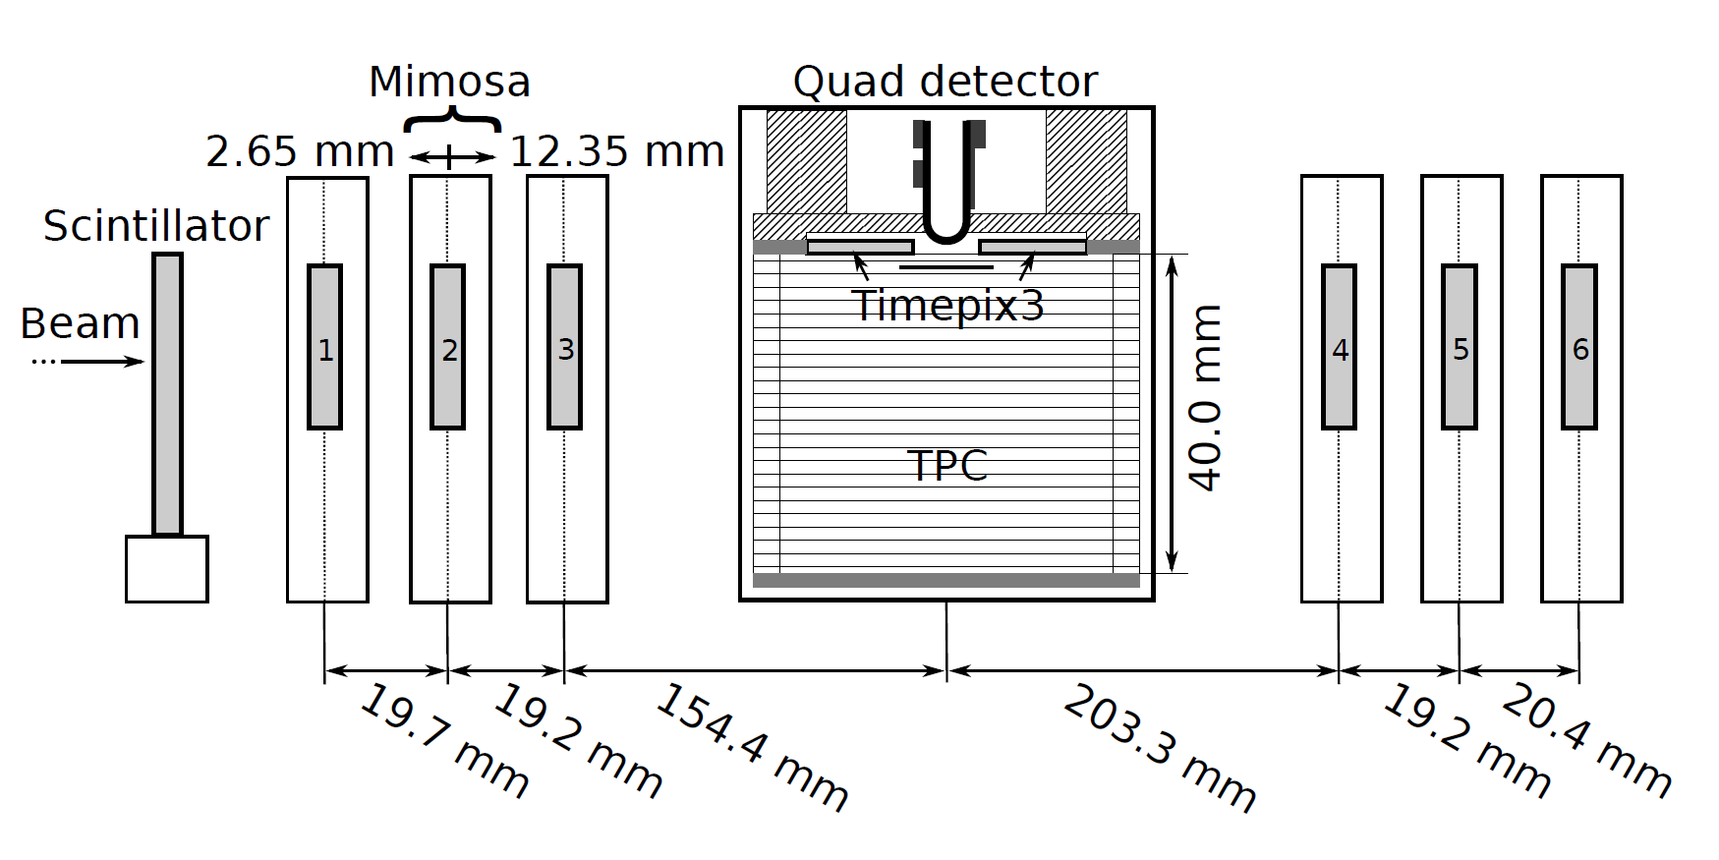
Test beam measurements (2018)
2.5 GeV electrons at the ELSA accelerator in Bonn, Germany
T2K gas with E_{drift} = 280 V/cm, V_{grid} = -350 V
Events are triggered by a scintillating plane
6 plane mimosa telescope with 18.4 μm × 18.4 μm sized pixels
180 º

Slide 14
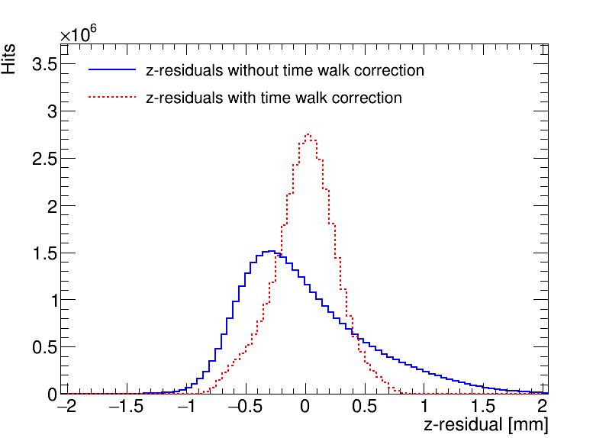
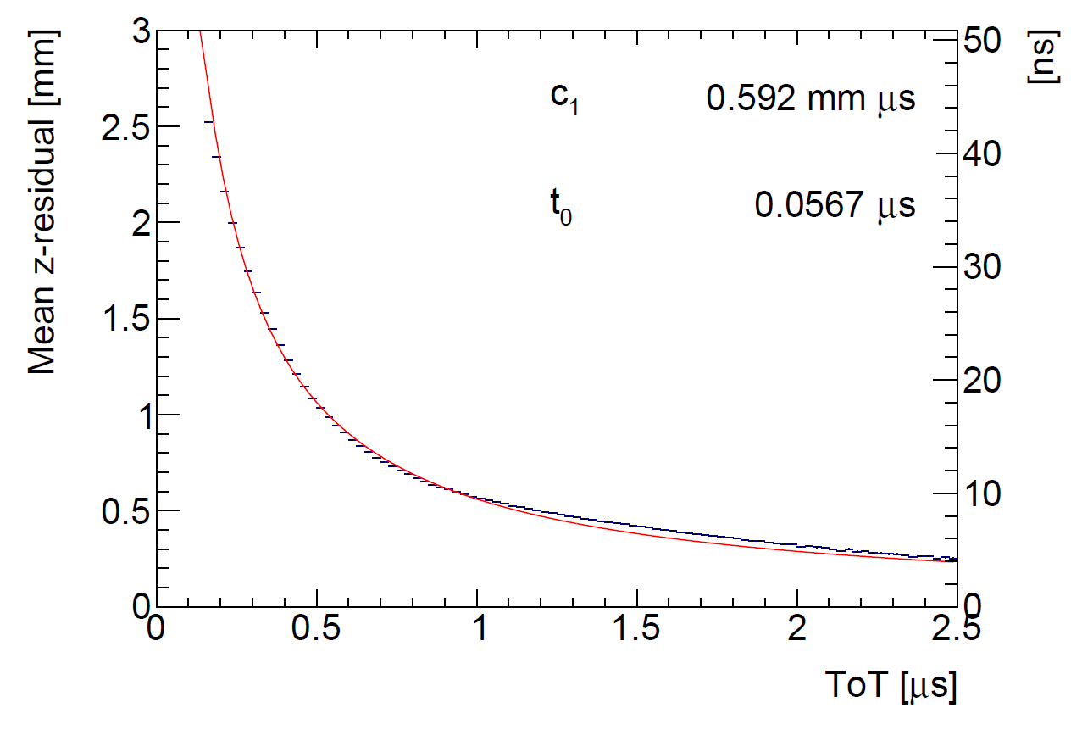
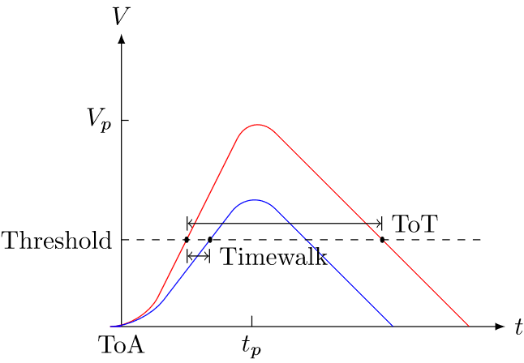

Time walk correction
Time walk error: time of arrival depends on signal amplitude
Time walk can be corrected using Time over Threshold (ToT) as a measure for signal strength
First order correction fitted and applied:
$$δz_{\text{timewalk}}=\frac{c_{1}}{t_{ToT}+t_{0}}+z_{0}$$
Distribution of residuals becomese more Gaussian after the time walk correction

Slide 15
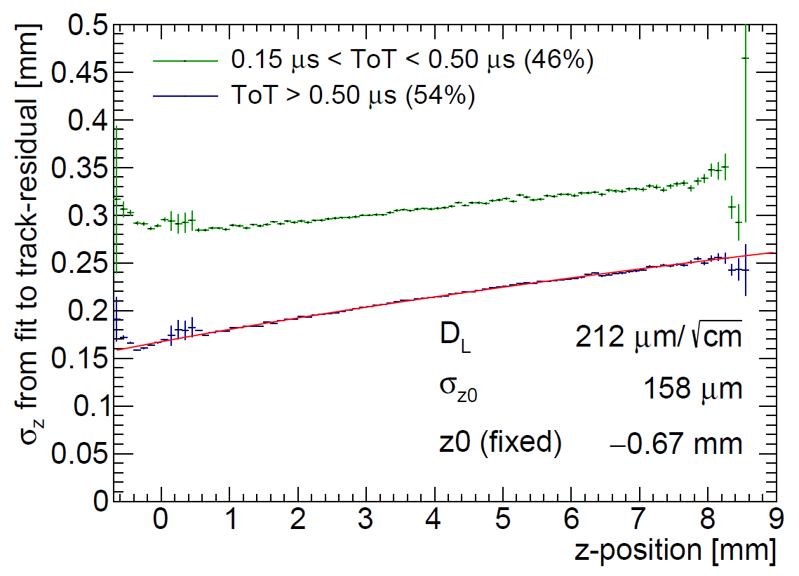
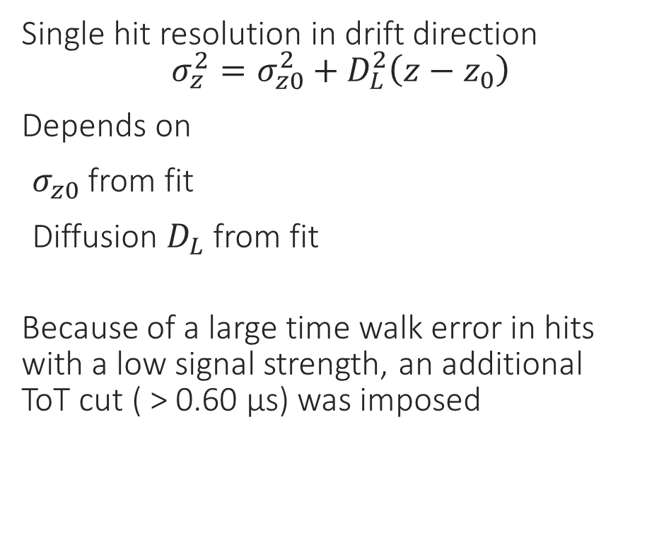
Hit resolution in the drift direction
Single hit resolution in drift direction
$$σ_{z}^{2}=σ_{z0}^{2}+D_{L}^{2}\left(z−z_{0}\right)$$
Depends on
$σ_{z0}$ from fit
Diffusion $D_{L}$ from fit
Because of a large time walk error in hits with a low signal strength, an additional
ToT cut ( > 0.60 µs) was imposed

Slide 16
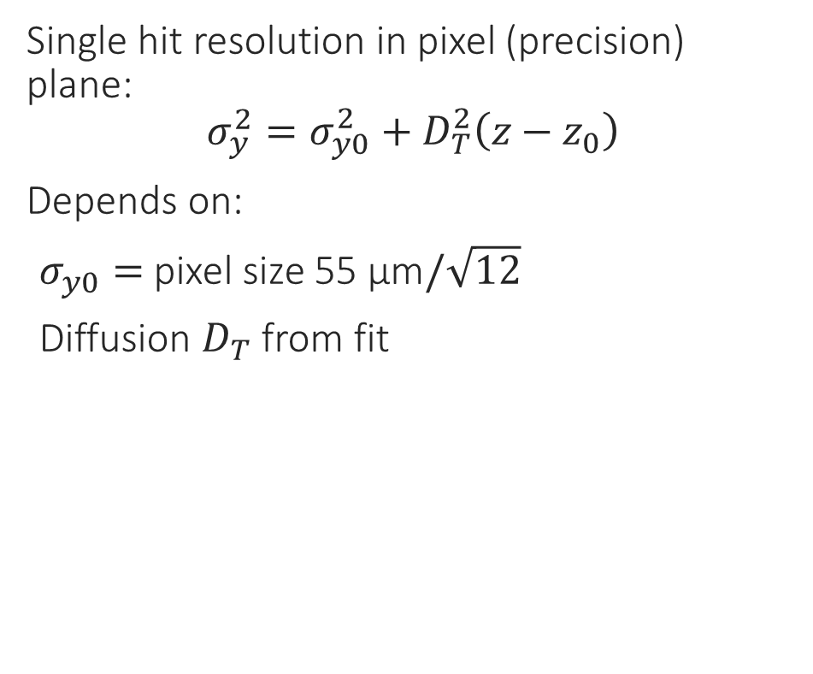
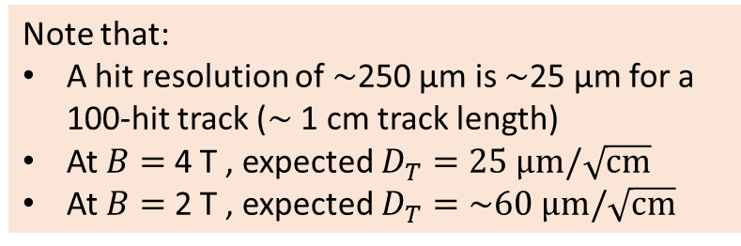

Hit resolution in the pixel (precision) plane
Single hit resolution in pixel (precision) plane:
$$σ_{y}^{2}=σ_{y0}^{2}+D_{T}^{2}\left(z−z_{0}\right)$$
Depends on:
$σ_{y0}=$ pixel size 55 µm$/\sqrt{12}$
Diffusion $D_{T}$ from fit
Scattering on guard
B$=0$ T
Note that:
A hit resolution of $\sim$250 µm is $\sim$25 µm for a 100-hit track ($\sim$ 1 cm track length)
At $B=$ 4 T , expected $D_{T}=25 \text{μm}/\sqrt{\text{cm}}$
At $B=$ 2 T , expected $D_{T}=\sim 60 \text{μm}/\sqrt{\text{cm}}$

Slide 17
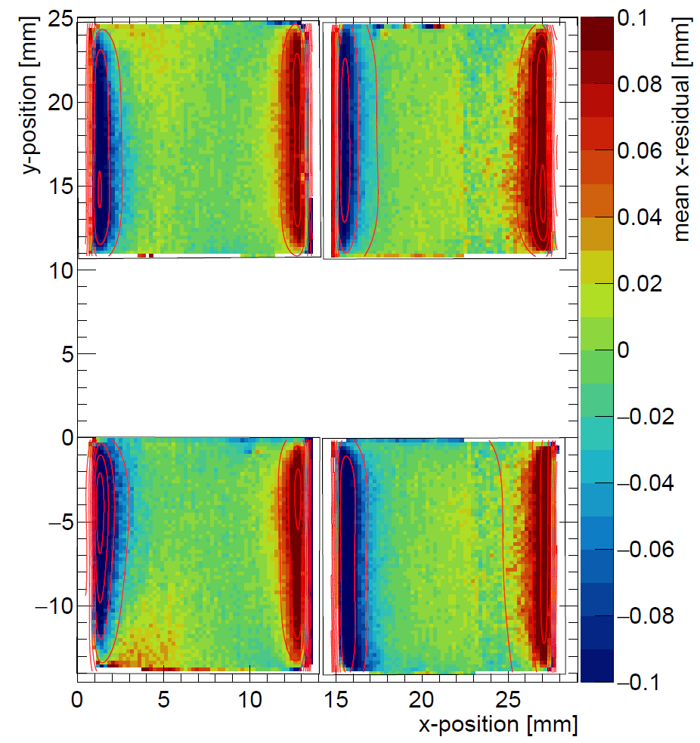
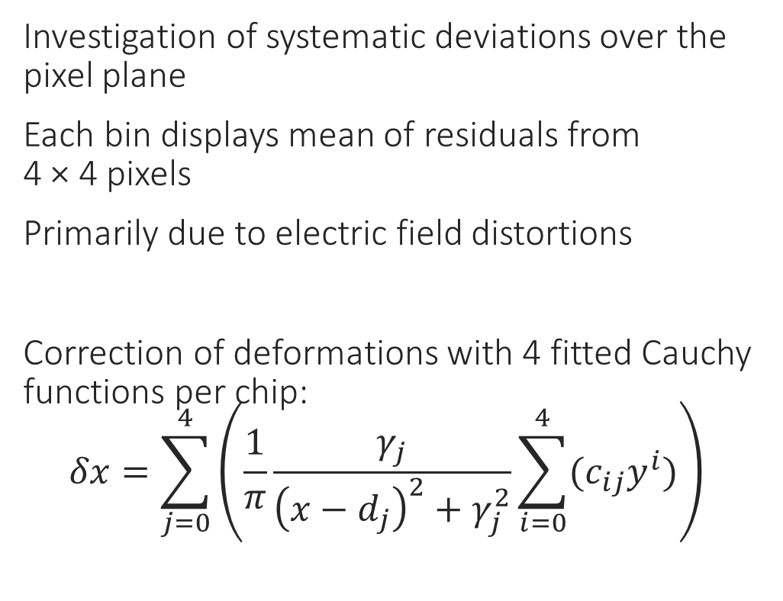
Deformations in the pixel (precision) plane
Investigation of systematic deviations over the pixel plane
Each bin displays mean of residuals from
4 × 4 pixels
Primarily due to electric field distortions
Correction of deformations with 4 fitted Cauchy functions per chip:
  $$δx=\sum_{j=0}^{4}{\left(\frac{1}{π}\frac{γ_{j}}{{\left(x−d_{j}\right)}^{2}+γ_{j}^{2}}\sum_{i=0}^{4}{{(c}_{ij}y^{i})}\right)}$$
Without correction

Slide 18
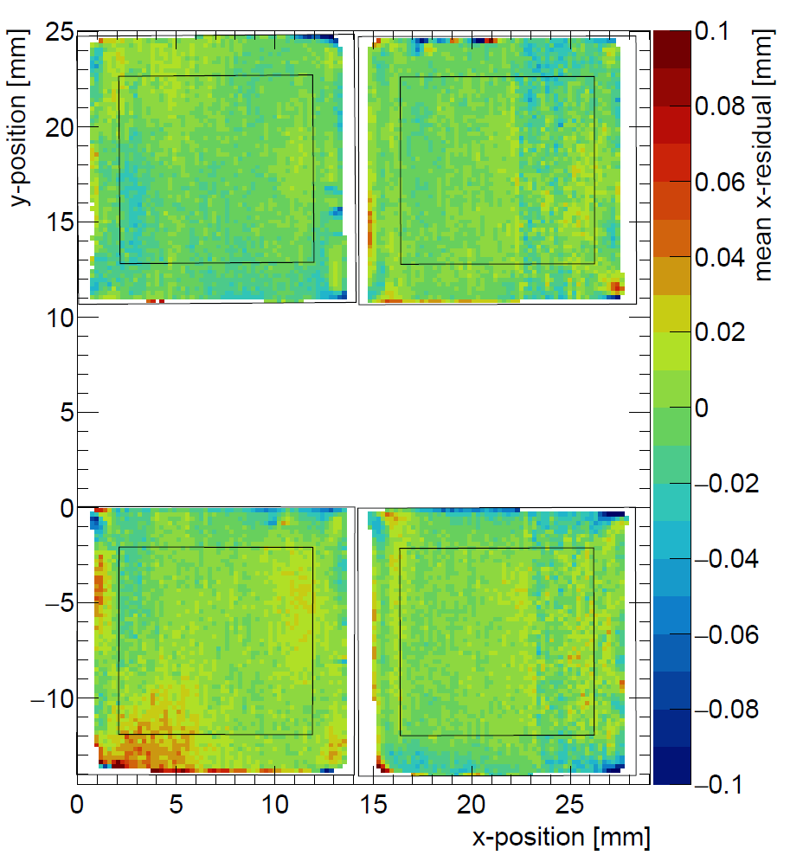
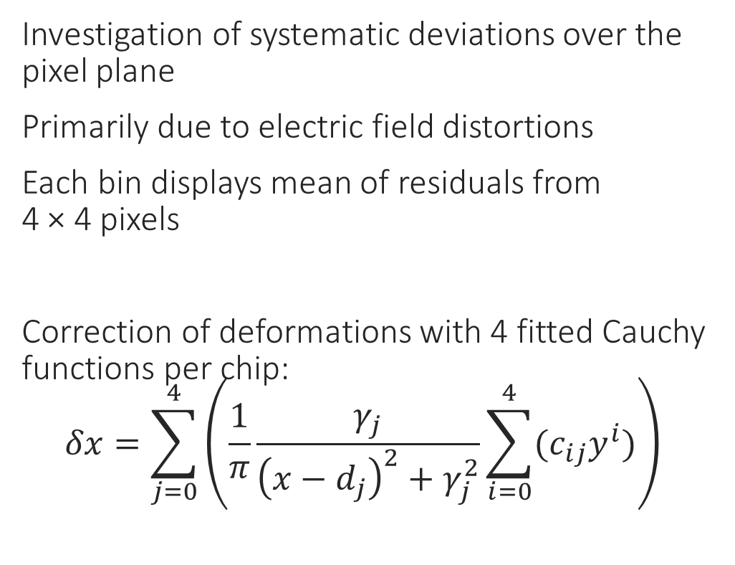
Deformations in the pixel (precision) plane
Investigation of systematic deviations over the pixel plane
Primarily due to electric field distortions
Each bin displays mean of residuals from
4 × 4 pixels
Correction of deformations with 4 fitted Cauchy functions per chip:
  $$δx=\sum_{j=0}^{4}{\left(\frac{1}{π}\frac{γ_{j}}{{\left(x−d_{j}\right)}^{2}+γ_{j}^{2}}\sum_{i=0}^{4}{{(c}_{ij}y^{i})}\right)}$$
With correction

Slide 19
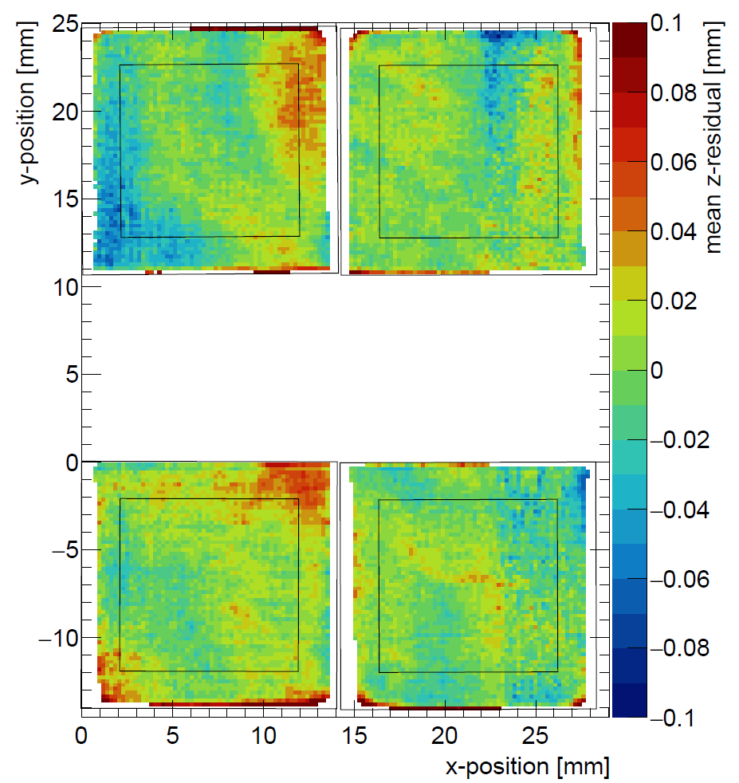
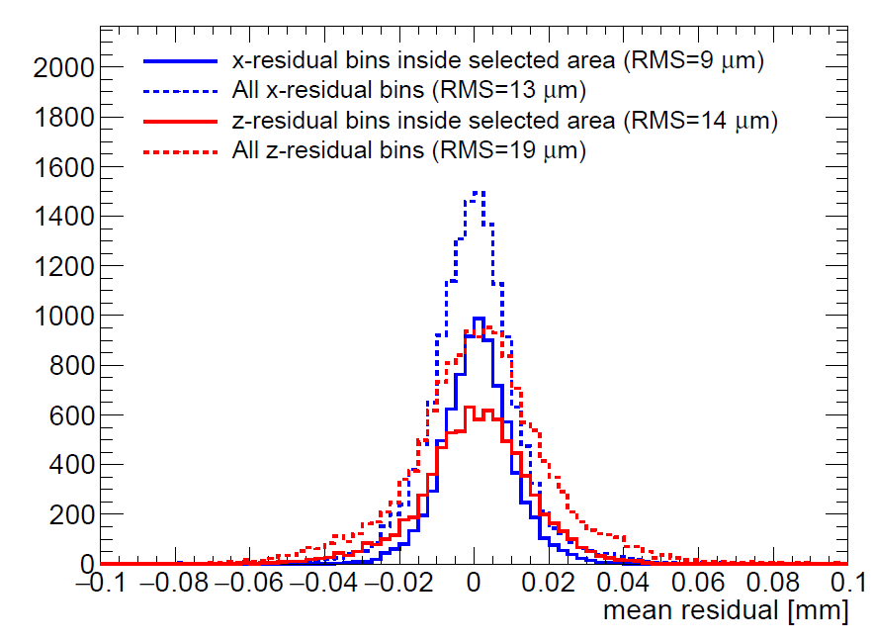
Deformations in pixel plane and drift direction
Each bin displays mean of residuals from 4 × 4 pixels
The RMS in the center of the chip is 9 µm (pixel plane after correction) and 14 µm (drift direction), which indicates small systematic errors
Corrected x deformations
Pixel (precision) plane
z deformations
Drift direction

Slide 20
8 quad module development
8 quad test box with (32 chips)
Simultaneous read out through one SPIDR board using a data concentrator
Field wires added to improve electric field, and reduce deformations
New field wires

Slide 21
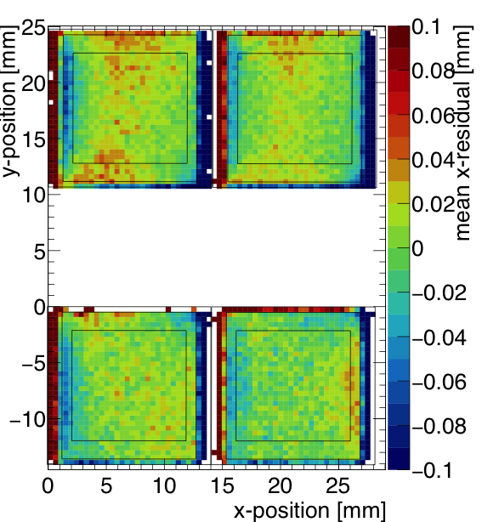
8 quad module development
Laser test indicate a reduction in electric field deformations with field wires
Early 2020 test beam planned at DESY with 1 T magnetic field
Preliminary
Uncorrected residuals from quad test beam
Uncorrected residuals from laser test with field wires

