Slide 1
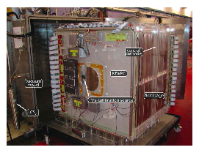
Thoughts on a negative ion Pixel Time Projection Chamber
Fred Hartjes,
Peter Kluit,
Kees Ligtenberg,
Jan Timmermans
A negative Ion TPC has potentially a smaller diffusion than a TPC based on drifting electrons
At ILC there is enough time collect also ion signals
Currently NITPCs are used in dark matter searches (Drift IIb NITPC)
Pixel read out – due to the fine granularity - allows to exploit high resolution regime
https://arxiv.org/pdf/0911.0323.pdf

Slide 2
Negative Ion TPC
In a Negative Ion TPC the negative ions drift and are detected. The drift process is slow the velocity (E field) about 1 m/s.
The idea for this detector concept was presented by Martoff et al. in NIMA A 440 (2000) 355. In 2005 a detector concept running at 1 bar was studied and published by the authors in NIM A 555 (2005) 55. For dark matter searches the NITPC usually runs at a lower pressure.
For current NITPC detectors two main gasses are considered and studied: CS₂ and SF₆. These gases are electronegative.
What happens is that the track creates ionization; electron plus a positive ion; the electron is then captured by the CS₂ and SF₆ and forms a negative ion. This negative ion then drifts to the cathode.
Near the readout plane the electric field is so strong that the electron is stripped off and starts a “standard” avalanche. The critical field density where this happens (SF₆ ) is E/n = 100 x 10⁻¹⁷ V cm².

Slide 3
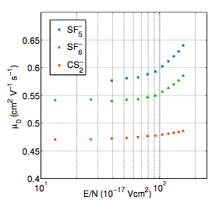
Negative Ion TPC
There are detailed measurements of CS₂ and SF₆ and of the mobility and the diffusion constant in a nice overview article: N.S. Phan et al. 2017 JINST 12 P02012
Drift velocity v_{d} = μ₀ E N₀/N (N₀ =2.687 10¹⁹ cm⁻³ at 273 K and 760 Torr).

Slide 4
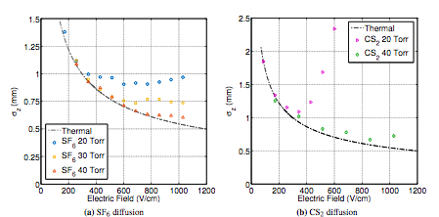
Negative Ion TPC
Here below the measurements for the longitudinal (z) resolution. For a drift length of 58.3 cm.
This corresponds to a diffusion constant of at 200 (400) V/cm of 160 (100) μm/√cm. NB the Quad had a longitudinal diffusion of 212 and a transverse of 298 μm/√cm @ 400 V/cm.
In the plot there is a theoretical curve that corresponds to the ultimate performance limit that one can achieve, if the diffusion is coming only from the thermal fluctuations in the gas. Note that these gases come close to this limit at 40 Torr. E.g. the diffusion of the T2K gas is a factor 2-3 higher at 400 V/cm than this limit.
Curve Nernst-Townsend-Einstein

Slide 5
Negative Ion TPC
Gas gain considerations. The results from Phan et al. for CS₂ are:
The measurements are puzzling; the gas gain is only dependent on the pressure 1/p²… and not so much on the E field;
One would expect the gas gain to increase with pressure and E field
The resolution seems to scale like E/p²
For our quad we have a typical E field of 400 V / 50 μm or 80 kV/cm
Pressure will be 760 Torr
This should be far above the threshold to strip the electrons from the ion
The measurements may imply that we need to use small fractions of CS₂

Slide 6
Negative Ion TPC
So this calls for an experiment with a quad at e.g. 400 V/cm with different gas mixtures:
e.g. 40 Torr/760 Torr; 5% CS₂ or SF₆ plus 720 Torr; 95% Ar or He.
One could also add a few percent of iC₄H₁₀ for the quenching.
This clearly needs measurements of v_{d}, gas gain and diffusion.
Note that the ions will have a very low ωτ (v_{d} B/E) due to the low velocity. This means that the B field will not suppress the transverse diffusion (as it does for the T2K gas). This also means that E cross B effects are small:
From HEED Kees has extracted the number of electrons/cm for a 2.5 GeV electron at 1013 mbar and 21 C; Ar: 97, SF₆: 275, CS₂: 261
It would be interesting to observe the low diffusion and optimize the gas and operating point.

