Slide 1

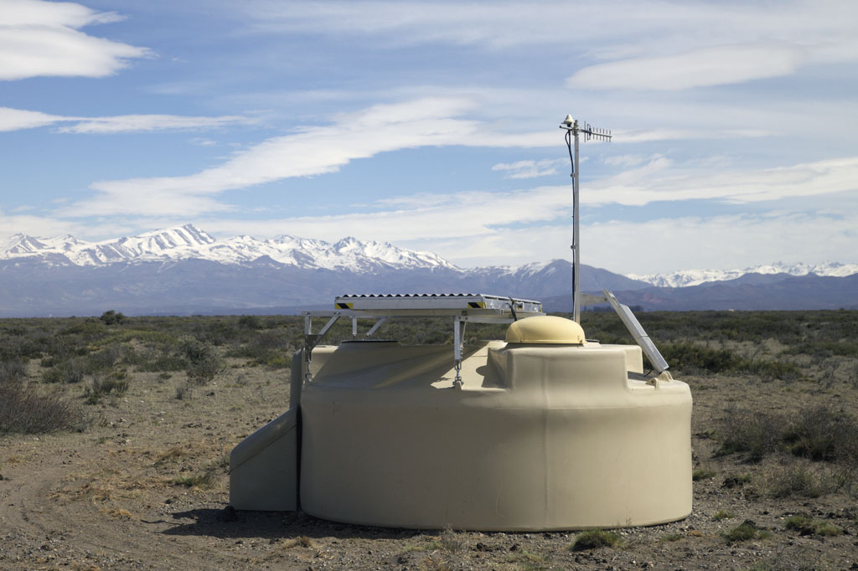

Ultra-high-energy cosmic rays
Sijbrand de Jong
Take home message:
Highest energy accelerators & interactions
Multi-messenger astroparticle physics
Coherent long term programme: Auger & GRAND
Nikhef Jamboree 2018 (SdJ)

Slide 2

Inside the Black Box
100 EeV
100000000000 GeV
Notes:
If you got a beam of 100 EeV (100 billion GeV!) from a black box, would you not want to see into the box how this is done ?

Slide 3
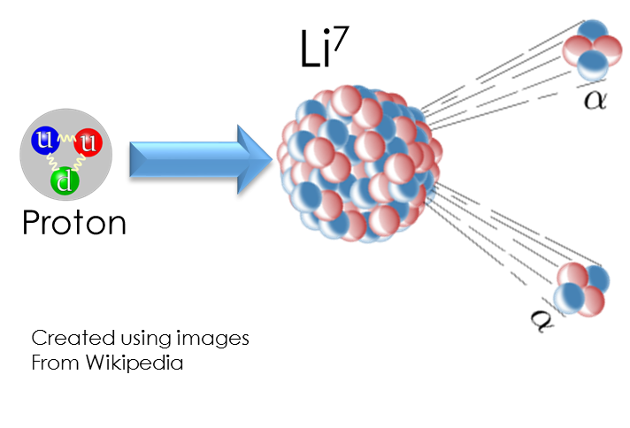
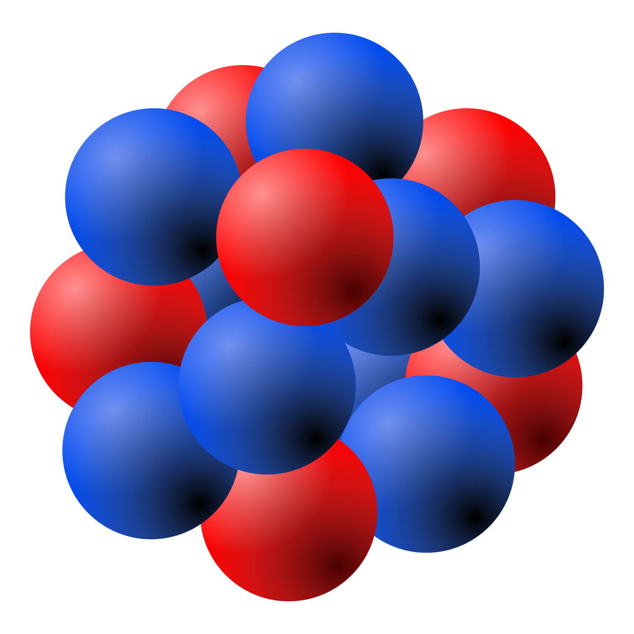
Highest energy interactions
√s = 300 TeV
Notes:
If y can have particle interactions at an invariant mass of 300 TeV would you not want to study them ?

Slide 4
Cosmic Rays in the Universe
Notes:
If, in the process, you could find out how ultra-high-energy particles swerve through the universe, wouldn’t you want to know ?

Slide 5
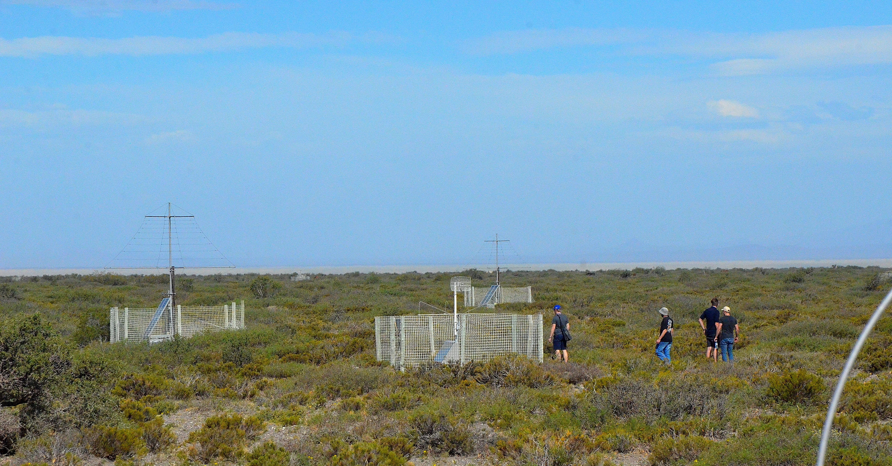
Inside the Black Box
Notes:
If you can do your research on a vast remote location surrounded by spectacular nature and dominated by good weather, wouldn’t you want to go there ?

Slide 6
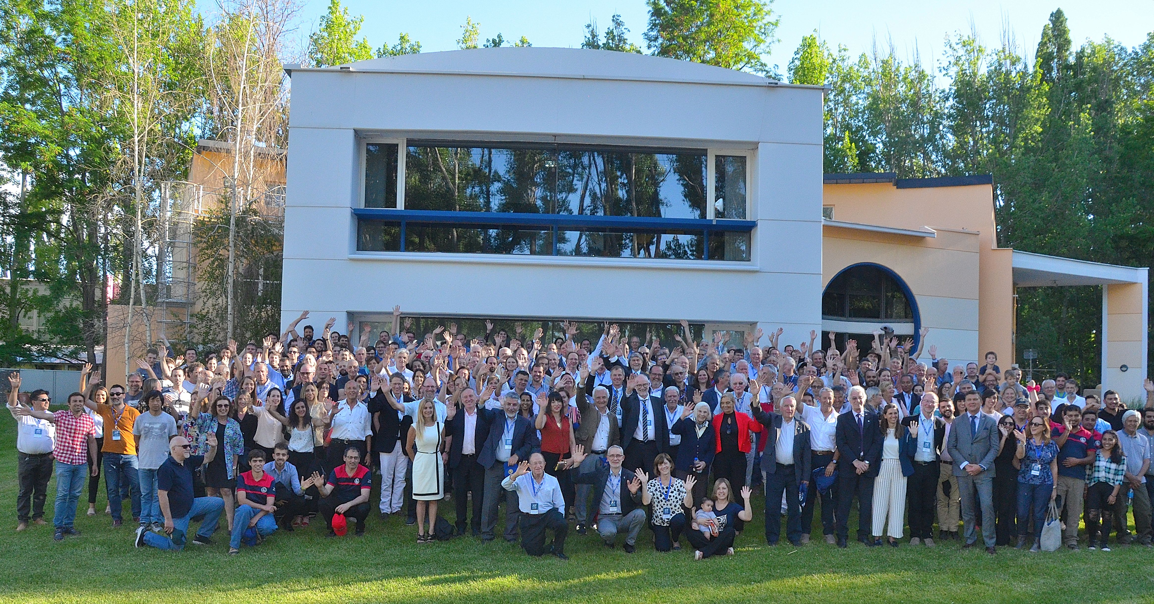
Inside the Black Box
Notes:
So why did you not join Auger yet ?
(This picture was taken at the 20 year anniversary of Auger a month ago, and the observatory is rejuvenating.)

Slide 7

Dutch Cosmic Ray group
SD+SSD: Senior staff: Charles Timmermans, SdJ
PhD students: Giuseppe de Mauro, Alexander Aab, Mart Pothast
BSc student: Henk Brans
Techs: Lesley Room, Tico Martinez, Sirous Alai Nasab, Arno Engels, Gerben Wulterkens, Emiel Visser,
Daniel Szalas, René Habraken, Auke Korporaal
Radio Detection: Senior Staff: Jörg Hörandel, Cristina Galea, SdJ, Charles Timmermans, Heino Falcke
Post-doc: Ugo Gaiccari, Rafael Alves Batista
PhD students: Fabrizia Canfora, Bjarni Pont, Tomas Fodran
MSc student: Abha Khakurdikar
Techs: Peter Dolron, Roel Jordans, Daniel Szalas, Sjoerd Timmer, Roy Bakker, Arno Engels,
Auke Korporaal, Jesse van Dongen, Wim Telkamp (external consultant)
GRAND: Senior staff: Charles Timmermans, Cristina Galea, SdJ
Techs: René Habraken, Daniel Szalas, Arno Engels

Slide 8
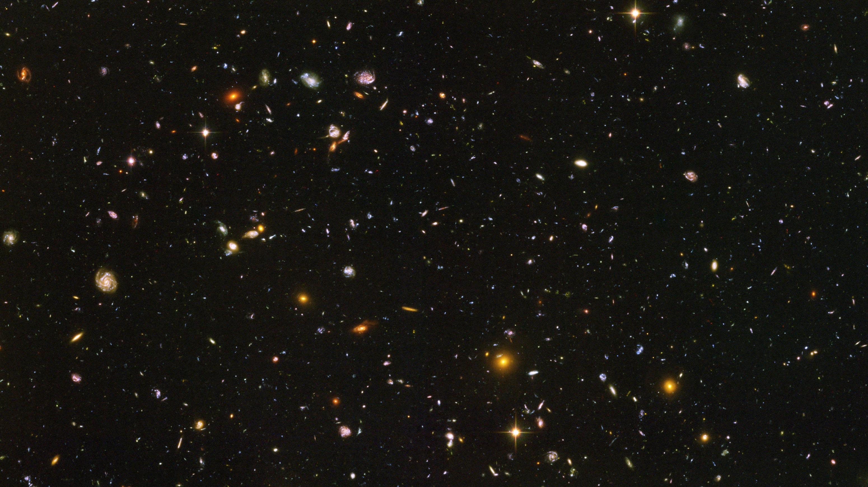
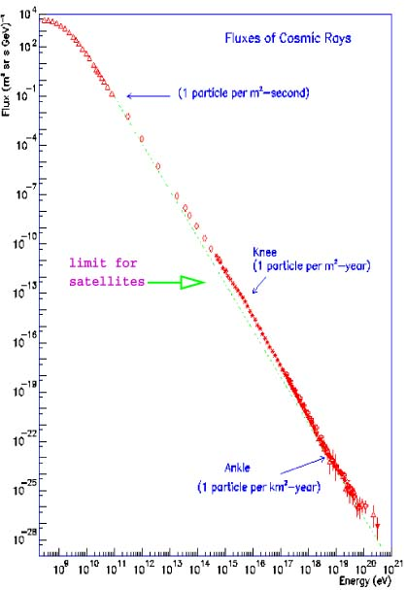

Energy spectrum and detector size
10⁴
10²
10⁻¹
10⁻⁴
10⁻⁷
10⁻¹⁰
10⁻¹³
10⁻¹⁶
10⁻¹⁹
10⁻²²
10⁻²⁵
10⁻²⁸
1 /m²/sec
Need huge detector
Flux [/m²/sr/GeV]
Nikhef open dag, 5 oktober 2019
knee
1 /m²/year
Region of interest:
100 - 1 per km² per century
ankle
1 /km²/year
10⁹ 10¹⁴ 10¹⁷ 10²⁰
* The luminosity sucks.
Energie [eV]
Notes:
To set the stage: Real life is more complicated, say more interesting. Never forget to read the fine print at the bottom of the page.

Slide 9
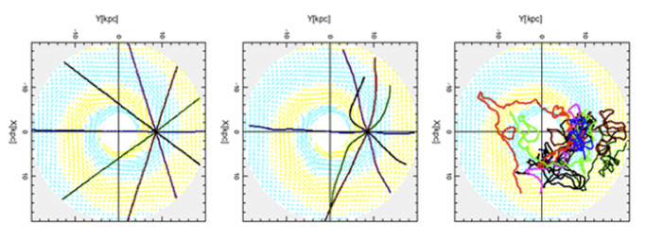
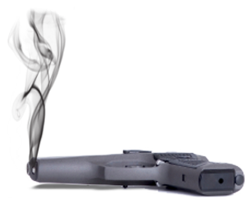
Cosmic magnetic field, particle type and sources
Trajectories of proton in our Milky Way
10¹⁸ eV 10¹⁹ eV 10²⁰ eV
GZK interactions/cosmic horizon
p + γ -> p/n + π -> p/n + γγ/μν
* An iron nucleus bends 26 times more than a proton in the same magnetic field.
** UHE photons and neutrinos may be detected and can serve as alternatives to determine the UHE cosmic ray sources.
Notes:
Magnetic fields in the universe are weak, but distances enormous and the bending proportional to Bdl is still very large.
Only protons at the maximum observed energy point back to their source.
Another complication is that these UHE protons may not even make it to be detected, because they meet an cosmic microwave background photon on their way and break up in lower energy particles. On the up side of that, the resulting UHE photons and neutrinos may be excellent probes to see what is going on.

Slide 10
Where are the sources ?
Two scenarios as Auger results
Maximum acceleration Cosmic Horizon
Upgrade
Upgrade
N
p
N
p
He
Fe
Fe
He
* Secretly Auger is getting warm on identifying sources and they may be surprising.
Notes:
The explanation of the highest energy particle spectrum is still unresolved: is there a maximum acceleration in the universe or is the end of the spectrum mainly due to the interactions with the cosmic microwave background. The key is in particle identification, which is presently very difficult with the observatory that we have, To fix this we need an upgrade.

Slide 11
Hadronic interactions and MC muon deficit
N_{μ}=R_{μ} × (2.148×10⁷)
Rate of muon production:
Corresponds to LHC models at √s = 10 TeV
Has significant discrepancy with LHC extrapolations at √s = 300 TeV
* Understanding hadronic interactions up to ultra-high energy
is fully entangled with understanding the cosmic ray particle type.
Notes:
On the hadronic interaction front at UHE, we see an excess of muons that is not easily explained while also remaining compatible with LHC results.
The reason for the excess may be something we have not understood in the SM, or it may be new physics beyond the SM.
One of the main limitations in figuring out what is going on, is that we do not even know what the incident projectile is.

Slide 12
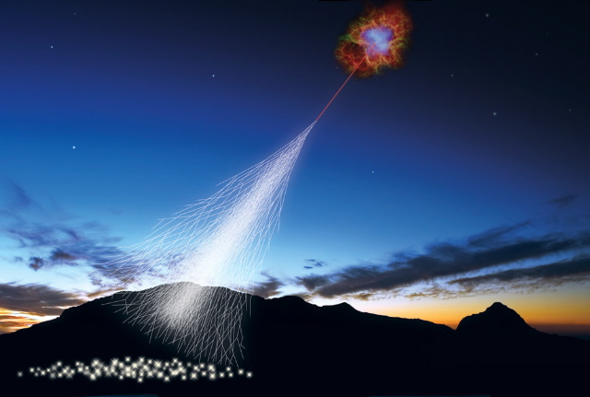
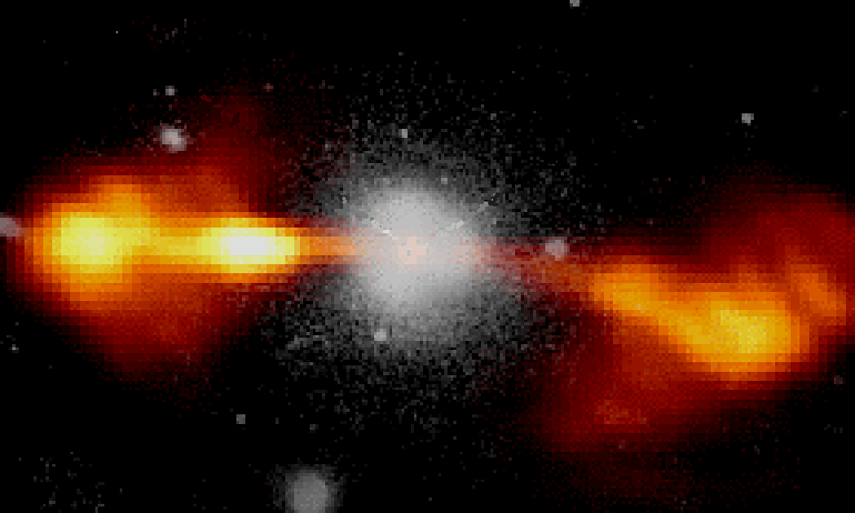
Ultra-High-Energy Cosmic Rays
Particle interactions
at the highest energy
ever seen
Origin of highest-energy
particles in the Universe
?
?
Particle type is the key !
We are installing the detector !
* This is the simplified picture.

Slide 13
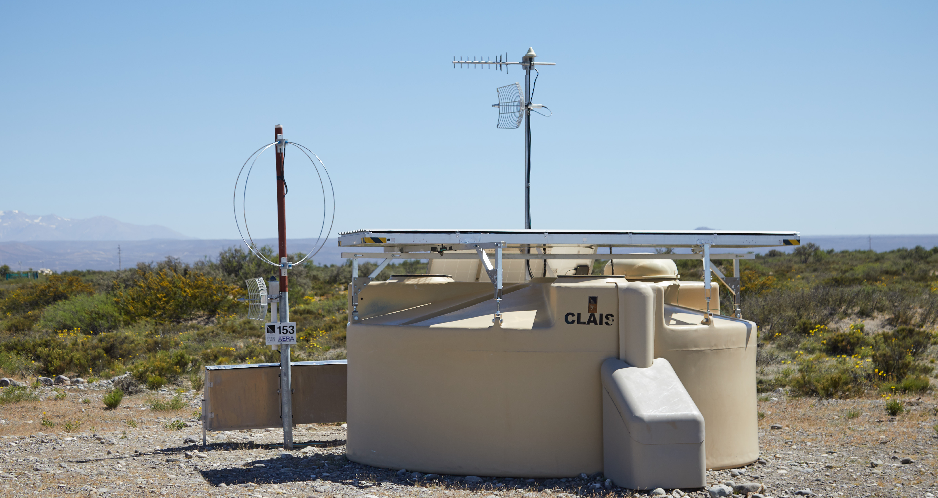
Particle-ID at highest energies
combination gives
e and μ separately
total # e
e + μ in
shower tail
total # e
μ in
shower
tail
a e + b μ
in shower tail
* Again a simplified picture.
Notes:
Short description of the functionality of the upgrade.
In the SSD upgrade, the Nikhef group plays a very significant role, the RD upgrade is completely dominated by Nikhef.

Slide 14
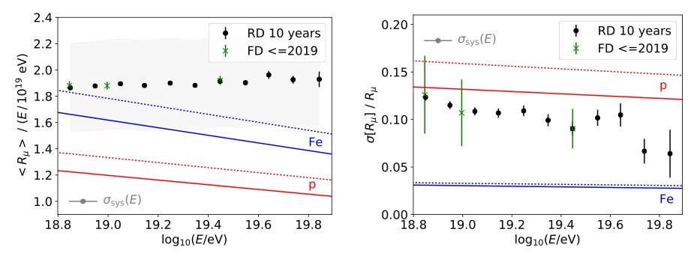
Auger RD science case
* Auger will be able to do the particle-id for TA in the US.
Notes:
Some more impression pictures and the statement that the design is well advanced, a 10 station prototype is in the field and that we expect flat out production in the course 2020, with installation in 2020 and 2021.

Slide 15
Auger RD
Antenna 5 m above ground
* Picture by Tim Huege (KIT).
Notes:
Some more impression pictures and the statement that the design is well advanced, a 10 station prototype is in the field and that we expect flat out production in the course 2020, with installation in 2020 and 2021.

Slide 16
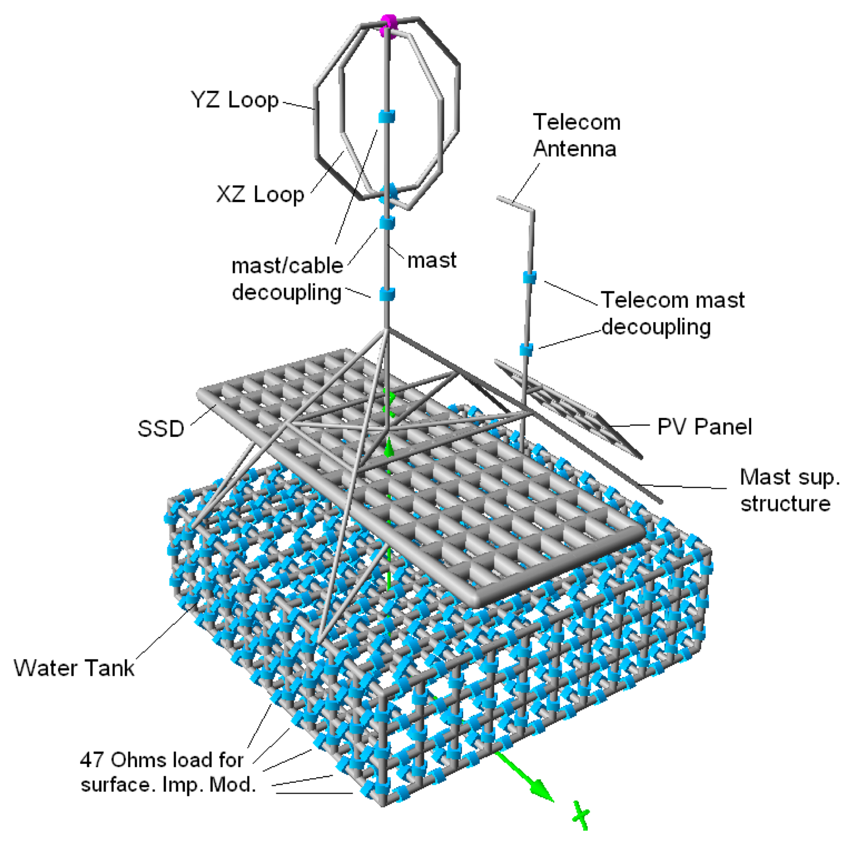
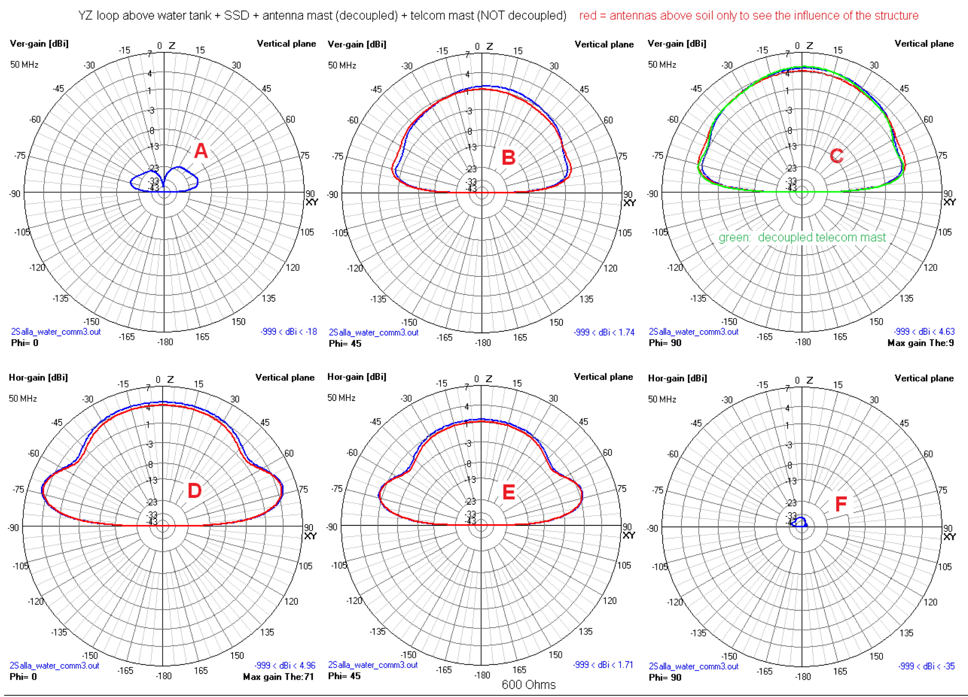
Auger RD
The antenna pattern = direction sensitive gain
is a key ingredient in understanding
the whole system
* And is damn hard to simulate and measure !
Notes:
Pictures of RD electronics.

Slide 17
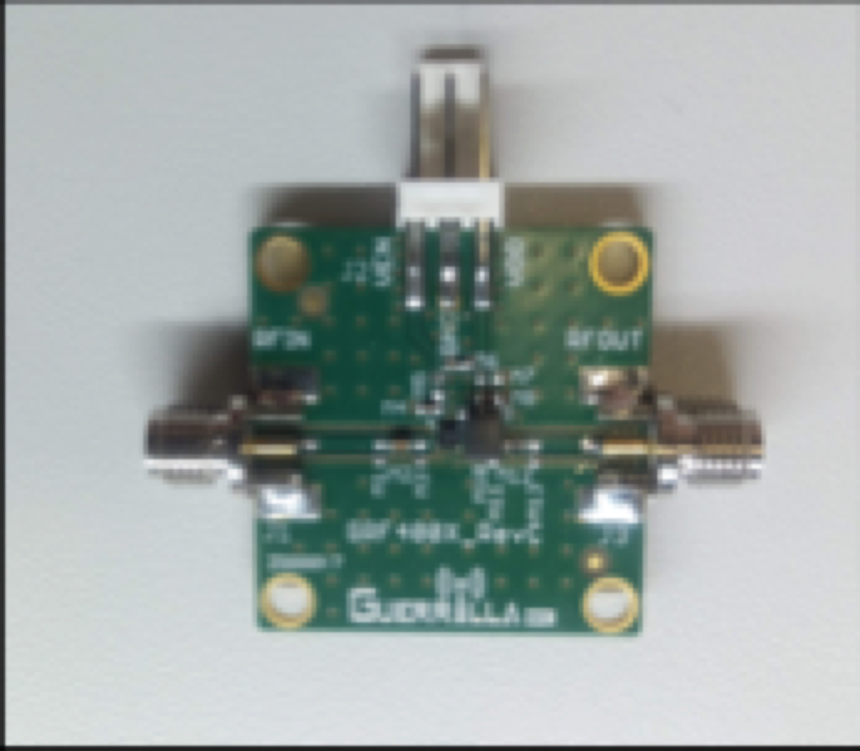
Auger RD
LNA and digitizer
developed by the radio lab
at Radboud University
* The Radboud Radio Lab was set up by Heino Falcke
and is of great significance to this project.
Notes:
Electronics board design in first pass ready.

Slide 18
Multi-messenger to find sources
Proton astronomy
Point sources
Cosmogenic
p+γ_{CMB} → p+π⁰
π⁰ → γ+ γ E_{γ} ≈ E_{p}/10
p+γ_{CMB} → n+π⁺
π⁺ → μ⁺+ ν_{μ} E_{ν} ≈ E_{p}/20
μ⁺ → e⁺+ ν_{μ}+ ν_{e} E_{ν} ≈ E_{p}/1000
A+γ_{CMB} → A′+p
p+γ_{CMB} → ν’s E_{ν} ≈ E_{A}/A/20
p+γ_{CMB} → γ’s E_{γ} ≈ E_{A}/A/10
p
N
Fe
He
Gamma & neutrino astronomy
* Being sensitive to both cosmic rays, neutrinos and photons is the key to guaranteed success.
Notes:
Recent Auger results on gamma and neutrino, introducing the need to go much larger in detection surface.

Slide 19
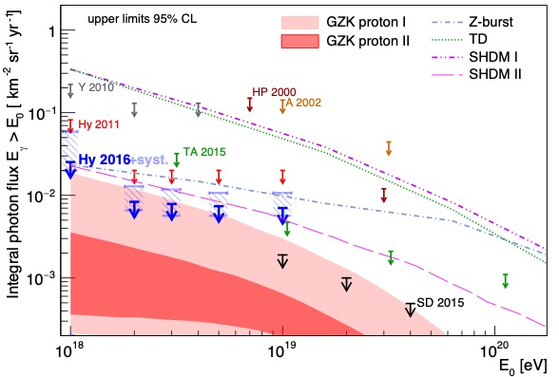
Multi-messenger: γ and ν
(Ultra-) High-Energy Neutrino Search Ultra-High-Energy photon search
Auger results for
Gamma and nu
Auger
ANTARES
IceCube
Auger will come close to first detection of UHE ν and γ,
but will not be able to collect significant statistics
* If Auger makes a significant detection it will present a new challenge in understanding.
Notes:
Recent Auger results on gamma and neutrino, introducing the need to go much larger in detection surface.

Slide 20
Future: UHE Neutrino radio detection
Neutrino
interaction
Tau decay
Radio frequency signal
Cosmic
neutrino
Air shower
Detection antennas
Giant Radio Array Neutrino Detector: GRAND
* GRAND, ending in “D”, not ending in “T”.
Notes:
Introduction of GRAND, the principle, the reach, the multipurpose character. Emphasis on using UHE gammas and neutrinos to figure out the particle type and sources of UHE CR, and the prospects for proton astronomy and multi-messenger due to the large aperture.

Slide 21
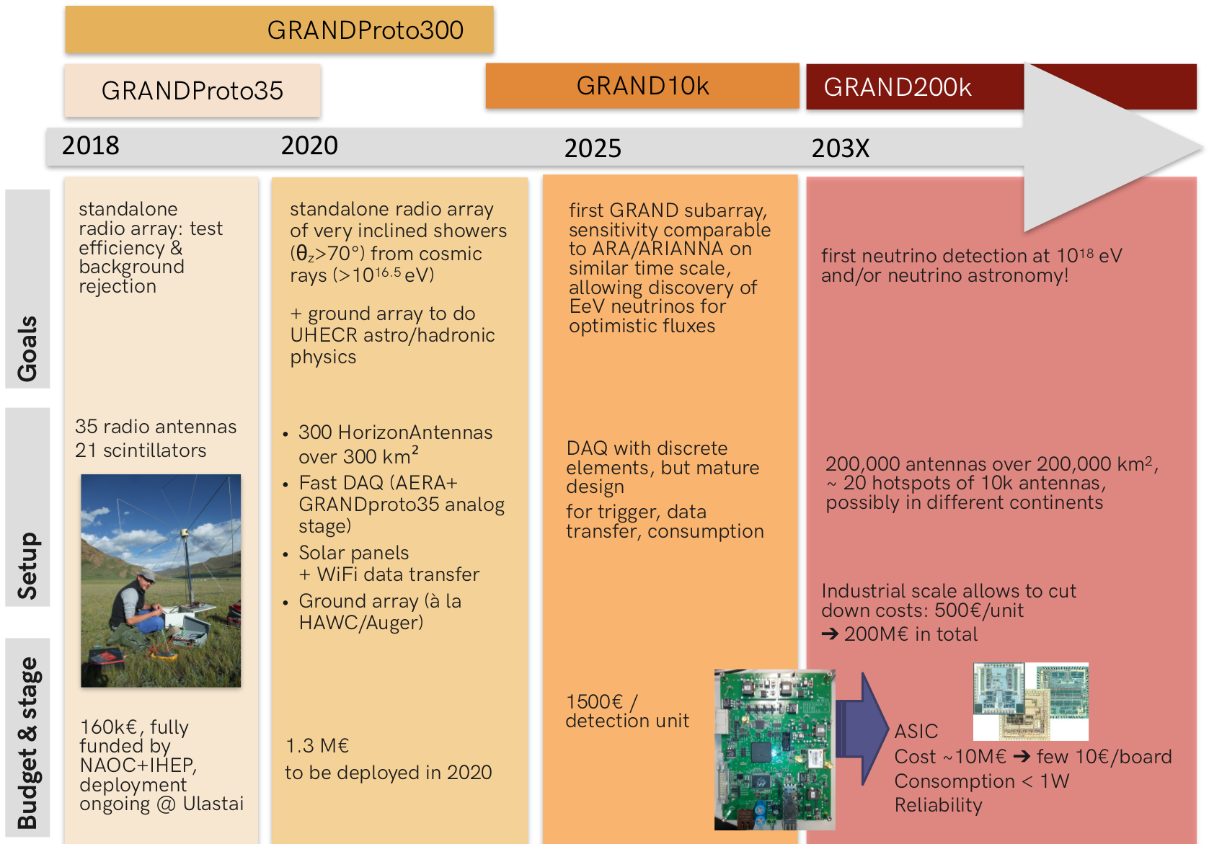
GRAND Road Map
Notes:
Stages of GRAND.

Slide 22
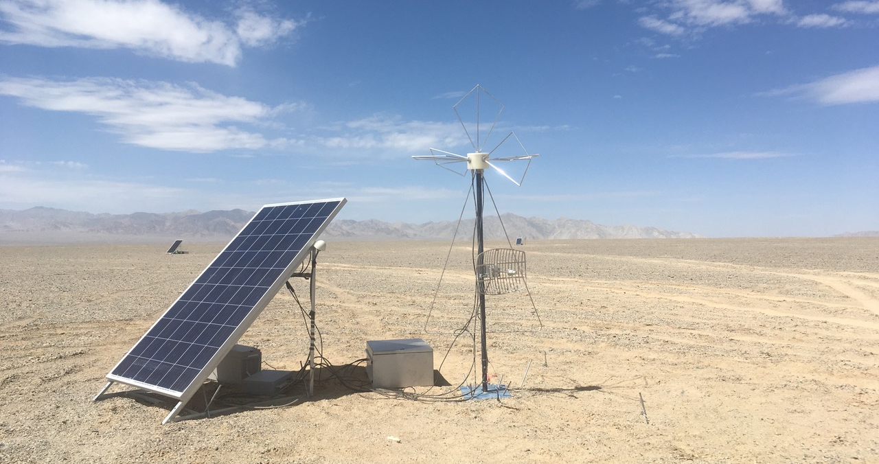
GRANDProto300 Site
* If you thought that Argentinian Pampa was not enough of a challenge, you can reconsider and join GRAND.
Notes:
A suitable site in China has been identified for GRAND300, which may be converted into the first hotspot, GRAND10k

Slide 23
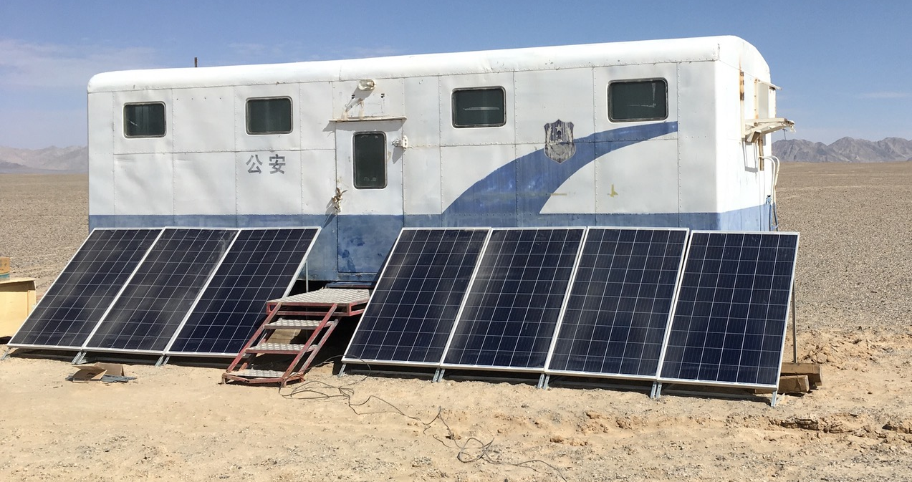
Impression of site and electronics
* Low cost, but effective.
Notes:
The central DAQ infrastructure !

Slide 24
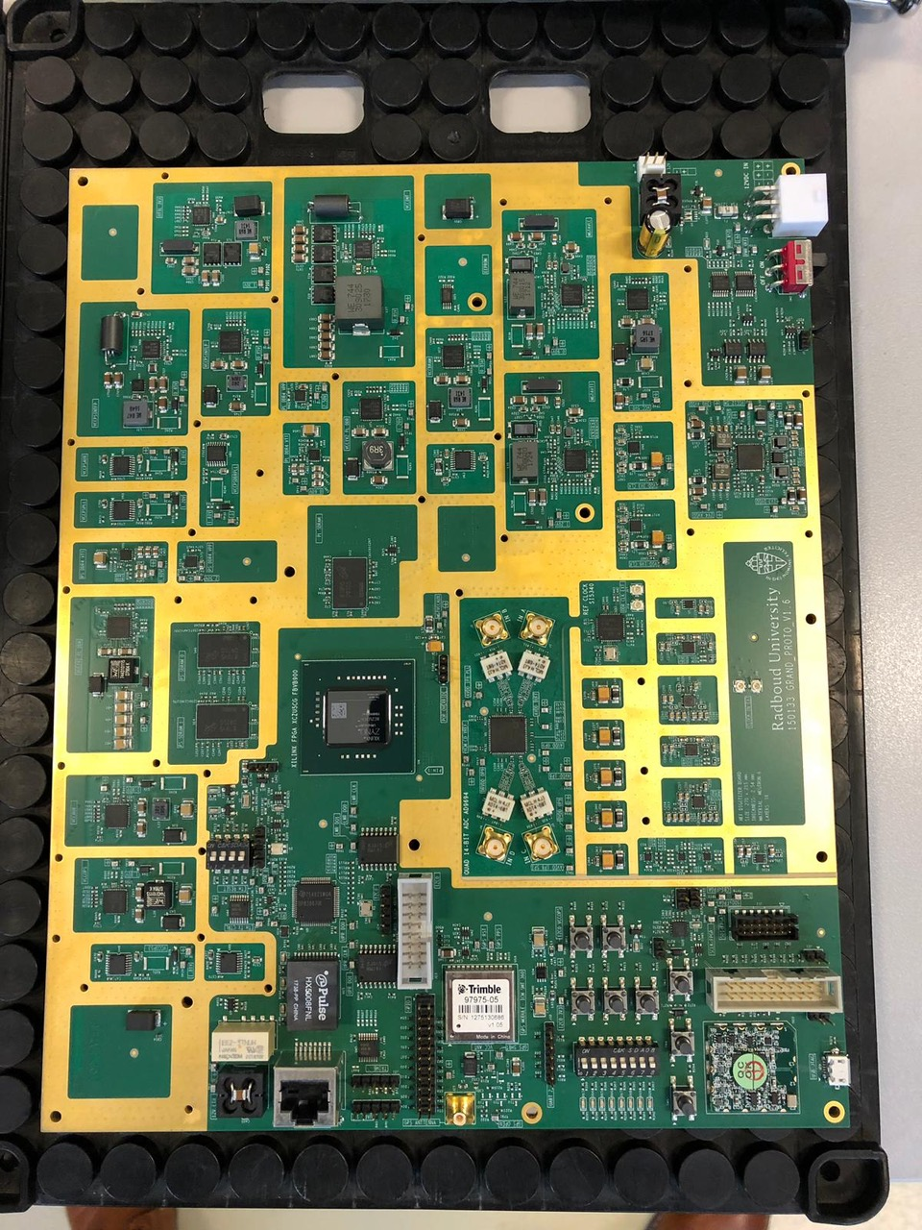
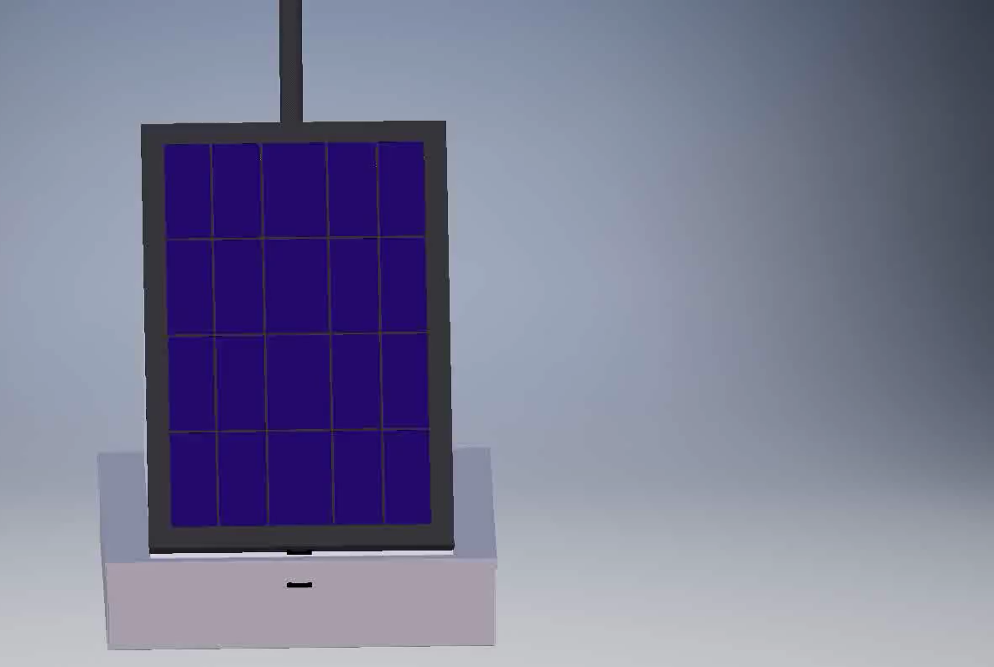
Nikhef/RU Electronics and Mechanics
* All done (again) by the RU Techno Center.
Notes:
Our group, using the Radboud University Techno Center, delivered the digitizer and auxiliary electronics and the mechanical design of the stations.

Slide 25
Summary
Researching the highest energy accelerators and interactions
Multi-messenger: cosmic rays, neutrinos, photons, …
In the middle of a major AugerPrime upgrade adventure
  Nikhef in leading position
At the start of the GRAND adventure
  Logical AugerPrime follow-up
  Again Nikhef in leading position
Exciting times ahead !

