Slide 1
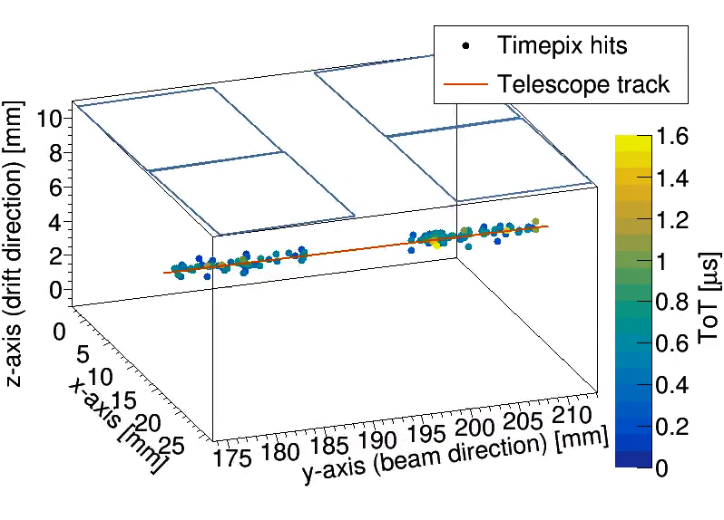



Performance of the GridPix quad TPC readout
Cornelis Ligtenberg, Y. Bilevych, K. Desch, H. van der Graaf, M. Gruber, F. Hartjes, K. Heijhoff,
J. Kaminski, P.M. Kluit, N. van der Kolk, G. Raven, T. Schiffer, J. Timmermans
The 2019 International Workshop on the High Energy Circular Electron Positron Collider, November 18, Beijing

Slide 2
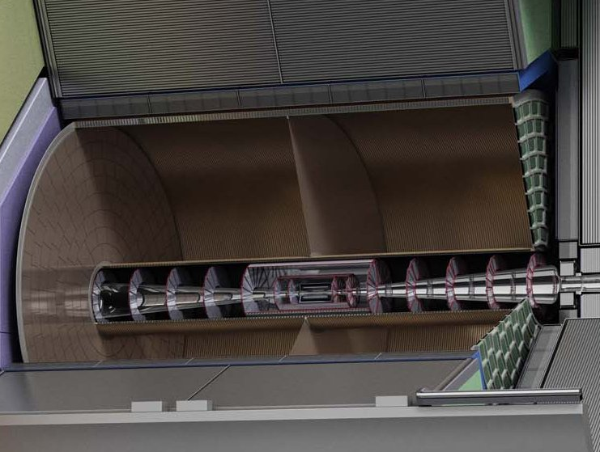
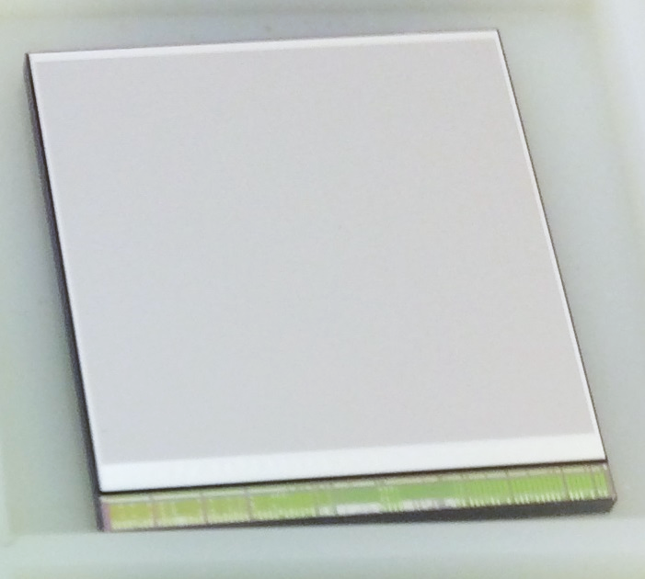

Introduction and outline
The goal is to develop a pixel readout for a large TPC
A large TPC with a 55 µm × 55 µm pixel readout
First Timepix3 based chip test beam (2017)
Quad module performance from test beam (2018)
Development of 8 quad detector (2019-2020)
Picture ILC TDR

Slide 3
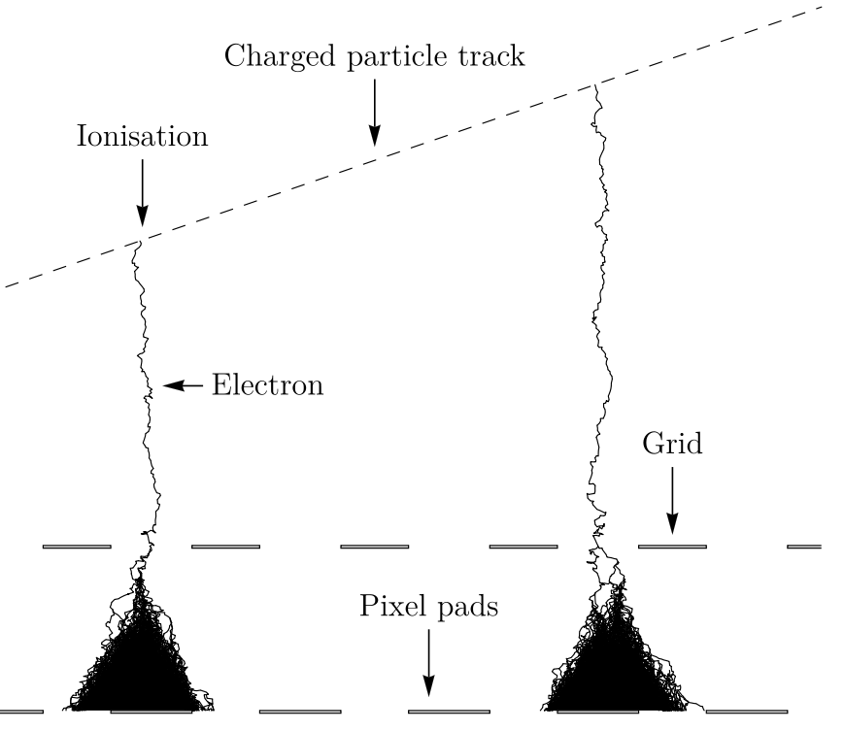
GridPix technology
GridPix is a type of micro-pattern gaseous TPC readout
The GridPix based on a Timepix3
  55 µm × 55 µm pixels
  Digital simultaneous registration of Time of Arrival (1.56 ns) and Time over Threshold
  An aligned Aluminium amplification grid is added by photolithographic postprocessing techniques
Single ionization electrons are detected with high efficiency
  The maximum possible information from a track is acquired
  dE/dx by cluster counting
35 µm
1 µm
50 µm
55 µm

Slide 4
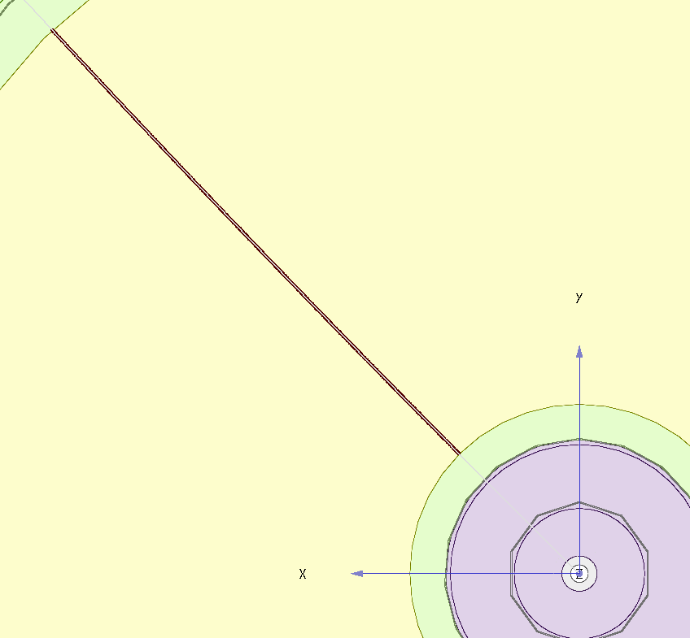
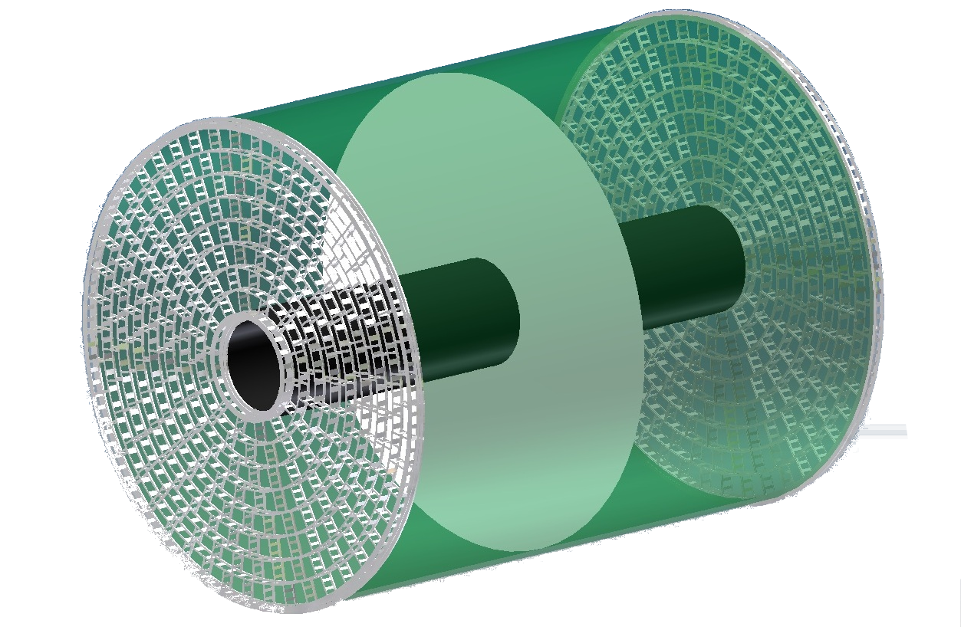
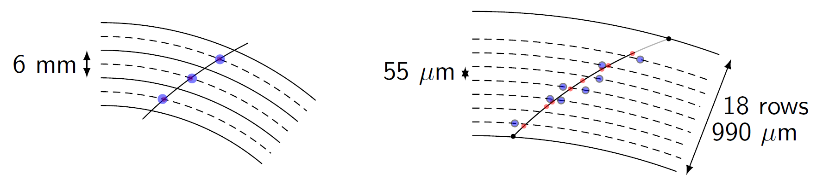
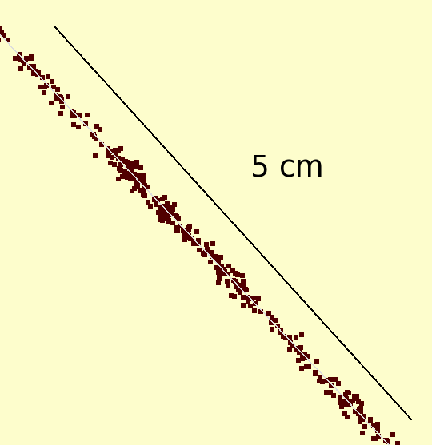


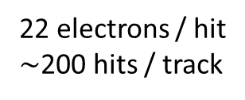
Simulation of ILD TPC with pixel readout
To study the performance of a large pixelised TPC, the pixel readout was implemented in the full ILD DD4HEP (Geant4) simulation
Changed the existing TPC pad readout to a pixel readout
Adapted Kalman filter track reconstruction to pixels
50 GeV muon track with pixel readout
Pads
Pixels
Continuous
3D tracking
6 mm
55 µm
22 electrons / hit
$∼$200 hits / track
1 electron / hit
$\sim$10 000 hits / track
Picture by Cornell

Slide 5
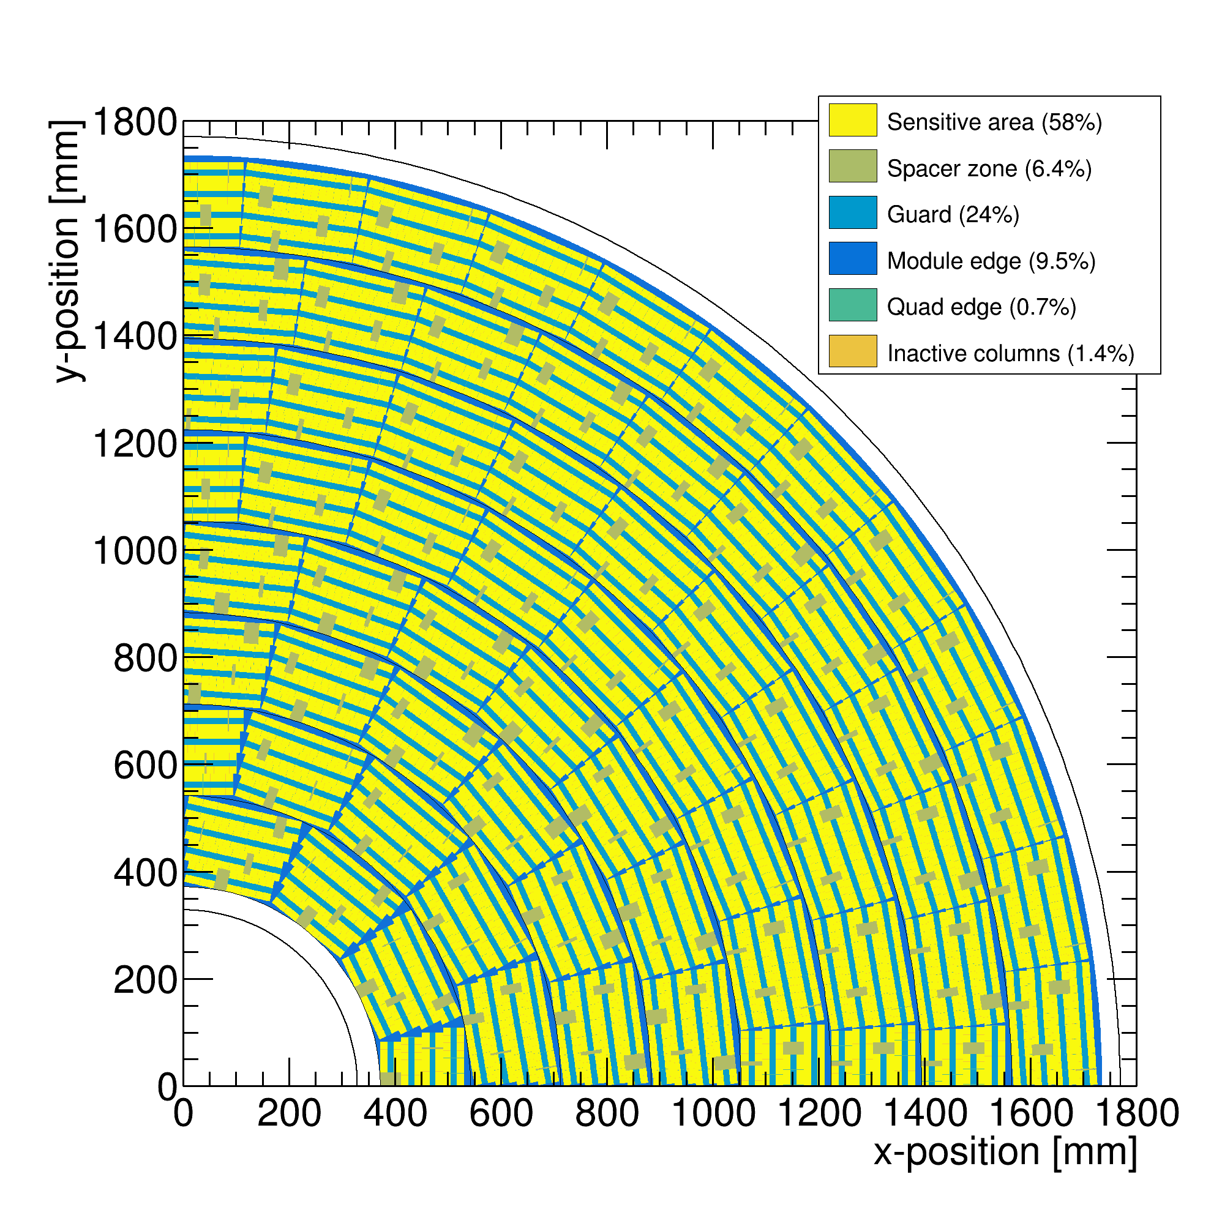
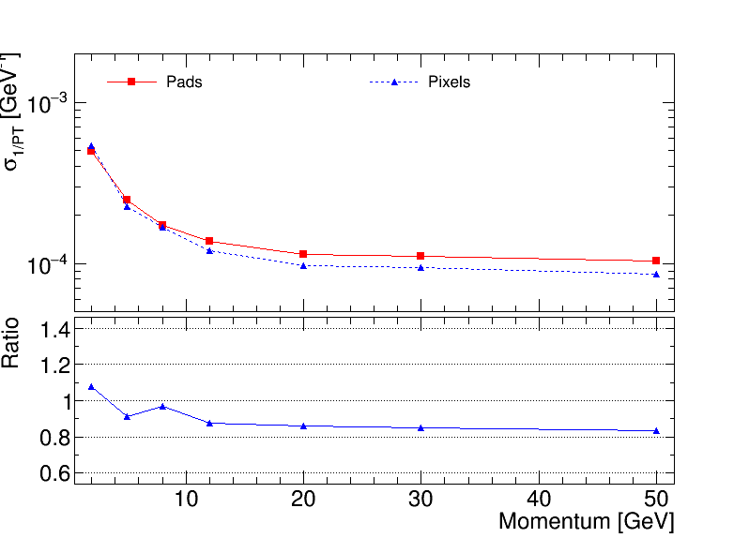

Performance of a GridPix TPC at ILC
From full simulation, momentum resolution can be determined
Momentum resolution is $\sim$15% better (with realistic coverage and delta’s)
Realistic tiling with quad module
Momentum resolution of the TPC for a 50 GeV muon
58% coverage

Slide 6
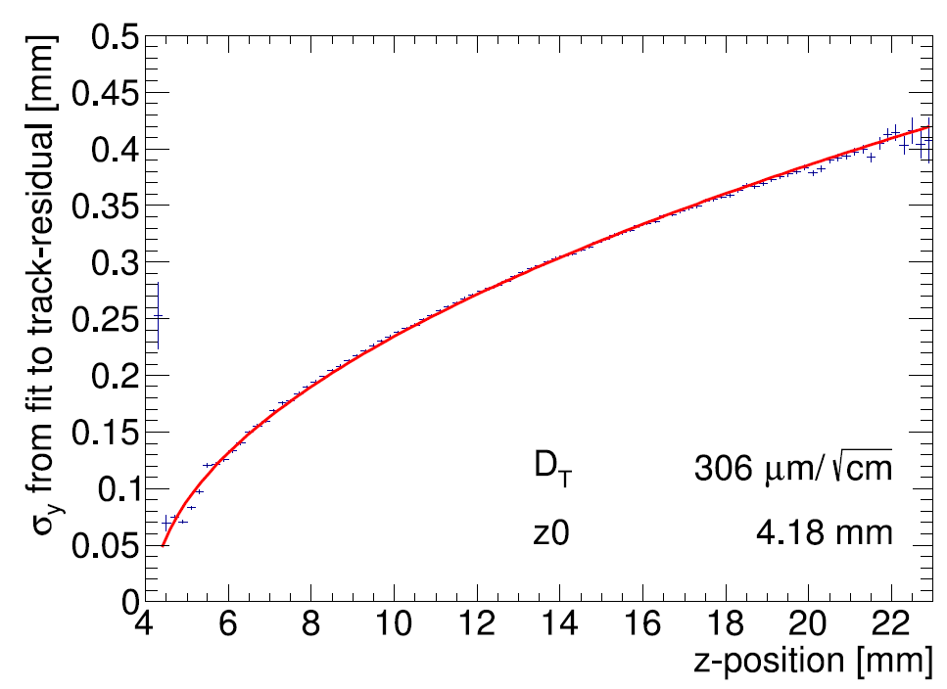
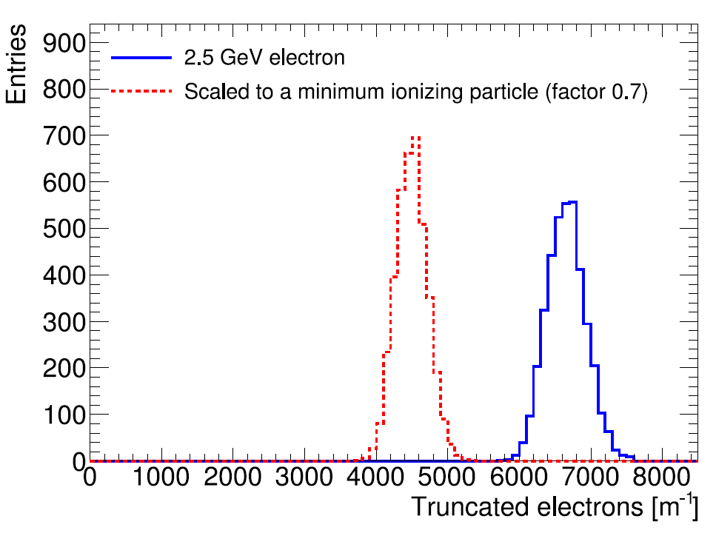
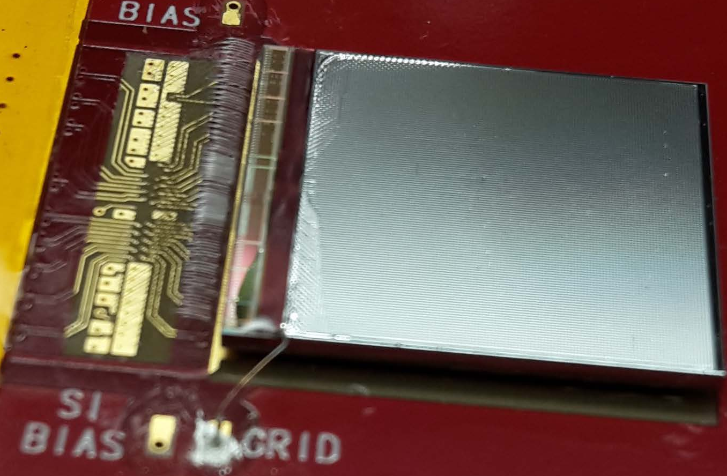


Single chip results (2017)
Hit resolution
A GridPix based on the Timepix3 chip was reliably operated in a test beam setup with 2.5 GeV electrons at ELSA (Bonn)
T2K gas and E_{drift} = 280 V/cm, V_{grid} = -350 V
The resolution is primarily limited by diffusion
Systematic uncertainties are low: < 10 µm in plane
Energy loss resolution (dE/dx) by electron counting is 4.1 % per meter
B$=0$ T
MIP
Electron
Published paper on this testbeam doi:10.1016/j.nima.2018.08.012

Slide 7
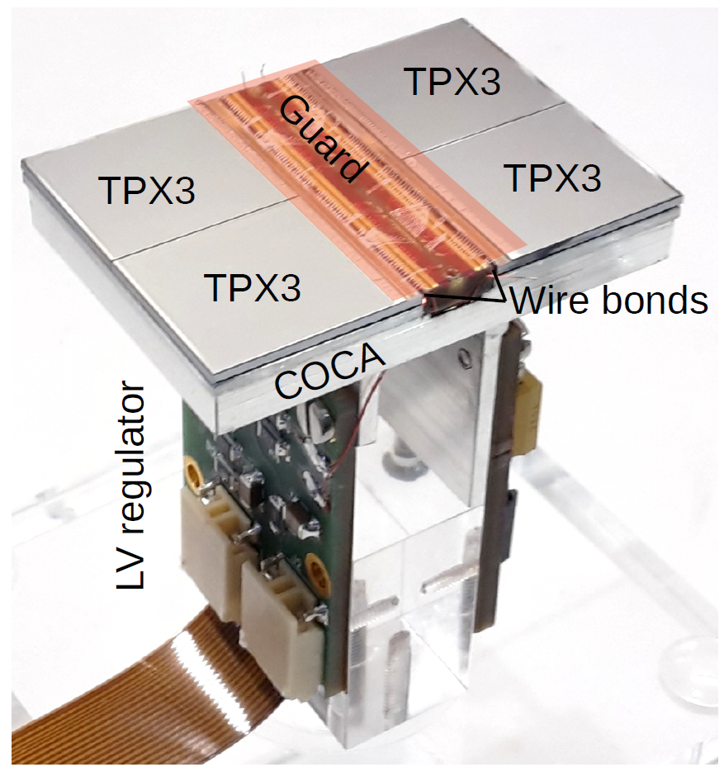
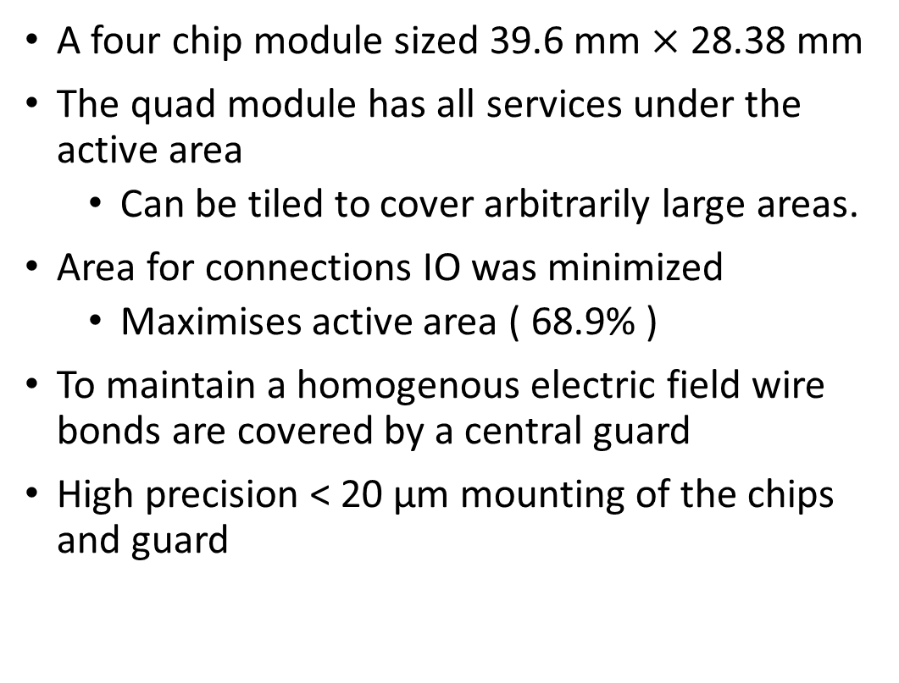
The quad module
A four chip module sized 39.6 mm $×$ 28.38 mm
The quad module has all services under the active area
  Can be tiled to cover arbitrarily large areas.
Area for connections IO was minimized
  Maximises active area ( 68.9% )
To maintain a homogenous electric field wire bonds are covered by a central guard
High precision < 20 μm mounting of the chips and guard
Cooling channels

Slide 8
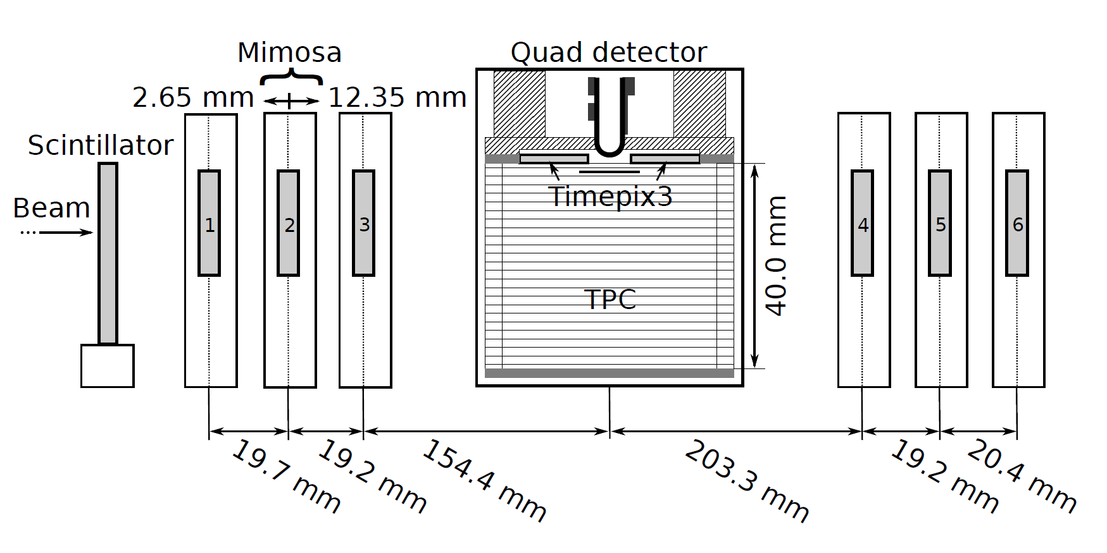
Test beam measurements (2018)
2.5 GeV electrons at the ELSA accelerator in Bonn, Germany
T2K gas with E_{drift} = 280 V/cm, V_{grid} = -350 V
Events are triggered by a scintillating plane
6 plane mimosa telescope with 18.4 μm × 18.4 μm sized pixels
180 º

Slide 9
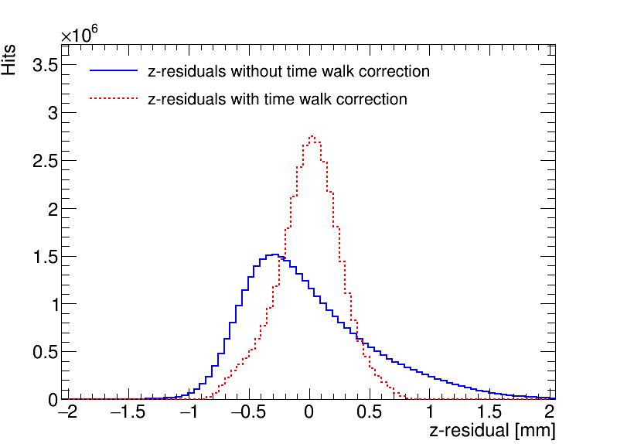
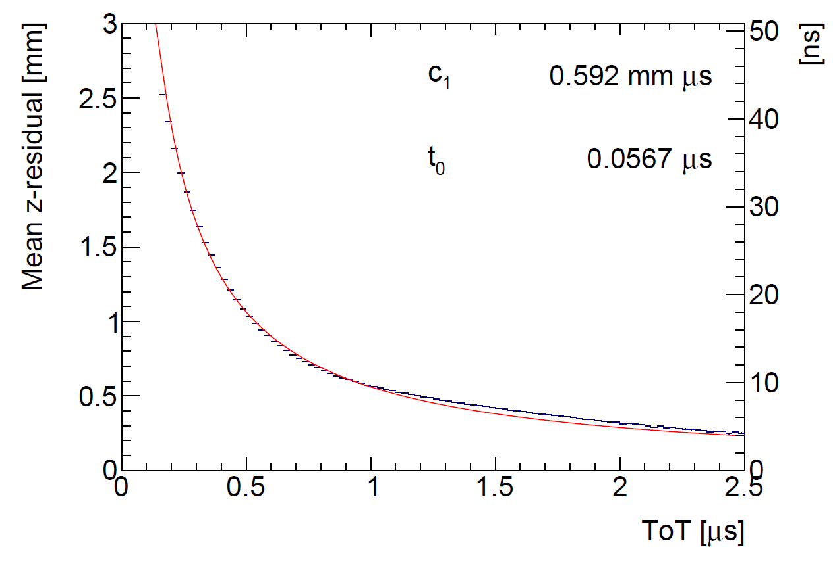
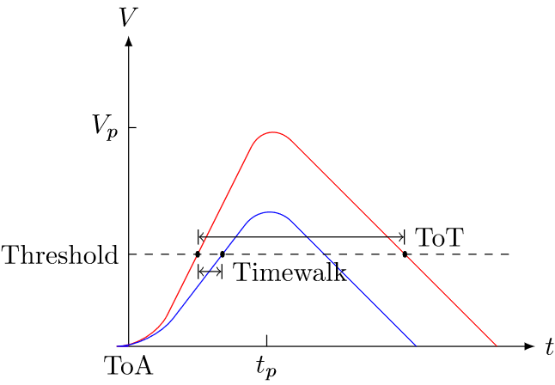
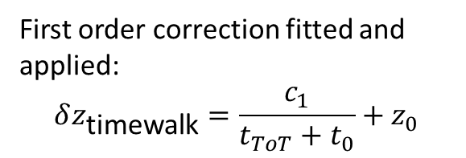
Time walk correction
Time walk error: time of arrival depends on signal amplitude
Time walk can be corrected using Time over Threshold (ToT) as a measure for signal strength
First order correction fitted and applied:
$$δz_{\text{timewalk}}=\frac{c_{1}}{t_{ToT}+t_{0}}+z_{0}$$
Distribution of residuals becomese more Gaussian after the time walk correction

Slide 10
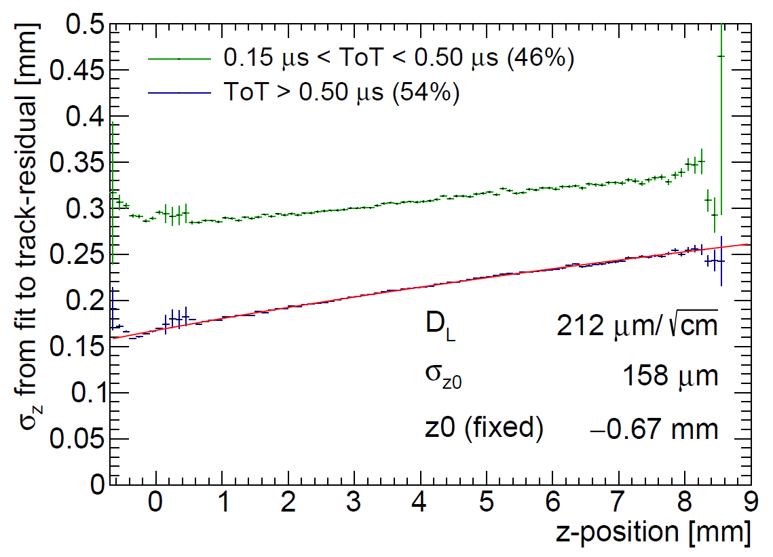
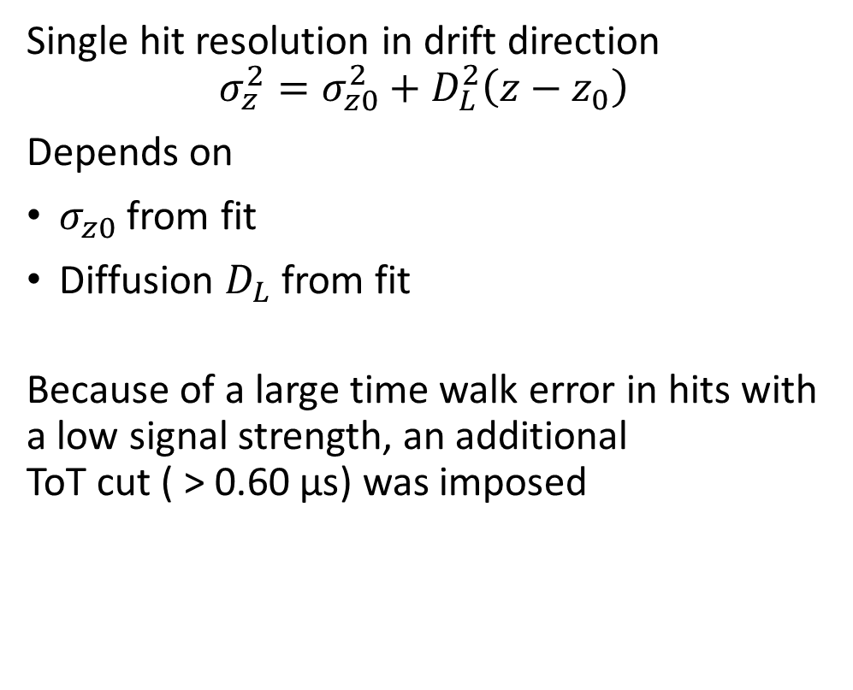
Hit resolution in the drift direction
Single hit resolution in drift direction
$$σ_{z}^{2}=σ_{z0}^{2}+D_{L}^{2}\left(z−z_{0}\right)$$
Depends on
$σ_{z0}$ from fit
Diffusion $D_{L}$ from fit
Because of a large time walk error in hits with a low signal strength, an additional
ToT cut ( > 0.60 µs) was imposed

Slide 11
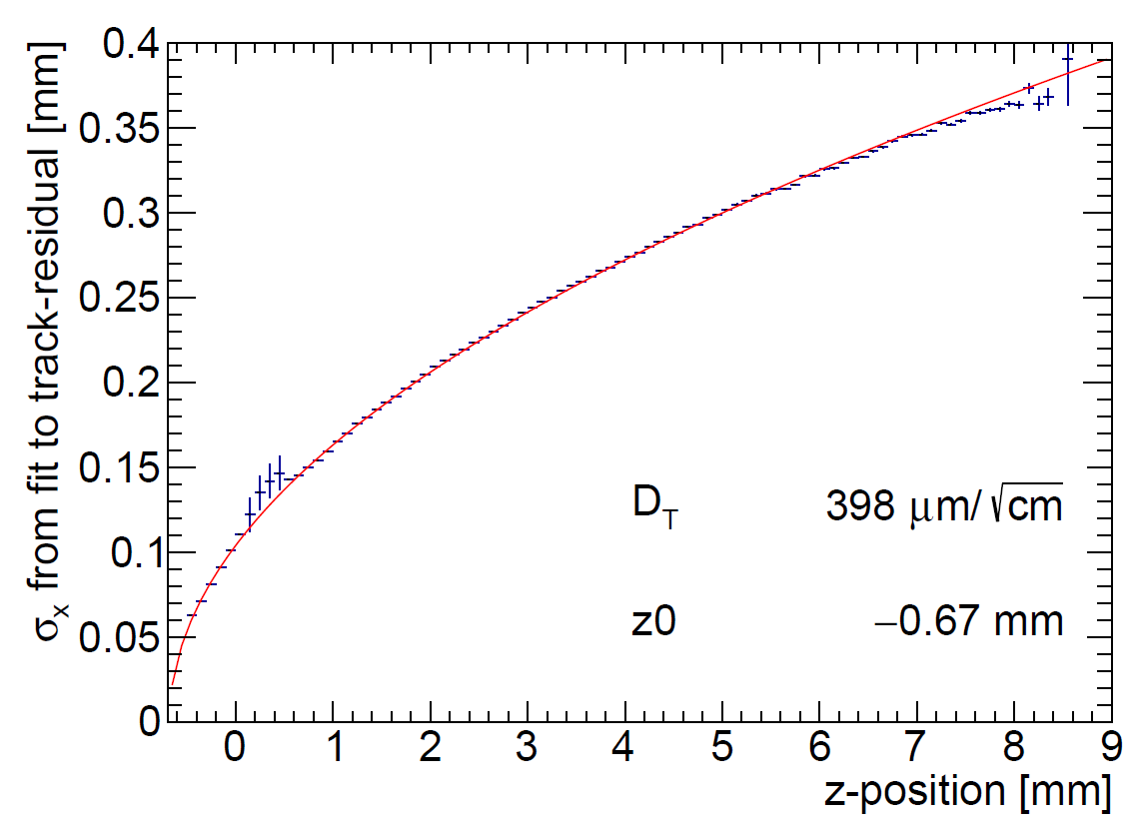

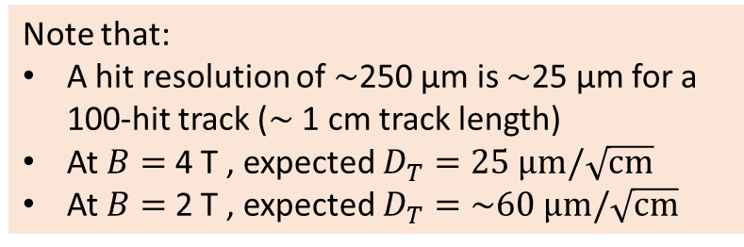

Hit resolution in the pixel (precision) plane
Single hit resolution in pixel (precision) plane:
$$σ_{y}^{2}=σ_{y0}^{2}+D_{T}^{2}\left(z−z_{0}\right)$$
Depends on:
$σ_{y0}=$ pixel size 55 µm$/\sqrt{12}$
Diffusion $D_{T}$ from fit
Scattering on guard
B$=0$ T
Note that:
A hit resolution of $\sim$250 µm is $\sim$25 µm for a 100-hit track ($\sim$ 1 cm track length)
At $B=$ 4 T , expected $D_{T}=25 \text{μm}/\sqrt{\text{cm}}$
At $B=$ 2 T , expected $D_{T}=\sim 60 \text{μm}/\sqrt{\text{cm}}$

Slide 12
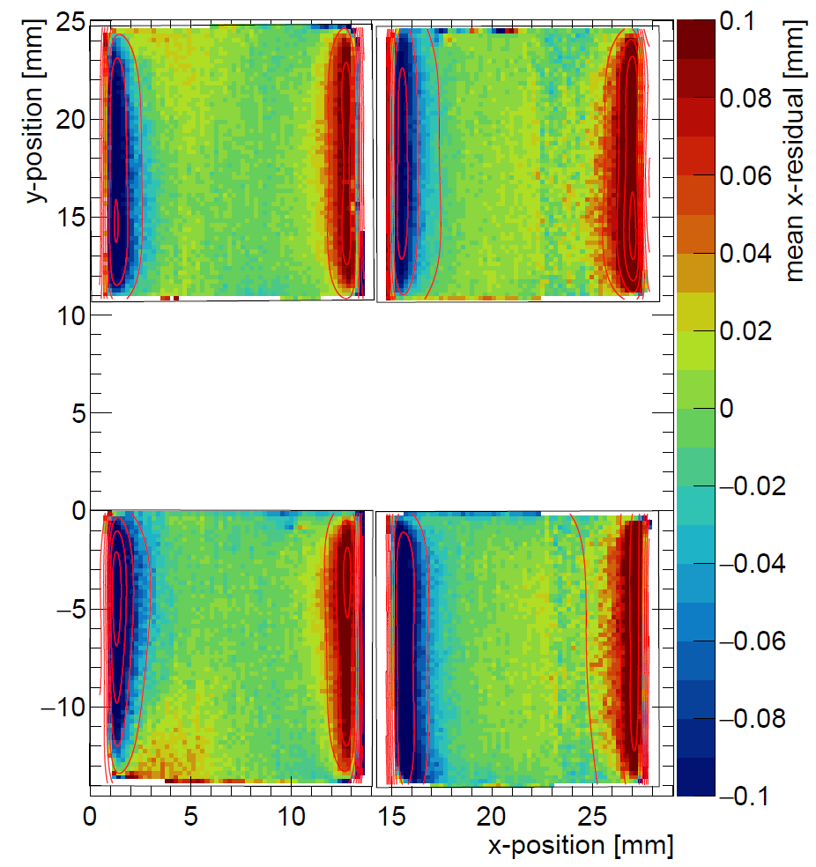
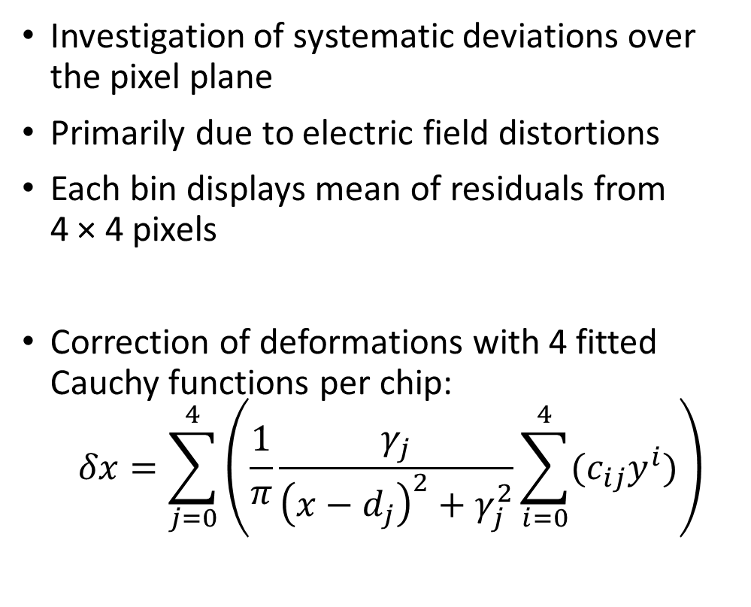
Deformations in the pixel (precision) plane
Without correction
Investigation of systematic deviations over the pixel plane
Primarily due to electric field distortions
Each bin displays mean of residuals from
4 × 4 pixels
Correction of deformations with 4 fitted Cauchy functions per chip:
  $$δx=\sum_{j=0}^{4}{\left(\frac{1}{π}\frac{γ_{j}}{{\left(x−d_{j}\right)}^{2}+γ_{j}^{2}}\sum_{i=0}^{4}{{(c}_{ij}y^{i})}\right)}$$

Slide 13
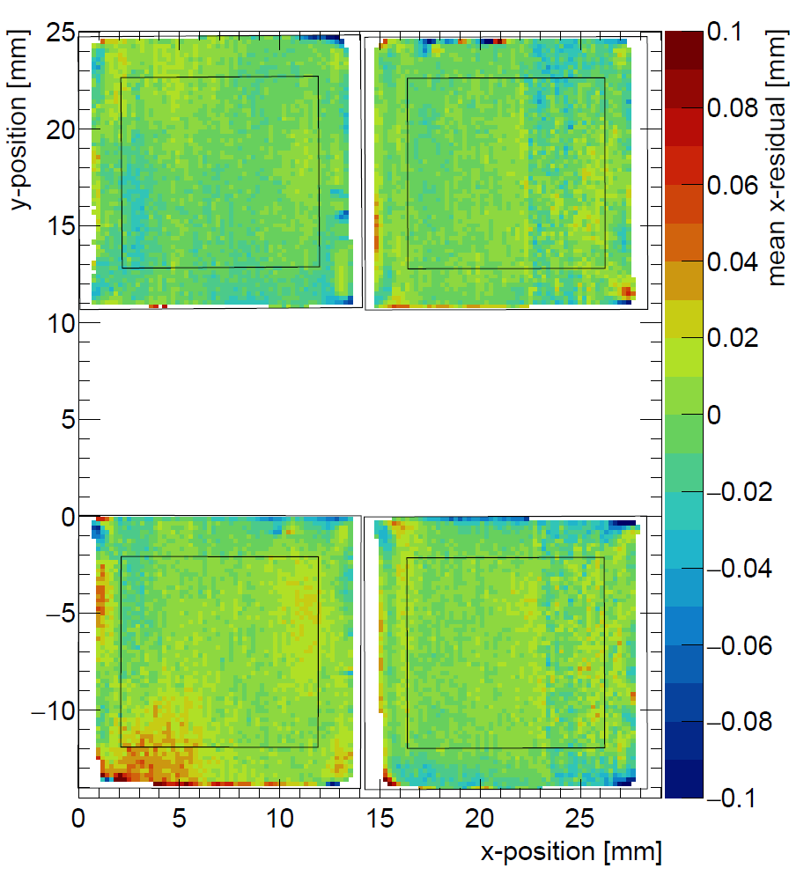
Deformations in the pixel (precision) plane
With correction
Investigation of systematic deviations over the pixel plane
Primarily due to electric field distortions
Each bin displays mean of residuals from
4 × 4 pixels
Correction of deformations with 4 fitted Cauchy functions per chip:
  $$δx=\sum_{j=0}^{4}{\left(\frac{1}{π}\frac{γ_{j}}{{\left(x−d_{j}\right)}^{2}+γ_{j}^{2}}\sum_{i=0}^{4}{{(c}_{ij}y^{i})}\right)}$$

Slide 14
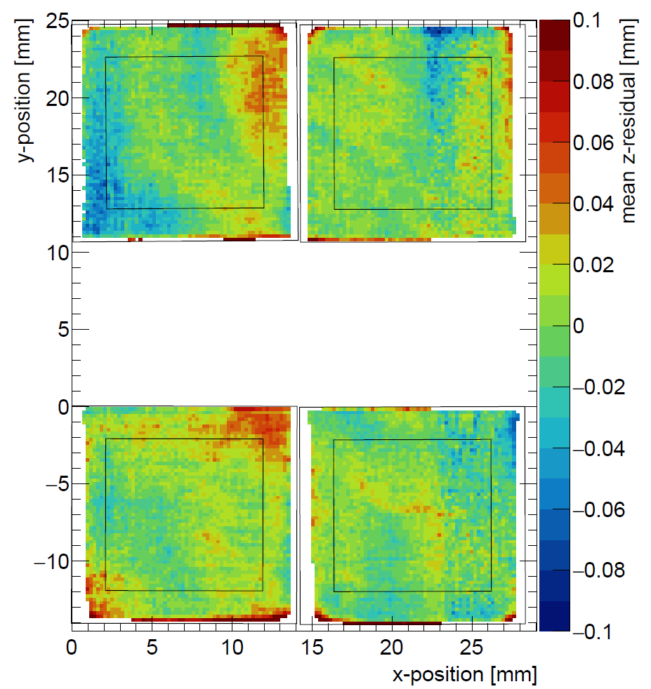
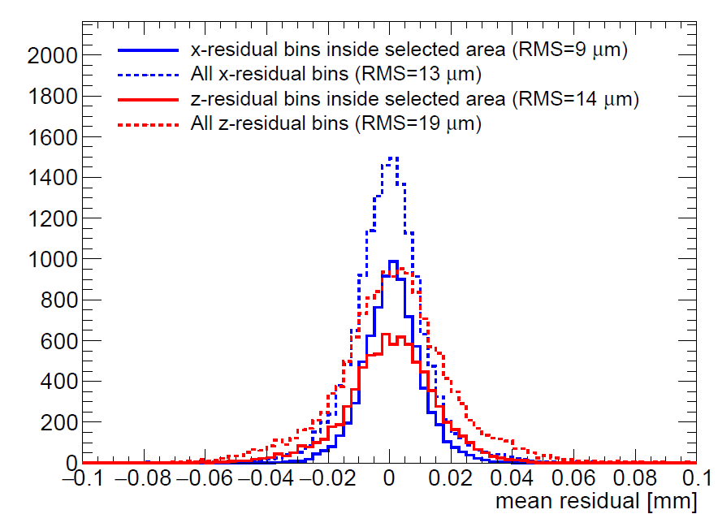
Deformations in pixel plane and drift direction
Each bin displays mean of residuals from 4 × 4 pixels
The RMS in the center of the chip is 9 µm (pixel plane after correction) and 14 µm (drift direction), which indicates small systematic errors
Corrected x deformations
Pixel (precision) plane
z deformations
Drift direction

Slide 15
8 quad module development
8 quad test box with (32 chips)
Simultaneous read out through one SPIDR board using a data concentrator
Field wires added to improve electric field, and reduce deformations
New field wires

Slide 16
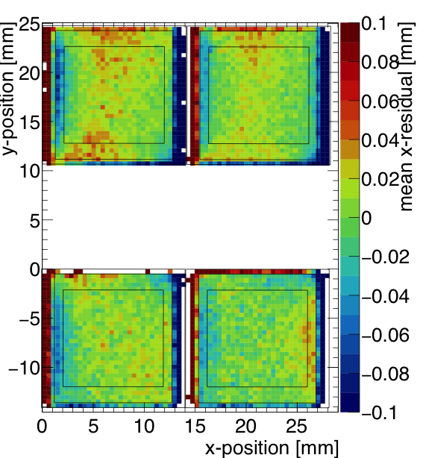
8 quad module development
Laser test indicate a reduction in electric field deformations with field wires
Early 2020 test beam planned at DESY with 1 T magnetic field
Preliminary
Uncorrected residuals from quad test beam
Uncorrected residuals from laser test with field wires

Slide 17
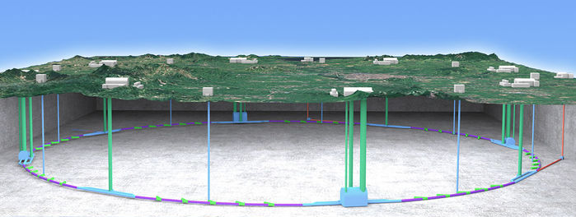
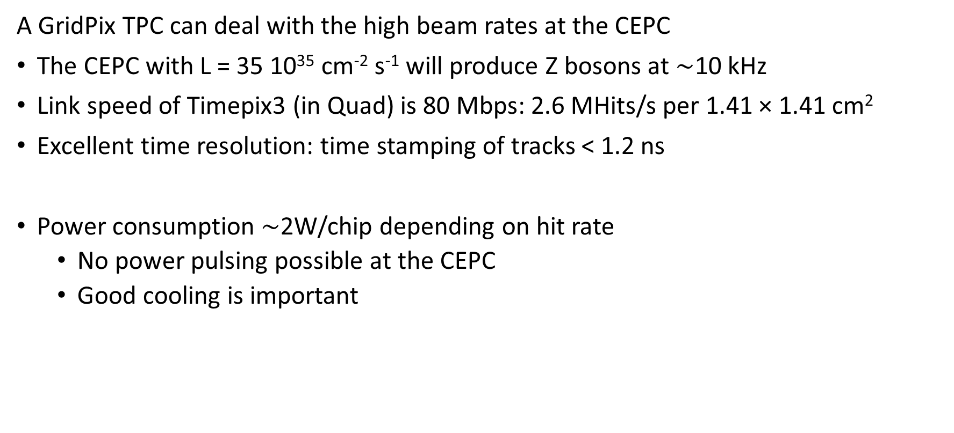
A GridPix TPC at the CEPC?
A GridPix TPC can deal with the high beam rates at the CEPC
The CEPC with L = 35 10³⁵ cm⁻² s⁻¹ will produce Z bosons at $\sim$10 kHz
Link speed of Timepix3 (in Quad) is 80 Mbps: 2.6 MHits/s per 1.41 × 1.41 cm²
Excellent time resolution: time stamping of tracks < 1.2 ns
Power consumption $\sim$2W/chip depending on hit rate
  No power pulsing possible at the CEPC
  Good cooling is important
Picture IHEP

Slide 18
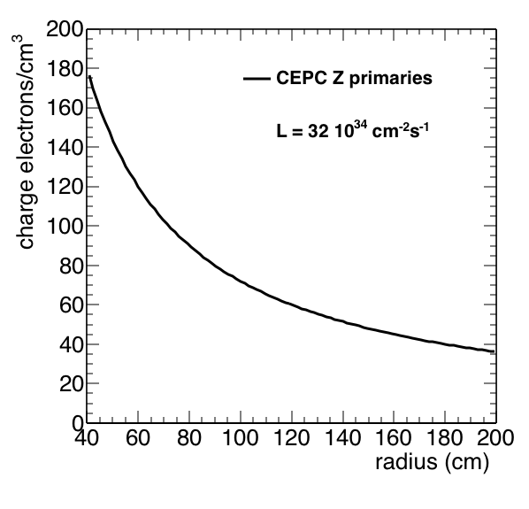
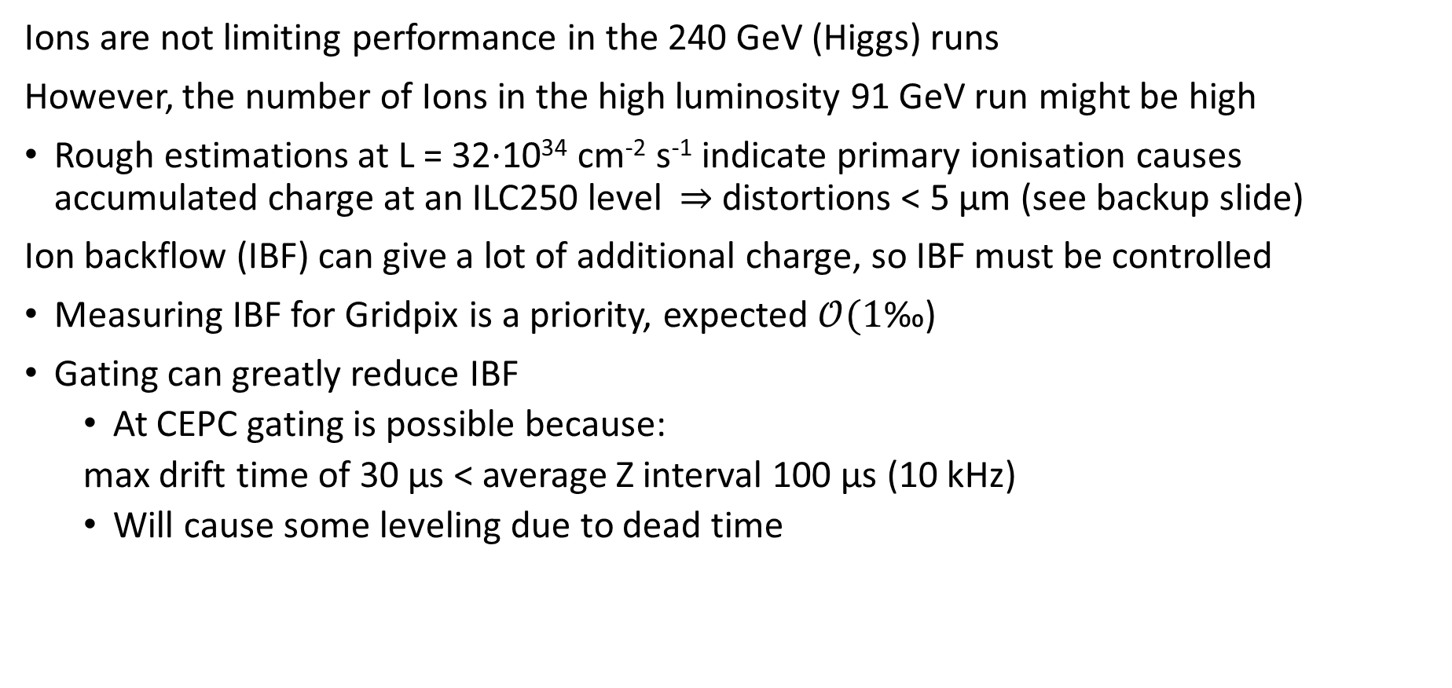
A GridPix TPC at the CEPC?
Ions are not limiting performance in the 240 GeV (Higgs) runs
However, the number of Ions in the high luminosity 91 GeV run might be high
Rough estimations at L = 32⋅10³⁴ cm⁻² s⁻¹ indicate primary ionisation causes accumulated charge at an ILC250 level $⇒$ distortions < 5 µm (see backup slide)
Ion backflow (IBF) can give a lot of additional charge, so IBF must be controlled
Measuring IBF for Gridpix is a priority, expected $𝒪(1\text{‰}\text{)}$
Gating can greatly reduce IBF
  At CEPC gating is possible because:
  max drift time of 30 µs < average Z interval 100 µs (10 kHz)
  Will cause some leveling due to dead time
Rough estimation

Slide 19
Conclusions
A quad module with four Timepix3 based GridPixes has been designed and built
  The resolution is limited by diffusion
  Systematic uncertainties are small: 9 µm (pixel plane) and 14 µm (drift direction)
A 8 quad detector with 32 chips is realized and is under investigation
Simulations show an improvement in momentum resolution of a pixel TPC readout over a pad readout
A GridPix pixel TPC is an interesting option for an experiment at the CEPC:
  High precision tracking in the transverse and longitudinal planes
  dE/dx by electron and cluster counting
  Excellent two track resolution
  Digital readout that can deal with high rates

Slide 20
Backup

Slide 21

Ions in CEPC TPC
Rough estimations at L = 35⋅10³⁵ cm⁻² s⁻¹ indicate primary ionisation at a ILC250 level $⇒$ < 5 µm distortions (This equals 8 µm with IBF = 1?) See Arai Daisuke
Simulation from CEPC CDR with Gain × IBF = 5 and L = 17⋅10³⁴ cm⁻² s⁻¹
$⇒$< 40 µm distortions ( This equals 16 µm at Gain × IBF = 1 and L = 32⋅10³⁴ cm⁻² s⁻¹ )
FCCee/TLEP studies at Gain × IBF = 1 and 16.8 kHz hadronic Zs by Philippe Schwemling
$⇒$< 22 µm distortions
Rough esitimation of primary ionisation
10 kHz Z event rate
500 ms will accumulate 5000 Z events
20 tracks / Z event and 10 000 e / track will make 10⁸ ions in volume
Volume is ~4 10⁷ resulting in 25 e/cm³
Similar to ILC250 accumulated charge
Rough estimation

Slide 22
Ion backflow
Ion backflow also needs to be controlled as this might lead to large distortions
Old measurements from GridPix (thesis M. Chefdeville) indicate backflow can be reduced to per mil level
New measurements are a priority

Slide 23
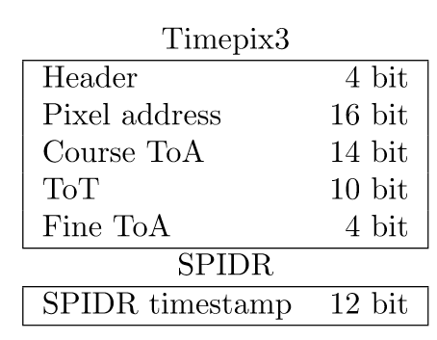
Timepix3 pixel chip
14.1 mm
256 × 256 pixels with 55 µm × 55 µm pitch
Sensitive area of 14.1 mm × 14.1 mm
TDC with 640 MHz clock, resulting in a 1.56 ns time resolution
Per pixel simultaneous measurement of arrival time (ToA) and signal amplitude (ToT)
Readout using SPIDR
Power consumption of 2W depending on hit rate
  good cooling is important
Wafer post-processed at IZM Berlin
Sensitive area
14.1 mm
2+3 mm
64 bit data packets

Slide 24
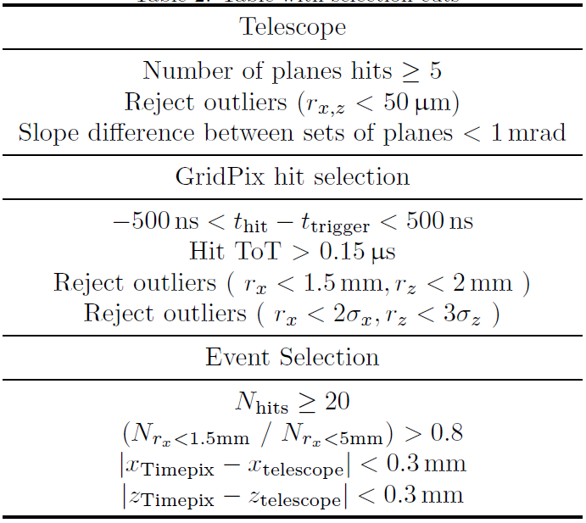
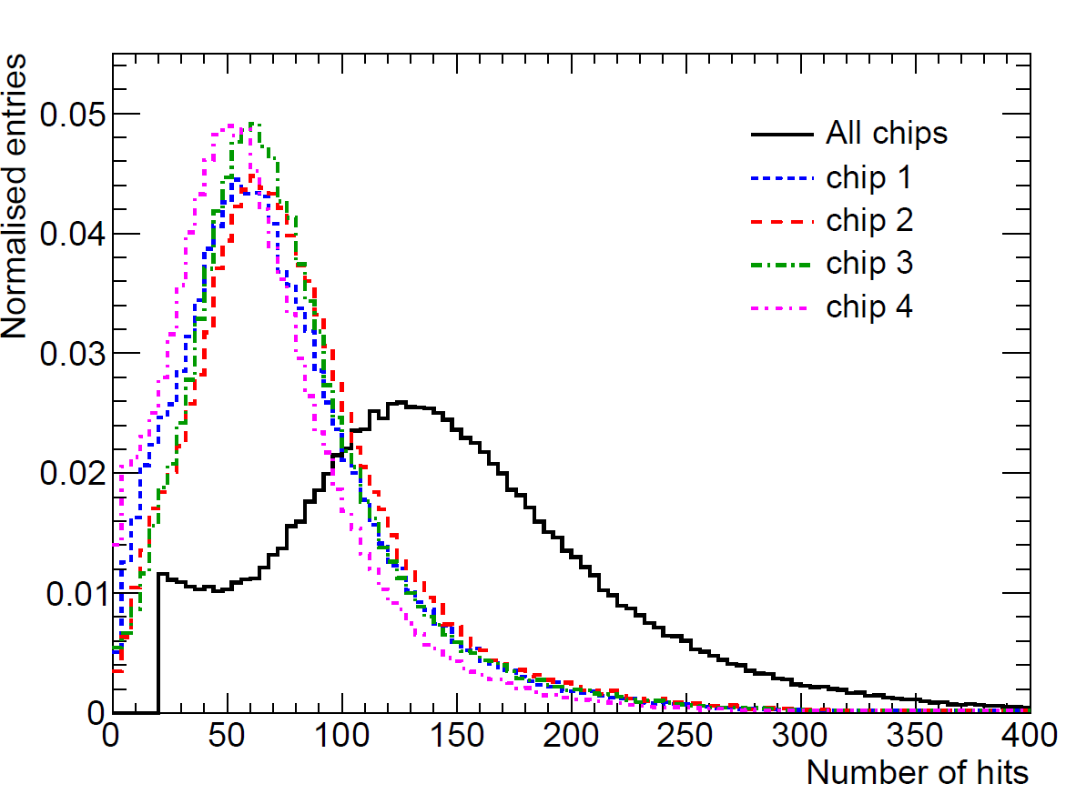
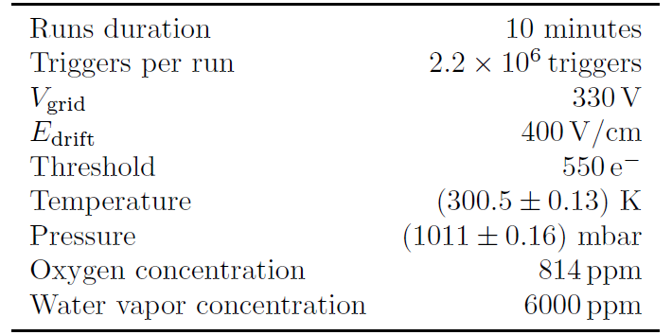
Run parameters and selections
Used T2K (Ar:CF₄:iC₄H₁₀ 95:3:2) gas with a water vapor contamination
  Drift speed 54.6 µm/ns (59.0 µm/ns expected by magboltz)
Most probable number of hits per 27.5 mm was 146 (225 expected)
  This is due to the low effective grid voltage and possibly read out problems
Use a stringent selection to get clean tracks

Slide 25
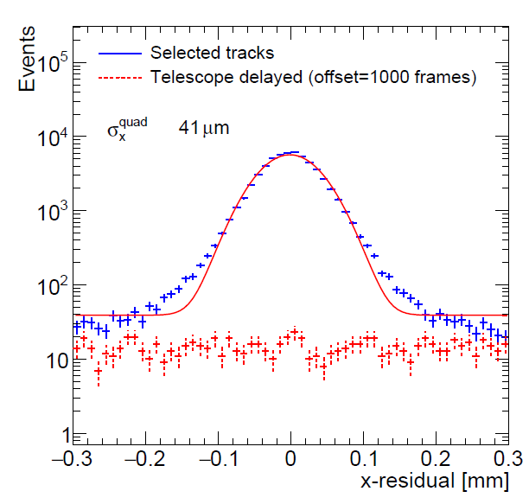
Resolution of quad module
Determine overall accuracy of a track position measurement by comparing the quad track with the telescope track
Subtract a background of unrelated tracks
Error contributions:
Statistical error using hit resolution
Systematic errors from RMS in pixel plane and drift direction
Multiple scattering contribution from simple Monte Carlo simulation
In the end, an unidentified contribution remains
Observed standard deviation | 41 µm
Statistical errors | 25 µm
Systematic errors in the pixel plane and drift direction | 19 µm
Multiple scattering | 22 µm
Unidentified systematic error | 14 µm

Slide 26
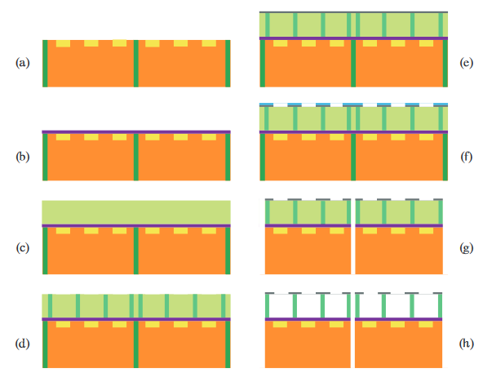
Production of GridPixes
Cleaning
Deposition of Protection layer
SU-8 covering
Exposure with mask
Aluminium layer is deposited
Another layer of photoresist is applied, exposer with a mask creates a hole pattern, and the holes are chemically etched
The wafer is diced
The unexposed SU-8 is resolved
Thesis Stergios Tsigaridas, Next Generation GridPix

Slide 27
Motivation for a pixelised TPC
Improved dE/dx by cluster counting
Improved measurement of low angle tracks
Improved double track seperation
Much reduced hodoscope effect
Lower occupancy in high rate environments
Fully digital read out

