Slide 1
CEPC Pixel Time Projection Chamber
LCWS 2019 Sendai: for one of the CEPC experiments there is interest in a pixel TPC
Discussed with Huirong Qi (see https://agenda.linearcollider.org/event/8217/contributions/44627/)
In his talk presented issues with a TPC running at the Z (next slide)
Higgs running no problem for TPC
For high Lumi Z run distortions due to Ion Back Flow
As ALICE one can run without gating (reducing the IBF of the GEMs)
Ion Back Flow measurements IBF with a MM show Gain*IBF = 5

Slide 2
CEPC Pixel TPC
Huirong Qi

Slide 3
CEPC Pixel TPC
What is the situation for a pixel TPC?
Large potential in terms of rate capabilities
Pattern recognition high granularity works in high Z rate
Question what is the IBF for our GridPix? O(0.1%) We will measure it.
Can we apply gating in Z collisions?
High(est) luminosity CEPC L = 32-50 (17-32) 10³⁴ cm⁻²s⁻¹ at 2 T.
CEPC Ring length 50 km with 12 000 bunches and a hadronic Z rate of 10-15 (5-10) k Hz (cross section 32 nb). Beam structure rather continuous 14 ns spacing.
Note that this Luminosity gives about 60-120 (30-60) G Zs per running year
Time between Z interactions 120-60 (200-100) μs
TPC drift takes 30 μs
So events are separated in the TPC; gating is possible

Slide 4
CEPC Pixel TPC
High rate capabilities of the GidPix pixel chip TPX3
Bonn test beam was 5 kHz electrons for a quad
Link speed 80 Mbps per chip (256x256x 55 x 55 μm²)
Testbeam 2018 1.3M hits/s per chip could be read out
In 2019 the link speed doubled to 2.6M hits/s per 1.42x1.42 cm².
Possible CEPC gating scheme for physics events
Make a GEM gating device a la ILD but now at 1-5 mm above the grid
Gating in a triggered mode;
if a hadronic Z interaction in TPC start gating
Gate length of 30-60 μs would stop the ions in Z triggered mode
the price is dead time, reduced efficiency;
One will start “leveling” if gate time = 20 μs -> efficiency 66-85%
Needs thinking but might work and reduce IBF and (therefore) distortions
NB: ILC gating can exploit bunch structure: Gate opens 50 μs before the first bunch and closes 50 μs after last bunch. Close time between bunches 200 ms. Device 1 cm above grid.

Slide 5
CEPC Pixel TPC
Important to estimate the charge in the TPC as it causes distortions.
Physics events like Zs
Other backgrounds γγ background and incoherent pairs from beam-beam interactions that produce hits
Rate estimates for primary electrons and charge and distortions from primary ions due to Zs (back of the envelop)
Assume that the ions stay 0-300 ms before reaching the mid plane of the TPC. With a rate of 10-15 kHz one will accumulate 3000 - 4500 Zs; This gives 30 tracks producing 10⁴ primary electrons and ions. TPC volume: Inner radius 40 cm; outer 180 cm; 400 cm length; so volume 3.8 10⁷ cm³. Charge density = 9-13 10⁸/3.8 10⁷ cm³ = 23-34 e/cm³. This is smaller than the charge at the ILC for 3000 bunches from beam-beam background (slide 7).

Slide 6
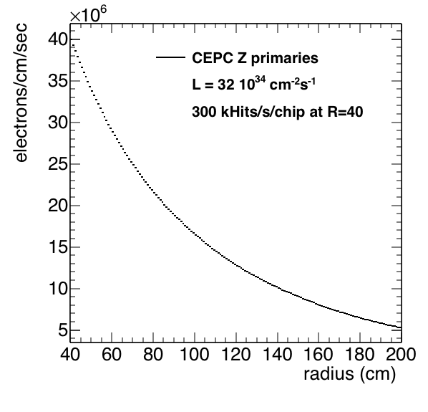
CEPC Pixel TPC rates
Rates primary electrons in a Pixel TPC (back of the envelop)
Using a simulation program the primary Z hit rate in the pixel TPC is calculated as a function of the radius.
The rate amount to 300 k hits /s at a radius of 40 cm.
This is a rate the current quad and read out can easily handle.
The test beam showed we can handle up to 2.6M hits/s per chip (1.42x1.42 cm²). So about a factor 10 higher than what is needed.

Slide 7
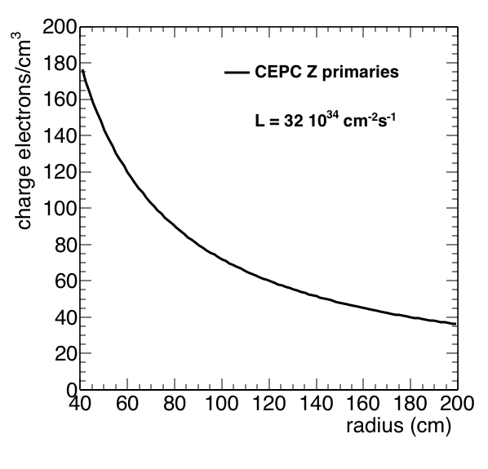
CEPC Pixel TPC charge
Charge from primary ions due to Zs (back of the envelop)
At ILC this accumulated charge in the TPC bkg leads to distortions of max 5 μm. See next slide for details. Here no ion back flow IBF=0 is used.
The CEPC study by presented by Huirong Qi (backup) gives a larger number of up to 80 μm with IBF=5 and a lower luminosity.
So assuming that the IBF for Zs can be gated (IBF < 1) with the proposed trigger scheme these distortions are rather small.

Slide 8
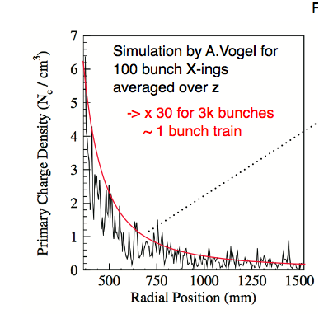
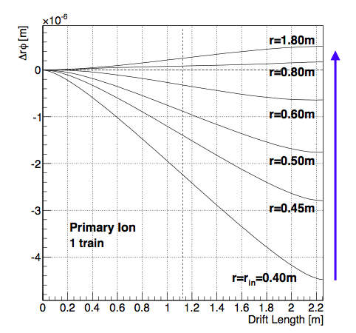
ILC beam-beam primary ions in TPC
So deformations for a primary charge distribution (x 30) are less than 5 μm
Studies from Keisuke Fuji https://agenda.linearcollider.org/event/5504/contributions/24543/attachments/20144/31818/PositiveIonEffects-kf.pdf)

Slide 9
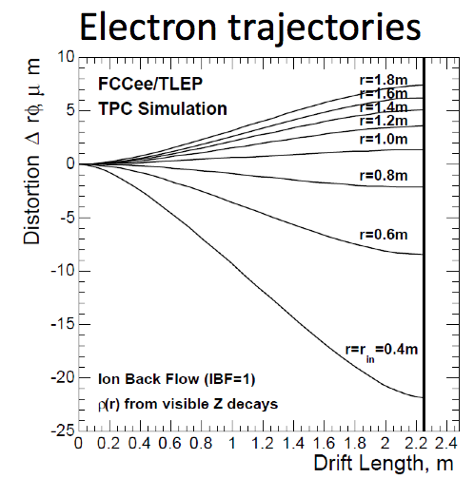
Pixel TPC for TLEP/FCCee
Distortions from primary ion from Zs have been performed by Schwemling for a TPC at TLEP/FCCee https://indico.cern.ch/event/467955/
Note here the Z rate is 16 kHz so
similar to CEPC at 50 10³⁴ cm⁻²s⁻¹.
Studies are more detailed – use Pythia plus distortion program from Keisuke Fuji- than a back of envelop calculation.
NB IBF is not zero but put to 1.
The number of ions/cm is not 100 but only 40. So a bit lowish.

Slide 10
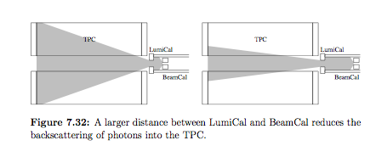
CEPC backgrounds Pixel TPC
What is the charge of the other backgrounds in the TPC?
At ILC beam-beam effects from primary ions are dominant over the physics interactions.
However TLEP and FCCee studies show that e.g. γγ background are very small at the Z. Also the incoherent pair production (backup slides) is several orders smaller than at the ILC.
As Adrian Vogel (DESY-thesis-08-036) in his thesis showed the detector -machine design is important to reduce the number of back scattered photons. See plot below.
DESY-thesis-08-036

Slide 11
backup

Slide 12
CEPC Pixel TPC
backup
CEPC Oxford
https://indico.cern.ch/event/783429/contributions/3379893/attachments/1830789/2998159/CEPC_Backgrounds_Oxford_Zhu.pdf

Slide 13
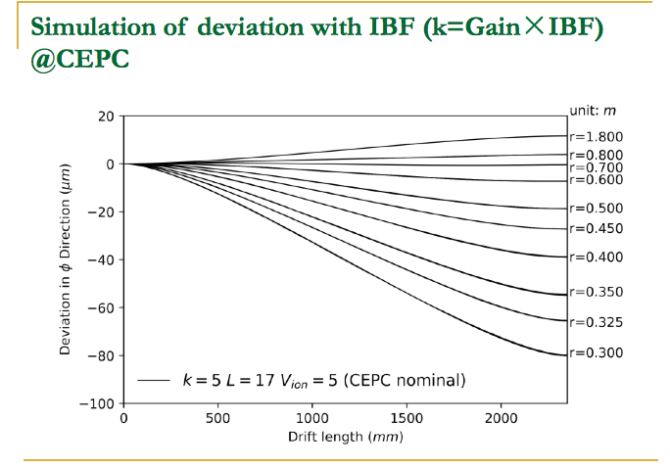
CEPC Pixel TPC
backup
Huirong Qi
This is based on
physics events
No beam-beam
Deviations due to
primary ions should
be factor 5 smaller
In my calculations
L = 32-50 10³⁴ cm⁻²s⁻¹ at 2 T.
here L = 17 10³⁴ cm⁻²s⁻¹

Slide 14
CEPC Pixel TPC
backup
CEPC Oxford
What is the energy (Z pole, 250 GeV) ?
What is the type of background?
What is a hit/particle in the TPC?
Maybe we can calculate the charge (Radius) from this distribution.
This is 8 10⁻⁵ particles/cm²/BX (R=40)
(assume z TPC 2*220 cm).

