Slide 1
Muon track reconstruction revisited
Same as presented on 25th of August, but now using km3 output (instead of JSirene)

Slide 2
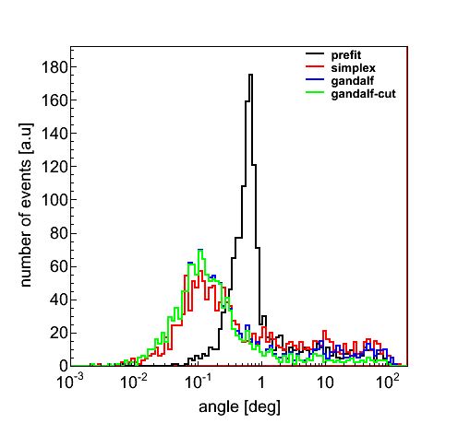
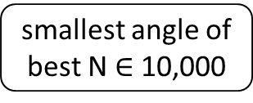
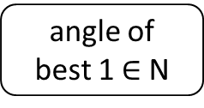
Angular resolution (I)
N = 12
angle of
best 1 $∈$ N
smallest angle of
best N $∈$ 10,000

Slide 3
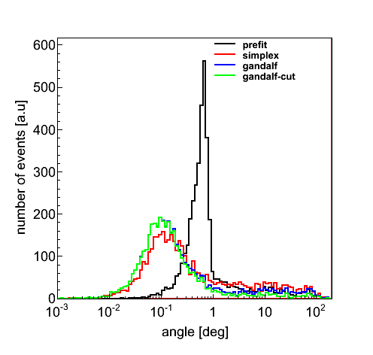

Slide 4
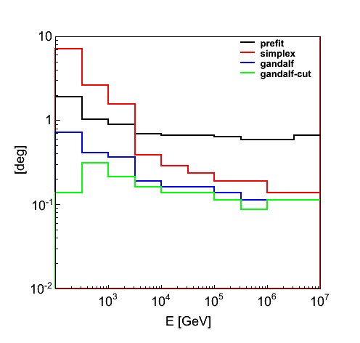
Angular resolution (II)
median

Slide 5
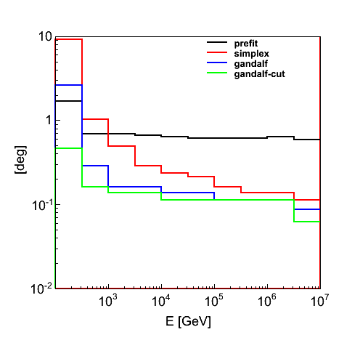

Slide 6
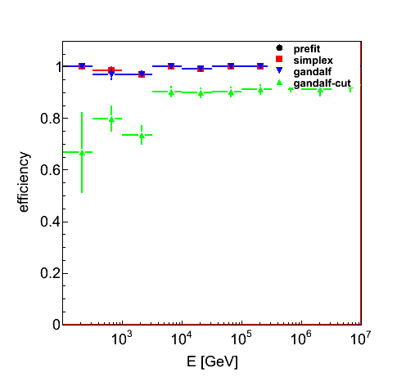
Efficiency¶
¶ Efficiency w.r.t. triggered events.

Slide 7
