Slide 1
IGTF RAT Communications Challenge September 2015

Slide 2
The RAT today
“responsible for assessing risk and setting time and deadlines for response and action for concerns and vulnerabilities” [https://tagpma.es.net/wiki/bin/view/IGTF-RAT/WebHome]
igtf-rat@eugridpma.org contains:
davidg@nikhef.nl
weisz@vcpc.univie.ac.at
jbasney@ncsa.uiuc.edu
yoshio.tanaka@aist.go.jp
vinod@ic.uff.br
jam@psc.edu
j.jensen.ral@googlemail.com
Eric.Yen@twgrid.org
ursula.epting@kit.edu
feyza@ulakbim.gov.tr

Slide 3
Rat Communication Challenge
“Perform periodic audits of member CA contact addresses and other issues.”
now also part of the response assessment programme
must be able to respond quickly (1 day) – asking for complex things that need checking might delay response
can ask for ACK, later measure follow-up?
separate questions from RAT CC process

Slide 4
Suspension guidance
IGTF AHM meeting consensus went into the “EUGridPMA Accreditation Guidelines” section 7:
"Sustained engagement of accredited authorities and timely response to policy and operational issues is essential to maintain the trust fabric. Consistent and long-term lack of communications, or persistent long-term operational issues, may lead to automatic or reviewed suspension and subsequent withdrawal of the trust anchor(s) of the authority from the IGTF trust anchor distribution.
* An authority may be suspended without further review for operational reasons if after 30 days of commencement of an operational failure condition the issue cannot be resolved, and no remediation has been communicated to the PMA within this period. * An authority may be suspended without further review when failing to respond to a designated Communications Challenge for more than 30 days.
* An authority may be suspended subject to peer review in case of policy compliance issues.
At any time an authority suffering compliance issues may communicate with the PMA, provide a remediation plan addressing the issues, and request the suspension to be reviewed, deferred, or annulled. Such communication shall in itself cause automatic suspension to be deferred.“

Slide 5
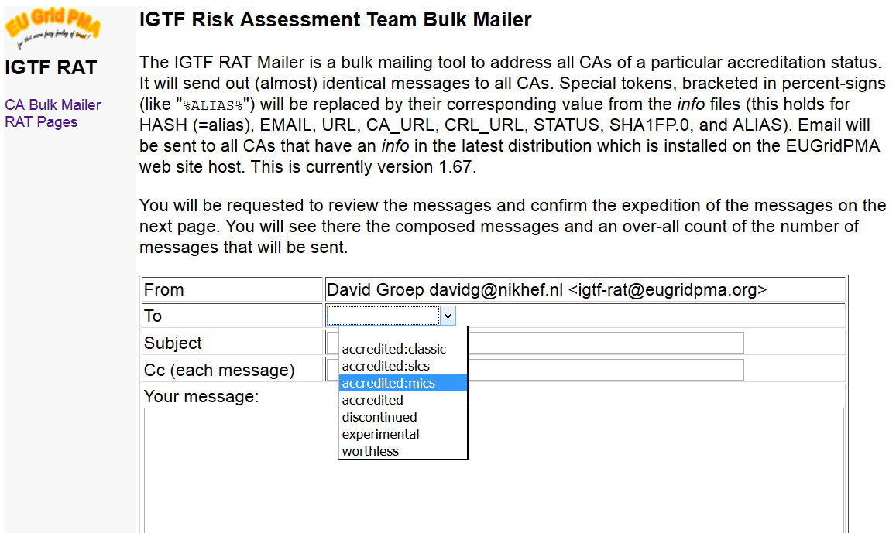
RAT CC Tools
Send (custom) mails per trust anchor
Taken from “info” meta-data, which must be up-to-date

Slide 6
… but when?
Last test was in 2013
Ursula Epting is planning to re-run the test in Oct/Nov this year
But it’s a lot of effort (still) to collect the results
Any volunteers to help also?
“All IGTF members are welcome to join the IGTF RAT.”

