Slide 1
Welcome to Amsterdam
EUGridPMA35
September 2015

Slide 2
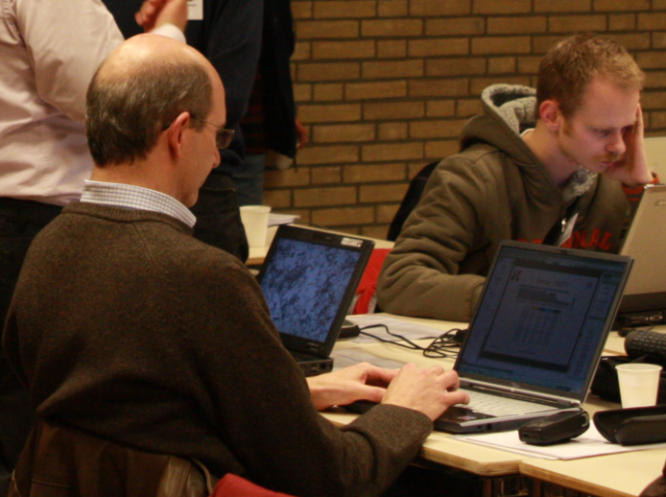
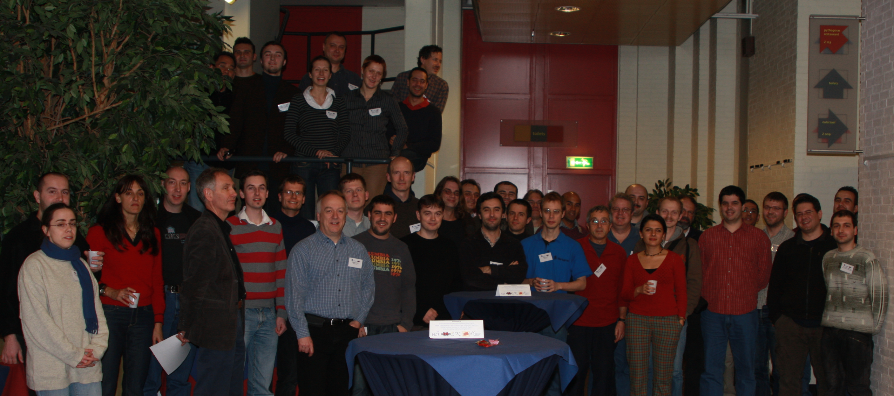
Welcome back in Amsterdam

Slide 3
Round Table and Introductions
Note taker
  Please …
Presentations
  Upload to the agenda page:
  https://www.eugridpma.org/agenda/35
    use “manage”, and then enter the password
    unless you have been invited to create an account
Agenda bashing

Slide 4
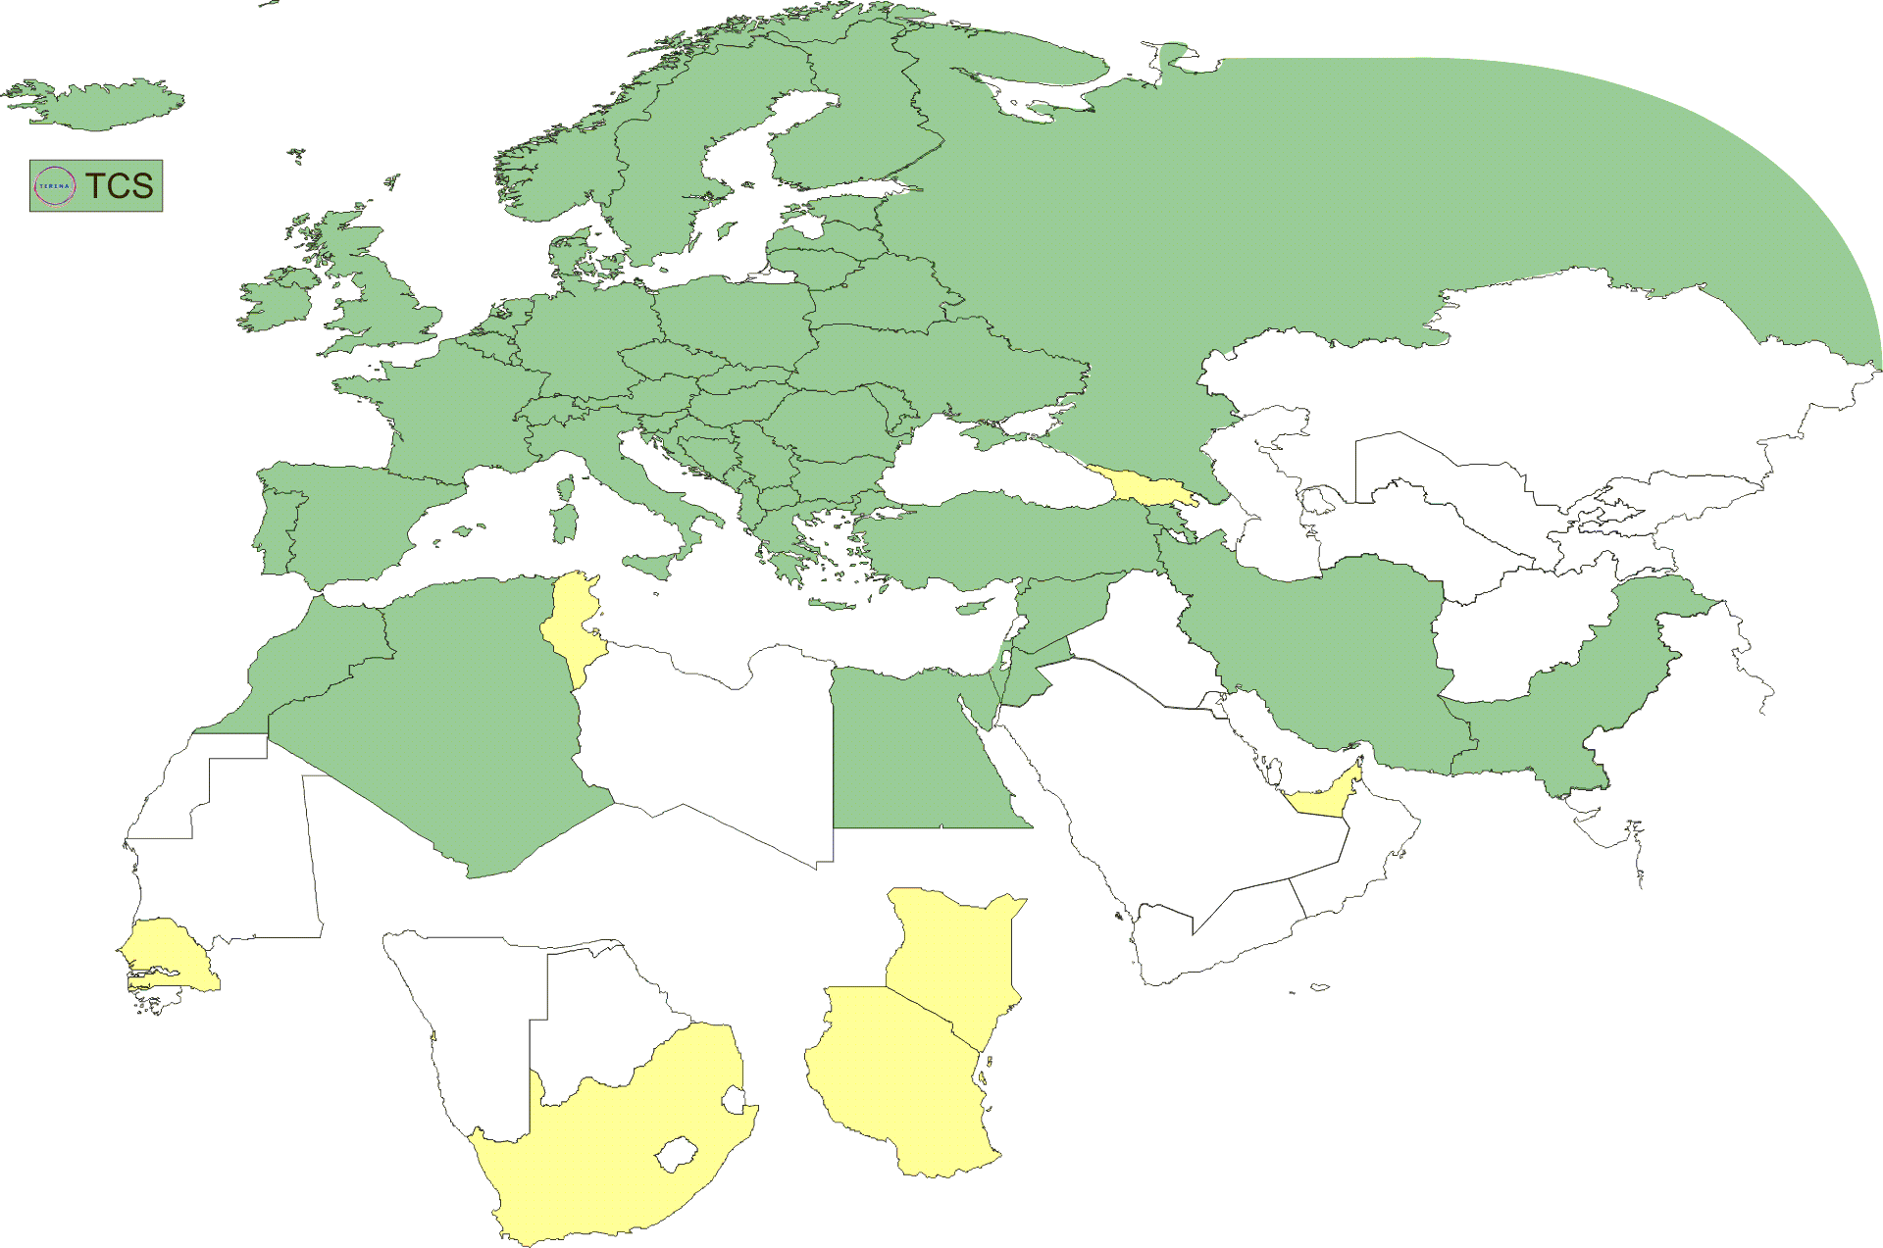
Geographical coverage of the EUGridPMA
26 of 28 EU member states (all except LU, MT)
+ AM, CH, DZ, EG, IL, IR, IS, JO, MA, MD, ME, MK, NO, PK, RO,
RS, RU, SY, TR, UA, CERN (int), DoEGrids(US)* + TCS (EU)
Pending or in progress
ZA, KE, TZ, SN, TN, AE, GE

Slide 5
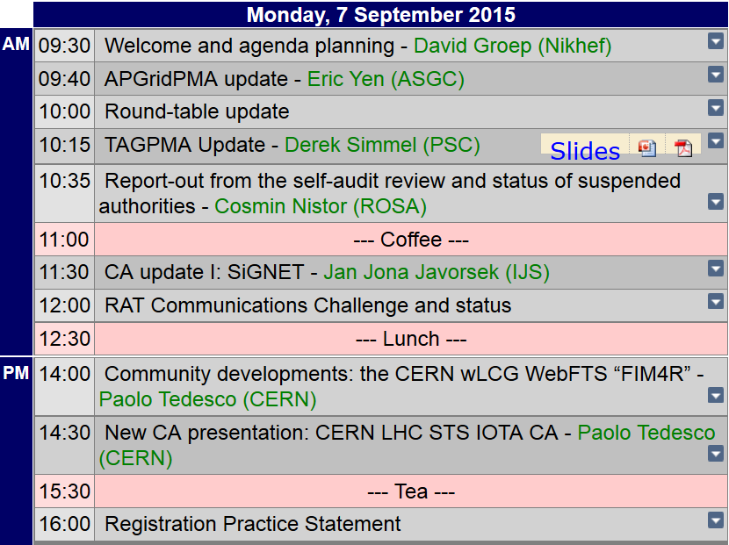
Agenda Monday (today)

Slide 6
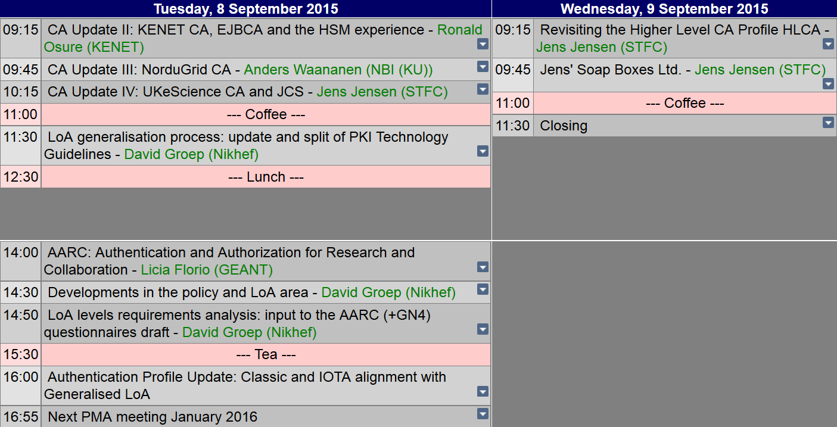
Tuesday and Wednesday

Slide 7
Dinner on Monday
We have reserved restaurant Girassol, on the Amstel River
Please be there at 19:00
To enter the restaurant, mention “David Groep” ;-)

Slide 8
IGTF+ Meeting Agenda
TAGPMA 22: UNAM, Mexico City: 30 Sep – 1 Oct 2015
I2TechX + REFEDS: Cleveland, OH, 4 + 5-8 Oct 2015
EWTI (+REFEDS, FIM4R): Vienna 30 Nov – 4 Dec 2015
https://identityworkshop.eu/
EUGridPMA 36: location tbc – January 11-13? 2016
APGridPMA & ISGC: Taipei, 13-18 March 2016
EUGridPMA 37: Ankara – May 9-11 2016
TNC2016 + REFEDS: 13+14-16 June 2016, Prague

