Slide 1
CEPC Pixel Time Projection Chamber
LCWS 2019 Sendai: for one of the CEPC experiments there is interest in a pixel TPC
Discussed with Huirong Qi (see https://agenda.linearcollider.org/event/8217/contributions/44627/)
In his talk presented issues with a TPC running at the Z (next slides)
Higgs running no problem for TPC
For high Lumi Z run distortions due to Ion Back Flow
As ALICE one can run without gating (reducing the IBF of the GEMs)
Ion Back Flow measurements IBF with a MM show Gain*IBF = 5

Slide 2
CEPC Pixel TPC

Slide 3
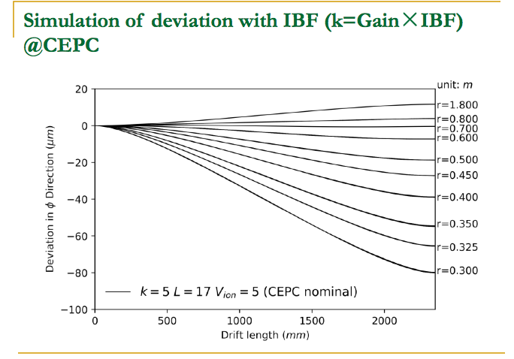
CEPC Pixel TPC
here L = 17 10³⁴ cm⁻²s⁻¹

Slide 4
CEPC Pixel TPC
What is the situation for a pixel TPC?
Large potential in terms of rate capabilities
Pattern recognition high granularity works in high Z rate
Question what is the IBF for our GridPix?
Huirong Qi asked whether he could get (buy) a quad to study in IHEP
Measure the IBF for the device and compare to MM
Can we apply gating in Z collisions?
Make a GEM gating device a la ILD at e.g. 1 mm or 0.5 mm above the grid
High(est) luminosity CEPC L = 32-50 10³⁴ cm⁻²s⁻¹ at 2 T.
CEPC Ring length 50 km with 12 000 bunches and a hadronic Z rate of 10-15 k Hz (cross section 30 nB). Beam structure rather continuous 1 ns spacing.
Note that this Luminosity gives about 60-120 G Zs per running year
Time between Z interactions 60-120 μs
TPC drift takes 30 μs
So events are separated in the TPC

Slide 5
CEPC Pixel TPC
Gating in a triggered mode;
if a hadronic Z interaction in TPC start gating
Gate length of 30-60 μs would stop the ions in Z triggered mode
the price is dead time, reduced efficiency;
One will start leveling if gate time = 20 μs -> efficiency 66-85%
Needs thinking but might work and reduce IBF and (therefore) distortions
High rate capabilities of the GidPix pixel chip TPX3
Bonn test beam was 5 kHz electrons for a quad
Link speed 80 Mbps per chip (256x256x 55 x 55 μm²)
Testbeam 2018 1.3M hits/s per chip could be read out
In 2019 the link speed doubled to 2.6M hits/s per 1.42x1.42 cm².
NB: ILC gating can profit from bunch structure: Gate opens 50 micro sec before the first bunch and closes 50 μs after last bunch

