Slide 1

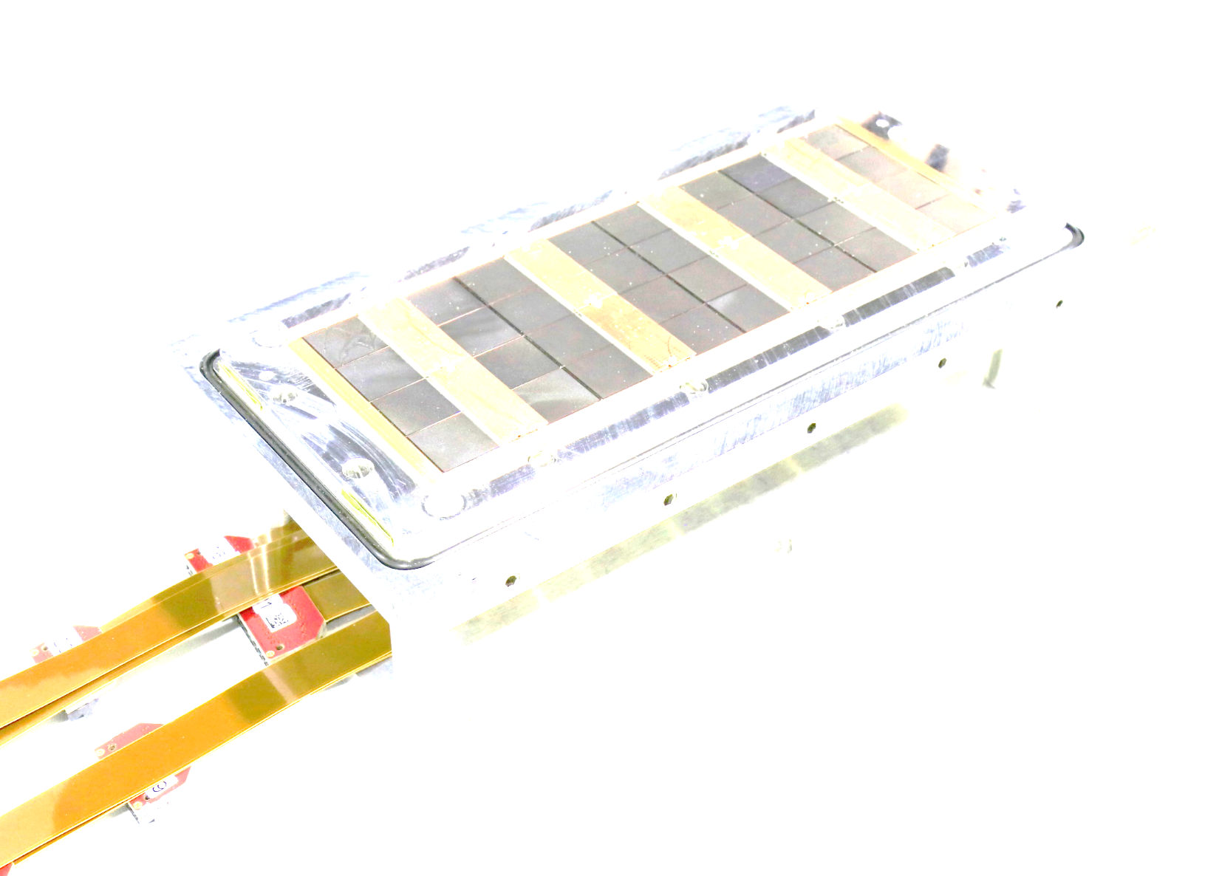
DESY testbeam preparations
Fred Hartjes
NIKHEF
Nikhef/Bonn LepCol meeting
November 4, 2019

Slide 2
Time schedule for the
December 2019 DESY testbeam
Friday Nov 15: Final decision on having the December testbeam
Thursday Nov 21: Start mockup setup at Nikhef
  Is DAQ working properly?
Monday Nov 25 13:00: Safety course at DESY for Fred, Kees, Jan
  We should get a access pass afterwards
Saturday Dec 7: travel to DESY and start installation
Monday Dec 9 13:00: Safety course for other testbeam participants (Gerhard, Harry, Naomi, Peter)
Monday Dec 9 15:00: Start testbeam
Saturday Dec 14: End Testbeam
  Pack all equipment for transport to Nikhef

Slide 3
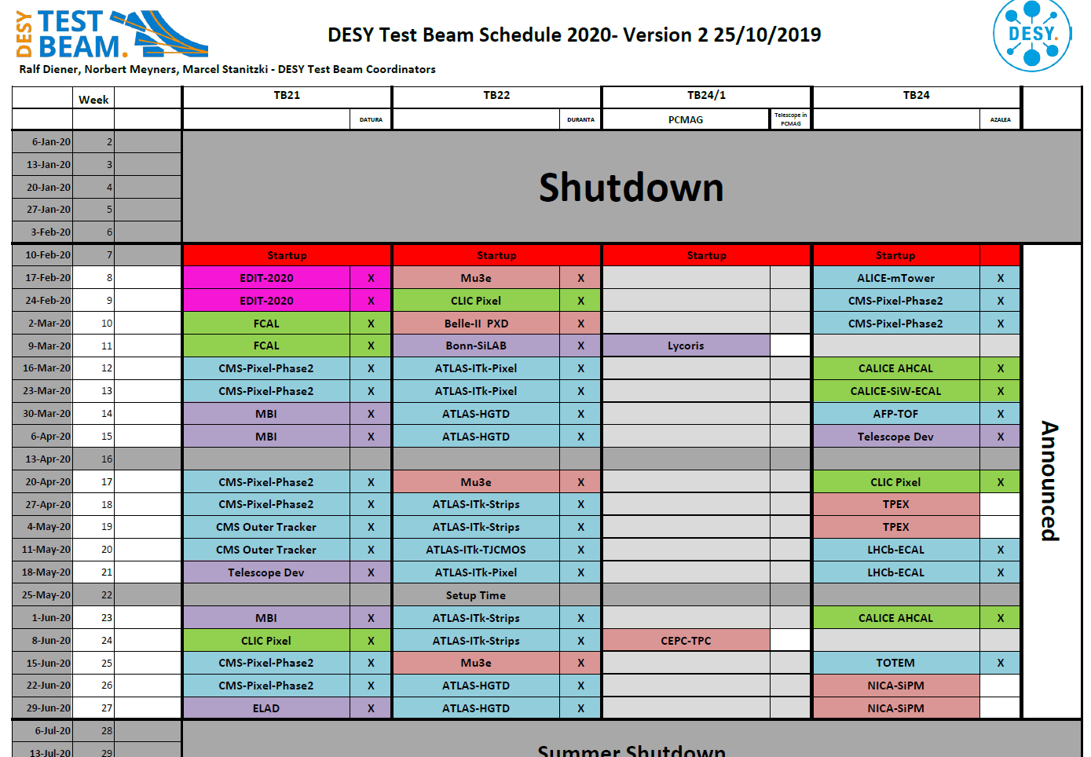
Schedule 2020
onzin

Slide 4
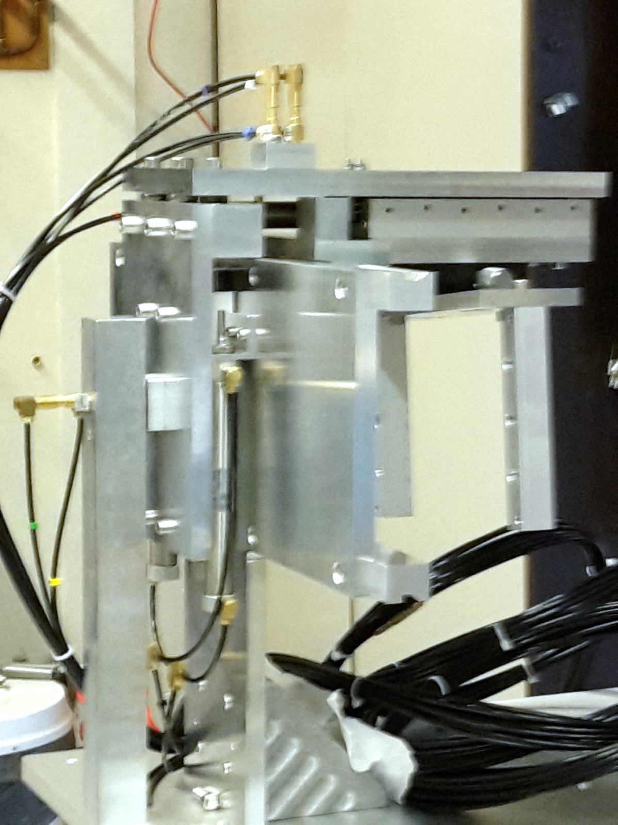
Non-magnetic testbeam hardware
All components have arrived
Mechanics finished
Vertical movement proceeds smoothly
Pneumatic X-Z stage remote control still to be done
  Hope to get the stage positions logged into the SPIDR data
DCS PC Levaard has solid state disk
  Also the backup disk is now built-in solid state

Slide 5
Critical issues
Non-magnetic LV board on concentrator
  Bas just finished the design
  Board manufactured around 11-11-2019
  Manual assembly by Bas to save time
Firmware concentrator and new SPIDR board
  No activity last two weeks
  Bas starts with it this week
Mimosa telescope planes
  From Bonn?
  From DESY?

Slide 6
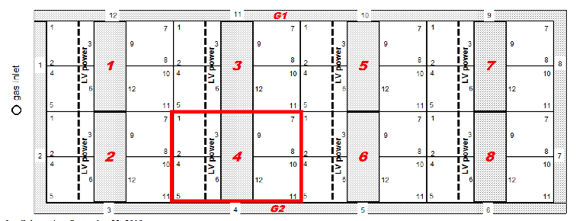
QUAD voltages
Orientation of quad
Certain values are quite different from expected
  Guard voltage -355 V
    -375 V expected
  Guard cage voltage (-338 V expected)
Guard
 | Run 996 14/10/2019
Guard voltage CH2 | -355 V
Guard Cage CH4 | -361 V
(Guard) Wires CH5 | -392 V
Grid voltage | -340 V
Drift field | -350 V / cm
Cathode voltage | -1740 V
Guard cage

Slide 7
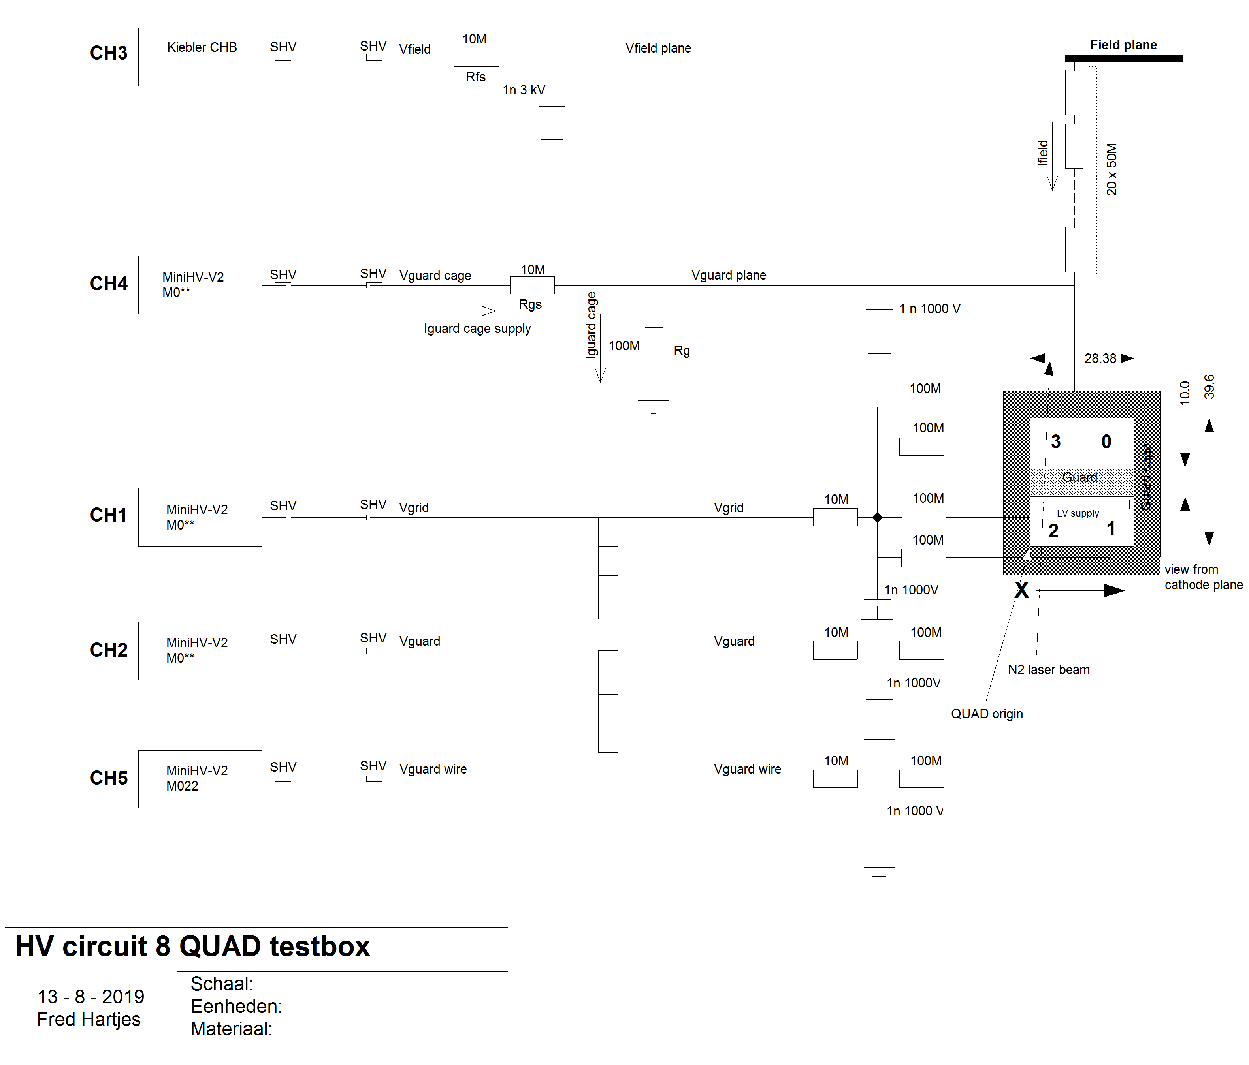
Checking HV values
Using electrostatic voltmeter
  Range +/- 1000 V
  => Vcathode cannot be verified
For Vguard cage we have to correct for the voltage drop across the 10 M ohm supply resistor
  Expected to be equal to the effective grid voltage
  Vguard cage current is 2390 nA => voltage drop is 24 V
=> calibration miniHVs is OK
Vguard cage
Parameter | CH# | Nominal | Measured
Vgrid | 1 | -340 | -342
Vguard | 2 | -355 | -356
Vguard cage | 4 | -361 => -337 | -337
Vwires | 5 | -392 | -392

Slide 8
Effective potential above grid
Potential reduced by amplification field leaking through the holes in the grid
Calculation done by Wilco Koppert on 30-9-2013
Example for DME/CO2 40/60
  Vgrid = -600 V
  Field = 865 V/cm
In this case (DME/CO2) the effective potential of the grid is reduced by 3.1 V
For T2K at Vgrid = -340 V the effective potential of the grid is reduced by 1.8 V
Units in cm
global driftgap=0.12
global dcathode=0.00015
global dgrid=0.00015
global ampgap=0.005
global dsinprot=0.0008
global pitch=0.0055
global gridradius=0.0015

Slide 9
Conclusions potentials check
Difference between expected and measured values are small, mostly 1 to 0 V
Vgrid measured -342 V
  => effective potential would be 340 V
  Measured on Vguard cage: 337 V
  Maybe the leakage through the grid is more than expected
Vgrid is 5 V more negative than Vguard cage where 2 V is expected
  Possibly the leak of the grounded TPX3 pads through the holes is bigger than expected
Guard electrode is 0.8 – 0.9 mm above the grid
=>Vguard should be at -337 – field across guard height = -365 to -369 V
  But best results at -355 V
  No explanation yet

Slide 10
Reference

Slide 11
Time schedule DESY testbeam
Proceeding with the testbeam or not?

Slide 12
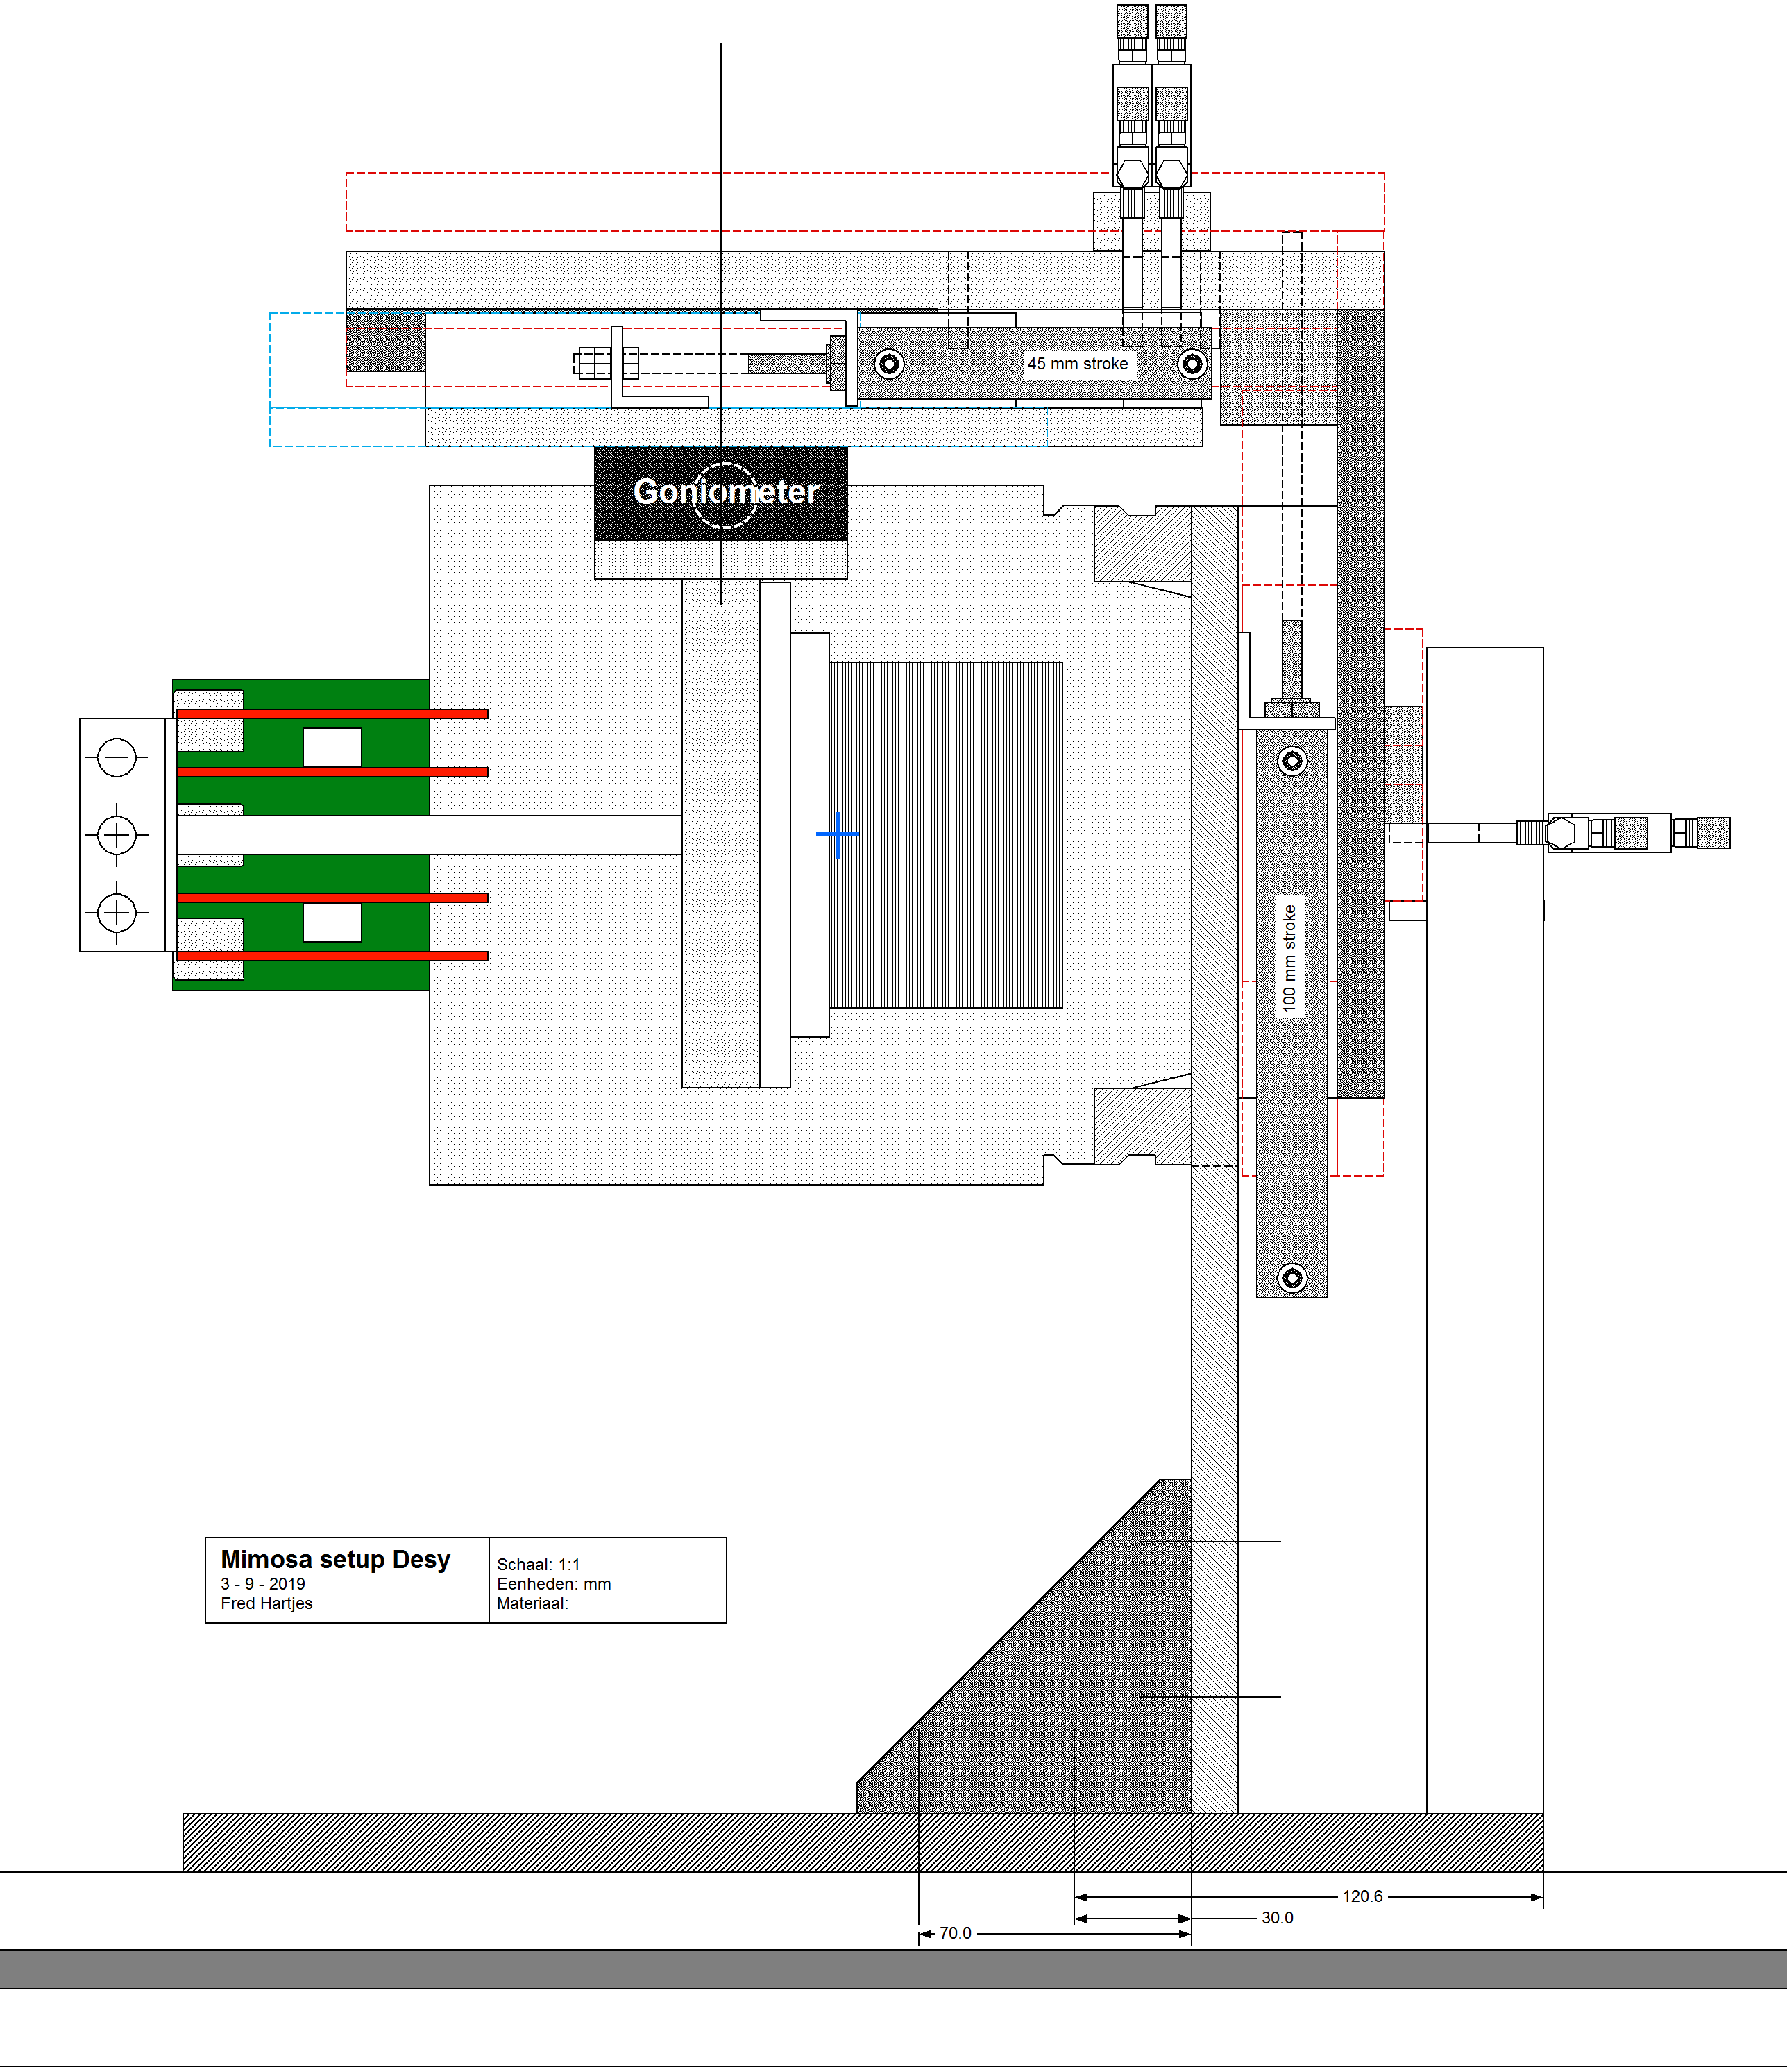
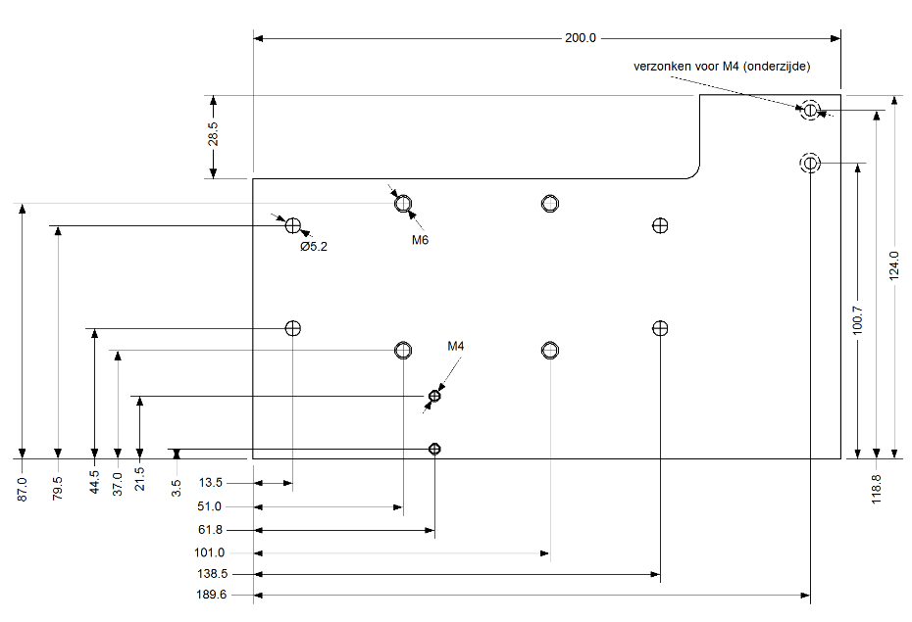
Setup mechanics
Design finished
  13 production drawings
In vertical direction (X coordinate) 3 positions
  X = 0 – 20; 20 – 40; 40 – 60 mm
Horizontal (Z coordinate) 4 positions
  Z = 0 – 10; 10 – 20; 20 – 30; 30 – 40 mm
Reproducibility ~ 30 μm expected
All pneumatically controlled

Slide 13
Setup mechanics
Production of mechanical components started (Oscar)
  Planned to be finished end October
Commercial components
  All ordered
  Mostly received
  Remaining 3 items expected in October
DCS PC Levaard
  Solid state disk has arrived
  Will be installed around October 22
  One-to-one copy of existing disk

Slide 14
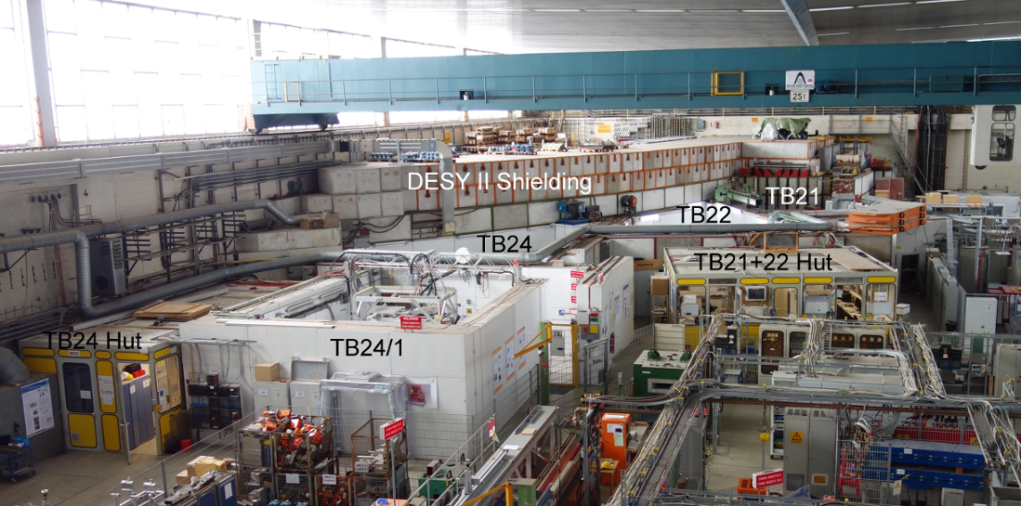
DESY testbeam Hall 2

Slide 15
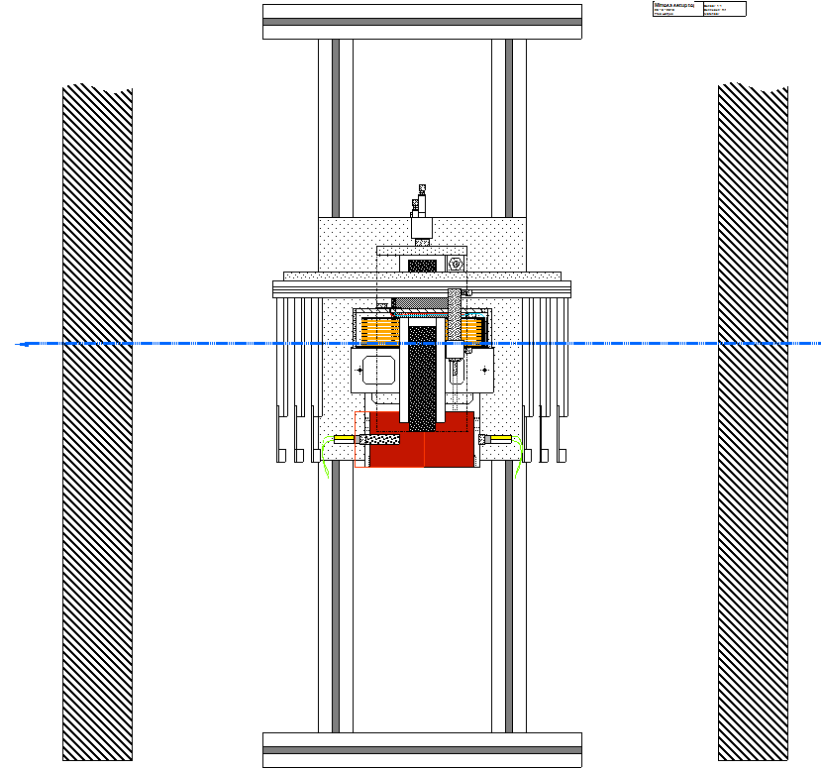
Testbox in magnet top view
DESY
support
frame
Testbox
Electron beam
Mimosa planes
Mimosa planes
~ 600 mm
Magnet wall
Magnet wall

Slide 16
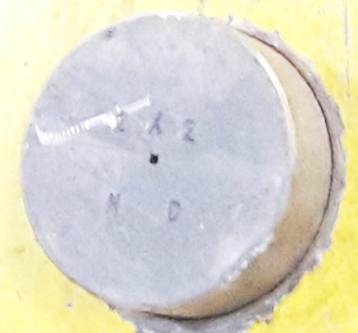
Floorplan DESY testbeam TB24/1
In December we may have a rather low energy (~ 3 GeV)
Rate depending on the applied collimator
Maximum 5 – 6 kHz
Beam height is 169.5 cm wrt the ground floor
hut
TB24
TB24/1
1T magnet

Slide 17
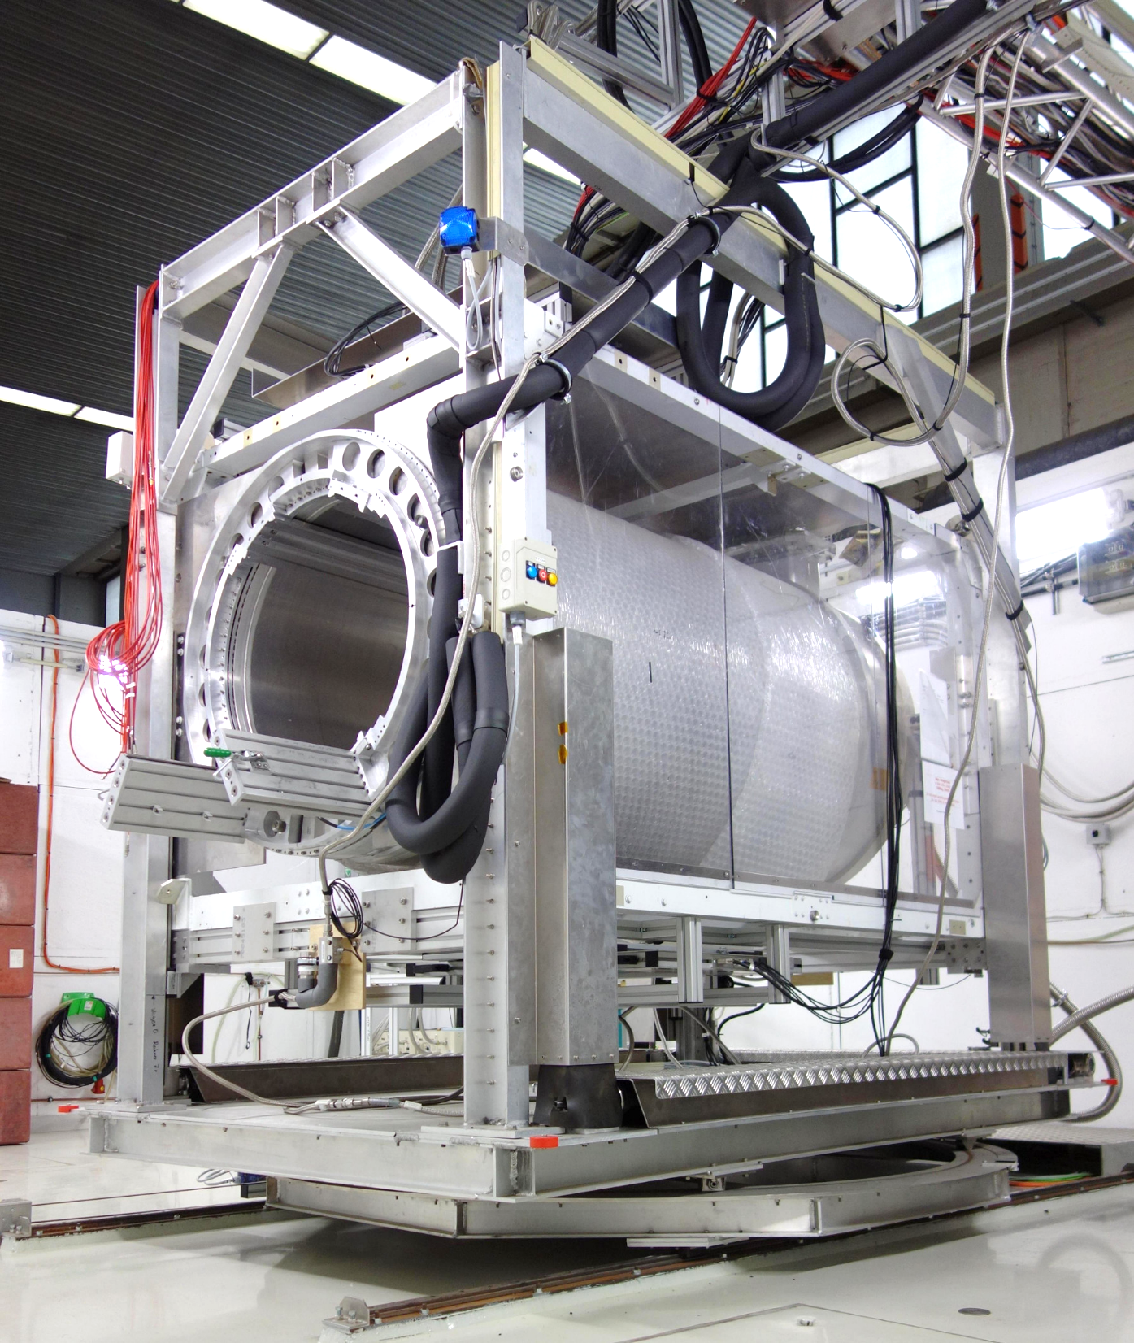
Solenoid magnet in TB24/1
Remotely movable vertically and sideward (X and Z)
Super conducting
  => no running power needed
  But how much time does it take to cool it down?
1T magnetic field horizontally
Radiation length magnet wall: 20%
Inner diameter: 85 cm

Slide 18
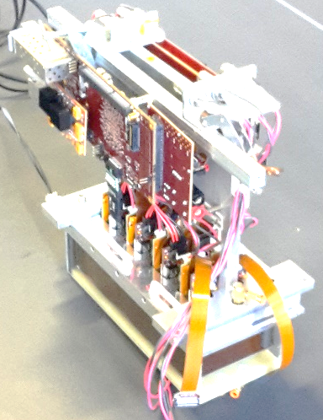
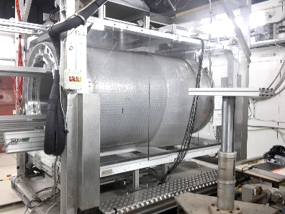
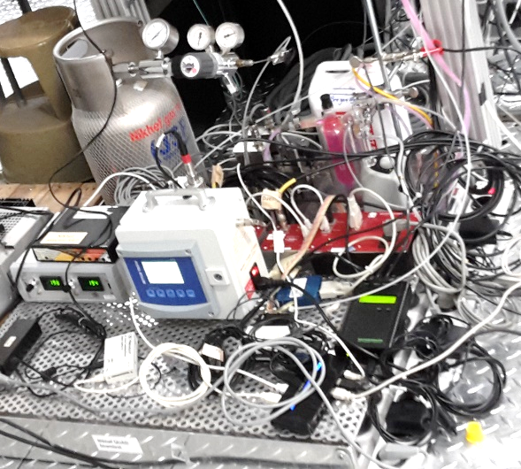
Floorplan DESY testbeam TB24/1
Leak tray with all services on wooden table
DCS PC Levaard also on that table
Cable length between leak tray and testbox: ~ 8 m
We cannot lay our own cables between the hut and our area
  Only possible when all beams are off
  We have to use available cables/tubing

Slide 19
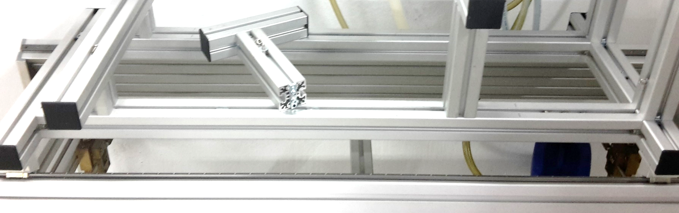
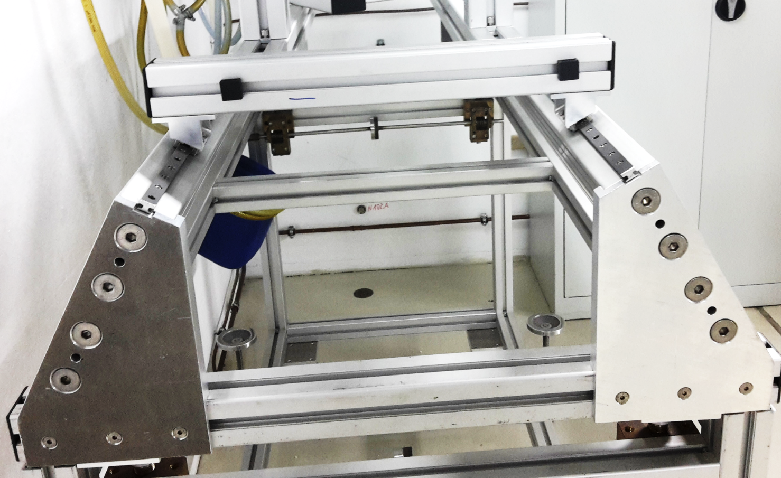
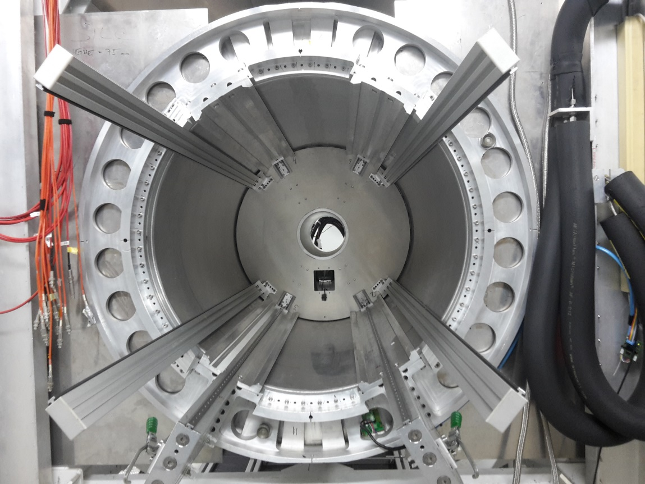
Mounting the testbox in the magnet
Our setup will be mounted on a frame on rails
Detector has to be installed at ~ 60 cm from the magnet entrance
85 cm

