Slide 1
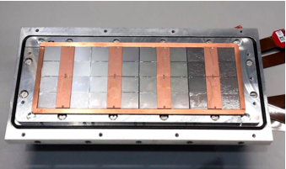
Quad Module Guard optimization
Laser scan of one quad of the 8-quad module
Need multiplexer to read out all quads. Not yet ready. So here 1 quad readout.
Runs 996 laser makes a track over two chips; scanning the laser start position in 0.2 mm steps.
Drift z position fixed at 6 mm from grid
Intermediate scans have been perfrormed to arrive at the best voltage settings

Slide 2
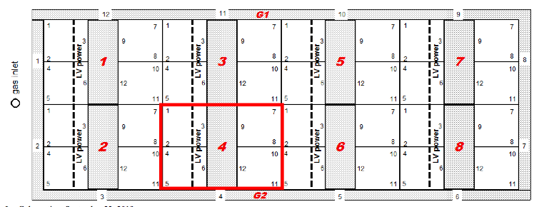
QUAD Module settings
Orientation of quad
 | Run 996 14/10/2019
Guard voltage CH2 | -355 V
Guard Cage CH4 | -361 V
(Guard) Wires CH5 | -392 V
Grid voltage | -340 V
Drift voltage | -350 V / cm
Cathode voltage | -1740 V

Slide 3
QUAD Module settings
Run 996
CH1 is Vgrid
CH2 is Vguard (central guard in the middle of the quad)
CH3 is Vcathode
CH4 is VguardCage
(the guard edge surrounding the 8 quads)
CH5 is Vwire (the wires over de gap between chips)

Slide 4
QUAD deformations 2D
chip1
chip2
μm
μm
Run 996
Excellent results for a very large (green) area. The ‘all’ region includes edges where the track ionization is partially measured and therefore biased to red/blue.
chip0
chip3

Slide 5
QUAD deformations 2D
chip1
chip2
Run 996
finer scale
Excellent results for a very large (green) area. The ‘all’ region includes edges where the track ionization is partially measured and therefore biased to red/blue.
chip0
chip3

Slide 6
QUAD deformations x
Excellent results for a very large area. The structure at the edges can be understood: the track ionization is partially measured and the average residual is baised.

Slide 7
QUAD Module efficiency vs y
Run 996
The efficiency as a function of y is sensitive to migration due to a wrong guard voltage
Looks flat and OK

Slide 8
QUAD Module efficiency vs x
Run 996
The efficiency uses closeby bins to sample the nr of expected hits.
Only the falling edges can be trusted.
Looks flat and consistent with the deformation plots. No sign of migration.

